Slide 1

Mini Project (23EECW301)
MINI PROJECT 23EECW301
TEAM DETAILS – TEAM No. 04
Sl.No. | Roll No. | Div | SRN | Name
1 | 553 | E | 01FE23BEC287 | SURAJ ALAGOUDA
2 | 552 | E | 01FE23BEC286 | SAHANA MATHAPATI
3 | 518 | E | 01FE23BEC251 | SAGAR NADAGADDI
4 | 543 | E | 01FE23BEC277 | PAVITRA INDI

Slide 2
Mini Project (23EECW301)
Introduction
Mobile chargers are compact power-conversion devices designed to safely convert 230V AC from the mains into a stable 5V DC supply required by smartphones and other portable gadgets.
With the wide spread use of the electronic devices, there is an increasing need for safe, stable, and reliable charging methods. A properly designed charger ensures protection from voltage fluctuations, delivers a well-regulated 5V DC output, and helps maintain battery health and device safety.
A conventional mobile charger uses a linear power supply circuit that converts the 230V AC mains into a stable 5V DC output, achieved through elements such as a step-down transformer, diode rectifier, filter network, and a fixed voltage regulator.
As linear charging approach provides a simple and reliable method of delivering clean DC power, making it ideal for basic mobile charging applications and small electronic devices ,and this simplicity and stability make it the ideal choice for ensuring consistent output under varying load conditions.
Overall, this makes the linear charger a dependable option for providing the required 5V DC supply for mobile devices.

Slide 3
Mini Project (23EECW301)
Literature Survey
Early mobile charging systems used linear power supplies with bulky transformers, which offered low efficiency and poor voltage stability.
Advancements in power electronics, SMPS-based chargers were developed to provide higher efficiency, compact size, and better voltage regulation. However, some studies note that SMPS circuits are not preferred in very simple or low-power applications because their design is more complex, requires more components, and involves high-frequency switching.
Research explains the use of bridge rectifiers and filter capacitors for converting AC to smooth DC while reducing ripple and improving power quality.
Comparative studies show that linear regulators such as the 7805 with modern PWM-based regulators and DC-DC buck converters, highlighting significant improvements in efficiency and heat reduction.
Literature also highlights the integration of essential protection features, including over-voltage protection, short-circuit protection, thermal shutdown constant-current, constant-voltage control to ensure safe charging.
Recent research emphasizes fast charging technologies such as Quick Charge and USB-PD, which use communication protocols to negotiate appropriate voltage and current levels between the charger and the mobile device.
Modern developments focus on miniaturization and improved efficiency, supported by high-frequency switching.

Slide 4
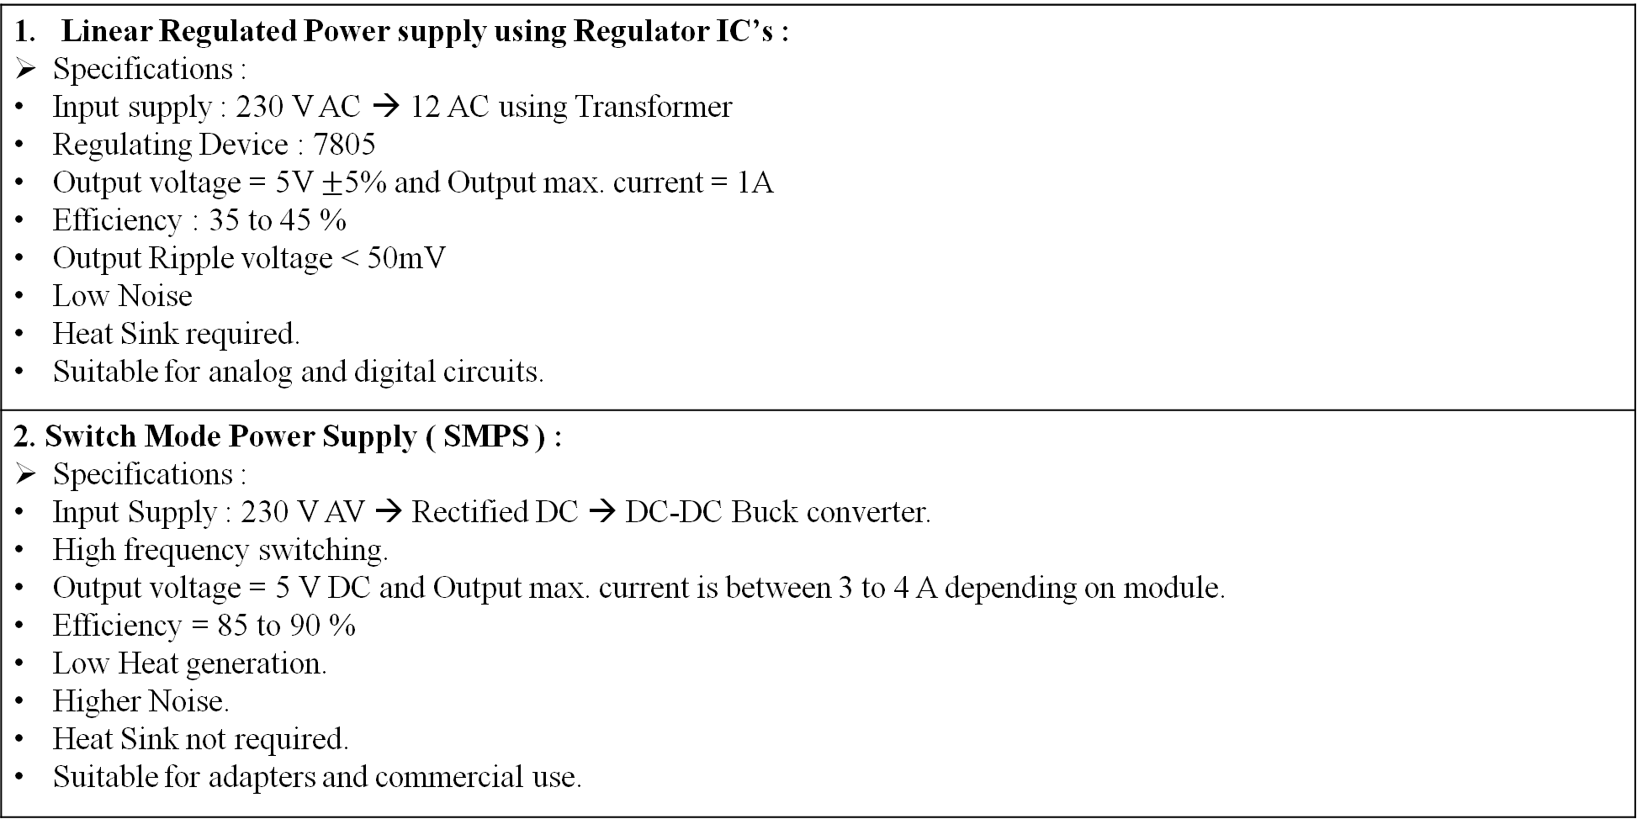
Mini Project (23EECW301)
Variants with Specifications
Linear Regulated Power supply using Regulator IC’s : Specifications : Input supply : 230 V AC → 12 AC using Transformer Regulating Device : 7805 Output voltage = 5V $±$5% and Output max. current = 1A Efficiency : 35 to 45 % Output Ripple voltage < 50mV Low Noise Heat Sink required. Suitable for analog and digital circuits.
2. Switch Mode Power Supply ( SMPS ) : Specifications : Input Supply : 230 V AV → Rectified DC → DC-DC Buck converter. High frequency switching. Output voltage = 5 V DC and Output max. current is between 3 to 4 A depending on module. Efficiency = 85 to 90 % Low Heat generation. Higher Noise. Heat Sink not required. Suitable for adapters and commercial use.

Slide 5
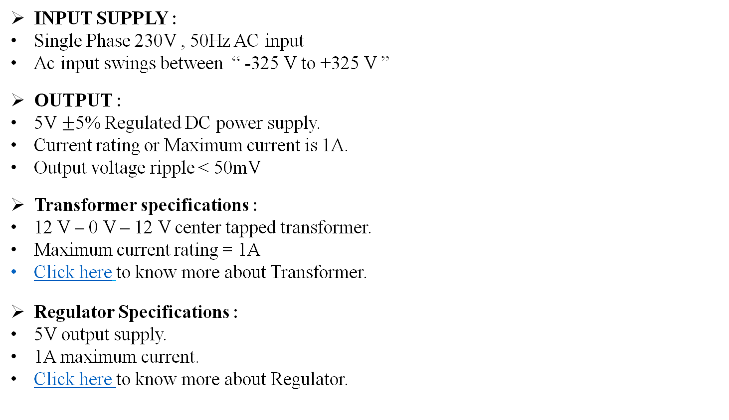
Mini Project (23EECW301)
Requirement Analysis
INPUT SUPPLY :
Single Phase 230V , 50Hz AC input
Ac input swings between “ -325 V to +325 V ”
OUTPUT :
5V $±$5% Regulated DC power supply.
Current rating or Maximum current is 1A.
Output voltage ripple < 50mV
Transformer specifications :
12 V – 0 V – 12 V center tapped transformer.
Maximum current rating = 1A
Click here to know more about Transformer.
Regulator Specifications :
5V output supply.
1A maximum current.
Click here to know more about Regulator.

Slide 6
Mini Project (23EECW301)
BLOCK DIAGRAM
INPUT SUPPLY
TRANFORMER
( Step – Down )
Bridge Rectifier
Filter Capacitor
230V , 50 Hz AC
Vpeak = 325 V
Swing limit : -325 V to +325 V
DC Offset = 0
230 V AC to 12 V AC
Click here to see info about transformer used.
Coverts from AC to DC
Diode 1N4007 used in bridge format.
Click here to see info about Bridge Rectifier used.
Removes small ripples present in input DC for Regulator.
Click here to see info about Filter Capacitor Used.
Linear Regulation
Short Circuit Protection
OUTPUT
Provides linear 5V regulated supply
Click here to see info about Linear Regulator (7805)
Click here to see info about Zener Diode Regulator
Click here to see info about Linear Regulator LM323
BJT based Short Circuit Protection Unit.
Used to protect the circuit.
5 V DC supply
Max 1 A current output
Max 5W power rating

Slide 7
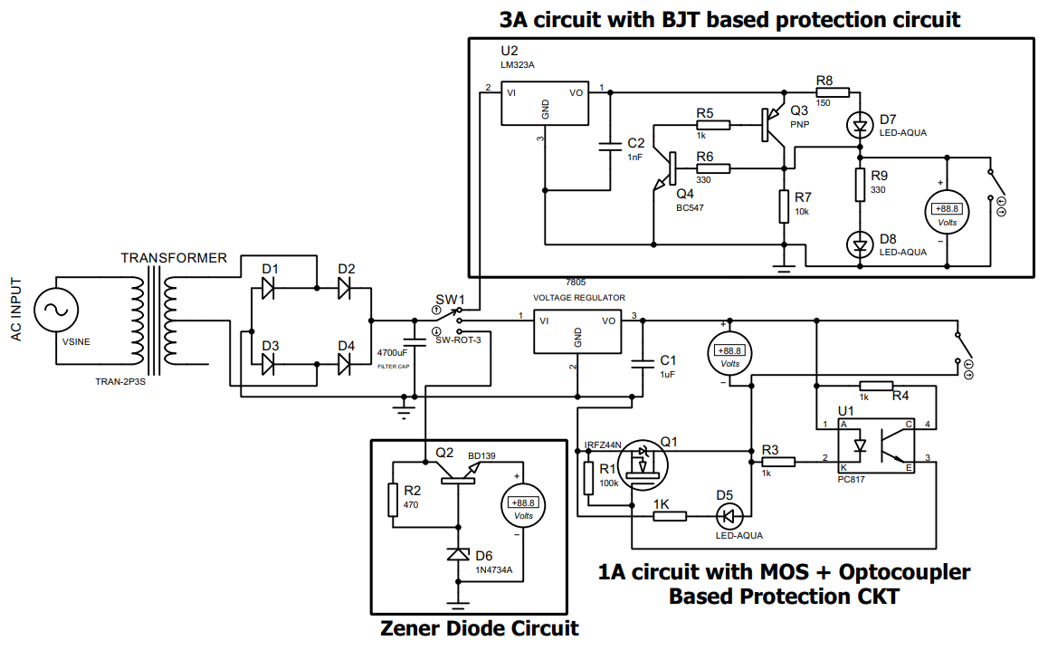
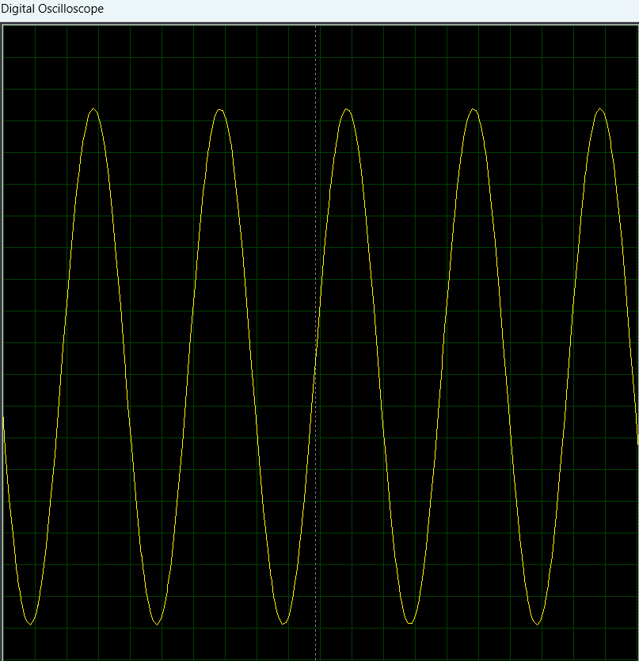
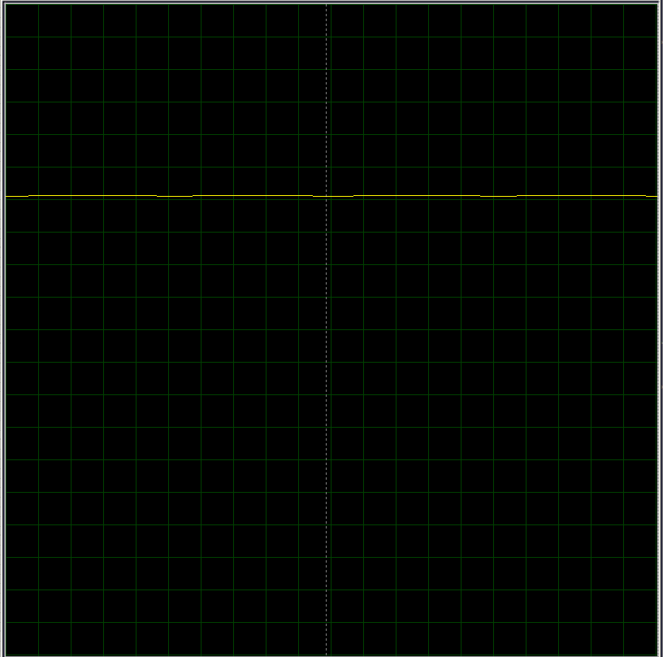
Mini Project (23EECW301)
Simulation Results
INPUT
OUTPUT

Slide 8
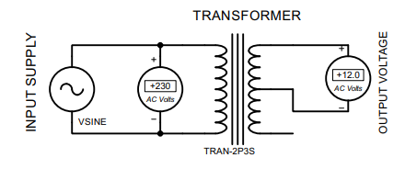
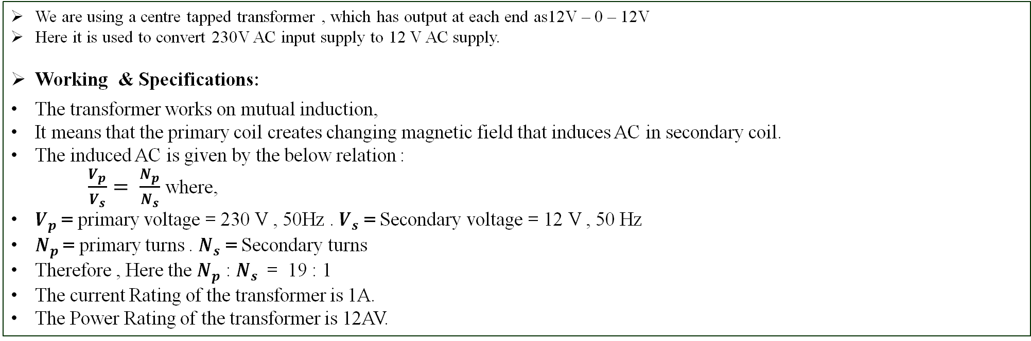
Mini Project (23EECW301)
TRANSFORMER
We are using a centre tapped transformer , which has output at each end as12V – 0 – 12V
Here it is used to convert 230V AC input supply to 12 V AC supply.
Working & Specifications:
The transformer works on mutual induction,
It means that the primary coil creates changing magnetic field that induces AC in secondary coil.
The induced AC is given by the below relation :
$\frac{V_{p}}{V_{s}}= \frac{N_{p}}{N_{s}}$ where,
$V_{p}$ = primary voltage = 230 V , 50Hz . $V_{s}$ = Secondary voltage = 12 V , 50 Hz
$N_{p}$= primary turns . $N_{s}$ = Secondary turns
Therefore , Here the $N_{p}$ : $N_{s}$ = 19 : 1
The current Rating of the transformer is 1A.
The Power Rating of the transformer is 12AV.

Slide 9
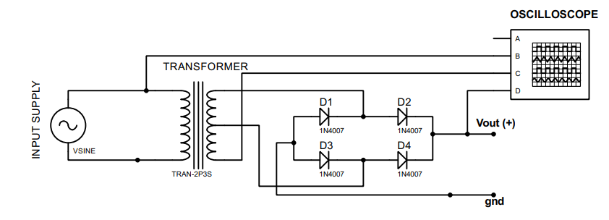
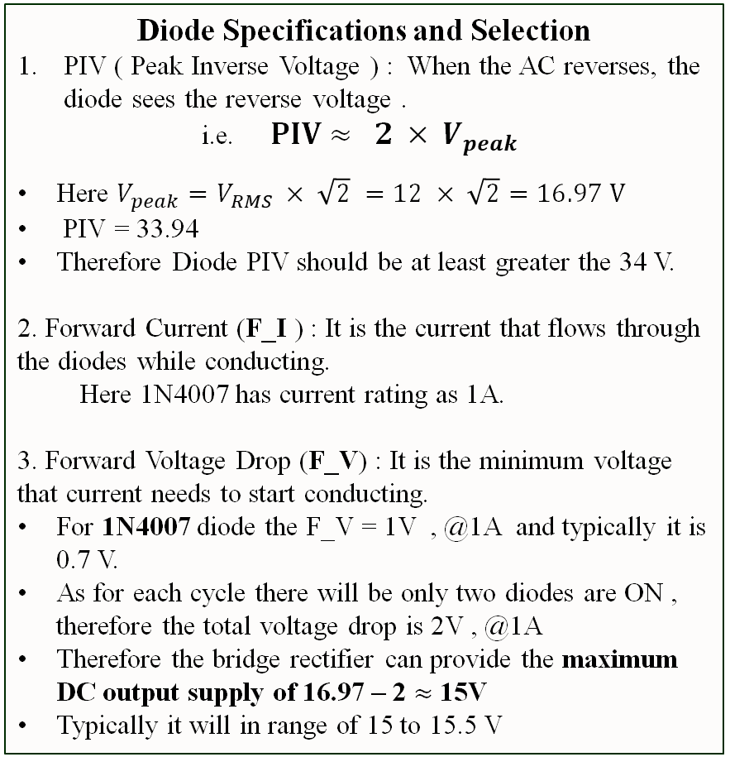
Mini Project (23EECW301)
BRIDGE RECTIFIER
Here the bridge rectifier is used to convert the 12 V AC supply into DC .
Why Bridge rectifier is Preferred over other rectifier circuits ?
It uses both half cycles of the AC signal , so that it increases the efficiency.
It provides Less ripples.
It is cheap and simple two wire input circuit.
Working :
In bridge Rectifier there are 4 diodes placed as shown below and for every cycle two diodes will be ON , providing output similar to the full wave rectifier.
Here the output supply will be having 100 Hz as frequency.
Diode Specifications and Selection
PIV ( Peak Inverse Voltage ) : When the AC reverses, the diode sees the reverse voltage .
i.e. $PIV≈ 2 × V_{peak}$
Here $V_{peak}=V_{RMS} × \sqrt{2} =12 × \sqrt{2}=16.97 V$
PIV = 33.94
Therefore Diode PIV should be at least greater the 34 V.
2. Forward Current (F_I ) : It is the current that flows through the diodes while conducting.
  Here 1N4007 has current rating as 1A.
3. Forward Voltage Drop (F_V) : It is the minimum voltage that current needs to start conducting.
For 1N4007 diode the F_V = 1V , @1A and typically it is 0.7 V.
As for each cycle there will be only two diodes are ON , therefore the total voltage drop is 2V , @1A
Therefore the bridge rectifier can provide the maximum DC output supply of 16.97 – 2 $≈$15V
Typically it will in range of 15 to 15.5 V

Slide 10
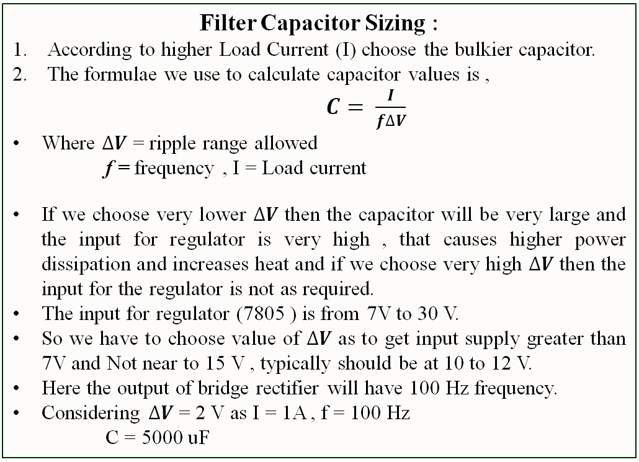


Mini Project (23EECW301)
Filter Capacitor
The output from the Bridge Rectifier Still Contains some amount of ripples and to remove that ripples we need to have a capacitor as filter.
The capacitor charges for peak voltage and discharges to fill or reduce the ripples
Amplitude
$$V_{peak}$$
Filter Capacitor Sizing :
According to higher Load Current (I) choose the bulkier capacitor.
The formulae we use to calculate capacitor values is ,
$C= \frac{I}{f∆V}$
Where $∆V$ = ripple range allowed
f = frequency , I = Load current
If we choose very lower $∆V$ then the capacitor will be very large and the input for regulator is very high , that causes higher power dissipation and increases heat and if we choose very high $∆V$ then the input for the regulator is not as required.
The input for regulator (7805 ) is from 7V to 30 V.
So we have to choose value of $∆V$ as to get input supply greater than 7V and Not near to 15 V , typically should be at 10 to 12 V.
Here the output of bridge rectifier will have 100 Hz frequency.
Considering $∆V$ = 2 V as I = 1A , f = 100 Hz
C = 5000 uF
Without Filter Capacitor
time
Amplitude
$$∆V$$
time
With Filter Capacitor

Slide 11
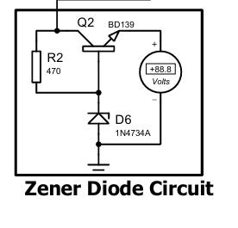
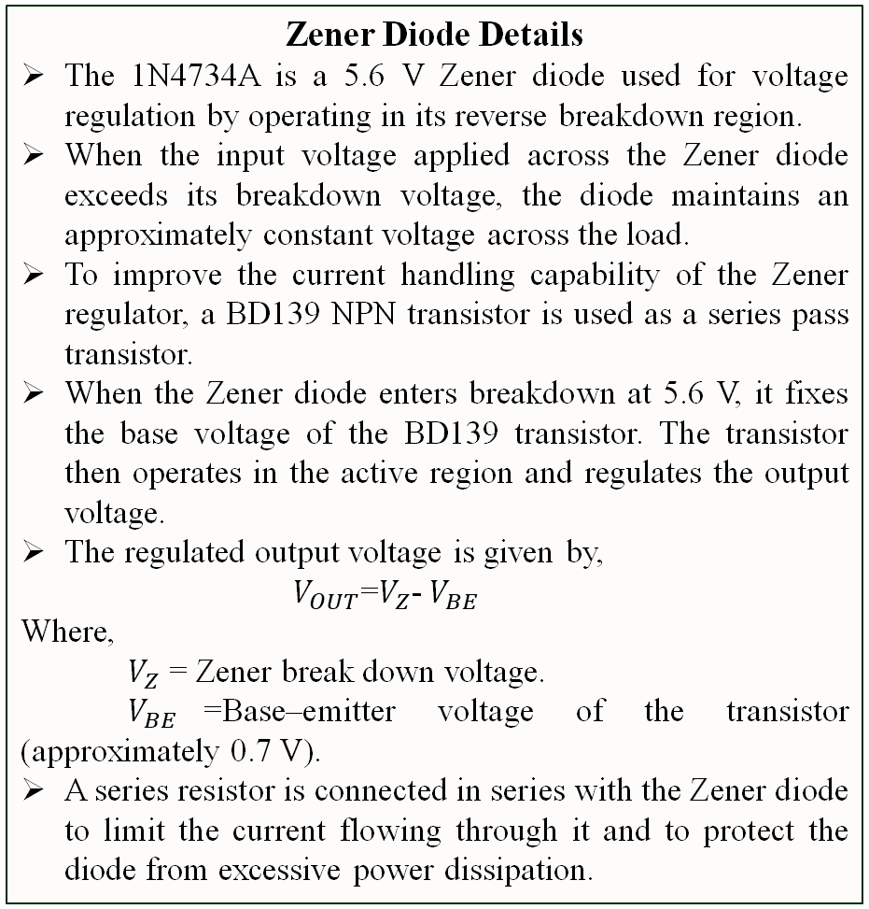
Mini Project (23EECW301)
Zener Diode as Linear Regulator
Zener Diode Details
The 1N4734A is a 5.6 V Zener diode used for voltage regulation by operating in its reverse breakdown region.
When the input voltage applied across the Zener diode exceeds its breakdown voltage, the diode maintains an approximately constant voltage across the load.
To improve the current handling capability of the Zener regulator, a BD139 NPN transistor is used as a series pass transistor.
When the Zener diode enters breakdown at 5.6 V, it fixes the base voltage of the BD139 transistor. The transistor then operates in the active region and regulates the output voltage.
The regulated output voltage is given by,
$V_{OUT}$=$V_{Z}$-${ V}_{BE}$
Where,
$V_{Z}$ = Zener break down voltage.
$V_{BE}$=Base–emitter voltage of the transistor (approximately 0.7 V).
A series resistor is connected in series with the Zener diode to limit the current flowing through it and to protect the diode from excessive power dissipation.
The Zener regulator provides a simple and low-cost method of voltage regulation and is commonly used as a reference voltage source in low-power circuits.
Zener regulators have limited current handling capability, poor thermal stability, and higher output ripple compared to integrated regulators.
As the load current increases, the output voltage may drop significantly, making the circuit unsuitable for applications requiring stable voltage under varying load conditions.
Due to these limitations, dedicated linear regulators such as the 7805 and LM323 are used instead of relying solely on the Zener regulator.

Slide 12
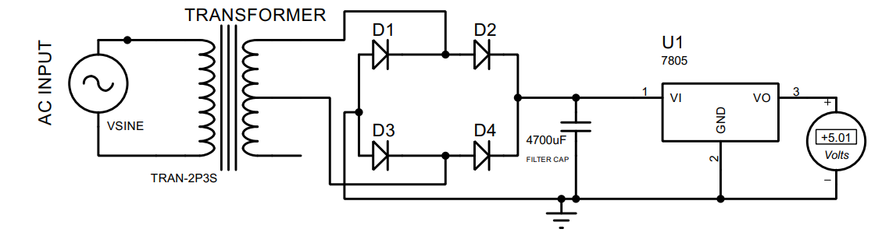
Mini Project (23EECW301)
Linear Regulator (L7805)
Here the Linear Regulator ( L7805 ) is used to provide constant 5V DC supply by taking varying Range of DC input supply.
A small capacitor should be added just after the output pin of the L7805 linear regulator because,
  To handle sudden Load Changes
  To increase the frequency stability
  To increase the stability of output supply
linear Regulator Details
The L7805 works in the range of 7V to 25 V .
But for the higher voltage the problem of overheat can occur.
If the input voltage is very high then while converting or regulating it to 5 volts there will be a massive power loss and that can cause overheat problem.
Here , If we consider very low ripple voltage range for filter capacitor then the input will automatically becomes higher and while converting that high voltage the massive m = power loss can cause higher heating issues.
Therefore the main drawback of this regulator is that it can’t handle high input voltages.
The heatsink is needed in case of max power dissipations , which causes increase in heat of the regulator.
According to Datasheet :
Thermal resistance junction to ambient (RθJA) = 83°C/W
Thermal resistance junction to case (RθJC) = 8.3°C/W
Maximum Junction Temperature = 150°C

Slide 13
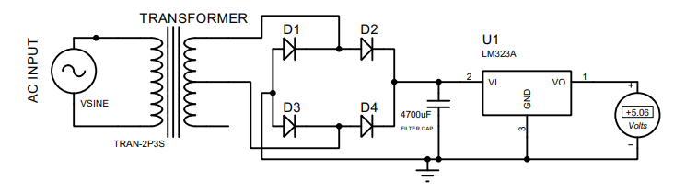
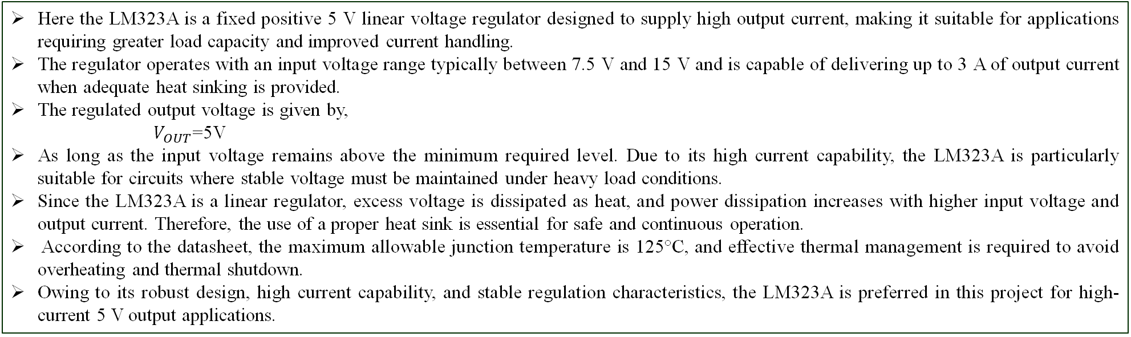
Mini Project (23EECW301)
Linear Regulator (LM323A)
Here the LM323A is a fixed positive 5 V linear voltage regulator designed to supply high output current, making it suitable for applications requiring greater load capacity and improved current handling.
The regulator operates with an input voltage range typically between 7.5 V and 15 V and is capable of delivering up to 3 A of output current when adequate heat sinking is provided.
The regulated output voltage is given by,
$V_{OUT}$=5V
As long as the input voltage remains above the minimum required level. Due to its high current capability, the LM323A is particularly suitable for circuits where stable voltage must be maintained under heavy load conditions.
Since the LM323A is a linear regulator, excess voltage is dissipated as heat, and power dissipation increases with higher input voltage and output current. Therefore, the use of a proper heat sink is essential for safe and continuous operation.
According to the datasheet, the maximum allowable junction temperature is 125°C, and effective thermal management is required to avoid overheating and thermal shutdown.
Owing to its robust design, high current capability, and stable regulation characteristics, the LM323A is preferred in this project for high-current 5 V output applications.

Slide 14
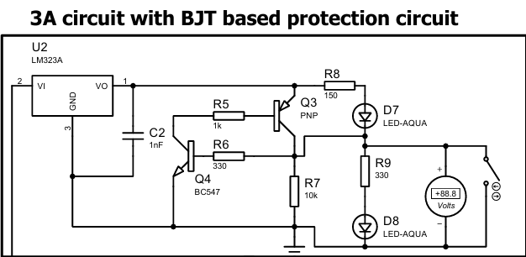
Mini Project (23EECW301)
Short Circuit Protection (SCP) Circuit
A short circuit protection circuit is a safety circuit that prevents damage by stopping current flow when the output is accidentally shorted.
Why do we need the SCP?
Prevents damages to the components like voltage regulator, diodes, other components.
Protects Power Supply and Transformer : As high current due to a short circuit can overheat the transformer and power supply components.
Protects the load damage: Due the uncontrolled current supply the load may get damaged.
Circuit Components.
SCP consist of PNP transistor(Q3) which act as main pass transistor that supplies power to the load. When Q3 is ON, current flows to the output and when it is OFF, the load is disconnected to protect the circuit during a short circuit. The PNP transistor is said to be ON when the base voltage is lower (i.e. <0.7v) and vice versa.
A NPN transistor(Q4) acts as a sensing transistor .It detects abnormal conditions such as excessive current during a short circuit and turns ON to disable Q4.
The resistors in the circuit control and limit current to the transistors, allowing the sensing transistor to detect excessive current and safely turn off the pass transistor during a short circuit.

Slide 15
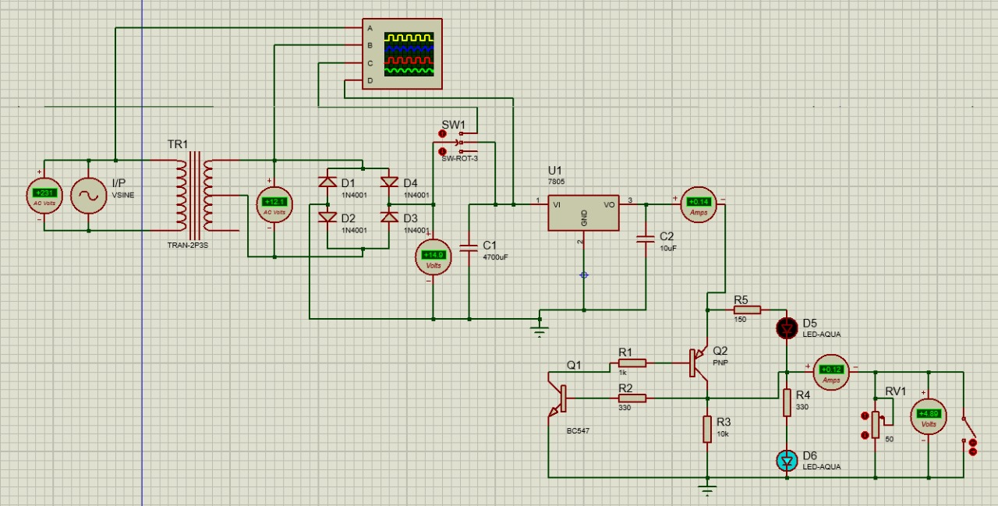
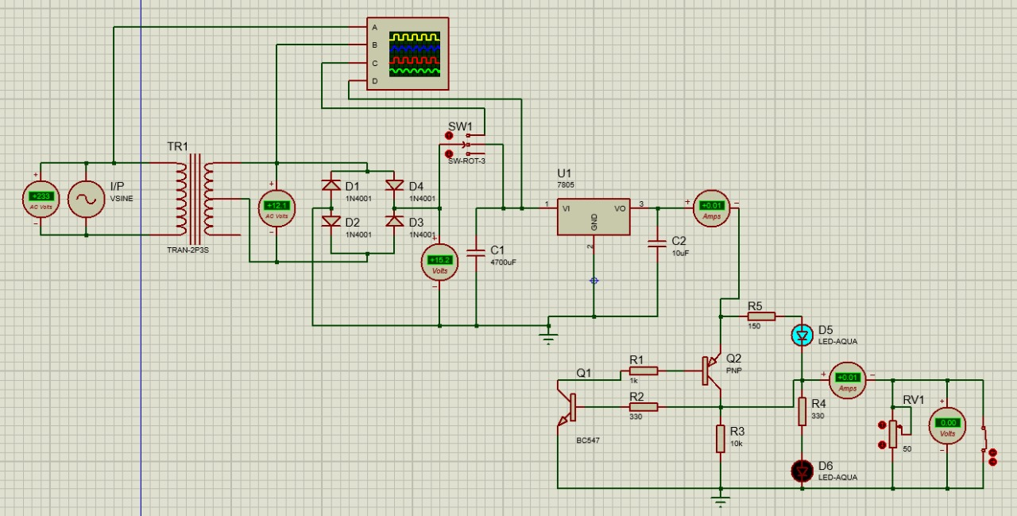
Mini Project (23EECW301)
Working of SCP
During Normal Operation
During Short Circuit
During normal operation, the load resistance is within a safe range, so the output current remains normal and the output voltage stays at a healthy level. Since no abnormal current is detected, the sensing transistor Q1 (BC547) remains OFF, allowing the pass transistor Q2(BC558) to stay ON and supply power to the load. As a result, current flows normally, the green LED (D6) glows to indicate proper operation, the green LED (D5) remains OFF, and the charger works correctly without any interruption.
During a short-circuit condition, the load resistance becomes nearly zero, causing the output current to rise sharply and the output voltage to drop. This abnormal condition is detected by the sensing transistor Q1 (BC547), which turns ON and removes the base drive of the pass transistor Q2 (BC558), forcing it to turn OFF and disconnect the load. As a result, current flow is stopped to protect the circuit, the green LED turns OFF(D6), to indicate a fault the LED (D5) turns ON and the charger is safely shut down until the short circuit is removed.

Slide 16

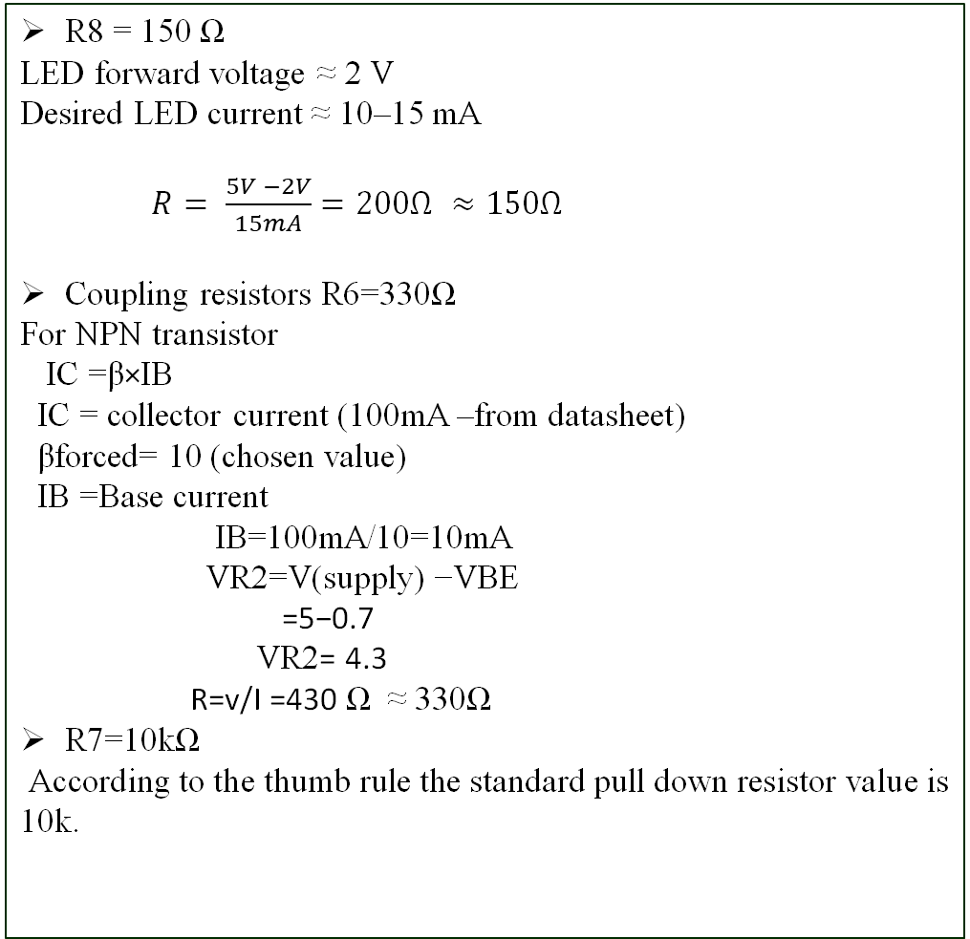
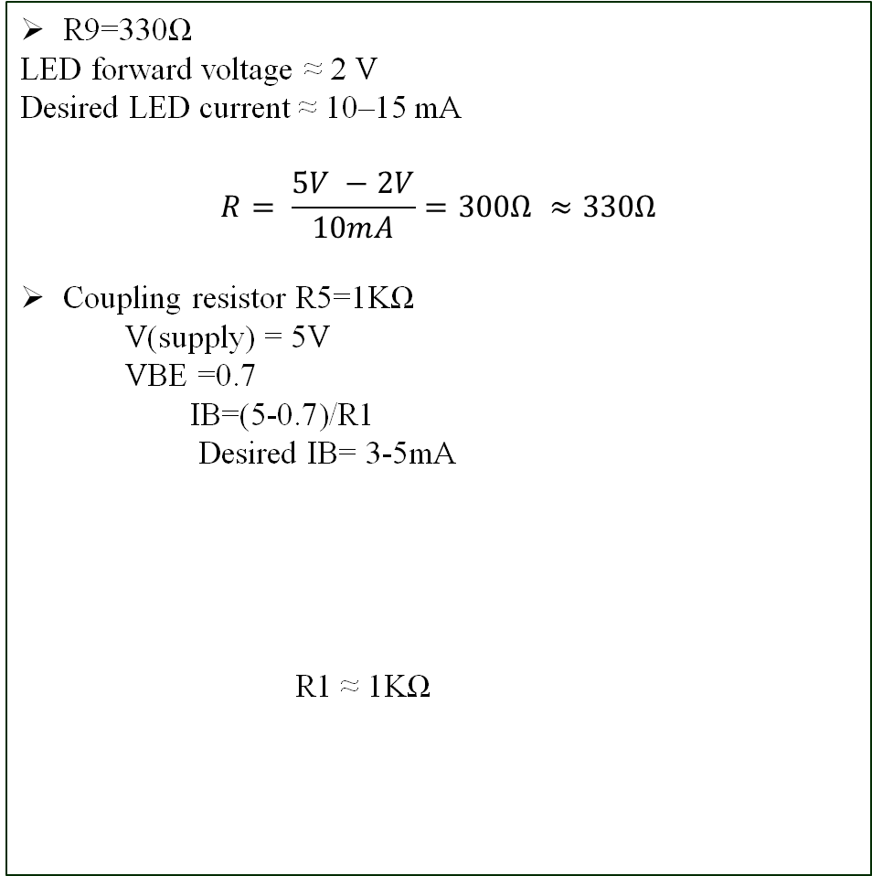
Mini Project (23EECW301)
Component Sizing
R8 = 150 Ω
LED forward voltage ≈ 2 V
Desired LED current ≈ 10–15 mA
$R= \frac{5V −2V}{15mA}=200Ω ≈150Ω$
Coupling resistors R6=330Ω
For NPN transistor
IC =β×IB
IC = collector current (100mA –from datasheet)
βforced= 10 (chosen value)
IB =Base current
IB=100mA/10=10mA
VR2=V(supply) −VBE
=5−0.7
VR2= 4.3
R=v/I =430 Ω ≈ 330Ω
R7=10kΩ
According to the thumb rule the standard pull down resistor value is 10k.
R9=330Ω
LED forward voltage ≈ 2 V
Desired LED current ≈ 10–15 mA
$$R= \frac{5V −2V}{10mA}=300Ω ≈330Ω$$
Coupling resistor R5=1KΩ
V(supply) = 5V
VBE =0.7
IB=(5-0.7)/R1
Desired IB= 3-5mA
R1 ≈ 1KΩ

Slide 17
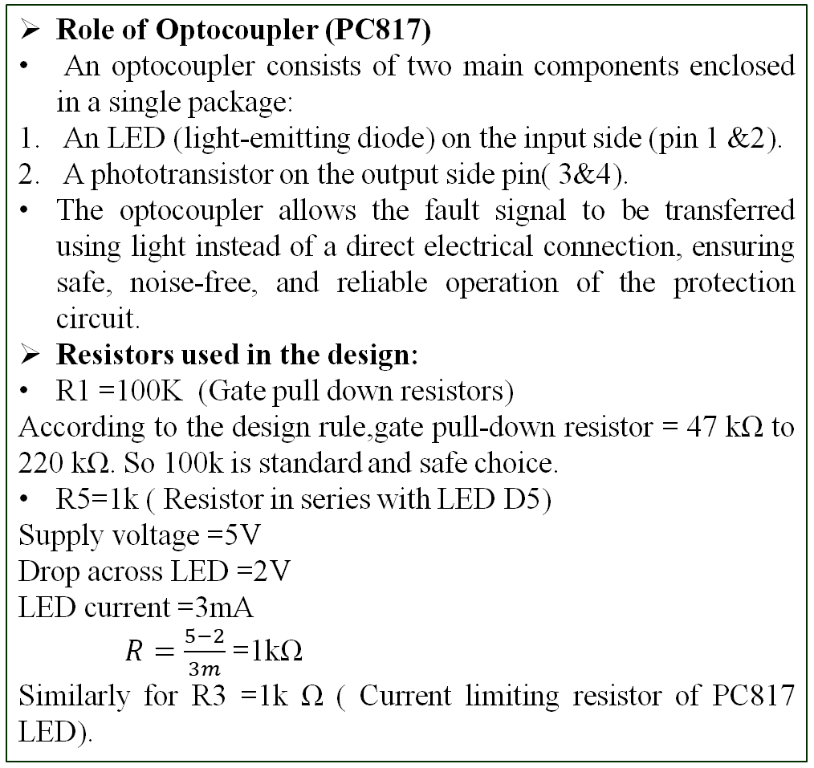
Mini Project (23EECW301)
MOSFET BASED SHORT CIRCUIT PROTECTION
A MOSFET-based short-circuit protection circuit uses a voltage-controlled MOSFET(IRFZ44N) as a electronic switch that automatically disconnects the load when a short circuit is detected, thereby protecting the power supply and connected devices.
Components Used :
IRFZ44N MOSFET – Power switching element
PC817 Optocoupler – Fault detection and isolation.
Resistors – Gate control and current limiting.
LED – Short circuit indication
Role of MOSFET in the Circuit
MOSFET works as a series pass switch, which is controlled by gate-to-source voltage (VGS) .Whenever VGS >Vth ,the MOSFET turns ON and act as closed switch and when VGS <Vth it behaves like open switch by getting OFF.
The MOSFET ensures that current flows to the load only during safe operating conditions and disconnects the load immediately during a short circuit or fault.
Role of Optocoupler (PC817)
An optocoupler consists of two main components enclosed in a single package:
An LED (light-emitting diode) on the input side (pin 1 &2).
A phototransistor on the output side pin( 3&4).
The optocoupler allows the fault signal to be transferred using light instead of a direct electrical connection, ensuring safe, noise-free, and reliable operation of the protection circuit.
Resistors used in the design:
R1 =100K (Gate pull down resistors)
According to the design rule,gate pull-down resistor = 47 kΩ to 220 kΩ. So 100k is standard and safe choice.
R5=1k ( Resistor in series with LED D5)
Supply voltage =5V
Drop across LED =2V
LED current =3mA
$R=\frac{5−2}{3m}$ =1kΩ
Similarly for R3 =1k Ω ( Current limiting resistor of PC817 LED).

Slide 18
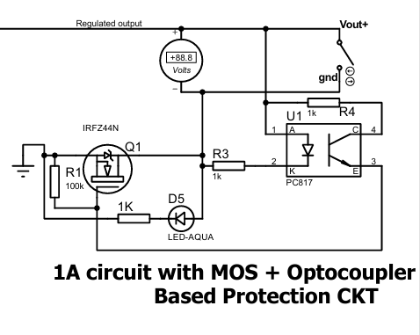
Mini Project (23EECW301)
Working of MOSFET-based SCP
During Normal Operation
During Short Circuit
During normal operation, as the internal LED of PC817 is connected to pin 1( connected to +ve teminal of load) & pin 2 ( connected to –ve terminal of load) .During normal operation the output voltage is normal ,so due to this LED path is not forward biased and hence it is OFF. When LED is off then the phototransistor(connected to pin 3 &4) is also OFF .Since phototransistor is OFF it do not affect the gate terminal of MOSFET and the optocoupler stays inactive .
The MOSFET gate has 5V( from the output voltage) and source is 0V so ,VGS > Vth as Vth of IRFZ44N is 4V. Now the MOSET is ON and behaves like closed switch . The drain-to-source resistance becomes very low and current flows from the supply, through the MOSFET, to the load.
The indication LED is connected in series with the PC817 phototransistor. As during the normal operation phototransistor is OFF, the LED current path is open. No current flows through the LED and the indication LED remains OFF.
During a short-circuit condition, the output terminal is shorted and hence the load resistance is ≈ 0 Ω and output voltage is also 0V ,so due this the LED path of PC817 is forward biased and it turns ON .When LED is ON the internal phototransistor also gets ON .When the phototransistor is ON it pulls the MOSFET gate to ground through the 100k resistor connected to ground .
Now the MOSET gate has 0V and hence VGS <Vth ,so the MOSFET is OFF and behave like open switch. The drain-to-source path opens so current does not flow to the load and disconnects the load from the supply and thereby protecting the circuit from the damage.
Due the forward biased path of the LED ,the indication LED current path is ON so current flows through the LED and the LED turns ON indicating the short circuit.

Slide 19
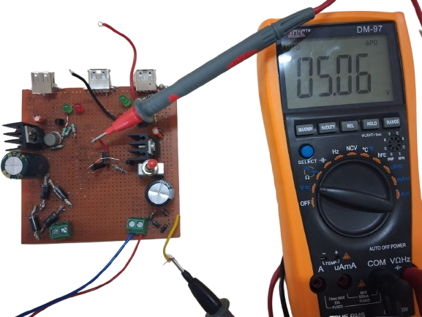
Mini Project (23EECW301)
HARDWARE IMPLEMENTATION RESULTS
VISTEON SCHOLAR PROGRAM
Title :How Cars Have Evolved Over the Last 2 Decades (≈ 2005–2025)
NAME :Sahana Mathapati
COLLEGE: KLE Technological University ,Hubli
Pre Assignment -1
Zener diode
Output voltage
Ground

Slide 20
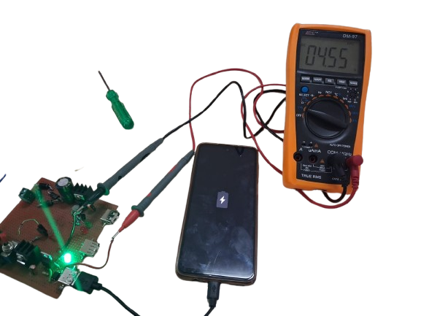
Mini Project (23EECW301)
HARDWARE IMPLEMENTATION RESULTS
VISTEON SCHOLAR PROGRAM
Title :How Cars Have Evolved Over the Last 2 Decades (≈ 2005–2025)
NAME :Sahana Mathapati
COLLEGE: KLE Technological University ,Hubli
Pre Assignment -1
Charging indicator

Slide 21
Mini Project (23EECW301)
Questions encountered during the project M
Title :How Cars Have Evolved Over the Last 2 Decades (≈ 2005–2025)
NAME :Sahana Mathapati
COLLEGE: KLE Technological University ,Hubli
Pre Assignment -1

Slide 22
Mini Project (23EECW301)
OUTPUT SPECIFICATIONS
What Output is expected ? The output the specifications are : 5V , 1A DC supply.
2. What does 5V , 1A DC supply actually mean ? It means the output should provide 5v constant supply voltage and the current ranging from 0 to 1A.
3. Why the current is Variable or 0 to 1A ? Because the current value will vary according to load , meaning that the load will draw how much current it needs.
4. What if output current is very less than required by the device ? If this occurs then the power supply doesn’t work properly and the output voltage may vary and the device will not charge properly (phone may show like “slow charging”);
5. How much Power is wasted as heat? P=(Vin−Vout) × current (I) At Vin = 12V, Vout = 5V, I = 1A → 7W heat!
6. Why we used specifically diode 1N4007? They are rectifier diodes , rated for 1A current low cost and standard for power supplies.

Slide 23
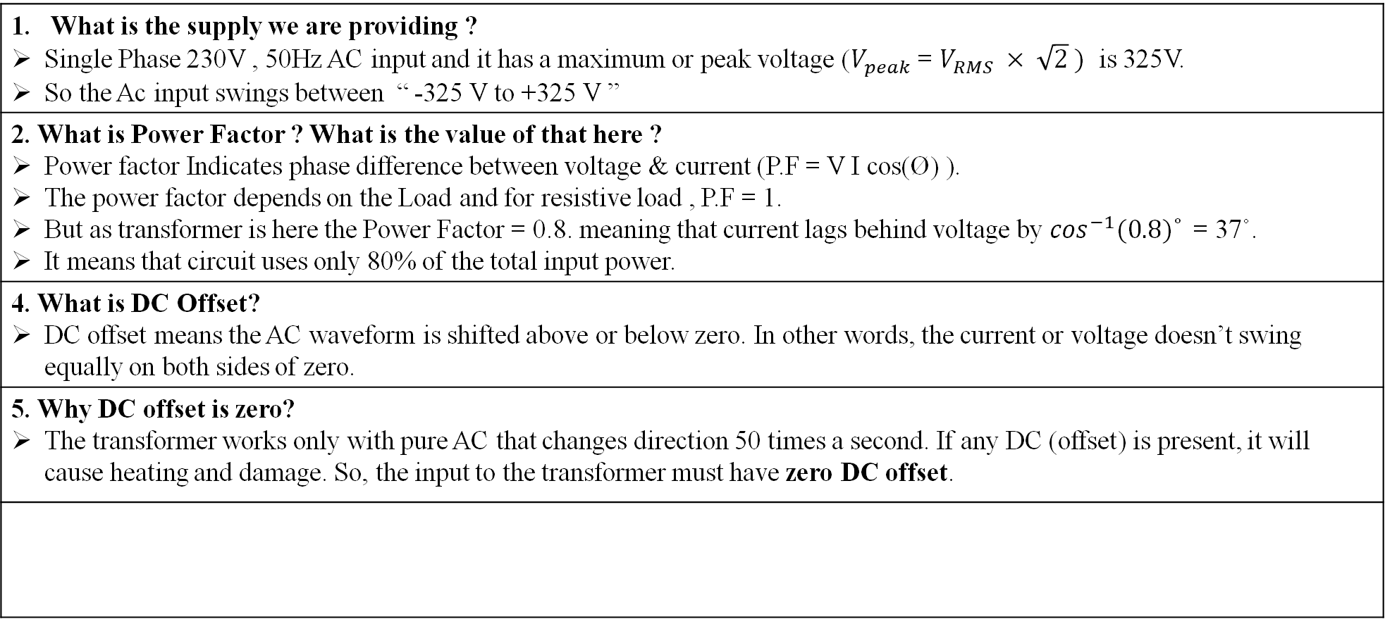
Mini Project (23EECW301)
INPUT SUPPLY
What is the supply we are providing ? Single Phase 230V , 50Hz AC input and it has a maximum or peak voltage ($V_{peak}$ = $V_{RMS} × \sqrt{2} )$ is 325V. So the Ac input swings between “ -325 V to +325 V ”
2. What is Power Factor ? What is the value of that here ? Power factor Indicates phase difference between voltage & current (P.F = V I cos(Ø) ). The power factor depends on the Load and for resistive load , P.F = 1. But as transformer is here the Power Factor = 0.8. meaning that current lags behind voltage by $\cos^{−1}(0.8)˚$ = 37˚. It means that circuit uses only 80% of the total input power.
4. What is DC Offset? DC offset means the AC waveform is shifted above or below zero. In other words, the current or voltage doesn’t swing equally on both sides of zero.
5. Why DC offset is zero? The transformer works only with pure AC that changes direction 50 times a second. If any DC (offset) is present, it will cause heating and damage. So, the input to the transformer must have zero DC offset.

Slide 24
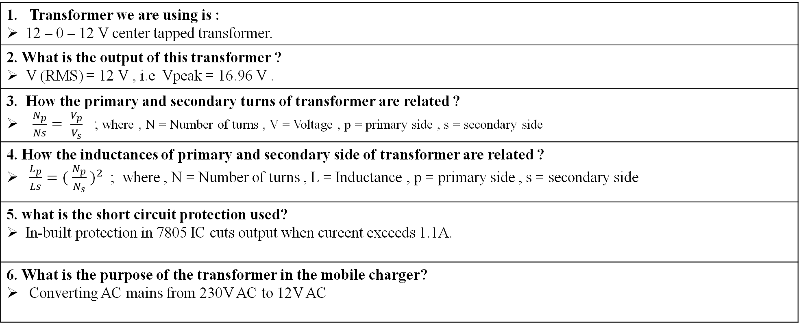
Mini Project (23EECW301)
TRANSFORMER
Transformer we are using is : 12 – 0 – 12 V center tapped transformer.
2. What is the output of this transformer ? V (RMS) = 12 V , i.e Vpeak = 16.96 V .
3. How the primary and secondary turns of transformer are related ? $\frac{N_{p}}{Ns}= \frac{V_{p}}{V_{s}}$ ; where , N = Number of turns , V = Voltage , p = primary side , s = secondary side
4. How the inductances of primary and secondary side of transformer are related ? $\frac{L_{p}}{Ls}={( \frac{N_{p}}{N_{s}} )}^{2}$ ; where , N = Number of turns , L = Inductance , p = primary side , s = secondary side
5. what is the short circuit protection used? In-built protection in 7805 IC cuts output when cureent exceeds 1.1A.
6. What is the purpose of the transformer in the mobile charger? Converting AC mains from 230V AC to 12V AC

Slide 25
Mini Project (23EECW301)
Bridge RECTIFIER
1. What is the purpose of a Bridge Rectifier and what does it do to the AC signal? A Bridge Rectifier converts AC (alternating current) to DC (direct current) by allowing current to flow in only one direction. It uses both positive and negative half-cycles of the AC signal, unlike half-wave rectifiers which use only one half-cycle.
2. Why are 4 diodes used in a Bridge Rectifier and what is their arrangement? 4 diodes are arranged in a diamond/bridge configuration to create two separate paths for current. During positive half-cycle, diodes 1 & 3 conduct; during negative half-cycle, diodes 2 & 4 conduct. This ensures output is always in the same direction (positive).
3. How does a Bridge Rectifier differ from a Half-Wave Rectifier? Half-wave: Uses 1 diode, conducts only one half-cycle (50Hz output), lower efficiency (~40%), high ripples. Bridge (Full-wave): Uses 4 diodes, conducts both half-cycles (100Hz output), higher efficiency (~80%), lower ripples. Bridge rectifier is preferred for better performance.
4. What is the output frequency of a Bridge Rectifier and why does it double from input? Input frequency = 50 Hz (AC). Since the bridge rectifier conducts both positive and negative half-cycles, the output frequency = 100 Hz (doubled). Each cycle of AC provides two pulses in the output, so output pulses = 2 × input frequency.
5. What does "Peak Inverse Voltage (PIV)" mean and why is it important for diode selection? PIV is the maximum reverse voltage a diode must withstand without breaking down. For bridge rectifiers, PIV = Peak voltage of secondary AC = √2 × RMS voltage = √2 × 12 = 16.97V. Diodes must have PIV rating > 16.97V (hence 1N4007 with 1000V PIV is used).

Slide 26
Mini Project (23EECW301)
Bridge RECTIFIER
6. Why is diode 1N4007 specifically used in the bridge rectifier of this project? 1N4007 diode has: (1) Peak Inverse Voltage (PIV) = 1000V (very high for safety margin), (2) Maximum forward current = 1A (matches project output), (3) Forward voltage drop ≈ 0.7V (acceptable loss), (4) Cheap and readily available. Perfect for 12V AC input.
7. What is the voltage loss across the Bridge Rectifier due to diode forward voltage drops? Each diode has a forward voltage drop of ~0.7V. In a bridge rectifier, 2 diodes conduct simultaneously, so total voltage drop = 2 × 0.7V = 1.4V. For 12V AC (peak = 16.97V DC), output = 16.97 - 1.4 = 15.57V. This ripple DC is then filtered and regulated.
8. What is "Ripple Voltage" in the Bridge Rectifier output and why must it be removed? Ripple voltage is the remaining AC component in the "DC" output from the rectifier. It appears as small voltage variations (pulsations) on top of the DC level. It must be removed because: (1) Electronic devices need pure DC, (2) Ripples cause noise and instability, (3) Can damage sensitive components. Solution: Use filter capacitor to smooth it.
9. How does the Bridge Rectifier output compare to ideal DC in terms of smoothness and ripple factor? Ideal DC: Perfectly flat at constant voltage. Bridge Rectifier output: Has significant ripples. Ripple factor = (RMS value of AC component) / (Average DC value) ≈ 0.48 (or 48%) for unfiltered bridge output. This is why a capacitor filter is essential to reduce ripple factor to <5%.
10. What is the efficiency of a Bridge Rectifier and how does it compare with other rectifier types? Bridge Rectifier efficiency ≈ 81.2% (defined as: ratio of DC power output to AC power input). Comparison: Half-wave rectifier ≈ 40%, Full-wave center-tap ≈ 81.2%, Bridge rectifier ≈ 81.2%. Bridge rectifier's higher efficiency makes it the preferred choice for power supplies, as less power is wasted as heat.

Slide 27
Mini Project (23EECW301)
FITER CAPACITOR
1.What is the purpose of a Filter Capacitor in this power supply circuit? A filter capacitor (also called smoothing capacitor) removes ripple voltage from the bridge rectifier output. It stores charge during peaks and releases it during valleys, smoothing the pulsating DC into a relatively pure DC voltage. This reduces ripple factor from ~48% to <5%.
2. Why is a large capacitance value (4700µF) chosen for the filter capacitor? Larger capacitance stores more charge, allowing it to maintain voltage more effectively between rectifier pulses. 1000µF is a compromise between: (1) Large enough to significantly reduce ripples, (2) Small enough to be practical and affordable, (3) Adequate for 1A maximum current output.
3. How does the Filter Capacitor charge and discharge in the circuit? Charging: When the bridge rectifier output voltage is at its peak, the capacitor charges to that peak voltage (bypassing the diodes). Discharging: Between rectifier pulses, the output voltage drops, but the charged capacitor discharges through the load, maintaining voltage. This creates a smoother DC output.
4. What is the relationship between capacitance, ripple voltage, and frequency? Ripple voltage ∝ 1/C (inversely proportional to capacitance). Ripple voltage ∝ 1/f (inversely proportional to frequency). Formula: Vripple = Iload × T / (2 × C), where T is the period between pulses. Higher C and higher frequency (100Hz for bridge) both reduce ripples.
5. Why must the Filter Capacitor have a voltage rating higher than the peak output voltage? Peak DC output ≈ 15.57V (from bridge rectifier). The capacitor must withstand this voltage plus any voltage spikes or transients. Standard practice: Use capacitor with voltage rating ≥ 1.5× to 2× peak voltage.

Slide 28
Mini Project (23EECW301)
FILTER CAPACITOR
6. What happens if the Filter Capacitor voltage rating is too low? If voltage rating is inadequate, the capacitor will: (1) Break down due to dielectric failure, (2) Leak current internally, (3) Explode if severely over-stressed, (4) Reduce circuit reliability and safety. Always use at least 25V rated capacitor for 12V AC input, not exactly 12V rated.
7. Why is electrolytic capacitor preferred over ceramic capacitor for filtering? Electrolytic capacitor: High capacitance (1000µF) in small size, cheap, suitable for low-frequency AC ripple (100Hz). Ceramic capacitor: Small capacitance (~100nF max), expensive for high values, better for high-frequency noise. Electrolytic is chosen because we need large capacitance for low-frequency 100Hz ripple filtering.
8. What is the polarity marking on the Filter Capacitor and why is it important? Electrolytic capacitors are polarized: Positive leg (longer) connects to positive DC, Negative leg (shorter) connects to ground/negative. Reversing polarity causes: Internal damage, leakage, explosion risk. In this circuit, positive plate connects to bridge rectifier output, negative to ground. Always respect polarity!
9. What is "Capacitor Inrush Current" and why is it a concern during circuit startup? At power-on, the uncharged capacitor looks like a short circuit, drawing a large current spike (inrush current). This can: (1) Damage diodes in the bridge rectifier, (2) Blow fuses, (3) Stress components. Solution: Use a current-limiting resistor (~10-47Ω) in series with capacitor or ensure diodes can handle the transient.
10. How does the Filter Capacitor improve the performance and efficiency of the power supply? Filter capacitor: (1) Reduces noise (ripple factor <5%), allowing sensitive circuits to work properly, (2) Maintains voltage stability under load variations, (3) Reduces heat dissipation in the linear regulator (7805) by providing better input voltage, (4) Protects downstream components from ripple-induced damage, (5) Improves overall power supply quality and reliability.

Slide 29
Mini Project (23EECW301)
Voltage Regulator
1. Why did we choose the 7805 regulator for the 5V mobile charging circuit? It provides a fixed 5V DC output and can supply up to 1A and also includes internal protection for short circuit ,thermal shutdown ,overcurrent.
2. What is the minimum input voltage required for the 7805? Vin = 5V + 2V = 7V
3. How do you calculate the power dissipation of 7805? P = (Vin – Vout) * I = (12 – 5 )* I= 7
4. what is the efficiency of the 7805 in the circuit? η = (VIN/VOUT) ×100 η = (5/12)×100 = 41.66
5. Why is 7805 a linear regulator? It drops excess voltage by converting it to heat, not by switching. A buck converter uses high-frequency switching → more efficient.
6. How does load regulation work in 7805? 7805 uses internal feedback to keep output exactly 5V even when load varies from 0A to 1A. Small changes in internal pass transistor adjust current flow.

Slide 30
Mini Project (23EECW301)
THANK YOU

