Slide 1

(Digital VLSI-05)
Department of Electronics and Communication Engineering
Minor Project VI semester
Python Driven Digital Design Using MyHdl
Under the guidance of:
Team members::
Pooja C
SL.NO | NAME | USN
1. | Pavitra V Indi | 01FE23BEC277
2. | Ankit B C | 01FE23BEC315
3. | Shailesh Patil | 01FE23BEC144
4. | Srinivas Y B | 01FE23BEC102

Slide 2
Contents
Introduction
Literature Survey
Problem statement
Objectives
Functional block diagram
Proposed Methodology
Results and Discussion
Conclusion and Future scope
References

Slide 3
Introduction
Digital circuits are traditionally designed using Verilog or VHDL, which require extensive coding and verification.
MyHDL is an open-source Python framework that enables digital hardware to be designed, simulated, and verified using Python.
The verified MyHDL design is automatically converted into synthesizable Verilog HDL for FPGA implementation.
This project implements 8-bit and 16-bit Booth Multipliers and a signed Multiply-Accumulate (MAC) unit using the MyHDL framework.
The generated Verilog is synthesized using Xilinx Vivado and deployed on the PYNQ-Z2 FPGA board.
Hardware operation is verified through Python programs in Jupyter Notebook, providing a complete Python-to-FPGA development workflow.

Slide 4
Literature survey
Reference | Technique | Major Contribution | Limitation
Jaic and Smith [5] | MyHDL Framework | Enhanced MyHDL with improved abstraction and HDL conversion | Requires manual optimization for synthesis
Villar et al. [8] | Python as HDL | Demonstrated Python as an effective hardware description language | Limited discussion on FPGA implementation
Decaluwe [2] | MyHDL | Provided simulation and automatic Verilog/VHDL conversion | Focused mainly on framework development
Huang et al. [4] | CPU–FPGA Programming | Unified Python-based software and hardware development | Targets heterogeneous computing systems

Slide 5
Literature survey
Reference | Technique | Major Contribution | Limitation
Anoop and Chalil [1] | FPGA Multipliers | Compared various multiplier architectures on FPGA | Uses conventional HDL implementation
Kamble and Ugale [6] | Vedic, Wallace, Array | Performance comparison of multiplier algorithms | No high-level hardware design methodology
Harika et al. [3] | Booth, Wallace | Analysed delay, power and area of multipliers | Limited implementation scope
Nair and Saraf [7] | Multiplier Review | Comprehensive comparison of multiplier architectures | Review-oriented; no hardware implementation

Slide 6
Problem statement
Traditional HDL design requires extensive coding.
Verilog/VHDL debugging is time-consuming.
Rapid hardware prototyping is difficult.
Auto-generated Verilog may have Vivado compatibility issues.
Manual optimization is often required before synthesis.
Hardware verification involves multiple design tools.
A simpler Python-to-FPGA workflow is needed.

Slide 7
Objectives
Design digital hardware using the MyHDL framework.
Develop 8-bit and 16-bit Booth Multipliers.
Design a signed Multiply-Accumulate (MAC) Unit.
Convert MyHDL designs into Verilog HDL.
Perform simulation and functional verification.
Implement the design using Xilinx Vivado.
Deploy the hardware on the PYNQ-Z2 FPGA.
Verify outputs using Python and Jupyter Notebook.
Demonstrate a complete Python-to-FPGA design flow.

Slide 8
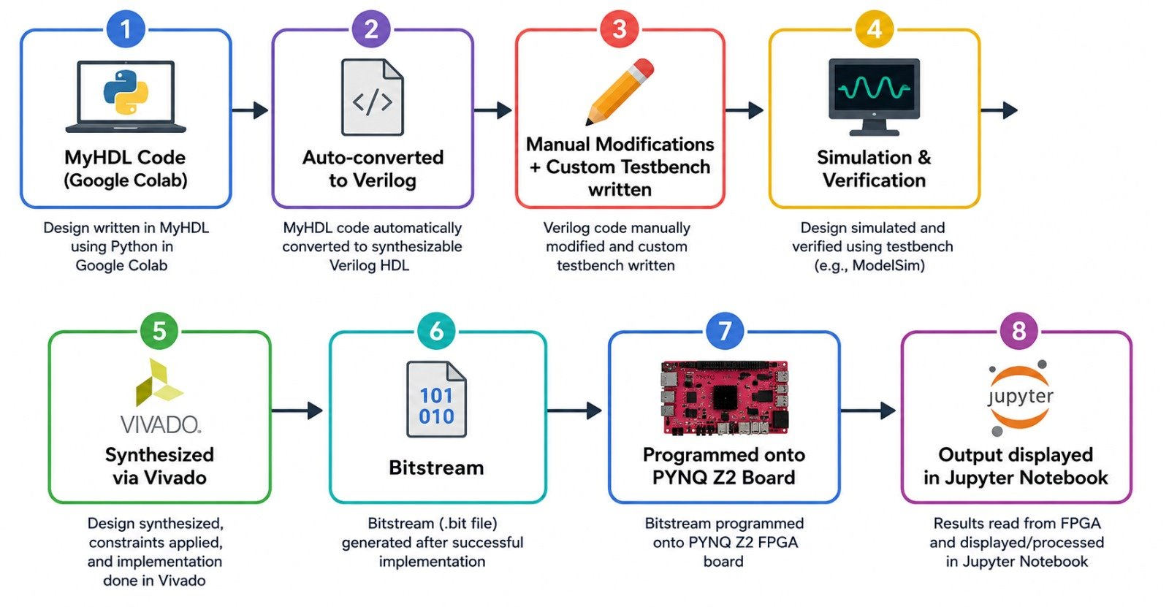
Functional block diagram

Slide 9
Proposed Methodology
1. Hardware Design
Develop the 8-bit and 16-bit Booth Multipliers.
Design the signed MAC Unit using MyHDL.
2. Functional Simulation
Simulate the hardware modules in MyHDL.
Verify signed arithmetic operations.
3. Verilog Generation
Convert the MyHDL design into synthesizable Verilog HDL.
Prepare the design for FPGA implementation.
4. FPGA Implementation
Synthesize and implement the Verilog design using Xilinx Vivado.
Generate the FPGA configuration bitstream.
5. Hardware Deployment
Program the PYNQ-Z2 FPGA board.
Configure the generated hardware overlay.
6. Output Verification
Execute the hardware using Jupyter Notebook.
Compare FPGA outputs with expected results.

Slide 10
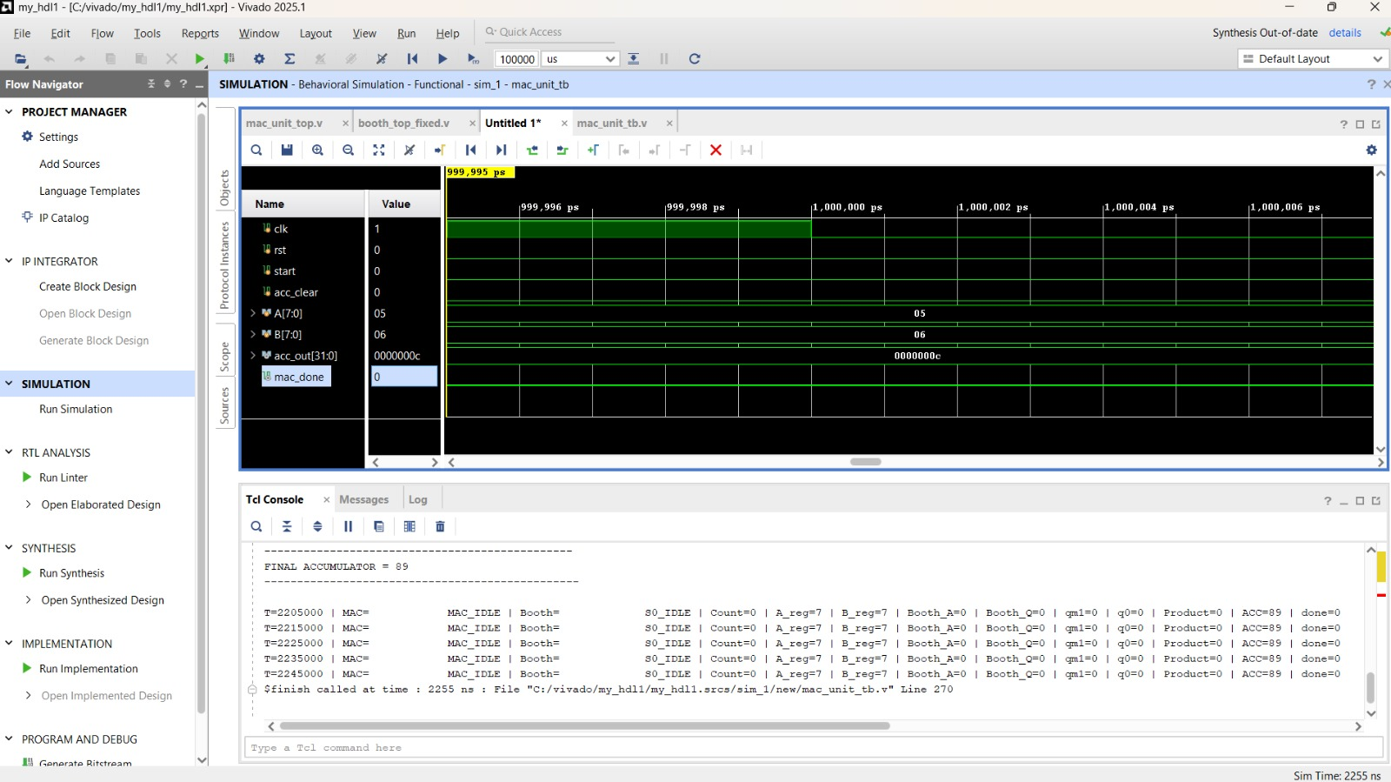
Results and discussions

Slide 11
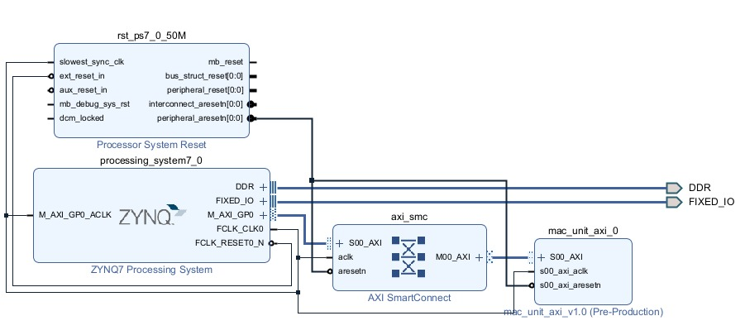
Results and discussions

Slide 12
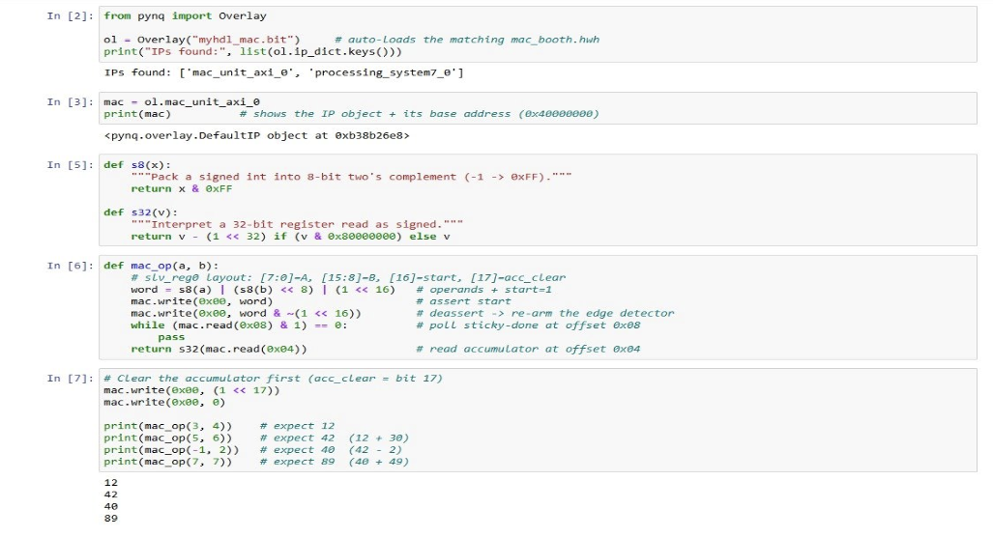
Results and discussions

Slide 13
Results and discussions
Results
Designed 8-bit & 16-bit Booth Multipliers.
Implemented the signed MAC Unit.
Generated Verilog HDL using MyHDL.
Synthesized and deployed on PYNQ-Z2 FPGA.
Verified outputs using Jupyter Notebook.
Hardware results matched expected outputs.
Demonstrated a complete Python-to-FPGA workflow.
Discussions
Correct hardware operation verified.
Accurate multiplication and accumulation.
Efficient Python-based design flow.
Successful FPGA implementation.
Reduced development complexity.
Scalable for future applications.

Slide 14
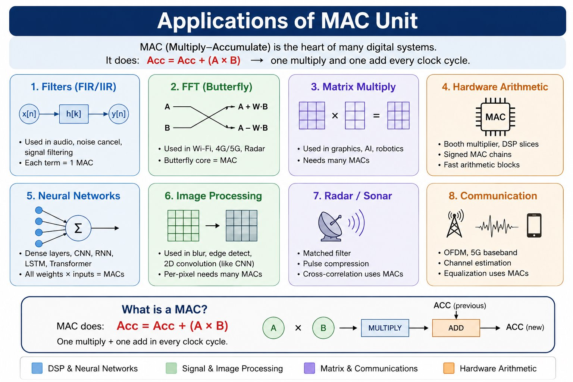
Conclusion and future scope
Extend to 32-bit/64-bit arithmetic units.
Develop parallel and pipelined MAC architectures.
Apply in DSP, AI, and Neural Networks.
Implement matrix multiplication accelerators.
Optimize for speed, power, and area.
Deploy on next-generation FPGA platforms.

Slide 15
Conclusion and future scope
Conclusion
Successfully designed 8-bit and 16-bit Booth Multipliers and a signed MAC Unit using the MyHDL framework.
Demonstrated automatic conversion from Python to synthesizable Verilog HDL.
Successfully synthesized and implemented the design using Xilinx Vivado on the PYNQ-Z2 FPGA.
Verified the hardware functionality through Python and Jupyter Notebook, obtaining correct signed arithmetic results.
Reduced hardware development effort by combining high-level Python programming with FPGA implementation.
Established a reliable and efficient Python-to-FPGA digital design workflow for digital arithmetic applications.

Slide 16
References in IEEE format
[1] Anoop C. and Anu Chalil. Implementation and analysis of multiplication algorithms for VLSI applications using FPGA. International Journal of Electrical, Electronics and Data Communication, 5(9):48–51, 2017.
[2] Jan Decaluwe. MyHDL: Designing digital hardware with Python. 2010. Presentation and Tutorial.
[3] K. Harika, B. V. Swetha, B. Renuka, D. Lakshman Rao, and S. Sridhar. Analysis of different multiplication algorithms and FPGA implementation. IOSR Journal of VLSI and Signal Processing, 4(2):29–35, 2014.
[4] Sitao Huang, Kun Wu, Sai Rahul Chalamalasetti, Izzat El Hajj, Cong Xu, Paolo Faraboschi, and Deming Chen. A Python-based high-level programming flow for CPU–FPGA heterogeneous systems. In IEEE/ACM Programming Environments for Heterogeneous Computing (PEHC), pages 20–26, 2021.
[5] Keerthan Jaic and Melissa C. Smith. Enhancing hardware design flows with MyHDL. In Proceedings of the ACM/SIGDA International Symposium on Field-Programmable Gate Arrays (FPGA), pages 28–31, 2015.
[6] Manoj M. Kamble and Sunita P. Ugale. FPGA implementation and analysis of different multiplication algorithm. International Journal of Computer Applications, 149(2):33–36, 2016.
[7] Savita Nair and Ajit Saraf. A review paper on comparison of multipliers based on performance parameters. In International Conference on Advances in Science and Technology (ICAST), pages 6–9, 2014.
[8] J. I. Villar, J. Juan, M. J. Bellido, J. Viejo, D. Guerrero, and Jan Decaluwe. Python as a hardware description language: A case study. In IEEE Conference, pages 117–122, 2011.

Slide 17
THANK YOU

