Slide 1





Pavitra Ramakrishnan s4159962
Assignment 3: Recommender System

Slide 2
I certify that this is all my own original work. If I took any parts from elsewhere, then they were non-essential parts of the assignment, and they are clearly attributed in our submission. I will show I agree to this honor code by typing “YES”: YES
Author:
Pavitra Ramakrishnan
Masters in Data Science
Affiliation:
School of Computing Technologies
RMIT University
Contact Details:
s4159962@student.rmit.edu.au
Notes:
Good evening Team,
My name is Pavitra Ramakrishnan and today I will be briefing you about my assignment.
I certify that this is my original work and the parts that have been taken our clearly attributed in my assignment

Slide 3

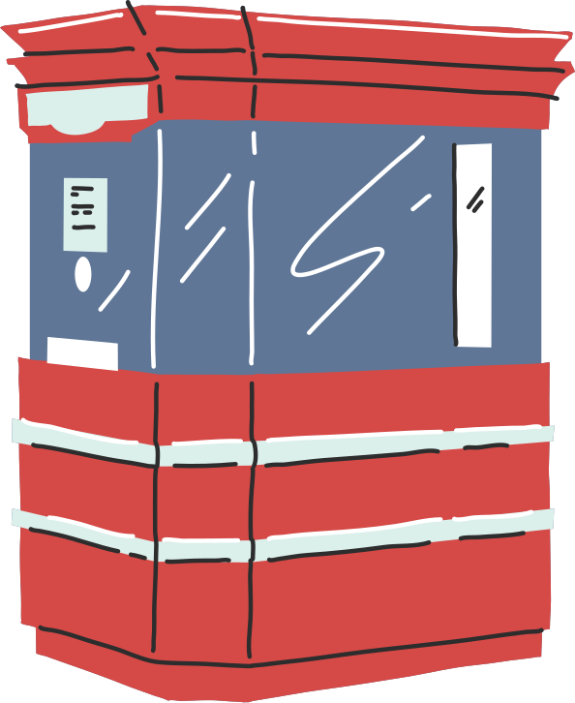

Contents
1
Objective
2
Introduction to Recommender Systems
3
Data Description
4
Method wise briefing
Evaluation of each method
5
Conclusion
6
Notes:
This is the content of my assignment,
I will be covering these segments in the following section

Slide 4

Objective
1
2
Implementation of collaborative filtering methods
Evaluation and comparison of each method and its performance
Notes:
The objective here is to implement five collaborative filtering methods and compare each model's performance specifically methods 3,4 and 5

Slide 5

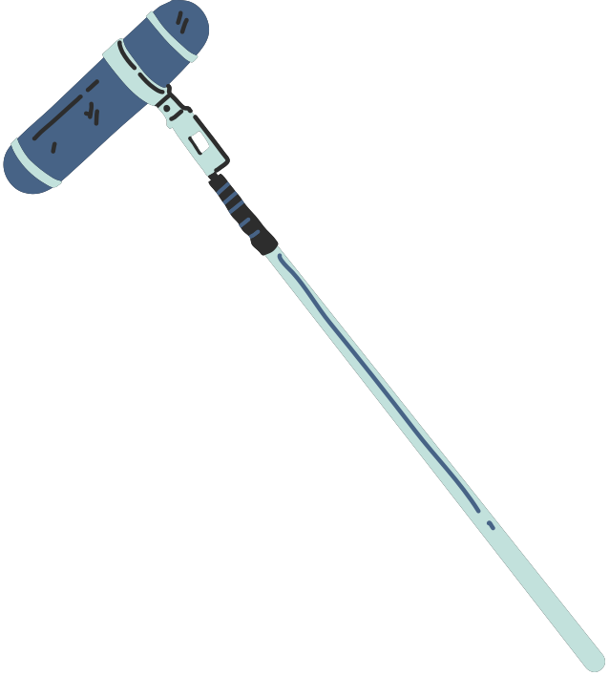

Introduction
Recommendation systems are filtering methods that predict and analyze whether a user will like or dislike an item/or items based on their previous preferences or choices.
The aim here is to identify which movies a user is likely to watch based on the previous movies that they have watched or other similar users have watched. The recommendation is also generated based on user-user or item-item similarity
Notes:
Recommendation systems are filtering methods used to recommend items to the user based on their previous preferences or choices.
The recommendation is also based on likings of other similar users or other similar items that the user has liked

Slide 6

Data Description
The dataset used has been sourced from the MovieLens website movielens.umn.edu, covering the time period from September 19, 1997, to April 22, 1998.
The dataset is limited to the user-item preferences and does not contain any demographic information of the user. The item description entails the genres, movie title, movie id etc.
Number of users: 943
Number of items: 1682
Notes:
The data was sourced from the Movie Lens website and does not contain any demographic information about the dataset.
There are 943 users and 1682 items

Slide 7
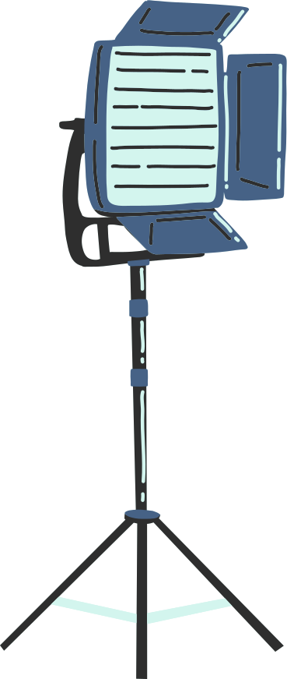
Method 1
Predicting ra,i as the average rating of the corresponding users.
The rating is predicted using the global average of all ratings
The implementation here is fast and robust
No customizaton possible
Lacks item specific context
MAE | RMSE
0.8259 | 1.0311
Notes:
I will quickly run over methods 1 and 2
Method 1 predicts the rating r ai as the average rating of all the other users.
Thus, the implimentation of this method is fast and robust. However, there is no customization possible in this case

Slide 8

Method 2
Predicting ra,i as the average rating of the corresponding items.
Outperforms method 1 since item popularity could have dominated user preferences or choices
MAE | RMSE
0.7961 | 1.0013
Notes:
Method 2 is similar to method 1 and predicts rai based on the average rating of all the items
This method slightly outperforms method 1

Slide 9
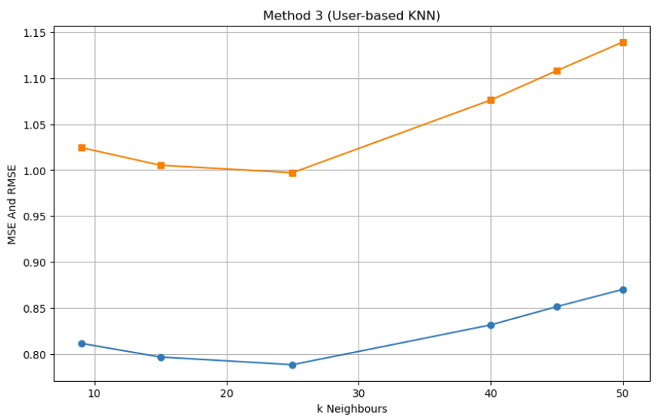

Method 3: User KNN Collaborative Filtering
MAE | RMSE
0.7887 | 0.9872
Technique used: Pearson Correlation
Different values of k were tested to optimize the model
The model took a longer processing time when compared
It was observed that the model performance kept on improving till k = 25 and then slowly started to decrease as k was increased.
Notes:
Method 3:
I used Pearson Correlation to implement this technique. Different ranges of k values were passes to find the optimal one.
The model worked the best with the least error captured at k = 25. The elbow point has been captured in the graph for both MAE and RMSE

Slide 10

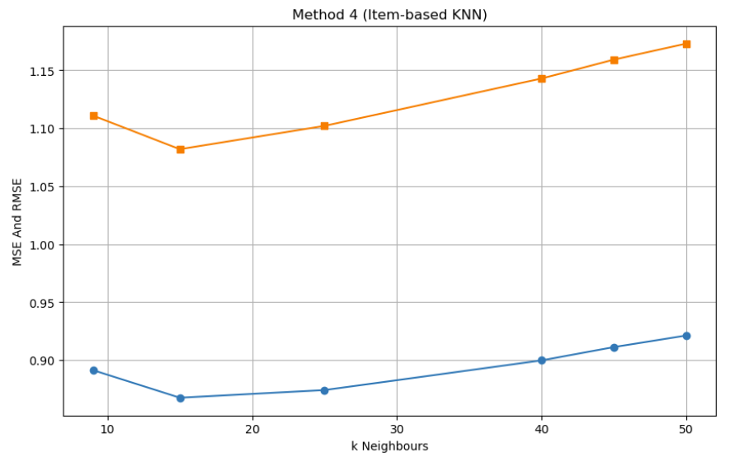
Method 4: Item KNN Collaborative Filtering
The technique that has been used for evaluation here is Pearson Correlation
Different values of k were tried to optimize the performance of the model
The model performance improved at k = 15 and then slowly started to detoriarate for increasing values of k
MAE | RMSE
0.868 | 1.072
Notes:
Method 4: Item based Collaborative filtering.
Again Pearson Correlation was used to find the similarity between items
The model captured a lot of noise and the least number of errors were spotted at k = 15. However the MAE and RMSE values were still high

Slide 11
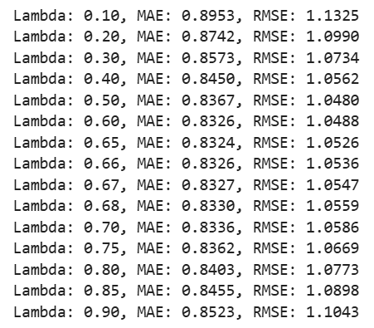
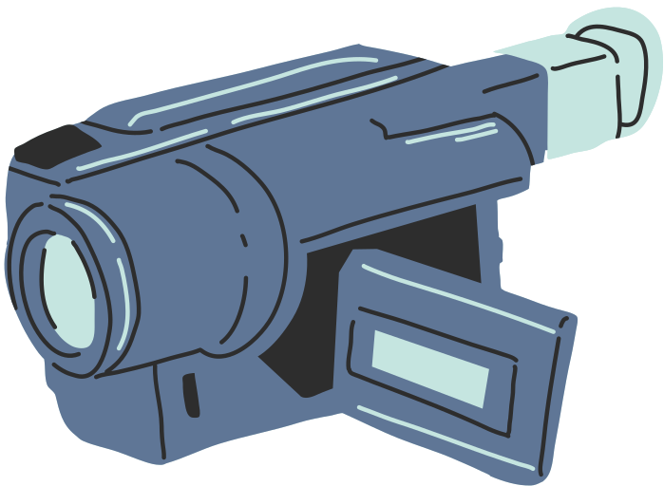
Method 5: Combined Collaborative Filtering
Theoretically, this method should have enhanced the accuracy of prediction and combined the strengths of both User based collaborative filtering and Item based collaborative filtering
Lambda parameter was tuned to improve the accuracy of the model
Yet, during evaluation, the performance managed to outperform method 4 but not method 3
One of the possible reasons could be a higher value of Item based KNN could have subsided the accuracy
MAE | RMSE
0.8367 | 1.0479
Notes:
It was initially expected that this model will outperform methods 3 and 4 and combine the strengths of both the models.
One of the reasons could be that the errors in method 4 could have diluted the accuracy provided by method 3.

Slide 12
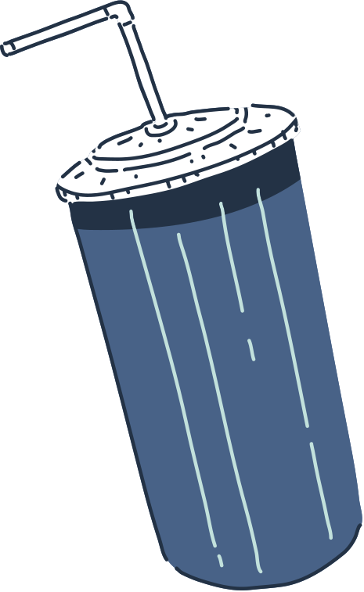

PERFORMANCE
COMPARISON
METHOD 3
METHOD 4
METHOD 5
Pearson correlation
Best model performance at k = 15
Achieved lowest MAE (0.7888) and RMSE (0.9972)
Outperforms method 4
Demonstrates extreme sensitivity to user behaviour
Pearson Correlation
Best performance at k = 15, with MAE = 0.8676 and RMSE = 1.0824
Outperforms method 1 and 2, but weak compared to method 3
Less effective possibly due to lower rating density per item
It was expected that model would outperform the rest of the models but ended up having a weaker accuracy compared to method 4 after fine tuning the K parameters in method 3 and method 4
Item Based Component degrading the overall prediction
Notes:
Performance comparison of all the five methods

Slide 13
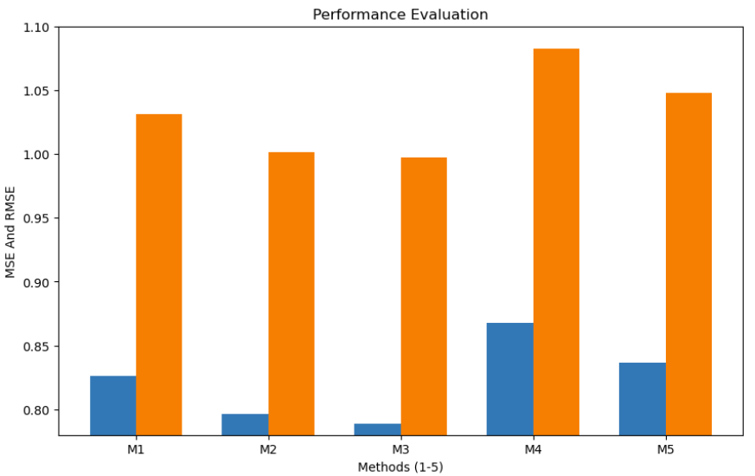
MSE and RMSE
Mean Squared Error (MSE) and Root Mean Sqaured Error (RMSE) are evaluation methods
MSE or MAE does not differentiate towards extrema, favorable when looking for rating accuracy
RMSE is sensitive to outliers and does not use absolute values, better when large prediction errors are not needed.
Notes:
MSE and RMSE are common evaluation metrics in recommendation systems.
A performance evaluation of all the five methods

Slide 14
Conclusion
Method 1: Simple, fast and stable but not personalized
Method 2: Captures general most favorable items
Method 3: Effectively captures user-user similarity and could indicate users had many overlapping items, best performance across all methods
Method 4: The performance of the model is weak and could indicate less amount of item to item similarity, sparse co-rated items could increase noise capture
Method 5: Combines user KNN prediction and item KNN prediction, the performance depends on both the base models

Slide 15
References
F. Maxwell Harper and Joseph A. Konstan. 2015. The MovieLens Datasets:
History and Context. ACM Transactions on Interactive Intelligent
Systems (TiiS) 5, 4, Article 19 (December 2015), 19 pages.
DOI=http://dx.doi.org/10.1145/2827872
Tumas Rackaitis. (2019, May 31). Evaluating Recommender Systems: Root Means Squared Error or Mean Absolute Error? Medium; TDS Archive. https://medium.com/data-science/evaluating-recommender-systems-root-means-squared-error-or-mean-absolute-error-1744abc2beac

