Slide 1


Slide 2

Meet the Team
Pavit Singh Makkar - Project Manager
Andres Marquez - Full Stack Developer
Avneet Kaur - Database Administrator
Simron Shrestha - UI UX Designer
Dipesh Ram Shrestha - Frontend Developer

Slide 3
HockeysHockey: Your Ultimate Hockey Lifestyle Store
Welcome to the world of HockeysHockey, where passion meets fashion! Today, we're thrilled to present an overview of HockeysHockey, your go-to destination for all things hockey. This presentation aims to provide insights into our brand, products, and the exciting opportunities that lie ahead.
Key Highlights:
Exhilarating fusion of hockey and lifestyle at HockeysHockey.
Discover a curated collection of hockey-themed T-shirts and accessories designed to elevate your style while celebrating your love for the game.
HockeysHockey, where every product tells a story, and your passion for hockey takes center stage. Let's dive in!

Slide 4

Brand Identity
1. HockeysHockey Logo and Tagline:
Displayed prominently is our distinctive HockeysHockey logo, a symbol of our commitment to the spirit of hockey. The logo encapsulates the dynamic energy of the game, reflecting our passion for excellence.
Tagline: "Elevate Your Game, Express Your Style." This succinct phrase captures the essence of our brand, inviting customers to merge their love for hockey with a unique sense of personal style.
2. Mission and Values:
Mission: At HockeysHockey, our mission is to inspire and empower individuals to embrace and express their love for hockey through stylish, high-quality apparel, skates, hockey sticks and accessories.
Values:
Passion: We are driven by a deep passion for hockey and a commitment to delivering products that resonate with fellow enthusiasts.
Inclusivity: Embracing the diverse community of hockey lovers, we celebrate the shared love for the sport in all its forms.

Slide 5
Product Offerings
Key Product Categories:
T-Shirts: Immerse yourself in our diverse collection of hockey-themed T-shirts. From classic designs that pay homage to iconic moments in the sport to contemporary styles that seamlessly blend comfort with style, our T-shirts are a canvas for expressing your love for hockey.
Accessories: Elevate your look with our range of accessories, including stylish hats and wristbands. Each accessory is crafted with precision, ensuring a perfect blend of functionality and fashion.
High-Quality Product Showcase:
Explore a selection of our popular products through high-quality images that capture the essence of HockeysHockey. These images provide a glimpse into the craftsmanship and attention to detail that define each piece in our collection.

Slide 6
User Experience
1. User-Friendly Interface:
Intuitive Design: Navigating the HockeysHockey website is a seamless and intuitive experience. Our user-friendly interface is designed to enhance accessibility and provide visitors with a hassle-free journey from landing on the homepage to making a purchase.
Responsive Design: Whether you're browsing on a desktop, tablet, or smartphone, our website adapts responsively to ensure a consistent and engaging experience across all devices.
2. Easy Navigation of Product Categories:
Clear Categorization: From T-shirts to accessories, each category is easily accessible, allowing users to find their desired items with minimal effort.
Search and Filters: Enhance the user experience with a robust search function and filters, enabling customers to narrow down their choices based on size, color, or specific themes related to their favorite hockey teams.

Slide 7
User Experience
3. Streamlined Checkout Process:
Secure Transactions: Highlight the security measures in place to ensure that every transaction is safe and secure. We prioritize the protection of customer information, building trust and confidence in our online shopping environment.
4. Customer-Focused Features:
Wishlist and Favorites: Encourage customer engagement with features like wishlist and favorites, allowing users to save items for later consideration or quick reordering.

Slide 8
Key Features
User-Friendly Interface
Secure E-commerce Functionality
Responsive Design
Product Catalog
Search and Navigation
Shipping and Order Tracking

Slide 9
In summary, the user experience at HockeysHockey goes beyond a simple transaction—it's about creating an enjoyable and efficient journey for every visitor.

Slide 10
Target Audience
Primary Audience:
Hockey Players- Direct Consumer Interest, Specific Needs and Preferences
Secondary Audience:
Parents and Guardians- Decision-Making Authority, Educational Resources
Tertiary Audience:
Gift Shoppers- Occasional Purchases

Slide 11
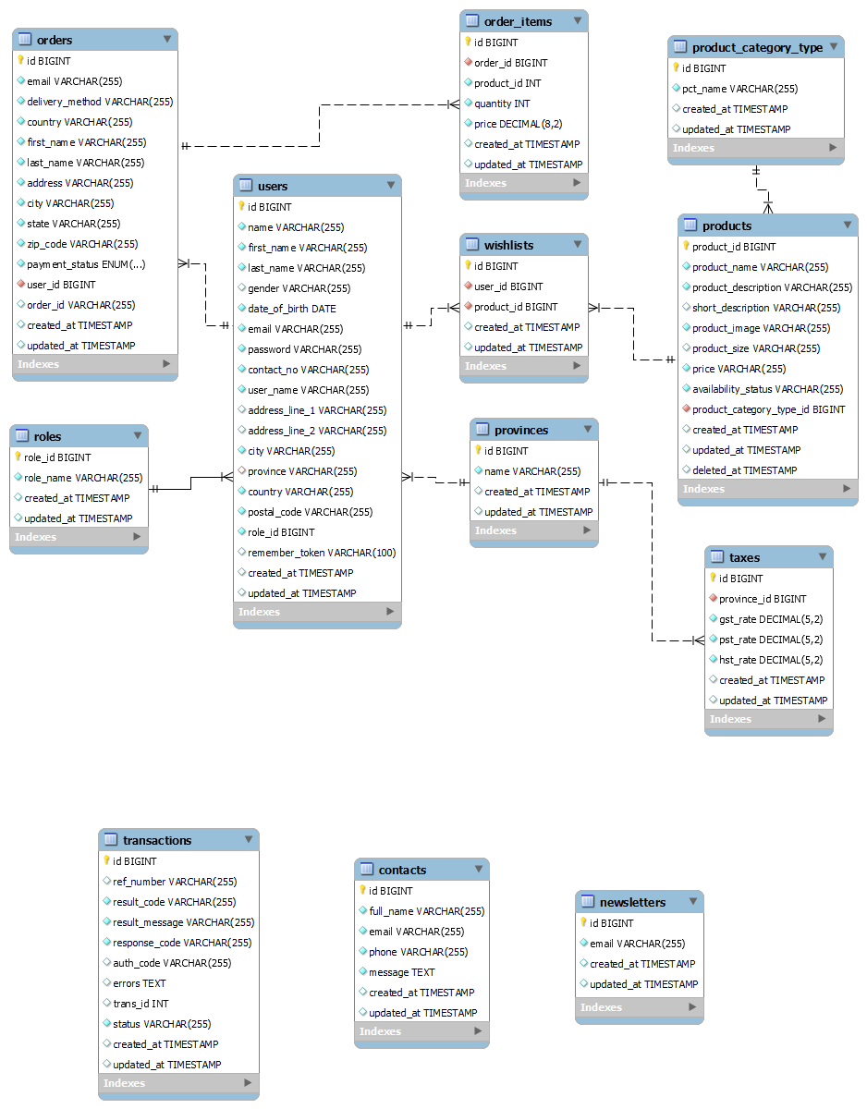
ERD

Slide 12
Some other tables used
Database
MySQL version 8.0.35-0ubuntu0.22.04.1 for Linux on x86_64 ((Ubuntu))
Database
MySQL version 8.0.35-0ubuntu0.22.04.1 for Linux on x86_64 ((Ubuntu))

Slide 13
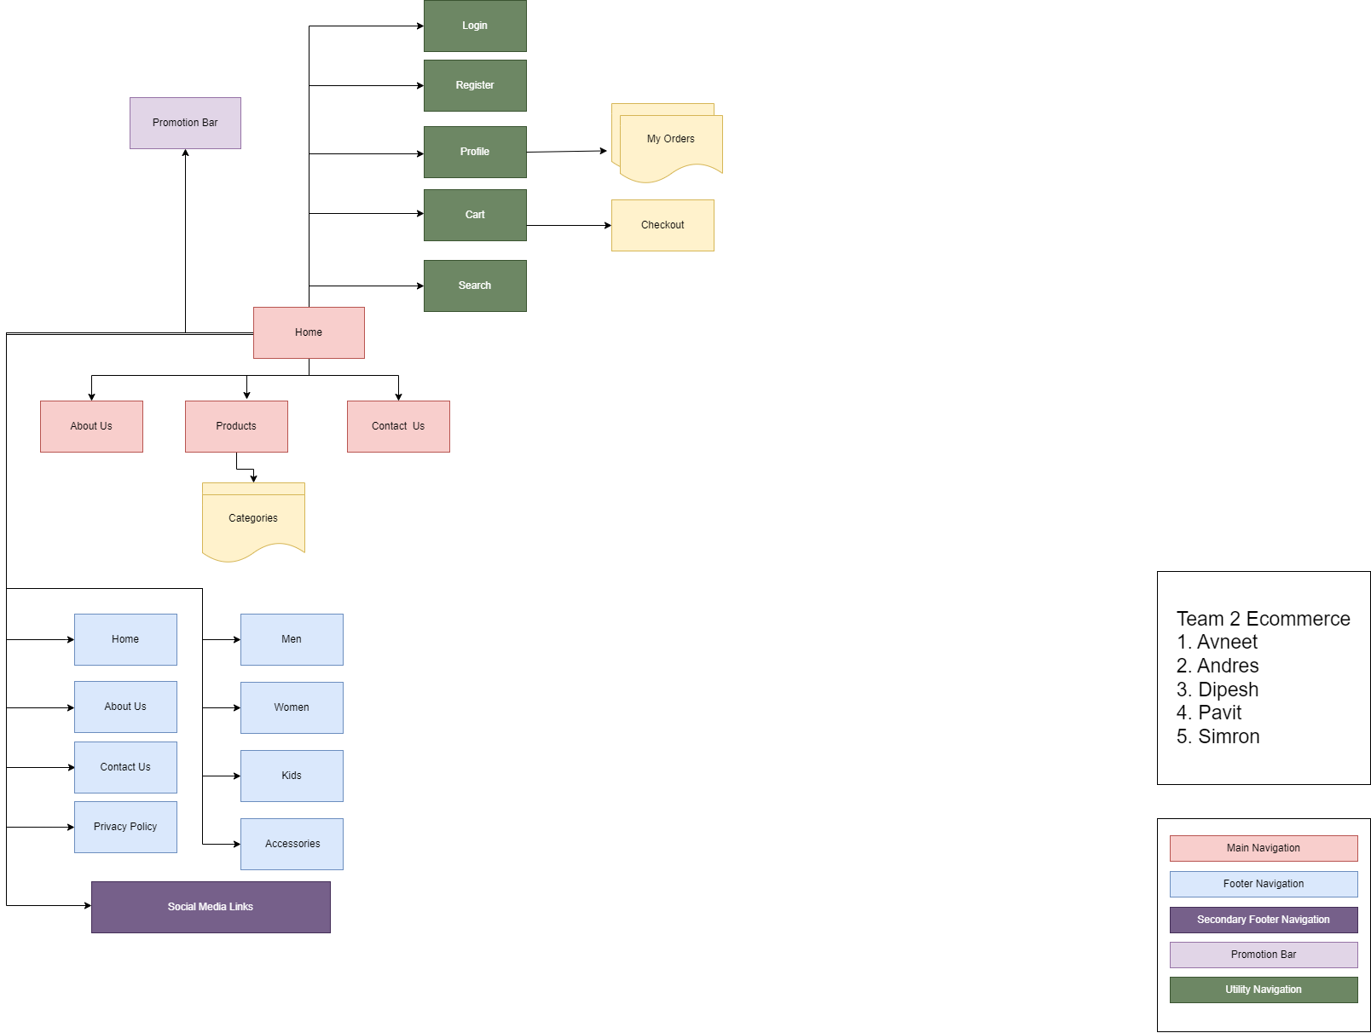
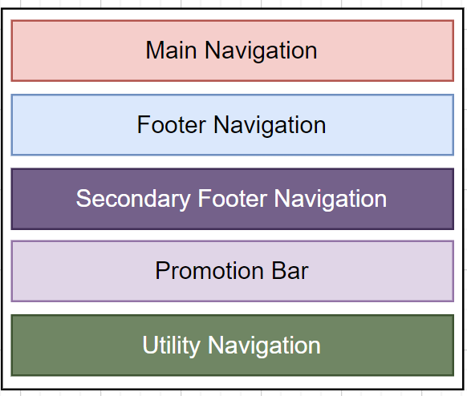
Frontend Sitemap

Slide 14
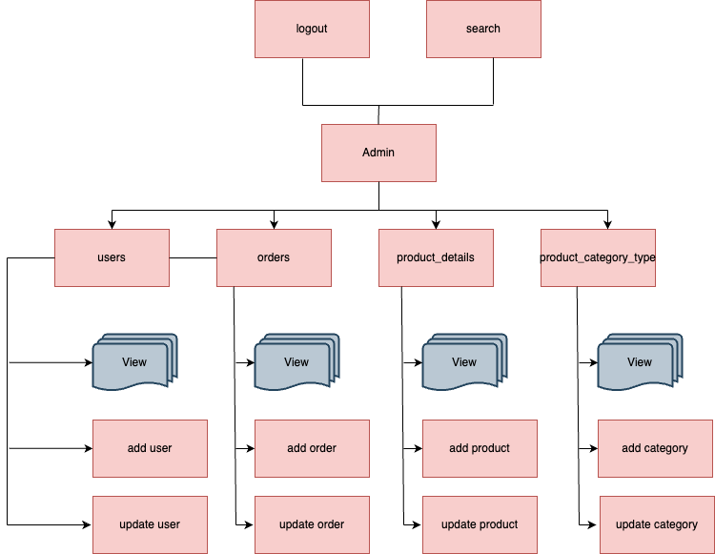
Backend Sitemap

Slide 15
Server
Backend
PHP version 8.1.2-1ubuntu2.14 (cli)
Built on Aug 18, 2023
PHP Copyright: The PHP Group
Zend Engine version 4.1.2
Zend Engine Copyright: Zend Technologies
Zend OPcache version 8.1.2-1ubuntu2.14
OPcache Copyright: Zend Technologies
Frontend
HTML / Blade
CSS
JavaScript
Cloud Hosting
Amazon AWS EC2
Authentication
Breeze Multi Authentication
(if(Auth::user()->isAdmin()))
Server
Apache Server

Slide 16
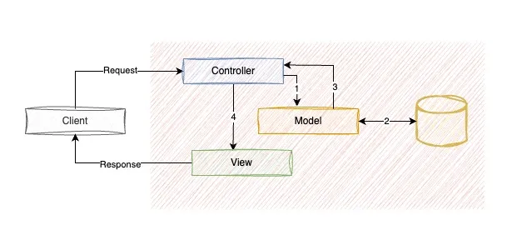
Monolithic Architecture
Monolithic architecture is a software design approach in which all aspects of application are woven together to form a big fat module and therefore developed, deployed, and maintained as a single unit.

Slide 17
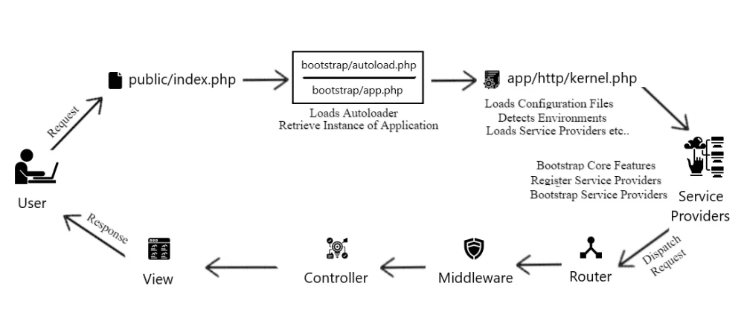
Laravel Request Lifecycle
References: https://dev.to/patelparixit07/laravel-request-lifecycle-195e

Slide 18
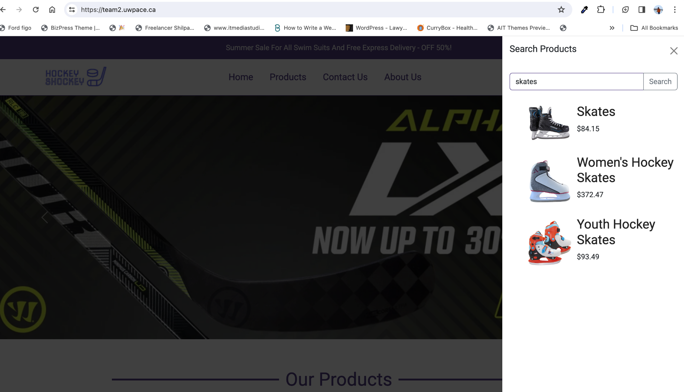

Slide 19
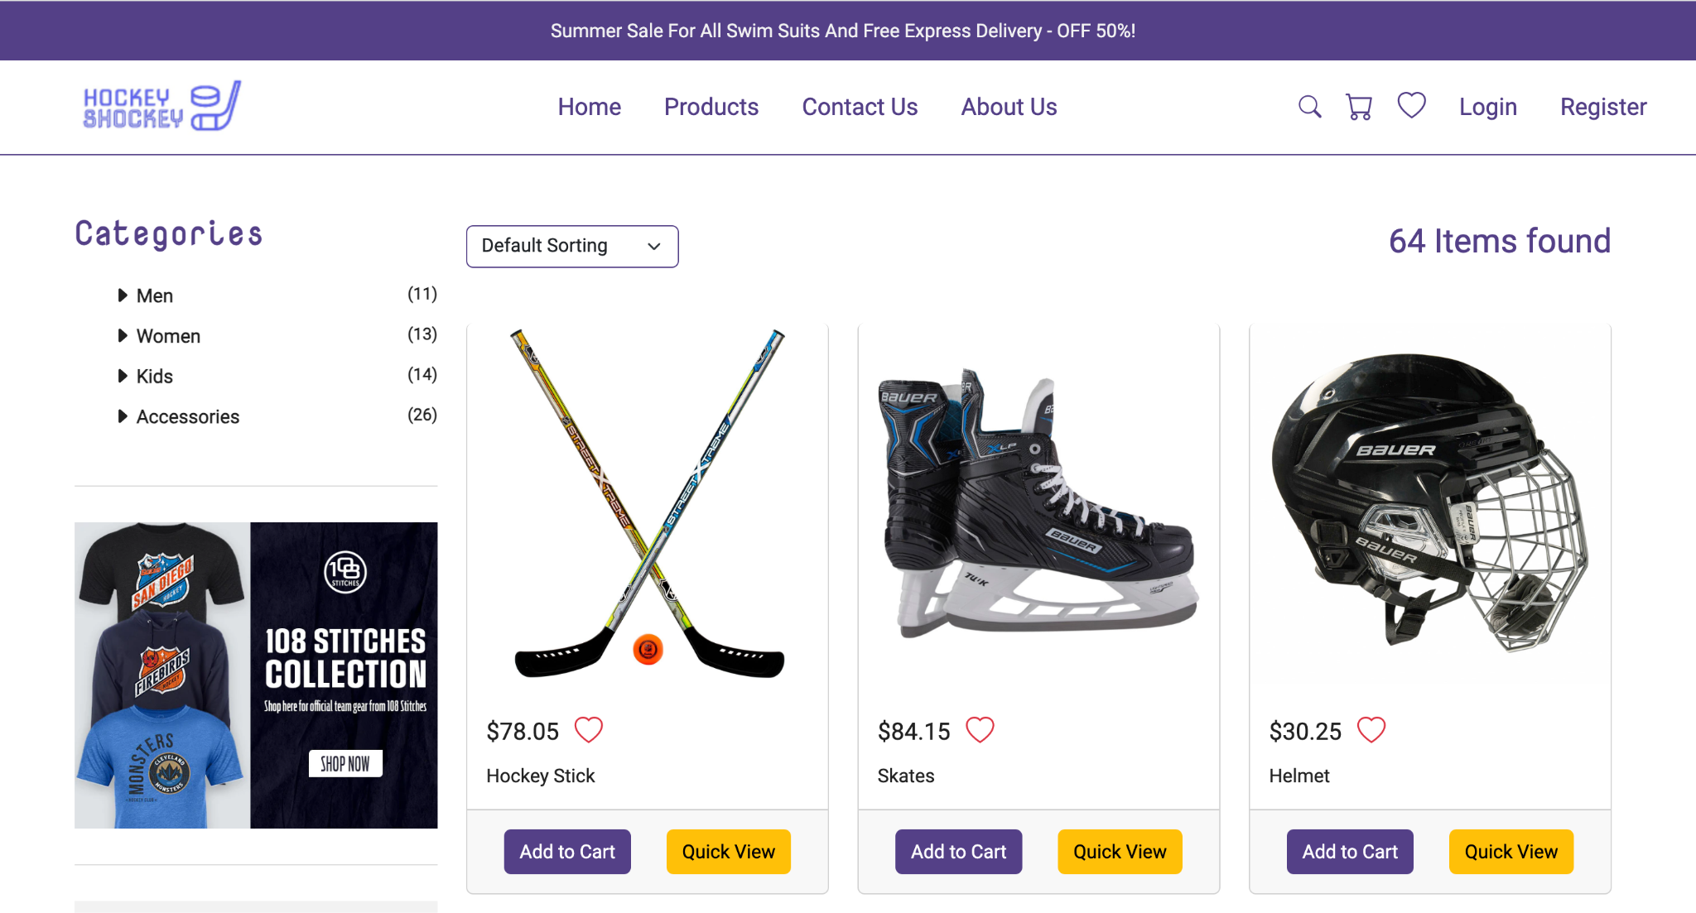

Slide 20
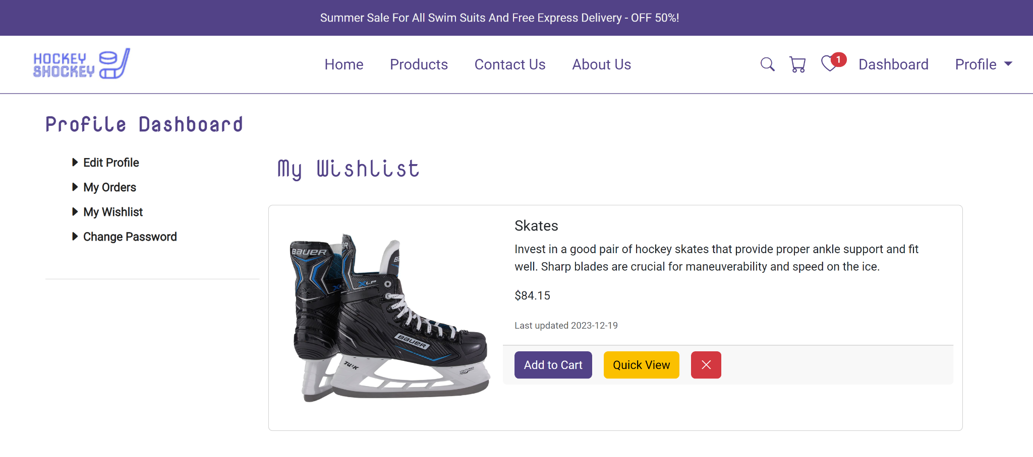
Value Adds

