Slide 1


Enhancing Belief Propagation Decoders for Correlated Errors Using Cycle Error Reconstruction
Debankan Sannamoth, Pavithran Iyer, and Joseph Emerson
APS March Meeting 2026
MAR-C09:5
16 March 2026
email: pavithran.sridhar@gmail.com , web: https://sites.google.com/view/piyer/home

Slide 2
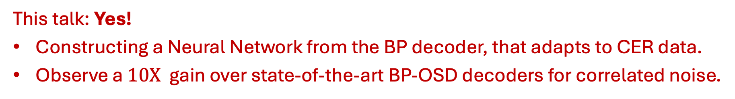
The Big Question …
Quantum Error Correction: Suppress Noise at the logical level with high overhead cost
i.i.d noise
Qubits, gates, measurements…
Hardware : errors are often correlated
Revealed using experimental noise characterization (CER technique)
Minimize the overhead using quantum LDPC codes
E.g. Hypergraph Product Codes
Tailoring decoding to the underlying noise: Belief Propagation (BP) Decoders for qLDPC
Can we enhance the performance of BP for correlated errors using experimental data?
This talk: Yes!
Constructing a Neural Network from the BP decoder, that adapts to CER data.
Observe a $10X$ gain over state-of-the-art BP-OSD decoders for correlated noise.

Slide 3
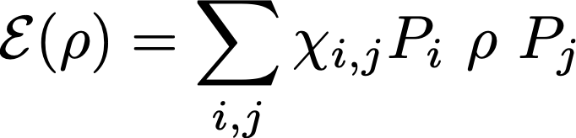

Cycle Error Reconstruction (CER)
Goal: Given a noisy circuit, extract rates of different Pauli errors.
Pauli decay rates: $χ_{i,i}≥0$
Pauli Errors

Slide 4






Cycle Error Reconstruction (CER)
Goal: Given a noisy circuit, extract rates of different Pauli errors.
Pauli decay rates: $χ_{i,i}≥0$
Pauli Errors
Cycle Error Reconstruction: Experimental protocol to estimate $χ_{i,i}$ for $n−$qubit CPTP maps $ℇ$.
$$σ_{1}$$
$$σ_{2}$$
$$λ_{σ}$$
$$σ_{n}$$
Nat Comm. 10, 5347 (2019), ACM Trans on Quantum Computing, 1, 1 (2020): $\{λ_{σ}\}→\{χ_{σ,σ}\}$

Slide 5
Can CER be useful to a decoder?
Encoder
Syndrome
Decoder
Unencoding
Noise

Slide 6
Can CER be useful to a decoder?
Encoder
Syndrome
Decoder
Unencoding
Noise
Decoder for Quantum Error Correction:
Given an error syndrome $s$, determine the most like class of Pauli errors that caused it.

Slide 7
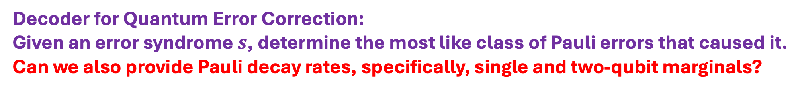
Can CER be useful to a decoder?
Encoder
Syndrome
Decoder
Unencoding
Noise
Decoder for Quantum Error Correction:
Given an error syndrome $s$, determine the most like class of Pauli errors that caused it.
Can we also provide Pauli decay rates, specifically, single and two-qubit marginals?

Slide 8
Hypergraph Product Codes
Combine two classical binary linear codes to obtain a quantum code

Slide 9
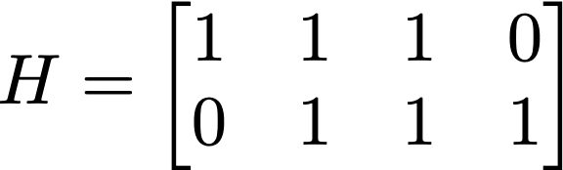
























Hypergraph Product Codes
Combine two classical binary linear codes to obtain a quantum code
$$v_{1}$$
$$c_{1}$$
$$v_{2}$$
$$v_{3}$$
$$c_{2}$$
$$v_{4}$$
$$c_{1}$$
$$c_{2}$$
$$v_{1}$$
$$v_{2}$$
$$v_{3}$$
$$v_{4}$$
$$v_{1}$$
$$c_{1}$$
$$v_{2}$$
$$v_{3}$$
$$c_{2}$$
$$v_{4}$$
$$c_{1}$$
$$c_{2}$$
$$v_{1}$$
$$v_{2}$$
$$v_{3}$$
$$v_{4}$$

Slide 10






























Hypergraph Product Codes
Combine two classical binary linear codes to obtain a quantum code
$$v_{1}$$
$$c_{1}$$
$$v_{2}$$
$$v_{3}$$
$$c_{2}$$
$$v_{4}$$
$$c_{1}$$
$$v_{1}$$
$$c_{1}$$
$$v_{2}$$
$$v_{3}$$
$$c_{2}$$
$$v_{4}$$
$$c_{2}$$
$$v_{1}$$
$$v_{2}$$
$$v_{3}$$
$$v_{4}$$
$$c_{2}$$
$$v_{4}$$
$$v_{1}$$
$$c_{1}$$
$$v_{2}$$
$$v_{3}$$
$$v_{1}$$
$$c_{1}$$
$$v_{2}$$
$$v_{3}$$
$$c_{2}$$
$$v_{4}$$
$$c_{1}$$
$$c_{2}$$
$$v_{1}$$
$$c_{1}$$
$$v_{2}$$
$$v_{3}$$
$$c_{2}$$
$$v_{4}$$
$$v_{1}$$
$$c_{1}$$
$$v_{2}$$
$$v_{3}$$
$$c_{2}$$
$$v_{4}$$
$$v_{1}$$
$$v_{2}$$
$$v_{3}$$
$$v_{4}$$
$$v_{1}$$
$$c_{1}$$
$$v_{2}$$
$$v_{3}$$
$$c_{2}$$
$$v_{4}$$

Slide 11
Hypergraph Product Codes
Combine two classical binary linear codes to obtain a quantum code
$$v_{1}$$
$$c_{1}$$
$$v_{2}$$
$$v_{3}$$
$$c_{2}$$
$$v_{4}$$
$$v_{4}$$
$$c_{1}$$
$$v_{1}$$
$$c_{1}$$
$$v_{2}$$
$$v_{3}$$
$$c_{2}$$
$$v_{4}$$
$$c_{2}$$
$$c_{2}$$
$$v_{1}$$
$$v_{2}$$
$$v_{3}$$
$$v_{4}$$
$$c_{2}$$
$$v_{4}$$
$$v_{3}$$
$$v_{1}$$
$$c_{1}$$
$$v_{2}$$
$$v_{3}$$
$$c_{1}$$
$$c_{2}$$
$$v_{2}$$
$$v_{1}$$
$$c_{1}$$
$$v_{2}$$
$$v_{3}$$
$$c_{2}$$
$$v_{4}$$
$$c_{1}$$
$$v_{1}$$
$$c_{1}$$
$$v_{2}$$
$$v_{3}$$
$$c_{2}$$
$$v_{4}$$
$$v_{1}$$
$$v_{2}$$
$$v_{3}$$
$$v_{4}$$
$$v_{1}$$
$$c_{1}$$
$$v_{2}$$
$$v_{3}$$
$$c_{2}$$
$$v_{4}$$
$$v_{1}$$

Slide 12
Hypergraph Product Codes
Combine two classical binary linear codes to obtain a quantum code
$$v_{1}$$
$$c_{1}$$
$$v_{2}$$
$$v_{3}$$
$$c_{2}$$
$$v_{4}$$
$$v_{4}$$
$$c_{1}$$
$$v_{1}$$
$$c_{1}$$
$$v_{2}$$
$$v_{3}$$
$$c_{2}$$
$$v_{4}$$
$$c_{2}$$
$$c_{2}$$
$$v_{1}$$
$$v_{2}$$
$$v_{3}$$
$$v_{4}$$
$$c_{2}$$
$$v_{4}$$
$$v_{3}$$
$$v_{1}$$
$$c_{1}$$
$$v_{2}$$
$$v_{3}$$
$$c_{1}$$
$$c_{2}$$
$$v_{2}$$
$$v_{1}$$
$$c_{1}$$
$$v_{2}$$
$$v_{3}$$
$$c_{2}$$
$$v_{4}$$
$$c_{1}$$
$$v_{1}$$
$$c_{1}$$
$$v_{2}$$
$$v_{3}$$
$$c_{2}$$
$$v_{4}$$
$$v_{1}$$
$$v_{2}$$
$$v_{3}$$
$$v_{4}$$
$$v_{1}$$
$$c_{1}$$
$$v_{2}$$
$$v_{3}$$
$$c_{2}$$
$$v_{4}$$
$$v_{1}$$

Slide 13


Hypergraph Product Codes
Hypergraph product (quantum) code: $\left(n,k\right)×\left(n,k\right)↦[\left[n_{1}n_{2}, k_{1}k_{2}\right]]$
and
qubits
$$c_{1}$$
$$v_{2}$$
$$v_{3}$$
$$c_{2}$$
$$v_{4}$$
$$v_{1}$$
and
Stabilizer
Generators
$$v_{1}$$
$$c_{1}$$
$$v_{2}$$
$$v_{3}$$
$$c_{2}$$
$$v_{4}$$
$$v_{1}$$
$$c_{1}$$
$$v_{2}$$
$$v_{3}$$
$$c_{2}$$
$$v_{4}$$
X-type
Z-type
$$v_{1}$$
$$c_{1}$$
$$v_{2}$$
$$v_{3}$$
$$c_{2}$$
$$v_{4}$$
$$v_{1}$$
$$c_{1}$$
$$v_{2}$$
$$v_{3}$$
$$c_{2}$$
$$v_{4}$$
$H$ : ($m × n)$ parity check matrix
# physical qubits: $n^{2}+m^{2}$ , # logical qubits: $k^{2}$
$$v_{1}$$
$$c_{1}$$
$$v_{2}$$
$$v_{3}$$
$$c_{2}$$
$$v_{4}$$

Slide 14
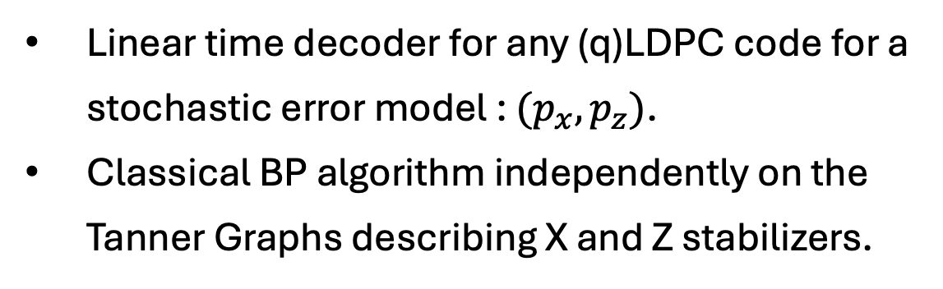
Belief Propagation (BP) Decoders
Linear time decoder for any (q)LDPC code for a stochastic error model : $(p_{x},p_{z})$.
Classical BP algorithm independently on the Tanner Graphs describing X and Z stabilizers.

Slide 15












Belief Propagation (BP) Decoders
Linear time decoder for any (q)LDPC code for a stochastic error model : $(p_{x},p_{z})$.
Classical BP algorithm independently on the Tanner Graphs describing X and Z stabilizers.
$$c_{1}$$
$$c_{2}$$
$$v_{1}$$
$$v_{2}$$
$$v_{3}$$
$$v_{4}$$
Checks
$$c_{1}$$
$$c_{2}$$
$$v_{1}$$
$$v_{2}$$
$$v_{3}$$
$$v_{4}$$
Bits

Slide 16
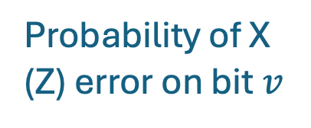
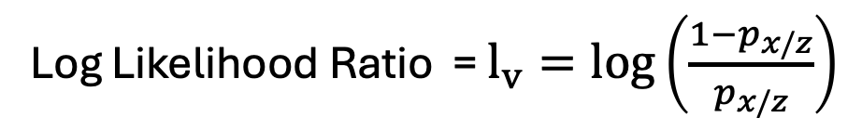
Belief Propagation (BP) Decoders
Linear time decoder for any (q)LDPC code for a stochastic error model : $(p_{x},p_{z})$.
Classical BP algorithm independently on the Tanner Graphs describing X and Z stabilizers.
$$c_{1}$$
$$c_{2}$$
$$v_{1}$$
$$v_{2}$$
$$v_{3}$$
$$v_{4}$$
Log Likelihood Ratio = $l_{v}=log\left(\frac{1−p_{x/z}}{p_{x/z}}\right)$
Probability of X (Z) error on bit $v$
Checks
$$c_{1}$$
$$c_{2}$$
$$v_{1}$$
$$v_{2}$$
$$v_{3}$$
$$v_{4}$$
Bits

Slide 17


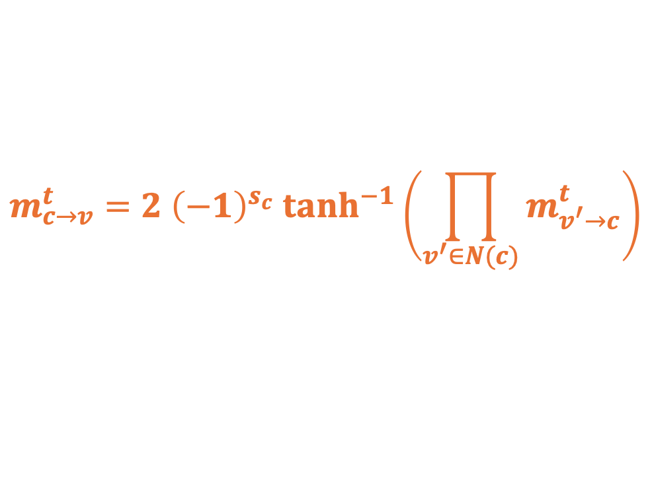
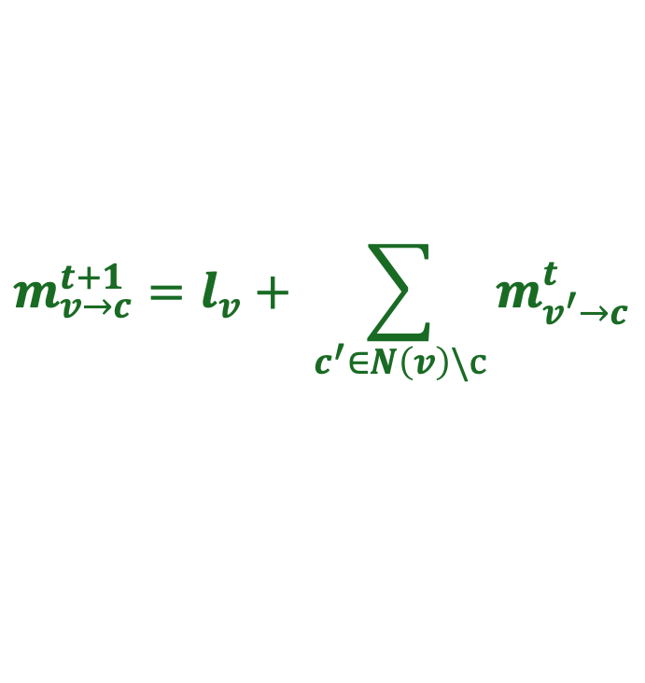
Belief Propagation (BP) Decoders
Linear time decoder for any (q)LDPC code for a stochastic error model : $(p_{x},p_{z})$.
Classical BP algorithm independently on the Tanner Graphs describing X and Z stabilizers.
$$c_{1}$$
$$c_{2}$$
$$v_{1}$$
$$v_{2}$$
$$v_{3}$$
$$v_{4}$$
Log Likelihood Ratio = $l_{v}=log\left(\frac{1−p_{x/z}}{p_{x/z}}\right)$
Probability of X (Z) error on bit $v$
Checks
$$c_{1}$$
$$c_{2}$$
$$m_{c→v}^{t}=2 {\left(−1\right)}^{s_{c}} tanh^{−1}\left(\prod_{v^{′}∈N(c)}{m_{v^{′}→c}^{t}}\right)$$
$$m_{v_{1}→c_{1}}^{t}$$
$$m_{c_{2}→v_{4}}^{t}$$
$$m_{v→c}^{t+1}=l_{v}+ \sum_{c^{′}∈N\left(v\right)\backslash c}{m_{v^{′}→c}^{t}}$$
$$v_{1}$$
$$v_{2}$$
$$v_{3}$$
$$v_{4}$$
Bits

Slide 18
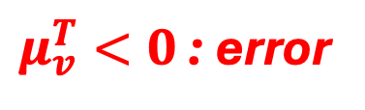

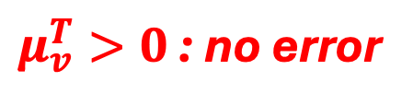
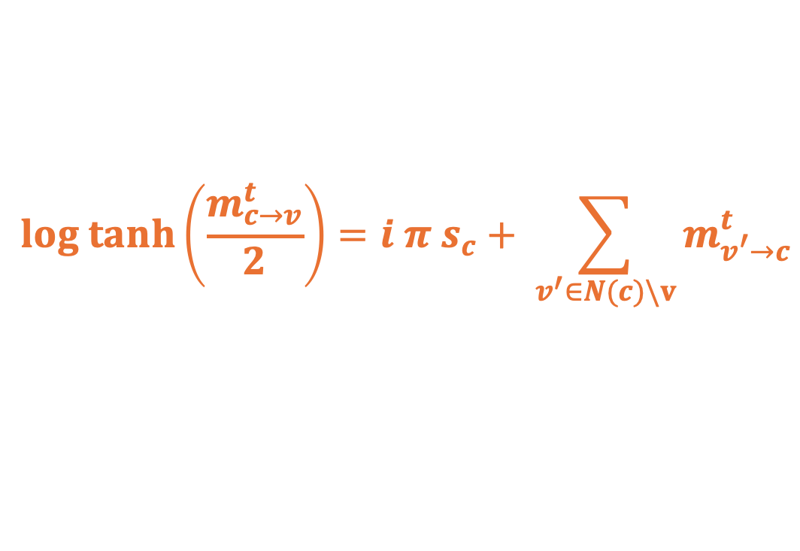
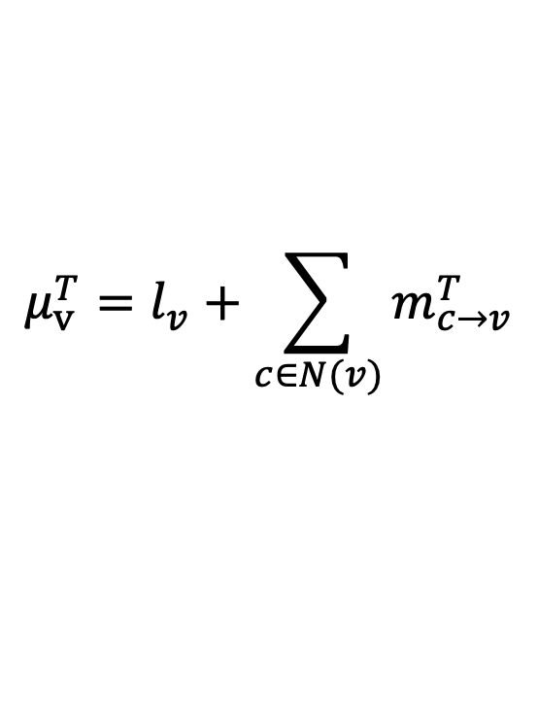
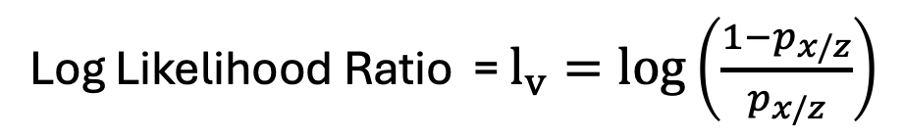

BP as a Neural Network
Log Likelihood Ratio = $l_{v}=log\left(\frac{1−p_{x/z}}{p_{x/z}}\right)$
Repeat for $T$ iterations
$$log tanh\left(\frac{m_{c→v}^{t}}{2}\right)=i π s_{c}+ \sum_{v^{′}∈N(c)\backslash v}{m_{v^{′}→c}^{t}}$$
$$m_{v→c}^{t+1}=l_{v}+ \sum_{c^{′}∈N\left(v\right)\backslash c}{m_{v^{′}→c}^{t}}$$
Compute refined beliefs
$$μ_{v}^{T}=l_{v}+\sum_{c∈N(v)}{m_{c→v}^{T}}$$
$μ_{v}^{T}>0$ : no error
$μ_{v}^{T}<0$ : error

Slide 19




BP as a Neural Network
Log Likelihood Ratio = $l_{v}=log\left(\frac{1−p_{x/z}}{p_{x/z}}\right)$
Repeat for $T$ iterations
$$log tanh\left(\frac{m_{c→v}^{t}}{2}\right)=i π s_{c}+ \sum_{v^{′}∈N(c)\backslash v}{m_{v^{′}→c}^{t}}$$
$$m_{v→c}^{t+1}=l_{v}+ \sum_{c^{′}∈N\left(v\right)\backslash c}{m_{v^{′}→c}^{t}}$$
$$m_{v→c}^{t}$$
$$m_{c→v}^{t}$$
Compute refined beliefs
$μ_{v}^{T}>0$ : no error
$$t$$
$$μ_{v}^{T}=l_{v}+\sum_{c∈N(v)}{m_{c→v}^{T}}$$
$μ_{v}^{T}<0$ : error
$$time$$

Slide 20
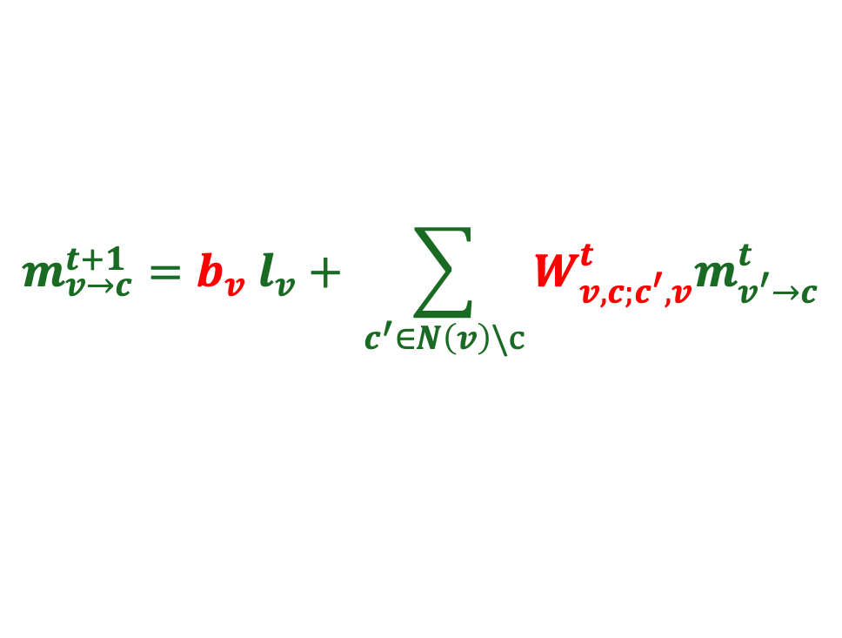
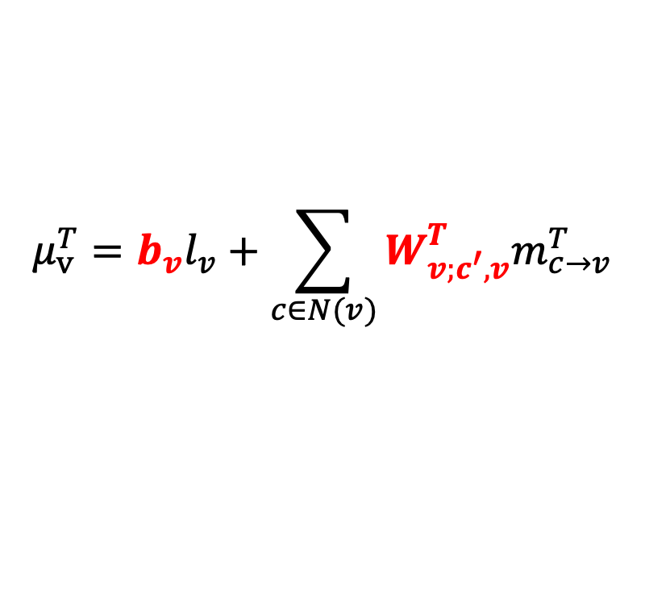
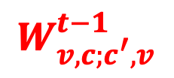
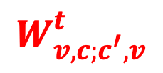
BP as a Neural Network
Log Likelihood Ratio = $l_{v}=log\left(\frac{1−p_{x/z}}{p_{x/z}}\right)$
$$W_{v,c;c^{′},v}^{t}$$
$$W_{v,c;c^{′},v}^{t−1}$$
Repeat for $T$ iterations
$$log tanh\left(\frac{m_{c→v}^{t}}{2}\right)=i π s_{c}+ \sum_{v^{′}∈N(c)\backslash v}{m_{v^{′}→c}^{t}}$$
$$m_{v→c}^{t+1}={b_{v} l}_{v}+ \sum_{c^{′}∈N\left(v\right)\backslash c}{{W_{v,c;c^{′},v}^{t}m}_{v^{′}→c}^{t}}$$
$$m_{v→c}^{t}$$
$$m_{c→v}^{t}$$
Compute refined beliefs
$$μ_{v}^{T}={b_{v}l}_{v}+\sum_{c∈N(v)}{{W_{v;c^{′},v}^{T}m}_{c→v}^{T}}$$
$μ_{v}^{T}>0$ : no error
$$t$$
$μ_{v}^{T}<0$ : error
$$time$$

Slide 21



BP as a Neural Network
Input layer
$$l_{1}$$
$$l_{2}$$
…
$$l_{n}$$
Nachmani et. al., 2016. IEEE (Allerton)
Liu, Poulin, 2019. Phys. Rev. Lett. 122, 200501

Slide 22
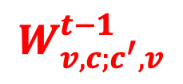
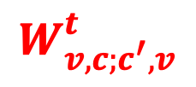


BP as a Neural Network
$$W_{v,c;c^{′},v}^{t}$$
Input layer
$$W_{v,c;c^{′},v}^{t−1}$$
$$l_{1}$$
$$l_{2}$$
…
…
…
…
$$l_{n}$$
$$m_{v→c}^{t}$$
$$m_{c→v}^{t}$$
Nachmani et. al., 2016. IEEE (Allerton)
Liu, Poulin, 2019. Phys. Rev. Lett. 122, 200501

Slide 23





BP as a Neural Network
$$W_{v,c;c^{′},v}^{t}$$
Input layer
$$W_{v,c;c^{′},v}^{t−1}$$
Final layer
$$l_{1}$$
$$μ_{1}$$
$$l_{2}$$
$$μ_{2}$$
…
…
…
…
…
…
$$l_{n}$$
$$μ_{n}$$
$$m_{v→c}^{t}$$
$$m_{c→v}^{t}$$
Activation function at layers
$$a\left(x\right)=2 tanh^{−1}\left(e^{x}\right)$$
$$a\left(x\right)=log tanh\left(x/2\right)$$
Nachmani et. al., 2016. IEEE (Allerton)
Liu, Poulin, 2019. Phys. Rev. Lett. 122, 200501

Slide 24



BP as a Neural Network
$$W_{v,c;c^{′},v}^{t}$$
Input layer
$$W_{v,c;c^{′},v}^{t−1}$$
Final layer
Error
$$l_{1}$$
$$μ_{1}$$
$${σ(μ}_{1})$$
$$l_{2}$$
$$μ_{2}$$
$${σ(μ}_{2})$$
…
…
…
…
…
…
$$l_{n}$$
$$μ_{n}$$
$${σ(μ}_{n})$$
$$m_{v→c}^{t}$$
$$m_{c→v}^{t}$$
Activation function at layers
$$a\left(x\right)=2 tanh^{−1}\left(e^{x}\right)$$
$$a\left(x\right)=log tanh\left(x/2\right)$$
Nachmani et. al., 2016. IEEE (Allerton)
Liu, Poulin, 2019. Phys. Rev. Lett. 122, 200501

Slide 25


BP as a Neural Network
$$W_{v,c;c^{′},v}^{t}$$
Input layer
$$W_{v,c;c^{′},v}^{t−1}$$
Final layer
Error
$$l_{1}$$
$$μ_{1}$$
$${σ(μ}_{1})$$
$$l_{2}$$
$$μ_{2}$$
$${σ(μ}_{2})$$
…
…
…
…
…
…
$$l_{n}$$
$$μ_{n}$$
$${σ(μ}_{n})$$
$$m_{v→c}^{t}$$
$$m_{c→v}^{t}$$
Weights obtaining from training the NN:
Activation function at layers
$$a\left(x\right)=2 tanh^{−1}\left(e^{x}\right)$$
$$s=H^{⊥}{(σ(μ}_{v})+e)$$
$Loss=\left|sin\left(π s_{c}/2\right)\right|$.
$$a\left(x\right)=log tanh\left(x/2\right)$$
Nachmani et. al., 2016. IEEE (Allerton)
Liu, Poulin, 2019. Phys. Rev. Lett. 122, 200501

Slide 26

Adding CER inputs to BP
Pauli decay rates: $χ_{i,i}≥0$

Slide 27


Adding CER inputs to BP
Single qubit error rates
${p_{i,I}, p}_{i,X}, p_{i,Z}, p_{i,Y}$ : on each qubit
Pauli decay rates: $χ_{i,i}≥0$
Two-qubit error rates
Two-qubit correlations: spatial cross-talk, frequency coupling (imperfect two-qubit gates)
${p_{ij,II}, p}_{i,XX}, …, p_{ZZ}$ : on qubit pairs
Fazio et al 2026. Phys. Rev. X 16, 011030
Harper and Flammia, 2023 . PRXQuantum.4.040311

Slide 28
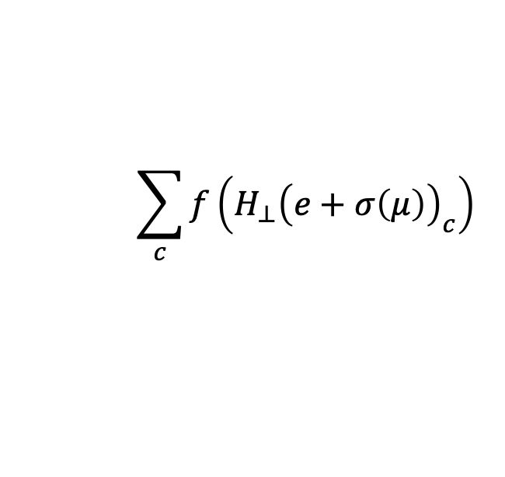
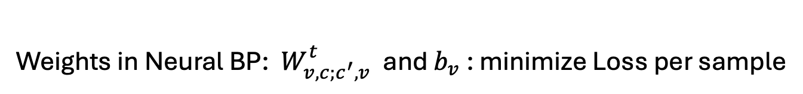
Adding CER inputs to BP
Memory noise:
Single qubit error rates
${p_{i,I}, p}_{i,X}, p_{i,Z}, p_{i,Y}$ : on each qubit
Pauli decay rates: $χ_{i,i}≥0$
Two-qubit error rates
Two-qubit correlations: spatial cross-talk, frequency coupling (imperfect two-qubit gates)
${p_{ij,II}, p}_{i,XX}, …, p_{ZZ}$ : on qubit pairs
Weights in Neural BP: ${ W}_{v,c;c^{′},v}^{t}$ and $b_{v}$ : minimize Loss per sample
$$\sum_{c}{f\left(H_{⊥}{\left(e+σ\left(μ\right)\right)}_{c}\right)}$$
Fazio et al 2026. Phys. Rev. X 16, 011030
Harper and Flammia, 2023 . PRXQuantum.4.040311

Slide 29
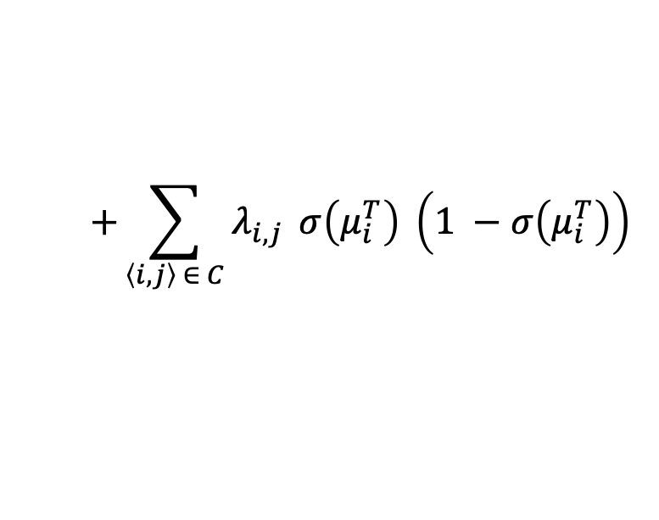
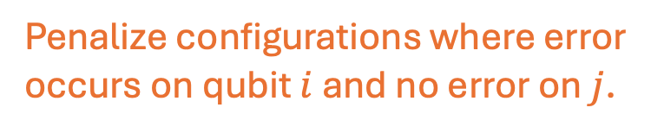
Adding CER inputs to BP
Memory noise:
Single qubit error rates
${p_{i,I}, p}_{i,X}, p_{i,Z}, p_{i,Y}$ : on each qubit
Pauli decay rates: $χ_{i,i}≥0$
Two-qubit error rates
Two-qubit correlations: spatial cross-talk, frequency coupling (imperfect two-qubit gates)
${p_{ij,II}, p}_{i,XX}, …, p_{ZZ}$ : on qubit pairs
Weights in Neural BP: ${ W}_{v,c;c^{′},v}^{t}$ and $b_{v}$ : minimize Loss per sample
$$\sum_{c}{f\left(H_{⊥}{\left(e+σ\left(μ\right)\right)}_{c}\right)}$$
$$+\sum_{\left\langle i,j\right\rangle ∈ C}{λ_{i,j}} σ\left(μ_{i}^{T}\right) \left(1 −σ\left(μ_{i}^{T}\right)\right)$$
Penalize configurations where error
occurs on qubit $i$ and no error on $j$.
Fazio et al 2026. Phys. Rev. X 16, 011030
Harper and Flammia, 2023 . PRXQuantum.4.040311
Connectivity graph (hardware)

Slide 30
Adding CER inputs to BP
Memory noise:
Single qubit error rates
${p_{i,I}, p}_{i,X}, p_{i,Z}, p_{i,Y}$ : on each qubit
Pauli decay rates: $χ_{i,i}≥0$
Two-qubit error rates
Two-qubit correlations: spatial cross-talk, frequency coupling (imperfect two-qubit gates)
${p_{ij,II}, p}_{i,XX}, …, p_{ZZ}$ : on qubit pairs
Weights in Neural BP: ${ W}_{v,c;c^{′},v}^{t}$ and $b_{v}$ : minimize Loss per sample
$$\sum_{c}{f\left(H_{⊥}{\left(e+σ\left(μ\right)\right)}_{c}\right)}$$
$$+\sum_{\left\langle i,j\right\rangle ∈ C}{λ_{i,j}} σ\left(μ_{i}^{T}\right) \left(1 −σ\left(μ_{i}^{T}\right)\right)$$
Penalize configurations where error
occurs on qubit $i$ and no error on $j$.
Fazio et al 2026. Phys. Rev. X 16, 011030
Harper and Flammia, 2023 . PRXQuantum.4.040311
Connectivity graph (hardware)
From CER

Slide 31


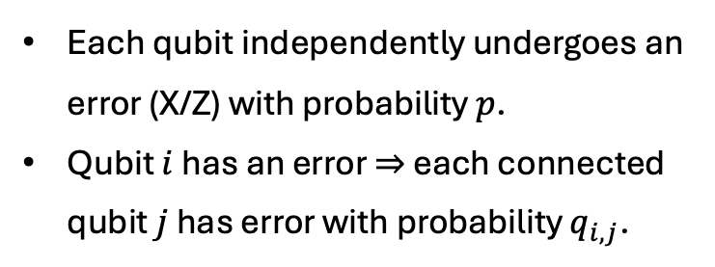











Numerical Results
Neural BP decoder vs. BP-OSD decoder for correlated error models. (Monte Carlo)
Error model: Ballistic Error Model
Each qubit independently undergoes an error (X/Z) with probability $p$.
Qubit $i$ has an error $⇒$ each connected qubit $j$ has error with probability $q_{i,j}$.
Training NN with
100 layers
CER marginals
${10}^{3}$ samples
Testing with
${10}^{5}$ samples
$10X$ gain.
$$q_{1,3}$$
$$3$$
$$5$$
$$7$$
…
$$1$$
$$q_{1,2}$$
$$q_{3,4}$$
…
…
$$2$$
$$q_{2,4}$$
$$4$$
$$6$$
$$8$$
CER provides two qubit marginals
Code: HGP of Hamming Codes: [[58,16,9]]
Nickerson and Brown, 2019, Quantum

Slide 32
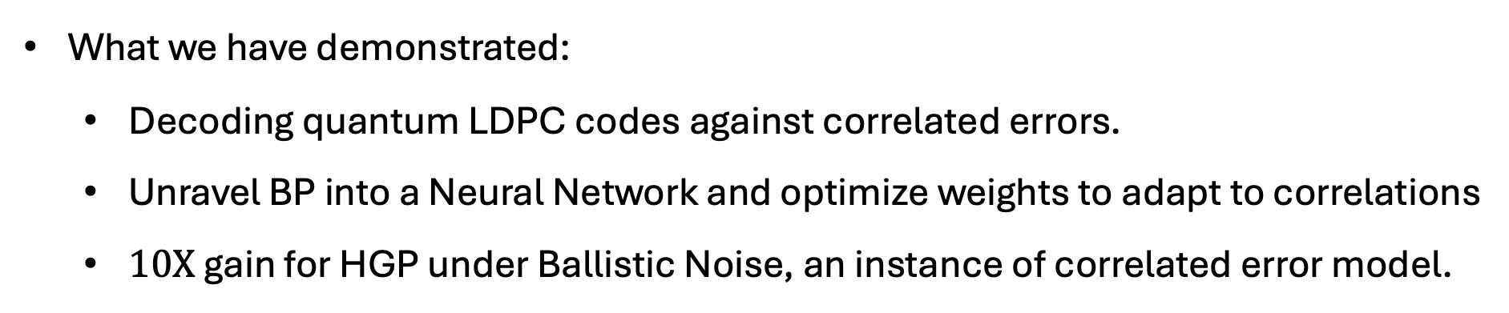
Conclusions and future work
What we have demonstrated:
Decoding quantum LDPC codes against correlated errors.
Unravel BP into a Neural Network and optimize weights to adapt to correlations
$10X$ gain for HGP under Ballistic Noise, an instance of correlated error model.
Future work and similar strategies:
Improving threshold for other family of quantum LDPC codes (La-Cross, Bicycle).
Circumventing
Correlated errors from Hamiltonian dynamics: beyond the Pauli paradigm.
Soft constraints and BP with higher dimensional messages.

