Slide 1

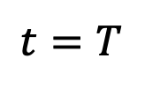
















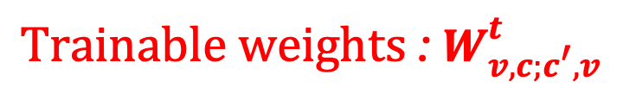
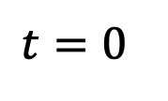



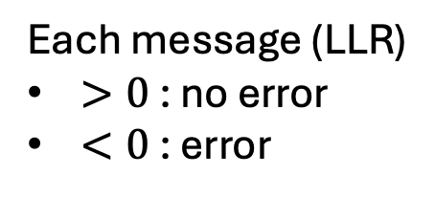
BP as a Neural Network
BP: iterative message-passing check $↔$ vertex nodes can be unraveled to a Neural Network
$$c_{1}$$
$$c_{2}$$
Each message (LLR)
$>0$ : no error
$<0$ : error
Repeat iteratively: $t=0,1, …,T$
$$m_{v_{1}→c_{1}}^{t}$$
$$m_{c_{2}→v_{4}}^{t}$$
$$v_{1}$$
$$v_{2}$$
$$v_{3}$$
$$v_{4}$$
$$t=0$$
$$t=T$$
Infer
$$l_{1}$$
$$μ_{1}$$
$${σ(μ}_{1})$$
$$l_{2}$$
$$μ_{2}$$
$${σ(μ}_{2})$$
…
…
…
…
…
…
$$l_{n}$$
$$μ_{n}$$
$${σ(μ}_{n})$$
$$m_{v→c}^{t}$$
$$m_{c→v}^{t}$$
Nachmani et. al., 2016. IEEE (Allerton)
$$Trainable weights \text{: }W_{v,c;c^{′},v}^{t}$$
Liu, Poulin, 2019. Phys. Rev. Lett. 122, 200501

Slide 2


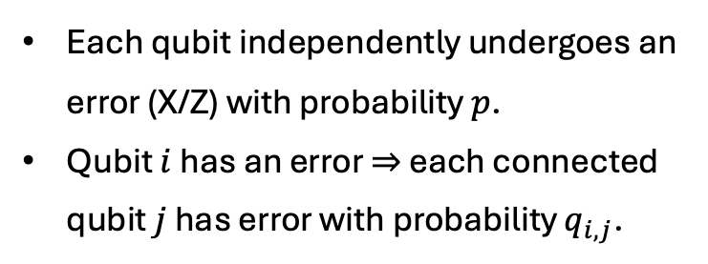











Preliminary Results
Neural BP decoder vs. BP-OSD decoder for correlated error models. (Monte Carlo)
Error model: Ballistic Error Model
Each qubit independently undergoes an error (X/Z) with probability $p$.
Qubit $i$ has an error $⇒$ each connected qubit $j$ has error with probability $q_{i,j}$.
Training NN with
100 layers
CER marginals
${10}^{3}$ samples
Testing with
${10}^{5}$ samples
$10X$ gain.
$$q_{1,3}$$
$$3$$
$$5$$
$$7$$
…
$$1$$
$$q_{1,2}$$
$$q_{3,4}$$
…
…
$$2$$
$$q_{2,4}$$
$$4$$
$$6$$
$$8$$
CER provides two qubit marginals
Nickerson and Brown, 2019, Quantum
Code: HGP of Hamming Codes: [[58,16,9]]
Roffe et. al. Phys. Rev. Research 2, 043423, 2020

