Slide 1


Enhancing Belief Propagation Decoders for Correlated Errors Using Cycle Error Reconstruction
Debankan Sannamoth, Pavithran Iyer, and Joseph Emerson
IQC Journal Club
26 May 2026
email: pavithran.sridhar@gmail.com , web: https://sites.google.com/view/piyer/home

Slide 2
The Big Question …
Quantum Error Correction: Suppress Noise at the logical level with high overhead cost
i.i.d noise
Qubits, gates, measurements…

Slide 3
The Big Question …
Quantum Error Correction: Suppress Noise at the logical level with high overhead cost
i.i.d noise
Qubits, gates, measurements…
Hardware : errors are often correlated
Revealed using experimental noise characterization (CER technique)
Minimize the overhead using quantum LDPC codes
E.g. Hypergraph Product Codes

Slide 4
The Big Question …
Quantum Error Correction: Suppress Noise at the logical level with high overhead cost
i.i.d noise
Qubits, gates, measurements…
Hardware : errors are often correlated
Revealed using experimental noise characterization (CER technique)
Minimize the overhead using quantum LDPC codes
E.g. Hypergraph Product Codes
Tailoring decoding to the underlying noise: Belief Propagation (BP) Decoders for qLDPC
Can we enhance the performance of BP for correlated errors using experimental data?

Slide 5
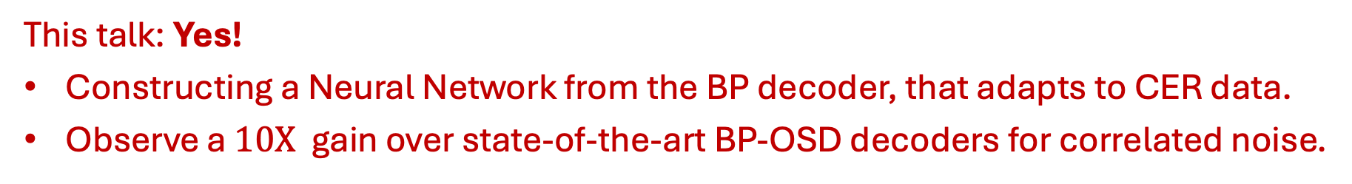
The Big Question …
Quantum Error Correction: Suppress Noise at the logical level with high overhead cost
i.i.d noise
Qubits, gates, measurements…
Hardware : errors are often correlated
Revealed using experimental noise characterization (CER technique)
Minimize the overhead using quantum LDPC codes
E.g. Hypergraph Product Codes
Tailoring decoding to the underlying noise: Belief Propagation (BP) Decoders for qLDPC
Can we enhance the performance of BP for correlated errors using experimental data?
This talk: Yes!
Constructing a Neural Network from the BP decoder, that adapts to CER data.
Observe a $10X$ gain over state-of-the-art BP-OSD decoders for correlated noise.

Slide 6
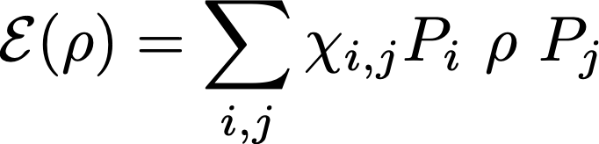
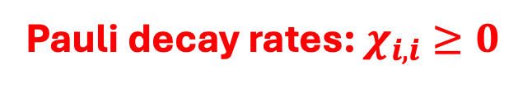
Cycle Error Reconstruction (CER)
Goal: Given a noisy circuit, extract rates of different Pauli errors.
Pauli decay rates: $χ_{i,i}≥0$
Pauli Errors

Slide 7






Cycle Error Reconstruction (CER)
Goal: Given a noisy circuit, extract rates of different Pauli errors.
Pauli decay rates: $χ_{i,i}≥0$
Pauli Errors
Cycle Error Reconstruction: Experimental protocol to estimate $χ_{i,i}$ for $n−$qubit CPTP maps $ℇ$.
$$σ_{1}$$
$$σ_{2}$$
$$λ_{σ}$$
$$σ_{n}$$
Nat Comm. 10, 5347 (2019), ACM Trans on Quantum Computing, 1, 1 (2020): $\{λ_{σ}\}→\{χ_{σ,σ}\}$

Slide 8
Can CER be useful to a decoder?
Encoder
Syndrome
Decoder
Unencoding
Noise

Slide 9
Can CER be useful to a decoder?
Encoder
Syndrome
Decoder
Unencoding
Noise
Decoder for Quantum Error Correction:
Given an error syndrome $s$, determine the most like class of Pauli errors that caused it.

Slide 10
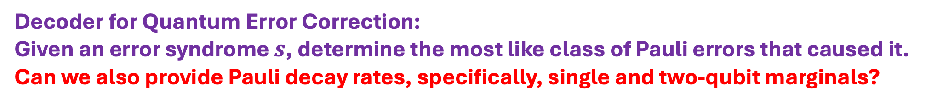
Can CER be useful to a decoder?
Encoder
Syndrome
Decoder
Unencoding
Noise
Decoder for Quantum Error Correction:
Given an error syndrome $s$, determine the most like class of Pauli errors that caused it.
Can we also provide Pauli decay rates, specifically, single and two-qubit marginals?

Slide 11
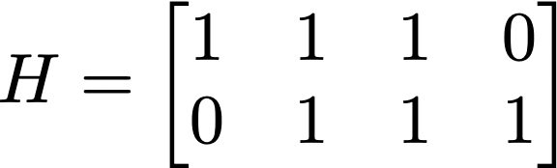
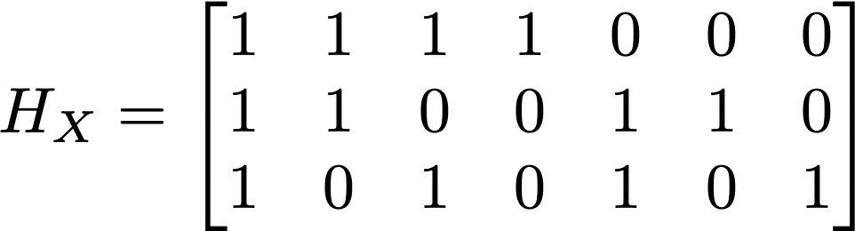
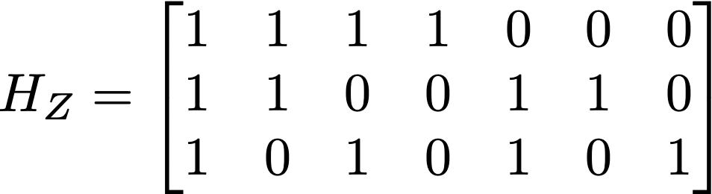







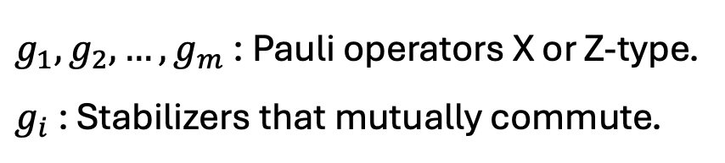













Quantum Error Correcting Codes
Classical codes: parity check matrix
Stabilizer codes: commuting Paulis
$g_{1},g_{2},…,g_{m}$ : Pauli operators X or Z-type.
$g_{i}$ : Stabilizers that mutually commute.
$$c_{1}$$
$$c_{2}$$
$$v_{1}$$
$$v_{2}$$
$$v_{3}$$
$$v_{4}$$
Codespace: $|ψ⟩∈ℋ_{2}^{n}$ such that $g_{i}|ψ⟩=|ψ⟩$
CSS Codes : stabilizers are X or Z type
Codewords: $\vec{v }∈Z_{2}^{n}$ such that $H⋅\vec{v }=0$.
$$g_{1}$$
Graphical representation: Tanner graph
$$g_{2}$$
$$c_{1}$$
$$c_{2}$$
$$g_{3}$$
$$g_{4}$$
$$g_{5}$$
$$v_{1}$$
$$v_{2}$$
$$v_{3}$$
$$v_{4}$$
$$g_{6}$$

Slide 12
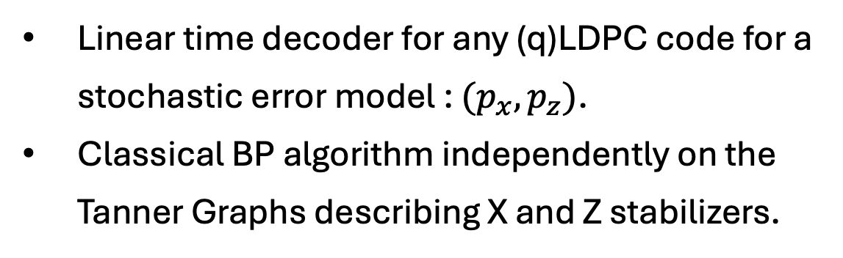
Belief Propagation (BP) Decoders
Linear time decoder for any (q)LDPC code for a stochastic error model : $(p_{x},p_{z})$.
Classical BP algorithm independently on the Tanner Graphs describing X and Z stabilizers.

Slide 13












Belief Propagation (BP) Decoders
Linear time decoder for any (q)LDPC code for a stochastic error model : $(p_{x},p_{z})$.
Classical BP algorithm independently on the Tanner Graphs describing X and Z stabilizers.
$$c_{1}$$
$$c_{2}$$
$$v_{1}$$
$$v_{2}$$
$$v_{3}$$
$$v_{4}$$
Checks
$$c_{1}$$
$$c_{2}$$
$$v_{1}$$
$$v_{2}$$
$$v_{3}$$
$$v_{4}$$
Bits

Slide 14
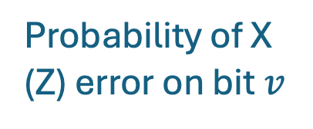
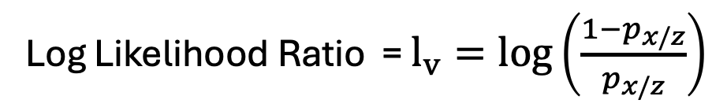
Belief Propagation (BP) Decoders
Linear time decoder for any (q)LDPC code for a stochastic error model : $(p_{x},p_{z})$.
Classical BP algorithm independently on the Tanner Graphs describing X and Z stabilizers.
$$c_{1}$$
$$c_{2}$$
$$v_{1}$$
$$v_{2}$$
$$v_{3}$$
$$v_{4}$$
Log Likelihood Ratio = $l_{v}=log\left(\frac{1−p_{x/z}}{p_{x/z}}\right)$
Probability of X (Z) error on bit $v$
Checks
$$c_{1}$$
$$c_{2}$$
$$v_{1}$$
$$v_{2}$$
$$v_{3}$$
$$v_{4}$$
Bits

Slide 15



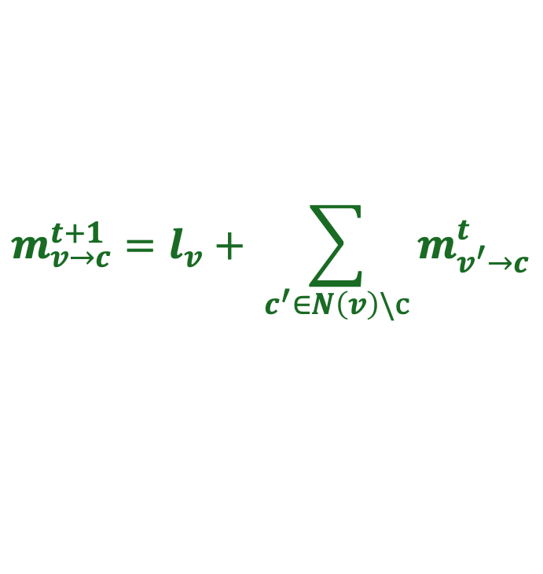
Belief Propagation (BP) Decoders
Linear time decoder for any (q)LDPC code for a stochastic error model : $(p_{x},p_{z})$.
Classical BP algorithm independently on the Tanner Graphs describing X and Z stabilizers.
$$c_{1}$$
$$c_{2}$$
$$v_{1}$$
$$v_{2}$$
$$v_{3}$$
$$v_{4}$$
Log Likelihood Ratio = $l_{v}=log\left(\frac{1−p_{x/z}}{p_{x/z}}\right)$
Probability of X (Z) error on bit $v$
Checks
$$c_{1}$$
$$c_{2}$$
$$m_{c→v}^{t}=2 {\left(−1\right)}^{s_{c}} tanh^{−1}\left(\prod_{v^{′}∈N(c)}{tanh \left(\frac{m_{v^{′}→c}^{t}}{2}\right)}\right)$$
$$m_{v_{1}→c_{1}}^{t}$$
$$m_{c_{2}→v_{4}}^{t}$$
$$m_{v→c}^{t+1}=l_{v}+ \sum_{c^{′}∈N\left(v\right)\backslash c}{m_{v^{′}→c}^{t}}$$
$$v_{1}$$
$$v_{2}$$
$$v_{3}$$
$$v_{4}$$
Bits

Slide 16


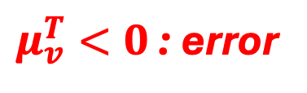
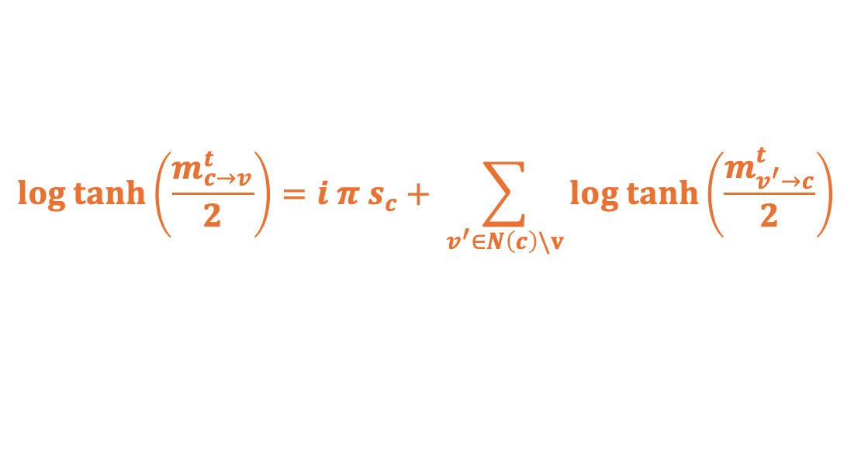
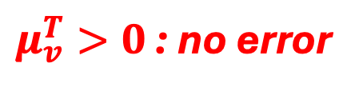
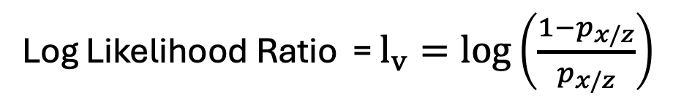
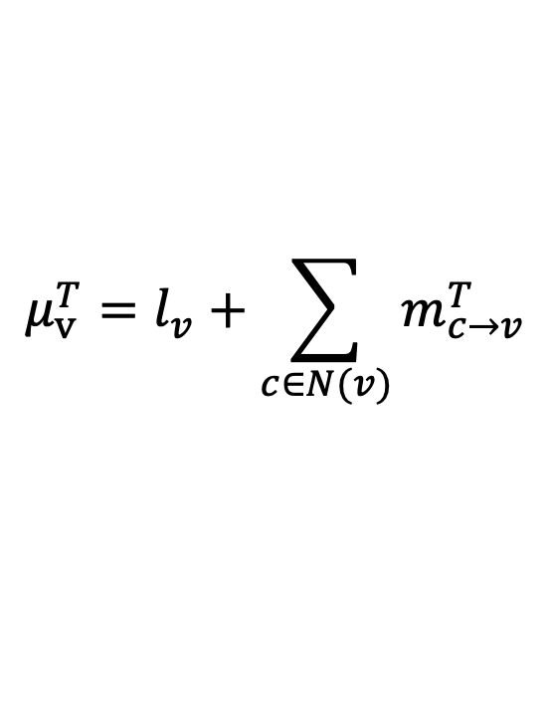
BP as a Neural Network
Log Likelihood Ratio = $l_{v}=log\left(\frac{1−p_{x/z}}{p_{x/z}}\right)$
Repeat for $T$ iterations
$$log tanh\left(\frac{m_{c→v}^{t}}{2}\right)=i π s_{c}+ \sum_{v^{′}∈N\left(c\right)\backslash v}{log tanh\left(\frac{m_{v^{′}→c}^{t}}{2}\right)}$$
$$m_{v→c}^{t+1}=l_{v}+ \sum_{c^{′}∈N\left(v\right)\backslash c}{m_{v^{′}→c}^{t}}$$
Compute refined beliefs
$$μ_{v}^{T}=l_{v}+\sum_{c∈N(v)}{m_{c→v}^{T}}$$
$μ_{v}^{T}>0$ : no error
$μ_{v}^{T}<0$ : error

Slide 17




BP as a Neural Network
Log Likelihood Ratio = $l_{v}=log\left(\frac{1−p_{x/z}}{p_{x/z}}\right)$
Repeat for $T$ iterations
$$log tanh\left(\frac{m_{c→v}^{t}}{2}\right)=i π s_{c}+ \sum_{v^{′}∈N\left(c\right)\backslash v}{log tanh\left(\frac{m_{v^{′}→c}^{t}}{2}\right)}$$
$$m_{v→c}^{t+1}=l_{v}+ \sum_{c^{′}∈N\left(v\right)\backslash c}{m_{v^{′}→c}^{t}}$$
$$m_{v→c}^{t}$$
$$m_{c→v}^{t}$$
Compute refined beliefs
$μ_{v}^{T}>0$ : no error
$$t$$
$$μ_{v}^{T}=l_{v}+\sum_{c∈N(v)}{m_{c→v}^{T}}$$
$μ_{v}^{T}<0$ : error
$$time$$

Slide 18
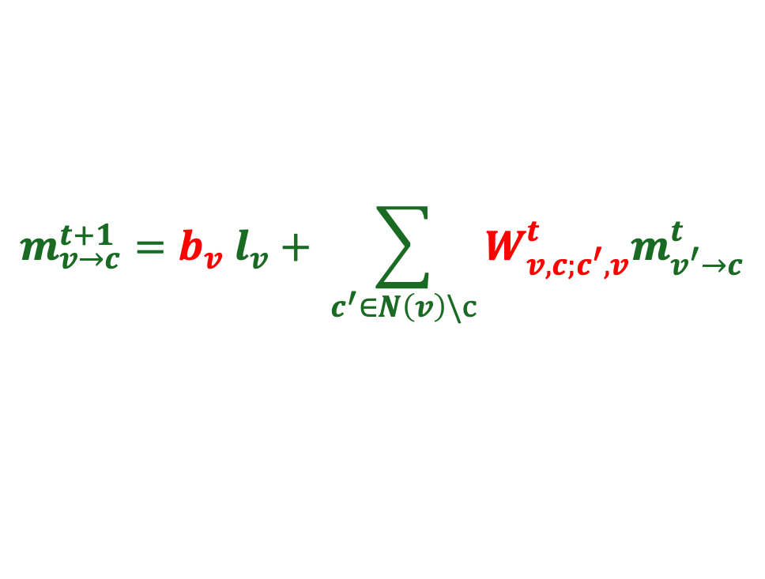
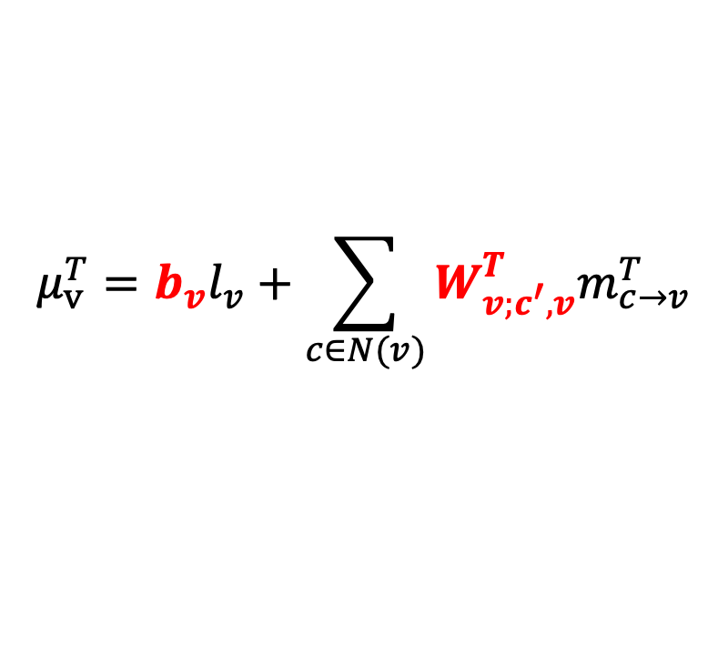
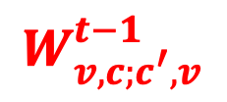
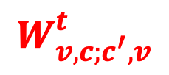
BP as a Neural Network
Log Likelihood Ratio = $l_{v}=log\left(\frac{1−p_{x/z}}{p_{x/z}}\right)$
$$W_{v,c;c^{′},v}^{t}$$
$$W_{v,c;c^{′},v}^{t−1}$$
Repeat for $T$ iterations
$$log tanh\left(\frac{m_{c→v}^{t}}{2}\right)=i π s_{c}+ \sum_{v^{′}∈N\left(c\right)\backslash v}{log tanh\left(\frac{m_{v^{′}→c}^{t}}{2}\right)}$$
$$m_{v→c}^{t+1}={b_{v} l}_{v}+ \sum_{c^{′}∈N\left(v\right)\backslash c}{{W_{v,c;c^{′},v}^{t}m}_{v^{′}→c}^{t}}$$
$$m_{v→c}^{t}$$
$$m_{c→v}^{t}$$
Compute refined beliefs
$$μ_{v}^{T}={b_{v}l}_{v}+\sum_{c∈N(v)}{{W_{v;c^{′},v}^{T}m}_{c→v}^{T}}$$
$μ_{v}^{T}>0$ : no error
$$t$$
$μ_{v}^{T}<0$ : error
$$time$$

Slide 19



BP as a Neural Network
Input layer
$$l_{1}$$
$$l_{2}$$
…
$$l_{n}$$
Nachmani et. al., 2016. IEEE (Allerton)
Liu, Poulin, 2019. Phys. Rev. Lett. 122, 200501

Slide 20
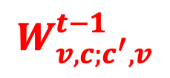
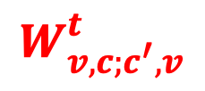


BP as a Neural Network
$$W_{v,c;c^{′},v}^{t}$$
Input layer
$$W_{v,c;c^{′},v}^{t−1}$$
$$l_{1}$$
$$l_{2}$$
…
…
…
…
$$l_{n}$$
$$m_{v→c}^{t}$$
$$m_{c→v}^{t}$$
Nachmani et. al., 2016. IEEE (Allerton)
Liu, Poulin, 2019. Phys. Rev. Lett. 122, 200501

Slide 21





BP as a Neural Network
$$W_{v,c;c^{′},v}^{t}$$
Input layer
$$W_{v,c;c^{′},v}^{t−1}$$
Final layer
$$l_{1}$$
$$μ_{1}$$
$$l_{2}$$
$$μ_{2}$$
…
…
…
…
…
…
$$l_{n}$$
$$μ_{n}$$
$$m_{v→c}^{t}$$
$$m_{c→v}^{t}$$
Activation function at layers
$$a\left(x\right)=2 tanh^{−1}\left(e^{x}\right)$$
$$a\left(x\right)=log tanh\left(x/2\right)$$
Nachmani et. al., 2016. IEEE (Allerton)
Liu, Poulin, 2019. Phys. Rev. Lett. 122, 200501

Slide 22



BP as a Neural Network
$$W_{v,c;c^{′},v}^{t}$$
Input layer
$$W_{v,c;c^{′},v}^{t−1}$$
Final layer
Error
$$l_{1}$$
$$μ_{1}$$
$${σ(μ}_{1})$$
$$l_{2}$$
$$μ_{2}$$
$${σ(μ}_{2})$$
…
…
…
…
…
…
$$l_{n}$$
$$μ_{n}$$
$${σ(μ}_{n})$$
$$m_{v→c}^{t}$$
$$m_{c→v}^{t}$$
Activation function at layers
$$a\left(x\right)=2 tanh^{−1}\left(e^{x}\right)$$
$$a\left(x\right)=log tanh\left(x/2\right)$$
Nachmani et. al., 2016. IEEE (Allerton)
Liu, Poulin, 2019. Phys. Rev. Lett. 122, 200501

Slide 23


BP as a Neural Network
$$W_{v,c;c^{′},v}^{t}$$
Input layer
$$W_{v,c;c^{′},v}^{t−1}$$
Final layer
Error
$$l_{1}$$
$$μ_{1}$$
$${σ(μ}_{1})$$
$$l_{2}$$
$$μ_{2}$$
$${σ(μ}_{2})$$
…
…
…
…
…
…
$$l_{n}$$
$$μ_{n}$$
$${σ(μ}_{n})$$
$$m_{v→c}^{t}$$
$$m_{c→v}^{t}$$
Weights obtaining from training the NN:
Activation function at layers
$$a\left(x\right)=2 tanh^{−1}\left(e^{x}\right)$$
$$s=H^{⊥}{(σ(μ}_{v})+e)$$
$Loss=\left|sin\left(π s_{c}/2\right)\right|$.
$$a\left(x\right)=log tanh\left(x/2\right)$$
Nachmani et. al., 2016. IEEE (Allerton)
Liu, Poulin, 2019. Phys. Rev. Lett. 122, 200501

Slide 24
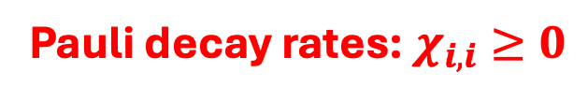
Adding CER inputs to BP
Pauli decay rates: $χ_{i,i}≥0$

Slide 25


Adding CER inputs to BP
Single qubit error rates
${p_{i,I}, p}_{i,X}, p_{i,Z}, p_{i,Y}$ : on each qubit
Pauli decay rates: $χ_{i,i}≥0$
Two-qubit error rates
Two-qubit correlations: spatial cross-talk, frequency coupling (imperfect two-qubit gates)
${p_{ij,II}, p}_{i,XX}, …, p_{ZZ}$ : on qubit pairs
Fazio et al 2026. Phys. Rev. X 16, 011030
Harper and Flammia, 2023 . PRXQuantum.4.040311

Slide 26
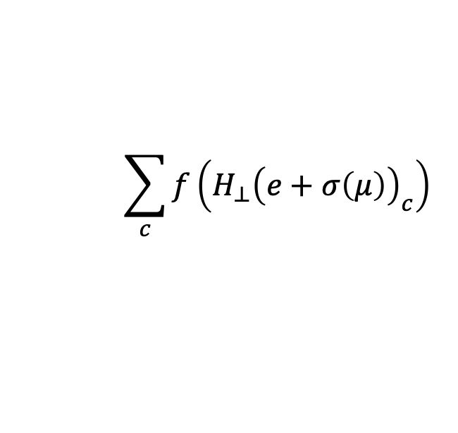
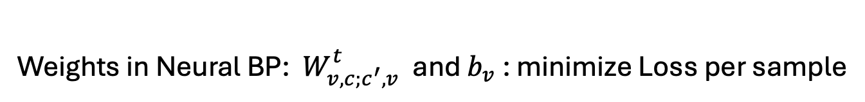
Adding CER inputs to BP
Memory noise:
Single qubit error rates
${p_{i,I}, p}_{i,X}, p_{i,Z}, p_{i,Y}$ : on each qubit
Pauli decay rates: $χ_{i,i}≥0$
Two-qubit error rates
Two-qubit correlations: spatial cross-talk, frequency coupling (imperfect two-qubit gates)
${p_{ij,II}, p}_{i,XX}, …, p_{ZZ}$ : on qubit pairs
Weights in Neural BP: ${ W}_{v,c;c^{′},v}^{t}$ and $b_{v}$ : minimize Loss per sample
$$\sum_{c}{f\left(H_{⊥}{\left(e+σ\left(μ\right)\right)}_{c}\right)}$$
Fazio et al 2026. Phys. Rev. X 16, 011030
Harper and Flammia, 2023 . PRXQuantum.4.040311

Slide 27
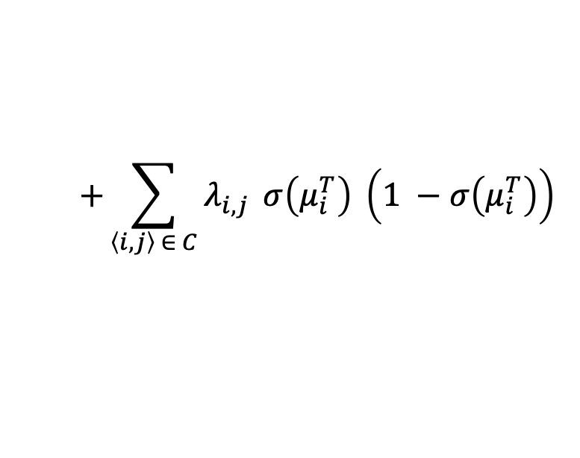
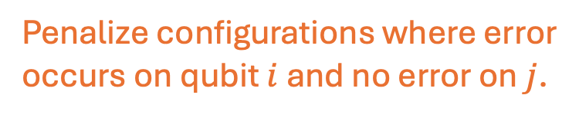
Adding CER inputs to BP
Memory noise:
Single qubit error rates
${p_{i,I}, p}_{i,X}, p_{i,Z}, p_{i,Y}$ : on each qubit
Pauli decay rates: $χ_{i,i}≥0$
Two-qubit error rates
Two-qubit correlations: spatial cross-talk, frequency coupling (imperfect two-qubit gates)
${p_{ij,II}, p}_{i,XX}, …, p_{ZZ}$ : on qubit pairs
Weights in Neural BP: ${ W}_{v,c;c^{′},v}^{t}$ and $b_{v}$ : minimize Loss per sample
$$\sum_{c}{f\left(H_{⊥}{\left(e+σ\left(μ\right)\right)}_{c}\right)}$$
$$+\sum_{\left\langle i,j\right\rangle ∈ C}{λ_{i,j}} σ\left(μ_{i}^{T}\right) \left(1 −σ\left(μ_{i}^{T}\right)\right)$$
Penalize configurations where error
occurs on qubit $i$ and no error on $j$.
Fazio et al 2026. Phys. Rev. X 16, 011030
Harper and Flammia, 2023 . PRXQuantum.4.040311
Connectivity graph (hardware)

Slide 28
Adding CER inputs to BP
Memory noise:
Single qubit error rates
${p_{i,I}, p}_{i,X}, p_{i,Z}, p_{i,Y}$ : on each qubit
Pauli decay rates: $χ_{i,i}≥0$
Two-qubit error rates
Two-qubit correlations: spatial cross-talk, frequency coupling (imperfect two-qubit gates)
${p_{ij,II}, p}_{i,XX}, …, p_{ZZ}$ : on qubit pairs
Weights in Neural BP: ${ W}_{v,c;c^{′},v}^{t}$ and $b_{v}$ : minimize Loss per sample
$$\sum_{c}{f\left(H_{⊥}{\left(e+σ\left(μ\right)\right)}_{c}\right)}$$
$$+\sum_{\left\langle i,j\right\rangle ∈ C}{λ_{i,j}} σ\left(μ_{i}^{T}\right) \left(1 −σ\left(μ_{i}^{T}\right)\right)$$
Penalize configurations where error
occurs on qubit $i$ and no error on $j$.
Fazio et al 2026. Phys. Rev. X 16, 011030
Harper and Flammia, 2023 . PRXQuantum.4.040311
Connectivity graph (hardware)
From CER

Slide 29
Numerical Results
Neural BP decoder vs. BP-OSD decoder for correlated error models. (Monte Carlo)
Nickerson and Brown, 2019, Quantum
Roffe et. al. Phys. Rev. Research 2, 043423, 2020

Slide 30





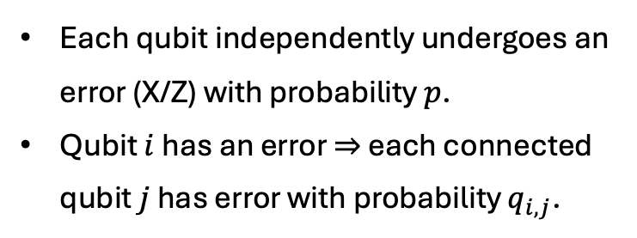







Numerical Results
Neural BP decoder vs. BP-OSD decoder for correlated error models. (Monte Carlo)
Error model: Ballistic Error Model
Each qubit independently undergoes an error (X/Z) with probability $p$.
Qubit $i$ has an error $⇒$ each connected qubit $j$ has error with probability $q_{i,j}$.
$$q_{1,3}$$
$$3$$
$$5$$
$$7$$
…
$$1$$
$$q_{1,2}$$
$$q_{3,4}$$
…
…
$$2$$
$$q_{2,4}$$
$$4$$
$$6$$
$$8$$
CER provides two qubit marginals
Nickerson and Brown, 2019, Quantum
Roffe et. al. Phys. Rev. Research 2, 043423, 2020

Slide 31
Numerical Results
Neural BP decoder vs. BP-OSD decoder for correlated error models. (Monte Carlo)
Error model: Ballistic Error Model
Each qubit independently undergoes an error (X/Z) with probability $p$.
Qubit $i$ has an error $⇒$ each connected qubit $j$ has error with probability $q_{i,j}$.
$$q_{1,3}$$
$$3$$
$$5$$
$$7$$
…
$$1$$
$$q_{1,2}$$
$$q_{3,4}$$
…
…
$$2$$
$$q_{2,4}$$
$$4$$
$$6$$
$$8$$
CER provides two qubit marginals
Nickerson and Brown, 2019, Quantum
Code: HGP of Hamming Codes: [[58,16,9]]
Roffe et. al. Phys. Rev. Research 2, 043423, 2020

Slide 32
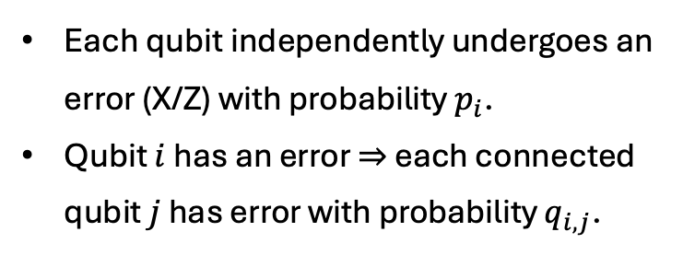
Numerical Results
Neural BP decoder vs. BP-OSD decoder for correlated error models. (Monte Carlo)
Error model: Ballistic Error Model
Each qubit independently undergoes an error (X/Z) with probability $p_{i}$.
Qubit $i$ has an error $⇒$ each connected qubit $j$ has error with probability $q_{i,j}$.
$$q_{1,3}$$
$$3$$
$$5$$
$$7$$
…
$$1$$
$$q_{1,2}$$
$$q_{3,4}$$
…
…
$$2$$
$$q_{2,4}$$
$$4$$
$$6$$
$$8$$
CER provides two qubit marginals
Nickerson and Brown, 2019, Quantum
Code: HGP of Hamming Codes: [[58,16,9]]
Roffe et. al. Phys. Rev. Research 2, 043423, 2020

Slide 33

Numerical Results
Neural BP decoder vs. BP-OSD decoder for correlated error models. (Monte Carlo)
Error model: Ballistic Error Model
Each qubit independently undergoes an error (X/Z) with probability $p$.
Qubit $i$ has an error $⇒$ each connected qubit $j$ has error with probability $q_{i,j}$.
Training NN with
100 layers
CER marginals
${10}^{3}$ samples
Testing with
${10}^{5}$ samples
$10X$ gain.
$$q_{1,3}$$
$$3$$
$$5$$
$$7$$
…
$$1$$
$$q_{1,2}$$
$$q_{3,4}$$
…
…
$$2$$
$$q_{2,4}$$
$$4$$
$$6$$
$$8$$
CER provides two qubit marginals
Nickerson and Brown, 2019, Quantum
Code: HGP of Hamming Codes: [[58,16,9]]
Roffe et. al. Phys. Rev. Research 2, 043423, 2020

Slide 34





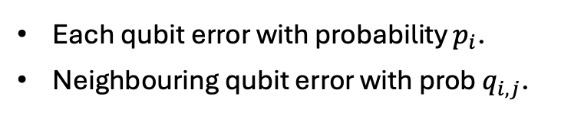









Numerical Results
Neural BP decoder vs. BP-OSD decoder for Ballistic error model (gain for each sample)
Error model: Ballistic Error Model
Each qubit error with probability $p_{i}$.
Neighbouring qubit error with prob $q_{i,j}$.
$$q_{1,3}$$
$$3$$
$$5$$
$$7$$
…
$$1$$
$$q_{1,2}$$
$$q_{3,4}$$
…
…
$$2$$
$$q_{2,4}$$
$$4$$
$$6$$
$$8$$
Sample $p_{i}$ and $q_{i,j}$ from Gaussian $𝒩(q,0.1)$.
Bicycle Bivariate codes: $[\left[72,10,6\right]]$ .
https://www.nature.com/articles/s41586-024-07107-7
Typically ~30x gains over state of the art

Slide 35
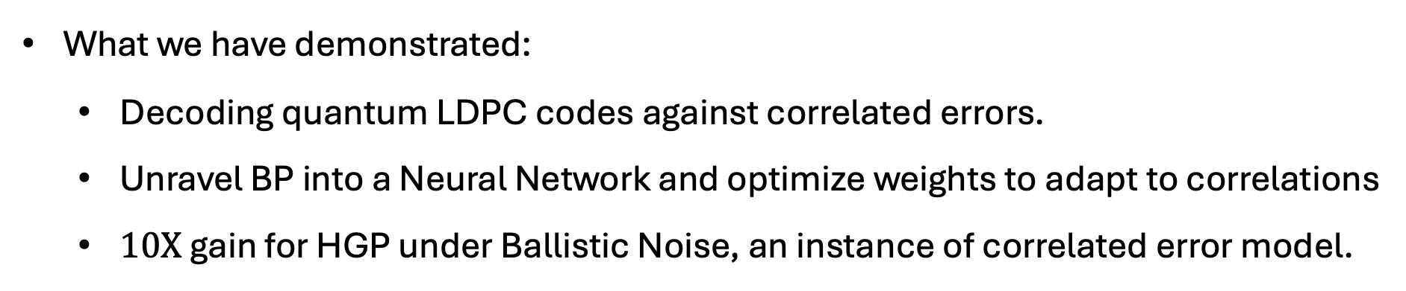
Conclusions and future work
What we have demonstrated:
Decoding quantum LDPC codes against correlated errors.
Unravel BP into a Neural Network and optimize weights to adapt to correlations
$10X$ gain for HGP under Ballistic Noise, an instance of correlated error model.

Slide 36
Conclusions and future work
What we have demonstrated:
Decoding quantum LDPC codes against correlated errors.
Unravel BP into a Neural Network and optimize weights to adapt to correlations
$10X$ gain for HGP under Ballistic Noise, an instance of correlated error model.
https://github.com/paviudes/CorrelatedBPDecoderWithCER
Future work and similar strategies:
Improving threshold for other family of quantum LDPC codes (La-Cross, Bicycle).
Soft constraints and BP with higher dimensional messages.

Slide 37
Supplementary Slides

Slide 38
Hypergraph Product Codes
Combine two classical binary linear codes to obtain a quantum code

Slide 39






















Hypergraph Product Codes
Combine two classical binary linear codes to obtain a quantum code
$$v_{1}$$
$$c_{1}$$
$$v_{2}$$
$$v_{3}$$
$$c_{2}$$
$$v_{4}$$
$$c_{1}$$
$$c_{2}$$
$$v_{1}$$
$$v_{2}$$
$$v_{3}$$
$$v_{4}$$
$$v_{1}$$
$$c_{1}$$
$$v_{2}$$
$$v_{3}$$
$$c_{2}$$
$$v_{4}$$
$$c_{1}$$
$$c_{2}$$
$$v_{1}$$
$$v_{2}$$
$$v_{3}$$
$$v_{4}$$

Slide 40






























Hypergraph Product Codes
Combine two classical binary linear codes to obtain a quantum code
$$v_{1}$$
$$c_{1}$$
$$v_{2}$$
$$v_{3}$$
$$c_{2}$$
$$v_{4}$$
$$c_{1}$$
$$v_{1}$$
$$c_{1}$$
$$v_{2}$$
$$v_{3}$$
$$c_{2}$$
$$v_{4}$$
$$c_{2}$$
$$v_{1}$$
$$v_{2}$$
$$v_{3}$$
$$v_{4}$$
$$c_{2}$$
$$v_{4}$$
$$v_{1}$$
$$c_{1}$$
$$v_{2}$$
$$v_{3}$$
$$v_{1}$$
$$c_{1}$$
$$v_{2}$$
$$v_{3}$$
$$c_{2}$$
$$v_{4}$$
$$c_{1}$$
$$c_{2}$$
$$v_{1}$$
$$c_{1}$$
$$v_{2}$$
$$v_{3}$$
$$c_{2}$$
$$v_{4}$$
$$v_{1}$$
$$c_{1}$$
$$v_{2}$$
$$v_{3}$$
$$c_{2}$$
$$v_{4}$$
$$v_{1}$$
$$v_{2}$$
$$v_{3}$$
$$v_{4}$$
$$v_{1}$$
$$c_{1}$$
$$v_{2}$$
$$v_{3}$$
$$c_{2}$$
$$v_{4}$$

Slide 41
Hypergraph Product Codes
Combine two classical binary linear codes to obtain a quantum code
$$v_{1}$$
$$c_{1}$$
$$v_{2}$$
$$v_{3}$$
$$c_{2}$$
$$v_{4}$$
$$v_{4}$$
$$c_{1}$$
$$v_{1}$$
$$c_{1}$$
$$v_{2}$$
$$v_{3}$$
$$c_{2}$$
$$v_{4}$$
$$c_{2}$$
$$c_{2}$$
$$v_{1}$$
$$v_{2}$$
$$v_{3}$$
$$v_{4}$$
$$c_{2}$$
$$v_{4}$$
$$v_{3}$$
$$v_{1}$$
$$c_{1}$$
$$v_{2}$$
$$v_{3}$$
$$c_{1}$$
$$c_{2}$$
$$v_{2}$$
$$v_{1}$$
$$c_{1}$$
$$v_{2}$$
$$v_{3}$$
$$c_{2}$$
$$v_{4}$$
$$c_{1}$$
$$v_{1}$$
$$c_{1}$$
$$v_{2}$$
$$v_{3}$$
$$c_{2}$$
$$v_{4}$$
$$v_{1}$$
$$v_{2}$$
$$v_{3}$$
$$v_{4}$$
$$v_{1}$$
$$c_{1}$$
$$v_{2}$$
$$v_{3}$$
$$c_{2}$$
$$v_{4}$$
$$v_{1}$$

Slide 42
Hypergraph Product Codes
Combine two classical binary linear codes to obtain a quantum code
$$v_{1}$$
$$c_{1}$$
$$v_{2}$$
$$v_{3}$$
$$c_{2}$$
$$v_{4}$$
$$v_{4}$$
$$c_{1}$$
$$v_{1}$$
$$c_{1}$$
$$v_{2}$$
$$v_{3}$$
$$c_{2}$$
$$v_{4}$$
$$c_{2}$$
$$c_{2}$$
$$v_{1}$$
$$v_{2}$$
$$v_{3}$$
$$v_{4}$$
$$c_{2}$$
$$v_{4}$$
$$v_{3}$$
$$v_{1}$$
$$c_{1}$$
$$v_{2}$$
$$v_{3}$$
$$c_{1}$$
$$c_{2}$$
$$v_{2}$$
$$v_{1}$$
$$c_{1}$$
$$v_{2}$$
$$v_{3}$$
$$c_{2}$$
$$v_{4}$$
$$c_{1}$$
$$v_{1}$$
$$c_{1}$$
$$v_{2}$$
$$v_{3}$$
$$c_{2}$$
$$v_{4}$$
$$v_{1}$$
$$v_{2}$$
$$v_{3}$$
$$v_{4}$$
$$v_{1}$$
$$c_{1}$$
$$v_{2}$$
$$v_{3}$$
$$c_{2}$$
$$v_{4}$$
$$v_{1}$$

Slide 43


Hypergraph Product Codes
Hypergraph product (quantum) code: $\left(n,k\right)×\left(n,k\right)↦[\left[n_{1}n_{2}, k_{1}k_{2}\right]]$
and
qubits
$$c_{1}$$
$$v_{2}$$
$$v_{3}$$
$$c_{2}$$
$$v_{4}$$
$$v_{1}$$
and
Stabilizer
Generators
$$v_{1}$$
$$c_{1}$$
$$v_{2}$$
$$v_{3}$$
$$c_{2}$$
$$v_{4}$$
$$v_{1}$$
$$c_{1}$$
$$v_{2}$$
$$v_{3}$$
$$c_{2}$$
$$v_{4}$$
X-type
Z-type
$$v_{1}$$
$$c_{1}$$
$$v_{2}$$
$$v_{3}$$
$$c_{2}$$
$$v_{4}$$
$$v_{1}$$
$$c_{1}$$
$$v_{2}$$
$$v_{3}$$
$$c_{2}$$
$$v_{4}$$
$H$ : ($m × n)$ parity check matrix
# physical qubits: $n^{2}+m^{2}$ , # logical qubits: $k^{2}$
$$v_{1}$$
$$c_{1}$$
$$v_{2}$$
$$v_{3}$$
$$c_{2}$$
$$v_{4}$$

