Slide 1


Enhancing Belief Propagation Decoders for Correlated Errors Using Cycle Error Reconstruction
Debankan Sannamoth, Pavithran Iyer, and Joseph Emerson
Update to Steve
23 June 2026
email: pavithran.sridhar@gmail.com , web: https://sites.google.com/view/piyer/home

Slide 2
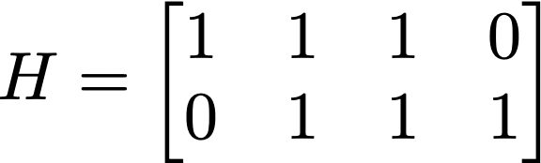



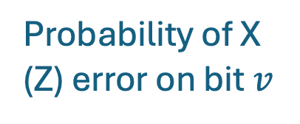



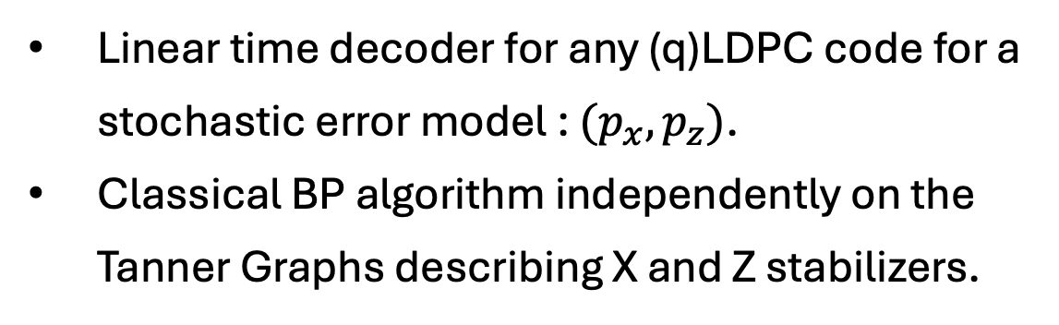

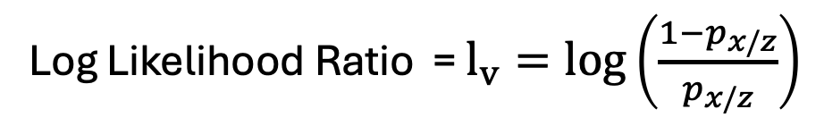





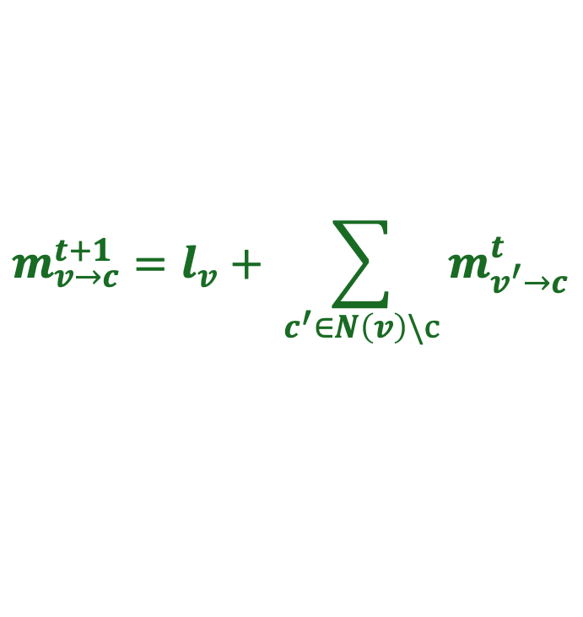



Belief Propagation (BP) Decoders
Linear time decoder for any (q)LDPC code for a stochastic error model : $(p_{x},p_{z})$.
Classical BP algorithm independently on the Tanner Graphs describing X and Z stabilizers.
$$c_{1}$$
$$c_{2}$$
$$v_{1}$$
$$v_{2}$$
$$v_{3}$$
$$v_{4}$$
Log Likelihood Ratio = $l_{v}=log\left(\frac{1−p_{x/z}}{p_{x/z}}\right)$
Probability of X (Z) error on bit $v$
Checks
$$c_{1}$$
$$c_{2}$$
$$m_{c→v}^{t}=2 {\left(−1\right)}^{s_{c}} tanh^{−1}\left(\prod_{v^{′}∈N(c)}{tanh \left(\frac{m_{v^{′}→c}^{t}}{2}\right)}\right)$$
$$m_{v_{1}→c_{1}}^{t}$$
$$m_{c_{2}→v_{4}}^{t}$$
$$m_{v→c}^{t+1}=l_{v}+ \sum_{c^{′}∈N\left(v\right)\backslash c}{m_{v^{′}→c}^{t}}$$
$$v_{1}$$
$$v_{2}$$
$$v_{3}$$
$$v_{4}$$
Bits

Slide 3


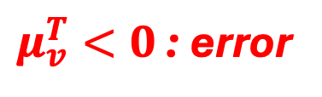
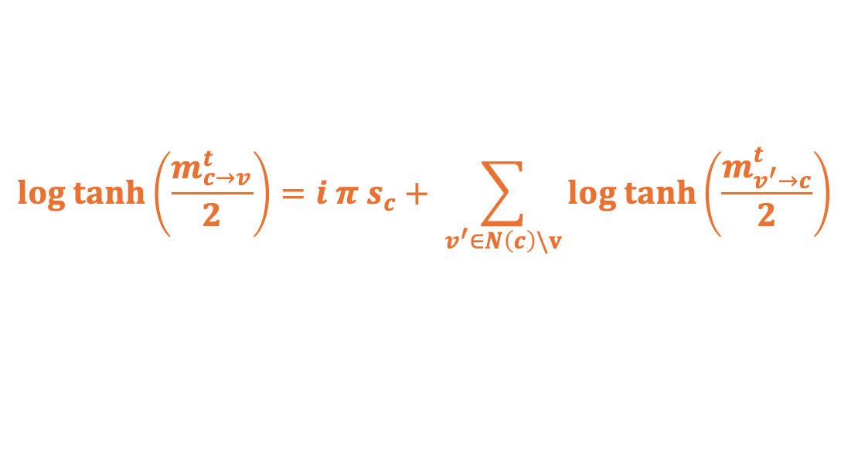
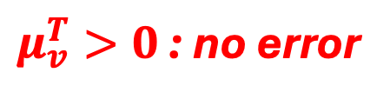
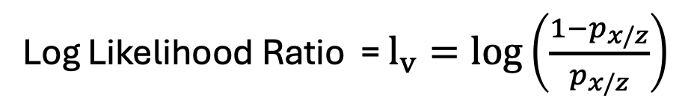
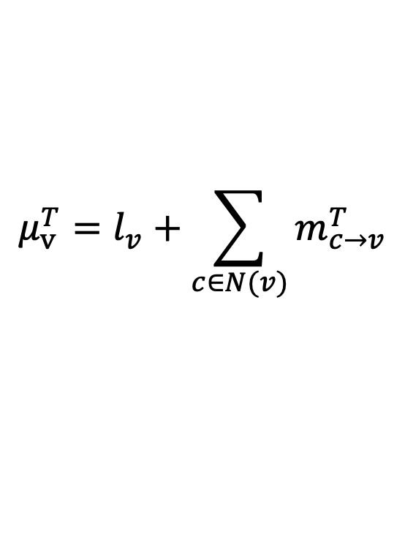
BP as a Neural Network
Log Likelihood Ratio = $l_{v}=log\left(\frac{1−p_{x/z}}{p_{x/z}}\right)$
Repeat for $T$ iterations
$$log tanh\left(\frac{m_{c→v}^{t}}{2}\right)=i π s_{c}+ \sum_{v^{′}∈N\left(c\right)\backslash v}{log tanh\left(\frac{m_{v^{′}→c}^{t}}{2}\right)}$$
$$m_{v→c}^{t+1}=l_{v}+ \sum_{c^{′}∈N\left(v\right)\backslash c}{m_{v^{′}→c}^{t}}$$
Compute refined beliefs
$$μ_{v}^{T}=l_{v}+\sum_{c∈N(v)}{m_{c→v}^{T}}$$
$μ_{v}^{T}>0$ : no error
$μ_{v}^{T}<0$ : error

Slide 4




BP as a Neural Network
Log Likelihood Ratio = $l_{v}=log\left(\frac{1−p_{x/z}}{p_{x/z}}\right)$
Repeat for $T$ iterations
$$log tanh\left(\frac{m_{c→v}^{t}}{2}\right)=i π s_{c}+ \sum_{v^{′}∈N\left(c\right)\backslash v}{log tanh\left(\frac{m_{v^{′}→c}^{t}}{2}\right)}$$
$$m_{v→c}^{t+1}=l_{v}+ \sum_{c^{′}∈N\left(v\right)\backslash c}{m_{v^{′}→c}^{t}}$$
$$m_{v→c}^{t}$$
$$m_{c→v}^{t}$$
Compute refined beliefs
$μ_{v}^{T}>0$ : no error
$$t$$
$$μ_{v}^{T}=l_{v}+\sum_{c∈N(v)}{m_{c→v}^{T}}$$
$μ_{v}^{T}<0$ : error
$$time$$

Slide 5
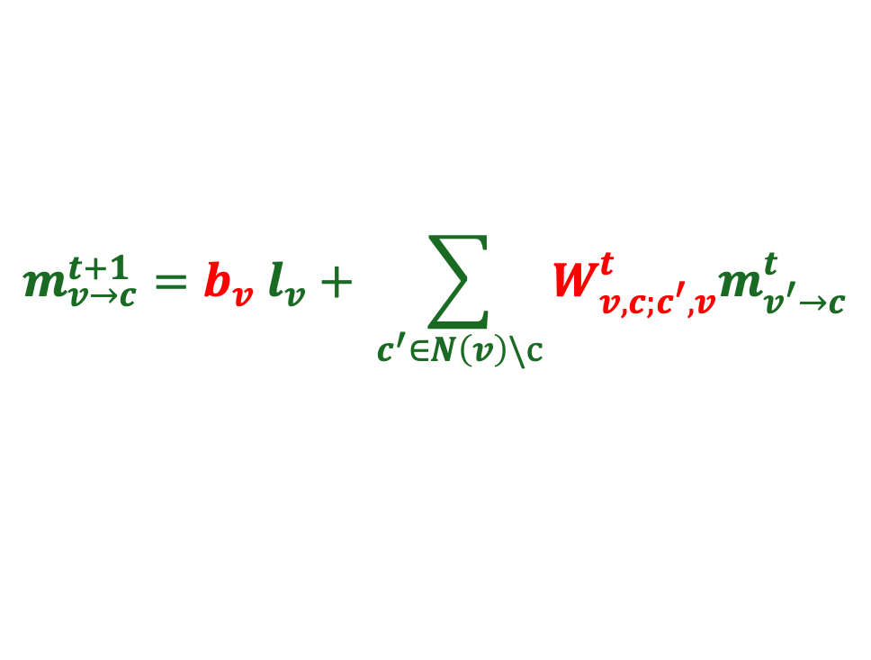
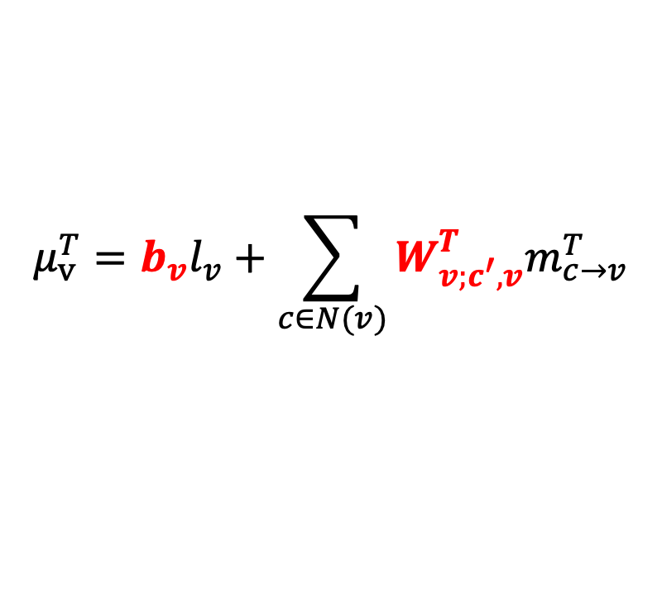
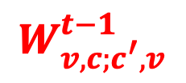
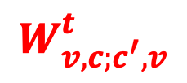
BP as a Neural Network
Log Likelihood Ratio = $l_{v}=log\left(\frac{1−p_{x/z}}{p_{x/z}}\right)$
$$W_{v,c;c^{′},v}^{t}$$
$$W_{v,c;c^{′},v}^{t−1}$$
Repeat for $T$ iterations
$$log tanh\left(\frac{m_{c→v}^{t}}{2}\right)=i π s_{c}+ \sum_{v^{′}∈N\left(c\right)\backslash v}{log tanh\left(\frac{m_{v^{′}→c}^{t}}{2}\right)}$$
$$m_{v→c}^{t+1}={b_{v} l}_{v}+ \sum_{c^{′}∈N\left(v\right)\backslash c}{{W_{v,c;c^{′},v}^{t}m}_{v^{′}→c}^{t}}$$
$$m_{v→c}^{t}$$
$$m_{c→v}^{t}$$
Compute refined beliefs
$$μ_{v}^{T}={b_{v}l}_{v}+\sum_{c∈N(v)}{{W_{v;c^{′},v}^{T}m}_{c→v}^{T}}$$
$μ_{v}^{T}>0$ : no error
$$t$$
$μ_{v}^{T}<0$ : error
$$time$$

Slide 6


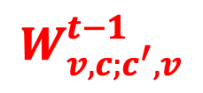



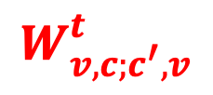










BP as a Neural Network
$$W_{v,c;c^{′},v}^{t}$$
Input layer
$$W_{v,c;c^{′},v}^{t−1}$$
Final layer
Error
$$l_{1}$$
$$μ_{1}$$
$${σ(μ}_{1})$$
$$l_{2}$$
$$μ_{2}$$
$${σ(μ}_{2})$$
…
…
…
…
…
…
$$l_{n}$$
$$μ_{n}$$
$${σ(μ}_{n})$$
$$m_{v→c}^{t}$$
$$m_{c→v}^{t}$$
Weights obtaining from training the NN:
Activation function at layers
$$a\left(x\right)=2 tanh^{−1}\left(e^{x}\right)$$
$$s=H^{⊥}{(σ(μ}_{v})+e)$$
$Loss=\left|sin\left(π s_{c}/2\right)\right|$.
$$a\left(x\right)=log tanh\left(x/2\right)$$
Nachmani et. al., 2016. IEEE (Allerton)
Liu, Poulin, 2019. Phys. Rev. Lett. 122, 200501

Slide 7
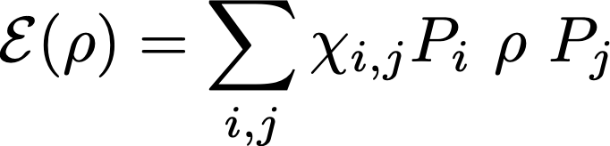

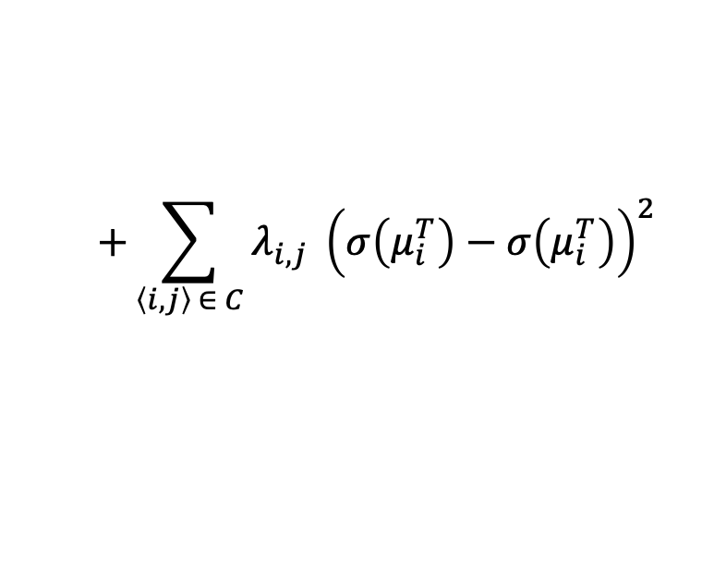

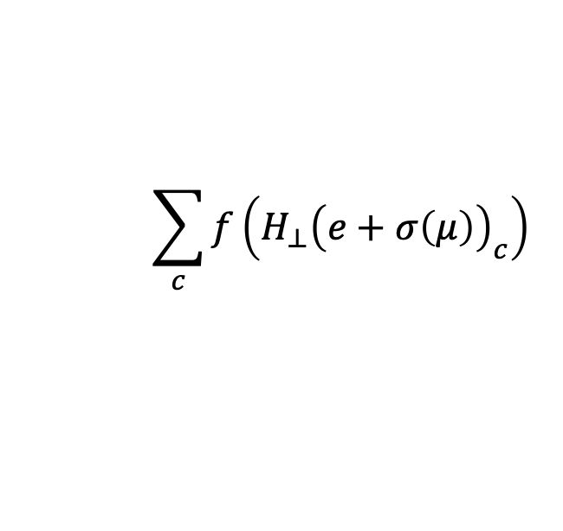


Adding CER inputs to BP
Memory noise:
Single qubit error rates
${p_{i,I}, p}_{i,X}, p_{i,Z}, p_{i,Y}$ : on each qubit
Pauli decay rates: $χ_{i,i}≥0$
Two-qubit error rates
Two-qubit correlations: spatial cross-talk, frequency coupling (imperfect two-qubit gates)
${p_{ij,II}, p}_{i,XX}, …, p_{ZZ}$ : on qubit pairs
Weights in Neural BP: ${ W}_{v,c;c^{′},v}^{t}$ and $b_{v}$ : minimize Loss per sample
$$\sum_{c}{f\left(H_{⊥}{\left(e+σ\left(μ\right)\right)}_{c}\right)}$$
$$+\sum_{\left\langle i,j\right\rangle ∈ C}{λ_{i,j}} {\left(σ\left(μ_{i}^{T}\right)−σ\left(μ_{i}^{T}\right)\right)}^{2}$$
Penalize configurations where error
occurs on qubit $i$ and no error on $j$.
Fazio et al 2026. Phys. Rev. X 16, 011030
Harper and Flammia, 2023 . PRXQuantum.4.040311
Connectivity graph (hardware)
From CER

Slide 8
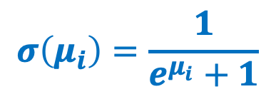
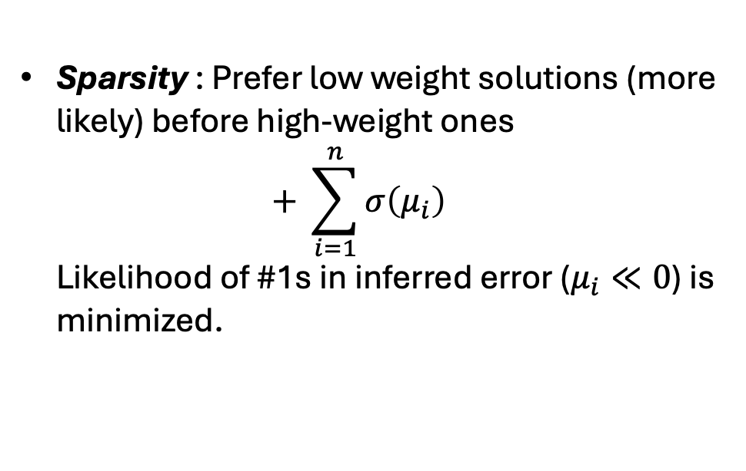
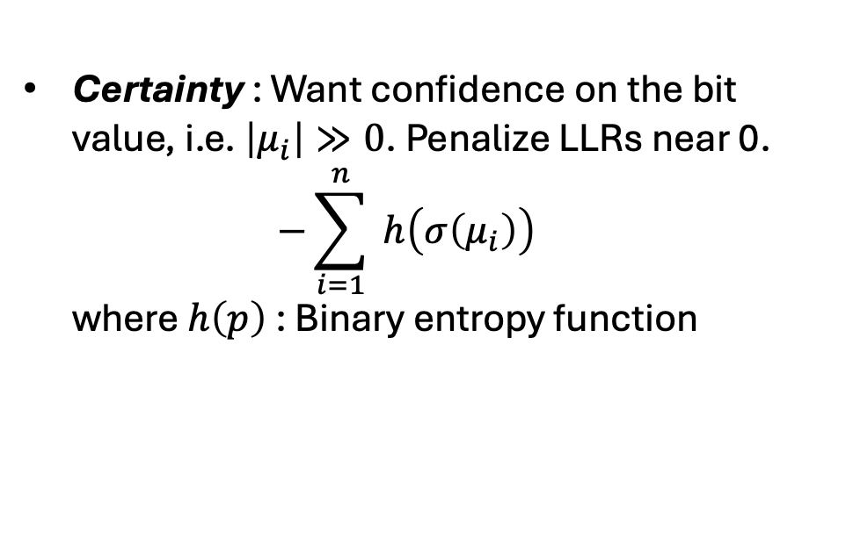
Other additions to Loss
We added two more considerations to the Loss function to encourage
Certainty : Want confidence on the bit value, i.e. $\left|μ_{i}\right|≫0$. Penalize LLRs near 0. $−\sum_{i=1}^{n}{ h\left(σ\left(μ_{i}\right)\right)}$ where $h\left(p\right)$ : Binary entropy function
Final layer
Error
$$μ_{1}$$
$${σ(μ}_{1})$$
$$μ_{2}$$
$${σ(μ}_{2})$$
…
…
…
Sparsity : Prefer low weight solutions (more likely) before high-weight ones $+ \sum_{i=1}^{n}{σ\left(μ_{i}\right)}$ Likelihood of #1s in inferred error ($μ_{i}≪0$) is minimized.
$$μ_{n}$$
$${σ(μ}_{n})$$
$$σ\left(μ_{i}\right)=\frac{1}{e^{μ_{i}}+1}$$

Slide 9


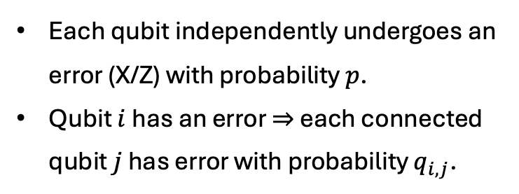











Numerical Results
Neural BP decoder vs. BP-OSD decoder for correlated error models. (Monte Carlo)
Error model: Ballistic Error Model
Each qubit independently undergoes an error (X/Z) with probability $p$.
Qubit $i$ has an error $⇒$ each connected qubit $j$ has error with probability $q_{i,j}$.
Training NN with
100 layers
CER marginals
${10}^{3}$ samples
Testing with
${10}^{5}$ samples
$10X$ gain.
$$q_{1,3}$$
$$3$$
$$5$$
$$7$$
…
$$1$$
$$q_{1,2}$$
$$q_{3,4}$$
…
…
$$2$$
$$q_{2,4}$$
$$4$$
$$6$$
$$8$$
CER provides two qubit marginals
Nickerson and Brown, 2019, Quantum
Code: HGP of Hamming Codes: [[58,16,9]]
Roffe et. al. Phys. Rev. Research 2, 043423, 2020

Slide 10





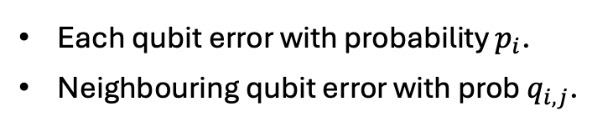









Numerical Results
Neural BP decoder vs. BP-OSD decoder for Ballistic error model (gain for each sample)
Error model: Ballistic Error Model
Each qubit error with probability $p_{i}$.
Neighbouring qubit error with prob $q_{i,j}$.
$$q_{1,3}$$
$$3$$
$$5$$
$$7$$
…
$$1$$
$$q_{1,2}$$
$$q_{3,4}$$
…
…
$$2$$
$$q_{2,4}$$
$$4$$
$$6$$
$$8$$
Sample $p_{i}$ and $q_{i,j}$ from Gaussian $𝒩(q,0.1)$.
Bicycle Bivariate codes: $[\left[72,10,6\right]]$ .
https://www.nature.com/articles/s41586-024-07107-7
Typically ~30x gains over state of the art

Slide 11

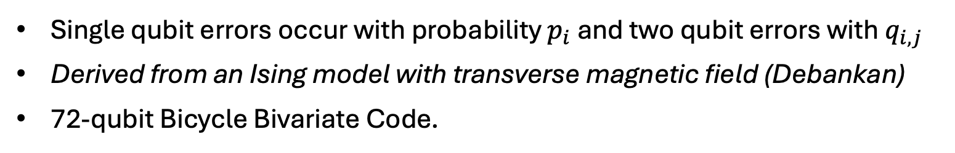
Modelling cross-talk
Single qubit errors occur with probability $p_{i}$ and two qubit errors with $q_{i,j}$
Derived from an Ising model with transverse magnetic field (Debankan)
72-qubit Bicycle Bivariate Code.
$$q_{1,3}$$
$$3$$
$$5$$
$$7$$
…
$$1$$
$$q_{1,2}$$
$$q_{3,4}$$
…
…
$$2$$
$$q_{2,4}$$
$$4$$
$$6$$
$$8$$
$p_{i}∼N\left(μ_{p},σ_{p}\right)$, $q_{i,j}∼N\left(μ_{q},σ_{q}\right)$
Small training instance: 100-layer Neural Network

Slide 12
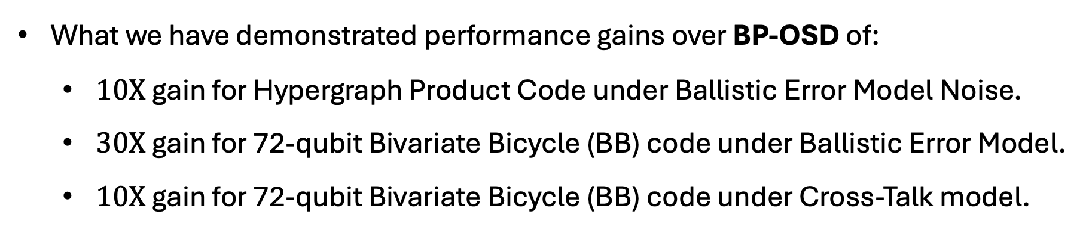
Conclusions and future work
What we have demonstrated performance gains over BP-OSD of:
$10X$ gain for Hypergraph Product Code under Ballistic Error Model Noise.
$30X$ gain for 72-qubit Bivariate Bicycle (BB) code under Ballistic Error Model.
$10X$ gain for 72-qubit Bivariate Bicycle (BB) code under Cross-Talk model.
https://github.com/paviudes/CorrelatedBPDecoderWithCER
We are currently trying to demonstrate performance gains with:
A larger code in a family: 90-qubit BB code or 288 qubit HGP.
Trying to show numerical evidence for a threshold (better than BP-OSD)

Slide 13
Supplementary Slides

Slide 15
Hypergraph Product Codes
Combine two classical binary linear codes to obtain a quantum code

Slide 16
























Hypergraph Product Codes
Combine two classical binary linear codes to obtain a quantum code
$$v_{1}$$
$$c_{1}$$
$$v_{2}$$
$$v_{3}$$
$$c_{2}$$
$$v_{4}$$
$$c_{1}$$
$$c_{2}$$
$$v_{1}$$
$$v_{2}$$
$$v_{3}$$
$$v_{4}$$
$$v_{1}$$
$$c_{1}$$
$$v_{2}$$
$$v_{3}$$
$$c_{2}$$
$$v_{4}$$
$$c_{1}$$
$$c_{2}$$
$$v_{1}$$
$$v_{2}$$
$$v_{3}$$
$$v_{4}$$

Slide 17






























Hypergraph Product Codes
Combine two classical binary linear codes to obtain a quantum code
$$v_{1}$$
$$c_{1}$$
$$v_{2}$$
$$v_{3}$$
$$c_{2}$$
$$v_{4}$$
$$c_{1}$$
$$v_{1}$$
$$c_{1}$$
$$v_{2}$$
$$v_{3}$$
$$c_{2}$$
$$v_{4}$$
$$c_{2}$$
$$v_{1}$$
$$v_{2}$$
$$v_{3}$$
$$v_{4}$$
$$c_{2}$$
$$v_{4}$$
$$v_{1}$$
$$c_{1}$$
$$v_{2}$$
$$v_{3}$$
$$v_{1}$$
$$c_{1}$$
$$v_{2}$$
$$v_{3}$$
$$c_{2}$$
$$v_{4}$$
$$c_{1}$$
$$c_{2}$$
$$v_{1}$$
$$c_{1}$$
$$v_{2}$$
$$v_{3}$$
$$c_{2}$$
$$v_{4}$$
$$v_{1}$$
$$c_{1}$$
$$v_{2}$$
$$v_{3}$$
$$c_{2}$$
$$v_{4}$$
$$v_{1}$$
$$v_{2}$$
$$v_{3}$$
$$v_{4}$$
$$v_{1}$$
$$c_{1}$$
$$v_{2}$$
$$v_{3}$$
$$c_{2}$$
$$v_{4}$$

Slide 18
Hypergraph Product Codes
Combine two classical binary linear codes to obtain a quantum code
$$v_{1}$$
$$c_{1}$$
$$v_{2}$$
$$v_{3}$$
$$c_{2}$$
$$v_{4}$$
$$v_{4}$$
$$c_{1}$$
$$v_{1}$$
$$c_{1}$$
$$v_{2}$$
$$v_{3}$$
$$c_{2}$$
$$v_{4}$$
$$c_{2}$$
$$c_{2}$$
$$v_{1}$$
$$v_{2}$$
$$v_{3}$$
$$v_{4}$$
$$c_{2}$$
$$v_{4}$$
$$v_{3}$$
$$v_{1}$$
$$c_{1}$$
$$v_{2}$$
$$v_{3}$$
$$c_{1}$$
$$c_{2}$$
$$v_{2}$$
$$v_{1}$$
$$c_{1}$$
$$v_{2}$$
$$v_{3}$$
$$c_{2}$$
$$v_{4}$$
$$c_{1}$$
$$v_{1}$$
$$c_{1}$$
$$v_{2}$$
$$v_{3}$$
$$c_{2}$$
$$v_{4}$$
$$v_{1}$$
$$v_{2}$$
$$v_{3}$$
$$v_{4}$$
$$v_{1}$$
$$c_{1}$$
$$v_{2}$$
$$v_{3}$$
$$c_{2}$$
$$v_{4}$$
$$v_{1}$$

Slide 19
Hypergraph Product Codes
Combine two classical binary linear codes to obtain a quantum code
$$v_{1}$$
$$c_{1}$$
$$v_{2}$$
$$v_{3}$$
$$c_{2}$$
$$v_{4}$$
$$v_{4}$$
$$c_{1}$$
$$v_{1}$$
$$c_{1}$$
$$v_{2}$$
$$v_{3}$$
$$c_{2}$$
$$v_{4}$$
$$c_{2}$$
$$c_{2}$$
$$v_{1}$$
$$v_{2}$$
$$v_{3}$$
$$v_{4}$$
$$c_{2}$$
$$v_{4}$$
$$v_{3}$$
$$v_{1}$$
$$c_{1}$$
$$v_{2}$$
$$v_{3}$$
$$c_{1}$$
$$c_{2}$$
$$v_{2}$$
$$v_{1}$$
$$c_{1}$$
$$v_{2}$$
$$v_{3}$$
$$c_{2}$$
$$v_{4}$$
$$c_{1}$$
$$v_{1}$$
$$c_{1}$$
$$v_{2}$$
$$v_{3}$$
$$c_{2}$$
$$v_{4}$$
$$v_{1}$$
$$v_{2}$$
$$v_{3}$$
$$v_{4}$$
$$v_{1}$$
$$c_{1}$$
$$v_{2}$$
$$v_{3}$$
$$c_{2}$$
$$v_{4}$$
$$v_{1}$$

Slide 20


Hypergraph Product Codes
Hypergraph product (quantum) code: $\left(n,k\right)×\left(n,k\right)↦[\left[n_{1}n_{2}, k_{1}k_{2}\right]]$
and
qubits
$$c_{1}$$
$$v_{2}$$
$$v_{3}$$
$$c_{2}$$
$$v_{4}$$
$$v_{1}$$
and
Stabilizer
Generators
$$v_{1}$$
$$c_{1}$$
$$v_{2}$$
$$v_{3}$$
$$c_{2}$$
$$v_{4}$$
$$v_{1}$$
$$c_{1}$$
$$v_{2}$$
$$v_{3}$$
$$c_{2}$$
$$v_{4}$$
X-type
Z-type
$$v_{1}$$
$$c_{1}$$
$$v_{2}$$
$$v_{3}$$
$$c_{2}$$
$$v_{4}$$
$$v_{1}$$
$$c_{1}$$
$$v_{2}$$
$$v_{3}$$
$$c_{2}$$
$$v_{4}$$
$H$ : ($m × n)$ parity check matrix
# physical qubits: $n^{2}+m^{2}$ , # logical qubits: $k^{2}$
$$v_{1}$$
$$c_{1}$$
$$v_{2}$$
$$v_{3}$$
$$c_{2}$$
$$v_{4}$$

