Slide 1
Project DSB2: Text Analysis and Stock Price Response
An Investigation into M&A Announcements
Pavle Savkovic

Slide 2
Hypothesis
• Complex language in M&A announcements might indicate attempts to mask issues or oversell the deal by “overcompensating” using complex language that’s hard to understand
• Shorter, straightforward announcements might reflect confidence and transparency.
• Length and complexity could influence market responses on merger announcements.

Slide 3
Data Collection and Preprocessing
• Data Sources:
- M&A announcements
- Stock price data from Refinitiv Eikon.
• Preprocessing Steps:
- Selected US-based financial companies (filter by industry code and country)
- Filtered announcements older than 10 years.
- Excluded companies with limited trading history.

Slide 4
Stock Price Data Treatment
• Key Steps:
- Return Index (RI): Basis for returns calculation.
- Logarithmic Returns:
r_t = ln(P_t / P_{t-1}).
- Estimation Window: 110 days before to 10 days before the announcement.
- Event Window: Day of announcement to 5 days after.

Slide 5
Abnormal and Cumulative Abnormal Returns
• Abnormal Returns (AR):
AR = r - r̂
• Cumulative Abnormal Returns (CAR):
CAR = Σ AR
• Purpose: Assess stock price reaction around the event window.

Slide 6
Text Features
• Text Length:
- Word count.
• Text Complexity Metrics:
- Flesch-Kincaid Grade Level – score that estimates the U.S. school grade level required to understand the text.
- Flesch Reading Ease (inverted) – readability score that indicates how easy the text is to read.
- Average Syllables per Word.
• Final Complexity Measure:
- Normalized and averaged these metrics.

Slide 7
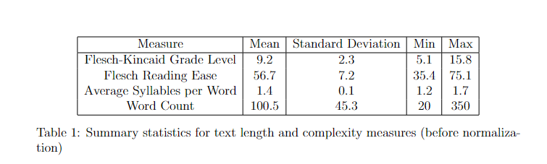
Descriptive Statistics
• Summary Table for Text Features:
| Measure | Mean | Std Dev | Min | Max |
|---------|------|---------|-----|-----|
| Flesch-Kincaid Grade Level | 9.2 | 2.3 | 5.1 | 15.8 |
| Flesch Reading Ease | 56.7 | 7.2 | 35.4 | 75.1 |
• Complexity Measure(before normalization):
Mean = 0.647
Std Dev = 0.053.
Min = 0.3512
Max = 0.915

Slide 8
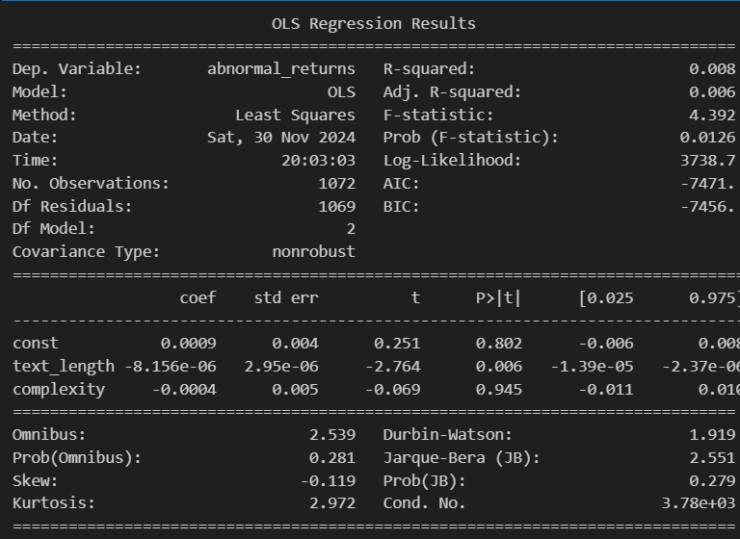
Regression Analysis
Results:
Text Length:
Coefficient: 0.0000 08
p-value: 0.006
Complexity Measure:
Coefficient: -0.0004
p-value: 0.945
R-Squared: 0.008

Slide 9
Key Observations
• Text Length:
- Statistically significant but negligible effect size.
• Text Complexity:
- Not a significant predictor of stock price response.
• Collinearity:
- Low VIF (1.145), no multicollinearity concerns.

Slide 10
Conclusion
• Main Findings:
- Complexity does not influence stock price responses in a meaningful way.
- Text length has negligible but statistically significant impact on stock price reactions.
• Future Directions:
- Explore additional text-based features.
- Utilize advanced machine learning models for deeper insights(random forest)

Slide 11
Questions?
• Thank you for your attention!

