Slide 1


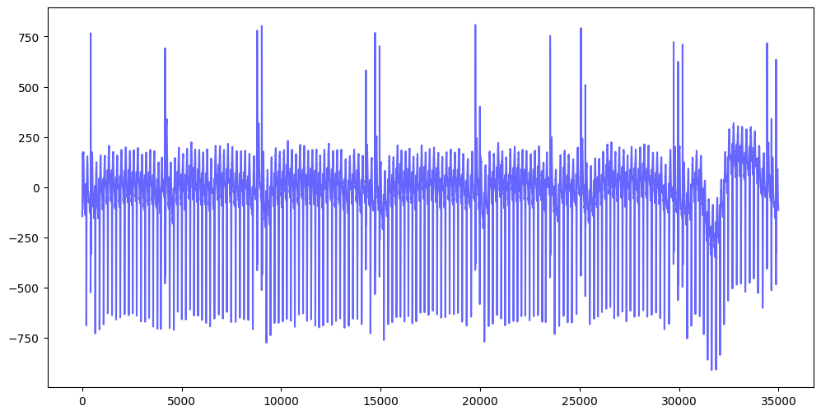

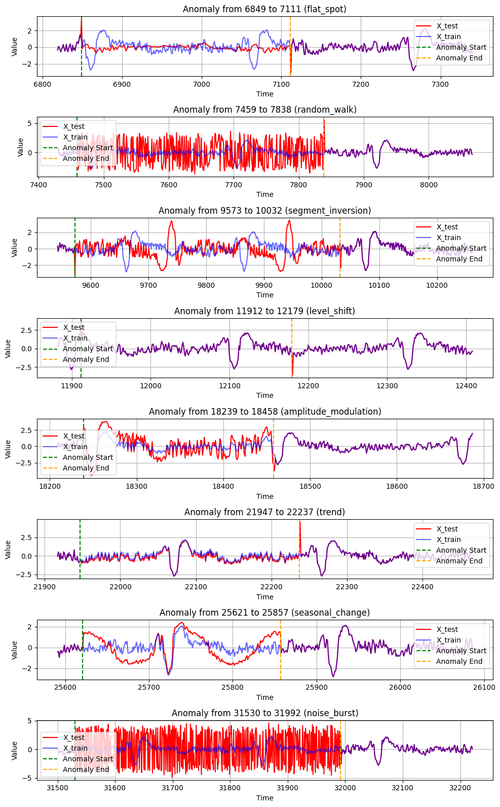
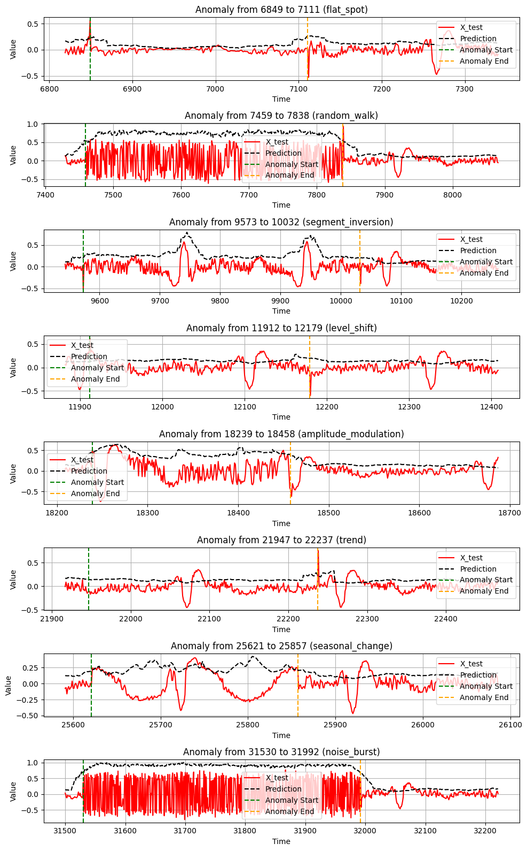
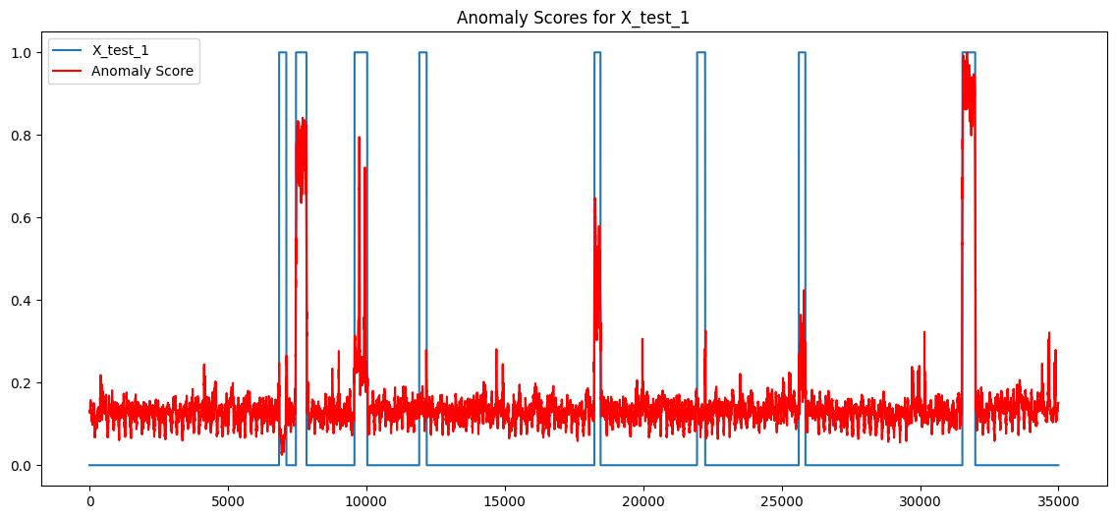
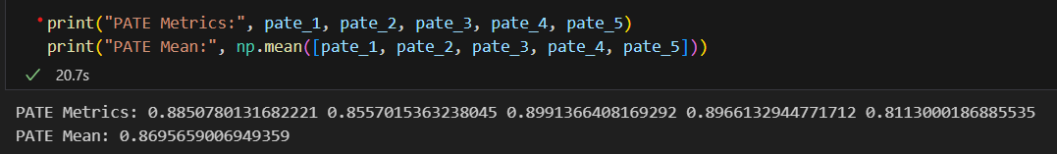
Time series is like a box of anomalies, you never know where they‘re gonna spike
¹Some Institute ²Another Institute
Houston, we have a pattern
Say PATE one more time, I dare you, I double dare you
.
Anomaly type | Does the model predict correctly?
Flat spot | Never
Random walk | Always
Segment inversion | Often
Level shift | Sometimes
Amplitude modulation | Often
Added trend | Never
Noise burst | Always
Scenario | Model performance
Shorter group anomalies <100 | Consistently high scores
Longer group anomalies >500 | High scores but not as consistent
Not aligned data | Consistent but slightly lower score
Train dataset
Preprocessing, where we‘re going we don‘t need preprocessing
Creating artificial test datasets
Making data stationary
Fitting a model
Forecasting anomaly scores
Graph, graph on the plot, what‘s the insight we have got?
X_train and X_test after preprocessing X_test and anomaly predictions
1. The stuff that artificial test datasets are made of
Function in Python to create 5 different test datasets.
Copying the train dataset
Insert different types of group anomalies of varying length
Shifting the dataset so it's not aligned with our train dataset
Saving the true anomaly labels as well as the true shift for evaluation
2. Look how they massacred my X_train
Align test data
Used scipy.correlate to calculate lag
Shift the test dataset to align with the train dataset
Average season
Calculate using disjoint window to capture seasonal patterns
Detrending
Applied first order differencing ∇1 [x](t) = xt − xt−1 (pad with 0)
Seasonal Adjustment
Extend average season across the full length and subtract it
Robust scaling followed by log normalization
3. We‘re gonna need a bigger model
GRU Autoencoder Architecture
4 GRU layers [64, 32, 32, 64]
Regularization
Dropout, batch normalization, learning rate reduction
Cross validation
Improves generalization
Anomaly detection
Calculates reconstruction errors
Window-based sequences and log normalization
Loss plot
It‘s not about the scores,
it‘s about understanding the message
Conclusion
4. Hasta la vista, anomalies
Preprocessing is important
Different models requires different approach
Deseasoning is not trivial
Aligning datasets was successful, average error over 5000 datasets: 2.37
Visualization helps us understand the process better
Baselines are hard to beat
Thresholds were not effective in increasing PATE score
Reconstruction error
Taking the mean absolute error of our reconstructions
Shift edges
Reshift the dataset so it matches the original
Normalization
Log normalization proved to be the best
Thresholds
Experimenting with setting thresholds
{Forrest Gump, Apollo 13, Back to the Future, The Maltese Falcon, The Godfather, Jaws, Terminator 2, Pulp Fiction, Snow White, The Dark Knight}
Konstantin Benischke
Knowledge Discovery and Data Mining 2
Pavle Savkovic
Notes:
I would also got for, “Discuss or discuss not, there is no try”

