Slide 1


Beyond the Speech:
Context-Aware Topic Labelling and
Linguistic Style in Parliamentary Debates
Pavle Savković
Master's Defense · 12 March 2026 · Computational Social Systems, University of Graz
Supervisor: Assoc.Prof. Dipl.-Ing. Dr.techn. Denis Helić
Co-Supervisor: Univ.-Prof. Dipl.-Wirt.-Inf. Dr. Stefan Thalmann
1
Beyond the Speech | Master's Defense | Pavle Savkovic | 12 Mar 2026
Notes:
Good afternoon. Welcome to my I’m master's thesis examination. The tile of my thesis is: Beyond the Speech: Context-Aware Topic Labelling and Linguistic Style in Parliamentary Debates. What is said in parliaments is of importance for every one of us. Biggest decisions are made there that have real life impact.
When politicians speak in parliament, they're not giving independent monologues, they're having a conversation. What the person before you says influences what you say, and what you say shapes what the person after you will say. Context is important.
Yet most computational tools treat each speech as if it exists in a vacuum. My thesis is about fixing that and after examining what kind of language politicians actually use.

Slide 2
Motivation
CAP = Comparative Agendas Project (21 policy domains, enabling cross-country comparison).
Speaker | Text | ParlaCAP topic | Our topic
Rudd, Amber | Our Energy Bill receives Royal Assent today. It is a vital part of our plan to ensure that families and businesses have access to secure, clean and affordable energy. We are delivering on our manifesto commitment to end subsidies for onshore wind. | Energy | Energy
Abrahams, Deborah | Evidence shows that sick and disabled people are at particular risk of fuel poverty, especially after the recent social security cuts by this Government. Will the Secretary of State look at better targeting of warm home discount funding? | Social Welfare | Energy
Tomlinson-Mynors, M. | I have been contacted by constituents concerned about fracking in Dorset. What reassurance can the Minister give about environmental considerations, public consultation, and ensuring fracking is considered only in appropriate locations? | Environment | Energy
2
Beyond the Speech | Master's Defense | Pavle Savkovic | 12 Mar 2026
Notes:
Let me show you the problem with a concrete example.
These are three real speeches from the British parliament. The first speaker is a minister announcing the energy bill, second speaker talks about risks of fuel poverty and prices of home warming, while 3rd talking about environmental considerations about fracking.
Any human in that room would say: this is all one discussion about the Energy Bill. But a standard topic labeler, reading each speech in isolation, gives three different answers: Energy, Social Welfare, Environment. The algorithm keeps changing its mind because it has no memory of what came before.
The fix is simple in principle: identify natural debate chunks or agendas, what I call episodes, and then assign a topic to the entire episode.
I want to explain one term I'll use throughout: CAP, the Comparative Agendas Project. We can see it columns 3 and 4. It's a standard classification system used across more than 50 countries that groups political topics into 21 broad categories: Health, Defense, Macroeconomics, Education, Foreign Policy, and so on. Using CAP means that "macroeconomics debate" in Austria and "macroeconomics debate" in Britain refer to exactly the same category, which is what makes cross-country comparison possible.

Slide 3
Research Questions
How does policy topic shape linguistic style?
1
Do institutional roles and demographics produce systematic style differences?
2
How do external shocks affect agenda attention and rhetoric?
3
3
Beyond the Speech | Master's Defense | Pavle Savkovic | 12 Mar 2026
Notes:
My thesis has three main questions.
First: does the topic being debated shape how politicians speak? Do Macroeconomics debates sound different from healthcare debates and what can we find out about language used?
Second: does your institutional role, if you’re in the government or the opposition, or your ideology, your position on left-right political spectrum change how you speak? What about demographic factors like age or gender?
Third: when a major external shock hits a pandemic, a migration crisis, a war, a financial collapse does it change what parliament talks about and how? And do things eventually return to normal and if yes how long does it take?

Slide 4
Dataset
Country | Period | Sitting Days | Speeches
Austria (AT) | 1996–2022 | 1,221 | 231,759
Croatia (HR) | 2003–2022 | 1,708 | 504,338
Great Britain (GB) | 2015–2022 | 2,209 | 670,912
Total | — | 4,627 | 1,407,009
4
Beyond the Speech | Master's Defense | Pavle Savkovic | 12 Mar 2026
Notes:
The data comes from ParlaMint, a project that has transcribed parliamentary debates from 29 European countries in their native languages, corpora containing more than a billion words over decades even a century worth of data for some countries .
I work with three countries: Austria, Croatia, and Great Britain, roughly 1.4 million speeches across 4,600 sitting days, spanning several decades.
Great Britain has the most speeches despite the shortest time window. That reflects how British parliament meets almost daily, compared to Austria's weekly sessions.
Idea behind selecting multiple countries is that finding the same patterns across all three is much stronger evidence than finding them in just one place and that our method is actually robust.

Slide 5
Method Overview
5
Beyond the Speech | Master's Defense | Pavle Savkovic | 12 Mar 2026
Notes:
The system works in two parallel tracks.
The top track is about assigning topics. We take the speeches, group them into coherent debate episodes, figure out what each episode is about, and assign it a CAP label.
The bottom track is about language style. For each speech, we run it through LIWC-22, the Linguistic Inquiry and Word Count tool. Let me explain what that means, because it comes up throughout the presentation.
LIWC is essentially a sophisticated word counter. You give it a text and it tells you what proportion of words fall into more than 100 psychological and linguistic categories. It helps us answer questions like: Is the language more analytical or is it more authentic and appeal to the emotional side? How often does the speaker say "we" versus "I"? How much certainty or tentative language? LIWC has been cited and used by thousands of research papers and is a very prominent tool in analyzing speech.
So now we have our two tracks working independently and then at the end we combine them. With stable topics and LIWC scores for every speech, we can ask and answer questions like: what does macroeconomics talk sound like linguistically? What does opposition rhetoric look like? How did language shift during COVID?

Slide 6
Segmentation
How a sitting gets segmented
BOUNDARY
BOUNDARY
S1
S2
S3
S4
S5
S6
S7
S8
S9
S10
S11
S12
Episode A
(e.g. Energy)
Episode B
(e.g. Environment)
Episode C
(e.g. Social Support)
Boundary Signals
Intuition
Semantic similarity drops (cosine between sliding windows; k auto-optimised per country)
Chairperson agenda cues (language-specific)
Agenda changes can be announced (chair cue) OR gradual (semantic drift), we capture both.
Fusing procedural markers + semantic cohesion gives robust episode boundaries.
Output: coherent episodes, the right unit for clustering and time-series aggregation.
6
Beyond the Speech | Master's Defense | Pavle Savkovic | 12 Mar 2026
Notes:
The key challenge is: how do you know where one episode ends and the next begins? Look at the diagram. S1 or speech 1 might be a minister announcing an Energy Bill(like the example from the beginning) then for the next hour people debate it back and forth. After a while, parliament moves to the next agenda item, say environmental regulations, and discusses that for another half an hour minutes, then moves on to Social Support for single parents.
Sometimes this transition is explicit the chairperson announces "we now move to the next item." That's easy to detect. Other times topics shift gradually: one fades out, another drifts in, with no formal announcement.
Our algorithm uses a hybrid signal. It watches for chairperson announcements, but also for moments where the semantic content or the meaning of consecutive speeches shifts noticeably, measured by the similarity of neighboring speech windows. For example, we look at the speeches around S5, compare lets say 3 speeches before and after using cosine similarity and when see a big change in the similarity that could be our potential boundary.
The output is a sequence of coherent episodes each a chunk of debate that stays on one consistent topic. That's what all downstream analysis is built on.

Slide 7
Topic Modelling & CAP Alignment
1
2
3
4
5
Embed
Reduce
Cluster
Keywords
Map → CAP
BAAI/bge-m3
1024-d, 8k tokens
chunk + average
UMAP
to 10 dimensions
GMM
soft cluster
assignments
c-TF-IDF
per cluster
top terms
GPT prompt
22 domains
7
Beyond the Speech | Master's Defense | Pavle Savkovic | 12 Mar 2026
Notes:
Once we have the episodes, assigning topics to them is much more reliable than doing it speech by speech.
The pipeline has five steps. First, we convert each episode into a numerical representation around 1,000 numbers that encode its meaning. The idea is that similar semantic meaning episodes would get similar numbers. Second, we compress those down to about 10 dimensions for better performance on the next steps. Third, we group similar episodes into clusters using a probabilistic method. At this step we end with between 170-200 clusters(groups of episodes with similar meaning). Fourth, we find the most unique and descriptive words in each cluster using TF-ID. Last step, we look at those keywords and assign each cluster to one of the 22 CAP categories. We end up classifying those 200ish clusters into 22 topics.
So if we take a look at one cluster and see keywords like doctor, vaccine, hospital, patient we would assign it Health label.
I decided to use LLM because of manual labor reasons and GPT speeds it up and performs just as well as I do.
The whole process is fully deterministic same input, same output, every time. This is deliberate: it means the system is auditable. You can look at the keywords, look at the prompt, and trace exactly why a cluster got labeled Health or Macroeconomics. No black box.

Slide 8
Evaluation
Our model vs. ParlaCAP and human labelers
Human annotator ceiling
the benchmark
Country | vs. ParlaCAP | vs. ParlaCAP | vs. Human Tests
 | Macro-F1 | Micro-F1 | Macro-F1
Austria (AT) | 0.55 | 0.57 | na
Great Britain (GB) | 0.47 | 0.51 | 0.43
Croatia (HR) | 0.52 | 0.56 | 0.47
α ≈ 0.60–0.68
Expert human inter-annotator agreement on the same test set.
8
Beyond the Speech | Master's Defense | Pavle Savkovic | 12 Mar 2026
Notes:
How good is the system? These numbers need careful unpacking at face value they can be misleading.
Let’s start with the human ceiling. The ParlaCAP project had expert annotators independently label the same speeches and those experts only agreed with each other 60 to 68 percent of the time. That's the practical ceiling for any automated system on this task.
But those human annotators were also reading each speech in isolation. So if you handed them the second speech from the Energy Bill debate, about sick people and fuel poverty, with no surrounding context, they would label it Social Welfare.
Now comes a question: what if those same annotators saw the full sitting in order and labeled it as a unit? I’m pretty sure they would agree far more than 60 to 68 percent of the time, because context removes ambiguity. This ceiling is on the task that's constrained to isolated speeches. It was measured under the exact same disadvantage we're trying to fix.
So when you look at our scores — macro-F1 between 0.47 and 0.55 against ParlaCAP labels, slightly lower against human tests keep those things in mind.
A fair evaluation would require episode-level gold-standard labels. Creating those is the most important next step for this line of work.

Slide 9
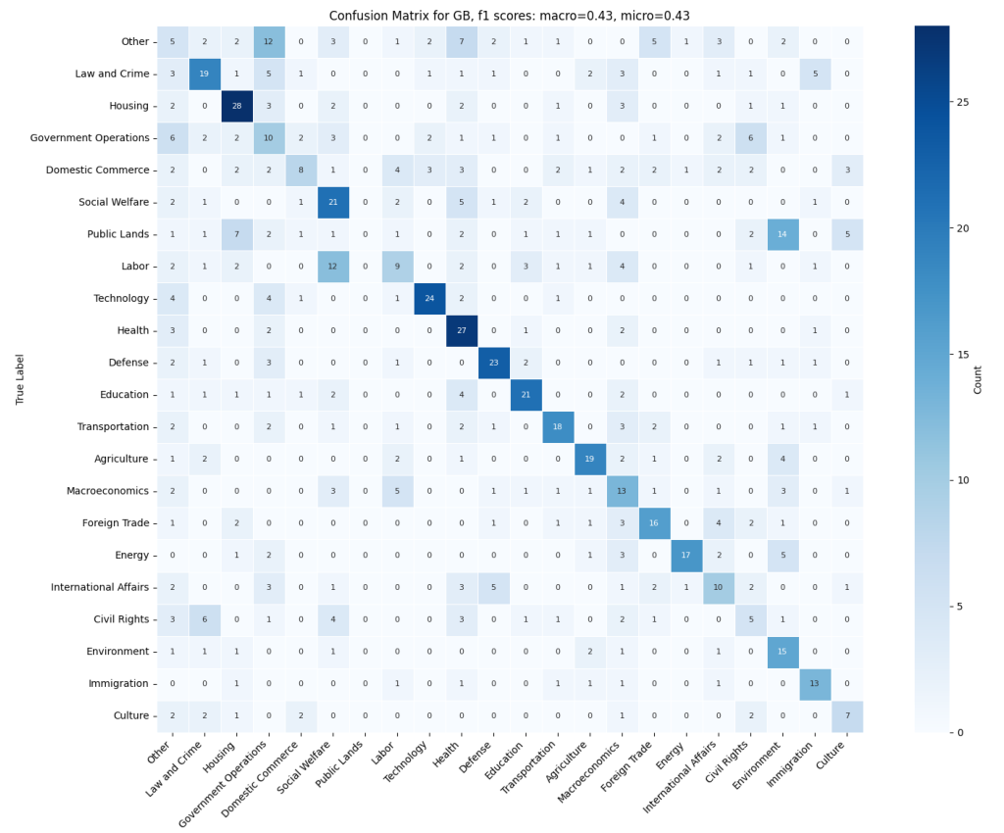
Where Do 'Errors' Happen?
Diagonal dominates
Most mass is on the diagonal, labels are on-target overall.
Semantic Neighbor confusions
Public Lands ↔ Environment
Labor ↔ Social Welfare
International Affairs ↔ Defense
Interpretation
Errors are not random, they reflect genuine boundary or mixed-issue episodes where multiple labels are plausible.
Notes:
Let's look more carefully at where the errors happen the pattern is informative.
This is a confusion matrix for British parliament. On the x axis we have topics that human experts assigned when labelling the test dataset(~500 speeches) and on the y axis we have topics as assigned by my model.
The diagonal dominates most labels are correct. But when mistakes occur, they cluster in predictable places: Public Lands gets confused with Environment, Labor with Social Welfare, International Affairs with Defense.
Those aren't random failures. They're adjacent domains, policy areas that are genuinely related and often co-occur in debates. The system isn't failing randomly, it's making the kind of mistakes a thoughtful person would make too, we’ve also seen that humans only agree around 2/3rds of the time.

Slide 10
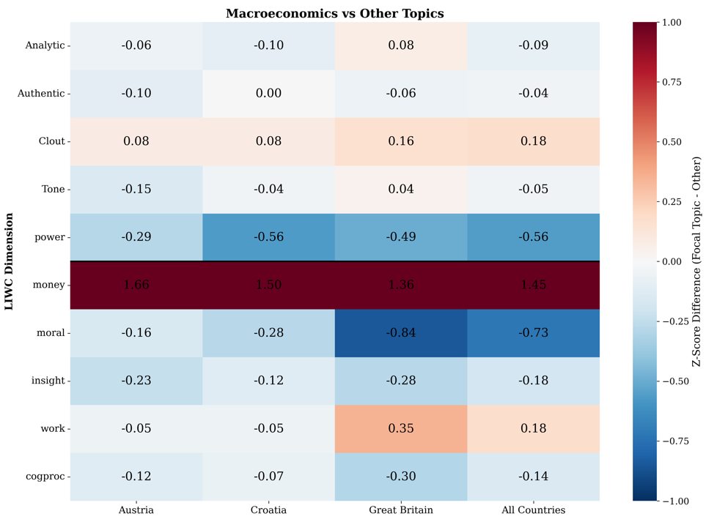
Topic Styles Are Distinctive: Macroeconomics vs Rest
Macroeconomics
money / clout ↑
moral / insight / power / cognitive processes ↓
Health
politic / power / money ↓
Tone / Analytic ↑
Each cell show
Δz = target topic − other topics
1.0 = one standard deviation higher than comparison
10
Beyond the Speech | Master's Defense | Pavle Savkovic | 12 Mar 2026
Notes:
Before reading the heatmap, let me briefly explain both the numbers and the labels. I compare the language of a target topic, here, macroeconomics to all other topics in the same country. Each cell is a standardized difference: topic minus non-topic. Positive means more of that LIWC dimension in macroeconomics; negative means less.
A reasonable question from the audience here is: what do these LIWC dimensions actually mean? As we said LIWC is a dictionary-based method that maps words into interpretable categories.
So if we see -0.73 for moral, that means speeches about macroeconomics uses substantially less moral-language vocabulary compared to the rest of the speeches. Some examples of words in a moral vocabulary are: deserve, honor, justice, right and wrong. The strongest pattern is the expected one: macroeconomics is consistently much higher on money language across countries. Seeing this was a big relief and a strong sanity check and this result being a good proof of topic labelling part of our pipeline working.
We can also see elevated clout and lower insight/power/cognitive processes.
All of the other topics were also explored. Topics differ not only in content, but also in their rhetorical style and each topic has its own unique style and rhetoric fingerprint.
I’ll also show the topic of Health that uses more positive tone more analytical language and less politic/power/money language compared to other topics.

Slide 11
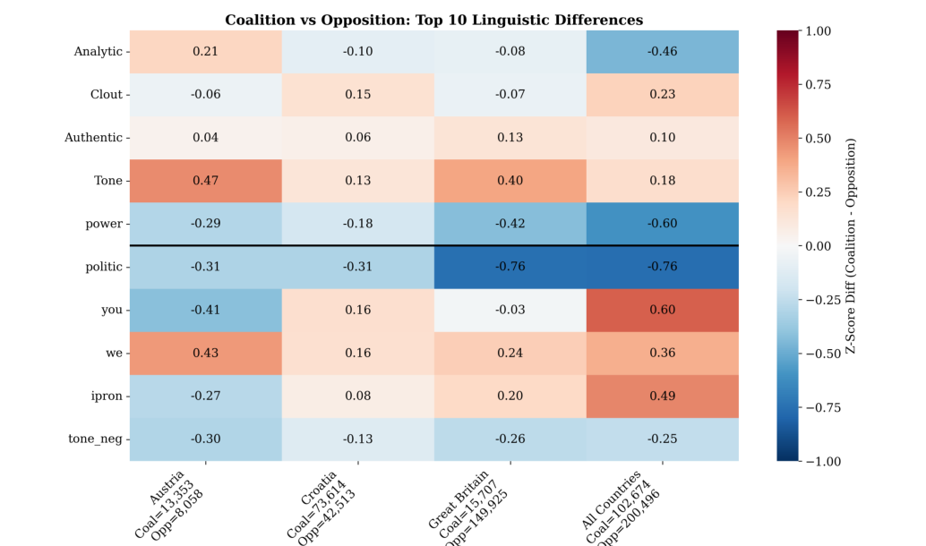
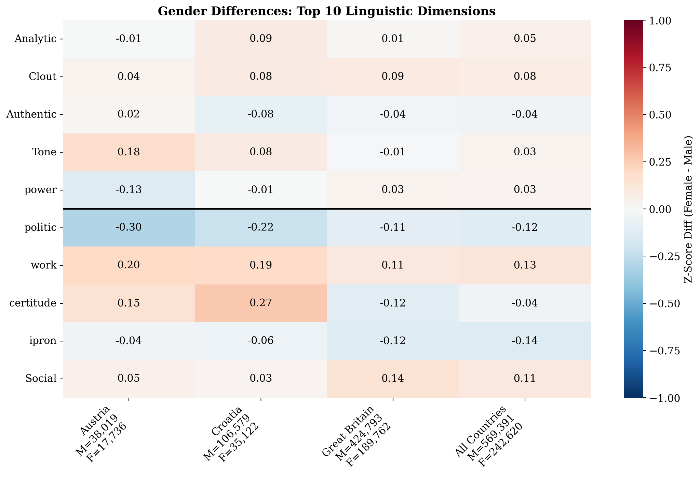
Institutional Role and Gender Shape Language Style
Coalition :
tone / authentic / we ↑
power/ politic ↓
Opposition: Inverse results
Left:
Δz = coalition − opposition
Women:
tone / clout / work/ social ↑
politic / I pronouns ↓
Men: Inverse results
Right:
Δz = women − men
11
Beyond the Speech | Master's Defense | Pavle Savkovic | 12 Mar 2026
Notes:
This slide uses the same logic, but now the comparison is between groups rather than topics. On the left, each cell shows speeches of politicians in coalition minus opposition. Here are some of the clearest effects in the thesis. Coalition speakers use positive tone, more authentic, and more collective we language. That fits their institutional position: they defend, explain, and present policy as a shared project. Opposition speakers show the inverse pattern, with relatively more politic and power language and you pronouns, which fits a more adversarial/accusing rhetorical role.
On the right, it shows female politicians minus male. Women have more positive tone and higher clout, work, and social language, while men are higher on politic and I pronoun usage.

Slide 12
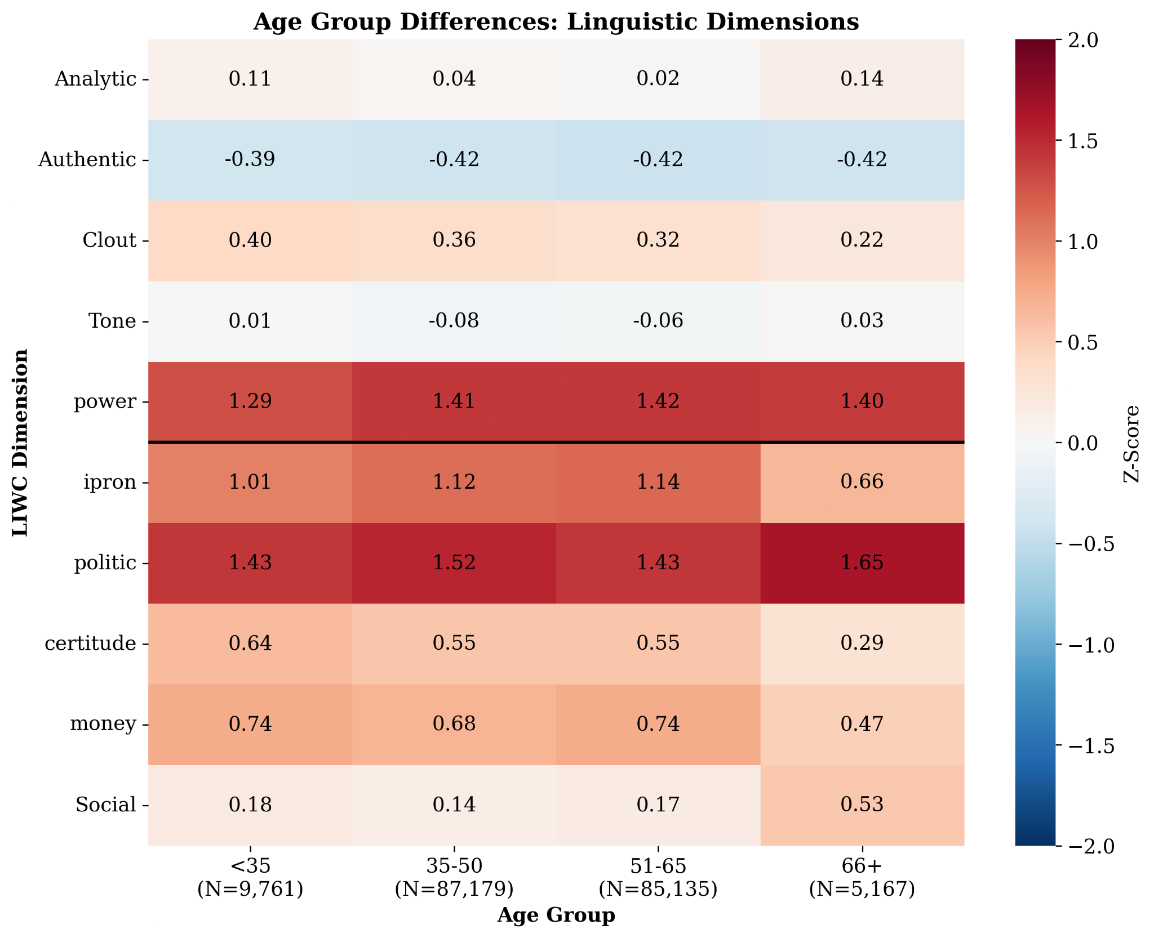
Age
All politicians sound political but age still creates a gradient
Younger politicians
(relative to older politicians):
↑ elevated
i pronouns
clout
money
certitude
↓ lower
social
power
politic
Cells show z-scores vs LIWC-22 benchmark corpus
0 = benchmark mean
±1 = one standard deviation.
12
Beyond the Speech | Master's Defense | Pavle Savkovic | 12 Mar 2026
Notes:
Here I am no longer comparing one parliamentary group to another. Instead, I compare each group to the LIWC-22 Test Kitchen benchmark corpus.
The benchmark corpus is LIWC’s large reference corpus, drawn from 15 different sources such as blogs, emails, movie dialogue, social media, news articles. It was created to provide a broad baseline of English language use across many contexts, so when I compare parliament to this benchmark, I am comparing it to a diverse external reference rather than to another parliamentary subgroup.
So the numbers here are standard z-scores relative to that benchmark.
The first broad pattern is that all age groups look clearly political: categories like power and politic are elevated across the board. In other words, regardless of age, parliamentarians do not sound like everyday language.
The second pattern is the age gradient. Younger politicians compared to older are relatively higher on more personal or self-presentational dimensions such as I pronouns, clout, money, and certitude, and lower on social, power and politic.

Slide 13
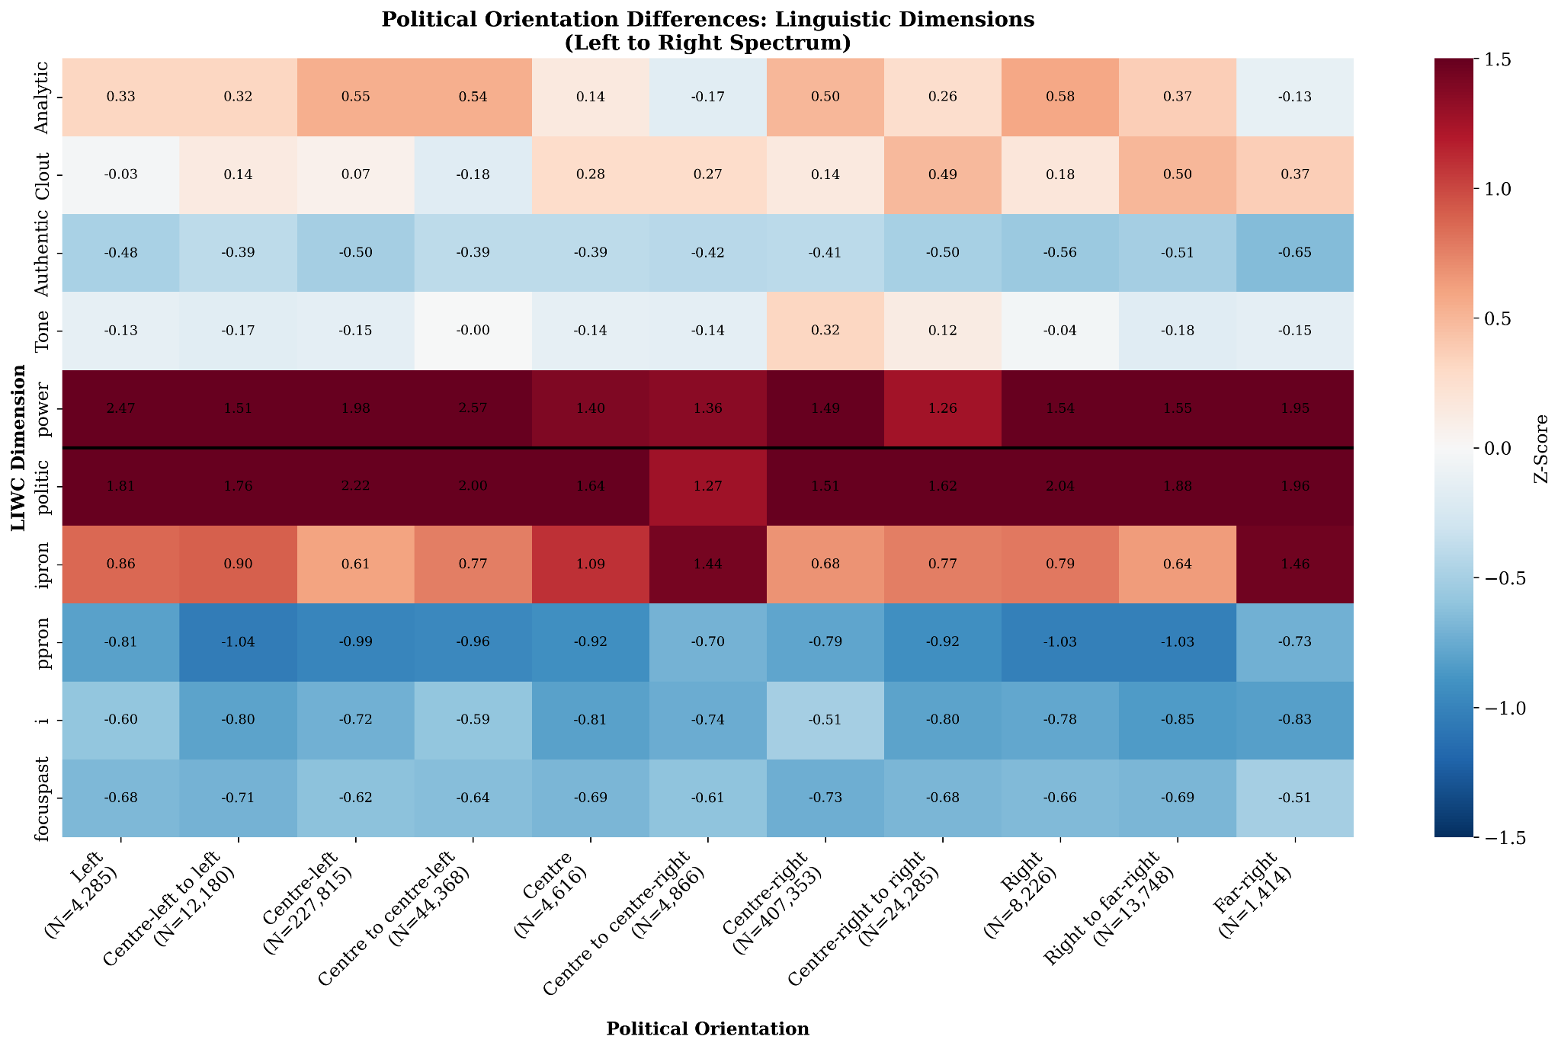
Political Left to Right Spectrum
Ideology
The surprising finding: ideology barely matters
Across the full left–right spectrum, linguistic style stays remarkably stable.
The dominant contrast is not left vs. right - it's parliamentary language vs. everyday language.
Parliament standardizes how you speak more than your ideology does
Notes:
This slide uses the same benchmark comparison as the previous one, so these are again z-scores relative to the LIWC-22 benchmark corpus.
I was quite excited about this analysis, because I expected ideology to leave a strong linguistic fingerprint. Intuitively, we might think that left-leaning and right-leaning parties should sound very different in the way they speak.
But the surprising result is how similar they look. The main contrast is not left versus right, but parliamentary language versus general language.
There are some smaller differences. But compared to topic and institutional role, ideology seems to matter much less for rhetorical style.
So the takeaway is that parliament as an institution appears to standardize language more than ideology differentiates it.

Slide 14
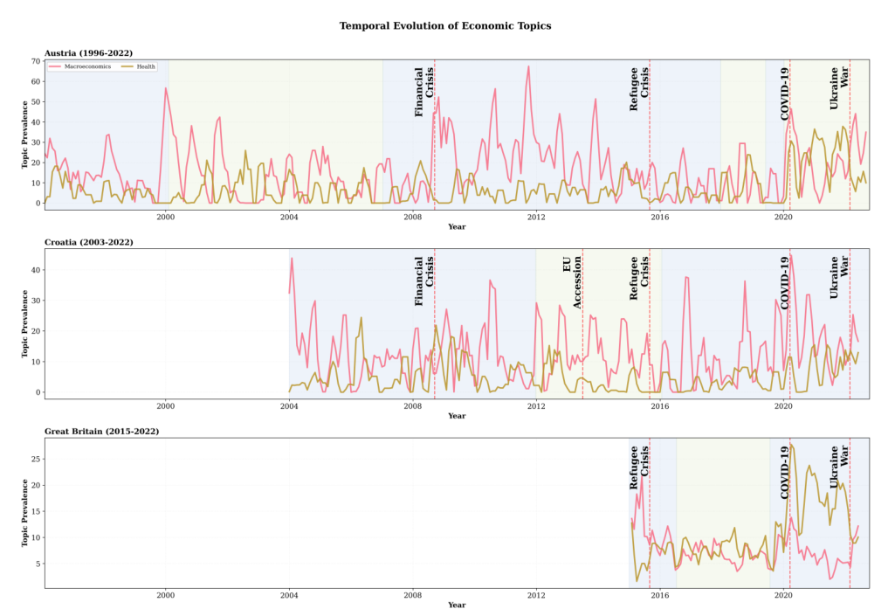
Agenda Dynamics: Crises Reallocate Attention
Red line - % of speeches about Macroeconomics
Gold line - % of speeches about Health
COVID-19 substitution
Budget-cycle rhythm
Effects revert
Health spikes sharply; Macroeconomics falls.
Macroeconomics peaks every autumn when the budget is debated, then recedes - visible in all three countries.
Both series return toward their long-run baseline post-crisis. Shocks are temporary reallocations, not structural shifts.
14
Beyond the Speech | Master's Defense | Pavle Savkovic | 12 Mar 2026
Notes:
Now let's look at how things change over time. Lines represent the % of speeches being about a certain topic.
The clearest finding: major crises temporarily reshape what parliament talks about. During COVID in 2020, health debate spiked dramatically and macroeconomic debate fell — parliament's attention shifted to the crisis. We all lived through that, and it shows up in the data exactly as you'd expect.
We also see a regular rhythmic pattern: macroeconomic debate peaks every autumn when national budgets are being debated, then recedes. This budget-cycle rhythm is visible in all three countries.
And crucially, after a crisis, parliament's topic distribution returns toward its long-run baseline. Crises are temporary disruptions to the agenda — not permanent structural shifts. That reversion only becomes visible because we're aggregating at the episode level. Speech-level analysis would be too noisy to see it.

Slide 15
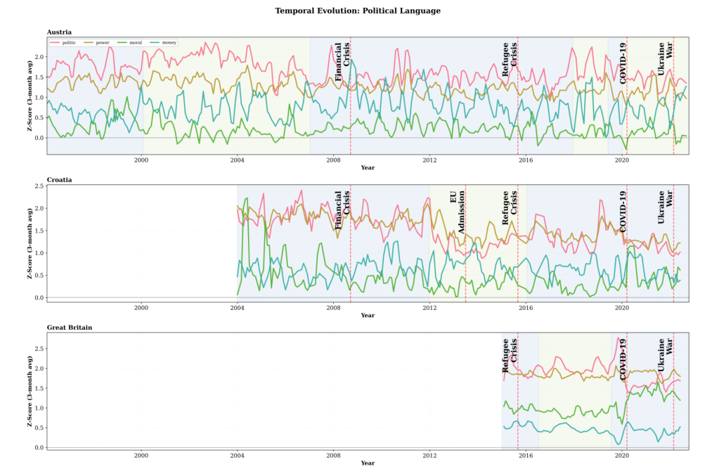
Rhetoric Follows Crises — and Mean-Reverts
red - politic gold- power
green - moral blue - money
Crisis spikes
Mean-reversion
politic language surges during migration crisis (2015), COVID-19 (2020), and the Ukraine war (2022) - across all three parliaments.
No permanent elevation: rhetoric returns to the institutional baseline once the acute crisis phase passes. Reversion rates differ by dimension (politic faster than moral).
15
Beyond the Speech | Master's Defense | Pavle Savkovic | 12 Mar 2026
Notes:
The same pattern that appeared in topic attention also shows up in how parliament speaks. Each line represents one liwc dimensions and how it changes over time.
Adversarial, politically-charged language what LIWC calls the "politic" dimension, covering words related to political conflict and power struggle spikes during major crises. The 2015 migration crisis, COVID in 2020, the Ukraine war in 2022. Across all three parliaments, roughly the same timing and direction.
But it doesn't stay elevated. Once these phases pass, rhetoric returns toward its baseline. Parliament absorbs the shock and reverts to its normal stylistic equilibrium.
Here's an important detail: different LIWC dimensions return to baseline at different speeds. Power language comes down faster than moral language. That difference in reversion speed is informative. It tells us something real about how institutions process different kinds of political pressure.

Slide 16
Conclusion
Context matters for topic labelling
Segmenting debates into agenda episodes produces more coherent topic assignments than treating speeches independently.
1
Topic and institutional role shape style most strongly
Policy domain and parliamentary role show clearer stylistic differences than ideology or demographics.
2
Crises affect both attention and rhetoric — temporarily
External shocks shift what parliaments discuss and how they speak, but both patterns largely return toward baseline.
3
Next steps
Build episode-level test labels
Extend to all 29 European parliaments available
Link rhetoric to outcomes
Test predictive models of legislative support
16
Notes:
To conclude, there are three main contributions.
First, context matters for topic labelling. Segmenting debate into agenda episodes produces more coherent topic assignments than treating speeches independently.
Second, topic and institutional role shape style most strongly. Gender, age, and ideology matter too, but their effects are generally smaller.
Third, crises affect both attention and rhetoric, but mostly temporarily. They shift what parliaments discuss and how they speak, but these shifts tend to move back toward baseline.
The main limitation is that my method works at the episode level, while most evaluation benchmarks are still speech-level. So the most important next step is to create episode-level gold labels.
After that, I see two main extensions: One is scaling the framework to all 29 European parliaments. Second would be linking rhetorical patterns to voting outcomes on certain policies. For example, an interesting next step would be to test whether certain styles of speech — such as stronger emotional framing, greater certainty, being more analytical or being more casual — are associated with higher levels of support for bills or legislative success.
That would shift the project from describing parliamentary language to asking whether rhetorical style also has predictive power.

Slide 17
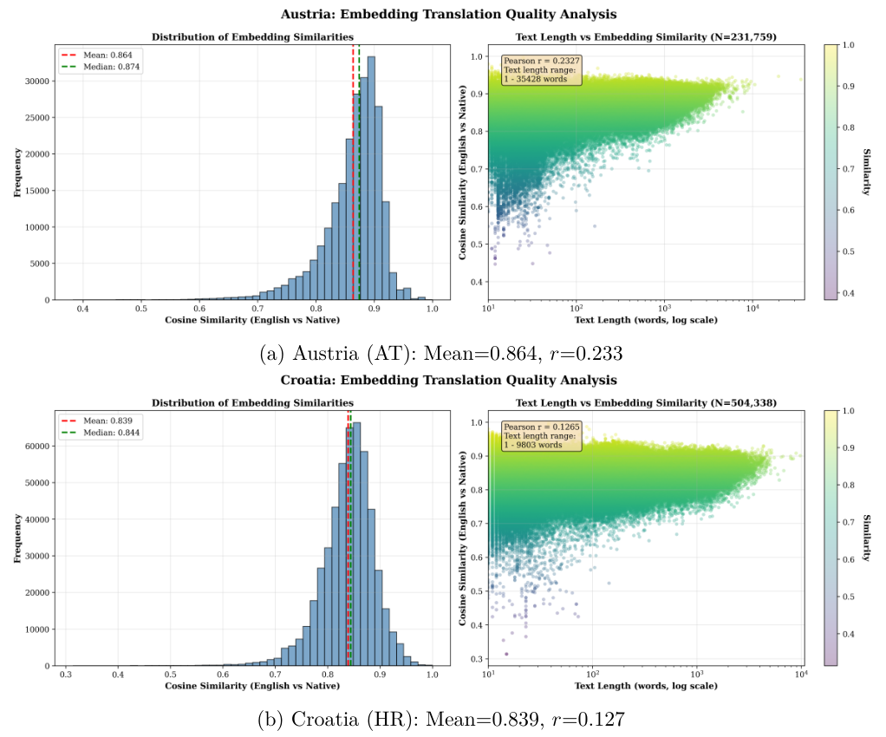
BACKUP: Cross-Lingual Embedding Consistency
Validation
Native-language vs. English MT embeddings: cosine similarity > 0.8 for the vast majority of speeches.
Mean similarity ≈ 0.86; median ≈ 0.87 (AT corpus).
Shorter speeches show more noise -- chunking + averaging handles this.
Validates the single-pipeline approach: LIWC on MT text with country-wise z-score normalisation.
B
Beyond the Speech | Master's Defense | Pavle Savkovic | 12 Mar 2026
Notes:
If the question is whether machine translation breaks the embedding space: I validated that native-language and English translation embeddings remain highly similar for the vast majority of speeches.
The mean and median similarity are around the mid-to-high 0.8 range in Austria, with more noise for very short speeches. Chunking and averaging reduces that noise.
This supports using a single pipeline across languages, and then doing LIWC on translated text with country-wise normalization.

