Slide 1
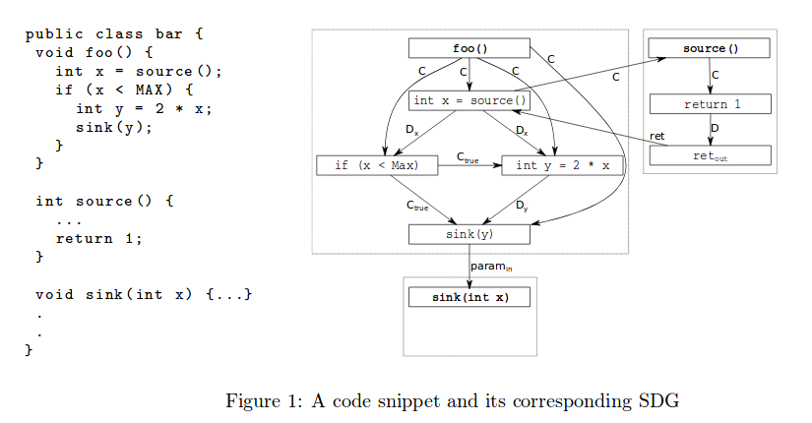
System Dependence Graphs for Java Programs
Pavlos Milaszewicz & Ito Franchilo Mikael Alcuaz

Slide 2
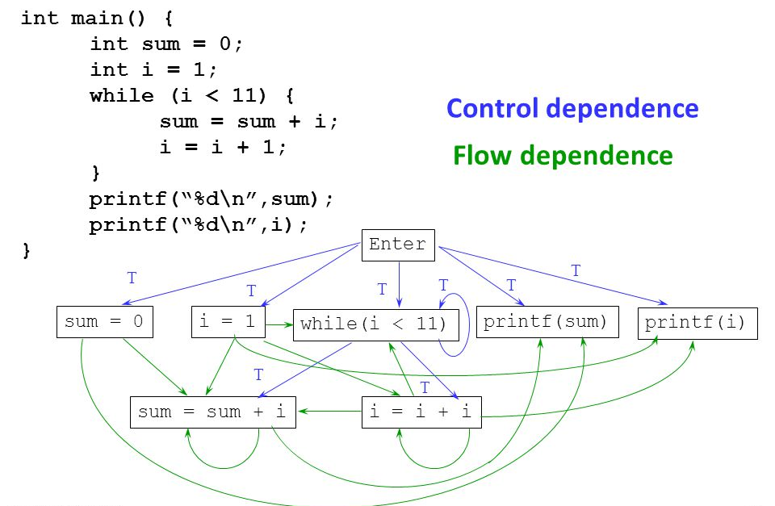
Program Dependence Graph (PDG)
Graph based representation capturing data and control flow information.
Intra-procedural.
Program slicing and optimization applications.
Built-in PDG generator via Soot.
Source: http://slideplayer.com/slide/4859950/

Slide 3
System Dependence Graph (SDG)
An extension of PDG's.
Models both inter/intra-procedural program dependencies.
Vulnerability analysis and bug finding applications.
Built-in SDG generator not currently available.

Slide 4
Project Goals
- Extend Soot PDG generation to include support for SDG’s by implementing a static analysis tool.
- Evaluate the static analysis against a set of real-world examples.
Source: Marcel & Malte

Slide 5
Soot SDG’s - Approach & Implementation
- Consider forward branched Soot flow (as opposed to backward, non branched, etc.) analysis.
- Base case: a method with no intra-function invocation(s). ←Basically a plain PDG.
- Consider how to detect one or more intra-function calls.
- Generate additional (mini) Soot PDG(s) for the intra-function call(s).
- Append extra PDG’s to the main PDG by analyzing the location of the in and out flows.

Slide 6
Overall Progress
Static analysis SDG generator ←~ 50% completed, problems encountered with poorly documented Soot API, out of date tutorials, etc.
(TODO) Test analysis against real world examples and evaluate results.
(TODO) Project report.

Slide 7
Possible Project Extensions
Consider corner cases (e.g. anonymous lambda functions, recursive calls, etc.).

Slide 8
Questions

