Slide 1
Supervised / Unsupervised Learning
Digital Signal and Image Processing Laboratory
Department of Electrical and Computer Engineering
University of Patras

Slide 2
Introduction (1)
Machine learning is a subfield of AI that uses algorithms (also known as models) in order to learn from data
In traditional programming, you hardcode all rules. In machine learning, you create models that find patterns on your data

Slide 3
Introduction (2)
There are four categories in machine learning: Supervised, unsupervised, semi-supervised and reinforcement learning;
Machine learning development process is divided by training, testing and inference phases;

Slide 4
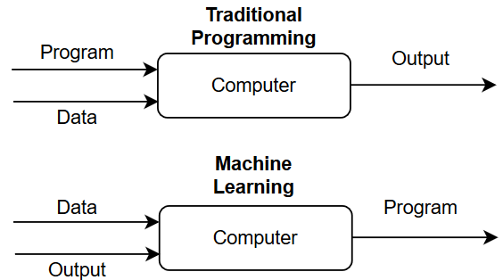
Machine Learning vs Traditional Programming
Prog.: Program = Data Structure + Algorithm
ML: Program = Data pattern + Model

Slide 5
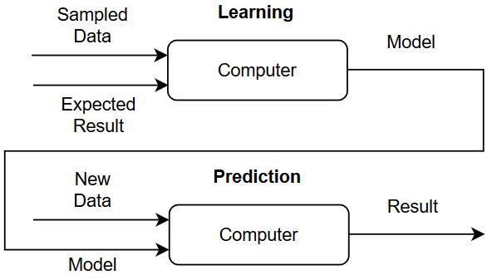
Supervised Learning
Supervision: ground-truth data —expected result. The “program” is a model
Phases: Training = Learning | Testing = Prediction

Slide 6
Supervised Learning: Types of Prediction (1)
Discrete categories: Classification
Continuous values: Regression
Linear and Logistic Regression
Logistic regression is a classification algorithm used to assign observations to a discrete set of classes.
Output transformation using the logistic sigmoid function to return a probability value which can then be mapped to two or more discrete classes.

Slide 7
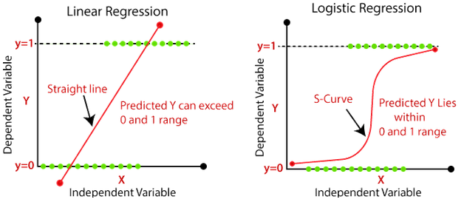
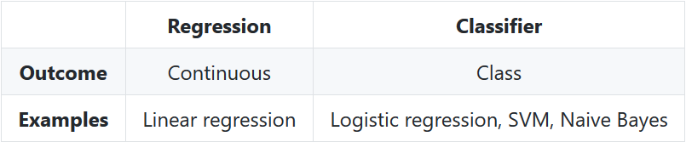
Supervised Learning: Types of Prediction (2)

Slide 8
Supervised Learning Overview (1)
System learns iteratively to predict an associated dataset from a given dataset
Iteration cycles
Update parameters: Algorithm
Make a prediction: Hypothesis
Ground-truth comparison
Calculate false answer cost: Feedback

Slide 9
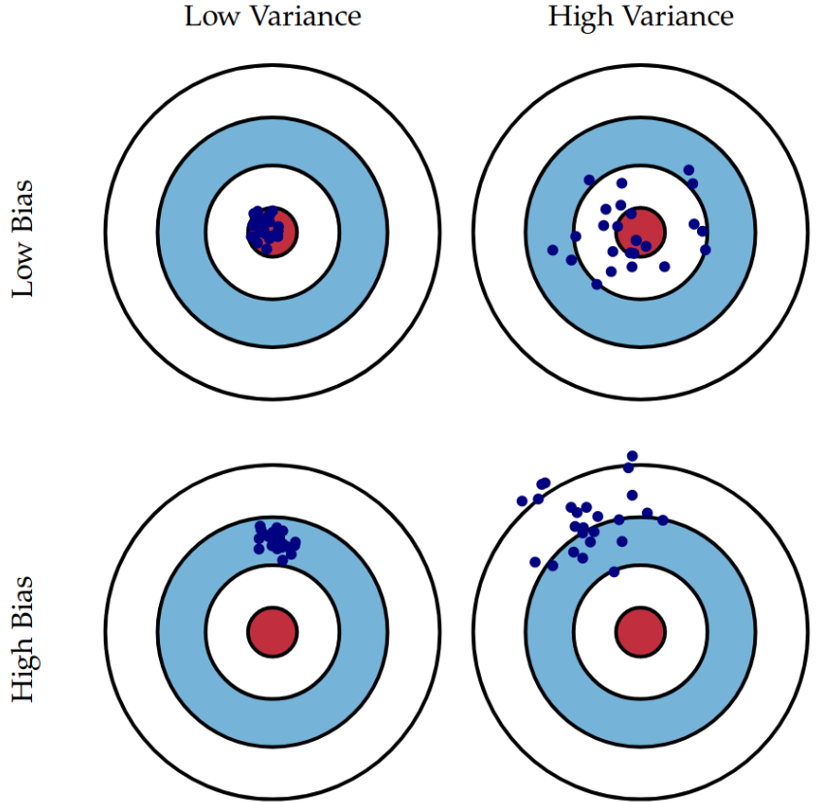
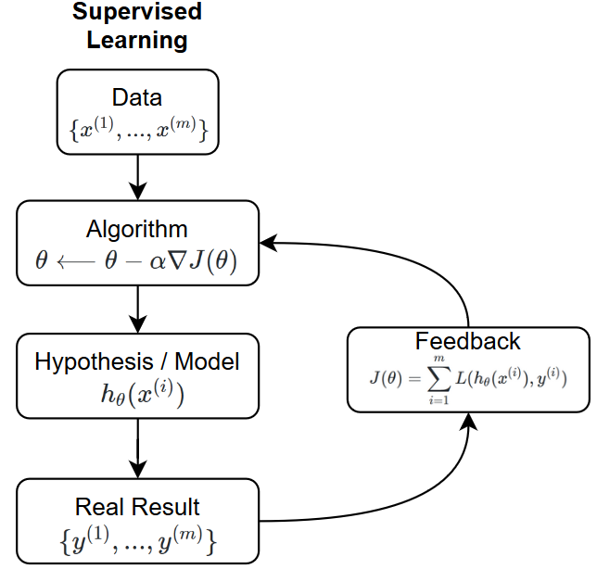
Supervised Learning Overview (2)

Slide 10
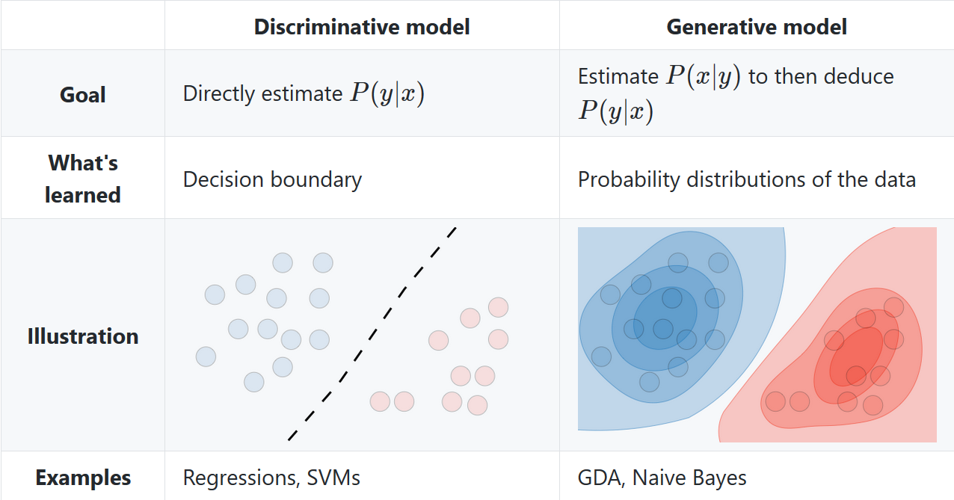
Model Types

Slide 11
Generative Models
A generative model first tries to learn how data is generated by estimating P(x∣y), which we can then use to estimate P(y∣x) by using Bayes' rule.
Assuming: Probability distributions of the data

Slide 12
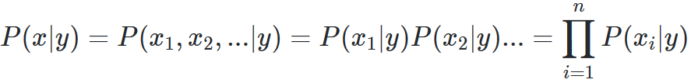
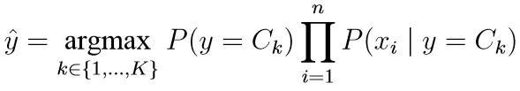
Generative Classifier: Naïve Bayes
Features of each data point are all independent, associated with K classes:
Classification: Maximizing the a-posteriori probability P(y | x) for each class/label

Slide 13

Generative Classifier: Naïve Bayes Models
Bernoulli Naïve Bayes
Binary vectors of length K
Multinomial Naïve Bayes
Integer vector (word IDs)
Gaussian Naïve Bayes
Multiclass Naïve Bayes
We permit y to range over C classes.

Slide 14


Generative Classifier: Naïve Bayes
Scalability and Applications
Maximum-likelihood training requires linear time, rather than iterative approximation
Text classification and spam detection

Slide 15
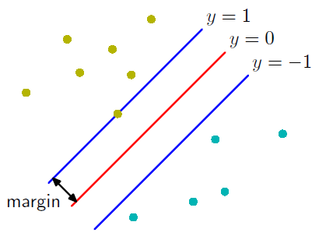
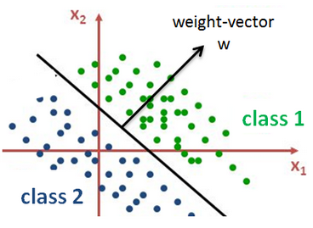
Discriminative Models
Decision boundaries by inferring knowledge from observed data.
Discriminative models make fewer assumptions about the underlying data distribution and rely more on data quality.

Slide 16
Discriminative Classifier
Support vector machine
A representation mapped so that the examples of the separate categories are divided by a maximized gap.
New examples are mapped into that same space and predicted to belong to a category based on the side of the gap on which they fall.

Slide 17
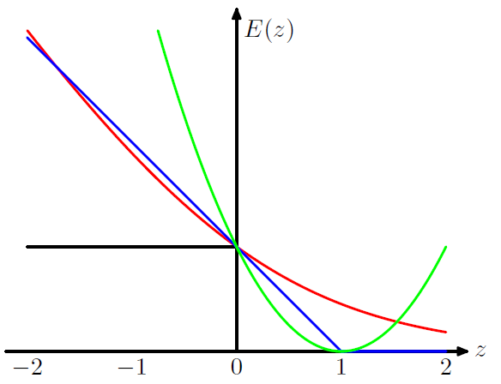
Error functions

Slide 18
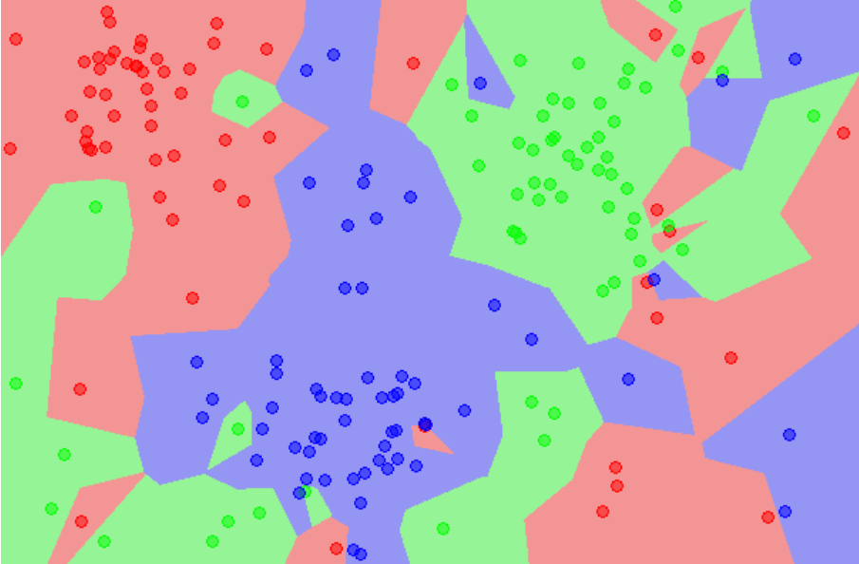
Other non-parametric approaches
k-Nearest Neighbors
The response of a data point is determined by the nature of its k neighbors from the training set.
It can be used in both classification and regression settings.

Slide 19
Unsupervised Learning
Clustering
The goal of unsupervised learning is to find hidden patterns in unlabeled data
Latent variables or hidden/unobserved variables that make estimation problems difficult - maximum likelihood estimation
Dimension reduction
A technique that finds the variance-maximizing directions onto which to project the data.

Slide 20
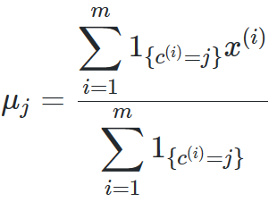

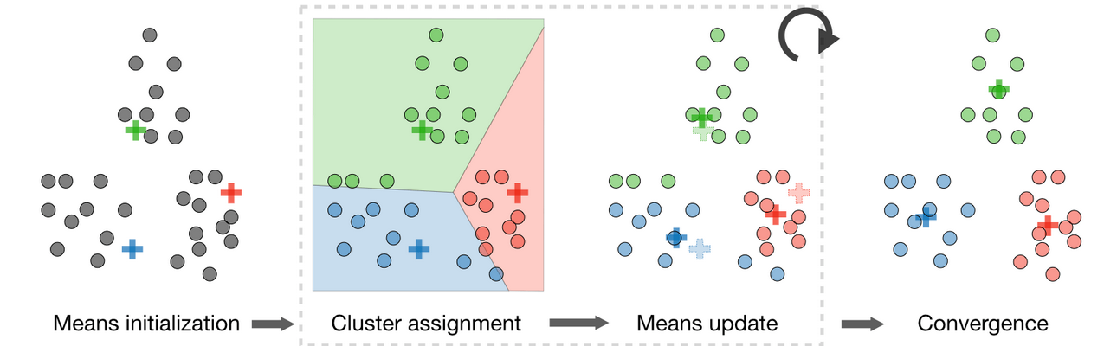
K-Means Clustering
Goal: After randomly initializing the cluster centroids is to repeat the following step until convergence:

Slide 21
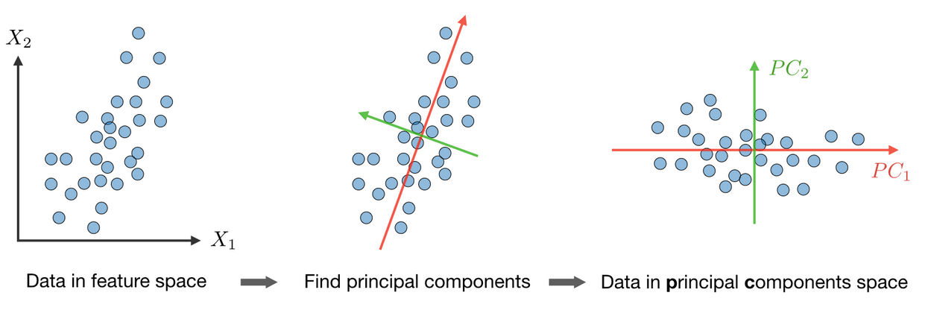
The Principal Component Analysis (PCA)
A dimension reduction technique that projects the data on k dimensions by maximizing the variance of the data as follows

Slide 22
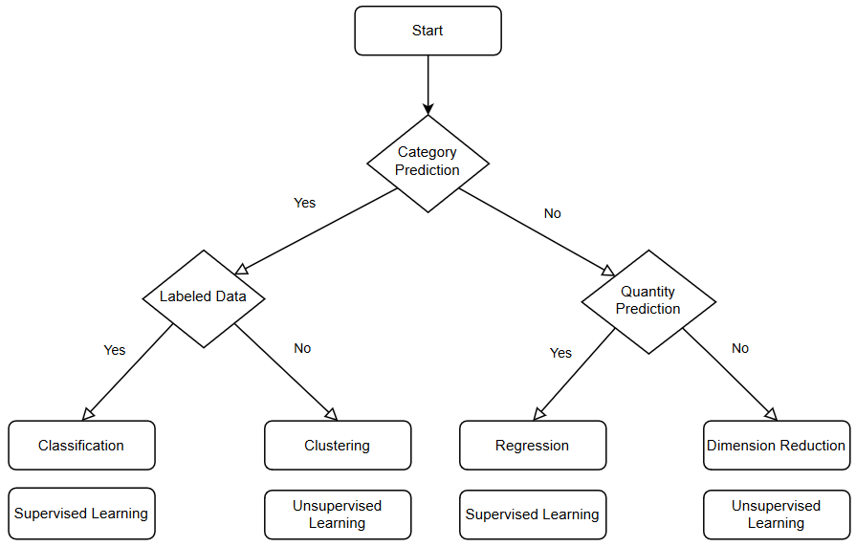
Final Overview

Slide 23
To wrap things up…
Supervised learning is ideal for modeling and having quality labeled data
Unsupervised methods achieve pattern recognition and can find relations within the dataset

Slide 24
Resources
https://stanford.edu/~shervine/teaching/cs-229/cheatsheet-supervised-learning
https://towardsdatascience.com/bias-and-variance-in-linear-models-e772546e0c30
https://stanford.edu/~shervine/teaching/cs-229/cheatsheet-unsupervised-learning
https://www.cs.cmu.edu/~mgormley/courses/10601-s17/slides/lecture5-nb.pdf

Slide 25
Drawings
https://drive.google.com/file/d/1RI4jBRCegcDQ6W9VUgeyrVexNovismCC/view?usp=sharing

