Slide 1
UNIT - 4
BASICS OF HADOOP
By
Dr. PRASANTA KUMAR SAHOO
PROFESSOR, DEPT. OF CSE

Slide 2
BASICS OF HADOOP
UNIT-IV
Contents
Data format
Features of Hadoop
Analyzing data with Hadoop
Design of Hadoop distributed file system (HDFS)
HDFS concepts
Hadoop related tools

Slide 3
About Hadoop
Apache Hadoop is an open source software framework used to develop data processing applications which are executed in a distributed computing environment.
in Hadoop, data resides in a distributed file system which is called as a Hadoop Distributed File system. The processing model is based on 'Data Locality' concept wherein computational logic is sent to cluster nodes(server) containing data. This computational logic is nothing, but a compiled version of a program written in a high-level language such as Java. Such a program, processes data stored in Hadoop HDFS.

Slide 4
Types of Hadoop File Formats
Text files : A text file is the most basic and a human-readable file. It can be written in any programming language like c, java or any editor.
Sequence File: The sequence file format can be used to store an image in the binary format. They store key-value pairs in a binary container format and are more efficient than a text file. However, sequence files are not human- readable.

Slide 5
Types of Hadoop File Formats
Avro data files: The Avro file format is ideal for long-term storage of important data. It can read from and write in many languages like Java, Scala and so on.
Parquet file format: Apache Avro is a language-neutral data serialization system. It was developed by Doug Cutting, the father of Hadoop. Parquet is a columnar format developed by Cloudera and Twitter. It is supported in Spark, MapReduce, Hive, Pig, Impala, Crunch, and so on. Like Avro, schema metadata is embedded in the file.

Slide 6
SOME OTHER DATA FORMATS
Photos – Pixel data - petabytes of storage
Trade data – Time-series data – terabytes of data per day
Gene data – Sequential data – petabytes of data
Internet Archive – Unstructured data – petabytes to terabytes of data

Slide 7
There’s a lot of data out there.
But you are probably wondering how it affects you?
Does the advent of “Big Data,” as it is being called, affect smaller organizations or individuals?
Yes…More data usually beats better algorithms

Slide 8
Hadoop Features
Suitable for Big Data Analysis
As Big Data tends to be distributed and unstructured in nature, HADOOP clusters are best suited for analysis of Big Data. Since it is processing logic (not the actual data) that flows to the computing nodes, less network bandwidth is consumed. This concept is called as data locality concept which helps increase the efficiency of Hadoop based applications.

Slide 9
Hadoop Features
Scalability : HADOOP clusters can easily be scaled to any extent by adding additional cluster nodes and thus allows for the growth of Big Data.
Fault Tolerance : HADOOP ecosystem has a provision to replicate the input data on to other cluster nodes. That way, in the event of a cluster node failure, data processing can still proceed by using data stored on another cluster node.

Slide 10
5.25’’ floppy disk – 1.2 MB - ~= 100kb/sec ~= 15 minutes.
5.25’’ hard disk – 1.3 GB - ~= 400kb/sec for 1x speed ~= 8 minutes.
5.25’’ compact disk – 700 MB/4.7 GB – [CD - 150kb/sec for 1x speed], [DVD – 1350kb/sec for 1x speed] ~= 3 minutes.
Today, Terabyte hard disk drives have a data transfer speed around 100 MB/sec. Two and a half hours to read all the data off the disk.

Slide 11
This is a long time to read all data on a single drive and writing is even slower.
The obvious way to reduce the time is to read from multiple disks at once.
Imagine if we had 100 drives, each holding one hundredth of the data.
Working in parallel, we could read the data in under two minutes.

Slide 12
The first problem to solve is hardware failure.
  Replication of data is solution (HDFS).
The second problem is that most analysis tasks need to be able to combine the data in some way.
  Various distributed systems allow data to be combined from multiple sources, but doing this correctly is notoriously challenging (MapReduce).
  Map Reduce provides a programming model that abstracts the problem from disk reads and writes, transforming it into a computation over sets of keys and values.

Slide 13
MapReduce
It is the core component of processing in a Hadoop Ecosystem as it provides the logic of data processing. It is a software framework which helps in writing applications that processes large data sets using distributed and parallel algorithms inside Hadoop environment.
In a MapReduce program, Map() and Reduce() are two functions.

Slide 14
MapReduce
  The Map function performs actions like filtering, grouping and sorting.
  While Reduce function aggregates and summarizes the result produced by map function.
  The result generated by the Map function is a key value pair (K, V) which acts as the input for Reduce function.
  We want to calculate the number of students in each department. Initially, Map program will execute and calculate the students appearing in each department, producing the key value pair as mentioned above. This key value pair is the input to the Reduce function. The Reduce function will then aggregate each department and calculate the total number of students in each department and produce the given result.

Slide 15
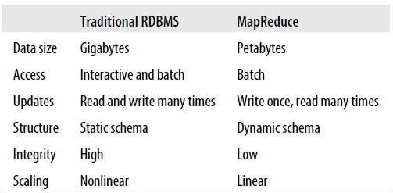
Comparison with other systems

Slide 16
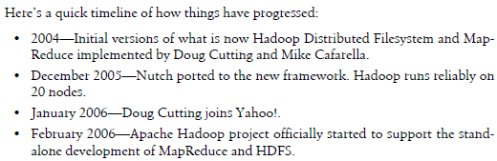
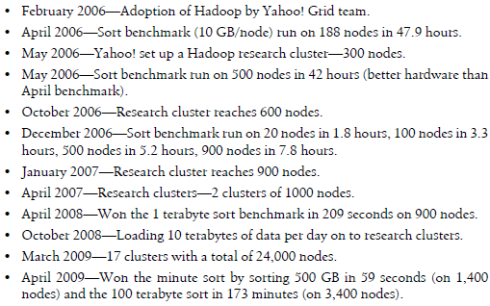
A brief history of Hadoop

Slide 17
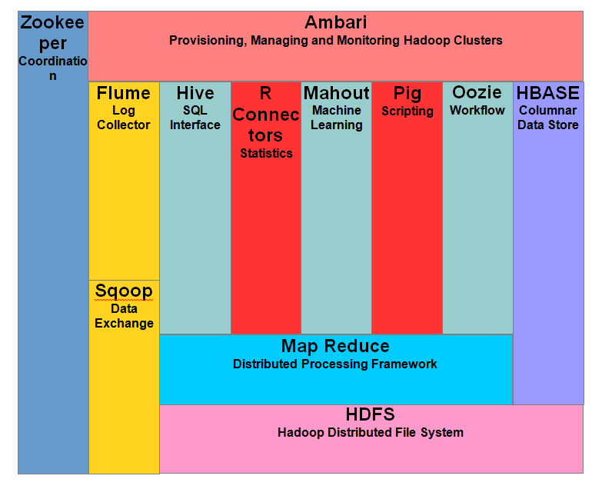
Hadoop EcoSystem and Components

Slide 18
HDFC EcoSystem
HDFS -> Hadoop Distributed File System
YARN -> Yet Another Resource Negotiator
MapReduce -> Data processing using programming
Spark -> In-memory Data Processing
PIG, HIVE-> Data Processing Services using Query (SQL-like)
HBase -> NoSQL Database

Slide 19
HDFC EcoSystem
Mahout, Spark MLlib -> Machine Learning
Apache Drill -> SQL on Hadoop
Zookeeper -> Managing Cluster
Oozie -> Job Scheduling
Flume, Sqoop -> Data Ingesting Services
Solr & Lucene -> Searching & Indexing
Ambari -> Provision, Monitor and Maintain cluster

Slide 20
YARN
YARN as the brain of your Hadoop Ecosystem. It performs all your processing activities by allocating resources and scheduling tasks.
It has two major components, i.e. ResourceManager and NodeManager.
  ResourceManager is again a main node in processing .
  It receives the processing requests, and then passes the parts of requests to corresponding NodeManagers accordingly, where the actual processing takes place.
  NodeManagers are installed on every DataNode. It is responsible for execution of task on every single DataNode.

Slide 21
PIG
PIG has two parts: Pig Latin, the language and the pig runtime, for the execution environment. It is same as Java and JVM.
It supports pig latin language, which has SQL like command structure.
In PIG, first the load command, loads the data. Then we perform various functions on it like grouping, filtering, joining, sorting, etc. At last, either you can dump the data on the screen or you can store the result back in HDFS.

Slide 22
APACHE HIVE
Facebook created HIVE for people who are fluent with SQL. Thus, HIVE makes them feel at home while working in a Hadoop Ecosystem.
Basically, HIVE is a data warehousing component which performs reading, writing and managing large data sets in a distributed environment using SQL-like interface.
HIVE + SQL = HQL

Slide 23
Mahout
Mahout provides an environment for creating machine learning applications which are scalable.
It performs collaborative filtering, clustering and classification. Some people also consider frequent item set missing as Mahout’s function. Let us understand them individually:

Slide 24
Mahout
Collaborative filtering: Mahout mines user behaviors, their patterns and their characteristics and based on that it predicts and make recommendations to the users. The typical use case is E-commerce website.
Clustering: It organizes a similar group of data together like articles can contain blogs, news, research papers etc.

Slide 25
Mhaout
Classification: It means classifying and categorizing data into various sub-departments like articles can be categorized into blogs, news, essay, research papers and other categories.
Frequent item set missing: Here Mahout checks, which objects are likely to be appearing together and make suggestions, if they are missing.

Slide 26
Spark
Apache Spark is a framework for real time data analytics in a distributed computing environment.
The Spark is written in Scala and was originally developed at the University of California, Berkeley.

Slide 27
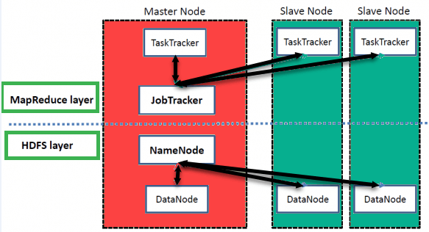
Hadoop Architecture

Slide 28
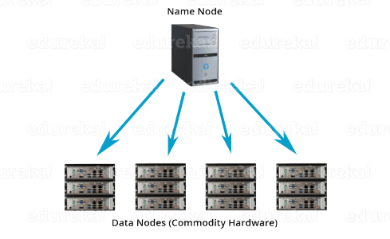
Name Node and Data Nodes

Slide 29
Name Node and Data Node
NameNode is the main node and it doesn’t store the actual data. It contains metadata, just like a log file or you can say as a table of content. Therefore, it requires less storage and high computational resources.
Data Nodes: data is stored here and hence it requires more storage resources. These DataNodes are commodity hardware (like your laptops and desktops) in the distributed environment.You always communicate to the NameNode while writing the data. Then, it internally sends a request to the client to store and replicate data on various DataNodes.

Slide 30
Hadoop Architecture
Hadoop has a Master-Slave Architecture for data storage and distributed data processing using MapReduce and HDFS methods.
NameNode: NameNode represented every files and directory which is used in the namespace.
DataNode: DataNode helps you to manage the state of an HDFS node and allows you to interacts with the blocks.

Slide 31
DIFFERNET NODES IN HADOOP
MasterNode: The master node allows you to conduct parallel processing of data using Hadoop MapReduce.
Slave node: The slave nodes are the additional machines in the Hadoop cluster which allows you to store data to conduct complex calculations. Moreover, all the slave node comes with Task Tracker and a DataNode. This allows you to synchronize the processes with the NameNode and Job Tracker respectively.

Slide 32
Apache Hadoop and the Hadoop Ecosystem
The Hadoop projects
MapReduce - A distributed data processing model and execution environment that runs on large clusters of commodity machines.
HDFS - A distributed filesystem that runs on large clusters of commodity machines.

Slide 33
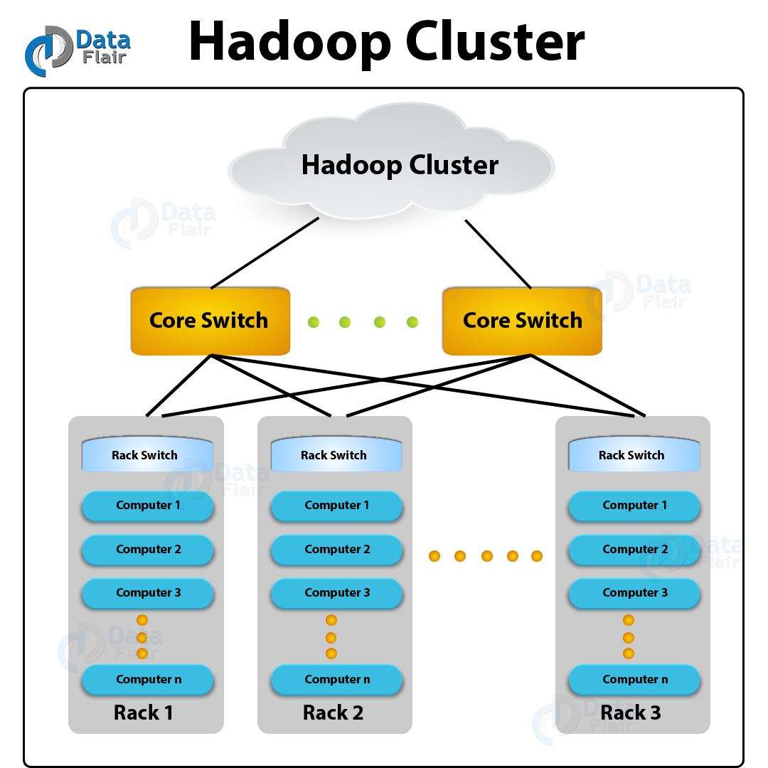

Slide 34
Scaling out
You’ve seen how MapReduce works for small inputs.
Now it’s time to take a bird’s-eye view of the system and look at the data flow for large inputs.
For simplicity, the examples so far have used files on the local file system.
However, to scale out, we need to store the data in a distributed file system, typically HDFS to allow Hadoop to move the Map Reduce computation to each machine hosting a part of the data.

Slide 35
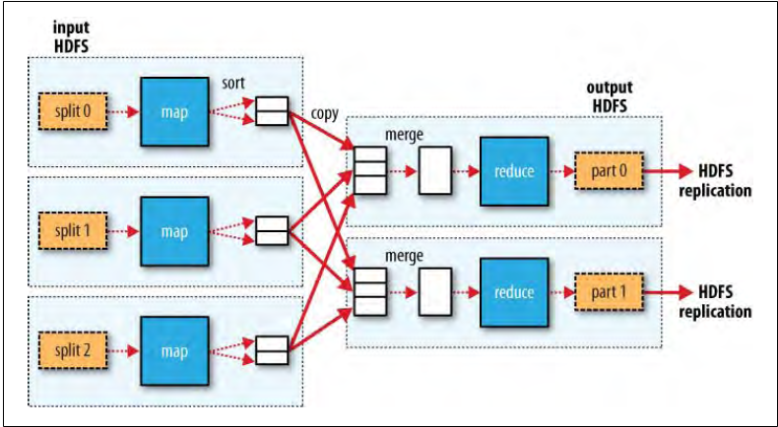
The dotted boxes indicate nodes,
The light arrows show data transfers on a node, and
The heavy arrows show data transfers between nodes.

Slide 36
Hadoop Streaming
Hadoop provides an API to MapReduce that allows you to write your map and reduce functions in languages other than Java.
Hadoop streaming is a utility that comes with the Hadoop distribution. This utility allows you to create and run Map/Reduce jobs with any executable or script as the mapper and/or the reducer.
Hadoop Streaming uses Unix standard stream as the interface between Hadoop and your program, so you can use any language that can read standard input and write to standard output to write your MapReduce program.
Streaming is naturally suited for text processing (although, as of version 0.21.0, it can handle binary streams, too), and when used in text mode, it has a line-oriented view of data.

Slide 37
Map input data is passed over standard input to your map function, which processes it line by line and writes lines to standard output.
Both the mapper and the reducer are python scripts that read the input from standard input and emit the output to standard output. The utility will create a Map/Reduce job, submit the job to an appropriate cluster, and monitor the progress of the job until it completes.
A map output key-value pair is written as a single tab-delimited line.
Input to the reduce function is in the same format a tab-separated key-value pair passed over standard input.
The reduce function reads lines from standard input, which the framework guarantees are sorted by key, and writes its results to standard output.
Languages for writing map and reduce functions other than java
  Ruby
  Python

Slide 38
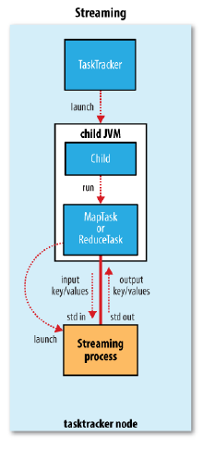

Slide 39
Hadoop pipes
Hadoop Pipes is the name of the C++ interface to Hadoop MapReduce.
Hadoop Pipes uses sockets to enable task trackers to communicate processes running the C++ map or reduce functions.
Unlike Streaming, which uses standard input and output to communicate with the map and reduce code, Pipes uses sockets as the channel over which the tasktracker communicates with the process running the C++ map or reduce function.
JNI is not used.

Slide 40
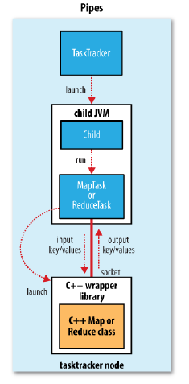

Slide 41
HADOOP FILE SYSTEM (HDFS)
HDFS is a filesystem designed for
  storing very large files with streaming data access patterns
  running on clusters of commodity hardware.

Slide 42
Very large files
“Very large” in this context means files that are hundreds of megabytes, gigabytes, or terabytes in size.
There are Hadoop clusters running today that store petabytes of data.

Slide 43
Streaming data access
HDFS is built around the idea that the most efficient data processing pattern is a write-once, read-many-times pattern.
A dataset is typically generated or copied analysis will involve a large proportion, if not all, of the dataset, so the time to read the whole dataset is more important than the latency in reading the first record.

Slide 44
Commodity hardware
Hadoop doesn’t require expensive, highly reliable hardware to run on.
It’s designed to run on clusters of commodity hardware (commonly available hardware available from multiple vendors) for which the chance of node failure across the cluster is high, at least for large clusters.
HDFS is designed to carry on working without a noticeable interruption to the user in the face of such failure.
It is also worth examining the applications for which using HDFS does not work so well.
While this may change in the future, these are areas where HDFS is not a good fit today.

Slide 45
Low-latency data access
Applications that require low-latency access to data, in the tens of milli seconds range, will not work well with HDFS.
Remember, HDFS is optimized for delivering a high throughput of data, and this may be at the expense of latency.
HBase is currently a better choice for low-latency access.

Slide 46
Lots of small files
Since the namenode holds file system meta data in memory, the limit to the number of files in a file system is governed by the amount of memory on the name node.
As a rule of thumb, each file, directory, and block takes about 150 bytes.
Files in HDFS may be written to by a single writer. Writes are always made at the end of the file. There is no support for multiple writers, or for modifications at arbitrary offsets in the file.

Slide 47
HDFS Concepts
Blocks
Namenodes and Datanodes

