Slide 1

Network Security

Slide 2
Information Security
It can be defined as “measures adopted to prevent the unauthorized use, misuse, modification or denial of use of knowledge, facts, data or capabilities”.

Slide 3
Attacks, Services and Mechanisms
Security Attack: Any action that compromises the security of information.
Security Mechanism: A mechanism that is designed to detect, prevent, or recover from a security attack.
Security Service: A service that enhances the security of data processing systems and information transfers. A security service makes use of one or more security mechanisms.

Slide 4
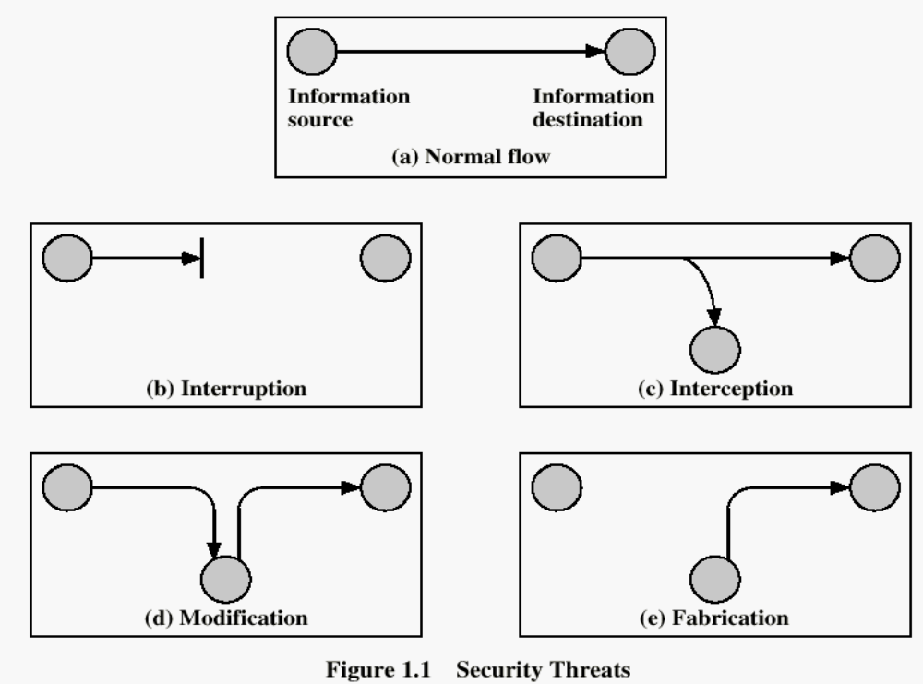
Security Threats

Slide 5
Security Threats
Interruption: This is an attack on availability
Interception: This is an attack on confidentiality
Modification: This is an attack on integrity
Fabrication: This is an attack on authenticity

Slide 6
Security Goals
Confidentiality
Integrity
Avalaibility

Slide 7
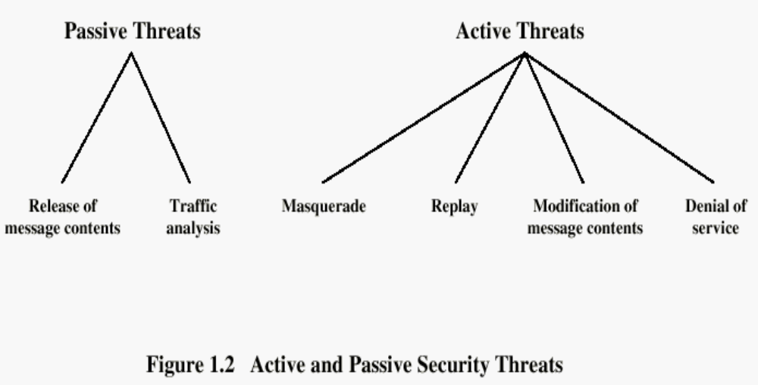

Slide 8
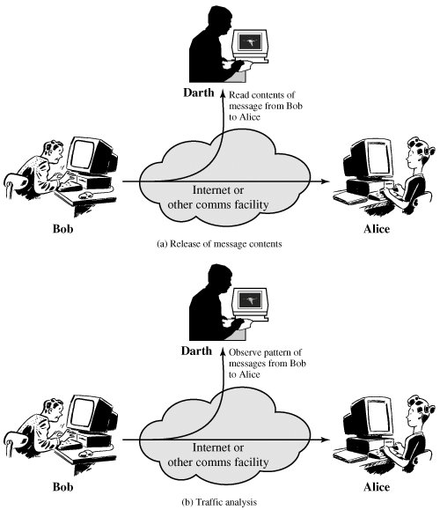

Slide 9
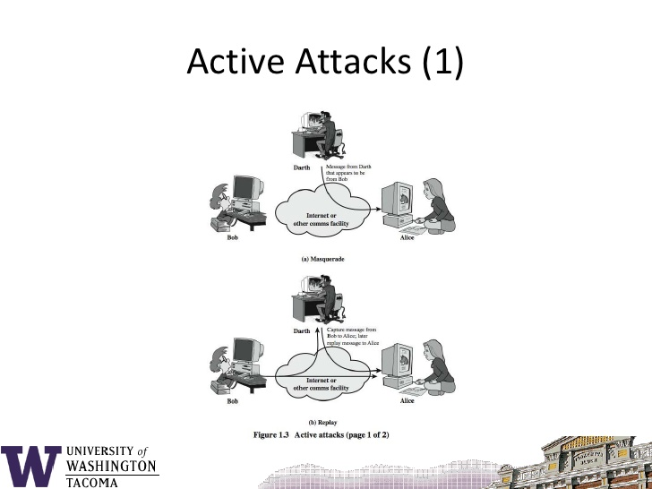

Slide 10
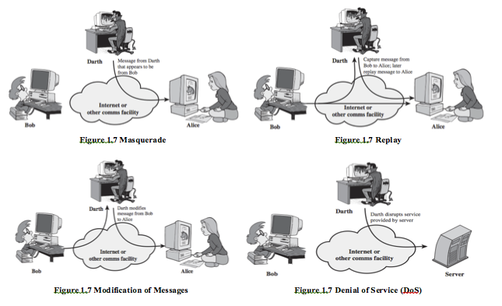

Slide 11
Security Services
Confidentiality (privacy)
Authentication (who created or sent the data)
Integrity (has not been altered)
Non-repudiation (the order is final)
Access control (prevent misuse of resources)
Availability (permanence, non-erasure)
  Denial of Service Attacks
  Virus that deletes files

Slide 12
A. Data confidentiality
These services provide for the protection of data from unauthorized disclosure as described below
Connection confidentiality - provides for the confidentiality of all user-data on a connection
Connectionless confidentiality - provides for the confidentiality of all user-data in a single data block.
Selective field confidentiality - provides for the confidentiality of selected fields within the user-data on a connection or in a single data block.
Traffic flow confidentiality This service provides for the protection of the information which might be derived from observation of traffic flows.

Slide 13
B. Authentication
The Assurance that the communicating entity is the one that it claims it to be.
  Peer entity authentication:
  Provides for the corroboration of the identity of a peer entity in an association. Used in association with a logical connection to provide confidence in the identity of the entities connected.
  b) Data origin authentication: Provides Corroboration of the source of a data unit. In a connectionless transfer, provides assurance that the source of received data is as claimed.

Slide 14
C. Integrity
Assurance that data received are exactly as sent by an unauthorized entity (i.e. contain no modification, insertion, deletion or replay.
  Connection integrity with recovery
  provides for the integrity of all user-data on a connection
  detects any modification, insertion, deletion or replay of any data within an entire data sequence (with recovery attempted).
  b) Connection integrity without recovery
    the previous one but with no recovery attempted (only detection).
  c) Selective field connection integrity –
    provides for the integrity of selected fields within the user data of data block transferred over a connection and determine whether the selected fields have been modified, inserted, deleted or replayed.

Slide 15
C. Integrity (contd..)
  Connectionless integrity
  provides for the integrity of a single data block
  determine whether a received data block has been modified.
  Additionally, a limited form of detection of replay may be provided.
  e) Selective field connectionless integrity
    provides for the integrity of selected fields within a single connectionless data block
    determine whether the selected fields have been modified.

Slide 16
D. Non-repudiation
Provides protection against denial by one of the entities involved in a communication of having participated in all or part of the communication.
  Non-repudiation , Origin
    Proof that the message was sent by the specified party -
      This will protect against any attempt by the sender to falsely deny sending the data or its contents.
  Non-repudiation, Destination
  Proof that the message was message was received by the specified party
        This will protect against any subsequent attempt by the recipient to falsely deny receiving the data or its contents.

Slide 17
E. Access control
Provides protection against unauthorized use of resources accessible
Example: the service controls who can have access to a resource, under what circumstances, and what those accessing the resource are allowed to do.

Slide 18
Security Mechanisms
Security Mechanism: A mechanism that is designed to detect, prevent, or recover from a security attack.
Sec. Mech. Types
Specific security mechanisms
Pervasive security mechanisms
May be incorporated into the appropriate protocol layer in order to provide some of the OSI security services.
Mechanisms that are not specific to any particular OSI security service or protocol layer.

Slide 19
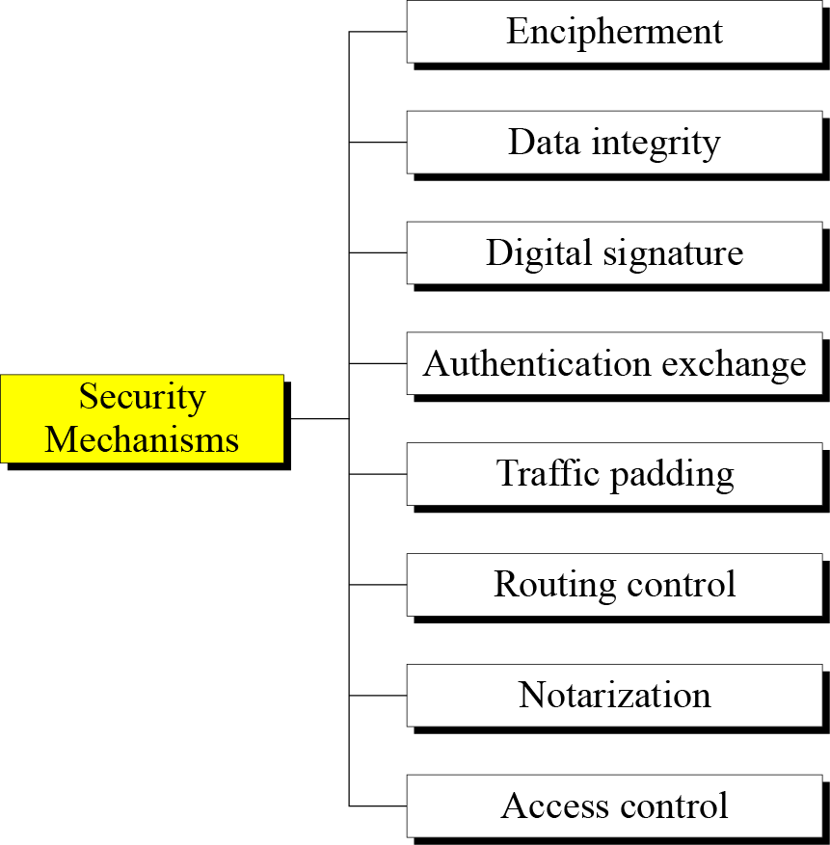
Specific Security Mechanisms
Notes:
1.#

Slide 20
Mechanisms | Explanation
Encipherment | The use of mathematical algorithms to transform data into a form that is not readily intelligible. The transformation and subsequent recovery of the data depend on an algorithm and zero or more encryption keys.
Digital Signature | Data appended to, or a cryptographic transformation of, a data unit that allows a recipient of the data unit to prove the source and integrity of the data unit and protect against forgery (e.g., by the recipient).
Access Control | Mechanisms that enforce access rights to resources.
Data Integrity | Mechanisms used to assure the integrity of a data unit or stream of data units.
Authentication Exchange | A mechanism intended to ensure the identity of an entity by means of information exchange
Traffic Padding | The insertion of bits into gaps in a data stream to frustrate traffic analysis attempts.
Routing Control | Enables selection of particular physically secure routes for certain data and allows routing changes, especially when a breach of security is suspected.
Notarization | The use of a trusted third party to assure certain properties of a data exchange.

Slide 21
Trusted Functionality
Security Label
Pervasive Mechanisms
Event Detection
Security Audit Trail
Security Recovery

Slide 22
Mechanisms | Explanation
Trusted functionality | That which is perceived to be correct with respect to some criteria(e.g., as established by a security policy)
Security Label | The marking bound to a resource( which may be a data unit) that names or designates the security attributes of that resource.
Event Detection | Detection of security-relevant events.
Security Audit Trail | Data collected & potentially used to facilitate a security audit, which is an independent review and examination of system records and activities.
Security Recovery | Deals with requests from mechanisms, such as event handling and management functions, and takes recovery actions.

Slide 23
Relationship between Security Services and Mechanisms
Mechanism
Service | Encipherment | Digital Signature | Access Control | Data Integrity | Authentication Exchange | Traffic Padding | Routing Control | Notarization
Peer entity authentication | Y | Y |  |  | Y
Data origin authentication | Y | Y
Access control |  |  | Y
Confidentiality | Y |  |  |  |  |  | Y
Traffic flow confidentiality | Y |  |  |  |  | Y | Y
Data integrity | Y | Y |  | Y
Nonrepudiation |  | Y |  | Y |  |  |  | Y
Availability |  |  |  | Y | Y

Slide 24
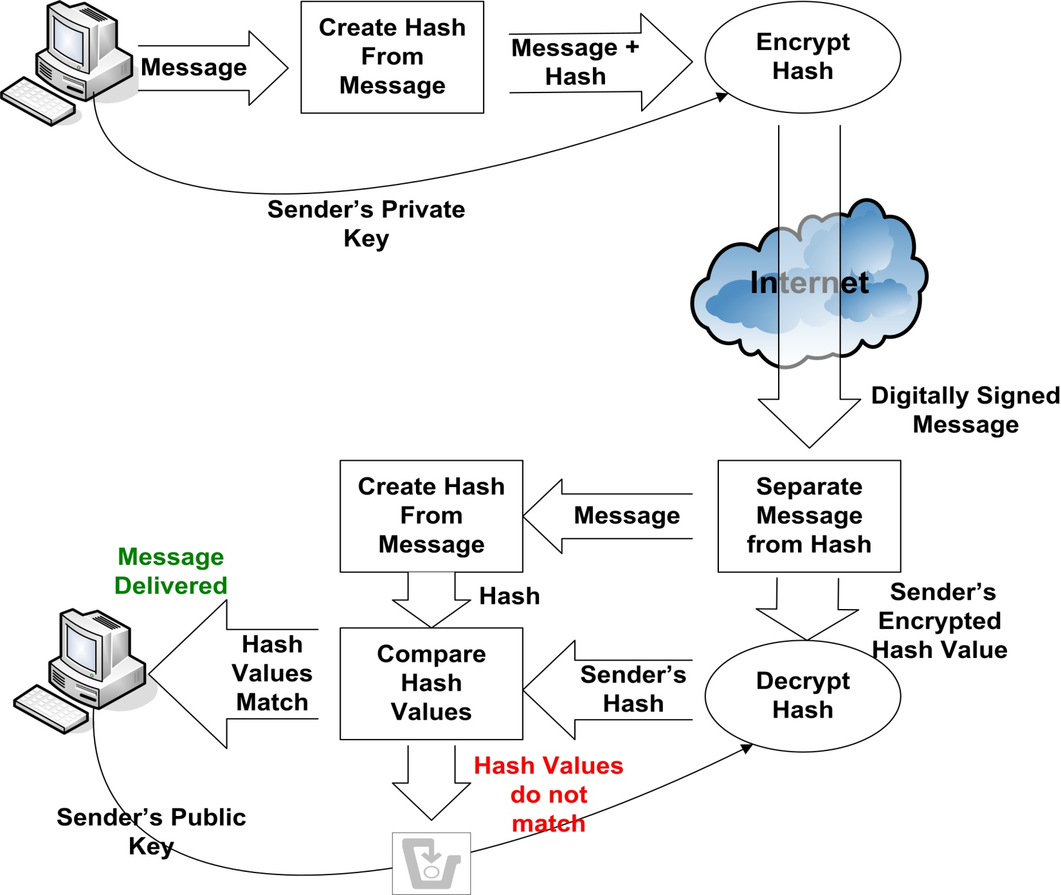
Digital Signature
digital signature – mathematical scheme for demonstrating the authenticity of a digital message or document.

Slide 25
Pervasive security mechanisms
Mechanisms | Explanation
Trusted Functionality | That which is perceived to be correct with respect to some criteria (e.g., as established by a security policy).
Security Label | The marking bound to a resource (which may be a data unit) that names or designates the security attributes of that resource.
Event Detection | Detection of security-relevant events.
Security Audit Trail | Data collected and potentially used to facilitate a security audit, which is an independent review and examination of system records and activities.
Security Recovery | Deals with requests from mechanisms, such as event handling and management functions, and takes recovery actions.

Slide 26
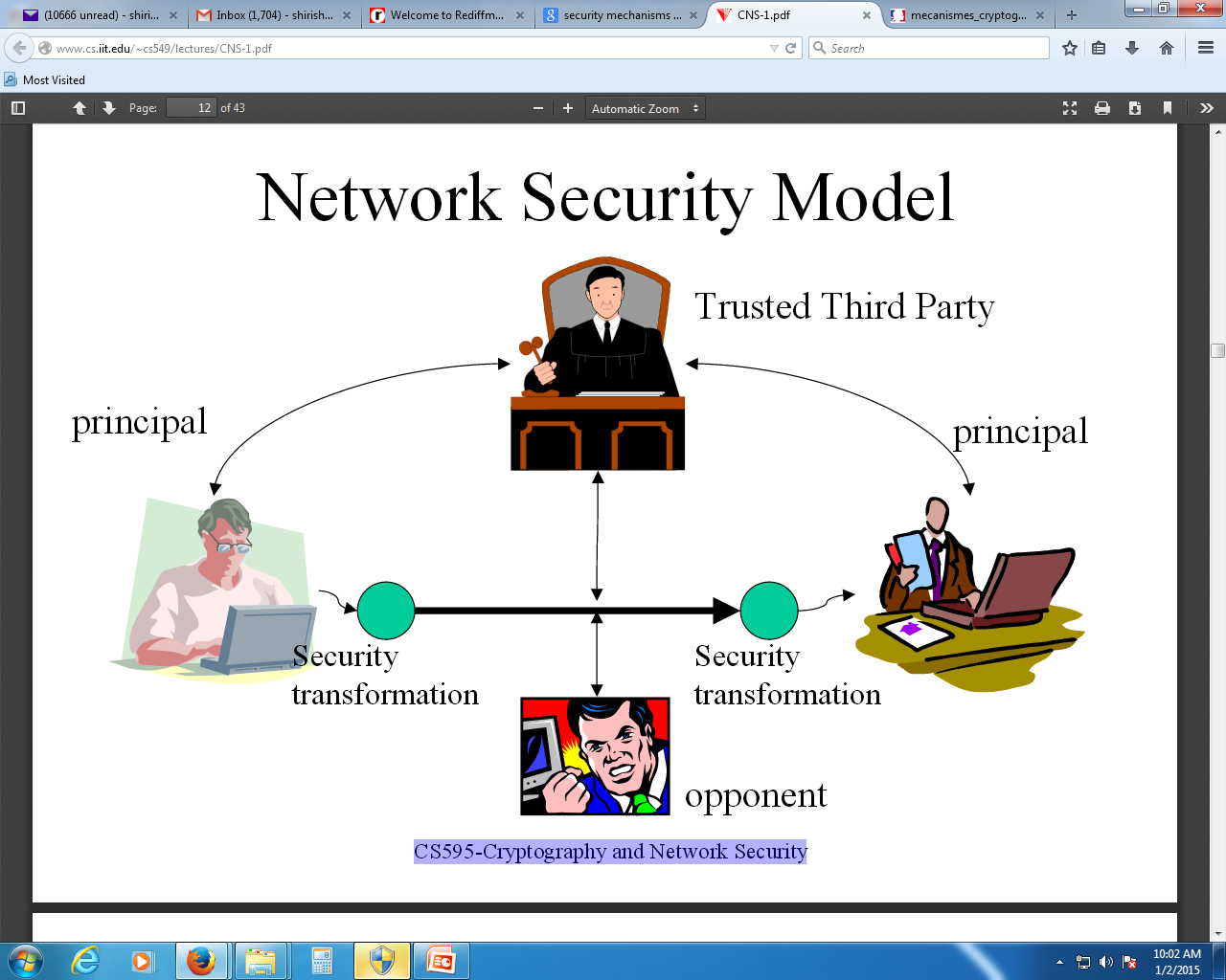

Slide 27
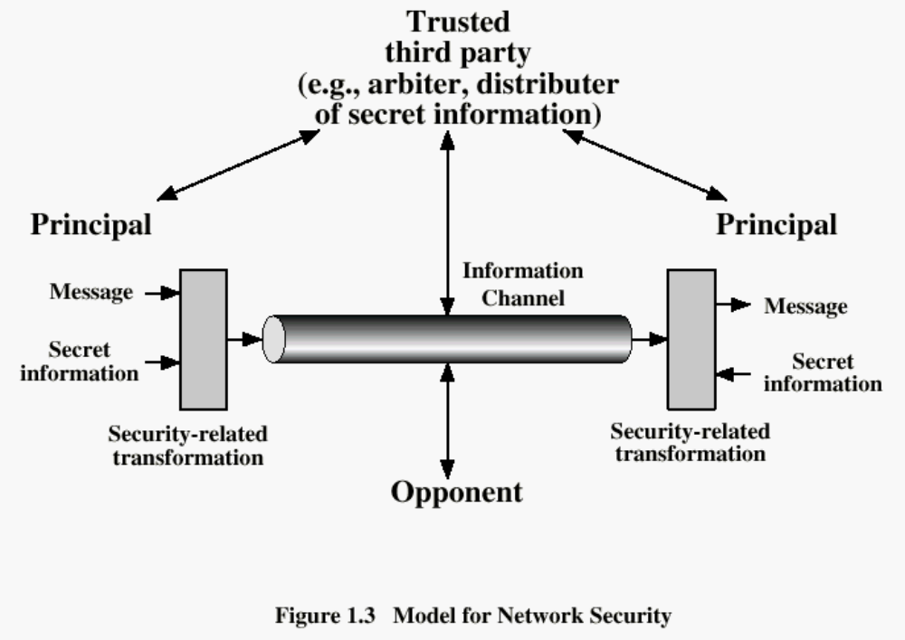
Henric Johnson

Slide 28
The model shows that there are four basic tasks in designing a particular security services:
Design an algorithm for performing the security-related transformation. The algorithm should be such that an opponent cannot defeat its purpose
Generate the secret information to be used with the algorithm.
Develop methods for the distribution and sharing of secret information.
Specify a protocol to be used by two principals that makes use of the security algorithm and the secret information to achieve a particular security service.

Slide 29
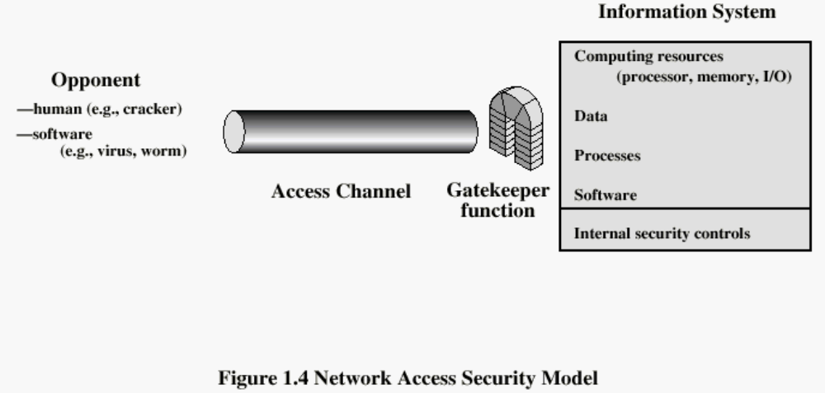

Slide 30
Hackers: can be some one who, with no malign intent, simply gets satisfaction fro breaking and entering a computer system.
Intruder: Can be a disgruntled employee who wishes to damage , or a criminal who seeks to exploit computer assets for financial gain
Another type of Unwanted access is the placement of logic that exploits vulnerabilities in the system and can affect application programs, such as editors, compilers.
Programs can present two kinds of threats:
Information access threats
Service threats
Viruses and Worms are software attacks.

Slide 31
The security mechanisms needed to cope with unwanted access fall into broad categories.
Gatekeeper functions include
Password-based login
Screening logic
Once unwanted user or software gain access, the second line of defense consists of a variety of internal controls that monitor, analyze information & attempt to detect the presence of unwanted intruders.

Slide 32
Methods of Defence
Encryption
Software Controls (access limitations in a data base, in operating system protect each user from other users)
Hardware Controls (smartcard)
Policies (frequent changes of passwords)
Physical Controls

Slide 33
Internet standards and RFCs
The Internet society – coordinating committee for Internet design, engineering, mgmt.
  Internet Architecture Board (IAB)
  Internet Engineering Task Force (IETF)
  Internet Engineering Steering Group (IESG)

Slide 34
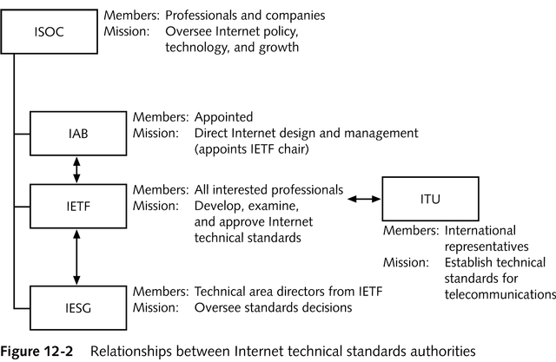
Technical Specifications

Slide 35
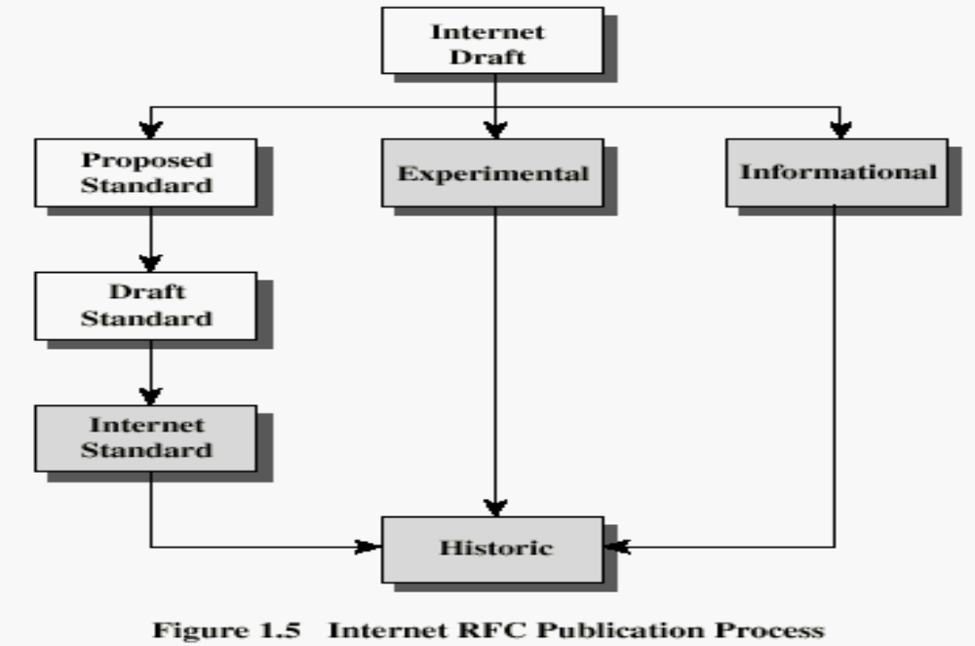
Internet RFC Publication Process

Slide 36
Recommended Reading
Pfleeger, C. Security in Computing. Prentice Hall, 1997.
Mel, H.X. Baker, D. Cryptography Decrypted. Addison Wesley, 2001.
Henric Johnson

