Slide 1
UNIT II

Slide 2
Control Flow Graphs and Path Testing
Introduction
Path Testing Definition
A family of structural test techniques based on judiciously selecting a set of test paths through the programs.
  Goal: Pick enough paths to assure that every source statement is executed at least once.
  It is a measure of thoroughness of code coverage.
  It is used most for unit testing on new software.
  Its effectiveness reduces as the software size increases.
  Path testing concepts are used in and along with other testing techniques
Code Coverage: During unit testing: # stmts executed at least once / total # stmts
ref boris beizer

Slide 3
Control Flow Graphs and Path Testing
Path Testing contd..
Assumptions:
  Software takes a different path than intended due to some error.
  Specifications are correct and achievable.
  Data definition & access are correct
Observations
  Structured programming languages need less of path testing.
  Assembly language, Cobol, Fortran, Basic & similar languages make path testing necessary.
ref boris beizer

Slide 4
Control Flow Graphs and Path Testing
_{L1}
Control Flow Graph
A simplified, abstract, and graphical representation of a program’s control structure using process blocks, decisions and junctions.
_{IF}
_{A = B ?}
_{NO: ELSE DO}
_{Process Block}
_{Do Process A}
_{Decisions}
_{YES: THEN DO}
_{Junctions}
₁
₂
_{CASE-OF}
_{CASE 1}
₁
_{CASE 2}
_{Case Statement}
₂
_{CASE N}
_{Control Flow Graph Elements}
_{N}
ref boris beizer

Slide 5
Control Flow Graphs and Path Testing
_{L1}
Control Flow Graph Elements:
Process Block:
  A sequence of program statements uninterrupted by decisions or junctions with a single entry and single exit.
Junction:
  A point in the program where control flow can merge (into a node of the graph)
  Examples: target of GOTO, Jump, Continue
Decisions:
  A program point at which the control flow can diverge (based on evaluation of a condition).
  Examples: IF stmt. Conditional branch and Jump instruction.
Case Statements:
  A Multi-way branch or decision.
  Examples: In assembly language: jump addresses table, Multiple GOTOs, Case/Switch
  For test design, Case statement and decision are similar.
ref boris beizer

Slide 6
Control Flow Graphs and Path Testing
_{L1}
Control Flow Graph Vs Flow Charts
Control Flow Graph | Flow Chart
Compact representation of the program | Usually a multi-page description
Focuses on Inputs, Outputs, and the control flow into and out of the block. | Focuses on the process steps inside
Inside details of a process block are not shown | Every part of the process block are drawn
ref boris beizer

Slide 7
Control Flow Graphs and Path Testing
_{L1}
Creation of Control Flow Graph from a program
One statement to one element translation to get a Classical Flow chart
Add additional labels as needed
Merge process steps
A process box is implied on every junction and decision
Remove External Labels
Represent the contents of elements by numbers.
We have now Nodes and Links
INPUT X, Y
Z := X + Y
V := X - Y
IF Z >= 0 GOTO SAM
JOE: Z := Z + V
SAM: Z := Z - V
FOR N = 0 TO V
Z := Z - 1
NEXT N
END
_{Z >= 0 ?}
_{NO}
_{INPUT X, Y}
_{Z := X + Y}
_{V := X - Y}
_{JOE}
_{Z := Z - 1}
_{LOOP}
_{N := 0}
_{Z := Z - V}
_{SAM}
_{Z := Z + V}
_{N = V ?}
_{NO}
_{N := N+1}
_{YES}
_{END}
_{One to One Flow Chart}
ref boris beizer

Slide 8
Control Flow Graphs and Path Testing
_{L1}
Creation of Control Flow Graph from a program
One statement to one element translation to get a Classical Flow chart
Add additional labels as needed
Merge process steps
A process box is implied on every junction and decision
Remove External Labels
Represent the contents of elements by numbers.
We have now Nodes and Links
INPUT X, Y
Z := X + Y
V := X - Y
IF Z >= 0 GOTO SAM
JOE: Z := Z + V
SAM: Z := Z - V
FOR N = 0 TO V
Z := Z - 1
NEXT N
END
_{Z >= 0 ?}
_{NO}
_{P1}
_{JOE}
_{P4}
_{LOOP}
_{P3}
_{SAM}
_{P2}
_{N = V ?}
_{NO}
_{P5}
_{YES}
_{END}
_{Simplified Flow Graph}
ref boris beizer

Slide 9
Control Flow Graphs and Path Testing
_{L1}
Creation of Control Flow Graph from a program
One statement to one element translation to get a Classical Flow chart
Add additional labels as needed
Merge process steps
A process box is implied on every junction and decision
Remove External Labels
Represent the contents of elements by numbers.
We have now Nodes and Links
INPUT X, Y
Z := X + Y
V := X - Y
IF Z >= 0 GOTO SAM
JOE: Z := Z + V
SAM: Z := Z - V
FOR N = 0 TO V
Z := Z - 1
NEXT N
END
₁
₂
₃
₄
₅
₆
₇
_{Simplified Flow Graph}
ref boris beizer

Slide 10
Control Flow Graphs and Path Testing
_{L1}
Linked List Notation of a Control Flow Graph
  Node Processing, label, Decision Next-Node
  1 (BEGIN; INPUT X, Y; Z := X+Y ; V := X-Y) : 2
  2 ( Z >= 0 ? ) : 4 (TRUE)
  : 3 (FALSE)
  3 (JOE: Z := Z + V) : 4
  4 (SAM: Z := Z – V; N := 0) : 5
  5 (LOOP; Z := Z -1) : 6
  6 (N = V ?) : 7 (FALSE)
  : END (TRUE)
  7 (N := N + 1) : 5
₁
₂
₃
₄
₅
₆
₇
ref boris beizer

Slide 11
Control Flow Graphs and Path Testing
_{L2}
Path Testing Concepts
Path is a sequence of statements starting at an entry, junction or decision and ending at another, or possibly the same junction or decision or an exit point.
Link is a single process (block) in between two nodes.
Node is a junction or decision.
Segment is a sequence of links. A path consists of many segments.
Path segment is a succession of consecutive links that belongs to the same path. (3,4,5)
  Length of a path is measured by # of links in the path or # of nodes traversed.
  Name of a path is the set of the names of the nodes along the path. (1,2,3 4,5, 6)
  (1,2,3,4, 5,6,7, 5,6,7, 5,6)
  Path-Testing Path is an “entry to exit” path through a processing block.
ref boris beizer

Slide 12
Control Flow Graphs and Path Testing
_{L2}
Path Testing Concepts..
Entry / Exit for a routines, process blocks and nodes.
  Single entry and single exit routines are preferable.
ref boris beizer

Slide 13
Control Flow Graphs and Path Testing
_{L2}
Path Testing Concepts..
  Multi-entry / Multi-exit routines: (ill-formed)
    A Weak approach: Hence, convert it to single-entry / single-exit routine.
    Integration issues:
    Large # of inter-process interfaces. Creates problem in Integration.
    More # test cases and also a formal treatment is more difficult.
    Theoretical and tools based issues
      A good formal basis does not exist.
      Tools may fail to generate important test cases.
Valid for caller A, B
Multi-
entry
routine
Multi-
Exit
Routine
Valid only for x
Called by x, y
Valid for caller A
Valid for x or y
Valid for caller B, C
Valid only for Y
ref boris beizer

Slide 14
Control Flow Graphs and Path Testing
_{L2}
Path Testing Concepts contd..
Convert a multi-entry / exit routine to a single entry / exit routine:
    Use an entry parameter and a case statement at the entry => single-entry
    Merge all exits to Single-exit point after setting one exit parameter to a value.
Case
Begin 1
₁
Begin 2
Begin
₂
Begin N
_{N}
Exit 1
₁
SET E = 1
Exit 2
₂
SET E = 1
Exit N
_{N}
SET E = 1
ref boris beizer

Slide 15
Control Flow Graphs and Path Testing
_{L2}
Path Testing Concepts
  Fundamental Path Selection Criteria
    A minimal set of paths to be able to do complete testing.
Complete Path Testing prescriptions:
  Exercise every path from entry to exit.
  Exercise every statement or instruction at least once.
  Exercise every branch and case statement in each direction, at least once.
ref boris beizer

Slide 16
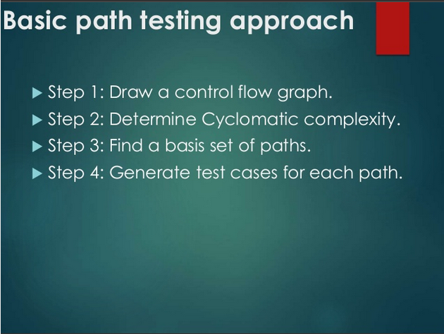
ref boris beizer

Slide 17
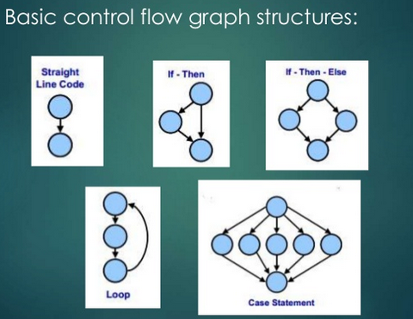
ref boris beizer

Slide 18

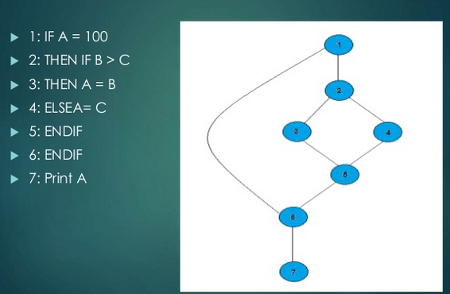
ref boris beizer

Slide 19
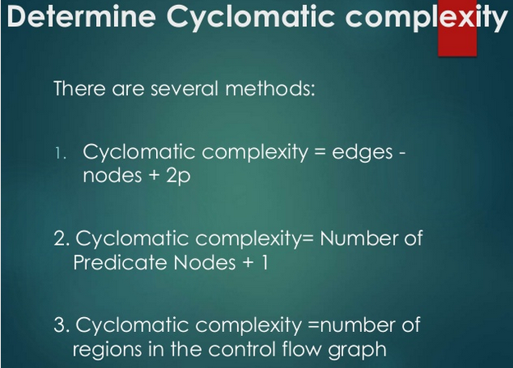
ref boris beizer

Slide 20
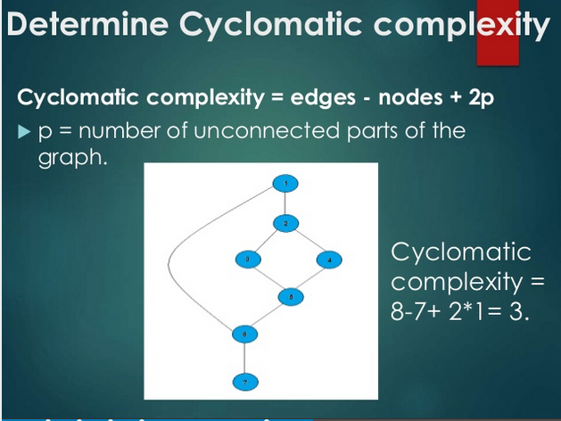
ref boris beizer

Slide 21
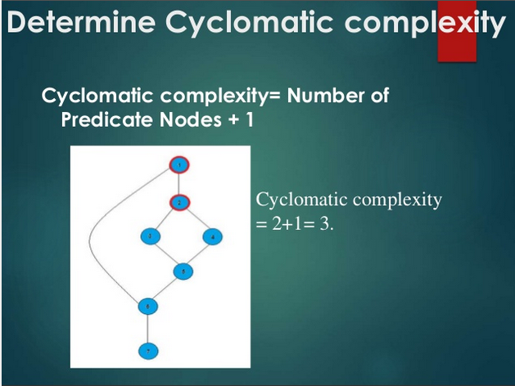
ref boris beizer

Slide 22
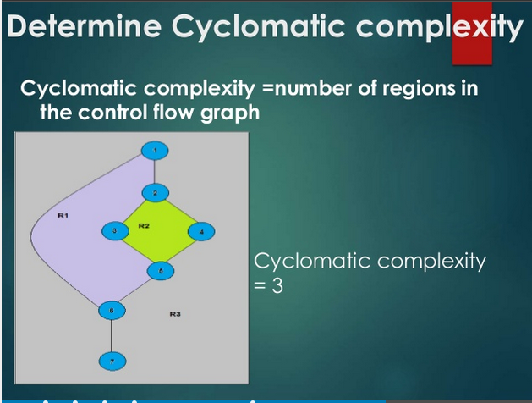
ref boris beizer

Slide 23
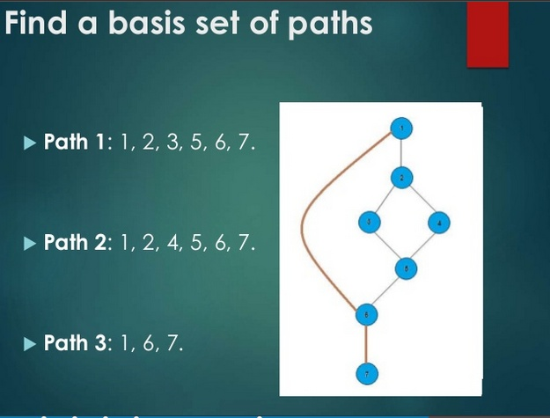
ref boris beizer

Slide 24
Control Flow Graphs and Path Testing
_{L2}
Path Testing Concepts
Path Testing Criteria :
  Path Testing (P∝ ):
  Execute all possible control flow paths thru the program; but typically restricted to entry-exit paths.
  Implies 100% path coverage.
  Statement Testing ( P₁) :
  Execute all statements in the program at least once under the some test.
  100% statement coverage => 100% node coverage.
  Denoted by C1
  C1 is a minimum testing requirement in the IEEE unit test standard: ANSI 87B.
  Branch Testing (P₂) :
  Execute enough tests to assure that every branch alternative has been exercised at least once under some test.
  Denoted by C2
  Objective: 100% branch coverage and 100% Link coverage.
  For well structured software, branch testing & coverage include statement coverage
ref boris beizer

Slide 25
Control Flow Graphs and Path Testing
_{L2}
Picking enough (the fewest) paths for achieving C1+C2
₂
₁
_{Z >= 0 ?}
_{NO}
_{f}
_{P1}
_{a}
_{b}
_{NO}
_{c}
_{END}
_{YES}
_{N = V ?}
_{LOOP}
_{SAM}
_{g}
_{e}
_{d}
₆
₄
₃
₅
Paths | Decisions |  | Process-link
 | 2 | 5 | a | b | c | d | e | f | g
abdeg | No | Y | Y | Y |  | Y | Y |  | Y
acdeg | Y | Y | Y |  | Y | Y | Y |  | Y
abdefeg | No | Y | Y | Y |  | Y | Y | Y | Y
acdefeg | Y | No | Y |  | Y | Y | Y | Y | Y
Does every decision have Y & N (C2)?
Are call cases of case statement marked (C2)?
Is every three way branch covered (C2)?
Is every link covered at least once (C1)?
Make small changes in the path changing only 1 link or node at a time.
ref boris beizer

Slide 26
Control Flow Graphs and Path Testing
_{L2}
Revised path selection Rules
Pick the simplest and functionally sensible entry/exit path
Pick additional paths as small variations from previous paths. (pick those with no loops, shorter paths, simple and meaningful)
Pick additional paths but without an obvious functional meaning (only to achieve C1+C2 coverage).
Be comfortable with the chosen paths to achieve C1+C2
ref boris beizer

Slide 27
Control Flow Graphs and Path Testing
_{L2}
Effectiveness of Path Testing
  Path testing catches ~65% of Unit Test Bugs ie., ~35% of all bugs.
  More effective for unstructured than structured software.
  Limitations
    Path testing may not do expected coverage if bugs occur.
    Path testing may not reveal totally wrong or missing functions.
    Unit-level path testing may not catch interface errors among routines.
    Data base and data flow errors may not be caught.
    Unit-level path testing cannot reveal bugs in a routine due to another.
    Not all initialization errors are caught by path testing.
    Specification errors cannot be caught.
ref boris beizer

Slide 28
Control Flow Graphs and Path Testing
_{L2}
  A lot of work
    Creating flow graph, selecting paths for coverage, finding input data values to force these paths, setting up loop cases & combinations.
  Careful, systematic, test design will catch as many bugs as the act of testing.
  Test design process at all levels at least as effective at catching bugs as is running the test designed by that process.
ref boris beizer

Slide 29
Control Flow Graphs and Path Testing
_{L3}
Predicates, Predicate Expressions
Path
  A sequence of process links (& nodes)
Predicate
  The logical function evaluated at a decision : True or False. (Binary , boolean)
Compound Predicate
  Two or more predicates combined with AND, OR etc.
Path Predicate
  Every path corresponds to a succession of True/False values for the predicates traversed on that path.
  A predicate associated with a path.
  “ X > 0 is True “ AND “W is either negative or equal to 122” is True
ref boris beizer

Slide 30
Control Flow Graphs and Path Testing
_{L3}
Predicates, Predicate Expressions…
Predicate Interpretation
  The symbolic substitution of operations along the path in order to express the predicate solely in terms of the input vector is called predicate interpretation.
  An input vector is a set of inputs to a routine arranged as a one dimensional array.
  Predicate interpretation may or may not depend on the path.
  Path predicates are the specific form of the predicates of the decisions along the selected path after interpretation.
ref boris beizer

Slide 31
Control Flow Graphs and Path Testing
_{L3}
Predicates, Predicate Expressions…
Process Dependency
  An input variable is independent of the processing if its value does not change as a result of processing.
  An input variable is process dependent if its value changes as a result of processing.
  A predicate is process dependent if its truth value can change as a result of processing.
  A predicate is process independent if its truth value does not change as a result of processing.
  Process dependence of a predicate doesn’t follow from process dependence of variables
  If all the input variables (on which a predicate is based) are process independent, then predicate is process independent.
ref boris beizer

Slide 32
Control Flow Graphs and Path Testing
_{L3}
Predicates, Predicate Expressions…
Correlation
  Two input variables are correlated if every combination of their values cannot be specified independently.
  Variables whose values can be specified independently without restriction are uncorrelated.
  A pair of predicates whose outcomes depend on one or more variables in common are correlated predicates.
  Every path through a routine is achievable only if all predicates in that routine are uncorrelated.
  If a routine has a loop, then at least one decision’s predicate must be process dependent. Otherwise, there is an input value which the routine loops indefinitely.
ref boris beizer

Slide 33
Control Flow Graphs and Path Testing
_{L3}
Predicates, Predicate Expressions…
Path Predicate Expression
  Every selected path leads to an associated boolean expression, called the path predicate expression, which characterizes the input values (if any) that will cause that path to be traversed.
  Select an entry/exit path. Write down un-interpreted predicates for the decisions along the path. If there are iterations, note also the value of loop-control variable for that pass. Converting these into predicates that contain only input variables, we get a set of boolean expressions called path predicate expression.
  Example (inputs being numerical values):
  If X ₅ > 0 .OR. X ₆ < 0 then
  X1 + 3X2 + 17 >= 0
X3 = 17
X4 – X1 >= 14 X2
ref boris beizer

Slide 34
Control Flow Graphs and Path Testing
_{L3}
Predicates, Predicate Expressions…
  A: X ₅ > 0 E: X ₆ < 0
  B: X1 + 3X2 + 17 >= 0 F: X1 + 3X2 + 17 >= 0
C: X3 = 17 G: X3 = 17
D: X4 – X1 >= 14 X2 H: X4 – X1 >= 14 X2
  Converting into the predicate expression form:
  A B C D + E B C D ⇒ ( A + E ) B C D
  If we take the alternative path for the expression: D then
  (A + E ) B C D
ref boris beizer

Slide 35
Control Flow Graphs and Path Testing
_{L3}
Predicates, Predicate Expressions…
Predicate Coverage:
  Look at examples & possibility of bugs: A B C D A + B + C + D
    Due to semantics of the evaluation of logic expressions in the languages, the entire expression may not be always evaluated.
    A bug may not be detected.
    A wrong path may be taken if there is a bug.
  Realize that on our achieving C2, the program could still hide some control flow bugs.
  Predicate coverage:
    If all possible combinations of truth values corresponding to selected path have been explored under some test, we say predicate coverage has been achieved.
    Stronger than branch coverage.
    If all possible combinations of all predicates under all interpretations are covered, we have the equivalent of total path testing.
ref boris beizer

Slide 36
Control Flow Graphs and Path Testing
_{L2}
Testing of Paths involving loops
Bugs in iterative statements apparently are not discovered by C1+C2.
But by testing at the boundaries of loop variable.
Types of Iterative statements
    Single loop statement.
    Nested loops.
    Concatenated Loops.
    Horrible Loops
  Let us denote the Minimum # of iterations by nmin
  the Maximum # of iterations by nmax
  the value of loop control variable by V
  the #of test cases by T
  the # of iterations carried out by n
  Later, we analyze the Loop-Testing times
ref boris beizer

Slide 37
Control Flow Graphs and Path Testing
_{L2}
Testing of path involving loops…
Testing a Single Loop Statement (three cases)
Case 1. nmin = 0, nmax = N, no excluded values
1. Bypass the loop.
If you can’t, there is a bug, nmin ≠ 0 or a wrong case.
2. Could the value of loop (control) variable V be negative?
could it appear to specify a –ve n ?
3. Try one pass through the loop statement: n = 1
4. Try two passes through the loop statement: n = 2
To detect initialization data flow anomalies:
Variable defined & not used in the loop, or
Initialized in the loop & used outside the loop.
5. Try n = typical number of iterations : nmin < n < nmax
6. Try n = nmax -1
7. Try n = nmax
8. Try n = nmax + 1.
What prevents V (& n) from having this value?
What happens if it is forced?
1
2
ref boris beizer

Slide 38
Control Flow Graphs and Path Testing
_{L2}
Testing of path involving loops…
Case 2.Single loop, nonzero minimum,No excluded values( nmin = +ve, nmax = N, no excluded values)
1. Try nmin - 1
Could the value of loop (control) variable V be < nmin?
What prevents that ?
2. Try nmin
3. Try nmin + 1
4. Once, unless covered by a previous test.
5. Twice, unless covered by a previous test.
4. Try n = typical number of iterations : nmin < n < nmax
5. Try n = nmax -1
6. Try n = nmax
7. Try n = nmax + 1.
What prevents V (& n) from having this value?
What happens if it is forced?
Note: only a case of no iterations, n = 0 is not there.
1
2
ref boris beizer

Slide 39
Control Flow Graphs and Path Testing
_{L2}
Testing of path involving loops…
  Compromise on # test cases for processing time.
  Expand tests for solving potential problems associated with initialization of variables and with excluded combinations and ranges.
  Apply Huang’s twice thorough theorem to catch data initialization problems.
1
2
3
4
ref boris beizer

Slide 40
Control Flow Graphs and Path Testing
_{L2}
Testing of path involving loops…
Testing Concatenated Loop Statements
  Two loops are concatenated if it’s possible to reach one after exiting the other while still on the path from entrance to exit.
  If these are independent of each other, treat them as independent loops.
  If their iteration values are inter-dependent & these are same path, treat these like a nested loop.
  Processing times are additive.
1
2
3
4
ref boris beizer

Slide 41
Control Flow Graphs and Path Testing
_{L2}
Testing of path involving loops…
Testing Horrible Loops
  Avoid these.
  Even after applying some techniques of paths, resulting test cases not definitive.
  Too many test cases.
  Thinking required to check end points etc. is unique for each program.
  Jumps in & out of loops and intersecting loops etc, makes test case selection an ugly task.
  etc. etc.
1
2
3
4
5
6
ref boris beizer

Slide 42
Control Flow Graphs and Path Testing
_{L2}
Path Testing Concepts…
Case 3. Single loop with excluded values
1. Treat this as single loops with excluded values as two sets.
2. Example:
V = 1 to 20 excluding 7,8,9 and10
Test cases to attempt are for:
V = 0,1,2,4,6,7 and V = 10,11,15,19,20,21
(underlined cased are not supposed to work)
1
2
ref boris beizer

Slide 43
Control Flow Graphs and Path Testing
_{L2}
Testing of path involving loops…
Testing a Nested Loop Statement
  Multiplying # of tests for each nested loop => very large # of tests
  A test selection technique:
    Start at the inner-most loop. Set all outer-loops to Min iteration parameter values: V_{min}.
    Test the V_{min,} V_{min} + 1, typical V, V_{max} - 1, V_{max} for the inner-most loop. Hold the outer-loops to V_{min.} Expand tests are required for out-of-range & excluded values.
    If you have done with outer most loop, Go To step 5. Else, move out one loop and do step 2 with all other loops set to typical values.
    Do the five cases for all loops in the nest simultaneously.
  Assignment: check # test cases = 12 for nesting = 2, 16 for 3, 19 for 4.
1
2
3
4
ref boris beizer

Slide 44
Control Flow Graphs and Path Testing
_{L2}
Testing of path involving loops…
Loop Testing Times
  Longer testing time for all loops if all the extreme cases are to be tested.
  Unreasonably long test execution times indicate bugs in the s/w or specs.
  Case: Testing nested loops with combination of extreme values leads to long test times.
    Show that it’s due to incorrect specs and fix the specs.
    Prove that combined extreme cases cannot occur in the real world. Cut-off those tests.
    Put in limits and checks to prevent the combined extreme cases.
    Test with the extreme-value combinations, but use different numbers.
  The test time problem is solved by rescaling the test limit values.
    Can be achieved through a separate compile, by patching, by setting parameter values etc..
ref boris beizer

Slide 45
Control Flow Graphs and Path Testing
_{L3}
Testing blindness
coming to the right path – even thru a wrong decision (at a predicate). Due to the
  interaction of some statements makes a buggy predicate work, and
  the bug is not detected by the selected input values.
calculating wrong number of tests at a predicate
  by ignoring the # of paths to arrive at it.
Cannot be detected by path testing and need other strategies
ref boris beizer

Slide 46
Control Flow Graphs and Path Testing
_{L3}
Testing blindness
  Assignment blinding: A buggy Predicate seems to work correctly as the specific value chosen in an assignment statement works with both the correct & buggy predicate.
    Correct Buggy
    X := 7 X := 7
    IF Y > 0 THEN … IF X + Y > 0 THEN … (check for Y=1)
  Equality blinding:
    When the path selected by a prior predicate results in a value that works both for the correct & buggy predicate.
    Correct Buggy
    IF Y = 2 THEN … IF Y = 2 THEN ..
    IF X + Y > 3 THEN … IF X > 1 THEN … (check for any X>1)
  Self-blinding
    When a buggy predicate is a multiple of the correct one and the result is indistinguishable along that path.
    Correct Buggy
    X := A X := A
    IF X - 1 > 0 THEN … IF X + A -2 > 0 THEN … (check for any X,A)
ref boris beizer

Slide 47
Control Flow Graphs and Path Testing
_{L4}
Achievable Paths
Objective is to select & test just enough paths to achieve a satisfactory notion of test completeness such as C1 + C2.
Extract the program’s control flow graph & select a set of tentative covering paths.
For a path in that set, interpret the predicates.
Trace the path through, multiplying the individual compound predicates to achieve a boolean expression. Example: (A + BC) ( D + E)
Multiply & obtain sum-of-products form of the path predicate expression:
AD + AE + BCD + BCE
Each product term denotes a set of inequalities that, if solved, will yield an input vector that will drive the routine along the selected path.
A set of input values for that path is found when any of the inequality sets is solved.
A solution found => path is achievable. Otherwise the path is unachievable.
ref boris beizer

Slide 48
Control Flow Graphs and Path Testing
_{L7}
Application of Path Testing
Integration, Coverage, and Paths in Called Components
Mainly used in Unit testing, especially new software.
In an Idealistic bottom-up integration test process – integrating one component at a time. Use stubs for lower level component (sub-routines), test interfaces and then replace stubs by real subroutines.
In reality, integration proceeds in associated blocks of components. Stubs may be avoided. Need to think about paths inside the subroutine.
To achieve C1 or C2 coverage:
  Predicate interpretation may require us to treat a subroutine as an in-line-code.
  Sensitization becomes more difficult.
  Selected path may be unachievable as the called components’ processing may block it.
Weaknesses of Path testing:
It assumes that effective testing can be done one level at a time without bothering what happens at lower levels.
predicate coverage problems & blinding.
ref boris beizer

Slide 49
Control Flow Graphs and Path Testing
_{L7}
Implementation & Application of Path Testing
Application of path testing to New Code
  Do Path Tests for C1 + C2 coverage
  Use the procedure similar to the idealistic bottom-up integration testing, using a mechanized test suite.
  A path blocked or not achievable could mean a bug.
  When a bug occurs the path may be blocked.
ref boris beizer

Slide 50
Control Flow Graphs and Path Testing
_{L7}
Implementation & Application of Path Testing
Application of path testing to Maintenance
  Path testing is applied first to the modified component.
  Use the procedure similar to the idealistic bottom-up integration testing, but without using stubs.
  Select paths to achieve C2 over the changed code.
  Newer and more effective strategies could emerge to provide coverage in maintenance phase.
ref boris beizer

Slide 51
Control Flow Graphs and Path Testing
_{L7}
Implementation & Application of Path Testing
Application of path testing to Rehosting
  Path testing with C1 + C2 coverage is a powerful tool for rehosting old software.
  Software is rehosted as it’s no more cost effective to support the application environment.
  Use path testing in conjunction with automatic or semiautomatic structural test generators.
ref boris beizer

Slide 52
Control Flow Graphs and Path Testing
_{L7}
Implementation & Application of Path Testing
Application of path testing to Rehosting..
  Process of path testing during rehosting
  A translator from the old to the new environment is created & tested. Rehosting process is to catch bugs in the translator software.
  A complete C1 + C2 coverage path test suite is created for the old software. Tests are run in the old environment. The outcomes become the specifications for the rehosted software.
Another translator may be needed to adapt the tests & outcomes to the new environment.
The cost of the process is high, but it avoids risks associated with rewriting the code.
Once it runs on new environment, it can be optimized or enhanced for new
functionalities (which were not possible in the old environment.)
ref boris beizer

Slide 53
_{U2}
  Data - Flow Testing - Basics

Slide 54
Data - Flow Testing - Basics
_{U2}
  In Data flow testing concentrate on the usage of variable.
  The importance of analyzing the use of variables in programs has been recognized for a long time.
  Variables have been seen as the main areas where a program can be tested structurally.
  Statements where variable receives values
  Statements where values are used
  Anomalies with variables
  “A variable that is defined but never used (referenced).
  A variable that is used but never defined.
  A variable that is defined twice before it is used.”
  Data Flow Testing (DFT) uses Control Flow Graph (CFG) to explore dataflow anomalies.

Slide 55
Data - Flow Testing - Basics
_{U2}
  Definition:
  Data-flow testing is a white box testing technique that can be used to detect improper use of data values due to coding errors.
  Data Flow Testing is a family of test strategies based on selecting paths through the program’s control flow in order to explore the sequence of events related to the status of data objects.
  Testing focuses on the points at which variables receive values and the points at which these values are used.
  Example:
  Pick enough paths to assure that every data item has been initialized prior to its use, or that all objects have been used for something.

Slide 56
Data - Flow Testing - Basics
_{U2}
Advantages of Data Flow Testing:
  Data Flow testing helps us to pinpoint any of the following issues:
  A variable that is declared but never used within the program.
  A variable that is used but never declared.
  A variable that is defined multiple times before it is used.
  De-allocating a variable before it is used.

Slide 57
Data - Flow Testing - Basics
_{U2}
Motivation:
  it is our belief that, just as one would not feel confident about a program without executing every statement in it as part of some test,
  one should not feel confident about a program without having seen the effect of using the value produced by each and every computation.

Slide 58
Data - Flow Testing - Basics
_{U2}
DATA FLOW MACHINES: There are two types of data flow machines with different architectures.
Von Neumann machines
Multi-instruction, multi-data machines (MIMD).
(1). Von Neumann Machine Architecture:
  Most computers today are von-neumann machines.
  This architecture features interchangeable storage of instructions and data in the same memory units.

Slide 59
Data - Flow Testing - Basics - Motivation
_{U2}
  Program Control flow with Von Neumann’s paradigm
  Given m, n, p, q, find e.
  e = (m+n+p+q) * (m+n-p-q)
  a := m + n
  b := p + q
  c := a + b
  d := a - b
  e := c * d
a = n+m
b=p+q
c=a+b
d=a-b
e=c*d
  Multiple representations of control flow graphs possible.

Slide 60
Data - Flow Testing - Basics
_{U2}
  The Von Neumann machine Architecture executes one instruction at a time in the following, micro instruction sequence:
    Fetch instruction from memory
    Interpret instruction
    Fetch operands
    Process or Execute
    Store result
    Increment program counter
    GOTO 1

Slide 61
Data - Flow Testing - Basics
_{U2}
Multi-instruction, Multi-data machines (MIMD) Architecture:
These machines can fetch several instructions and objects in parallel.
They can also do arithmetic and logical operations simultaneously on different data objects.
The decision of how to sequence them depends on the compiler.

Slide 62
Data - Flow Testing - Basics
_{U2}
Multi-instruction, Multi-data machines (MIMD) Architecture:
These machines can fetch several instructions and objects in parallel.
They can also do arithmetic and logical operations simultaneously on different data objects.
The decision of how to sequence them depends on the compiler.

Slide 63
Data - Flow Testing - Basics
_{U2}
Data Object State and Usage: Data Objects can be created, killed and used.
They can be used in two distinct ways:
In a Calculation
As a part of a Control Flow Predicate.
The following symbols denote these possibilities:
  Defined: d - defined, created, initialized etc
  Killed or undefined: k - killed, undefined, released etc
  Usage: u - used for something (c - used in Calculations, p - used in a predicate)

Slide 64
Data - Flow Testing - Basics
_{U2}
Defined (d):
An object is defined explicitly when it appears in a data declaration.
Or implicitly when it appears on the left hand side of the assignment.
It is also to be used to mean that a file has been opened.
A dynamically allocated object has been allocated.
Something is pushed on to the stack.
A record written.

Slide 65
Data - Flow Testing - Basics
_{U2}
2. Killed or Undefined (k):
  An object is killed on undefined when it is released or otherwise made unavailable.
  When its contents are no longer known with certitude (with aboslute certainity / perfectness).
  Release of dynamically allocated objects back to the availability pool.
  Return of records.
  The old top of the stack after it is popped.
  An assignment statement can kill and redefine immediately. For example, if A had been previously defined and we do a new assignment such as A : = 17, we have killed A's previous value and redefined A

Slide 66
Data - Flow Testing - Basics
_{U2}
3. Usage (u):
A variable is used for computation (c) when it appears on the right hand side of an assignment statement.
A file record is read or written.
It is used in a Predicate (p) when it appears directly in a predicate.

Slide 67
Data - Flow Testing - Basics - Motivation
_{U2}
  Program Flow using Data Flow Machines paradigm
  BEGIN
  PAR DO
  READ m, n, n, p, q
  END PAR
  PAR DO
  a := m+n
  b := p+q
  END PAR
  PAR DO
  c := a+b
  d := a-b
  END PAR
  PAR DO
  e := c * d
  END PAR
  END
n
m
p
q
a := m+n
b := p+q
c := a+b
d := a-b
e := c * d
  The interrelations among the data items remain same.

Slide 68
Data - Flow Testing - Basics – Data Flow Anomalies
_{U2}
  Actions on data objects
    - no action from START to this point
    From this point till the EXIT
      - d normal
      - u anomaly
    - k anomaly
    k- normal
    u - normal - possibly an anomaly
    d - possibly anomalous

Slide 69
Data - Flow Testing - Basics
_{U2}
  Data Flow Anomaly State graph
    Data Object State
        K, D, U, A
    Processing Step
        k, d, u

Slide 70
Data - Flow Testing - Basics
_{U2}
  Data Flow Anomaly State graph
    Object state
    Unforgiving Data flow state graph
Undefined
K
k, u
d
u
d, k
U
D
A
u
Anomalous
d
Defined
d, k, u
Used

Slide 71
Data - Flow Testing - Basics
_{U2}
  Data Flow Anomaly State graph
    Forgiving Data flow state graph
u
A ⇒ DD, DK, KU
k
u
KU
K
k
k
u
DK
d
k
u
d
U
k
D
d
u
d
DD
u
d

Slide 72
Data - Flow Testing - Basics
_{U2}
  Data Flow State Graphs
    Differ in processing of anomalies
    Choice depends on Application, language, context

Slide 73
Data - Flow Testing - Basics
_{U2}
  Static vs Dynamic Anomaly Detection
    Static analysis of data flows
    Dynamic analysis
    Intermediate data values

Slide 74
Data - Flow Testing - Basics
_{U2}
Insufficiency of Static Analysis (for Data flow)
  Validation of Dead Variables
  Validation of pointers in Arrays
  Validation of pointers for Records & pointers
  Dynamic addresses for dynamic subroutine calls
  Identifying False anomaly on an unachievable path
  Recoverable anomalies & Alternate state graph
  Concurrency, Interrupts, System Issues

Slide 75
Data - Flow Testing - Basics
_{U2}
  Data Flow Model
    Based on CFG
    CFG annotated with program actions
    link weights : dk, dp, du etc..
    Not same as DFG
    For each variable and data object

Slide 76
Data - Flow Testing - Basics : Data Flow Model
_{U2}
  Procedure to Build:
    Entry & Exit nodes
    Unique node identification
    Weights on out link
    Predicated nodes
    Sequence of links
      Join
      Concatenate weights
      The converse

Slide 77
Data - Flow Testing - Basics : Data Flow Model
_{U2}
  Example: a^{n} – 1
Z = b + ---------
START a - 1
INPUT a, b, n
Z := 0
IF a = 1 THEN Z := 1
GOTO DONE1
r := 1 c := 1
POWER:
c := c * a
r := r + 1
IF r <= n THEN GO TO POWER
Z := (c – 1) / (a – 1)
DONE1:
Z := b + Z
END

Slide 78
Data - Flow Testing - Basics – Data Flow model
_{U2}
  CFG for the Example
Read a,b,n
Z := 0
Z := 1
Z := b + Z
1
2
5
6
a = 1?
P1
Y
Z := (c-1)/(a-1)
3
P2
4
r < n ?
r := 1 c:=1
r := r+1, c:= c*a
Y

Slide 79
Data - Flow Testing - Basics – Data Flow model
_{U2}
  CFG annotated – Data Flow Model for Z
d or kd
cd or ckd
1
d
2
5
6
a = 1?
P1
Y
d or kd
3
P2
4
r < n ?
Y

Slide 80
Data - Flow Testing - Basics – Data Flow model
_{U2}
  CFG annotated – Data Flow Model for c
1
2
5
6
a = 1?
P1
Y
-d
c-
3
ckd or kd
P2
4
r < n ?
Y

Slide 81
Data - Flow Testing - Basics – Data Flow model
_{U2}
  CFG annotated – Data Flow Model for r
1
2
5
6
a = 1?
P1
Y
-d
p-
3
ckd or kd
P2
4
r < n ?
Y

Slide 82
Data - Flow Testing - Basics – Data Flow model
_{U2}
  CFG annotated – Data Flow Model for b
1
d
2
5
c
6
a = 1?
P1
Y
3
P2
4
r < n ?
Y

Slide 83
Data - Flow Testing - Basics – Data Flow model
_{U2}
  CFG annotated – Data Flow Model for n
1
d
2
5
6
a = 1?
P1
Y
p-
3
P2
4
r < n ?
Y

Slide 84
Data - Flow Testing - Basics – Data Flow model
_{U2}
  CFG annotated – Data Flow Model for a
1
d
2
5
6
a = 1?
P1
p
c-
3
c
P2
4
r < n ?
Y

Slide 85
LOGIC-BASED TESTING
  Programmers and Logic
“Logic” is one of the most often used words In programmers’ vocabularies but one of their least used techniques.
Boolean Algebra is being the simplest form of logic.
Boolean Algebra is to logic as arithmetic is to mathematics.

Slide 86
LOGIC-BASED TESTING
  Decision Tables
A decision table is a table that consists of four areas called the condition stub, the condition entry, the action stub and the action entry.
Each column of the table is a rule that specifies the conditions under which the actions named in the action stub will take place.

Slide 87
LOGIC-BASED TESTING
  An example of a Decision Table
CONDITION ENTRY
 | RULE 1 | RULE 2 | RULE 3 | RULE 4
CONDITION 1 CONDITION 2 CONDITION 3 CONDITION 4 | YES YES NO NO | YES I YES YES | NO NO NO NO | NO I I YES
ACTION 1 ACTION 2 ACTION 3 | YES NO NO | YES NO NO | NO YES NO | NO NO YES
CONDITION STUB
ACTION STUB
ACTION ENTRY

Slide 88
LOGIC-BASED TESTING
The condition stub is a list of names of conditions.
A rule specifies whether a condition should or should not be met for the rule to be satisfied. “yes” means that the conditions must be met, and “No” means that conditions must not be met, and “I” means that the conditions plays no part in the rule, or it is immaterial to the rule.
The action stub names the actions the routine will take or initiate if the rule is satisfied.
If the action entry is “YES” , the action will take place; if “NO” , the action will not take place.
Some of the rules are not specified by the decision table for which a default action to be taken are called Default Rules.

Slide 89
LOGIC-BASED TESTING
Action 1 will take place if condition 1 and 2 are met and if condition 3 and 4 are not met (rule 1) or if condition 1,3 and 4 are met (rule 2)
 | RULE 1 | RULE 2 | RULE 3 | RULE 4
CONDITION 1 CONDITION 2 CONDITION 3 CONDITION 4 | YES YES NO NO | YES I YES YES | NO NO NO NO | NO I I YES
DEFAULT ACTION | YES | YES | YES | YES

Slide 90
LOGIC-BASED TESTING
Decision Table Processors
Decision tables can be automatically translated into code and as such are a higher order language.
The decision table translator checks the source decision table for consistency and completeness and fills in any required default rules.
Decision tables as a source language have the virtue of clarity, direct correspondence to specifications, and maintainability.

Slide 91
LOGIC-BASED TESTING
Decision tables as a Basis for Test Case Design
If a specification is given as a decision table, it follows that decision tables should be used for test case design.
If a program’s logic is implemented as a decision table, decision table should also be used as a basis for test design.
It is not always possible or desirable to implement the program as a decision table because the program’s logical behavior is only part of its behavior. The program interfaces with other programs, there are restrictions or the decision table language may not have needed features.
The use of a decision table model to design tests is warranted when:
The specification is given as a decision table or can be easily converted into one.
The order in which the predicates are to be evaluated does not affect interpretation of the rules or the resulting action.
Once a rule is satisfied and an action is selected, no other rule need be examined.
If several actions can result from satisfying rule, the order in which the actions are executed doesn’t matter.

Slide 92
LOGIC-BASED TESTING
Expansion of Immaterial Cases
Improperly specified immaterial entries (I) cause most decision-table contradictions.
If a condition’s truth value is immaterial in a rule, satisfying the rule doesnot depend on the condition. It doesn’t mean that the case is impossible.
For example,
Rule 1: “ if the persons are male and over 30, then they shall receive a 15% raise”
Rule 2: “but if the persons are female, then they shall receive a 10% raise.”
The above rules state that age is material for a male’s raise, but immaterial for determining a female’s raise.

Slide 93
LOGIC-BASED TESTING
Expansion of Immaterial Cases
 | Rule 2.1 | Rule 2.2 | Rule 4.1 | Rule 4.2 | Rule 4.3 | Rule 4.4
CONDITION1 CONDITION2 CONDITION3 CONDITION4 | YES YES YES YES | YES NO YES YES | NO YES YES YES | NO YES NO YES | NO NO NO YES | NO NO YES YES

Slide 94
LOGIC-BASED TESTING
The expansion of an Inconsistent Specification
Rule 1.1 | Rule 1.2 | Rule 2.1 | Rule 2.2
Yes Yes Yes No | Yes No Yes No | Yes No Yes No | Yes No No No
Yes No | Yes No | No Yes | No Yes
 | Rule 1 | Rule 2
Condition 1 Condition 2 Condition 3 Condition 4 | Yes I Yes No | Yes No I No
Action 1 Action 2 | Yes No | No yes

Slide 95
LOGIC-BASED TESTING
Test Case Design
Test case design by decision tables begins with examining the specification’s consistency and completeness.
This is done by expanding all immaterial cases and checking the expanded tables.
Once the specification have been verified, the objective of the test case is to show that the implementation provides the correct action for all combinations of predicate values.

Slide 96
LOGIC-BASED TESTING
Decision tables and Structure
Decision tables can also be used to examine a program’s structure.
D
R1
8
Action 1
B
D
D¹
A
R3
1
A
B
B¹
R2
9
Action 3
A¹
C
C
R4
R5
D
D
C¹
R6
10
Action 2
D¹

Slide 97
LOGIC-BASED TESTING
 | Rule 1 | Rule 2 | Rule 3 | Rule 4 | Rule 5 | Rule 6
Condition A Condition B Condition C Condition D | Yes Yes I Yes | Yes No I I | Yes Yes I No | No I Yes I | No I No Yes | No I No No
Action 1 Action 2 Action 3 | Yes No No | Yes No No | No Yes No | No Yes No | No Yes No | No No Yes
The decision table corresponding to the previous decision tree

