Slide 1
UNIT -III

Slide 2
Establishing Testing Policy
A software testing policy serves two purposes.
First, it is the basis for defining what software testers will include in the test processes.
Second, it explains to outside parties, such as organizational management, IT customers and users, as well as project person-nel, the role and responsibilities of software testing.

Slide 3
A Test Policy is a high level document and is at the top of the hierarchy of the Test Documentation structure.
The purpose of the Test Policy document is to represent the testing philosophy of the company as a whole and to provide a direction which the testing department should adhere to and follow.
It should apply to both new projects and maintenance work.

Slide 4
Establishing Testing Policy
Criteria for a Testing Policy
A testing policy is management’s definition of testing for a department .
A testing policy involves the following four criteria:
    Definition of testing. A brief but clear definition of testing.
    Testing system. The method through which testing will be achieved and enforced.
    Evaluation. How information services management will measure and evaluate testing.
    Standards. The standards against which testing will be measured.

Slide 5
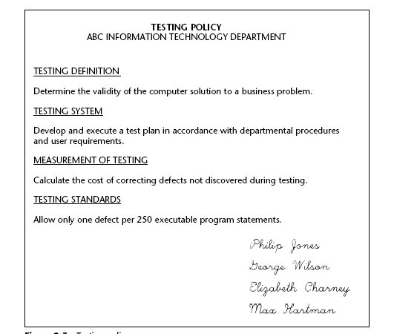
Establishing Testing Policy

Slide 6
Methods for Establishing a Testing Policy
The following three methods can be used to establish a testing policy:
1. Management directive.
One or more senior IT managers write the policy.
They determine what they want from testing, document that into a policy, and issue it to the department.
This is an economical and effective method to write a testing policy
the potential disadvantage is that it is not an organizational policy, but rather the policy of IT management.

Slide 7
Methods for Establishing a Testing Policy
2. Information services consensus policy.
IT management convenes a group of the more senior and respected individuals in the department to jointly develop a policy.
While senior management must have the responsibility for accepting and issuing the policy, the development of the policy is representative of the thinking of all the IT department, rather than just senior management.
The advantage of this approach is that it involves the key members of the IT department. Because of this participation, staff is encouraged to follow the policy.
The disadvantage is that it is an IT policy and not an organizational policy.

Slide 8
Methods for Establishing a Testing Policy
3. Users’ meeting.
Key members of user management meet in conjunction with the IT department to jointly develop a testing policy.
Again, IT management has the final responsibility for the policy, but the actual policy is developed using people from all major areas of the organization.
The advantage of this approach is that it is a true organizational policy and involves all of those areas with an interest in testing.
The disadvantage is that it takes time to follow this approach, and a policy might be developed that the IT department is obligated to accept because it is a consensus policy and not the type of policy that IT itself would have written.

Slide 9
Structured Approach to Testing
All too often, testing after coding is the only verification technique used to determine the adequacy of the system.
All errors are costly, but the later in the SDLC the error is discovered, the more costly the error. Indeed, an error discovered in the latter parts of the SDLC must be paid four different times.
The first cost is developing the program erroneously, which may include writing the wrong specifications, coding the system wrong, an documenting the sys-tem improperly.
Second, the system must be tested to detect the error.
Third, the wrong specifications and coding must be removed and the proper specifications, coding, and documentation added.
Fourth, the system must be retested to determine whether the problem(s) have been corrected.

Slide 10
Structured Approach to Testing
If information services has as its goal lower cost and higher quality systems
It must not isolate verification to a single phase in the development process; rather, it must incorporate verification into each phase of development.
One of the most prevalent and costly mistakes on systems development projects today is to defer the activity of detecting and correcting problems until late in the project.
A major justification for an early verification activity is that many costly errors are made before coding begins.

Slide 11
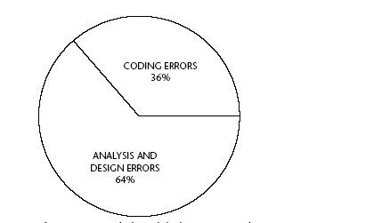
Structured Approach to Testing
Studies have shown that the majority of system errors occur in the design phase.
Figure represents the results of numerous studies that show that approximately two-thirds of all detected system errors can be attributed to errors made during the design phase.
This means that almost two-thirds of the errors must be specified and coded into programs before they can be detected

Slide 12
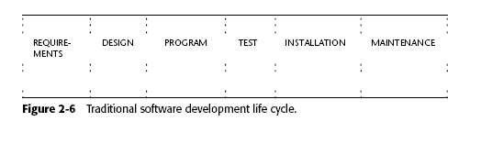
Structured Approach to Testing
The following activities should be performed at each phase:
■ Analyze the software documentation for internal testability and adequacy.
■Generate test sets based on the software documentation at this phase.
In addition, the following should be performed during the design and program phases:
■ Determine that the software documentation is consistent with the software documentation produced during previous phases.
■Refine or redefine test sets generated earlier.

Slide 13
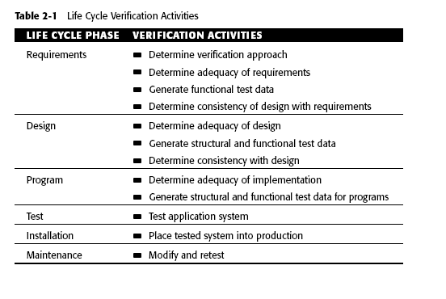
Structured Approach to Testing

Slide 14
Structured Approach to Testing
Requirements
The verification activities performed during the requirements phase of software development are extremely significant.
The adequacy of the requirements must be thoroughly analyzed and initial test cases generated with the expected (correct) responses.
Developing scenarios of expected system use may help to determine the test data and anticipated results.
Requirements defined to later phases of development can be very costly.
A determination of the importance of software quality attributes should be made at this stage.
Both product requirements and validation requirements should be established.

Slide 15
Structured Approach to Testing
Design
During the design phase, the general testing strategy is formulated and a test plan is produced.
If needed, an independent test team is organized.
A test schedule with observable milestones should be determined.
At this same time, the framework for test documentation should be established.
During the design phase, validation support tools should be acquired or developed and the test procedures themselves should be produced.
In addition to test organization and the generation of test cases, the design itself should be analyzed and examined for errors.

Slide 16
Structured Approach to Testing
Simulation can be used to verify properties of the system structures and subsystem interaction, design walkthroughs should be used by the developers to verify the flow and logical structure of the system, while design inspection should be performed by the test team.
Areas of concern include missing cases, faulty logic, module interface mismatches, data structure inconsistencies, erroneous I/O assumptions, and user interface inadequacies.
The detailed design must prove to be internally coherent, complete, and consistent with the preliminary design and requirements.

Slide 17
Structured Approach to Testing
Program
Actual testing occurs during the program stage of development. Many testing tools and techniques exist for this stage of system development.
Code walkthrough and code inspection are effective manual techniques.
Static analysis techniques detect errors by analyzing program characteristics such as data flow and language construct usage.
For programs of significant size, automated tools are required to perform this analysis. Dynamic analysis, performed as the code actually executes, is used to determine test coverage through various instrumentation techniques.
Formal verification or proof techniques are used to provide further quality assurance.

Slide 18
Structured Approach to Testing
Test
During the test process, Test sets, test results, and test reports should be catalogued and stored in a database.
For all but very small systems, automated tools are required to do an adequate job
test data generation aids, test coverage tools, test results management aids, and report generators are usually required.
Installation
The process of placing tested programs into production is an important phase normally executed within a narrow time span.

Slide 19
Structured Approach to Testing
Testing during this phase must ensure that the correct versions of the program are placed into production, that data if changed or added is correct, and that all involved parties know their new duties and can perform them correctly.
Maintenance
More than 50 percent of a software system’s life cycle costs are spent on maintenance.
As the system is used, it is modified either to correct errors or to augment the original system. After each modification, the system must be retested.
Such retesting activity is termed regression testing. The goal of regression testing is to minimize the cost of system revalidation.

Slide 20
Structured Approach to Testing
Usually only those portions of the system impacted by the modifications are retested. However, changes at any level may necessitate retesting, re-verifying, and updating documentation at all levels below it.
For example, a design change requires design re-verification, unit retesting, and subsystem retesting.
Test cases generated during system development are reused or used after appropriate modifications.

Slide 21
Economics of System Development Life Cycle testing
The risk of over-testing is the unnecessary use of valuable resources in testing computer systems that have no flaws, or so few flaws that the cost of testing far exceeds the value of detecting the system defects.
Effective testing is conducted throughout the system development life cycle (SDLC).
The SDLC represents the activities that must occur to build software, and the sequence in which those activities must occur.

Slide 22
Economics of System Development Life Cycle
Most of the problems associated with testing occur from one of the following causes.
- Failing to give the testing objective.
  - Testing at the wrong phase in the life cycle
  - Using ineffective testing techniques
The cost-effectiveness of testing is illustrated in Figure as a testing cost curve.
As the cost of testing increases, the number of undetected defects decreases.
The left side of the illustration represents an under-test situation in which the cost of testing is less than the resultant loss from undetected defects.
At some point, the two lines cross and an over-test condition begins. In this situation, the cost of testing to uncover defects exceeds the losses from those defects.
.

Slide 23
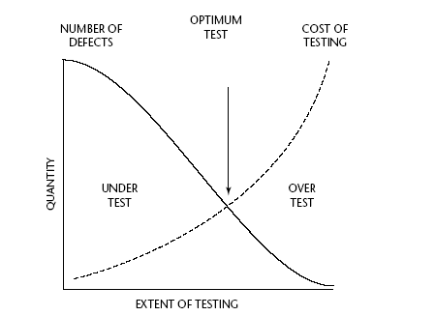
Economics of System Development Life Cycle testing
Testing Cost Curve

Slide 24
Economics of System Development Life Cycle testing
These facts are illustrated in Figure for a hypothetical system with 1,000 lines of source code. A normal SDLC test process is shown on the left in which testing occurs only after coding.
In this example, all 60 errors remain after coding for testing, which detects 48 errors (60 times 80 percent equals 48) at an average cost ten times as great as those detected prior to coding, resulting in a cost of 480 units.
To that, we must add 1,200 units of cost representing the 12 remaining errors to be detected during production at a cost of 100 units each.
The net test cost is 1,680 units. Using life-cycle testing,
this can be reduced to 582 units or only one-third of the normal SDLC test concept cost (illustrated on the right side of Figure 2-5).

Slide 25
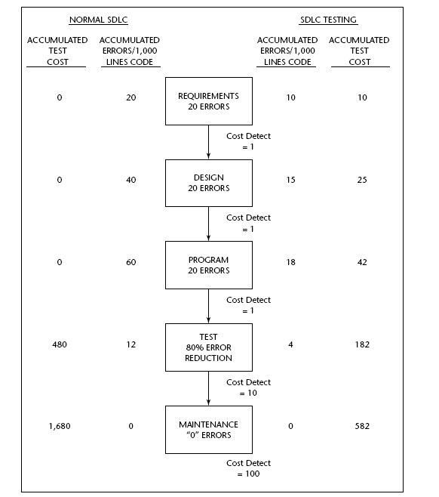
Economics of System Development Life Cycle testing
E
C
O
No
M
I
C
s of
SDLC Te
sting

Slide 26
Software Quality
McCall’s quality factors
Factors that affect software quality can be categorized in two broad groups:
Factors that can be directly measured (e.g. defects uncovered during testing)
Factors that can be measured only indirectly (e.g. usability or maintainability)

Slide 27
Product metrics
Product metrics for computer software helps us to assess quality.
Measure
When you obtain/observe/measure a value of directly observable property of an entity, you have a measure
. Each measure has a standard unit of measure (UOM) like seconds, meter, kilograms etc.
In software development and software testing, most commonly used measures are:
•Number of Defects found in a system or component
•Lines of Code (LOC, kLOC)
• Number of Test Cases

Slide 28
Product metrics
Metric
A metric in contrast, is a derived value which cannot be observed/measured directly.
It is a number derived from one or more measures by a formula (or estimation).
Best known metrics in software development and software testing are:
•Number of defects found per kLOC, which serves as an estimation of quality of code
• Productivity, i.e. Size / Effort
Indicator
-- An indicator is “a thing that indicates the state or level of something”, thus it can be simply just a number showing value of a particular measure or metric.
A metric or a combination of metrics that provide insight into the software process, a software project or a product itself

Slide 29
Product Metrics for analysis , Design , Test and maintenance
Product metrics for the Analysis model
Function Point Analysis (FPA)
FPA is a popular method for estimating and measuring the size of application software based on the functionality of the software from the user’s point of view.
Thorough this method, the size of an application system’s functionality is calculated in terms of Function Point Count (FPC).
Allan J Albrecht of IBM proposed FPC as a size measure in 1970’s.

Slide 30
Product metrics for the Analysis model
According to IFPUG, the objective of function point analysis are to:
  Measure functionality of a software system as seen from the user’s perspective.
  Measure the size of software systems independent of technology used for implementation.
  Create a measurement methodology that is simple enough to minimize the overhead of the measurement process.
  Create a consistent measure among various projects and organizations.
Function point can be computed for a new system being developed (called Development Function Point) as well as for Enhancement work (called Enhancement Function Points).

Slide 31
Product metrics for the Analysis model
Counting Development Function Points
SRS
Identify Data Functions And Determine complexity
ILF &EIF
Identify Transaction Functions and Determine complexity
EI, EO & EQ
Compute Unadjusted Function Points
Rate on 14 General System Characteristics
Compute Value Adjustment Factor (VAF)
Compute the Function Point Count (FPC)

Slide 32
The quality of the SRS, which is an output of the requirement definition, is critical to the accurate determination of the size of the system in terms of FPC.
In the first two steps we identify the various functions in the system.
From the FPA point of view, function could be either data functions or transaction functions.
Only user requested and user identifiable functions are identified.
Data functions relate to the functionality of the system
Transaction functions contribute functionality by taking in data or extracting and providing data from system to users or other systems.
Data and transaction functions can be extracted from the functional requirements of the SRS.

Slide 33
Unadjusted function points are assigned for all identified functions, to arrive at the total unadjusted function point.
In the next step, we rate the system on 14 general system characteristics (GSC).
Using a formula we compute what is called a value adjusted factor (VAF).
Multiply the VAF with the unadjusted function point to arrive at the function point count (FPC).

Slide 34
Identify Data Functions and Determine their complexity
  Data function types represent functionality provided to the user to meet internal and external data representations.
  Two data function types
    Internal Logical Files(ILF) and
    External Interface Files (EIF).
An Internal Logical Files (ILF) is a group of information stored in the system and maintained by the system.
ILF is a logical grouping of data or control information that is stored in the system, used within it and maintained by it.
External Interface Files (EIF) is a unique file that is shared between the system and some external application(s).
It is a user identifiable logical grouping of data or control information that is used by the system, but not maintained by it.

Slide 35
To determine the complexity of ILFs and EIFs, the number of Data Element Types (DET) and Record Element Types (RET) in each ILF and EIF are identified.
A DET is a user recognizable unique and non-recursive field in the ILF/EIF.
A user recognizable sub group of DETs within an ILF/EIF is an RET (also called data structure, logical group of fields).
The number of DETs and RETs determine the complexity of an ILF or EIF.
The higher the number of DETs or RETs, the higher is the complexity.
The complexity is determine using the following table:
 | 1-19 DETs | 20-50 DETs |  | >51 DETs
1 RET | simple | simple | average
2-5 RET | simple | average | complex
>6 RET | average | complex | complex

Slide 36
Identify Transaction Functions and Determine their complexity:
Transaction function types represent the functionality provided to the user to process data by the application and comprise EI, EO and EQ.
External Input (EI): EI is a unique business event that needs to update the data in system.
External Output (EO): is a unique data or control output that crosses the boundary to go out of a system. Typically, reports would be identified as EOs:
External Inquiry (EQ): is a unique combination of an input and an output where the input causes the immediate generations of the output.
To determine the complexity of an EI, the number of DET and File Types Referenced (FTR) are identified.
The complexity of the EQ is determined using the following table:
 | 1-5 DETs | 6-19 DETs |  | >20 DETs
0-1 FTR | simple | simple | average
2-3 FTR | simple | average | complex
>4 FTR | average | complex | complex

Slide 37
Compute unadjusted function points:
The unadjusted Function Points for each function depends on the function type (ILF, EIF, EI, EO, and EQ) complexity of the function (simple, average and complex) determined in the previous section.
At the end of this step, the column “UFP” should be filled and the “Total UFP” in the IKF, EIF, EI, EO, and EQ tables should be filled up.
Complexity | Function Type
 | ILF | EIF | EI | EO | EQ
Simple Average Complex | 7 10 15 | 5 7 10 | 3 4 6 | 4 5 7 | 3 4 6

Slide 38
Rate on 14 General System Characteristics
The FPA method recognizes 14 GSCs that influence the Function Point Count (FPC).
These GSCs are related to the “non-functional requirements” and “design constraints” identified in the SRS.
Each GSCs associated descriptions that help determine the degree of influence of that characteristic.
The rating for the degree of influence for each characteristics ranges on a scale of zero to five, from no influence to strong influence.

Slide 39
Compute Value Adjustment Factor (VAF):
Value Adjustment Factor calculation
S.No | GSC Name | Rating | Comments/reasons
1 2 3 4 5 6 7 8 9 10 11 12 13 14 | Data communication Distributed data processing Performance Heavily used configuration Transaction rate On-line data entry End user efficiency Online update Complex processing Reusability Installation ease Operational ease Multiple sites Facilitate change
 | Total (TDI) =
 | VAF = (TDI * 0.01)+0.65 =
The next step is to compute the VAF.
This is uses 14 GSCs and the rating assigned to each of them in the previous step.
The degrees of influence rating of each GSC are then added to give the Total Degree of Influence (TDI) is then computed using the formula.
VAF = (TDI*0.01) +0.65
The value of TDI ranges from a minimum of 0 to a maximum 70.

Slide 40
Value Adjustment Factors
Does the system require reliable backup and recovery?
Are specialized data communications required to transfer information to or from the application?
Are there distributed processing functions?
Is performance critical?
Will the system run in an existing, heavily utilized operational environment?
Does the system require on-line data entry?
Does the on-line data entry require the input transaction to be built over multiple screens or operations?
(More on next slide)

Slide 41
Value Adjustment Factors (continued)
Are the internal logical files updated on-line?
Are the inputs, outputs, files, or inquiries complex?
Is the internal processing complex?
Is the code designed to be reusable?
Are conversion and installation included in the design?
Is the system designed for multiple installations in different organizations?
Is the application designed to facilitate change and for ease of use by the user?

Slide 42
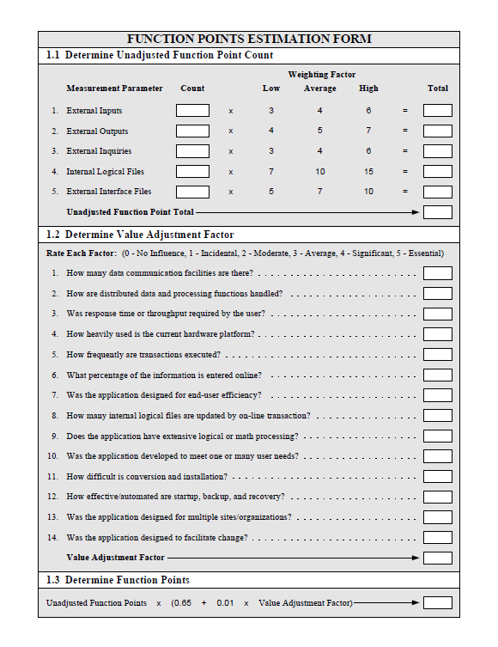
Compute the Function Point Count (FPC):
For a development project the function point is computed as
FPC = UFP * VAF

Slide 43
Product metrics for Design
These metrics place emphasis on the architectural structure and effectiveness of modules or components within the architecture
They are “black box” in that they do not require any knowledge of the inner workings of a particular software component
Card and Glass define three software design complexity measures.

Slide 44
Hierarchical Architecture Metrics
Fan out: the number of modules immediately subordinate to the module i, that is, the number of modules directly invoked by module
Structural complexity
  S(i) = f²_{out}(i), where f_{out}(i) is the “fan out” of module
Data complexity
  D(i) = v(i)/[f_{out}(i) + 1], where v(i) is the number of input and output variables that are passed to and from module
System complexity
  C(i) = S(i) + D(i)
As each of these complexity values increases, the overall architectural complexity of the system also increases
This leads to greater likelihood that the integration and testing effort will also increase

Slide 45
Hierarchical Architecture Metrics (continued)
Shape complexity
  size = n + a, where n is the number of nodes and a is the number of arcs
  Allows different program software architectures to be compared in a straightforward manner
Connectivity density (i.e., the arc-to-node ratio)
  r = a/n
  May provide a simple indication of the coupling in the software architecture

Slide 46
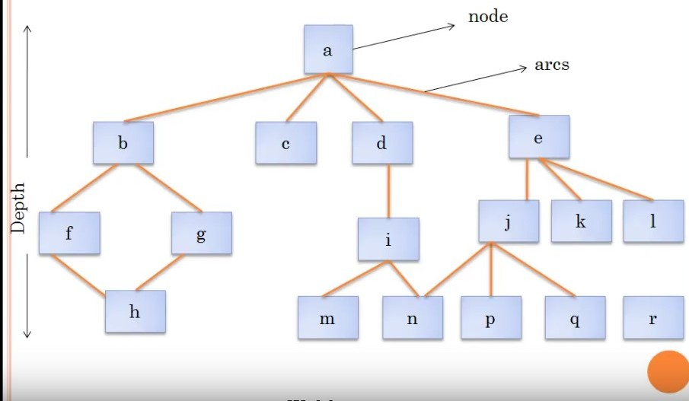

Slide 47
Size= 17+18=35
Depth=4, the longest path from the root (top) node to a leaf node
Width=6, Maximum number of nodes at any one level of the architecture
R=a/n
R=18/17=1.06

Slide 48
Metrics for Design Model
DSQI(Design Structure Quality Index)
US air force has designed the DSQI
Compute s1 to s7 from data and architectural design
S1:Total number of modules
S2:Number of modules whose correct function depends on the data input
S3:Number of modules whose function depends on prior processing
S4:Number of data base items
S5:Number of unique database items
S6: Number of database segments
S7:Number of modules with single entry and exit
Once values S1 through S7 are determined for a computer program, the following intermediate values can be computed

Slide 49
Metrics for Design Model
Calculate D1 to D6 from s1 to s7 as follows:
D1=1 if standard design is followed otherwise D1=0
D2(module independence)=(1-(s2/s1))
D3(module not depending on prior processing)=(1-(s3/s1))
D4(Data base size)=(1-(s5/s4))
D5(Database compartmentalization)=(1-(s6/s4)
D6(Module entry/exit characteristics)=(1-(s7/s1))

Slide 50
Metrics for Design Model
DSQI=sigma of WiDi
i=1 to 6,Wi is weight assigned to Di
If sigma of wi is 1 then all weights are equal to 0.167(if all Di are weighted equally , then wi=0.167)
DSQI of present design be compared with past DSQI. If DSQI is significantly lower than the average, further design work and review are indicated

Slide 51
METRIC FOR SOURCE CODE
HSS(Halstead Software science)
Primitive measure that may be derived after the code is generated or estimated once design is complete
n₁ = the number of distinct operators that appear in a program
n₂ = the number of distinct operands that appear in a program
N₁ = the total number of operator occurrences.
N₂ = the total number of operand occurrence.
Overall program length N can be computed:
N = n₁ log2 n₁ + n₂ log2 n₂
Program Volume may be defined
V = N log₂ (n₁ + n₂)

Slide 52
Halstead uses these primitive measures to develop expressions for the overall program length, potential minimum volume for an algorithm, the actual volume(number of bits required to specify a program),language level, and other features such as development effort, development time and even projected number of faults in the software.

Slide 53
Example
if (k < 2)
{
if (k > 3)
x = x*k;
}
Distinct operators: if ( ) { } > < = * ;
Distinct operands: k 2 3 x
n₁ = 10
n₂ = 4
N₁ = 13
N₂ = 7
n₁ = the number of distinct operators that appear in a program
n₂ = the number of distinct operands that appear in a program
N₁ = the total number of operator occurrences.
N₂ = the total number of operand occurrence

Slide 54
METRIC FOR TESTING
Program Level and Effort
PL = 1/[(n₁ / 2) x (N₂ / n₂ l)]
e = V/PL

Slide 55
METRICS FOR MAINTENANCE
M_{t} = the number of modules in the current release
F_{c} = the number of modules in the current release that have been changed
F_{a} = the number of modules in the current release that have been added.
F_{d} = the number of modules from the preceding release that were deleted in the current release
The Software Maturity Index (SMI), is defined as:
SMI = [M_{t – (}F_{c} + F_{a +} F_{d)/} M_{t} ]
As the SMI (i.e., the fraction) approaches 1.0, the software product begins to stabilize
The average time to produce a release of a software product can be correlated with the SMI

