Slide 1
Module 3

Slide 2
Modeling / Prediction
Y=f(X)+ε
Y: Dependent Variable
f(): Some function
X: Input Variables
ε: Noise
Our task is relatively straightforward: in general we have X, we may have some or all values of Y, ε we can do nothing about; we want to learn an approximation of f().
Why do we want to learn f()? Prediction and Inference

Slide 3
A simple example: College Graduation Rates
Y=f(X)+ε
Y: Dependent Variable
f(): Some function
X: Input Variables
ε: Noise
X: Student / Faculty Ratio, or any other property of a college.
Y: The Graduation Rate (% of frosh that go on to graduate, I assume).
f(): Whatever we want it to be. We start with a simple line.

Slide 4
Linear Model
f(X) = b0 + b1 * X1
b0 -> The intercept
b1 -> The slope of the dependent variable X1.
Y = f(X) + ε ➔ Y = b0 + b1*X1 + ε
We learn f(X) in this case through linear regression with the lm() function.

Slide 5
Data set
Using the college dataset again:
college <- read.csv("College.csv")
rownames(college) <- college$X
college$X <- NULL
college <- college[college$Grad.Rate < 100,]

Slide 6
Investigate by eye
Do we see a relationship between student / faculty ratio and grad. rate?
Yes.
plot(college$S.F.Ratio,college$Grad.Rate)

Slide 7
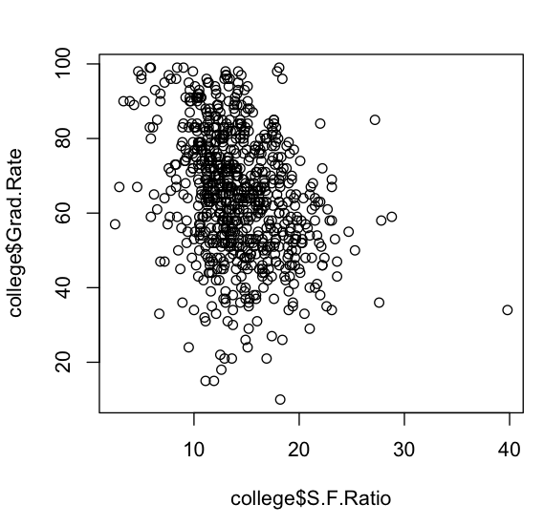
Lower S.F rates seem to correlate with higher Graduation Rates.

Slide 8
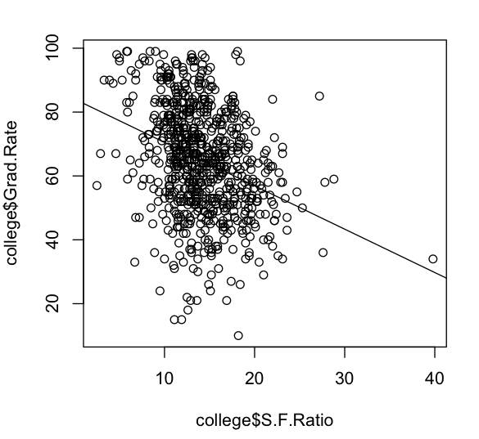
Learn linear model
lm.fit <- lm(Grad.Rate ~ S.F.Ratio,data=college)
abline(lm.fit)
print(summary(lm.fit))

Slide 9
Learn linear model
> summary(lm.fit)
Call:
lm(formula = Grad.Rate ~ S.F.Ratio, data = college)
Residuals:
Min 1Q Median 3Q Max
-54.006 -10.690 0.724 11.640 39.502
Coefficients:
Estimate Std. Error t value Pr(>|t|)
(Intercept) 84.0830 2.1268 39.536 <2e-16 ***
S.F.Ratio -1.3583 0.1454 -9.345 <2e-16 ***
---
Signif. codes: 0 ‘***’ 0.001 ‘**’ 0.01 ‘*’ 0.05 ‘.’ 0.1 ‘ ’ 1
Residual standard error: 15.86 on 764 degrees of freedom
Multiple R-squared: 0.1026, Adjusted R-squared: 0.1014
F-statistic: 87.32 on 1 and 764 DF, p-value: < 2.2e-16

Slide 10
Prune outlier
college.s <- college[college$S.F.Ratio < 30,]
plot(college.s$S.F.Ratio,college.s$Grad.Rate)
lm.fit.s <- lm(Grad.Rate ~ S.F.Ratio,data=college.s)
abline(lm.fit.s)
print(summary(lm.fit.s)) ## basically the same
Should see that the outlier was having very little effect.

Slide 11
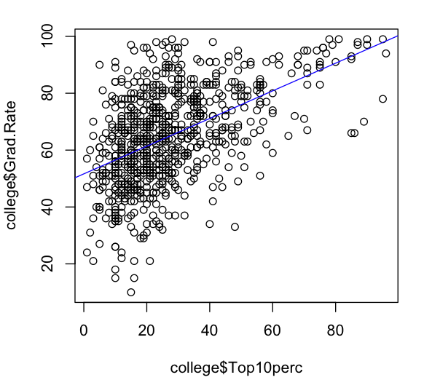
What about % students from the top 10% of their graduating HS class?
plot(college$Top10perc,college$Grad.Rate)
lm.fit <- lm(Grad.Rate ~ Top10perc,data=college)
abline(lm.fit,col='blue')
print(summary(lm.fit))
A pretty good relationship:

Slide 12
What model have we learned?
coef(lm.fit)
(Intercept) Top10perc
51.6430252 0.4866471
confint(lm.fit)
So, our model (Y=f(X) + ε) now is:
Grad.Rate = 51.6 + .48 * Top10perc + ε

Slide 13
What if we had 4 new colleges we hadn’t seen before. Could we guess their graduation rate?
newcolleges <- data.frame(
CollegeName=c("MattU","PavoTech","ApoorvaCollege","SheamusInstitute"),
Top10perc=c(50,60,99,5)
)
rownames(newcolleges) <- newcolleges$CollegeName
predict(lm.fit,newdata=newcolleges)
MattU PavoTech ApoorvaCollege SheamusInstitute
75.97538 80.84185 99.82108 54.07626
predict(lm.fit,newdata=newcolleges,interval="prediction")
fit lwr upr
MattU 75.97538 47.49454 104.45621
PavoTech 80.84185 52.32649 109.35720
ApoorvaCollege 99.82108 71.05317 128.58900
SheamusInstitute 54.07626 25.59637 82.55615

Slide 14
Diagnostic plot
par(mfrow=c(2,2))
plot(lm.fit)

Slide 15
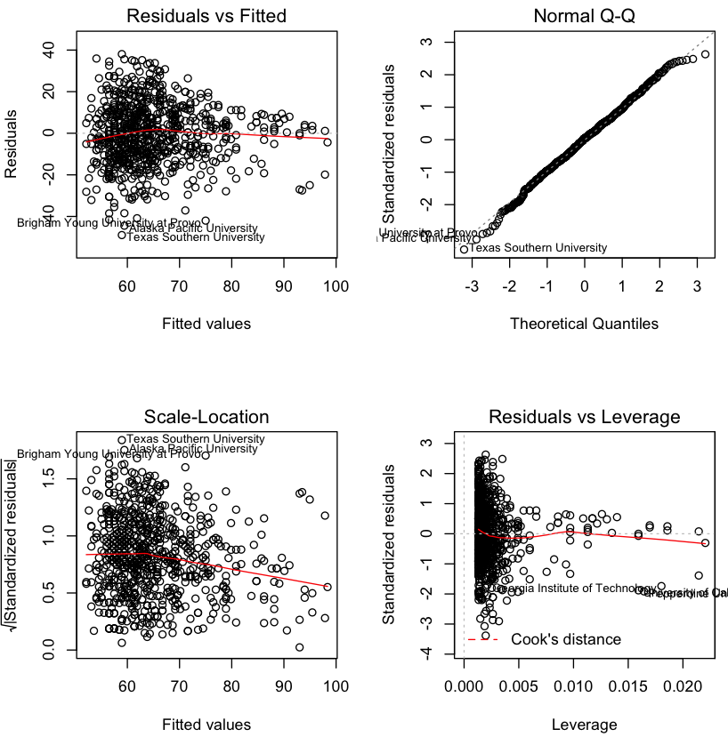
Diagnostic plot
par(mfrow=c(2,2))
plot(lm.fit)
How wrong we were
Our guess

Slide 16
Multiple regression
f(X) ➔ b0 + b1*X1 + b2*X2
Learning over multiple features simultaneously.
Keep X1 as Top10perc, make X2 Private
Private an indicator variable, so value of X2 will be {0,1}, so really just learning a separate intercept:
Grad.Rate = b0 + b1*(Top10Perc) + b2*{0,1}
If not private:
Grad.Rate = b0 + b1*(Top10perc)
If private:
Grad.Rate = b0 + b1*(Top10perc) + b2

Slide 17
Multiple regression
lm.fit.mult <- lm(Grad.Rate ~ Top10perc + Private,data=college)
print(summary(lm.fit.mult))
coef(lm.fit.mult)
par(mfrow=c(1,1))
plot(college$Top10perc,college$Grad.Rate,col=ifelse(college$Private=="Yes",'red','blue'))
abline(lm.fit.mult,col='blue')
abline(a=coef(lm.fit.mult)[1] + coef(lm.fit.mult)[3], b= coef(lm.fit.mult)[2],col='red')
legend('bottomright',legend=c("Private (1)","Not Private (0)"),fill=c("red","blue"))

Slide 18
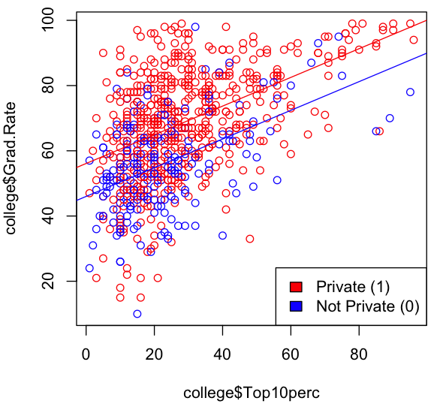
Multiple regression
lm.fit.mult <- lm(Grad.Rate ~ Top10perc + Private,data=college)
print(summary(lm.fit.mult))
coef(lm.fit.mult)
par(mfrow=c(1,1))
plot(college$Top10perc,college$Grad.Rate,col=ifelse(college$Private=="Yes",'red','blue'))
abline(lm.fit.mult,col='blue')
abline(a=coef(lm.fit.mult)[1] + coef(lm.fit.mult)[3], b= coef(lm.fit.mult)[2],col='red')
legend('bottomright',legend=c("Private (1)","Not Private (0)"),fill=c("red","blue"))

Slide 19
Multiple regression
## what about just using every variable?
## The code for that is “~.”
lm.fit.all <- lm(Grad.Rate ~ ., data=college)
print(summary(lm.fit.all))
As you can see from the summary, the fit appears to be good, as there’s a high R2: 0.48 vs 0.31 for our last model.
However, this model is almost certainly overfit, given the number of free parameters vs the number of colleges.
Additionally, the significances and weights are difficult or impossible to interpret since most of the input variables are highly correlated.

Slide 20
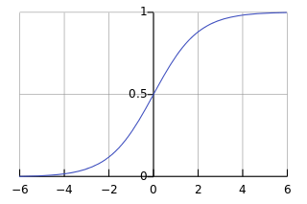
Logistic Regression
Goal: Make a true / false classifier.
Replace f(X) with a logistic function.

Slide 21
Logistic regression
college$AcceptanceRate <- college$Accept / college$Apps
glm.fit <- glm(Private ~ AcceptanceRate + F.Undergrad,data=college,family='binomial')
predict(glm.fit,type='response')
## plot the results
p <- predict(glm.fit,type='response')
plot(p[order(p)],col=ifelse(college$Private=="Yes",'red','blue')[order(p)],ylab="Probability of PrivateYes")
legend('bottomright',legend=c("PrivateYes","PrivateNo"),fill=c("red","blue"))
abline(h=0.5,lty=2)

Slide 22
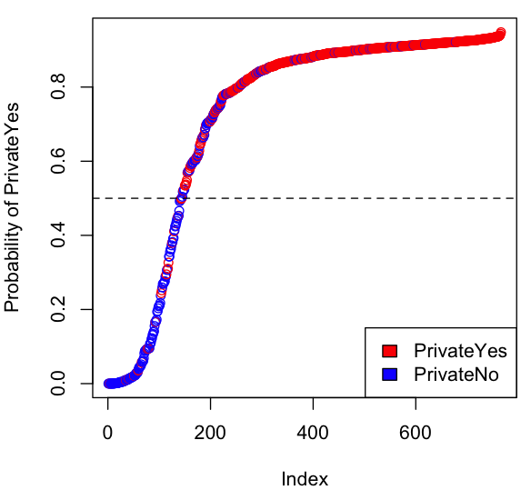
Logistic regression
college$AcceptanceRate <- college$Accept / college$Apps
glm.fit <- glm(Private ~ AcceptanceRate + F.Undergrad,data=college,family='binomial')
predict(glm.fit,type='response')
## plot the results
p <- predict(glm.fit,type='response')
plot(p[order(p)],col=ifelse(college$Private=="Yes",'red','blue')[order(p)],ylab="Probability of PrivateYes")
legend('bottomright',legend=c("PrivateYes","PrivateNo"),fill=c("red","blue"))
abline(h=0.5,lty=2)

Slide 23
Logistic regression
table(PredictedPrivate=p > .5, isPrivate=college$Private)
isPrivate
PredictedPrivate No Yes
FALSE 124 19
TRUE 87 536
Pretty good accuracy!
But, we’re over-determined, since we’re testing on the same data that we learned our regression on. This means the above accuracy is not to be trusted.
A better way: cross validation.

Slide 24
Cross Validation
An unbiased way to see if the classifier you’re learning would be accurate on new data, for example a new set of colleges you’d never seen before.
10-fold cross validation:
Learn the classifier on 90% of the data, test on remaining 10%.
Repeat 10 times, until you’ve tested on every record.

Slide 25
Logistic regression
college$CV.index <- rep(1:10,length=nrow(college))
for(i in 1:10) {
in.fold <- college$CV.index != i
glm.fit.cv <- glm(Private ~ AcceptanceRate + F.Undergrad, data=college[in.fold,],family='binomial')
p <- predict(glm.fit.cv,type='response',newdata=college[!in.fold,])
college[!in.fold,'prediction'] <- p
}
table(PredictedPrivate=college$prediction > .5, isPrivate=college$Private)
isPrivate
PredictedPrivate No Yes
FALSE 122 20
TRUE 89 535
Wow! Still good accuracy!

Slide 26
ROC Curve
install.packages("ROCR")
library("ROCR")
pred <- prediction(college$prediction,college$Private=="Yes")
perf <- performance(pred,measure='tpr',x.measure='fpr')
perf.auc <- performance(pred,measure='auc')
plot(perf)
abline(a=0,b=1,lty=3)
text(.5,.2,paste("AUC:",formatC(perf.auc@y.values[[1]])))
A standard way to judge classifier sensitivity and specificity is to use a Receiver Operator Characteristic (ROC) curve and measure the area under the curve (AUC).

Slide 27
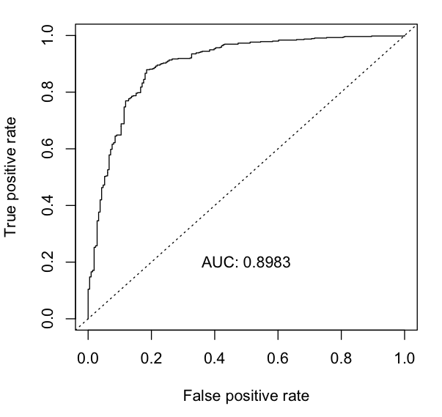
ROC Curve
Great ROC curve!
Along the diagonal signals random data.
Up the y axis signals perfect classification.
.898 is a very high AUC!

