Slide 1
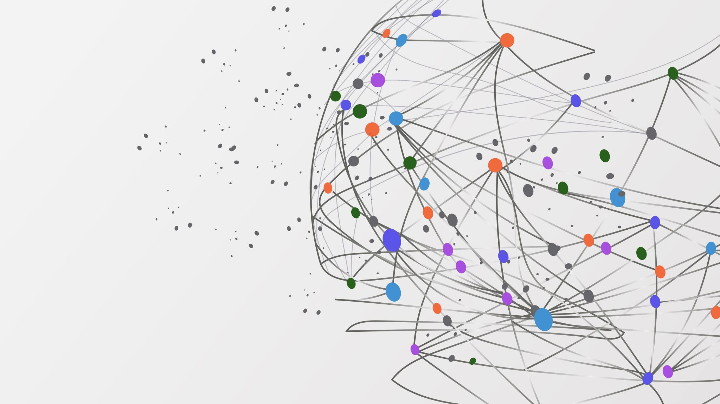
m-MIMO Channel Reconstruction

Slide 2
Overview
5G Networks utilize massive Multi-Input Multi-Output (m-MIMO) antennas to enhance:
Channel bandwidth
Coverage
Capacity through beamforming and spatial multiplexing
However, increased number of antennas complicates the measurement of Channel State Information (CSI), which describes the impact of the channel on the signal
ML algorithms are increasingly being used to improve the accuracy, feedback overhead, and run time of channel reconstruction
Although ML requires significant data and computational resources for training, the resulting models can identify trends in multi-dimensional data that are not apparent to humans
ML algorithms offer faster execution and equivalent, if not better, performance compared to classical algorithms

Slide 3
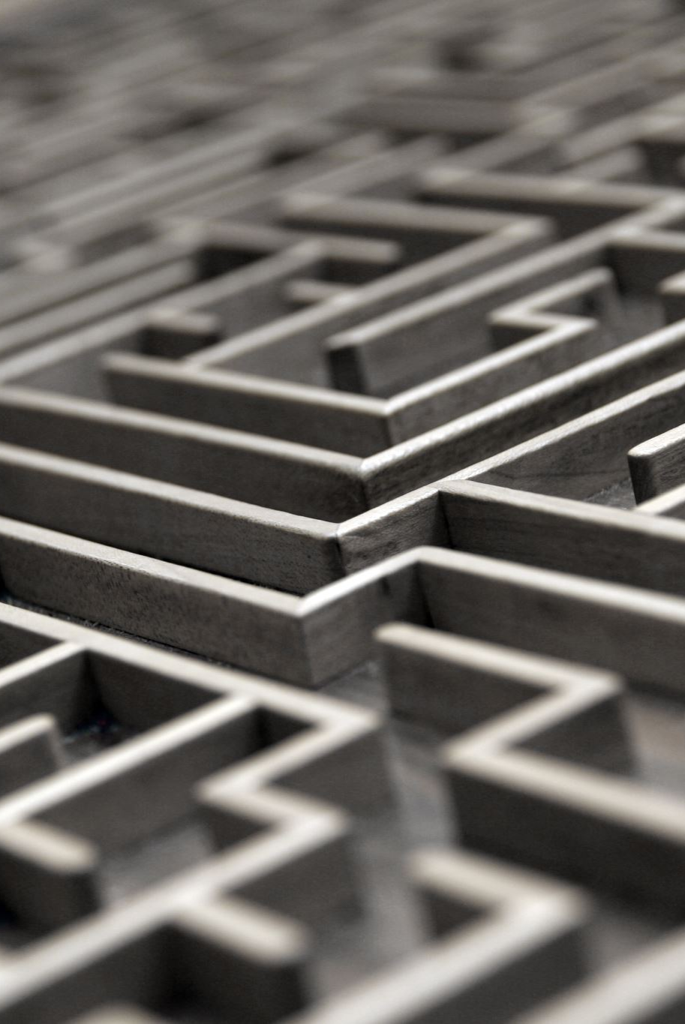
Purpose & Scope
Analyzing path estimation techniques in m-MIMO systems, specifically looking at runtime and performance
Results will be presented to determine which techniques are the most practical for path gain delay and angle estimation
NOMP and LASSO algorithms have shown great potential in accurately estimating CSI in wireless communication systems
However, they are computationally intensive and have a real-time constraint, which means they must be able to quickly calculate CSI to provide accurate results that are relevant for longer periods
To address this issue, a ML algorithm could be used for path estimation
Trained models can often solve complex problems with a faster runtime than traditional algorithms
Using the YOLO algorithm to identify the dominant paths by representing the sparse channel as an image

Slide 4

LASSO
Linear regression method that reduces the absolute prediction error by shrinking it, along with a tuning parameter that sets the minimum value for the sum of the regression coefficients
The goal of LASSO regression is to minimize the coefficients in the β vector while satisfying the given equation

Slide 5

YOLO
A set of deep learning models developed for real-time object detection in colored images with complex classification targets
YOLO has the advantage of detect- ing smaller objects in an image, which is a crucial feature for many real-world applications
The YOLO network structure consists of three parts: the input layer, the hidden layers, the output layers. The input layer takes a compressed version of an image, and it specifies three values that define the required image input size: image width, height, and the number of channels. Image width and height describe the image size, while the number of channels represents the values for each pixel
The hidden layer is where most of the training of the model’s weights occurs, and it provides the backbone for the object detection network
When the three parts of the YOLO model are combined, a preprocessed image can be given to the model to predict the location and bounds of target objects within the image

Slide 6
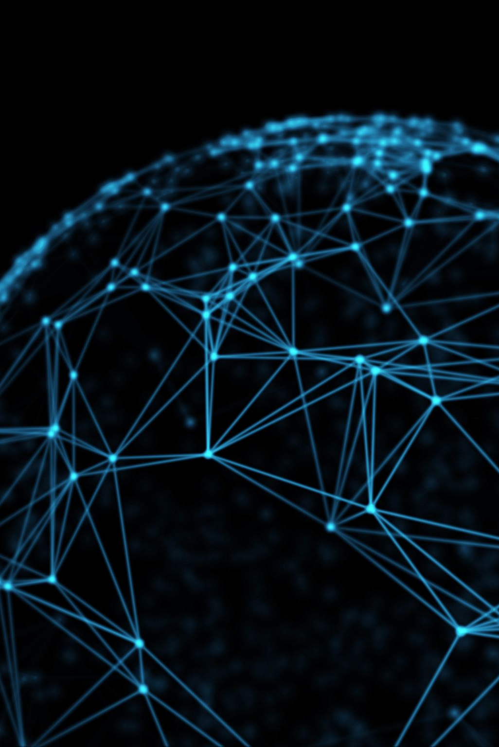
Deep Neural Networks
Designed using multi-layered neural networks, which employ different techniques such as Convolution Neural Networks (CNN), skip connections, and residual neural networks to achieve their objectives
Provide the ability to effectively tackle the problem of downlink channel reconstruction for m-MIMO systems using advanced deep learning techniques.

Slide 7
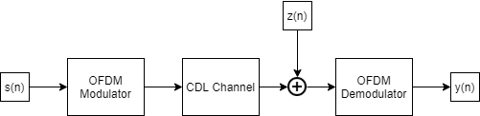
Simulation
The pilots were modulated using the ’nrOFDMModulate’ function
The carrier was set to a central frequency of 3.5GHz, 90MHz bandwidth, 75kHz sub-carrier spacing, and 32 transmit and receive antennas
The modulated signal was passed through a custom delay profile using the ’nrCDLChannel’ channel object, which sup- ports variable path count, gains, delays, angles, and angle spread

Slide 8
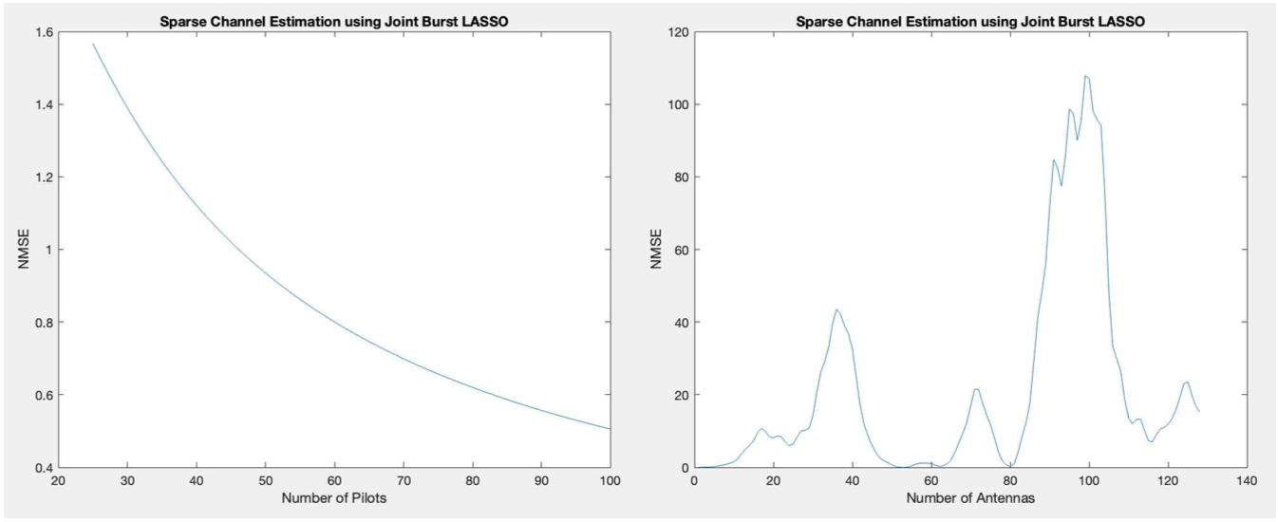
LASSO Implementation
Using LASSO as a regression method for channel reconstruction of sparse channels
As anticipated, increasing the number of pilot symbols in the reference signal reduces the error in the estimated channel vector at an exponential rate
Confirming the belief that the accuracy of the channel vector is directly proportional to the number of pilot symbols used in downlink channel reconstruction
Did not work well due to high NMSE error and inconsistent results with other published works on the same technique

Slide 9
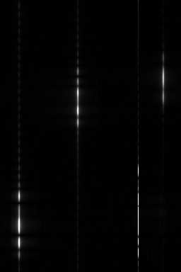
Image Generation
The bright spots in the image correspond to paths, and their positions are determined by the antenna steering vector and the delay-related phase vector
Different channel conditions result in different images. By varying the angle and delay of the paths, the locations of the spots in the image change
the brightness of the points relates to the gain of the paths
Varying degrees of SNR affect the image, resulting in noise appearing as static
As the SNR decreases, static in the points becomes less recognizable from the static in the background
Using advanced image detection techniques like YOLO can help identify points in images with high noise

Slide 10

YOLO Implementation
After generating the channel images using the received channel measurements, the spots within the images must be detected and the bounds set to represent the channel paths back in the delay and angular domain for channel reconstruction
YOLO, a fast object detection model, is utilized to extract the bounding boxes of the spots in the images
To train the object detection model, labeled data comprising a training, validation, and test set of images must be generated
Once the YOLO object detection model is trained with labeled data, testing data can be used to predict the average precision and generate Precision-Recall Curve plots to evaluate the precision and recall of the detector
The Precision-Recall Curve can then be used to adjust the threshold of the detector.

Slide 11
DNN and AutoKeras
A deep neural network was used to directly predict the path gains and delays from the generated images, without going through the object detection, coordinate translation, and path calculations
This approach was an image regression model that attempted to predict the path components by extracting the path information encoded in the image
DNNs have the potential to improve image-based path recognition from received pilots
This effort did not yield satisfactory results as the DNN was unable to predict the paths accurately
AutoKeras, a DNN framework that uses Keras from Tensorflow, was used to automatically generate and validate the models.

Slide 12

Conclusion, Contributions, Future Work
Investigated channel reconstruction for m-MIMO systems using NR communication systems simulated with MATLAB’s 5G Toolbox
State-of-the-art channel reconstruction techniques were replicated
DNNs have the potential to improve image-based path recognition from received pilots
Implementing state-of-the-art deep learning solutions is resource-intensive and may require more time and better resources
Supporting more complex antenna arrays will require extrapolating the math to higher dimensions, as a single angle will not be enough to represent the path
Further research is needed to gain a deeper understanding of antenna configurations and channel reconstruction mathematics

