Slide 1



Crop Prediction and Fertilizer Recommendation System Using ML
Name: Pawan Kumar N
AICTE ID: STU67d64be2275fd1742097378

Slide 2

Learning Objectives
Understand how machine learning aids agriculture: Learn how data can be used to guide crop selection and fertilizer use.
Analyze soil and climate parameters effectively: Work with features like N, P, K, pH, temperature, and rainfall.
Develop machine learning models for predictions: Train and evaluate models like Random Forest for classification tasks.
Apply Python libraries in real-world projects: Use pandas, NumPy, scikit-learn, and visualization tools for EDA and modeling.
GOAL
Source :
www.freepik.com/

Slide 3
Tools and Technology used
Python: Used for writing the core logic of prediction and recommendation models.
Jupyter Notebook: Provided an interactive environment for writing code and visualizing data step-by-step.
Pandas & Numpy: Helped with data handling, cleaning, and numerical operations on large datasets.
Scikit-learn: Used for building, training, and evaluating machine learning models like Random Forest.
Matplotlib & Seaborn: Used to create visualizations like heatmaps, bar charts, and accuracy plots.
Python
Jupyter Notebook
Pandas, NumPy
Scikit-learn
Matplotlib, Seaborn

Slide 4
Methodology
Data Collection & Preparation: Gathered soil and weather datasets, cleaned missing values, and normalized features.
Exploratory Data Analysis (EDA): Visualized feature distributions and relationships to understand patterns in data.
Model Training & Evaluation: Used Random Forest for crop prediction; tuned parameters and evaluated accuracy.
Fertilizer Rule-Based System: Compared actual vs. ideal N-P-K values to generate fertilizer suggestions.
Validation & Output Interpretation: Tested models on unseen data and verified recommendations with known scenarios.

Slide 5

Problem Statement:
Lack of data-driven guidance for farmers: Farmers often rely on guesswork to choose crops and fertilizers.
Inefficient use of soil nutrients: Incorrect fertilizer application harms yields and the environment.
Limited awareness of climate-soil compatibility: Choosing unsuitable crops for local conditions reduces productivity.
Need for accessible, intelligent recommendations: Small and mid-scale farmers lack expert systems to assist in decision-making.

Slide 6
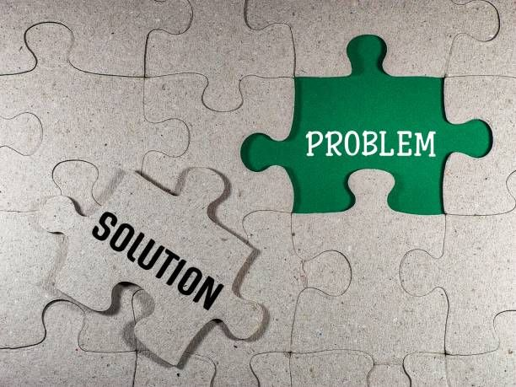
Solution: Using Green skill with AI & ML and decision tree I was able to achieve 98.45% accuracy and 100% with respect to fertiliser and help out the farmer to select the best crop and fertiliser.
Smart Crop Prediction System: Uses soil and climate data to recommend the most suitable crop.
Fertilizer Recommendation Engine: Suggests corrective actions based on nutrient imbalance in the soil.
Machine Learning for Informed Decisions: Applies trained models (like Random Forest) to deliver accurate results.
User-Friendly and Scalable Design: Designed to be easily deployable for real-world farming applications.
GitHub Link: https://github.com/pawan-25k/Edunet.git

Slide 7
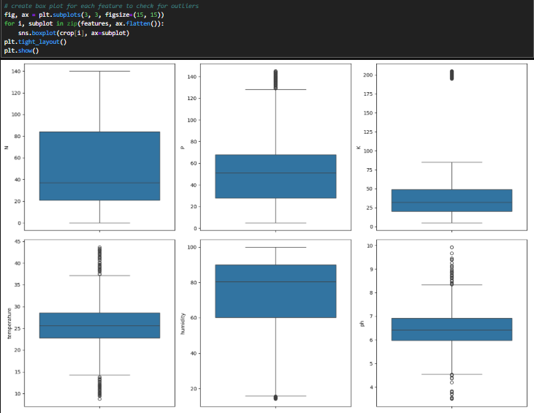
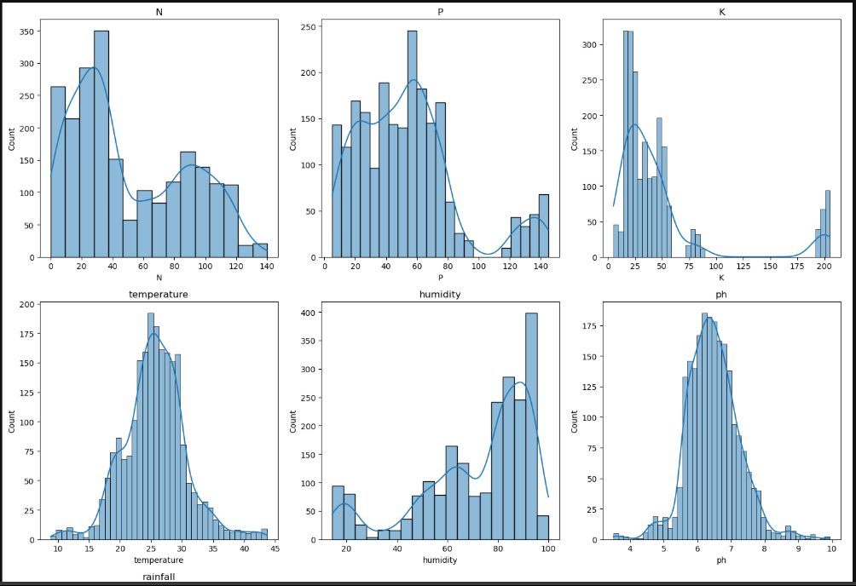
Screenshot of Output:

Slide 8
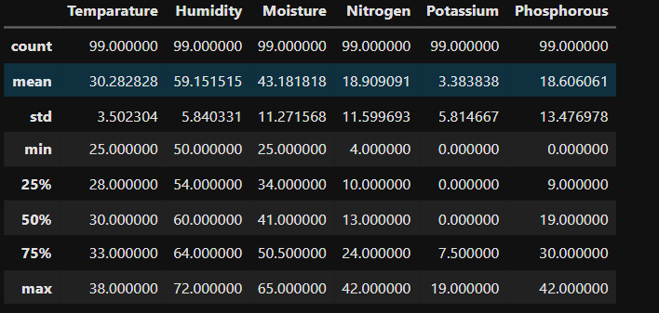
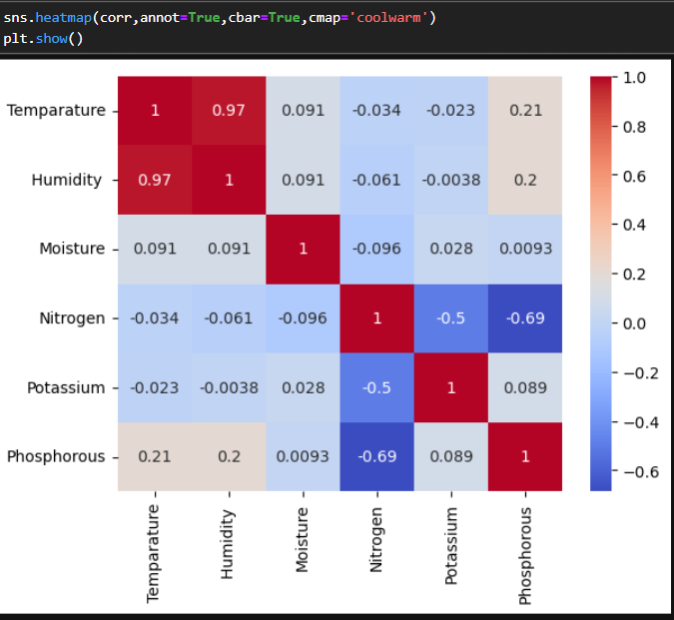
Screenshot of Output:

Slide 9
Conclusion:
This project successfully demonstrates how machine learning can empower modern agriculture. By predicting the most suitable crop based on soil and climate conditions, and recommending fertilizers through nutrient analysis, the system supports smarter, data-driven farming. It improves yield, promotes sustainability, and offers a scalable solution for farmers seeking personalized guidance. With future integration of real-time data, this tool has the potential to become a valuable asset in precision agriculture.
Future Scope:
Real-Time Weather Integration Incorporate live weather APIs to make crop recommendations more dynamic and location-specific.
Soil Sensor & IoT Connectivity Connect with IoT devices to fetch real-time soil data (moisture, pH, nutrients) for accurate predictions.
Mobile & Web App Deployment Build a farmer-friendly interface for easy access to predictions and recommendations on mobile or desktop.
Advanced Fertilizer Optimization Use AI to not only suggest fertilizers but also calculate optimal quantity and schedule based on crop lifecycle.

Slide 10

Thank You

