Slide 1
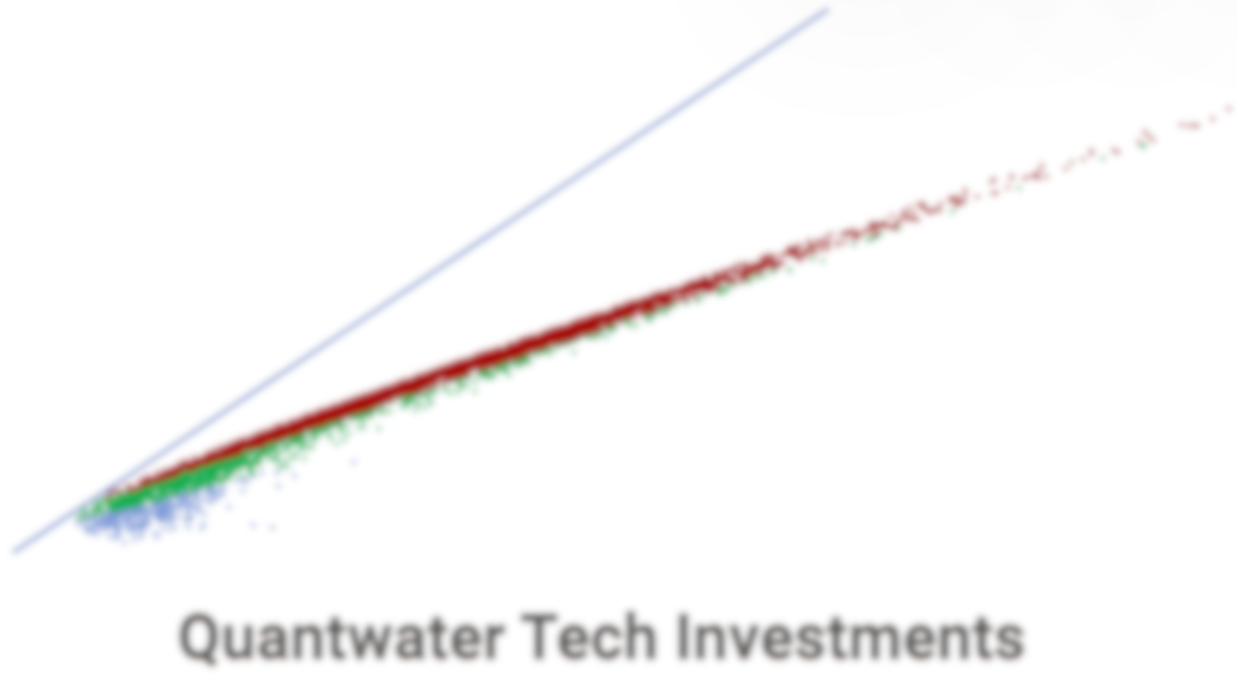
Project Spider Accelerating the Energy Transition 4thMar 2024 Pawan Quantwater Tech Investments
29th December 2025
Economic Data Releases & Their Historical Impact on Assets

Slide 2
Overview
Date | Day | Time (IST) | Cur. | Imp. | Event
29-Dec-25 | Mon | 21:00 | USD | 3 | Crude Oil Inventories
31-Dec-25 | Wed | 3:00 | USD | 3 | FOMC Meeting Minutes
31-Dec-25 | Wed | 7:00 | CNY | 3 | Manufacturing PMI (Dec)
31-Dec-25 | Wed | 19:00 | USD | 3 | Initial Jobless Claims
31-Dec-25 | Wed | 20:15 | USD | 3 | Chicago PMI (Dec)
01-Jan-26 | Thu | 19:15 | USD | 3 | S&P Global Manufacturing PMI (Dec)
Annexure: Key Terms & Links

Slide 3
Project Spider Accelerating the Energy Transition 4thMar 2024 Pawan Quantwater Tech Investments
Crude Oil Inventories

Slide 4
Crude Oil Inventories
Event | Crude Oil Inventories |  |  | Description
Actual: |  |  |  | The Energy Information Administration's (EIA) Crude Oil Inventories measures the weekly change in the number of barrels of commercial crude oil held by US firms. The level of inventories influences the price of petroleum products, which can have an impact on inflation. If the increase in crude inventories is more than expected, it implies weaker demand and is bearish for crude prices. The same can be said if a decline in inventories is less than expected. If the increase in crude is less than expected, it implies greater demand and is bullish for crude prices. The same can be said if a decline in inventories is more than expected.
Forecast:
Previous: | -1.274M
Time (GMT): | 15:30
Release Date | Actual | Forecast | Previous
17-Dec-25 | -1.27 | -2.40 | -1.81
10-Dec-25 | -1.81 | -1.20 | 0.574
03-Dec-25 | 0.574 | -1.90 | 2.774
26-Nov-25 | 2.774 | -1.30 | -3.42
19-Nov-25 | -3.42 | -0.60 | 6.413
13-Nov-25 | 6.413 | 1.000 | 5.202

Slide 5
Project Spider Accelerating the Energy Transition 4thMar 2024 Pawan Quantwater Tech Investments
Crude Oil Inventories
USOIlRoll

Slide 6
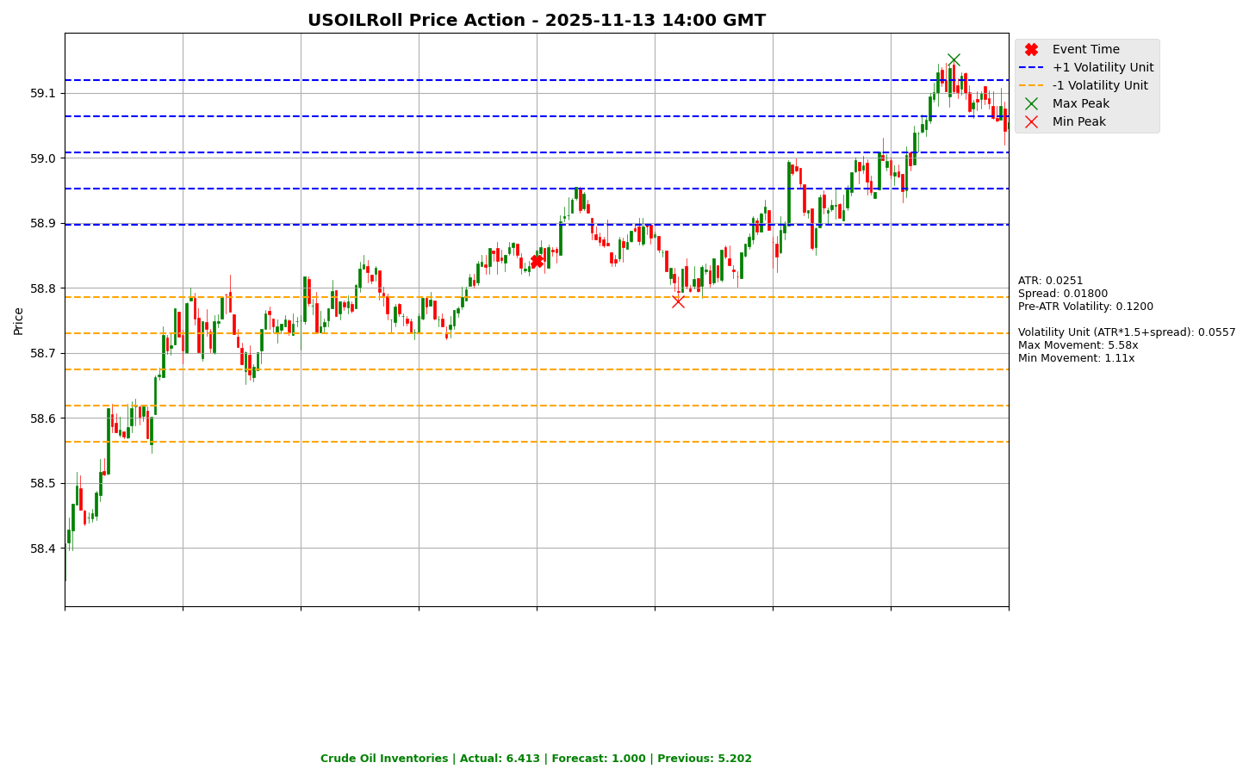

Slide 7
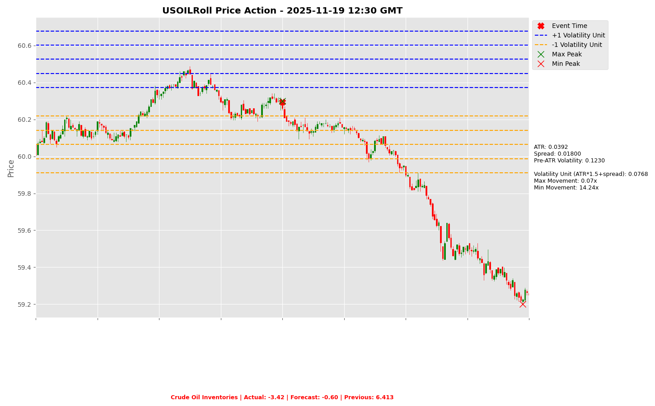

Slide 8
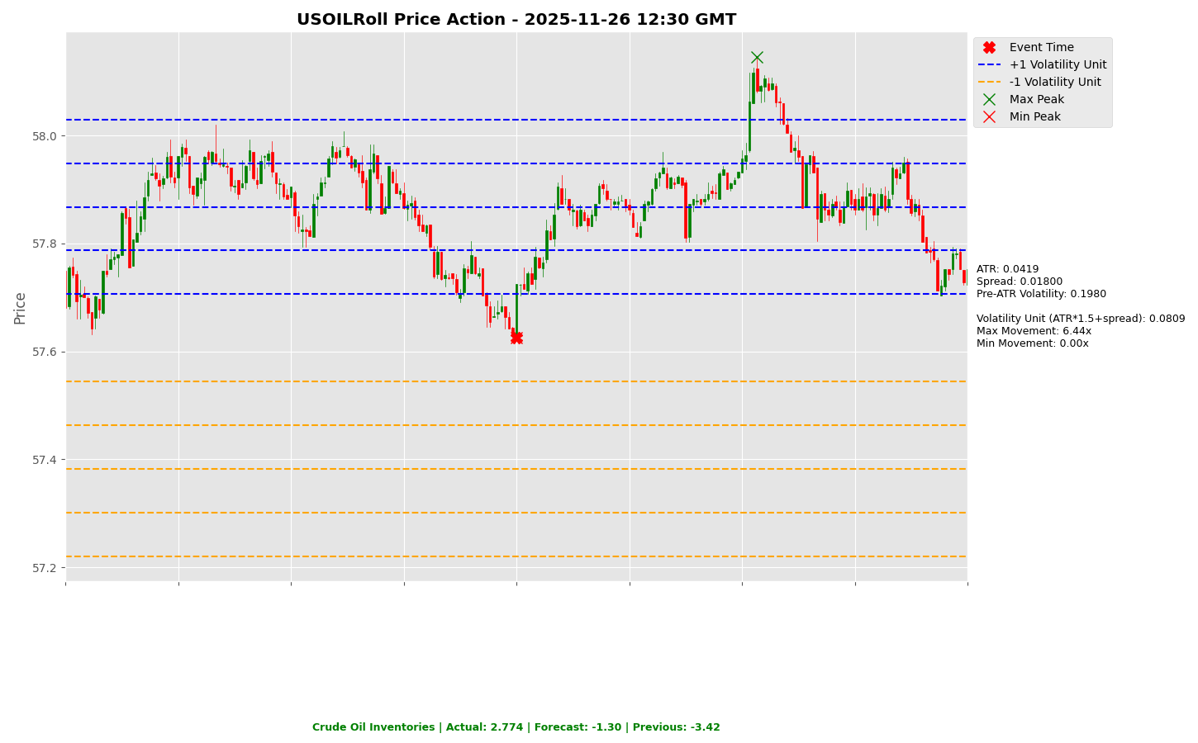

Slide 9
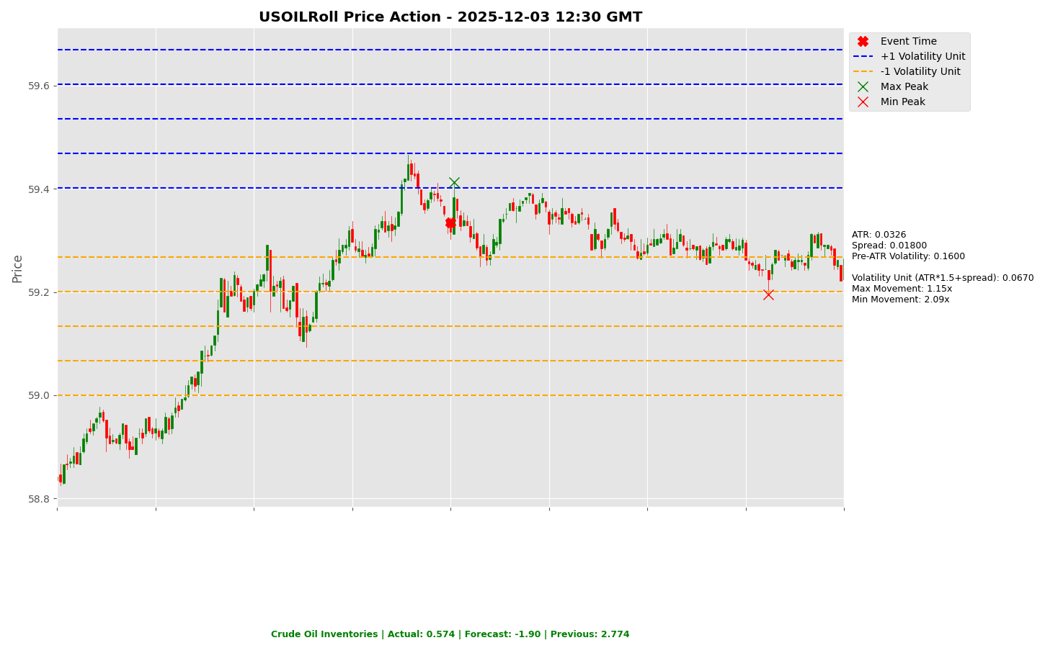

Slide 10
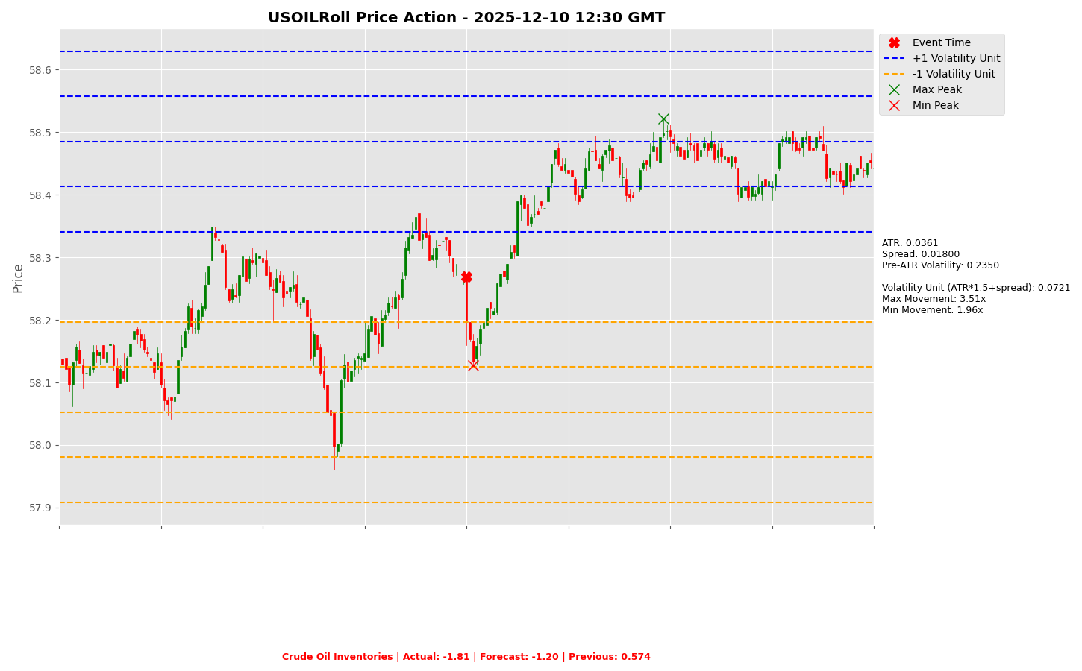

Slide 11
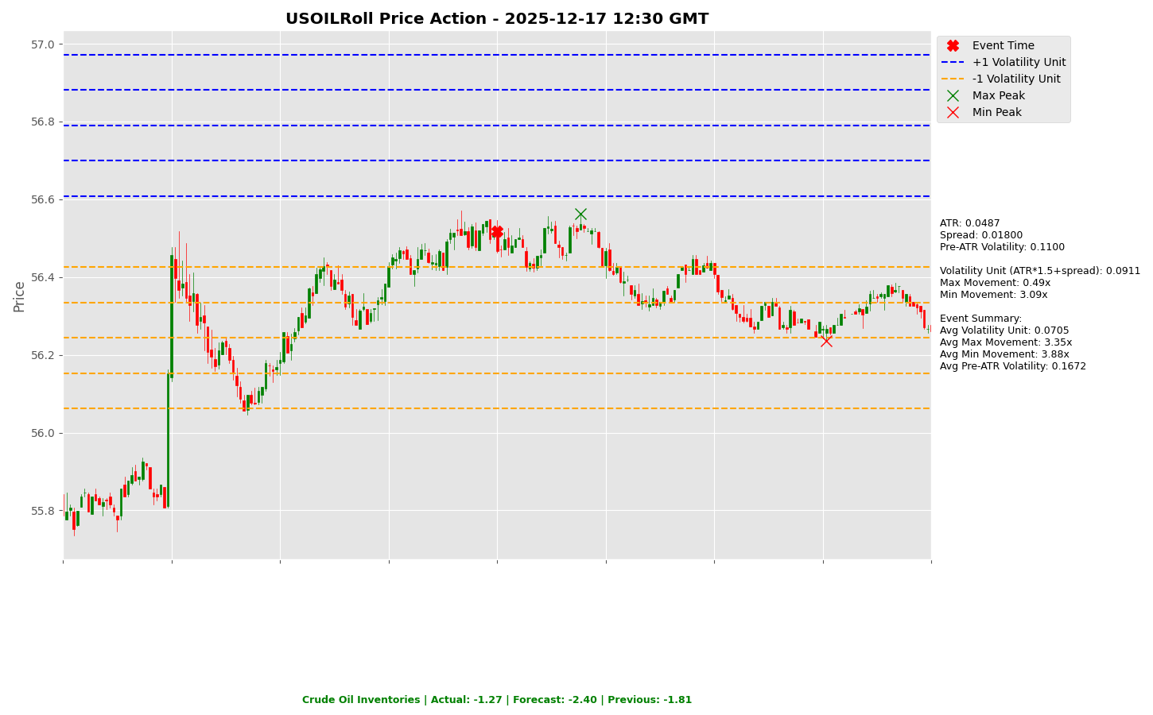

Slide 12
Project Spider Accelerating the Energy Transition 4thMar 2024 Pawan Quantwater Tech Investments
FOMC Meeting Minutes

Slide 13
FOMC Meeting Minutes
Event | FOMC Meeting Minutes |  |  | Description
Actual: |  |  |  | The Federal Open Market Committee (FOMC) Meeting Minutes are a detailed record of the committee's policy-setting meeting held about three weeks earlier. The minutes offer detailed insights regarding the FOMC's stance on monetary policy, so currency traders carefully examine them for clues regarding the outcome of future interest rate decisions.
Forecast:
Previous:
Time (GMT): | 21:30
Release Date | Actual | Forecast | Previous
20-Nov-25
08-Oct-25
20-Aug-25
09-Jul-25
28-May-25
09-Apr-25

Slide 14
Project Spider Accelerating the Energy Transition 4thMar 2024 Pawan Quantwater Tech Investments
FOMC Meeting Minutes
USDJPY

Slide 15
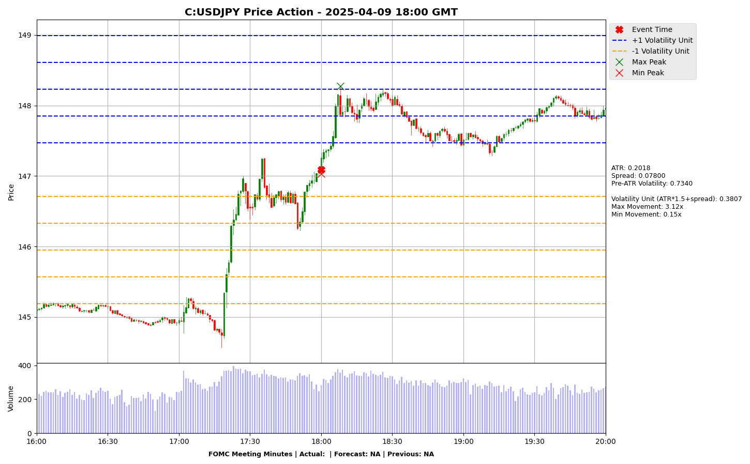

Slide 16
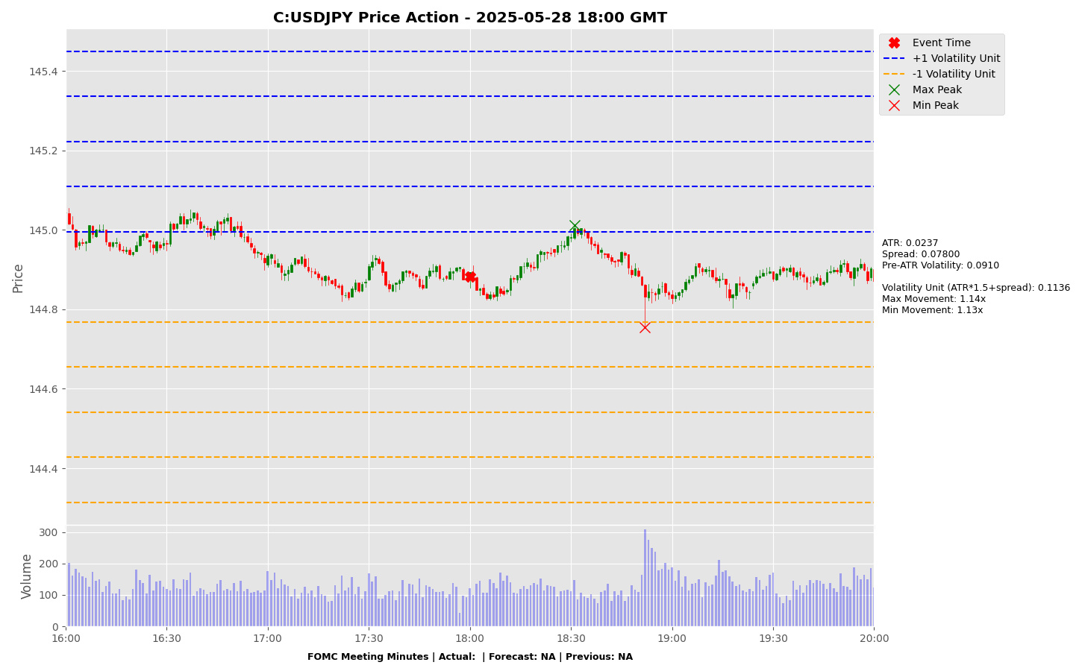

Slide 17
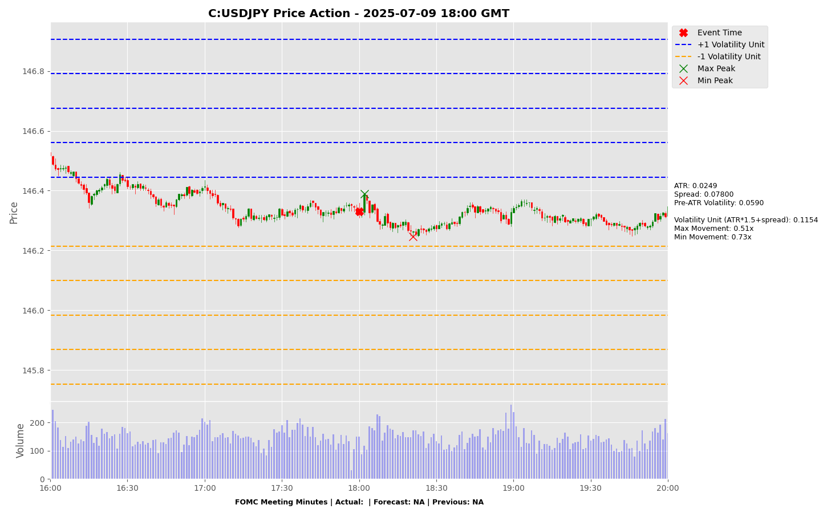

Slide 18
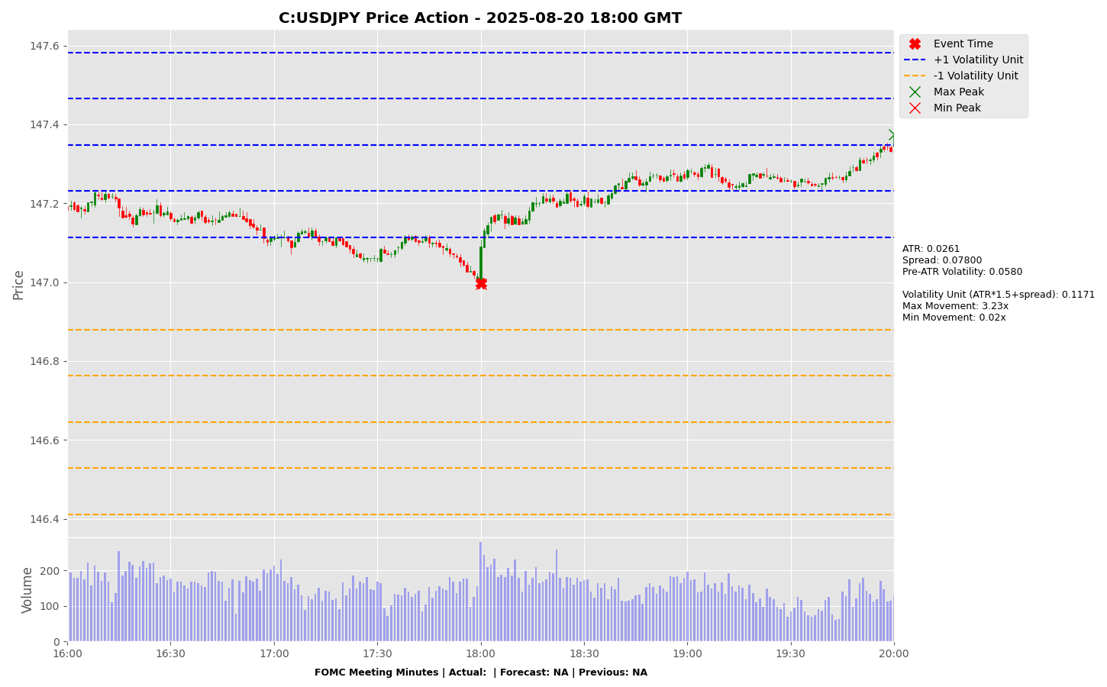

Slide 19
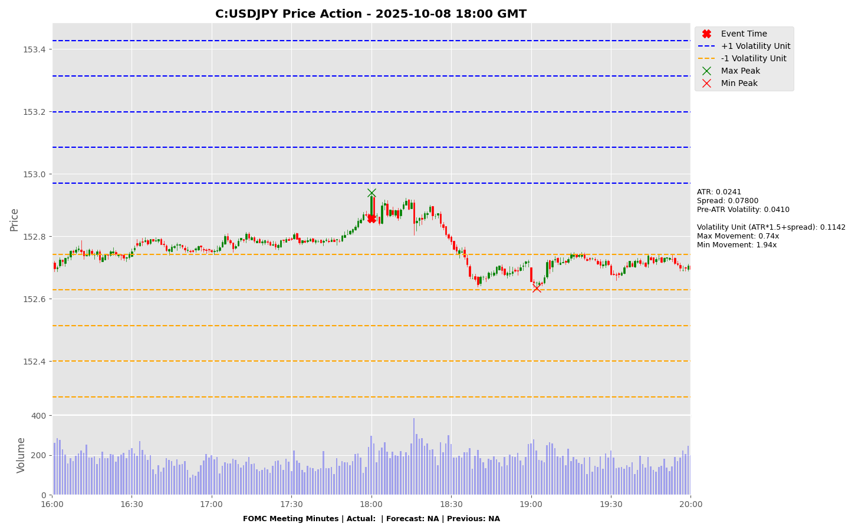

Slide 20
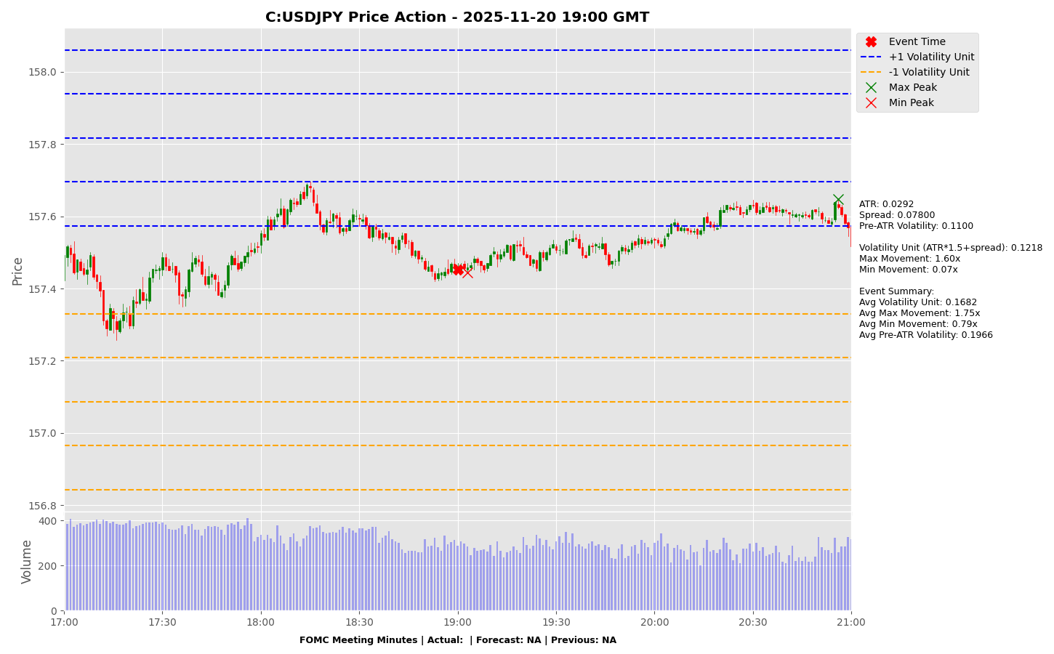

Slide 21
Project Spider Accelerating the Energy Transition 4thMar 2024 Pawan Quantwater Tech Investments
FOMC Meeting Minutes
EURUSD

Slide 22
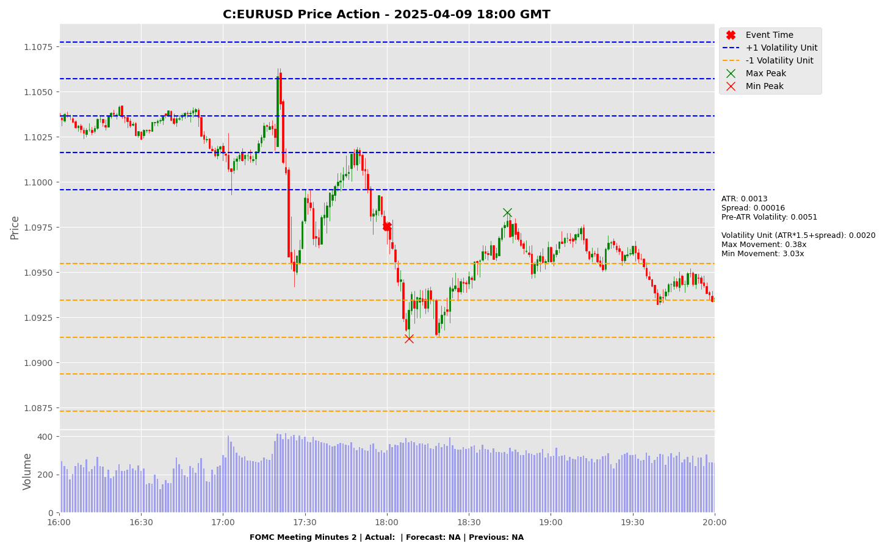

Slide 23
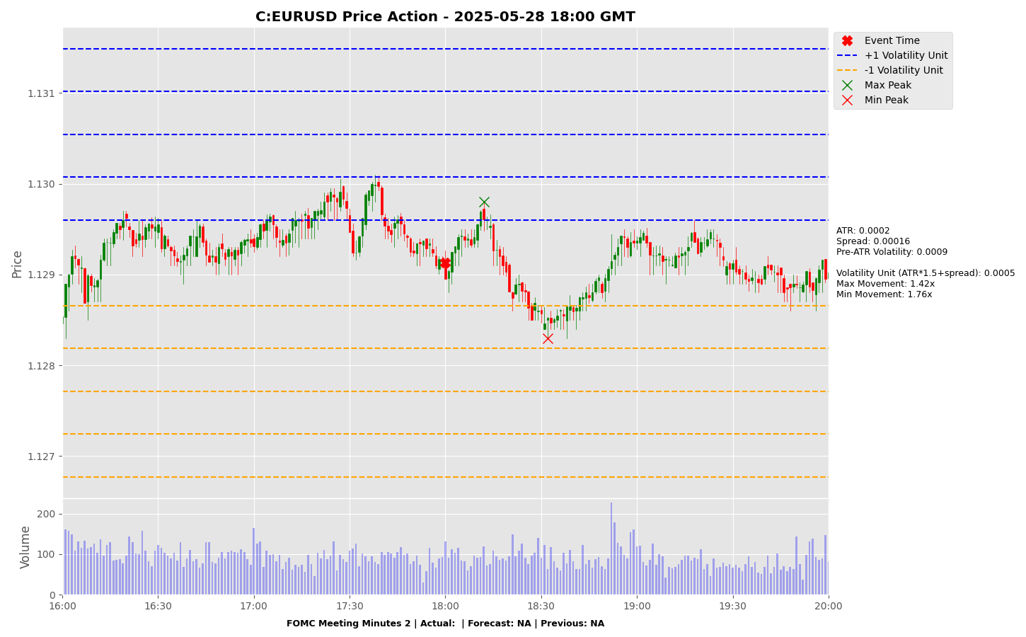

Slide 24
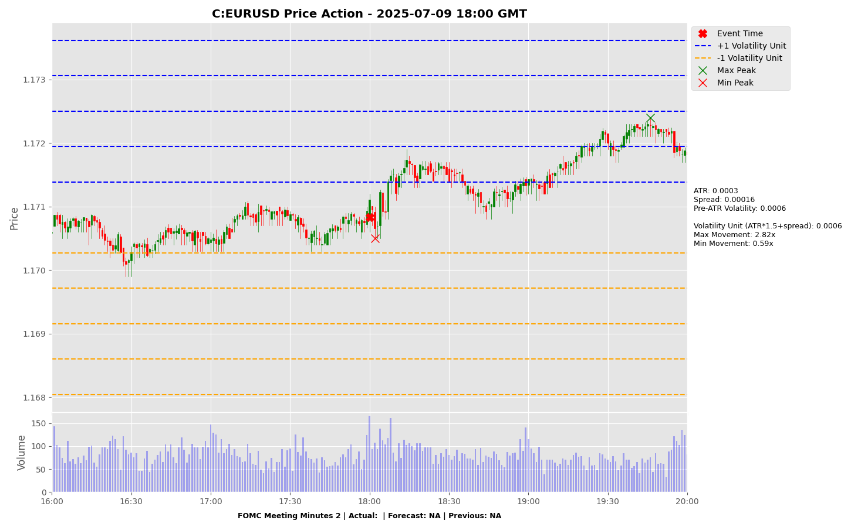

Slide 25
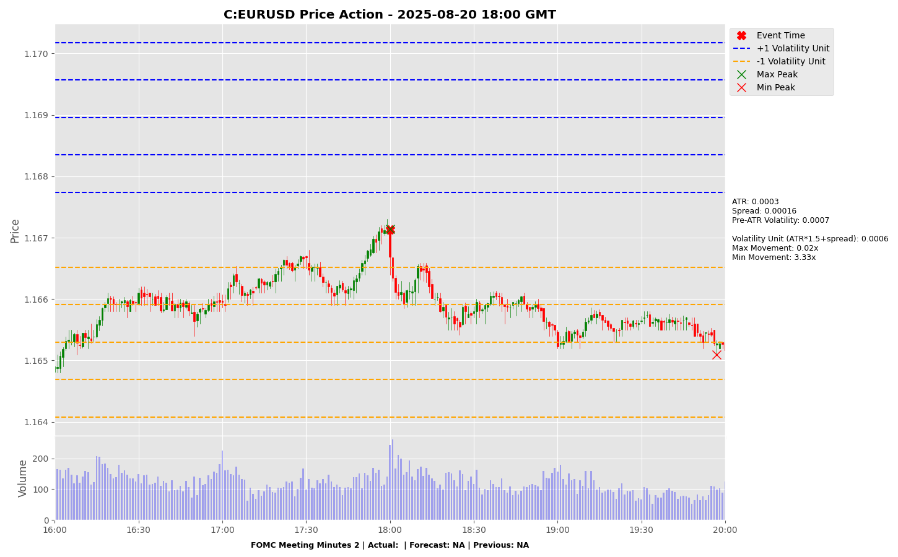

Slide 26
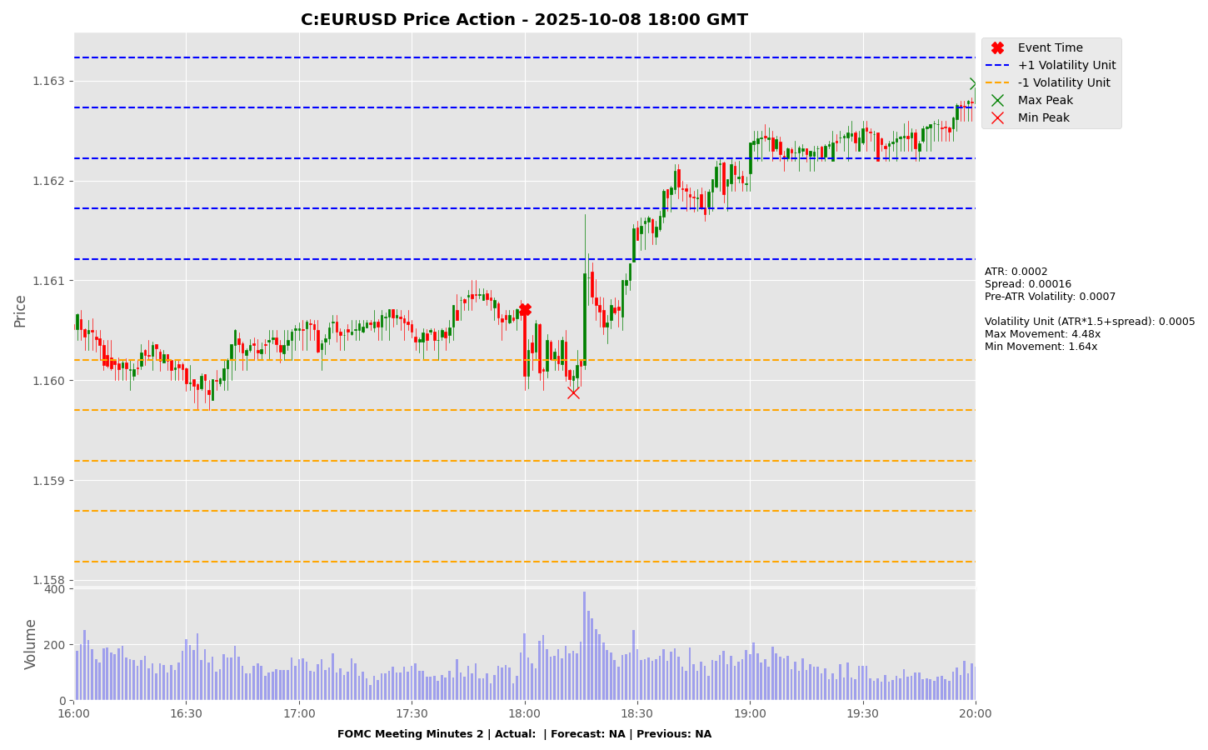

Slide 27
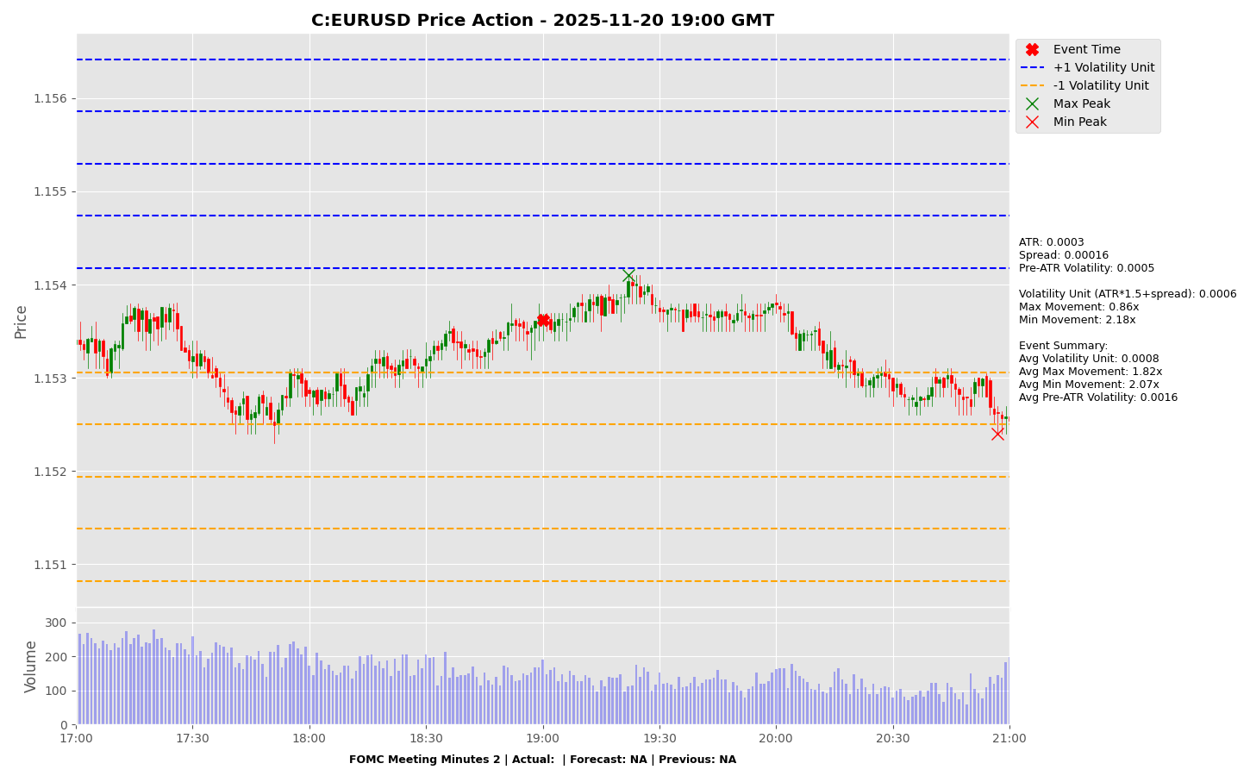

Slide 28
Project Spider Accelerating the Energy Transition 4thMar 2024 Pawan Quantwater Tech Investments
Manufacturing PMI (Dec)

Slide 29
Manufacturing PMI (Dec)
Event | Manufacturing PMI (Dec) |  |  | Description
Actual: |  |  |  | China Manufacturing Purchasing Managers Index (PMI) provides an early indication each month of economic activities in the Chinese manufacturing sector.It is compiled by China Federation of Logistics & Purchasing (CFLP) and China Logistics Information Centre (CLIC), based on data collected by the National Bureau of Statistics (NBS).Li & Fung Research Centre is responsible for drafting and disseminating the English PMI report. Every month questionnaires are sent to over 700 manufacturing enterprises all over China. The data presented here is compiled from the enterprises responses about their purchasing activities and supply situations. The PMI should be compared to other economic data sources when used in decision-making. A higher than expected reading should be taken as positive/bullish for the CNY , while a lower than expected reading should be taken as negative/bearish for the CNY.
Forecast:
Previous:
Time (GMT): | 1:30
Release Date | Actual | Forecast | Previous
30-Nov-25 | 49.20 | 49.20 | 49.00
31-Oct-25 | 49.00 | 49.60 | 49.80
30-Sep-25 | 49.80 | 49.60 | 49.40
31-Aug-25 | 49.40 | 49.50 | 49.30
31-Jul-25 | 49.30 | 49.70 | 49.70
30-Jun-25 | 49.70 | 49.60 | 49.50

Slide 30
Project Spider Accelerating the Energy Transition 4thMar 2024 Pawan Quantwater Tech Investments
Manufacturing PMI (Dec
USDCNH

Slide 31
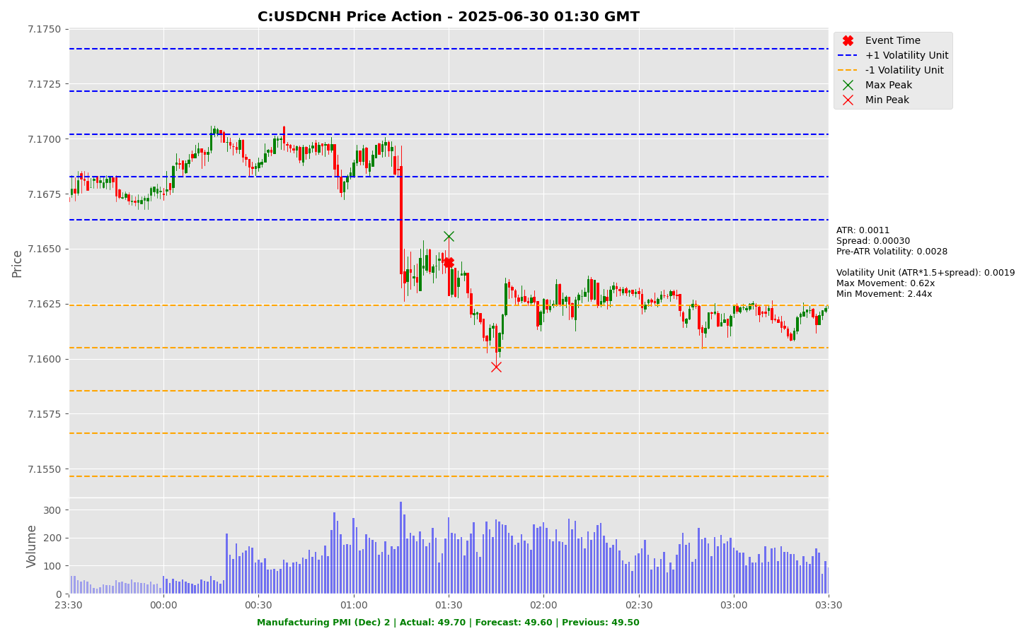

Slide 32
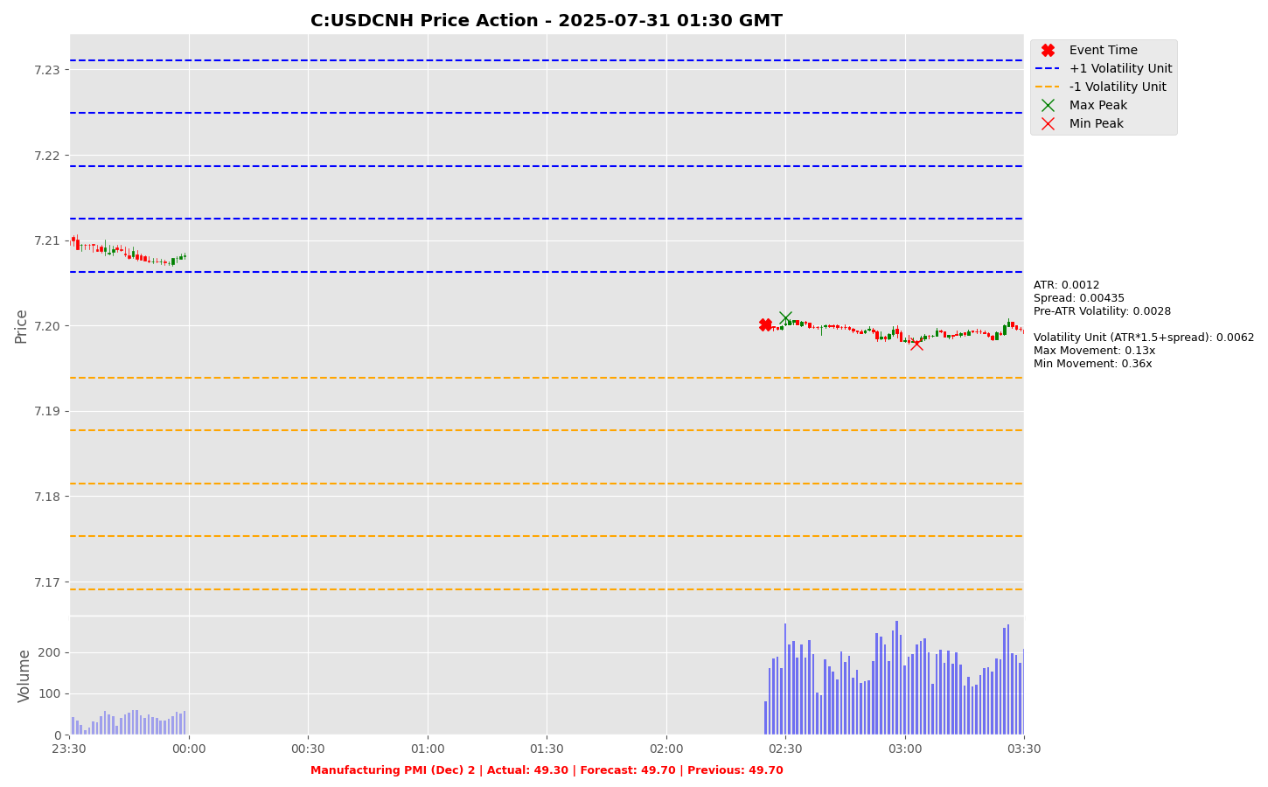

Slide 33
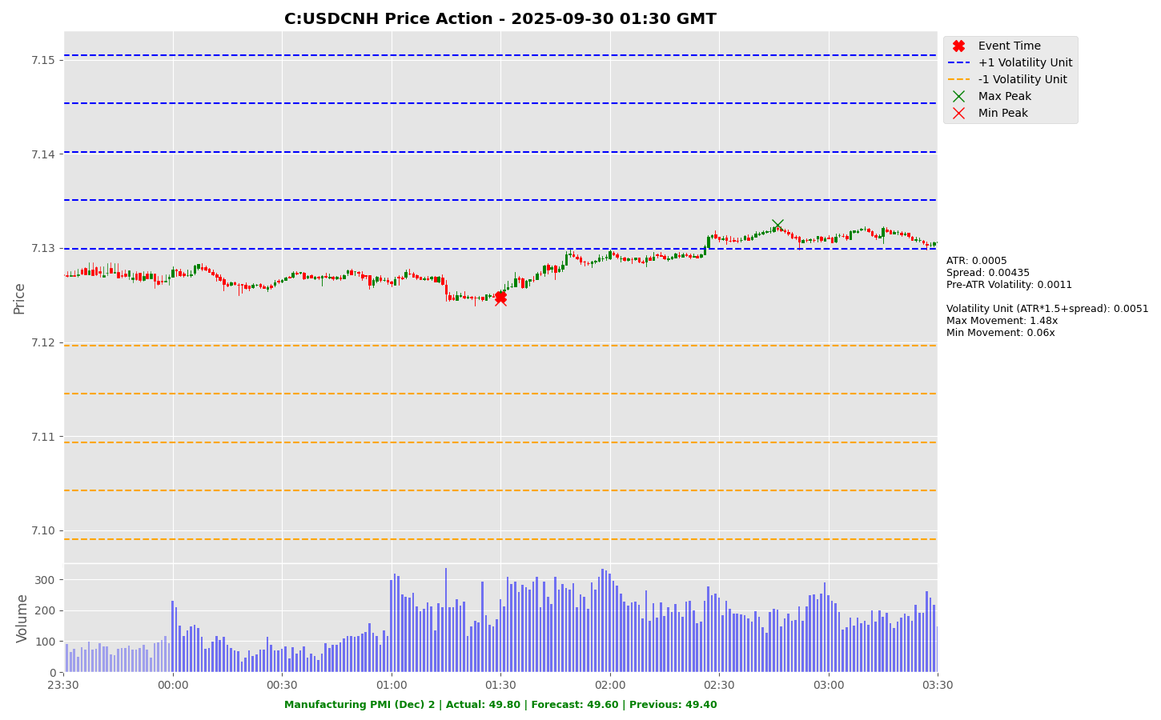

Slide 34
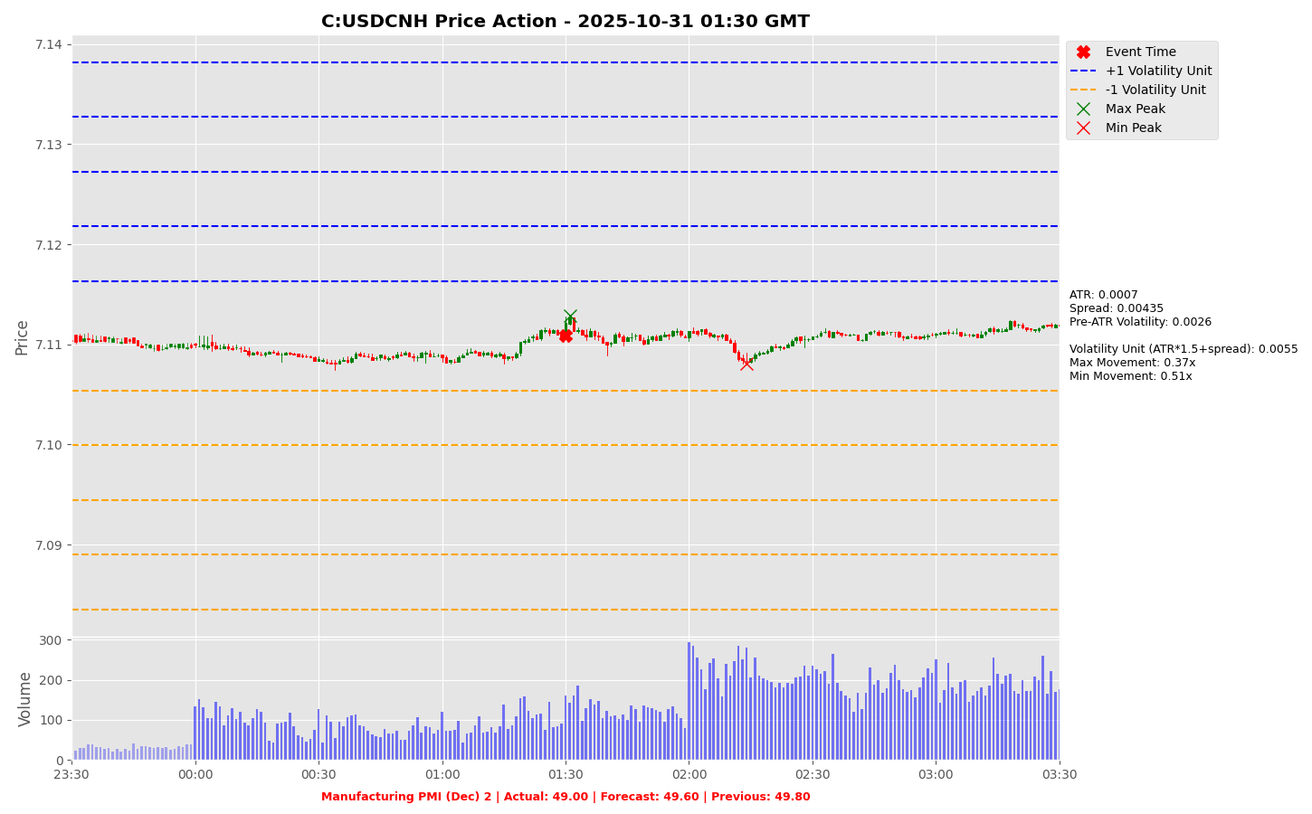

Slide 35
Project Spider Accelerating the Energy Transition 4thMar 2024 Pawan Quantwater Tech Investments
Initial Jobless Claims

Slide 36
Initial Jobless Claims
Event | Initial Jobless Claims |  |  | Description
Actual: |  |  |  | Initial Jobless Claims measures the number of individuals who filed for unemployment insurance for the first time during the past week. This is the earliest U.S. economic data, but the market impact varies from week to week. A higher than expected reading should be taken as negative/bearish for the USD, while a lower than expected reading should be taken as positive/bullish for the USD.
Forecast:
Previous:
Time (GMT): | 13:30
Release Date | Actual | Forecast | Previous
24-Dec-25 | 214 | 224 | 224
18-Dec-25 | 224 | 224 | 237
11-Dec-25 | 236 | 220 | 192
04-Dec-25 | 191 | 219 | 218
26-Nov-25 | 216 | 226 | 222
20-Nov-25 | 220 |  | 228

Slide 37
Project Spider Accelerating the Energy Transition 4thMar 2024 Pawan Quantwater Tech Investments
Initial Jobless Claims
USDJPY

Slide 38
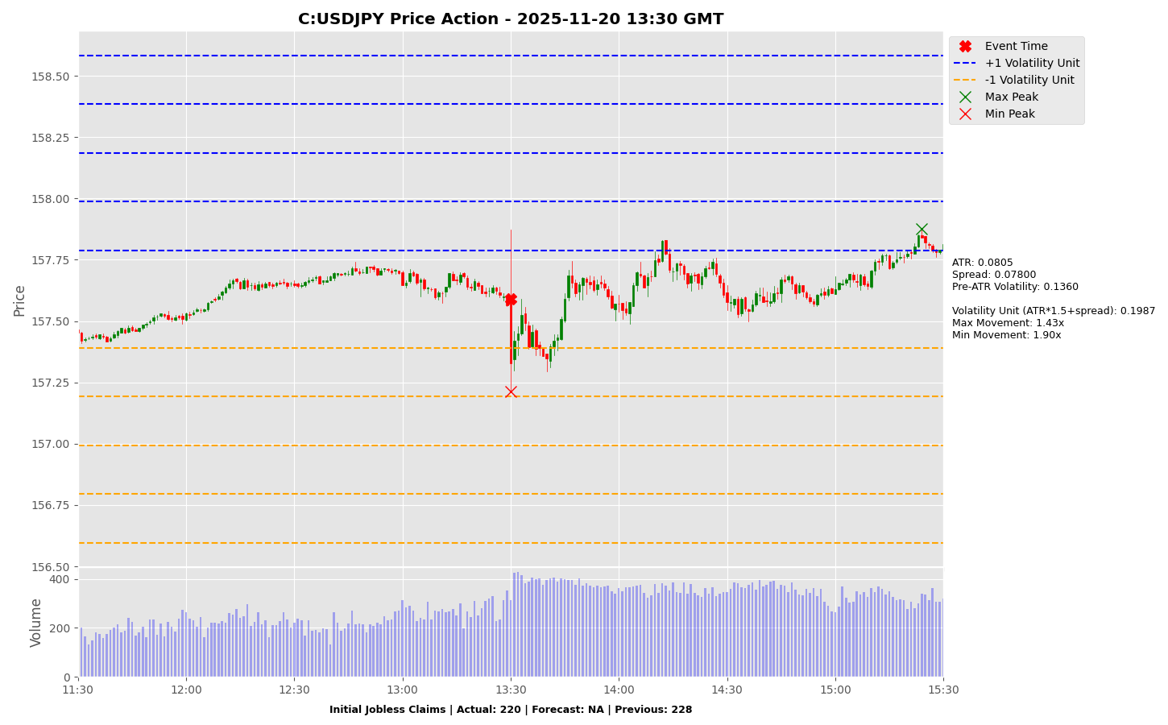

Slide 39
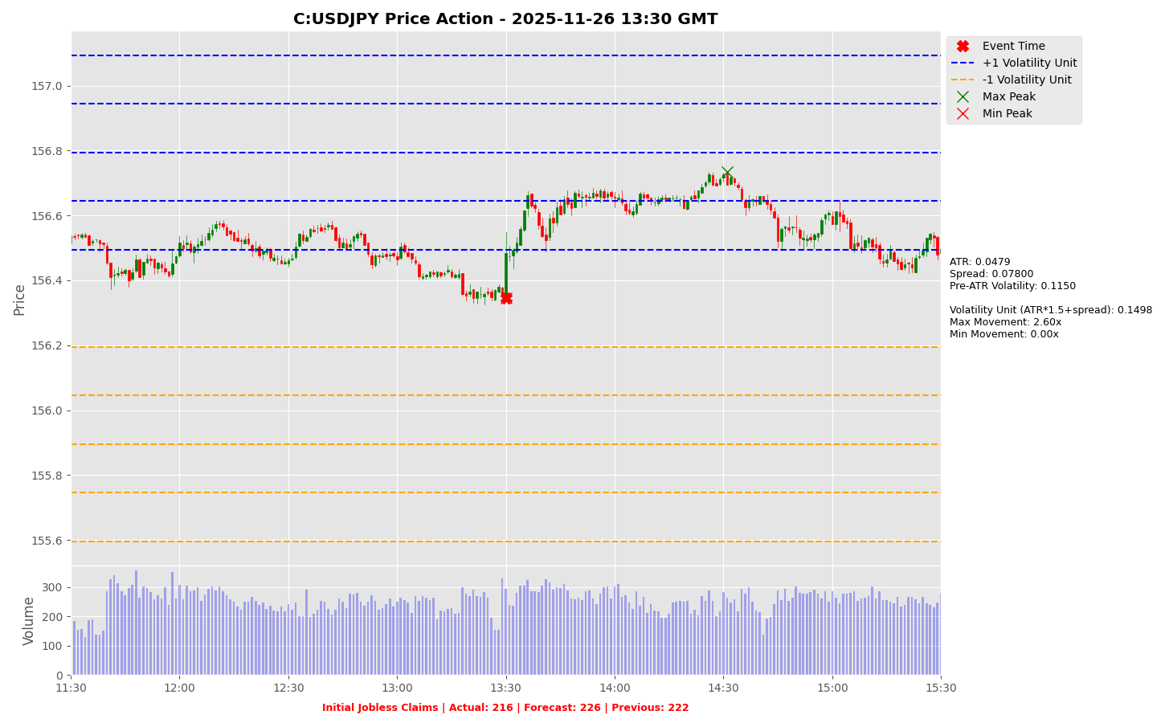

Slide 40
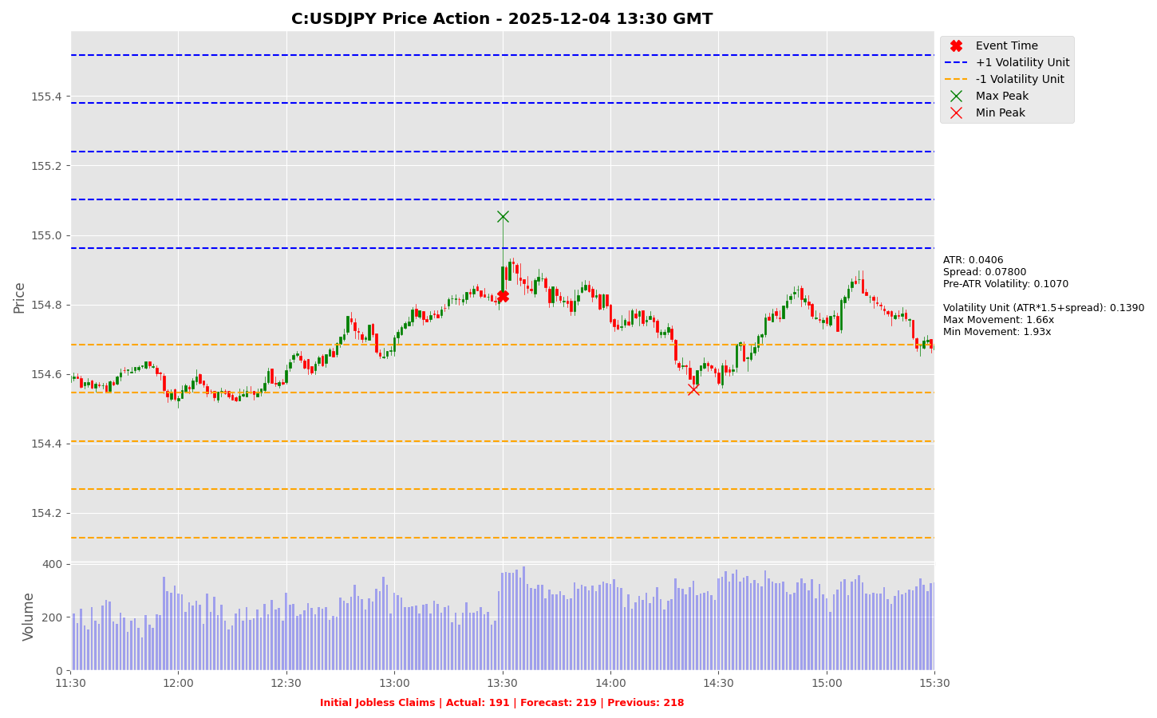

Slide 41
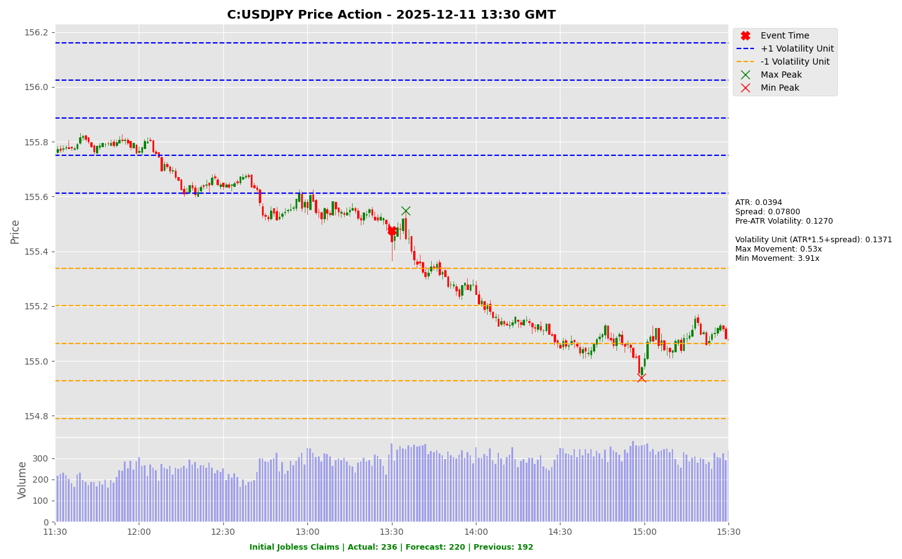

Slide 42
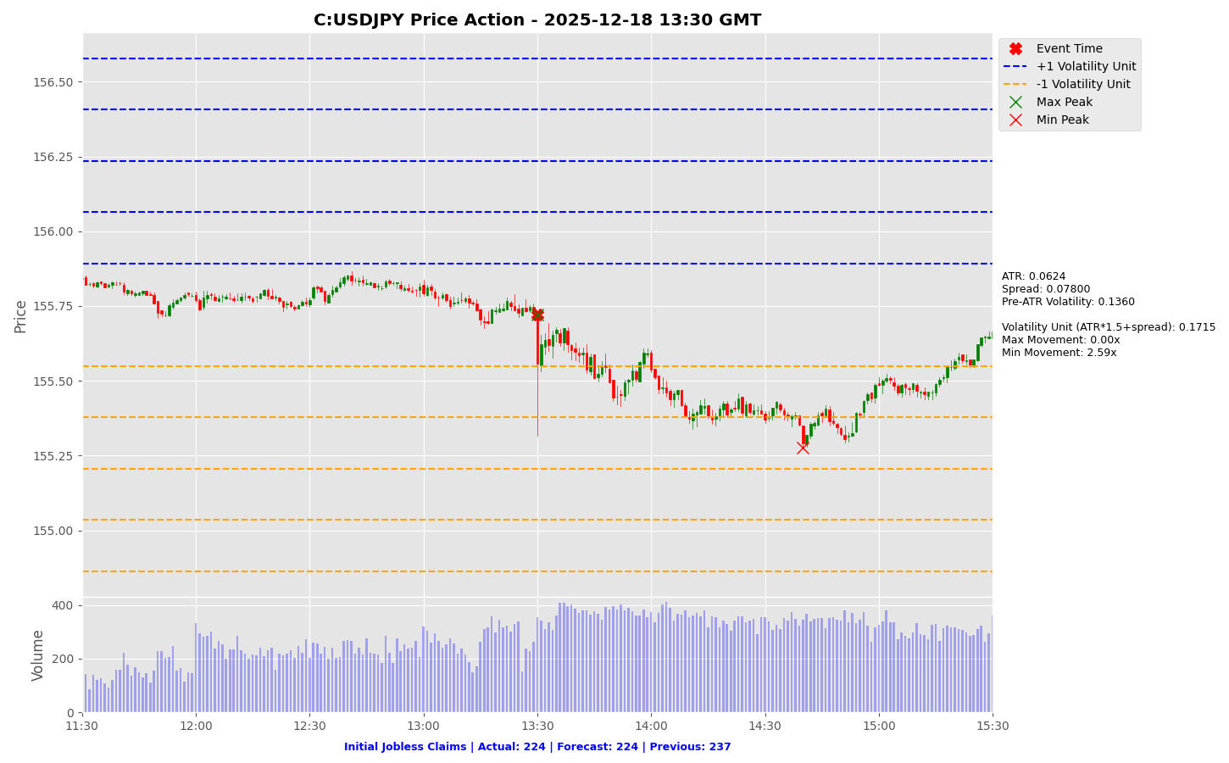

Slide 43
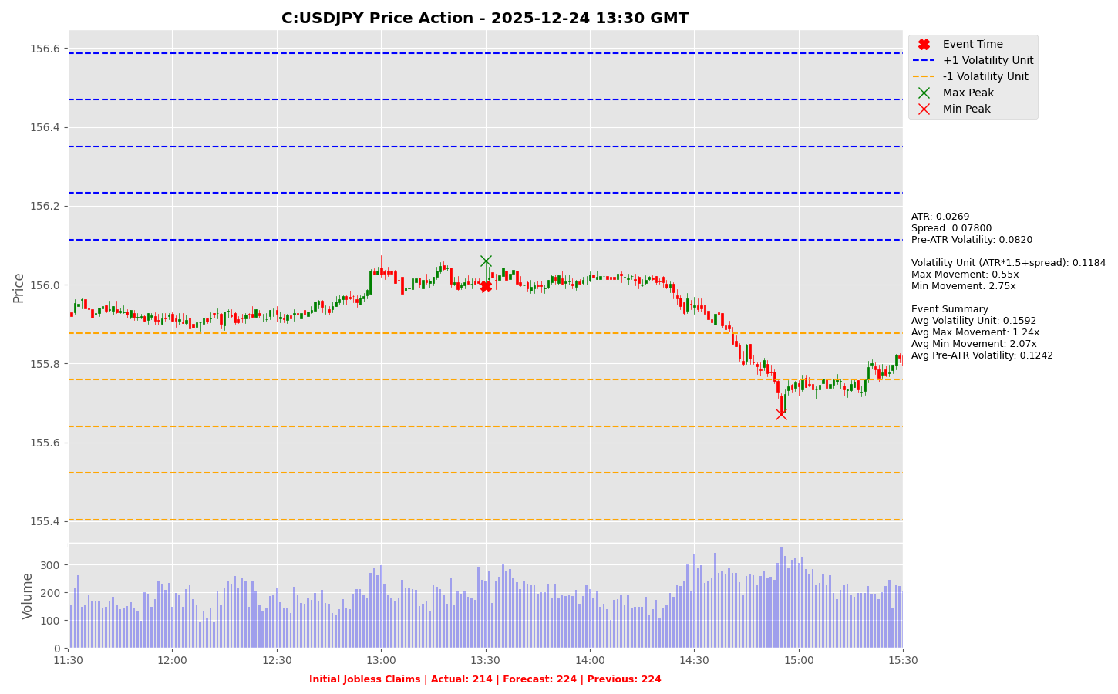

Slide 44
Project Spider Accelerating the Energy Transition 4thMar 2024 Pawan Quantwater Tech Investments
Initial Jobless Claims
EURUSD

Slide 45
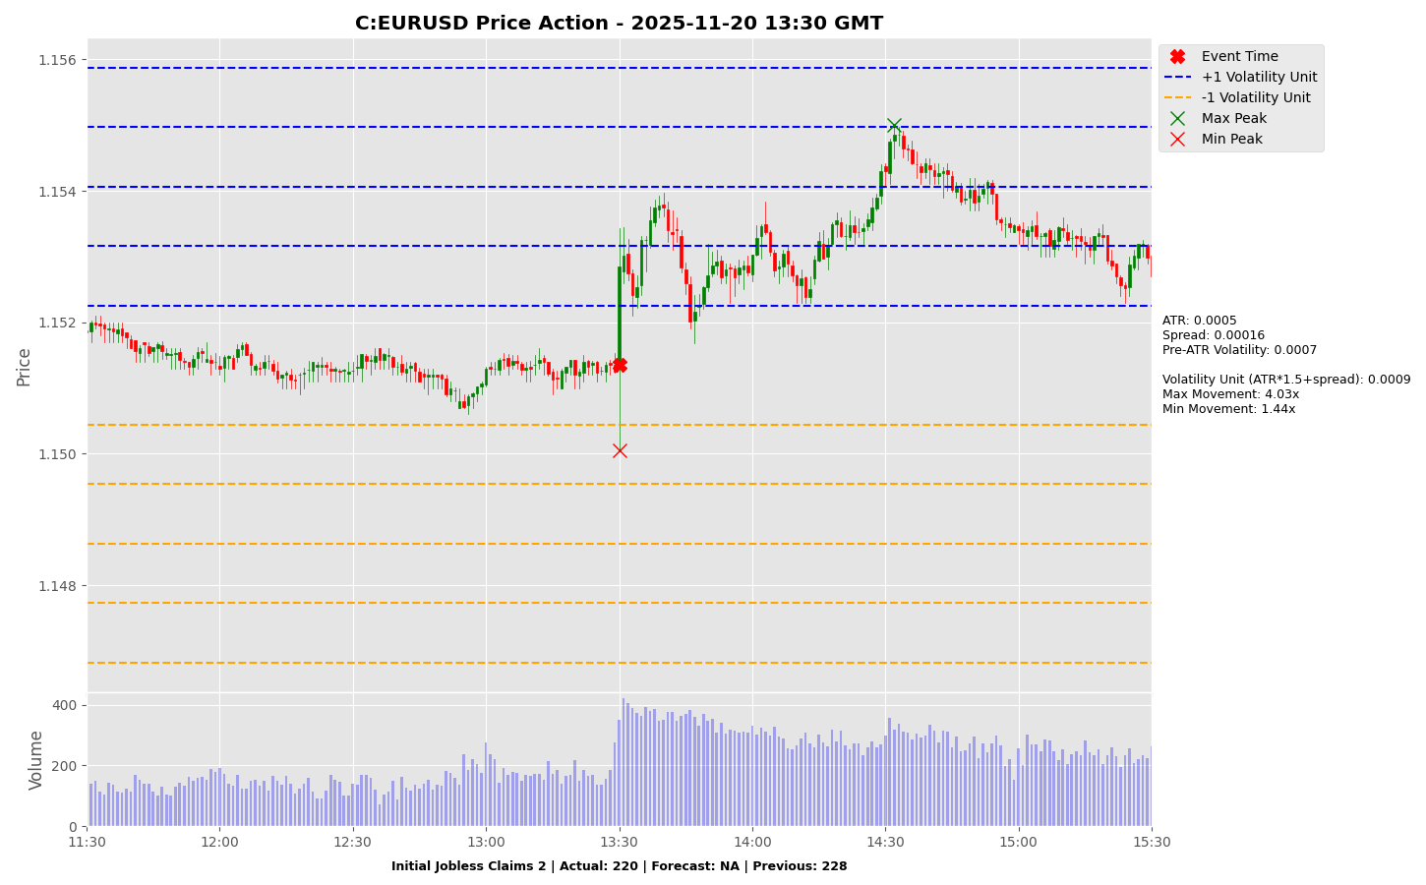

Slide 46
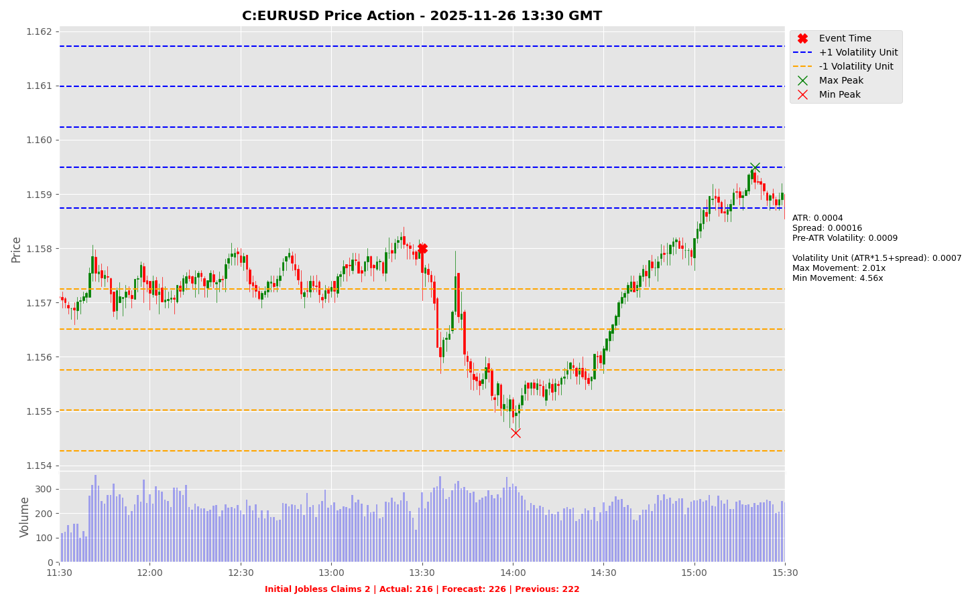

Slide 47
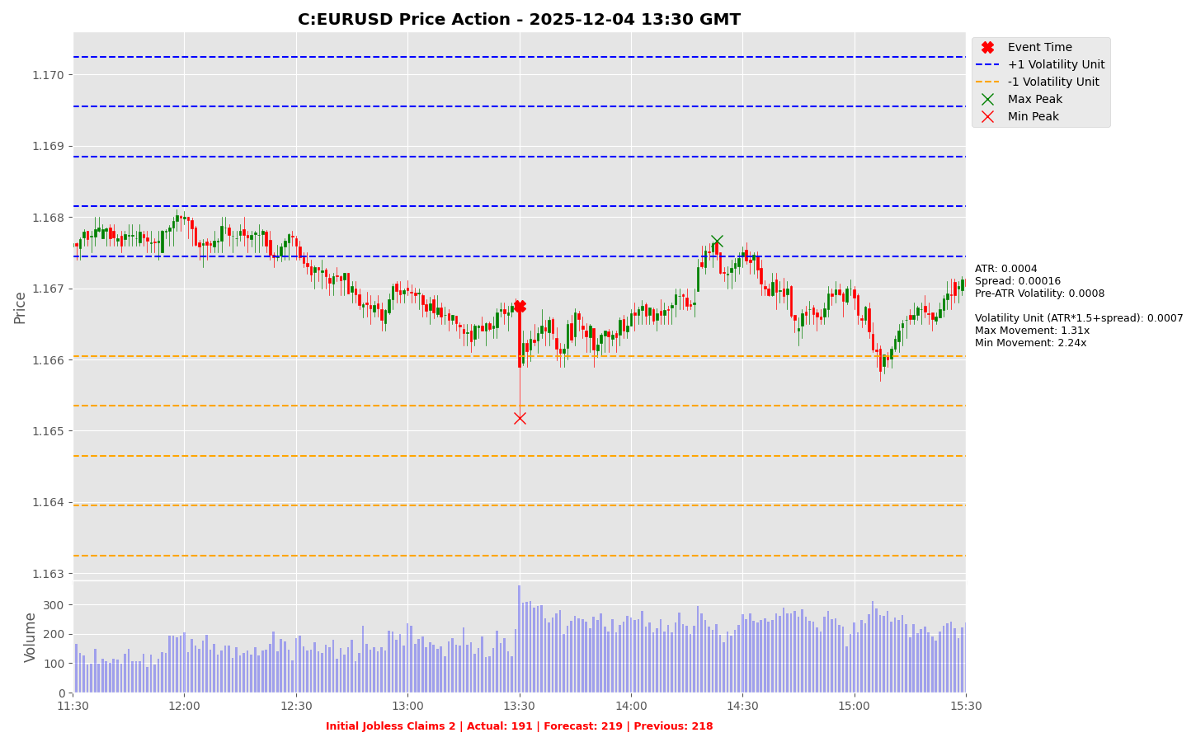

Slide 48
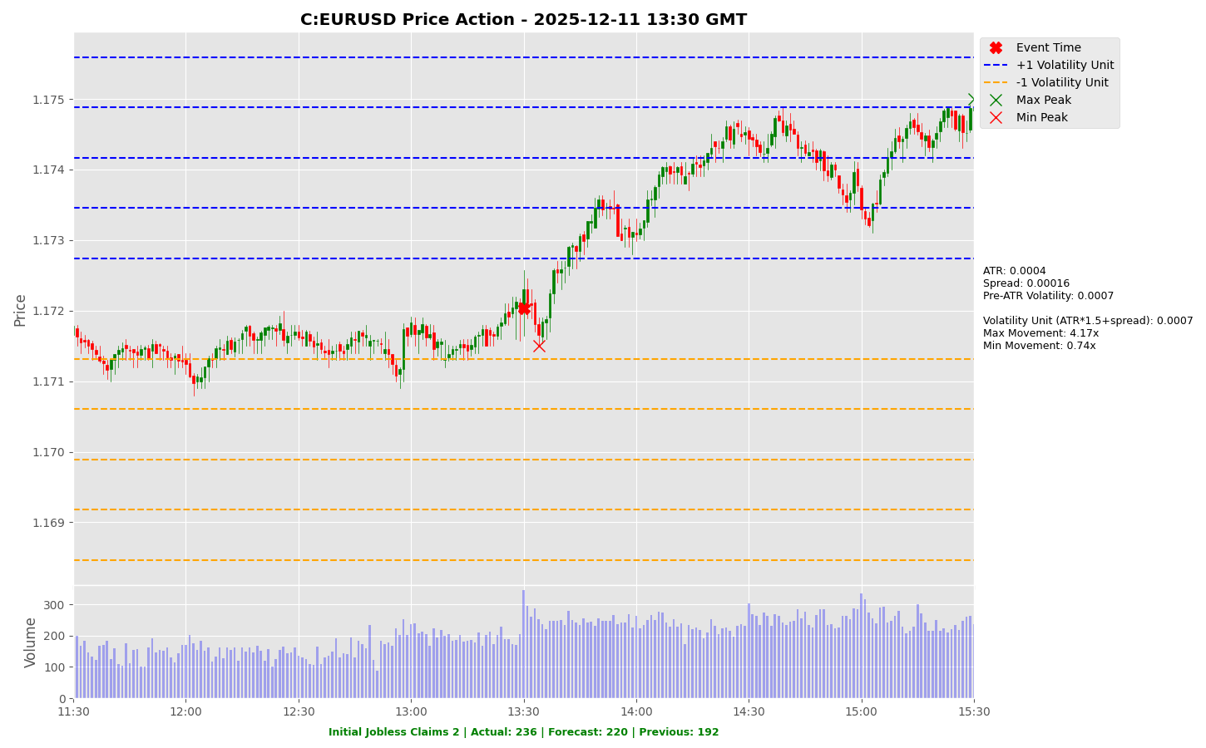

Slide 49
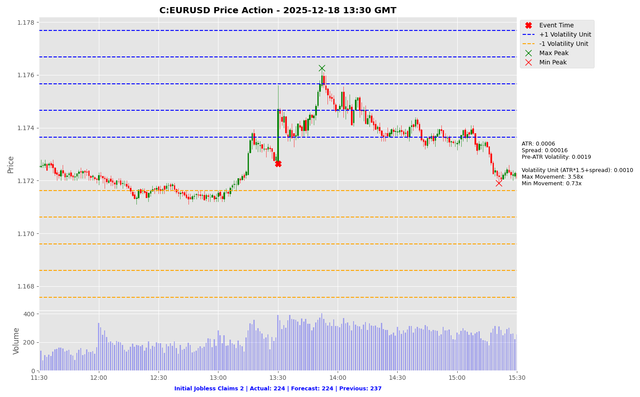

Slide 50
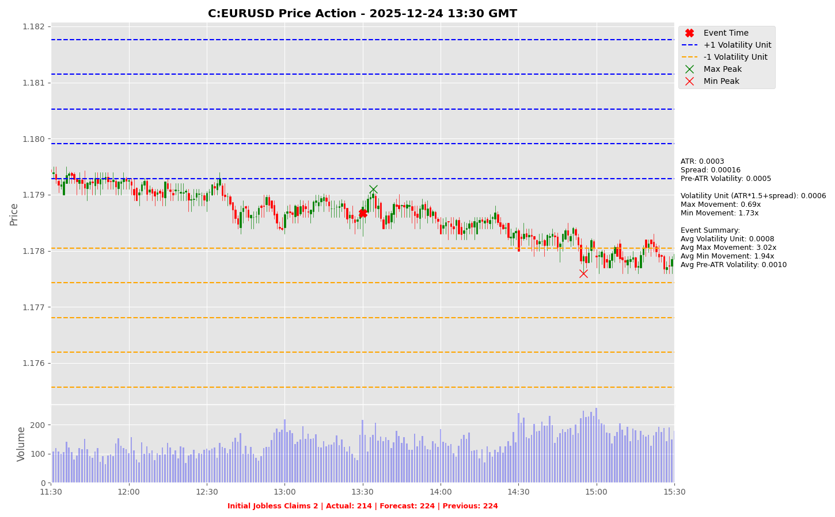

Slide 51
Project Spider Accelerating the Energy Transition 4thMar 2024 Pawan Quantwater Tech Investments
Chicago PMI (Dec)

Slide 52
Chicago PMI (Dec)
Event | Chicago PMI (Dec) |  |  | Description
Actual: |  |  |  | The Chicago Purchasing Managers' Index (PMI) determines the economic health of the manufacturing sector in Chicago region. A reading above 50 indicates expansion of the manufacturing sector; a reading below indicates contraction. The Chicago PMI can be of some help in forecasting the ISM manufacturing PMI. A higher than expected reading should be taken as positive/bullish for the USD, while a lower than expected reading should be taken as negative/bearish for the USD.
Forecast:
Previous: | 49.20
Time (GMT): | 14:45
Release Date | Actual | Forecast | Previous
26-Nov-25 | 36.30 | 44.30 | 43.80
31-Oct-25 | 43.80 | 42.30 | 40.60
30-Sep-25 | 40.60 | 43.40 | 41.50
29-Aug-25 | 41.50 | 46.60 | 47.10
31-Jul-25 | 47.10 | 41.90 | 40.40
30-Jun-25 | 40.40 | 42.70 | 40.50

Slide 53
Project Spider Accelerating the Energy Transition 4thMar 2024 Pawan Quantwater Tech Investments
Chicago PMI (Dec)
USDJPY

Slide 54
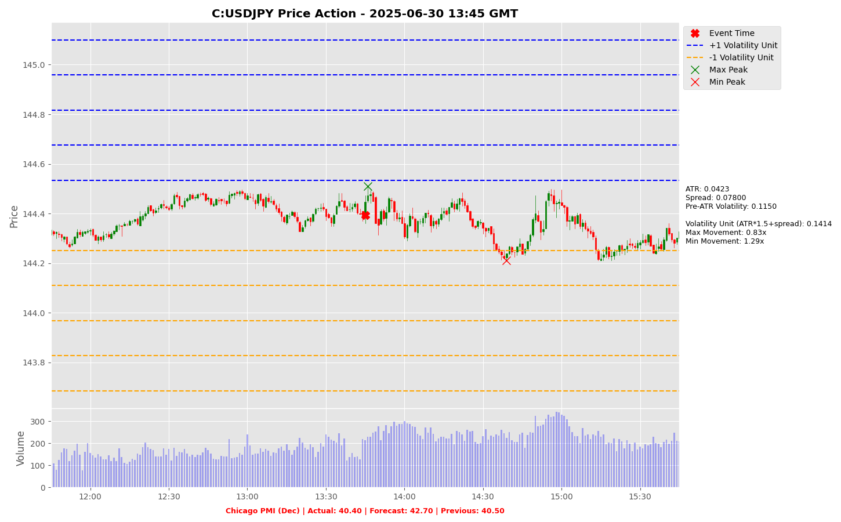

Slide 55
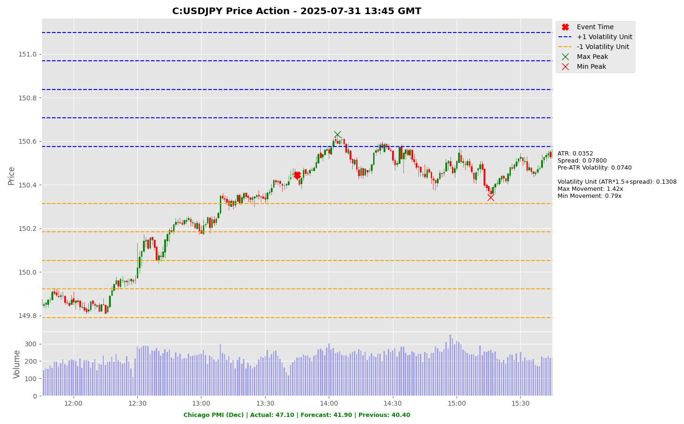

Slide 56
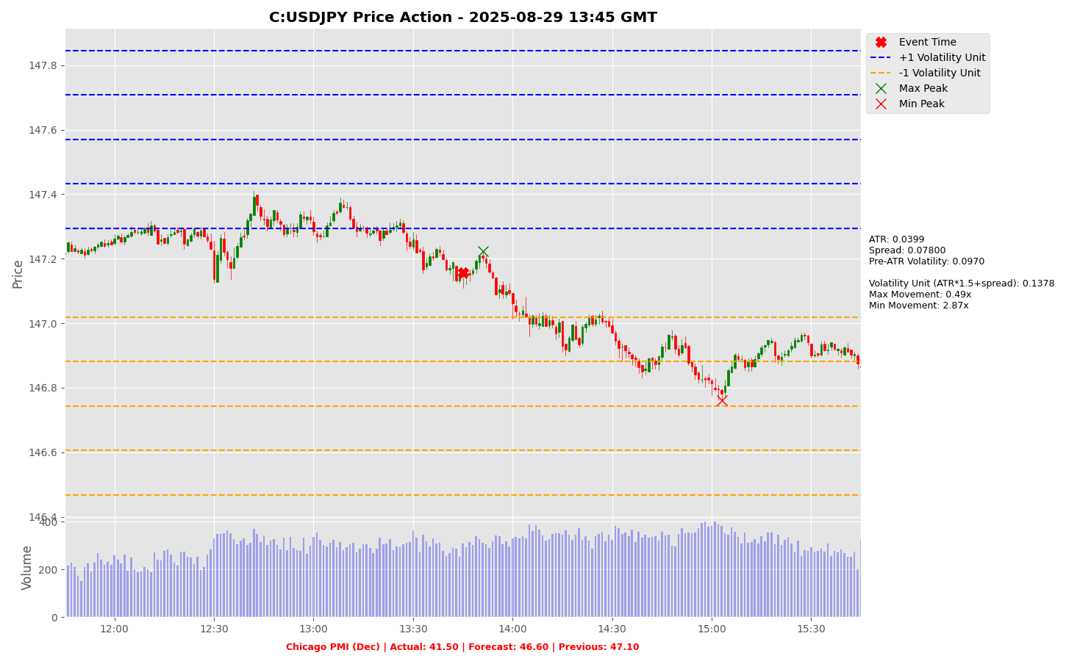

Slide 57
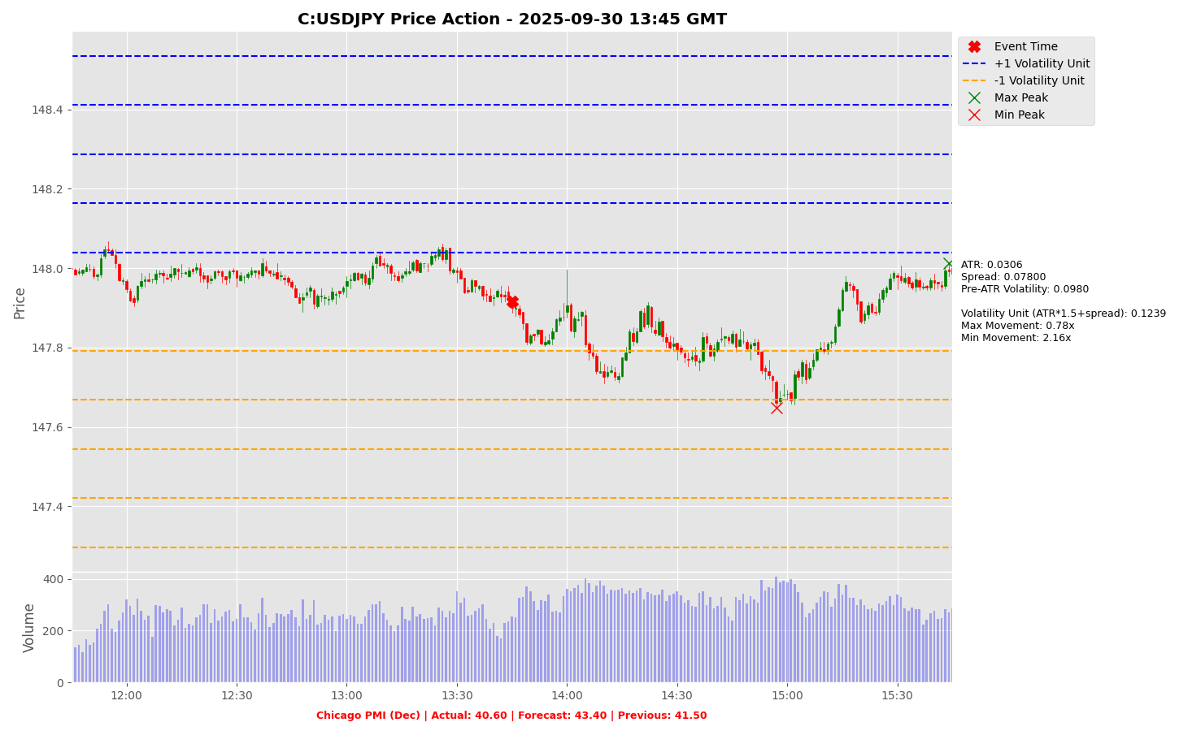

Slide 58
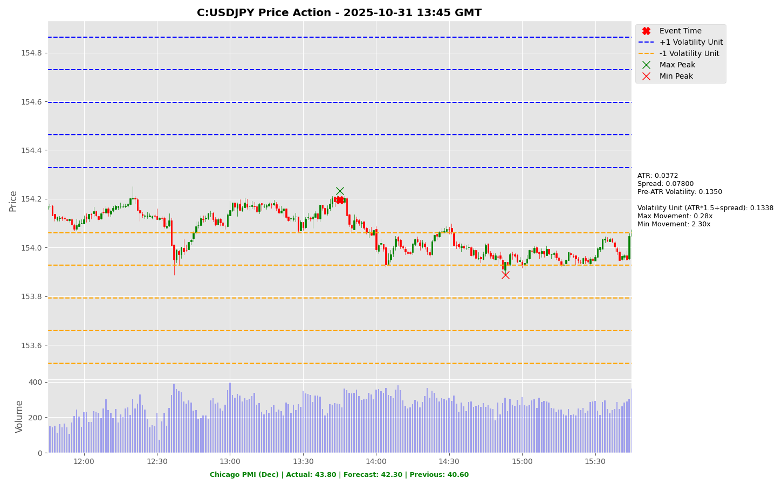

Slide 59
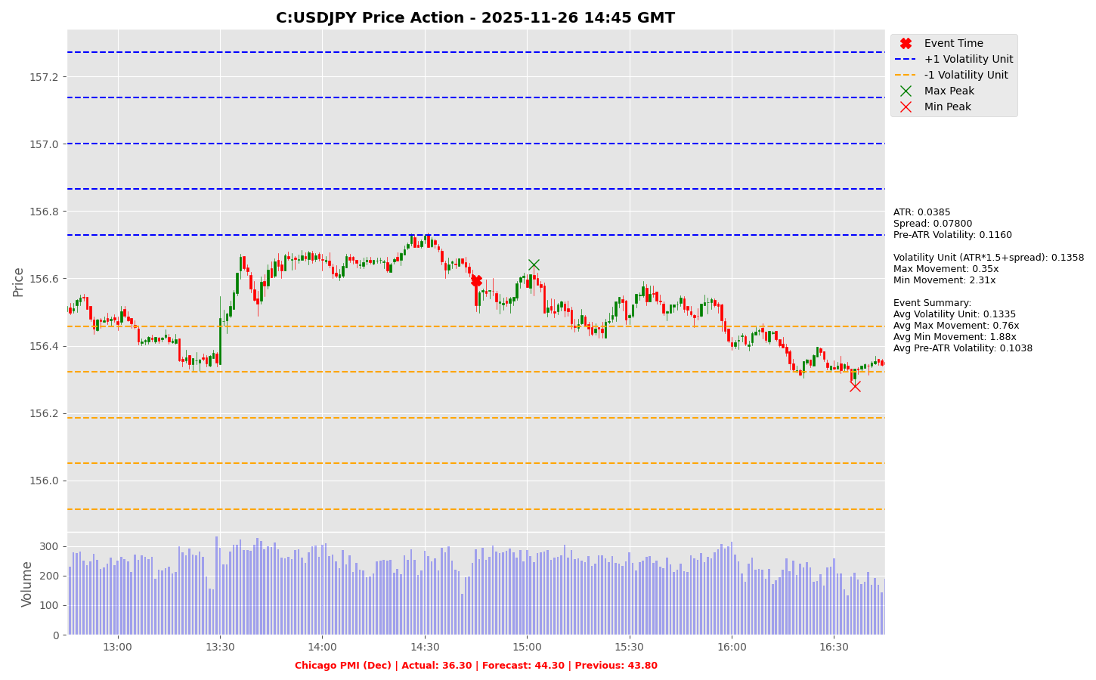

Slide 60
Project Spider Accelerating the Energy Transition 4thMar 2024 Pawan Quantwater Tech Investments
Chicago PMI (Dec)
EURUSD

Slide 61
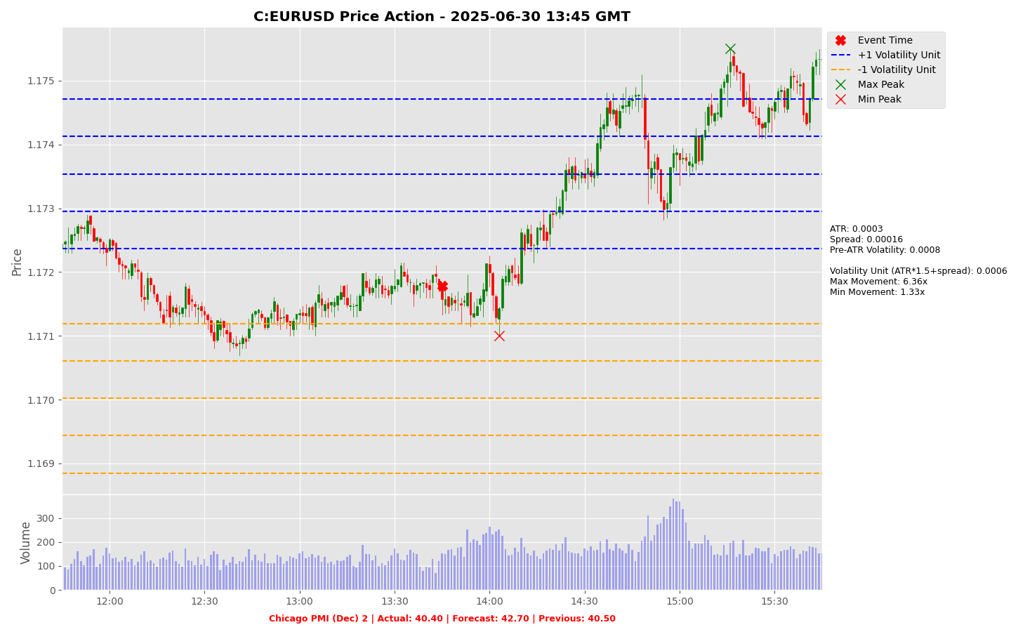

Slide 62
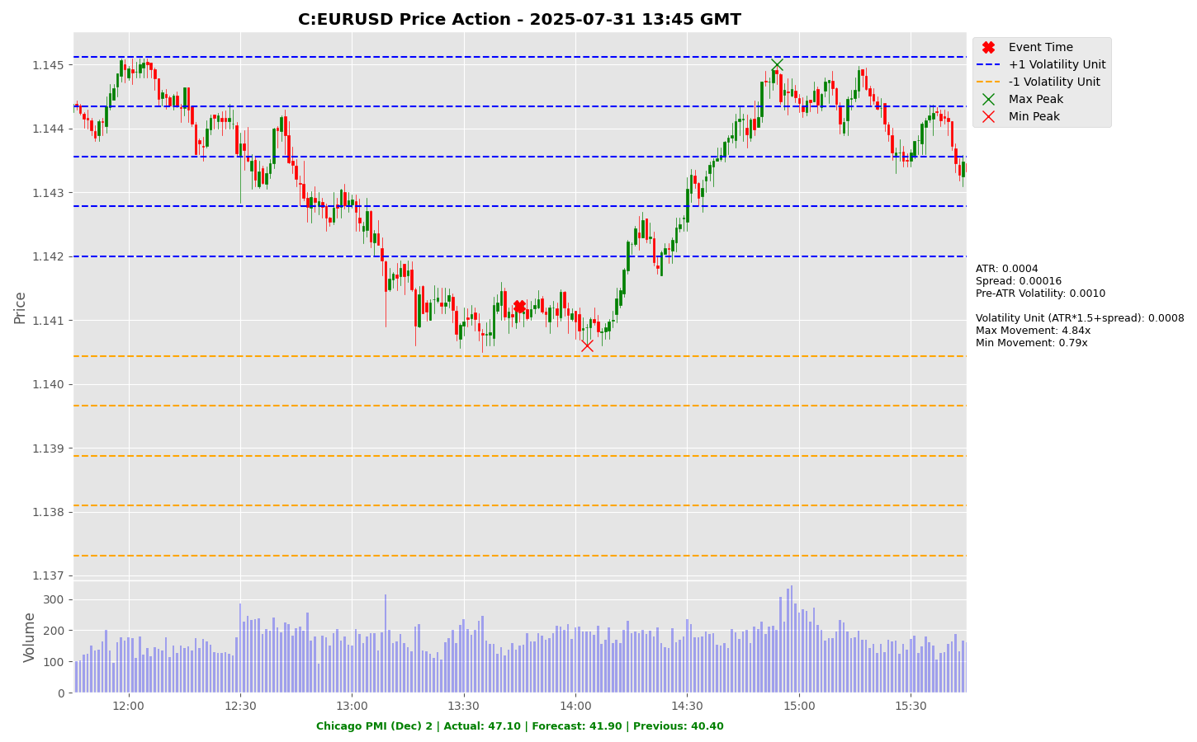

Slide 63
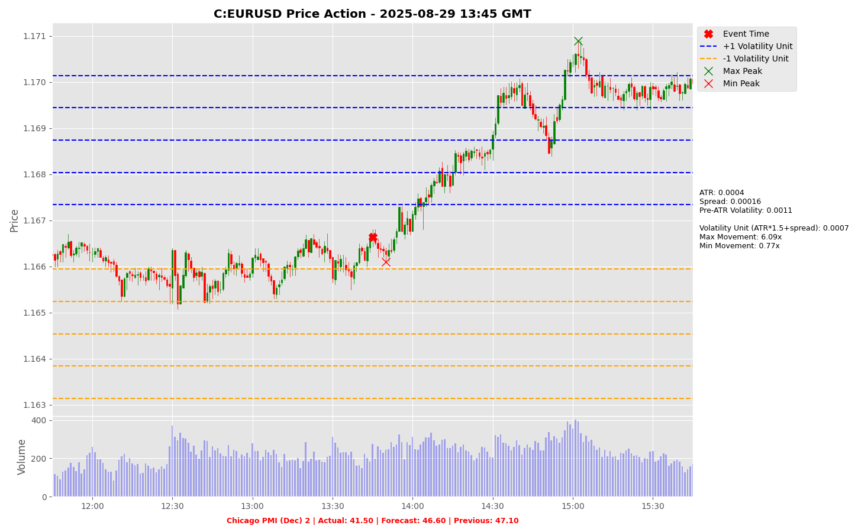

Slide 64
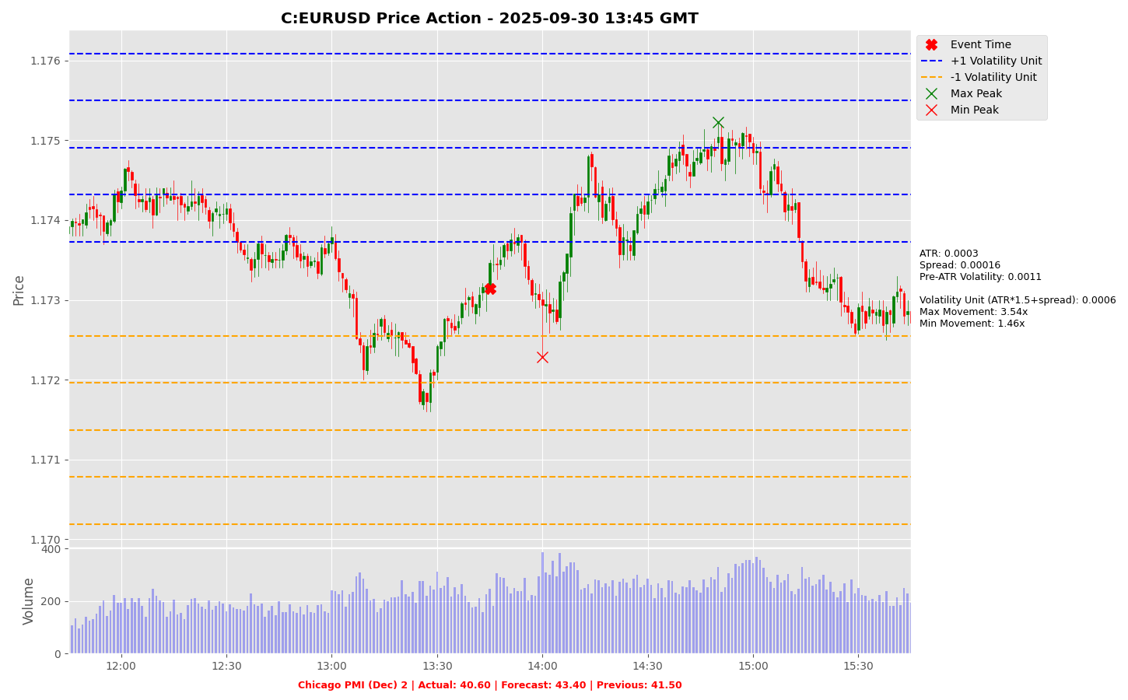

Slide 65
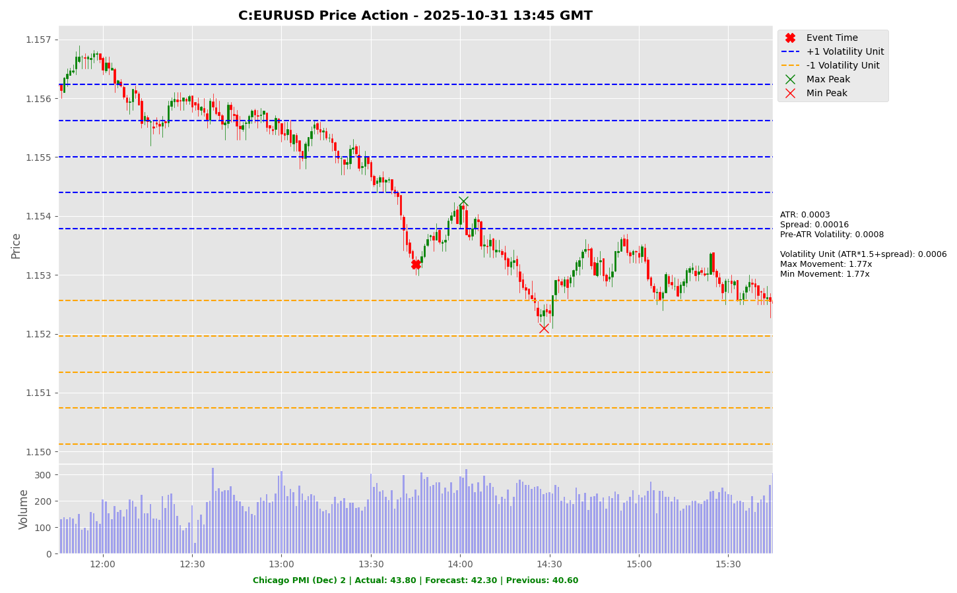

Slide 66
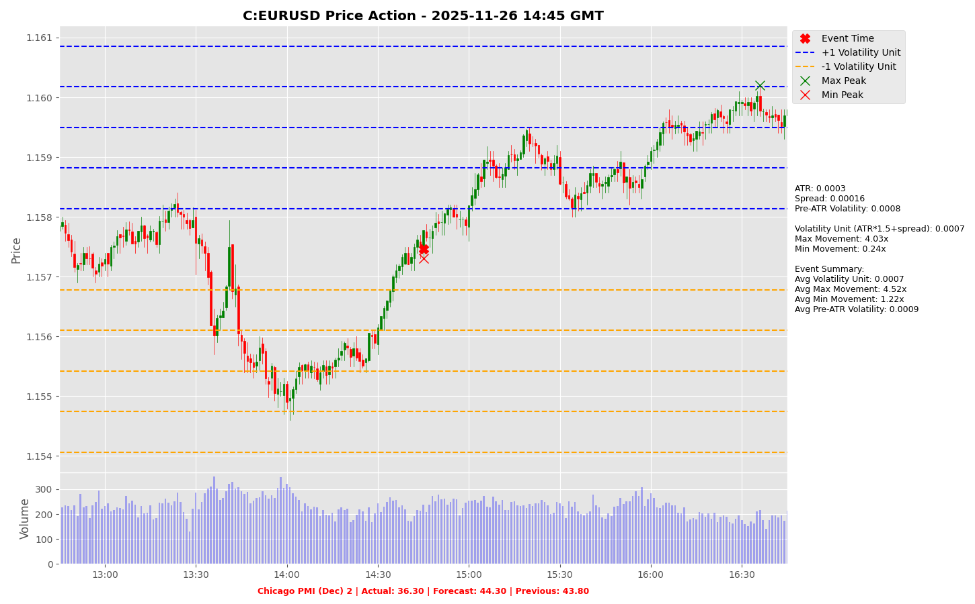

Slide 67
Project Spider Accelerating the Energy Transition 4thMar 2024 Pawan Quantwater Tech Investments
S&P Global Manufacturing PMI (Dec)

Slide 68
S&P Global Manufacturing PMI (Dec)
Event | S&P Global Manufacturing PMI (Dec) |  |  | Description
Actual: |  |  |  | The Manufacturing Purchasing Managers' Index (PMI) measures the activity level of purchasing managers in the manufacturing sector. A reading above 50 indicates expansion in the sector; below 50 indicates contraction. Traders watch these surveys closely as purchasing managers usually have early access to data about their company’s performance, which can be a leading indicator of overall economic performance. A higher than expected reading should be taken as positive/bullish for the USD while a lower than expected reading should be taken as negative/bearish for the USD.
Forecast:
Previous:
Time (GMT): | 13:45
Release Date | Actual | Forecast | Previous
16-Dec-25 | 51.80 | 52.00 | 52.20
16-Dec-25 | 51.80 | 52.00 | 52.20
16-Dec-25 | 51.80 | 52.00 | 52.20
16-Dec-25 | 51.80 | 52.00 | 52.20
16-Dec-25 | 51.80 | 52.00 | 52.20
16-Dec-25 | 51.80 | 52.00 | 52.20

Slide 69
Project Spider Accelerating the Energy Transition 4thMar 2024 Pawan Quantwater Tech Investments
S&P Global Manufacturing PMI (Dec)
USDJPY

Slide 70
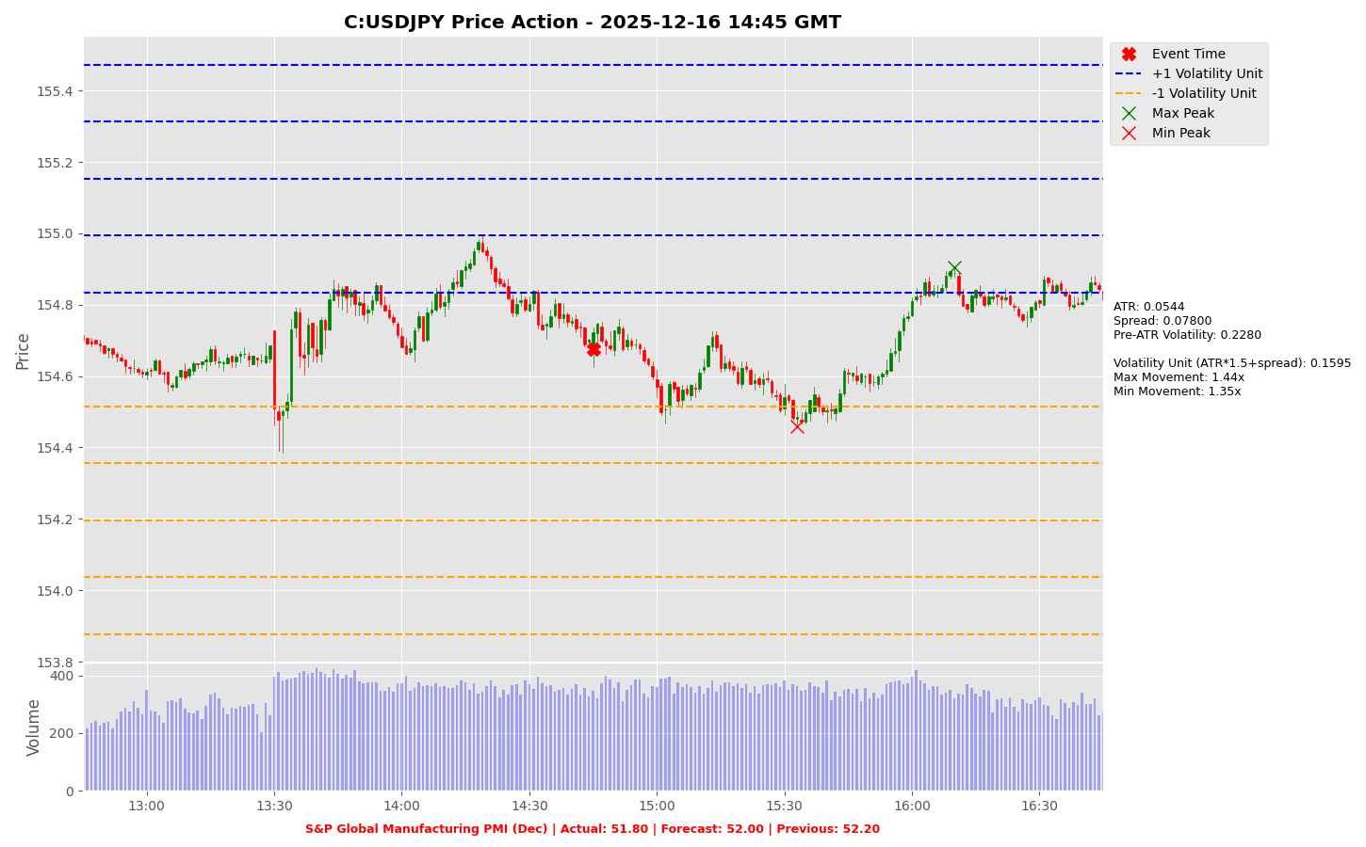

Slide 71
Project Spider Accelerating the Energy Transition 4thMar 2024 Pawan Quantwater Tech Investments
S&P Global Manufacturing PMI (Dec)
EURUSD

Slide 72
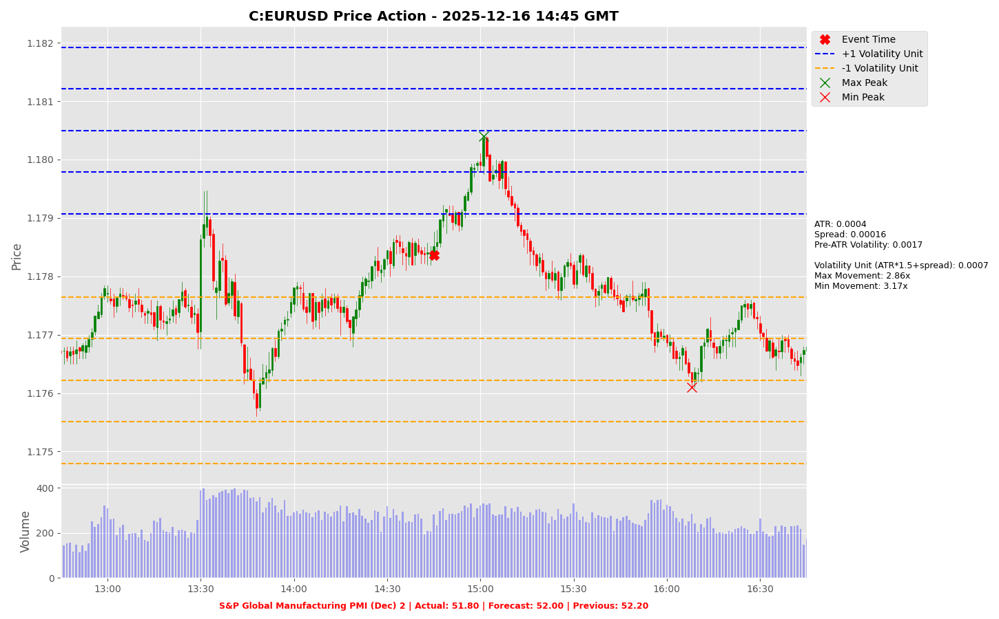

Slide 73
Project Spider Accelerating the Energy Transition 4thMar 2024 Pawan Quantwater Tech Investments
Appendix

Slide 74
Important Information
Quantwater Tech Investments Data Release Deck – 28th December 2025 This document is for informational purposes only and does not constitute investment advice, an offer, or a solicitation to buy or sell any securities or financial instruments. Past performance is not indicative of future results. Investments involve inherent risks, including the possible loss of principal. No representation or warranty, express or implied, is made regarding the accuracy, completeness, or reliability of the information contained herein. The information in this presentation is derived from publicly available sources and internal analysis as of the date indicated and is subject to change without notice. Quantwater Tech Investments and its affiliates do not undertake any obligation to update or revise this material. Neither Quantwater Tech Investments nor any of its affiliates, officers, or employees shall be liable for any direct or indirect losses arising from the use of this information. Any misrepresentation is strictly prohibited.

Slide 75
Key Economic & Analytical Concepts
Economic Data Interpretation
Price Movements
Forecast Vs. Actual: Comparing predicted values with released data
Previous Reading: Last reported value
Market Impact: How releases affect financial markets
Max Movement: Largest upward price move after event
Min Movement: Largest downward price move after event
Both measured in Volatility Units
Average True Range (ATR)
Using This Analysis
Definition: A technical indicator that measures market volatility
Calculations:
Calculate True Range (TR) for each period:
TR = max [(high - low), abs(high – previous close), abs(low – previous close)]
ATR = Simple moving average of TR over N periods (typically 14)
Interpretation:
Higher ATR = Higher Volatility
Lower ATR = Lower Volatility
Usage in Our Analysis:
Helps standardize price movements across different market conditions
Forms the basis of our Volatility Unit Calculations
Analyzing volatility across different economic releases helps identify patterns in market reactions.
This approach allows for evaluating the significance of economic indicators based on their market impact.
Adhering to standard trading guidelines, the risk amount should not exceed 5% of the trading balance, typically. A risk-reward ratio of 1:1.5x or greater, guided by the win ratio and historical data from this presentation or other estimates, can be used to determine the appropriate risk level, take-profit point, and position size.
Trade automation on the MT5/MT4 platform can be implemented using the expert advisor linked below, which takes the specified parameters as input.
An MT5/MT4 account can be accessed through a brokerage/securities dealer firm or by using a proprietary (prop) trading account.*
Example:
Volatility analysis of economic releases, such as the CPI event, helps identify patterns in market reactions. For instance, if the CPI event typically results in a minimum movement of 0.5x and a maximum movement of 3x, a stop-loss of 1x and a take-profit of 3x can be strategically applied.
Following prudent risk management, the risk per trade should not exceed 5% of the trading balance, typically. For a $100,000 trading account (max loss amount post which trading is halted), this translates to a $5,000 stop-loss and a $15,000 take-profit.
The guiding principle is that a win ratio of at least 50% combined with a risk-reward ratio of over 1.5 ensures positive expected cash flow. By limiting risk to 5% of the account balance, potential drawdowns from consecutive losses are minimized, preserving capital and maintaining positive cash flow expectations.
If you need further assistance, please don’t hesitate to contact us.
*Disclaimer: The links are provided for informational purposes only and connect to third-party websites. We are not affiliated with, nor do we endorse, any of these external sites. Trading carries a significant risk of financial loss. Your risk is your own responsibility, and you should carefully consider your investment objectives and risk tolerance before trading.
Volatility Unit
Resources
Formula: (ATR * multiple) + Spread (multiple is typically 1.5)
Purpose: Standardizes price movements
https://github.com/pawan-pro/quantwater-tech-investments/blob/main/QuantPulse
https://quantwatertech.netlify.app/research
https://quantwater.tech/blog

Slide 76
Thank You!
Thank You!
Pawan Jatale
pawan@quantwater.tech
Founder
Quantwater Tech Investments

