Slide 1

Project Spider Accelerating the Energy Transition 4thMar 2024 Pawan Quantwater Tech Investments
30th March 2026
Economic Data Releases & Their Historical Impact on Assets

Slide 2
German CPI (MoM) (Mar)

Slide 3
German CPI (MoM) (Mar)
Release Date | Actual | Forecast | Previous
2026-01-06 | 0.00 | 0.30 | -0.20
2026-01-16 | 0.00 | 0.00 | -0.20
2026-01-30 | 0.10 | 0.00 | 0.00
2026-02-17 | 0.10 | 0.10 | 0.00
2026-02-27 | 0.20 | 0.50 | 0.10
2026-03-11 | 0.20 | 0.20 | 0.10

Slide 4
German CPI (MoM) (Mar)
C:EURJPY

Slide 5
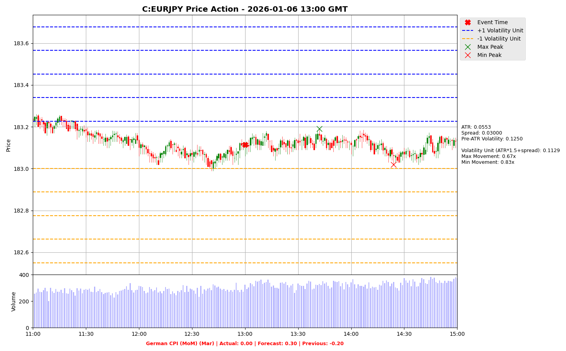

Slide 6
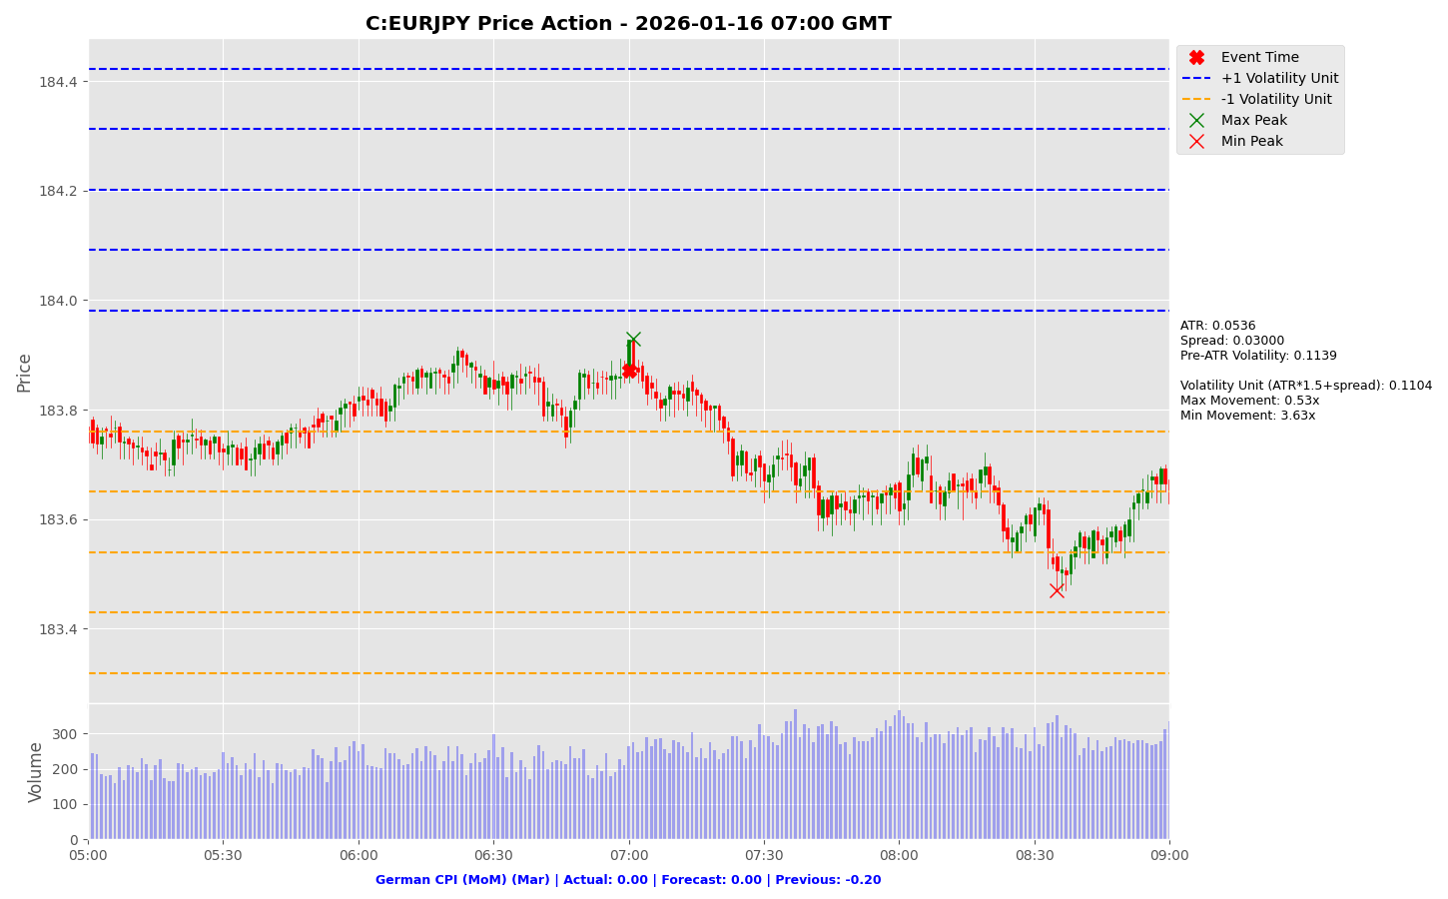

Slide 7
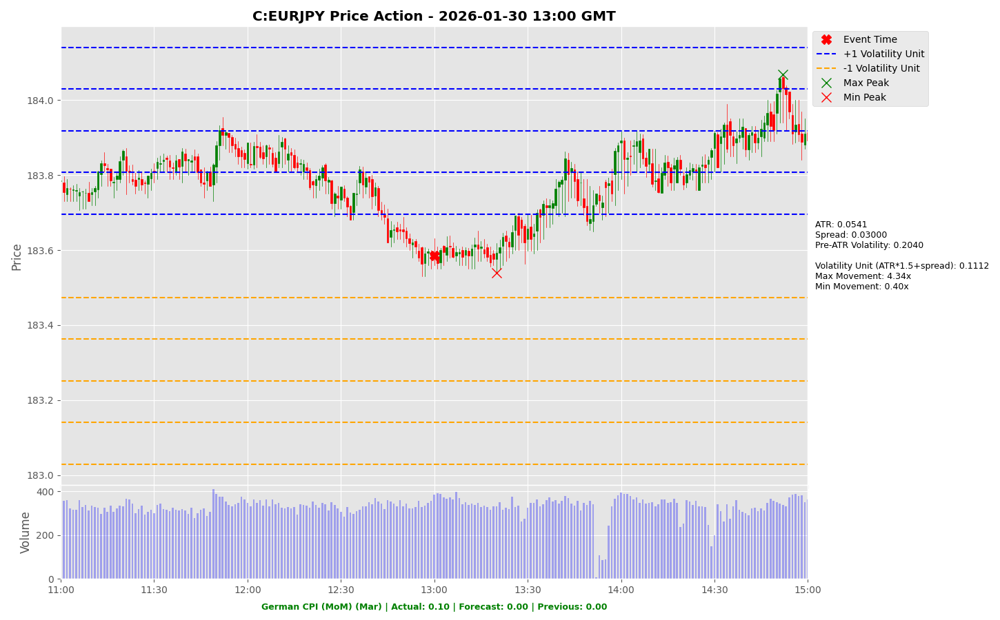

Slide 8
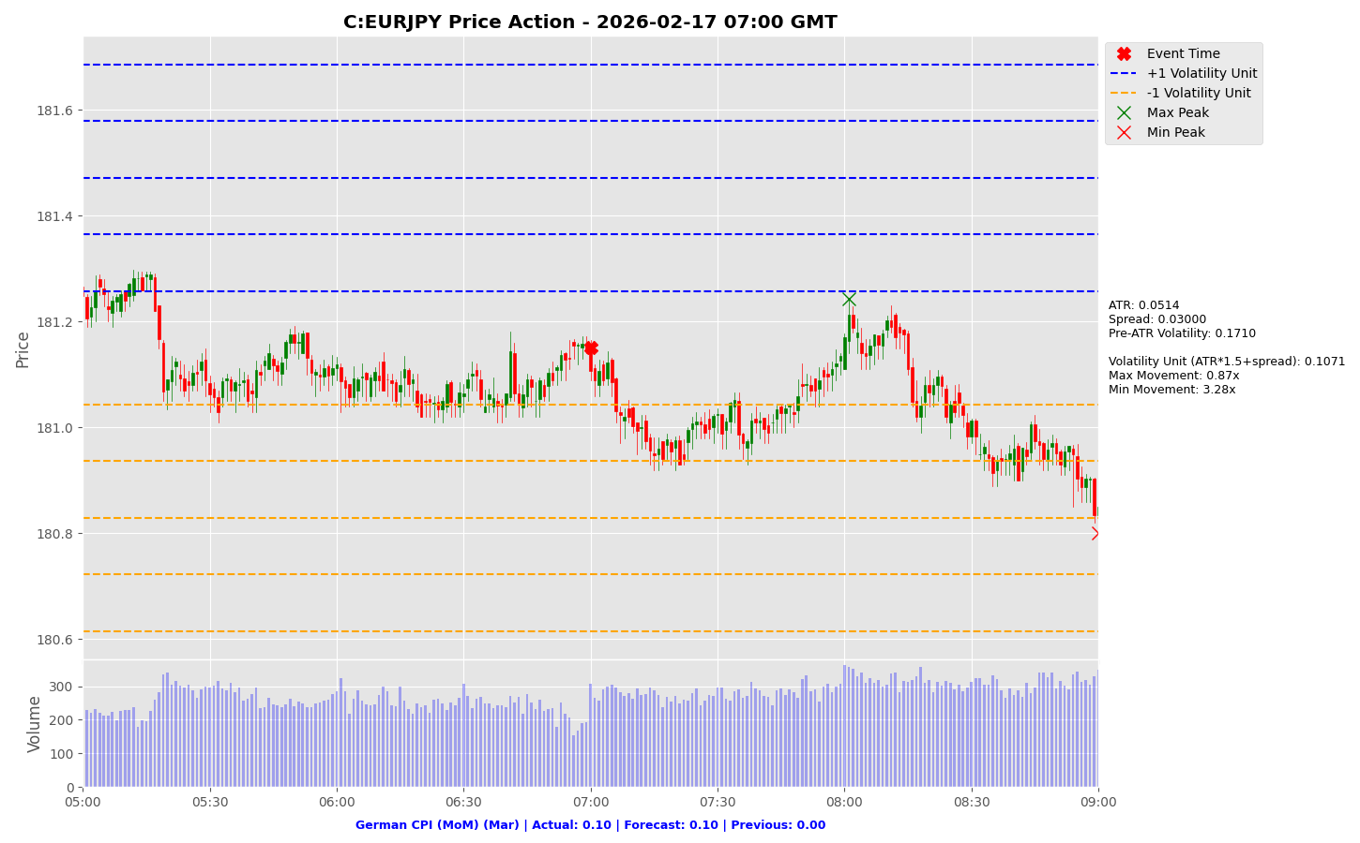

Slide 9
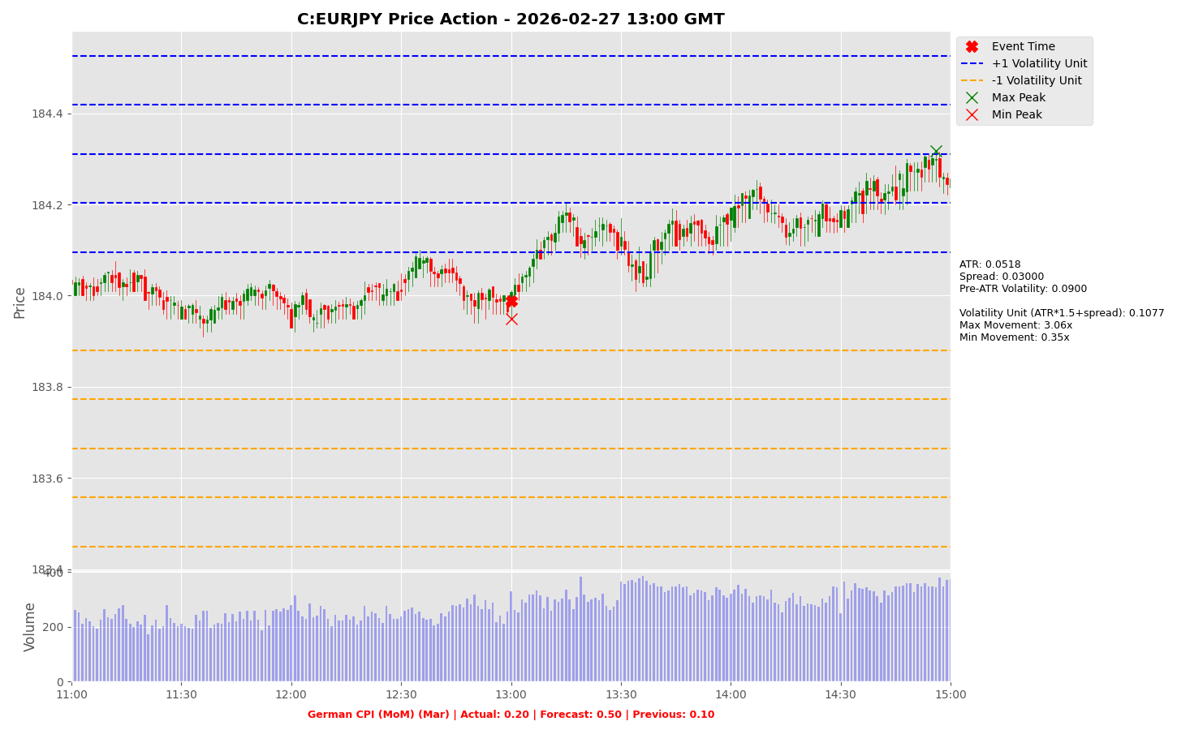

Slide 10
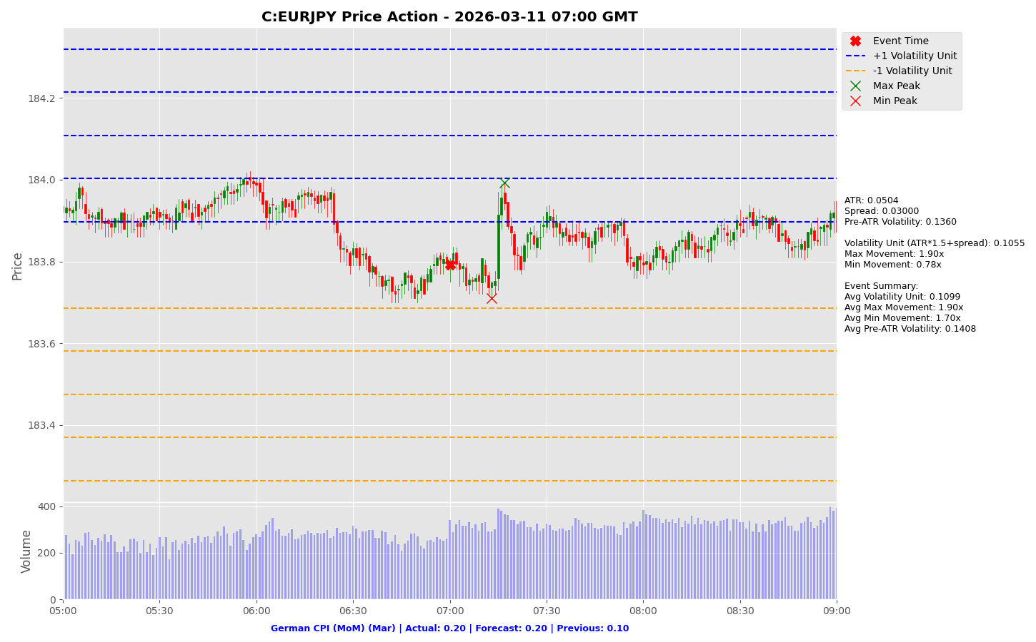

Slide 11
German CPI (MoM) (Mar)
C:EURUSD

Slide 12
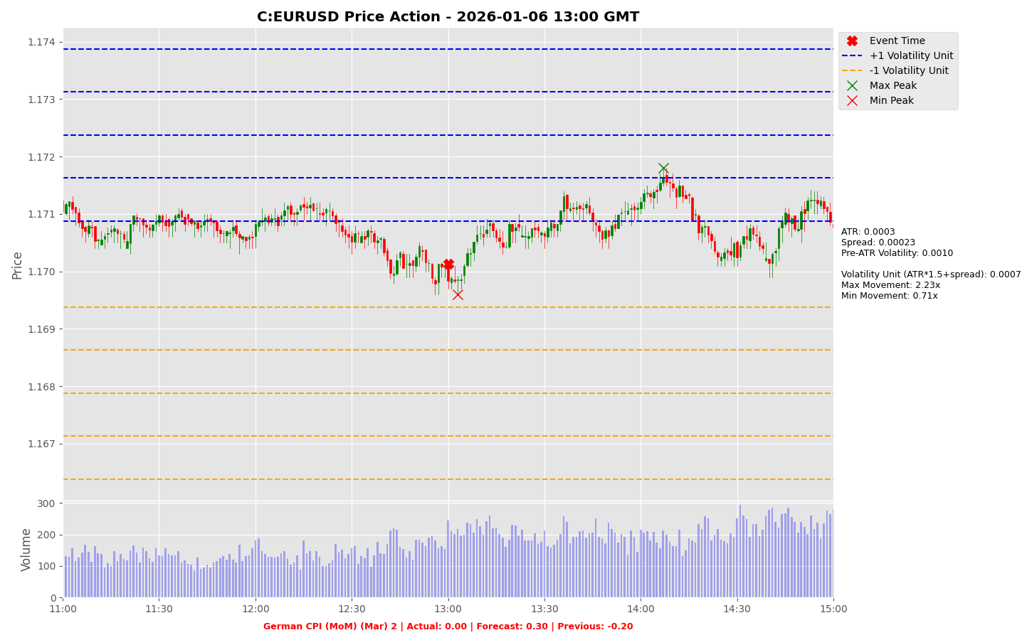

Slide 13
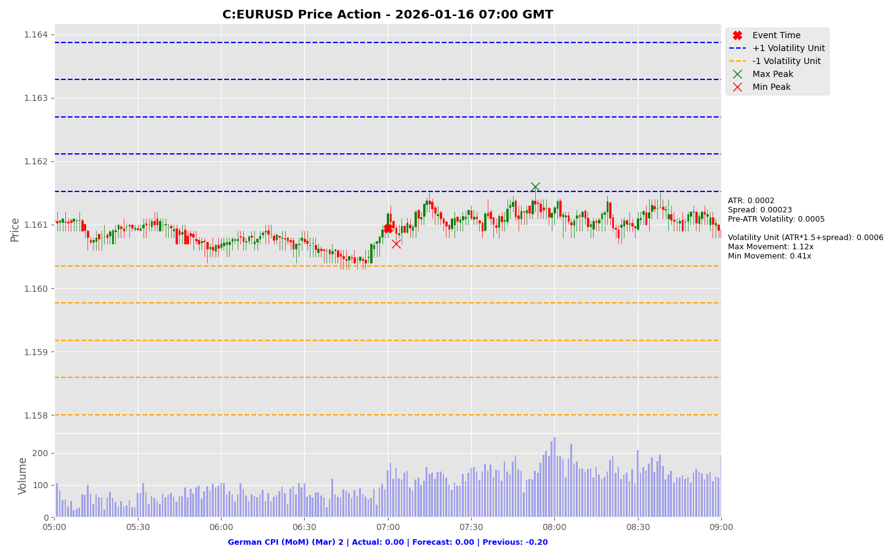

Slide 14
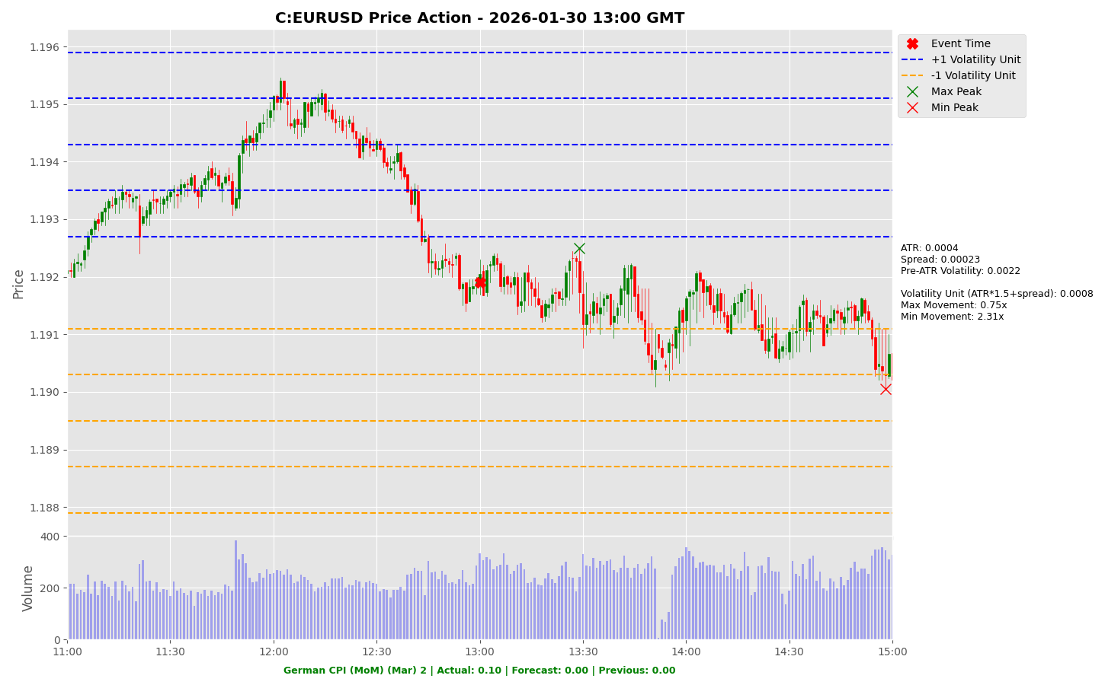

Slide 15
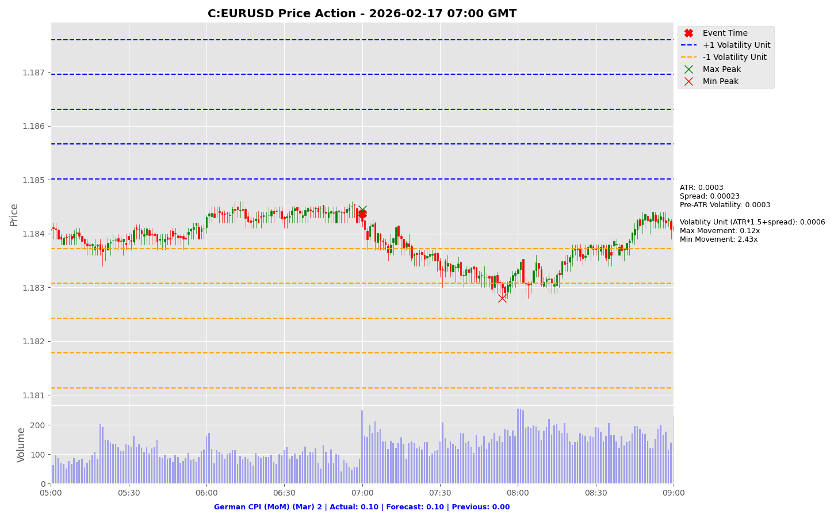

Slide 16
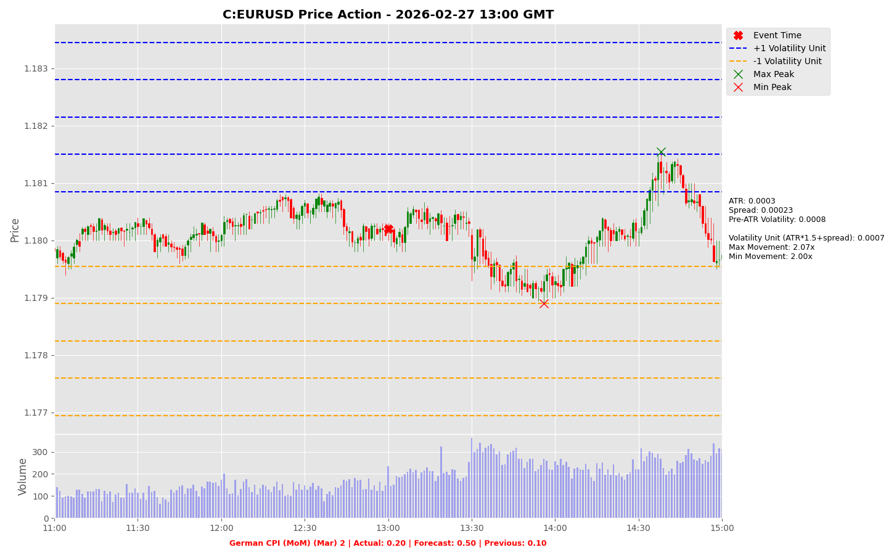

Slide 17
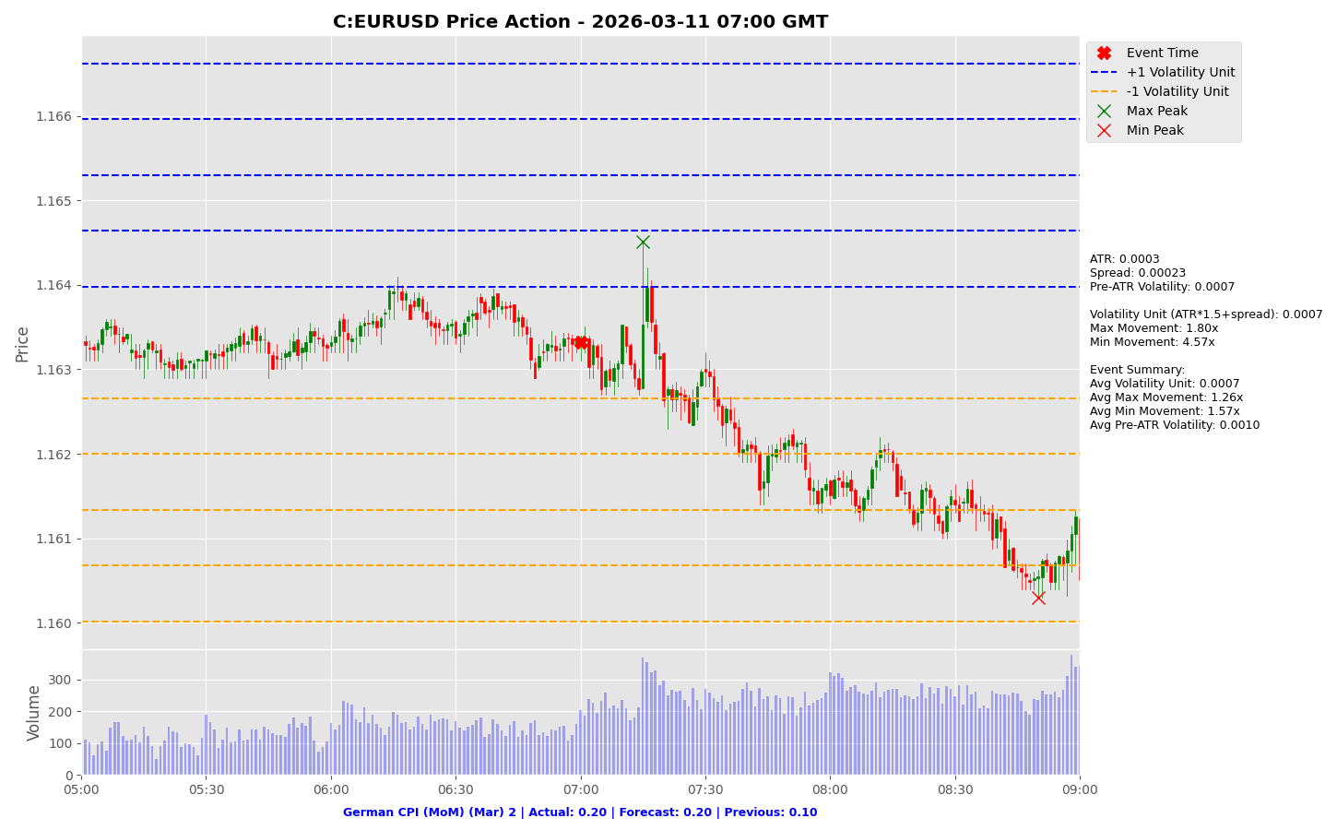

Slide 18
Fed Chair Powell Speaks

Slide 19
Fed Chair Powell Speaks
Release Date | Actual | Forecast | Previous
2025-08-22 |  | NA | NA
2025-09-23 |  | NA | NA
2025-10-09 |  | NA | NA
2025-10-14 |  | NA | NA
2025-12-02 |  | NA | NA
2026-03-21 |  | NA | NA

Slide 20
Fed Chair Powell Speaks
C:USDJPY

Slide 21
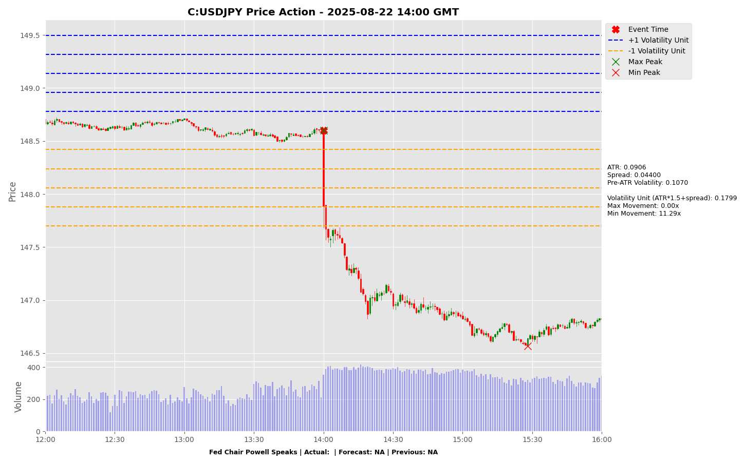

Slide 22
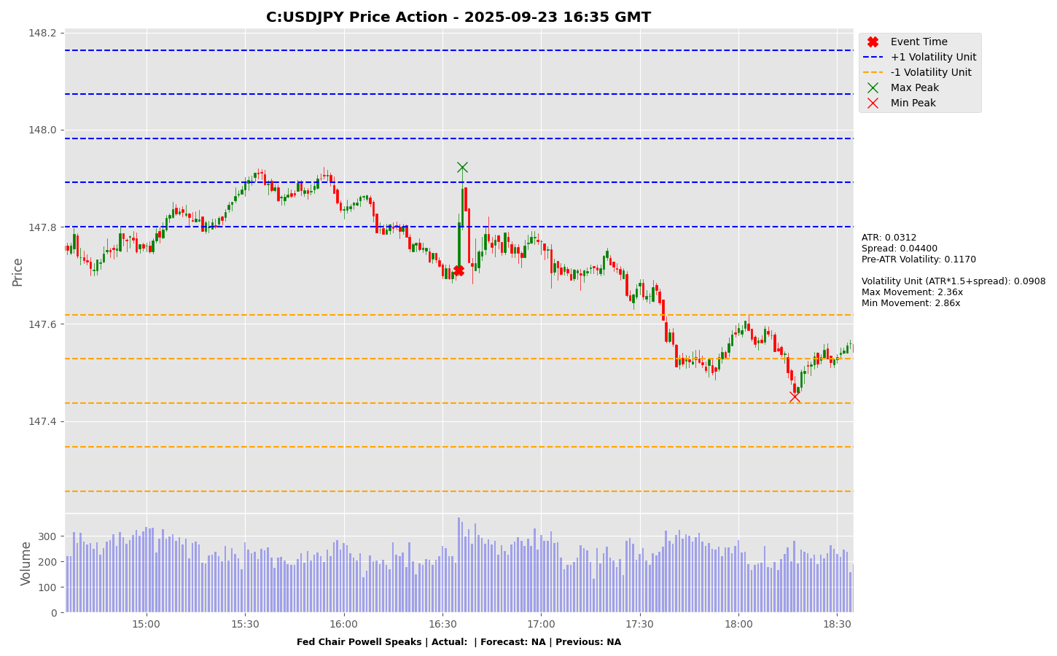

Slide 23
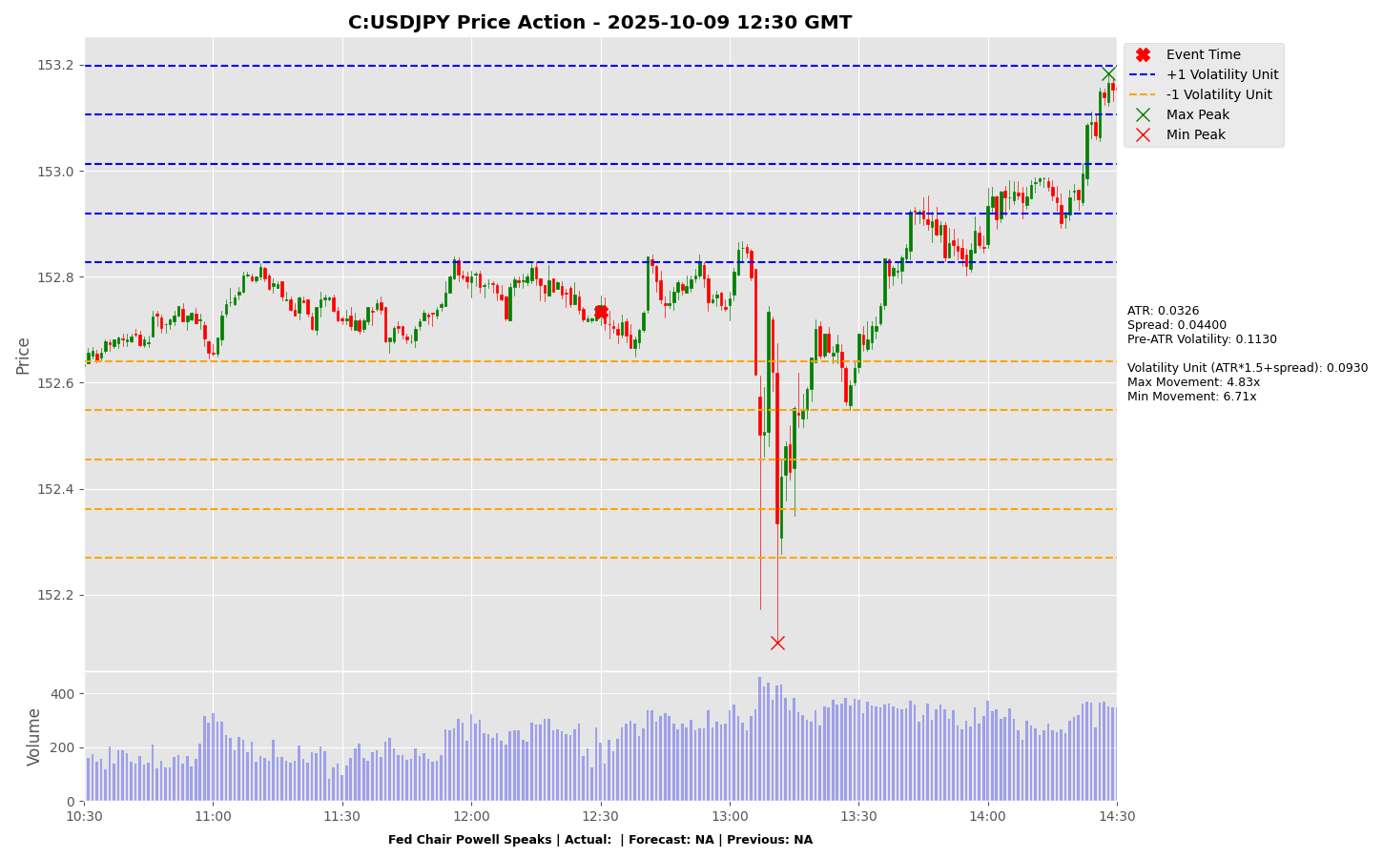

Slide 24
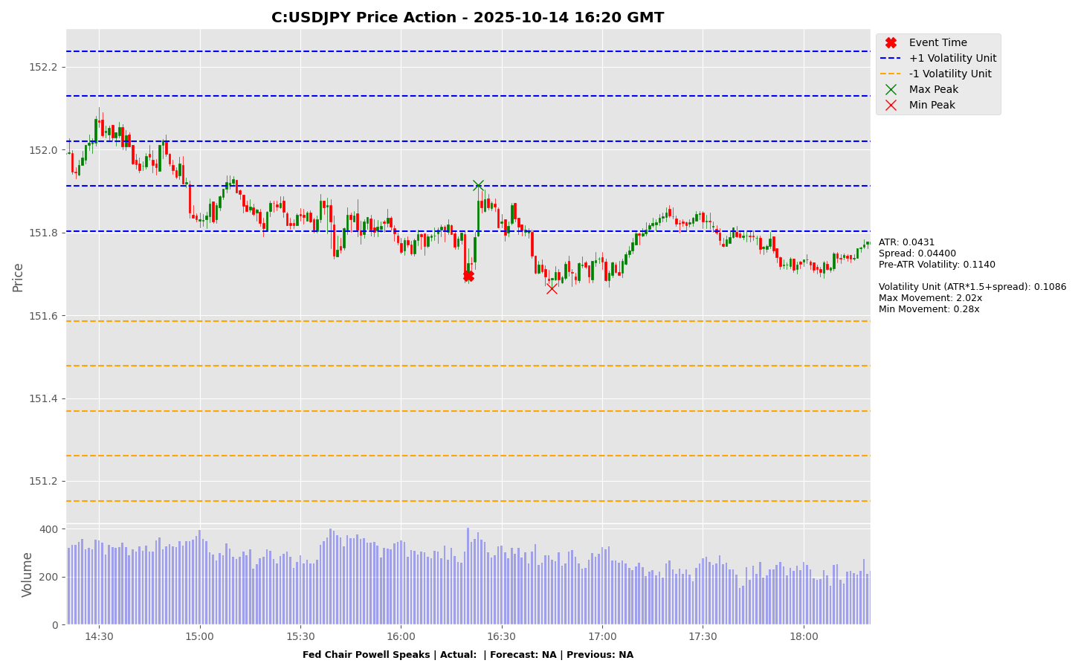

Slide 25
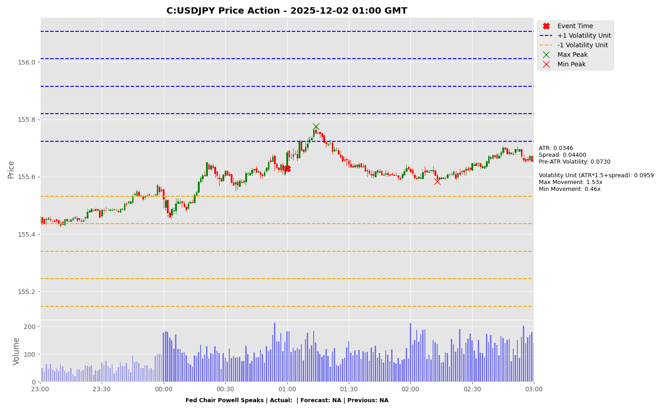

Slide 26
Fed Chair Powell Speaks
C:EURUSD

Slide 27
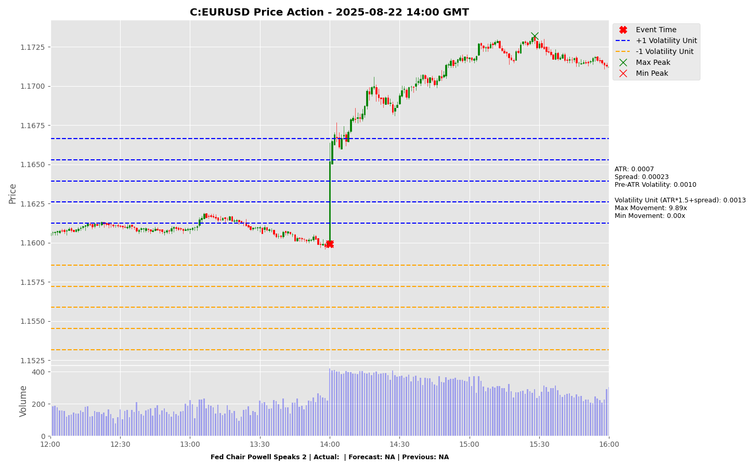

Slide 28
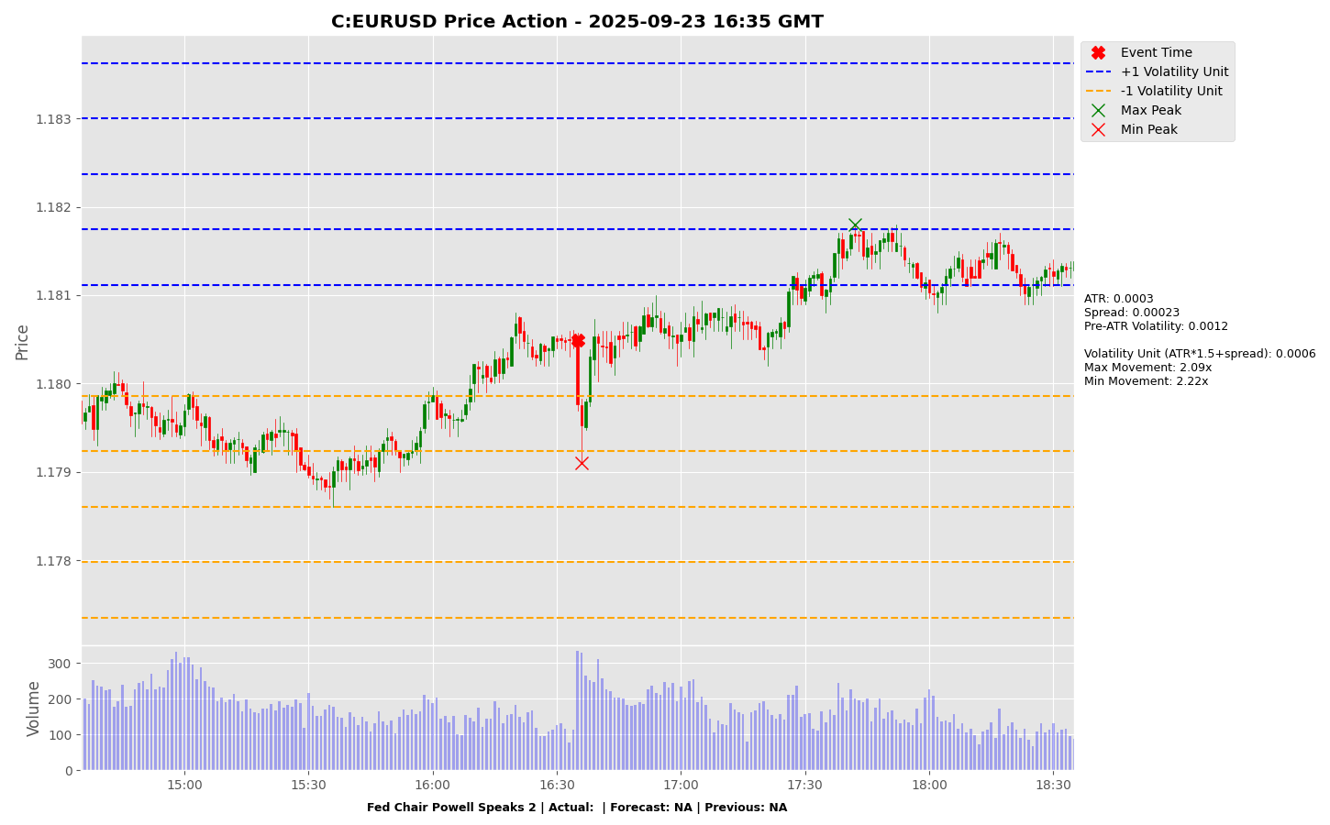

Slide 29
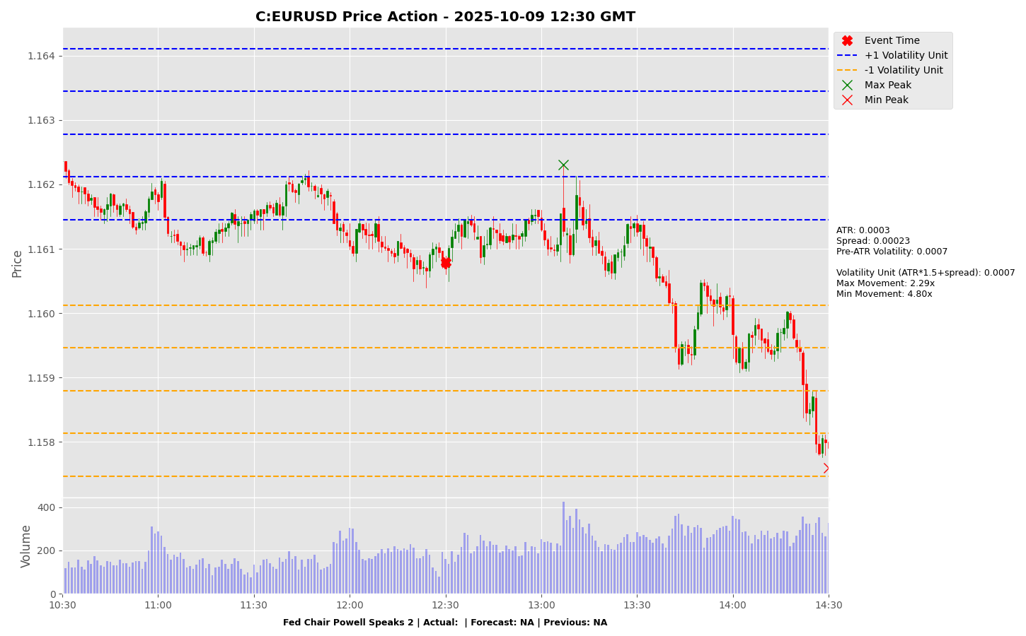

Slide 30
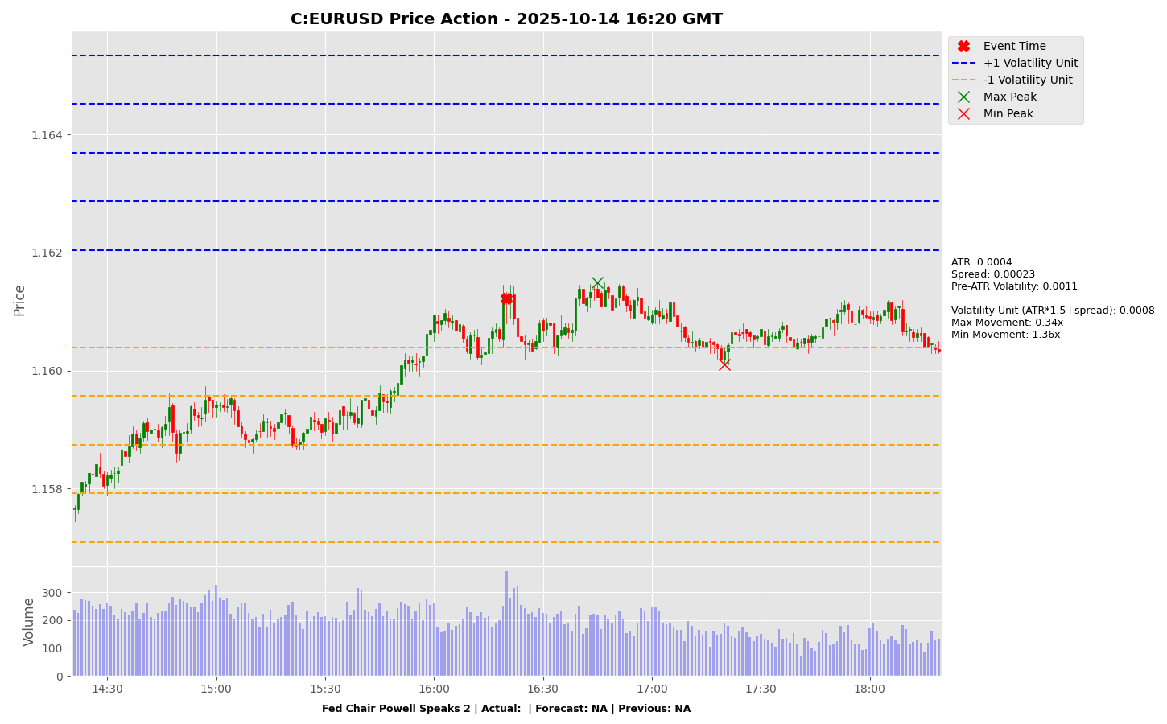

Slide 31
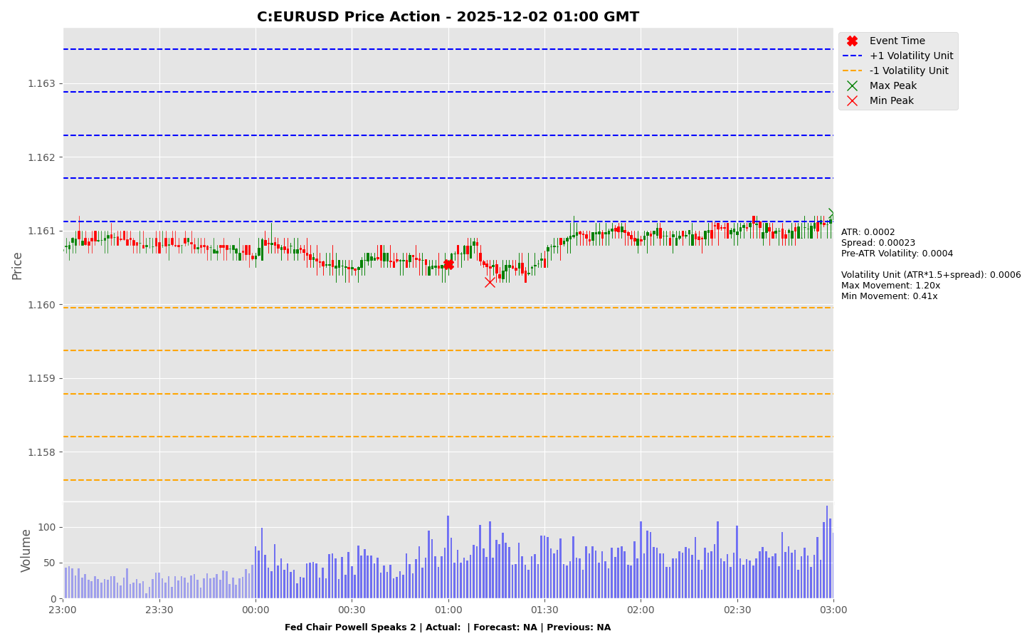

Slide 32
Manufacturing PMI (Mar)

Slide 33
Manufacturing PMI (Mar)
Release Date | Actual | Forecast | Previous
2025-09-30 | 49.8 | 49.6 | 49.4
2025-10-31 | 49.0 | 49.6 | 49.8
2025-11-30 | 49.2 | 49.2 | 49.0
2025-12-31 | 50.1 | 49.2 | 49.2
2026-01-31 | 49.3 | 50.1 | 50.1
2026-03-04 | 49.0 | 49.1 | 49.3

Slide 34
Manufacturing PMI (Mar)
C:USDCNH

Slide 35
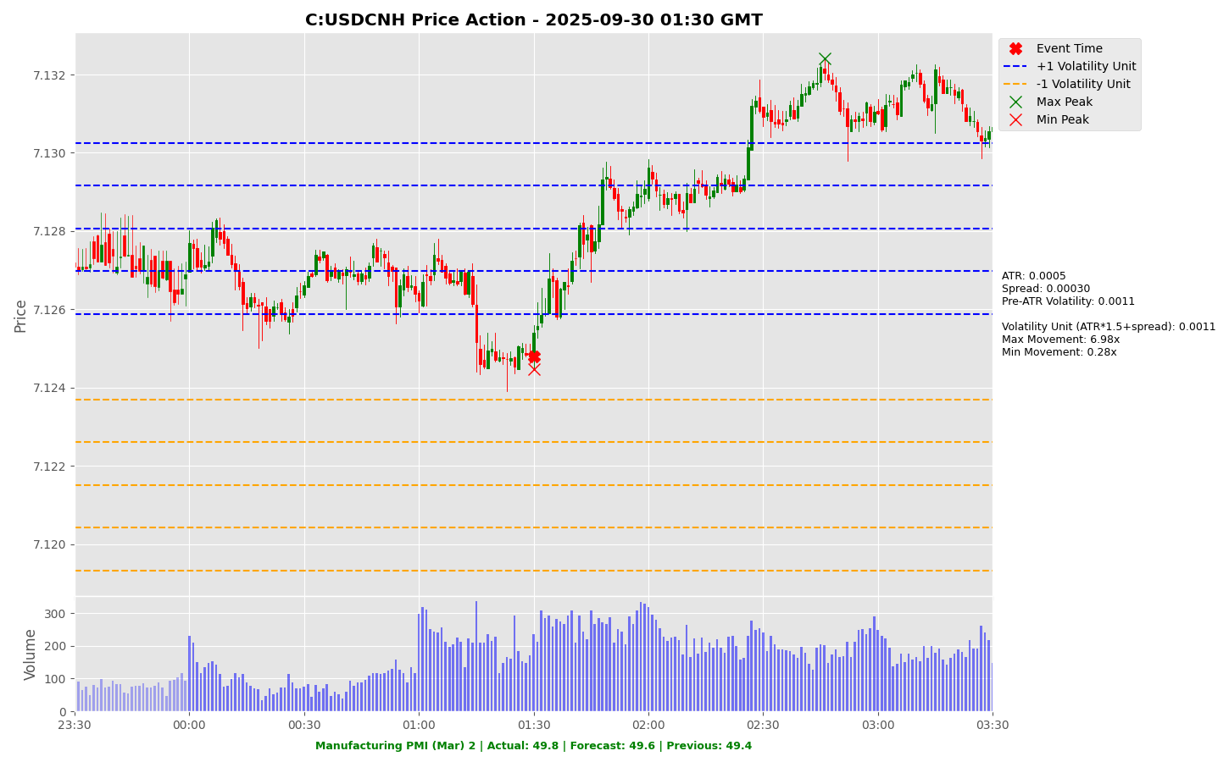

Slide 36
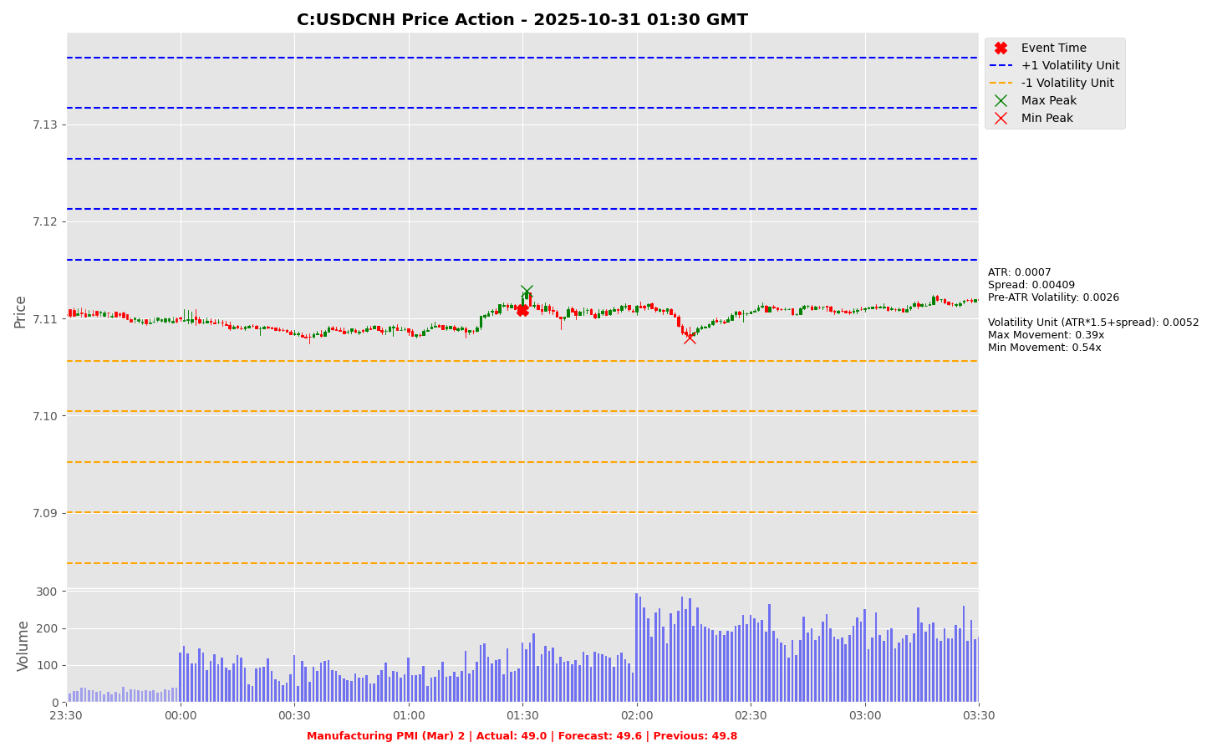

Slide 37
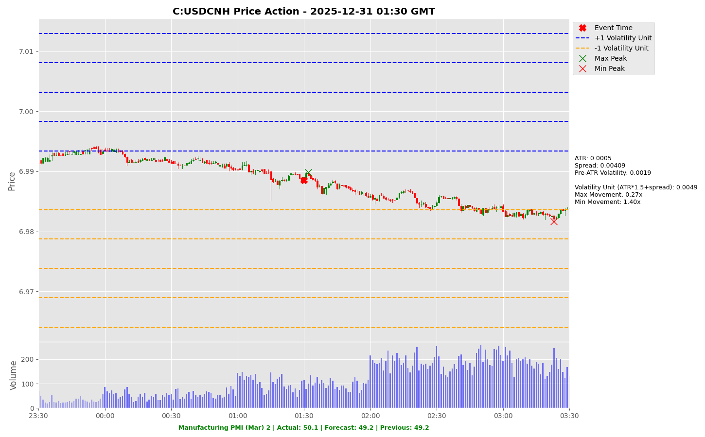

Slide 38
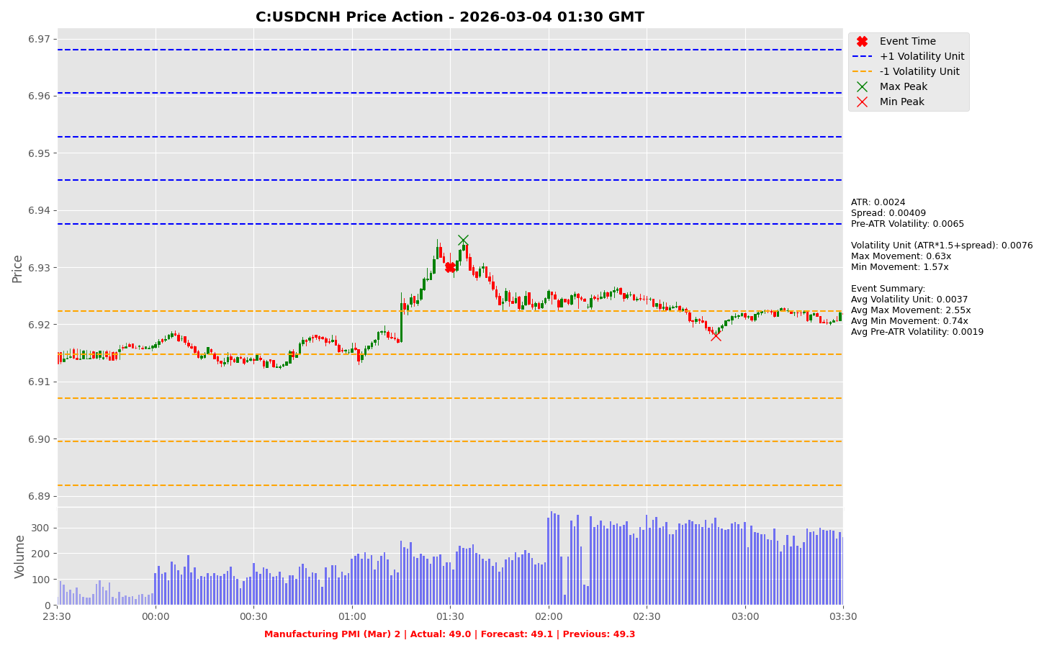

Slide 39
GDP (QoQ) (Q4)

Slide 40
GDP (QoQ) (Q4)
Release Date | Actual | Forecast | Previous
2025-06-30 | 0.70 | 0.70 | 0.10
2025-08-14 | 0.30 | 0.10 | 0.70
2025-09-30 | 0.30 | 0.30 | 0.70
2025-11-13 | 0.10 | 0.20 | 0.30
2025-12-22 | 0.10 | 0.10 | 0.20
2026-02-12 | 0.10 | 0.20 | 0.10

Slide 41
GDP (QoQ) (Q4)
C:GBPJPY

Slide 42
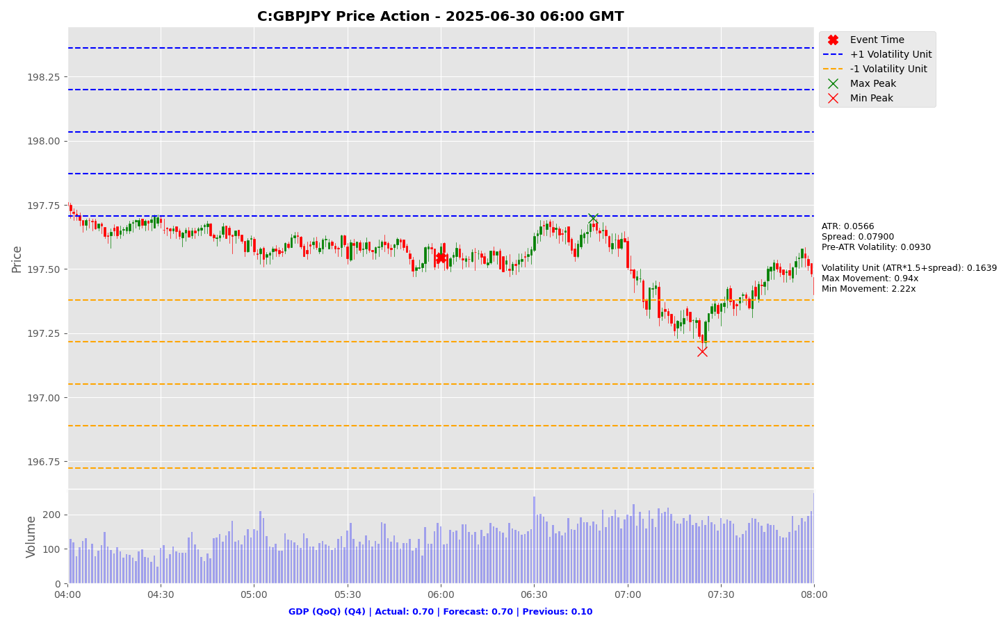

Slide 43
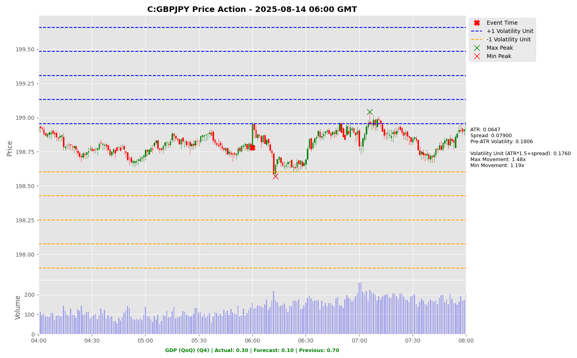

Slide 44
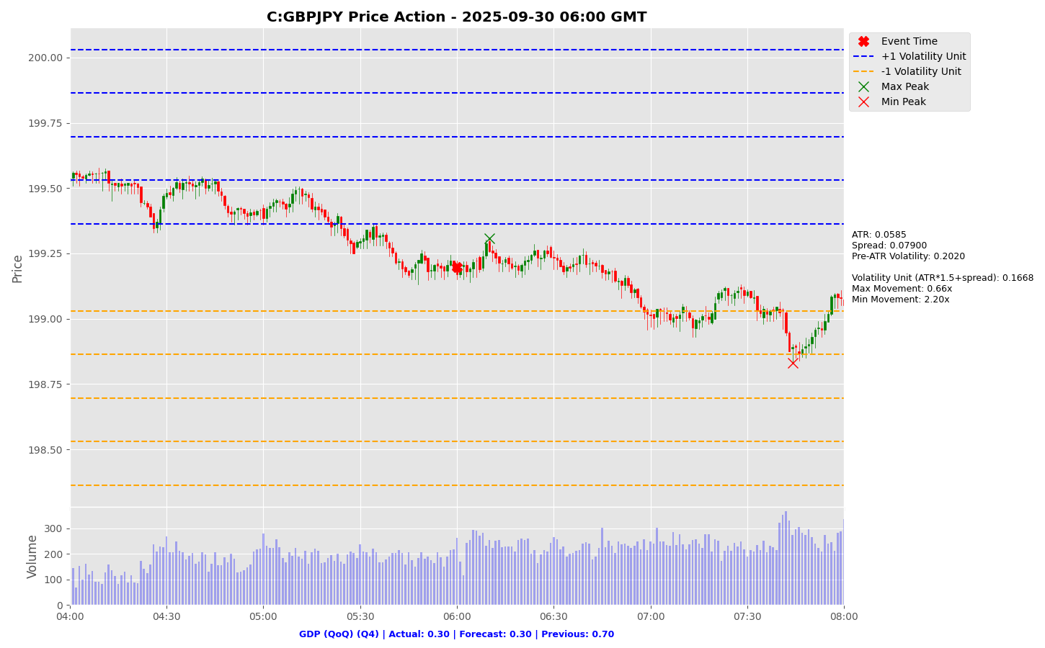

Slide 45
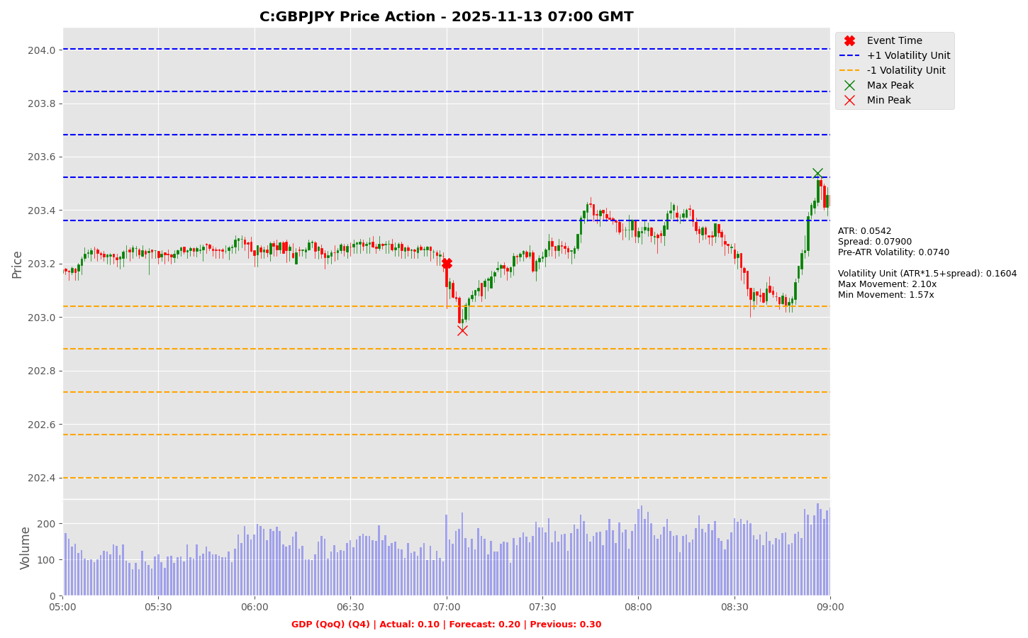

Slide 46
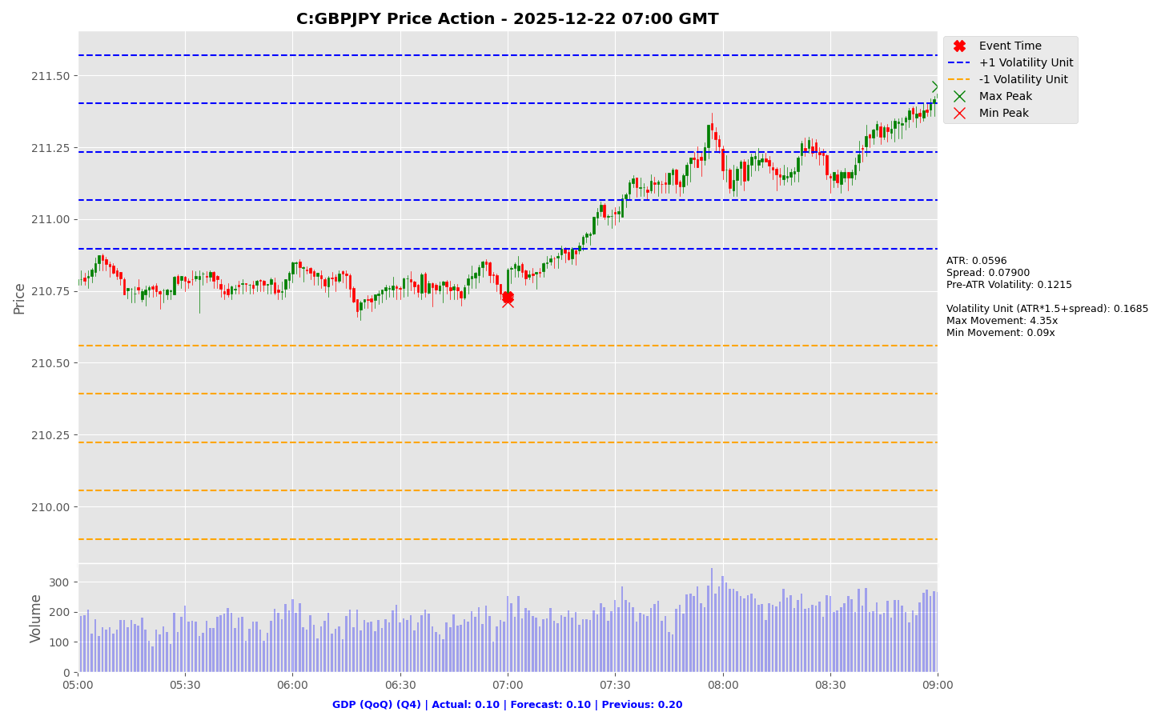

Slide 47
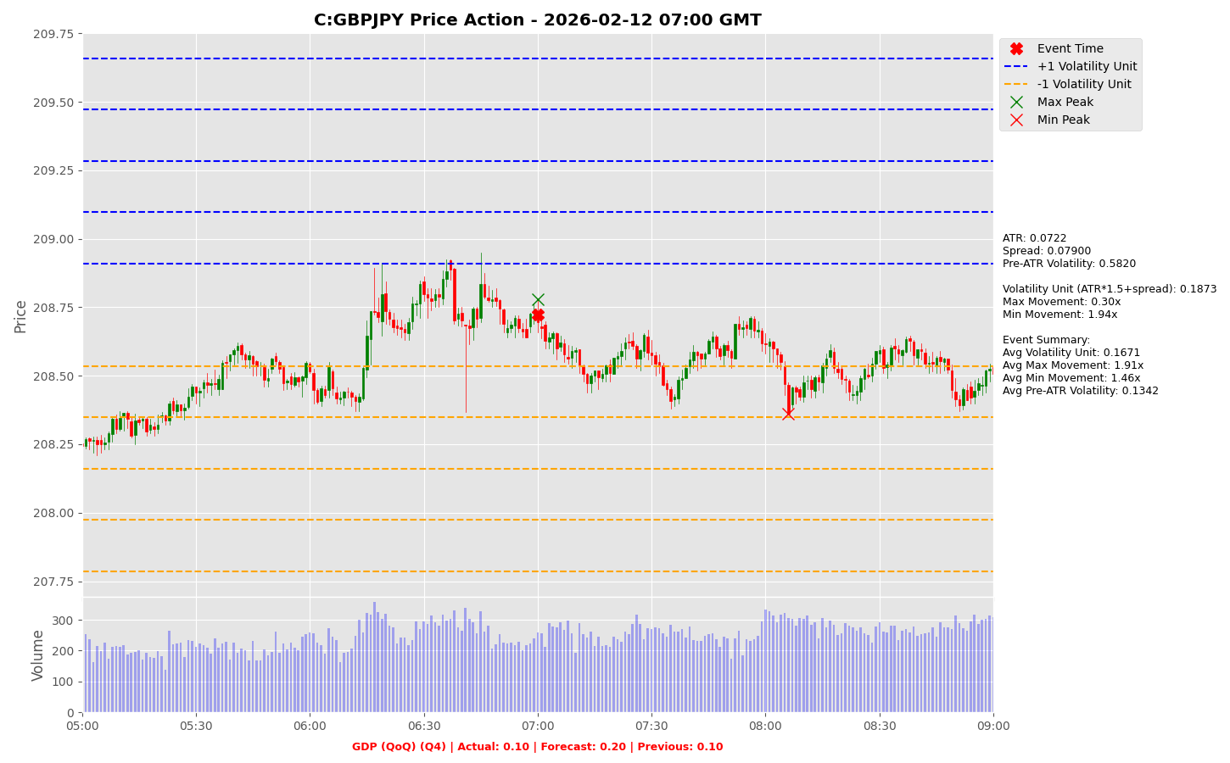

Slide 48
GDP (QoQ) (Q4)
C:GBPUSD

Slide 49
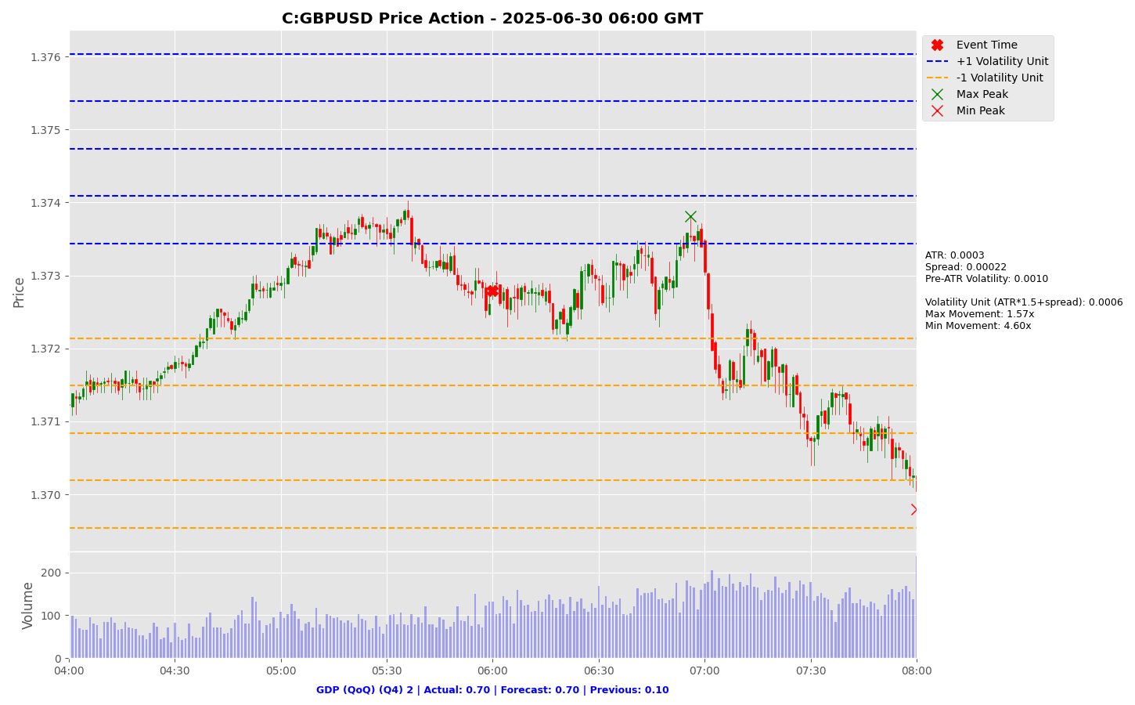

Slide 50
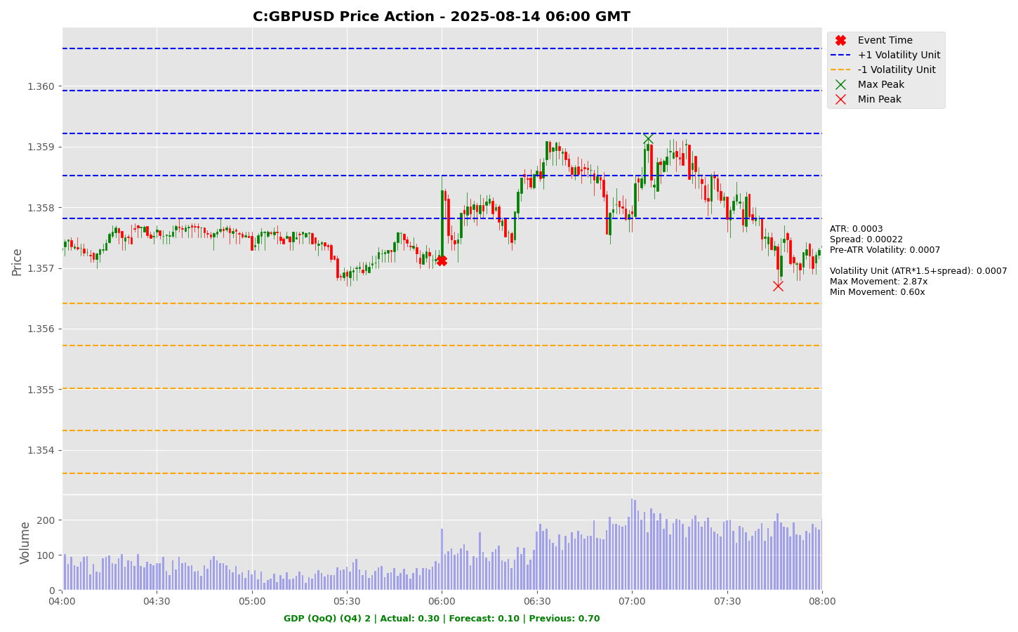

Slide 51
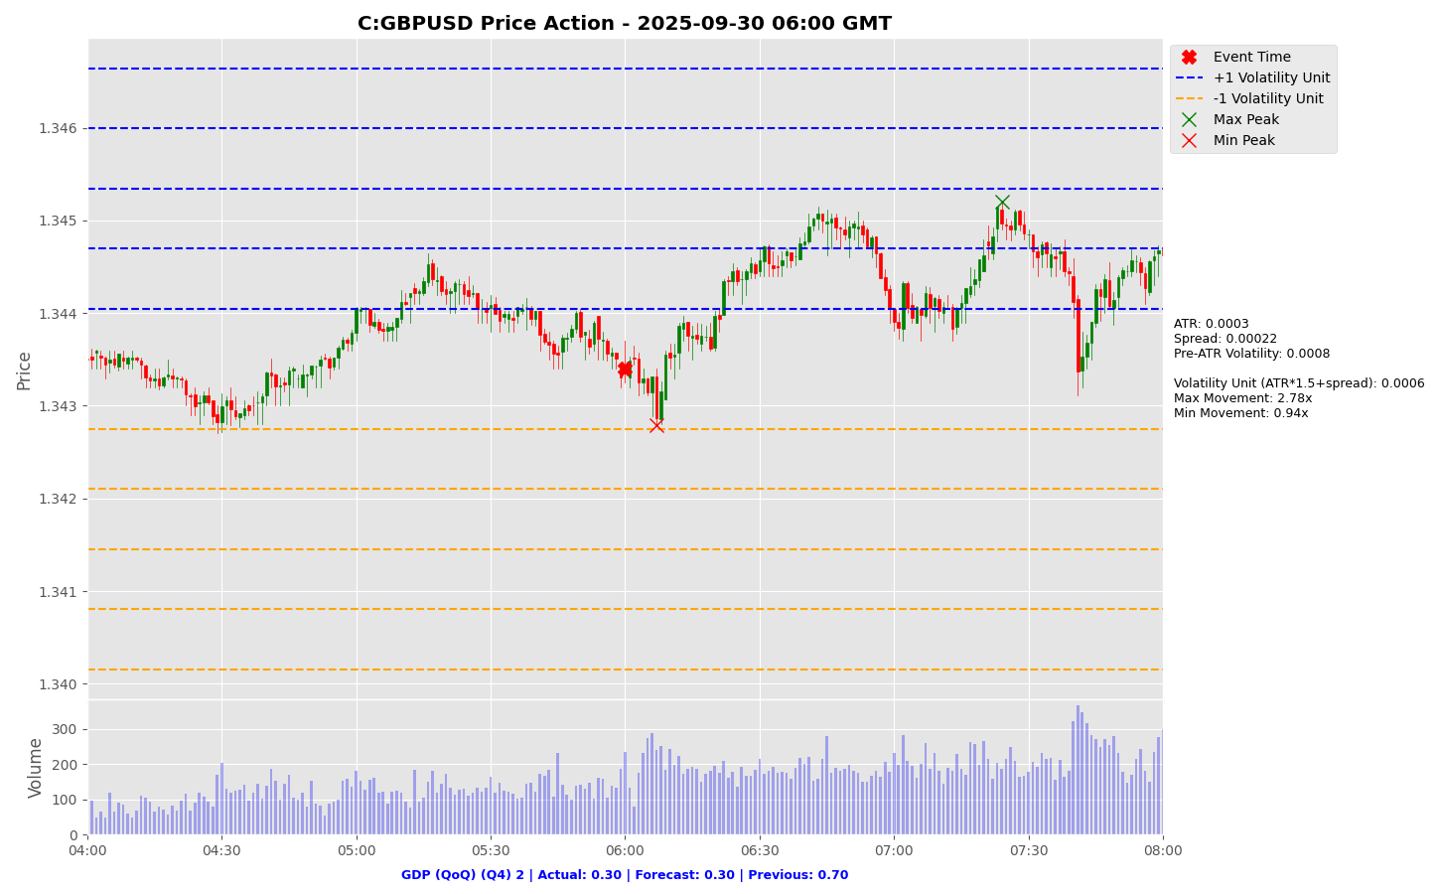

Slide 52
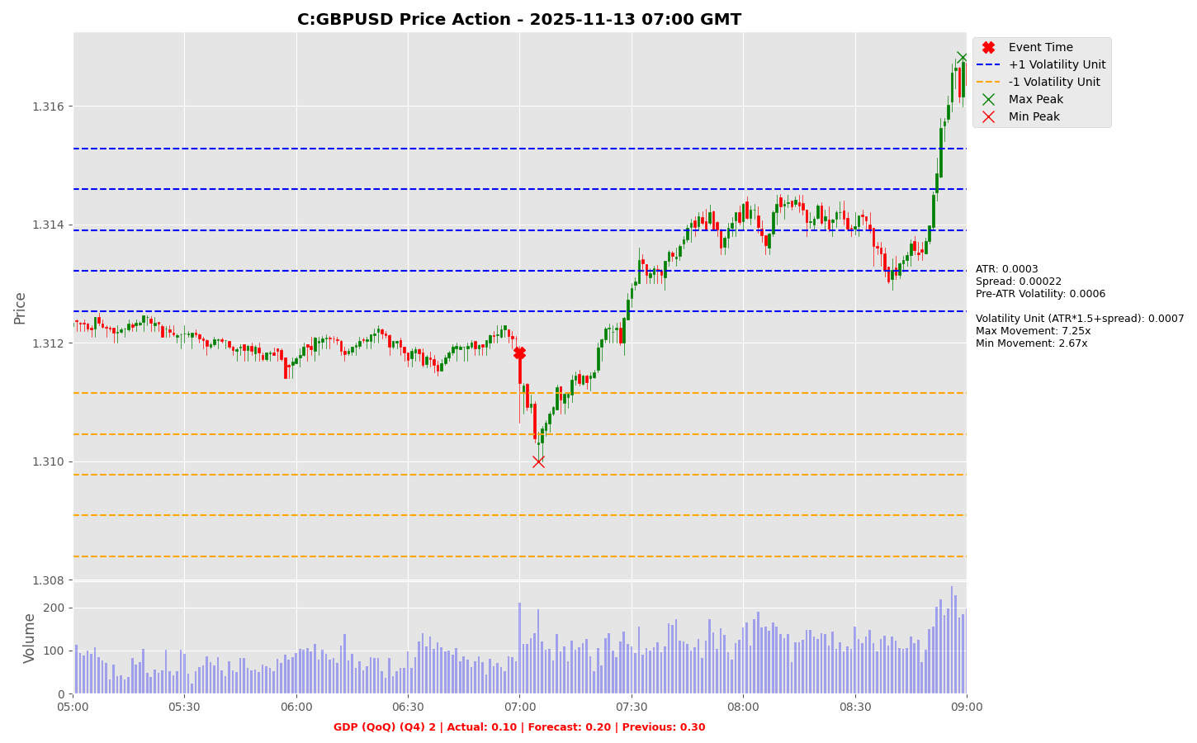

Slide 53
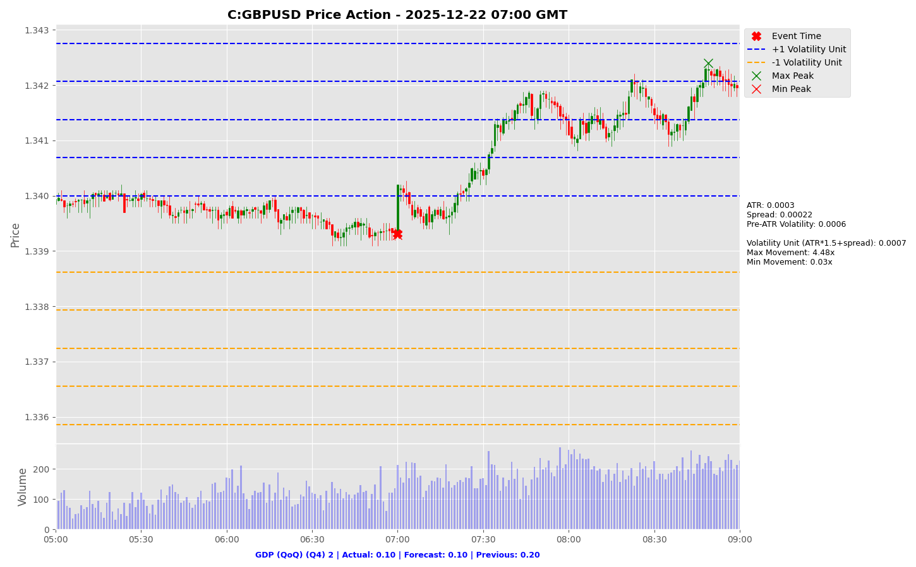

Slide 54
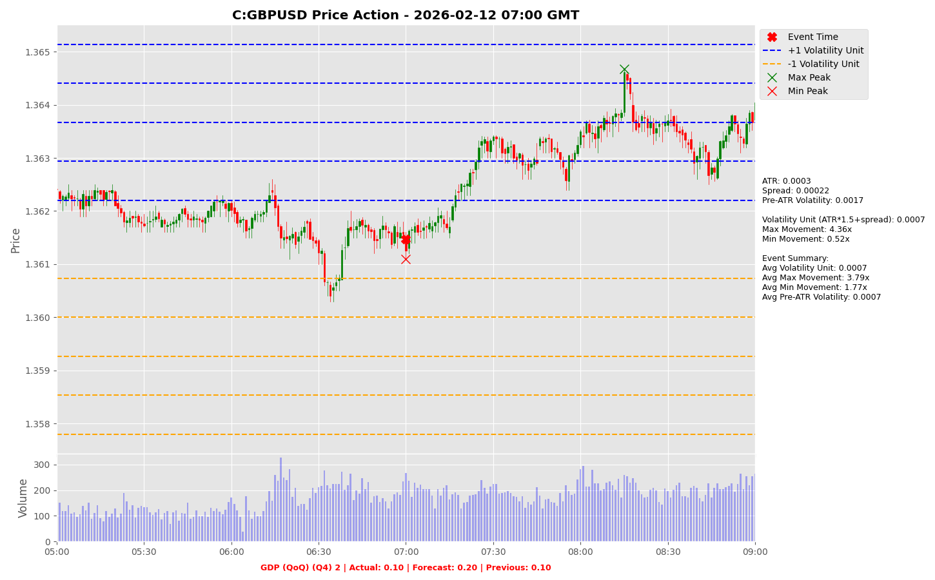

Slide 55
GDP (YoY) (Q4)

Slide 56
GDP (YoY) (Q4)
Release Date | Actual | Forecast | Previous
2025-06-30 | 1.30 | 1.30 | 1.50
2025-08-14 | 1.20 | 1.00 | 1.30
2025-09-30 | 1.40 | 1.20 | 1.70
2025-11-13 | 1.30 | 1.30 | 1.40
2025-12-22 | 1.30 | 1.30 | 1.40
2026-02-12 | 1.00 | 1.20 | 1.20

Slide 57
GDP (YoY) (Q4)
C:GBPJPY

Slide 58


Slide 59


Slide 60
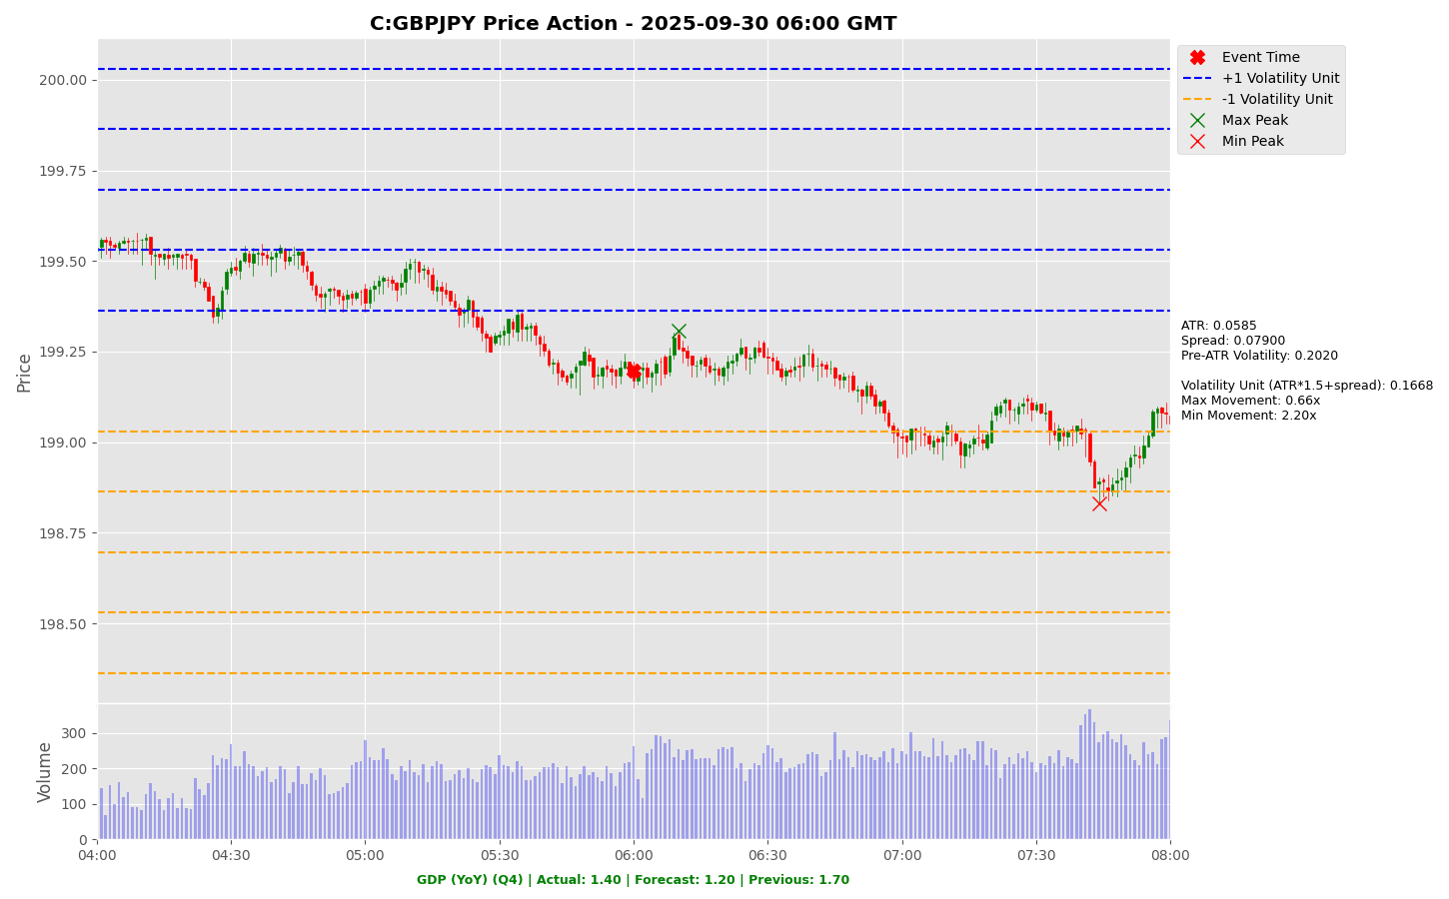

Slide 61
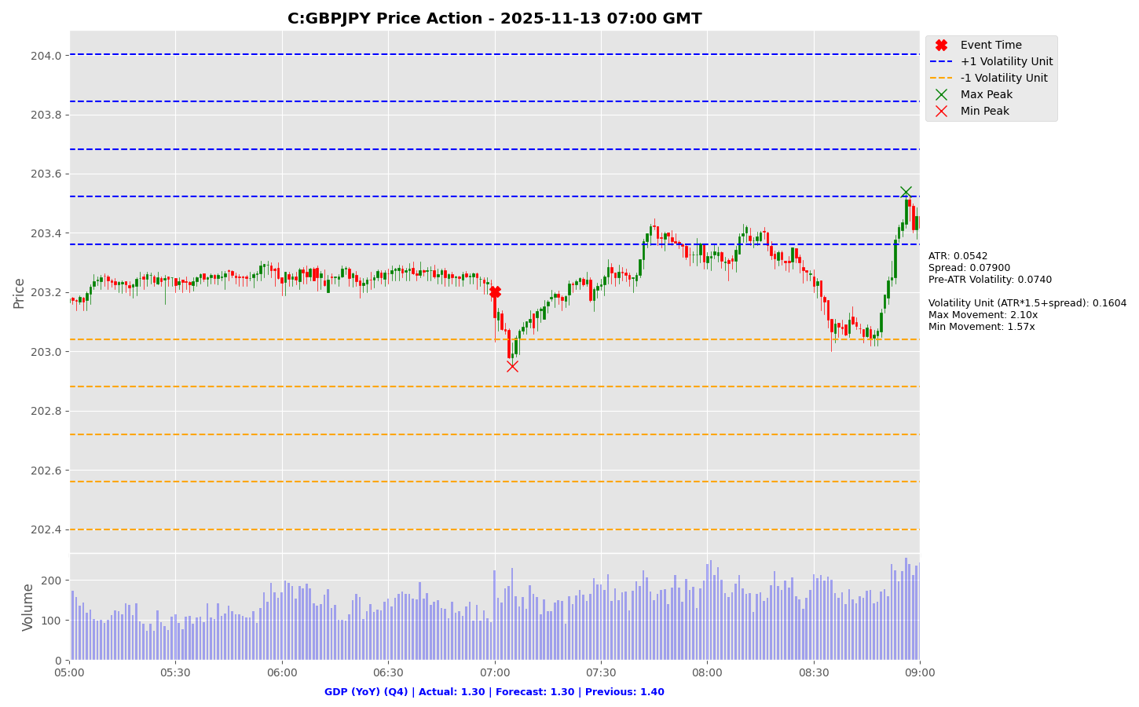

Slide 62


Slide 63
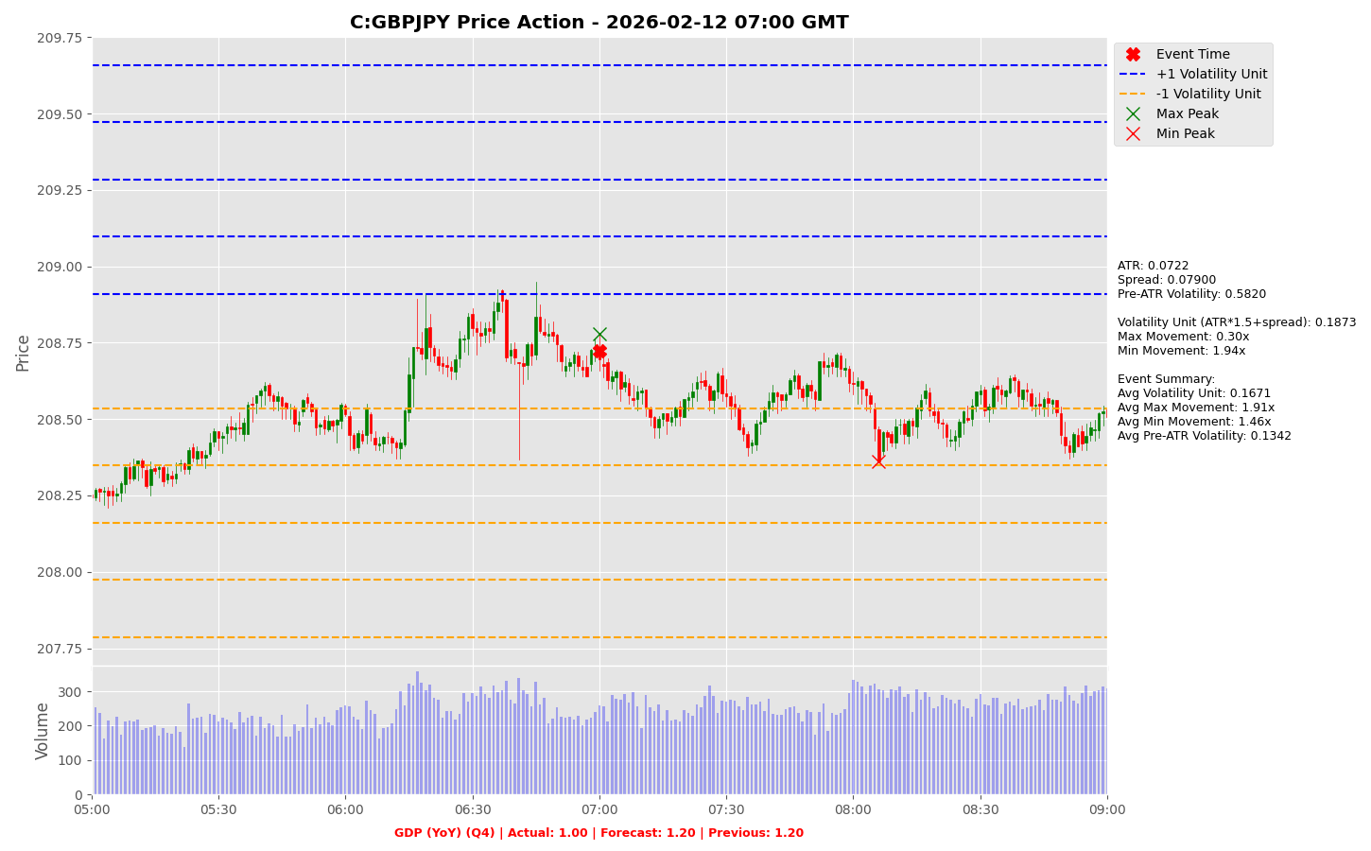

Slide 64
GDP (YoY) (Q4)
C:GBPUSD

Slide 65


Slide 66


Slide 67


Slide 68
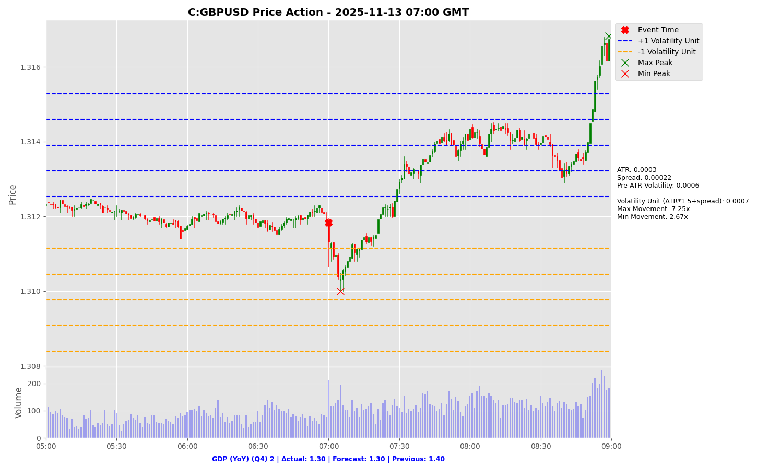

Slide 69


Slide 70


Slide 71
CPI (YoY) (Mar)

Slide 72
CPI (YoY) (Mar)
Release Date | Actual | Forecast | Previous
2026-01-07 | 2.00 | 2.00 | 2.10
2026-01-19 | 1.90 | 2.00 | 2.10
2026-02-04 | 1.70 | 1.70 | 2.00
2026-02-25 | 1.70 | 1.70 | 1.90
2026-03-03 | 1.90 | 1.70 | 1.70
2026-03-18 | 1.90 | 1.90 | 1.70

Slide 73
CPI (YoY) (Mar)
C:EURJPY

Slide 74
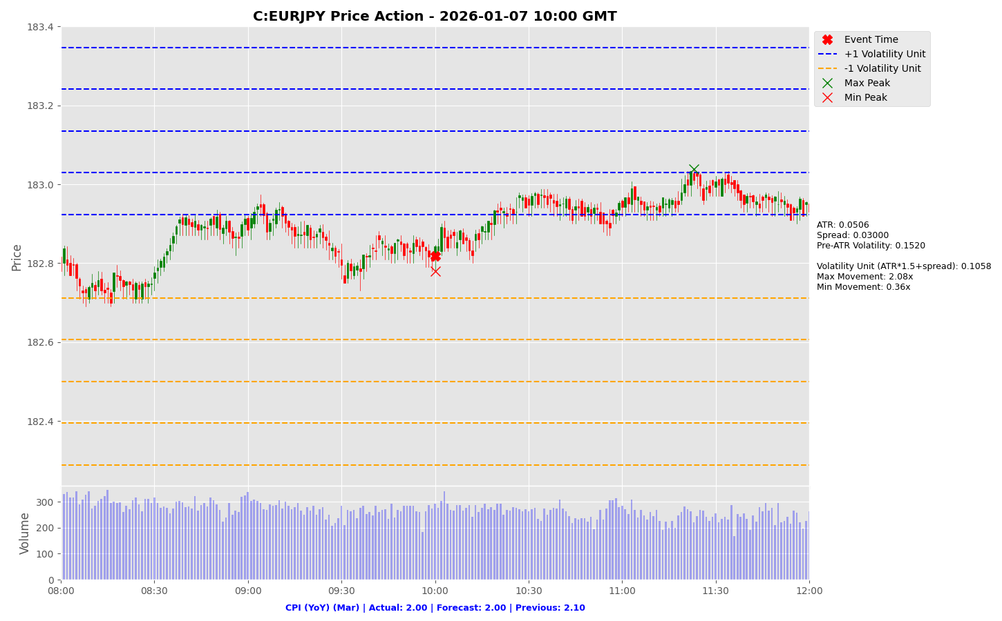

Slide 75
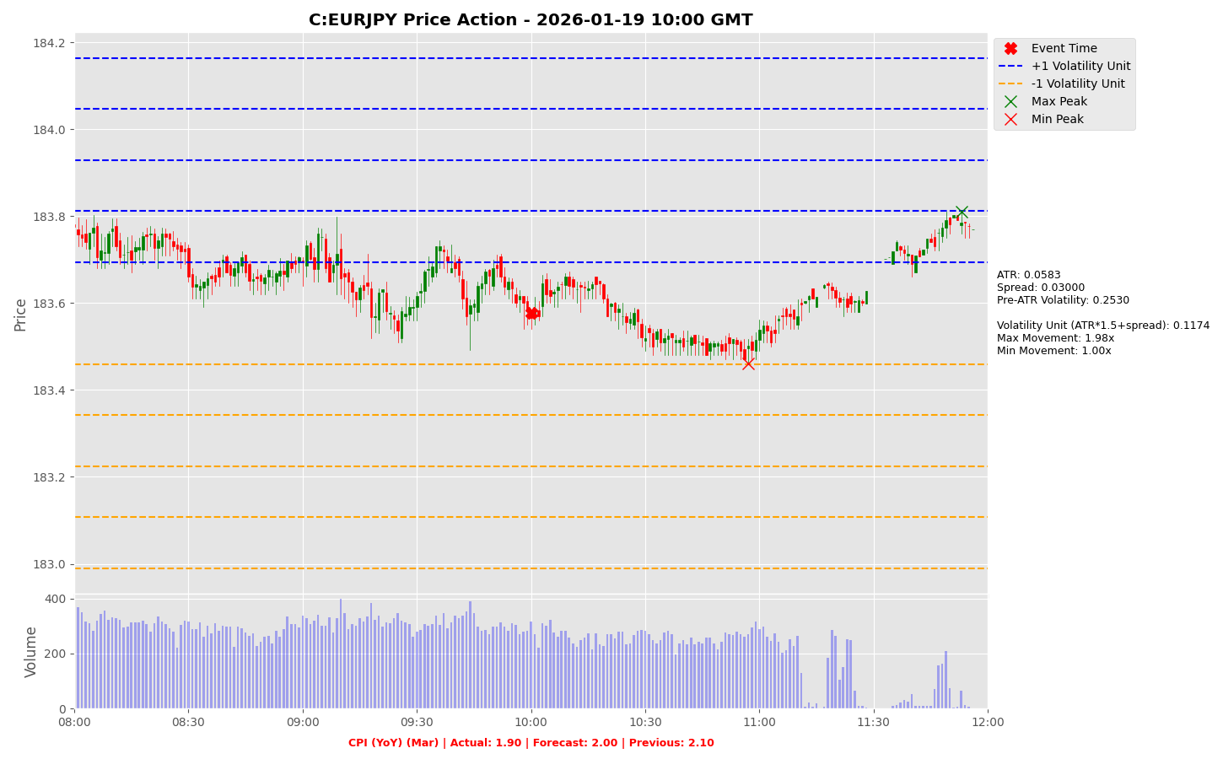

Slide 76
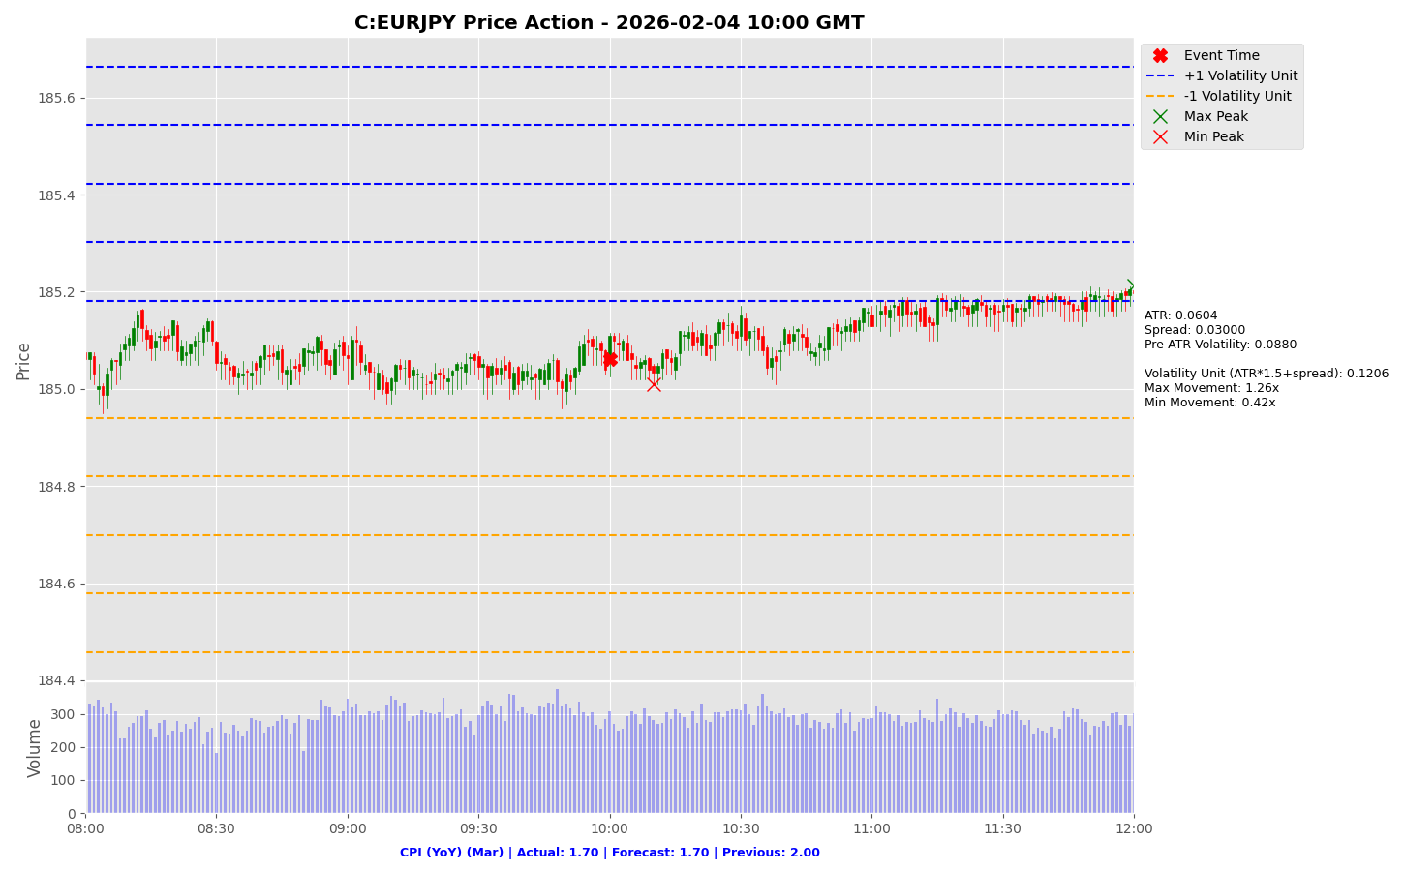

Slide 77
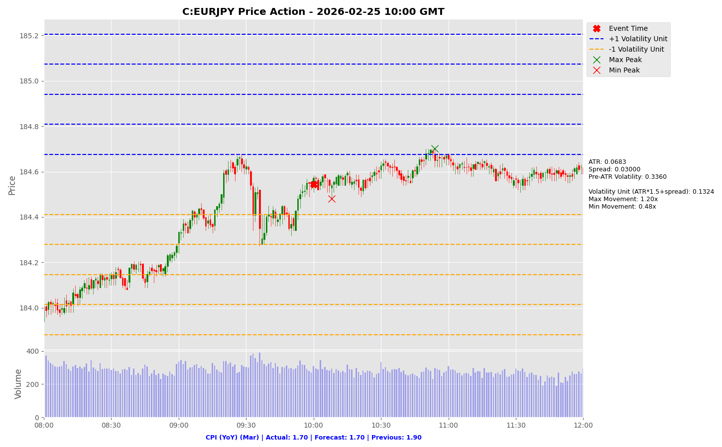

Slide 78
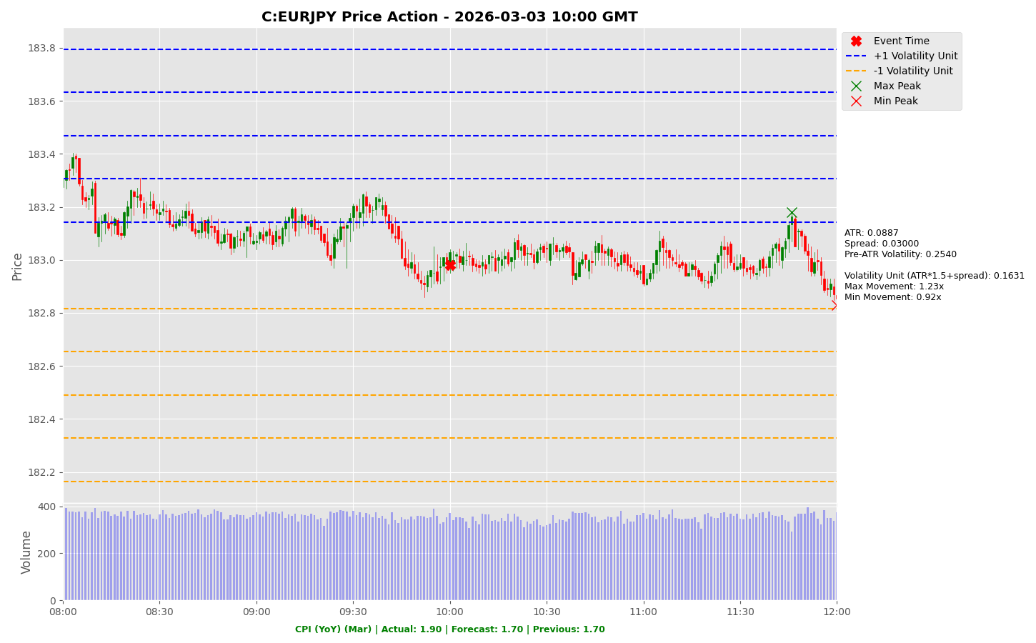

Slide 79
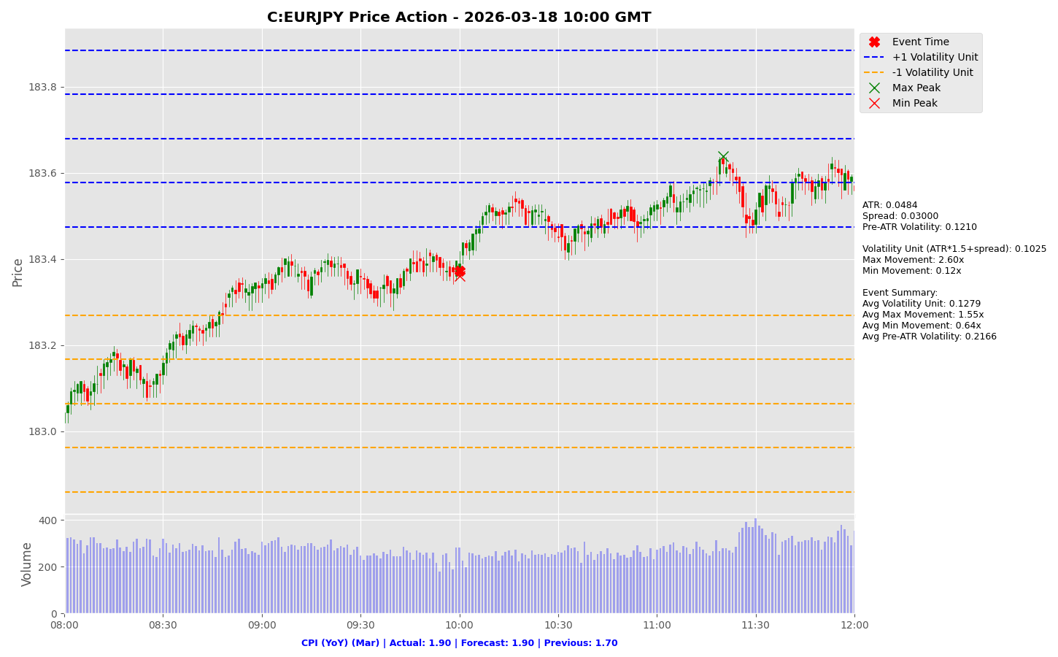

Slide 80
CPI (YoY) (Mar)
C:EURUSD

Slide 81
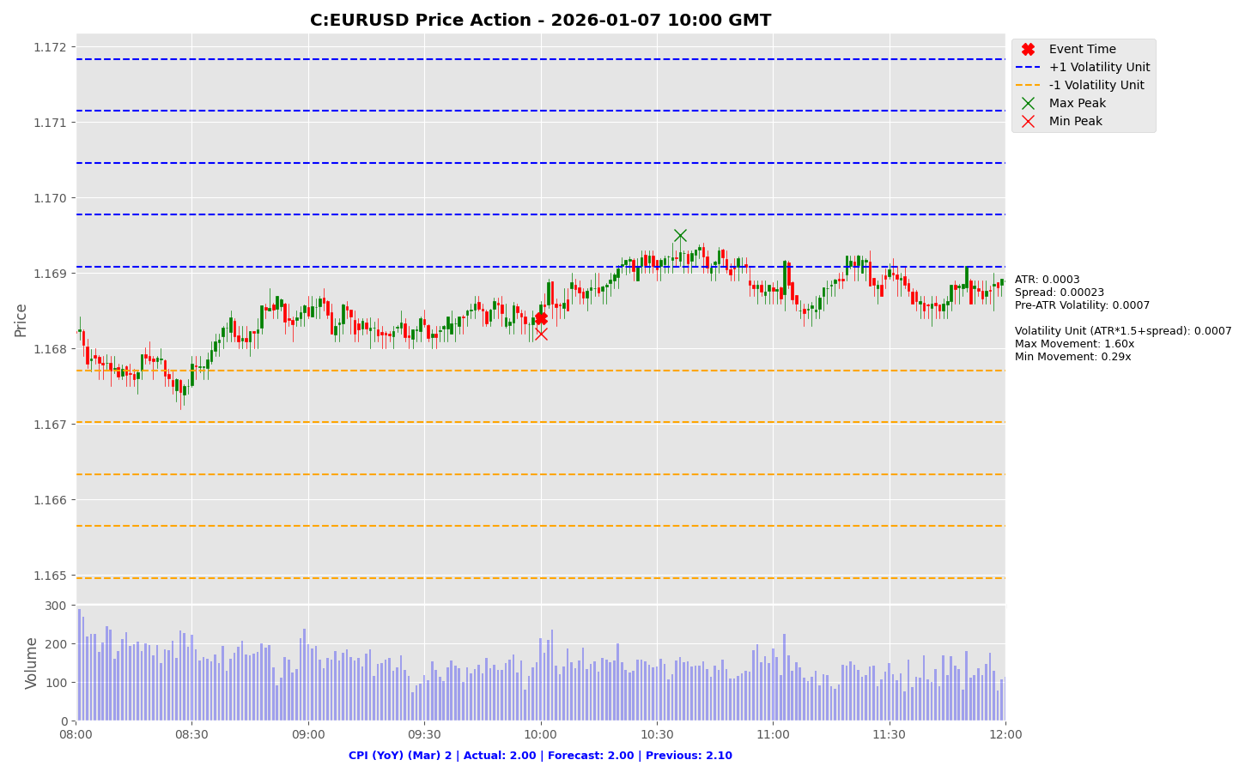

Slide 82
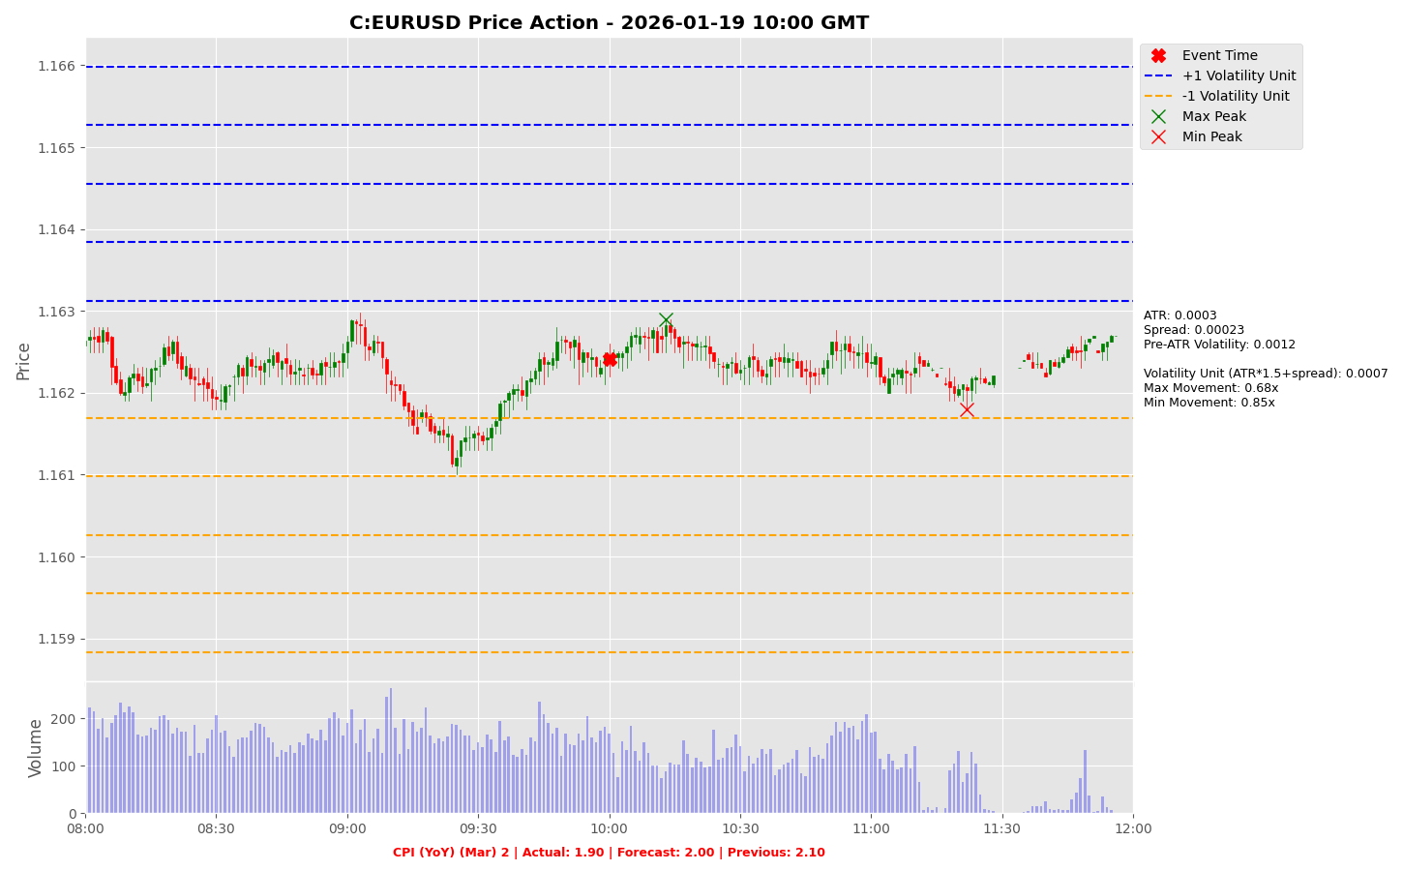

Slide 83


Slide 84


Slide 85


Slide 86


Slide 87
Chicago PMI (Mar)

Slide 88
Chicago PMI (Mar)
Release Date | Actual | Forecast | Previous
2025-09-30 | 40.60 | 43.40 | 41.50
2025-10-31 | 43.80 | 42.30 | 40.60
2025-11-26 | 36.30 | 44.30 | 43.80
2025-12-30 | 43.50 | 39.80 | 36.30
2026-01-30 | 54.00 | 43.50 | 42.70
2026-02-27 | 57.70 | 52.00 | 54.00

Slide 89
Chicago PMI (Mar)
C:USDJPY

Slide 90


Slide 91


Slide 92


Slide 93


Slide 94


Slide 95


Slide 96
Chicago PMI (Mar)
C:EURUSD

Slide 97


Slide 98


Slide 99


Slide 100


Slide 101


Slide 102


Slide 103
CB Consumer Confidence (Mar)

Slide 104
CB Consumer Confidence (Mar)
Release Date | Actual | Forecast | Previous
2025-09-30 | 94.20 | 96.00 | 97.80
2025-10-28 | 94.60 | 93.40 | 95.60
2025-11-25 | 88.70 | 93.50 | 95.50
2025-12-23 | 89.10 | 91.70 | 92.90
2026-01-27 | 84.50 | 90.60 | 94.20
2026-02-24 | 91.20 | 87.40 | 89.00

Slide 105
CB Consumer Confidence (Mar)
C:USDJPY

Slide 106


Slide 107


Slide 108


Slide 109


Slide 110


Slide 111


Slide 112
CB Consumer Confidence (Mar)
C:EURUSD

Slide 113


Slide 114


Slide 115


Slide 116


Slide 117


Slide 118


Slide 119
JOLTS Job Openings (Feb)

Slide 120
JOLTS Job Openings (Feb)
Release Date | Actual | Forecast | Previous
2025-09-30 | 7.227 | 7.190 | 7.208
2025-12-09 | 7.670 | NA | 7.658
2025-12-09 | 7.658 | 7.200 | 7.227
2026-01-07 | 7.146 | 7.610 | 7.449
2026-02-05 | 6.542 | 7.200 | 6.928
2026-03-13 | 6.946 | 6.760 | 6.550

Slide 121
JOLTS Job Openings (Feb)
C:USDJPY

Slide 122


Slide 123


Slide 124


Slide 125


Slide 126


Slide 127
JOLTS Job Openings (Feb)
C:EURUSD

Slide 128


Slide 129


Slide 130


Slide 131


Slide 132


Slide 133
ADP Nonfarm Employment Change (Mar)

Slide 134
ADP Nonfarm Employment Change (Mar)
Release Date | Actual | Forecast | Previous
2025-10-01 | -32.0 | 52.00 | -3.00
2025-11-05 | 42.00 | 32.00 | -29.0
2025-12-03 | -32.0 | 5.00K | 47.00
2026-01-07 | 41.00 | 49.00 | -29.0
2026-02-04 | 22.00 | 46.00 | 37.00
2026-03-04 | 63.00 | 50.00 | 11.00

Slide 135
ADP Nonfarm Employment Change (Mar)
C:USDJPY

Slide 136


Slide 137


Slide 138


Slide 139


Slide 140


Slide 141


Slide 142
ADP Nonfarm Employment Change (Mar)
C:EURUSD

Slide 143


Slide 144


Slide 145


Slide 146


Slide 147


Slide 148


Slide 149
Retail Sales (MoM) (Feb)

Slide 150
Retail Sales (MoM) (Feb)
Release Date | Actual | Forecast | Previous
2025-09-16 | 0.60 | 0.20 | 0.60
2025-11-25 | 0.20 | 0.40 | 0.60
2025-12-16 | 0.00 | 0.10 | 0.10
2026-01-14 | 0.60 | 0.50 | -0.10
2026-02-10 | 0.00 | 0.40 | 0.60
2026-03-06 | -0.20 | -0.30 | 0.00

Slide 151
Retail Sales (MoM) (Feb)
C:USDJPY

Slide 152


Slide 153


Slide 154


Slide 155


Slide 156


Slide 157


Slide 158
Retail Sales (MoM) (Feb)
C:EURUSD

Slide 159


Slide 160


Slide 161


Slide 162


Slide 163


Slide 164


Slide 165
Core Retail Sales (MoM) (Feb)

Slide 166
Core Retail Sales (MoM) (Feb)
Release Date | Actual | Forecast | Previous
2026-01-14 | 0.50 | 0.40 | 0.20
2026-01-14 | 0.70 | 0.40 | 0.40
2026-02-10 | 0.00 | 0.30 | 0.40
2026-02-10 | 0.30 | 0.30 | 0.60
2026-03-06 | 0.00 | 0.10 | 0.00
2026-03-06 | 0.40 | 0.20 | 0.10

Slide 167
Core Retail Sales (MoM) (Feb)
C:USDJPY

Slide 168


Slide 169


Slide 170


Slide 171
Core Retail Sales (MoM) (Feb)
C:EURUSD

Slide 172


Slide 173


Slide 174


Slide 175
S&P Global Manufacturing PMI (Mar)

Slide 176


Slide 177


Slide 178
S&P Global Manufacturing PMI (Mar)
C:USDJPY

Slide 179


Slide 180


Slide 181
ISM Manufacturing PMI (Mar)

Slide 182
ISM Manufacturing PMI (Mar)
Release Date | Actual | Forecast | Previous
2025-10-01 | 49.10 | 49.00 | 48.70
2025-11-03 | 48.70 | 49.40 | 49.10
2025-12-01 | 48.20 | 49.00 | 48.70
2026-01-05 | 47.90 | 48.30 | 48.20
2026-02-02 | 52.60 | 48.50 | 47.90
2026-03-02 | 52.40 | 51.70 | 52.60

Slide 183
ISM Manufacturing PMI (Mar)
C:USDJPY

Slide 184


Slide 185


Slide 186


Slide 187


Slide 188


Slide 189


Slide 190
ISM Manufacturing PMI (Mar)
C:EURUSD

Slide 191


Slide 192


Slide 193


Slide 194


Slide 195


Slide 196


Slide 197
ISM Manufacturing Prices (Mar)

Slide 198
ISM Manufacturing Prices (Mar)
Release Date | Actual | Forecast | Previous
2025-10-01 | 61.90 | 62.70 | 63.70
2025-11-03 | 58.00 | 62.40 | 61.90
2025-12-01 | 58.50 | 59.50 | 58.00
2026-01-05 | 58.50 | 59.00 | 58.50
2026-02-02 | 59.00 | 59.30 | 58.50
2026-03-02 | 70.50 | 60.60 | 59.00

Slide 199
ISM Manufacturing Prices (Mar)
C:USDJPY

Slide 200


Slide 201


Slide 202


Slide 203


Slide 204


Slide 205


Slide 206
ISM Manufacturing Prices (Mar)
C:EURUSD

Slide 207


Slide 208


Slide 209


Slide 210


Slide 211


Slide 212


Slide 213
Average Hourly Earnings (MoM) (Mar)

Slide 214
Average Hourly Earnings (MoM) (Mar)
Release Date | Actual | Forecast | Previous
2025-11-20 | 0.20 | 0.30 | 0.40
2025-12-16 | 0.10 | 0.30 | 0.40
2025-12-16 | 0.40 | NA | 0.20
2026-01-09 | 0.30 | 0.30 | 0.20
2026-02-11 | 0.40 | 0.30 | 0.10
2026-03-06 | 0.40 | 0.30 | 0.40

Slide 215
Average Hourly Earnings (MoM) (Mar)
C:USDJPY

Slide 216


Slide 217


Slide 218


Slide 219


Slide 220


Slide 221
Average Hourly Earnings (MoM) (Mar)
C:EURUSD

Slide 222


Slide 223


Slide 224


Slide 225


Slide 226


Slide 227
Nonfarm Payrolls (Mar)

Slide 228
Nonfarm Payrolls (Mar)
Release Date | Actual | Forecast | Previous
2025-11-20 | 119.0 | 53.00 | -4.00
2025-12-16 | 64.00 | 51.00 | -105.0
2025-12-16 | -105.0 | NA | 108.0
2026-01-09 | 50.00 | 66.00 | 56.00
2026-02-11 | 130.0 | 66.00 | 48.00
2026-03-06 | -92.0 | 58.00 | 126.0

Slide 229
Nonfarm Payrolls (Mar)
C:USDJPY

Slide 230


Slide 231


Slide 232


Slide 233


Slide 234


Slide 235
Nonfarm Payrolls (Mar)
C:EURUSD

Slide 236


Slide 237


Slide 238


Slide 239


Slide 240


Slide 241
Unemployment Rate (Mar)

Slide 242
Unemployment Rate (Mar)
Release Date | Actual | Forecast | Previous
2025-11-20 | 4.30 | 4.30 | 4.20
2025-12-16 | 4.60 | 4.50 | 4.40
2025-12-16 | 4.40 | 4.30 | 4.30
2026-01-09 | 4.40 | 4.50 | 4.50
2026-02-11 | 4.30 | 4.40 | 4.40
2026-03-06 | 4.40 | 4.30 | 4.30

Slide 243
Unemployment Rate (Mar)
C:USDJPY

Slide 244


Slide 245


Slide 246


Slide 247


Slide 248


Slide 249
Unemployment Rate (Mar)
C:EURUSD

Slide 250


Slide 251


Slide 252


Slide 253


Slide 254


Slide 255
S&P Global Services PMI (Mar)

Slide 256
S&P Global Services PMI (Mar)
Release Date | Actual | Forecast | Previous
2026-03-04 | 51.70 | 52.30 | 52.70
2026-03-04 | 51.70 | 52.30 | 52.70
2026-03-04 | 51.70 | 52.30 | 52.70
2026-03-24 | 51.10 | 52.00 | 51.70
2026-03-24 | 51.10 | 52.00 | 51.70
2026-03-24 | 51.10 | 52.00 | 51.70

Slide 257
S&P Global Services PMI (Mar)
C:USDJPY

Slide 258


Slide 259


Slide 260
S&P Global Services PMI (Mar)
C:EURUSD

Slide 261


Slide 262


Slide 263
Project Spider Accelerating the Energy Transition 4thMar 2024 Pawan Quantwater Tech Investments
Appendix

Slide 264
Important Information
Quantwater Tech Investments Data Release Deck – 29th March 2026 This document is for informational purposes only and does not constitute investment advice, an offer, or a solicitation to buy or sell any securities or financial instruments. Past performance is not indicative of future results. Investments involve inherent risks, including the possible loss of principal. No representation or warranty, express or implied, is made regarding the accuracy, completeness, or reliability of the information contained herein. The information in this presentation is derived from publicly available sources and internal analysis as of the date indicated and is subject to change without notice. Quantwater Tech Investments and its affiliates do not undertake any obligation to update or revise this material. Neither Quantwater Tech Investments nor any of its affiliates, officers, or employees shall be liable for any direct or indirect losses arising from the use of this information. Any misrepresentation is strictly prohibited.

Slide 265
Key Economic & Analytical Concepts
Economic Data Interpretation
Price Movements
Forecast Vs. Actual: Comparing predicted values with released data
Previous Reading: Last reported value
Market Impact: How releases affect financial markets
Max Movement: Largest upward price move after event
Min Movement: Largest downward price move after event
Both measured in Volatility Units
Average True Range (ATR)
Using This Analysis
Definition: A technical indicator that measures market volatility
Calculations:
Calculate True Range (TR) for each period:
TR = max [(high - low), abs(high – previous close), abs(low – previous close)]
ATR = Simple moving average of TR over N periods (typically 14)
Interpretation:
Higher ATR = Higher Volatility
Lower ATR = Lower Volatility
Usage in Our Analysis:
Helps standardize price movements across different market conditions
Forms the basis of our Volatility Unit Calculations
Analyzing volatility across different economic releases helps identify patterns in market reactions.
This approach allows for evaluating the significance of economic indicators based on their market impact.
Adhering to standard trading guidelines, the risk amount should not exceed 5% of the trading balance, typically. A risk-reward ratio of 1:1.5x or greater, guided by the win ratio and historical data from this presentation or other estimates, can be used to determine the appropriate risk level, take-profit point, and position size.
Trade automation on the MT5/MT4 platform can be implemented using the expert advisor linked below, which takes the specified parameters as input.
An MT5/MT4 account can be accessed through a brokerage/securities dealer firm or by using a proprietary (prop) trading account.*
Example:
Volatility analysis of economic releases, such as the CPI event, helps identify patterns in market reactions. For instance, if the CPI event typically results in a minimum movement of 0.5x and a maximum movement of 3x, a stop-loss of 1x and a take-profit of 3x can be strategically applied.
Following prudent risk management, the risk per trade should not exceed 5% of the trading balance, typically. For a $100,000 trading account (max loss amount post which trading is halted), this translates to a $5,000 stop-loss and a $15,000 take-profit.
The guiding principle is that a win ratio of at least 50% combined with a risk-reward ratio of over 1.5 ensures positive expected cash flow. By limiting risk to 5% of the account balance, potential drawdowns from consecutive losses are minimized, preserving capital and maintaining positive cash flow expectations.
If you need further assistance, please don’t hesitate to contact us.
*Disclaimer: The links are provided for informational purposes only and connect to third-party websites. We are not affiliated with, nor do we endorse, any of these external sites. Trading carries a significant risk of financial loss. Your risk is your own responsibility, and you should carefully consider your investment objectives and risk tolerance before trading.
Volatility Unit
Resources
Formula: (ATR * multiple) + Spread (multiple is typically 1.5)
Purpose: Standardizes price movements
https://github.com/pawan-pro/quantwater-tech-investments/blob/main/QuantPulse
https://quantwatertech.netlify.app/research
https://quantwater.tech/blog

Slide 266

Thank You!
Thank You!
Pawan Jatale
pawan@quantwater.tech
Co-Founder
Quantwater Tech Investments

