Slide 1
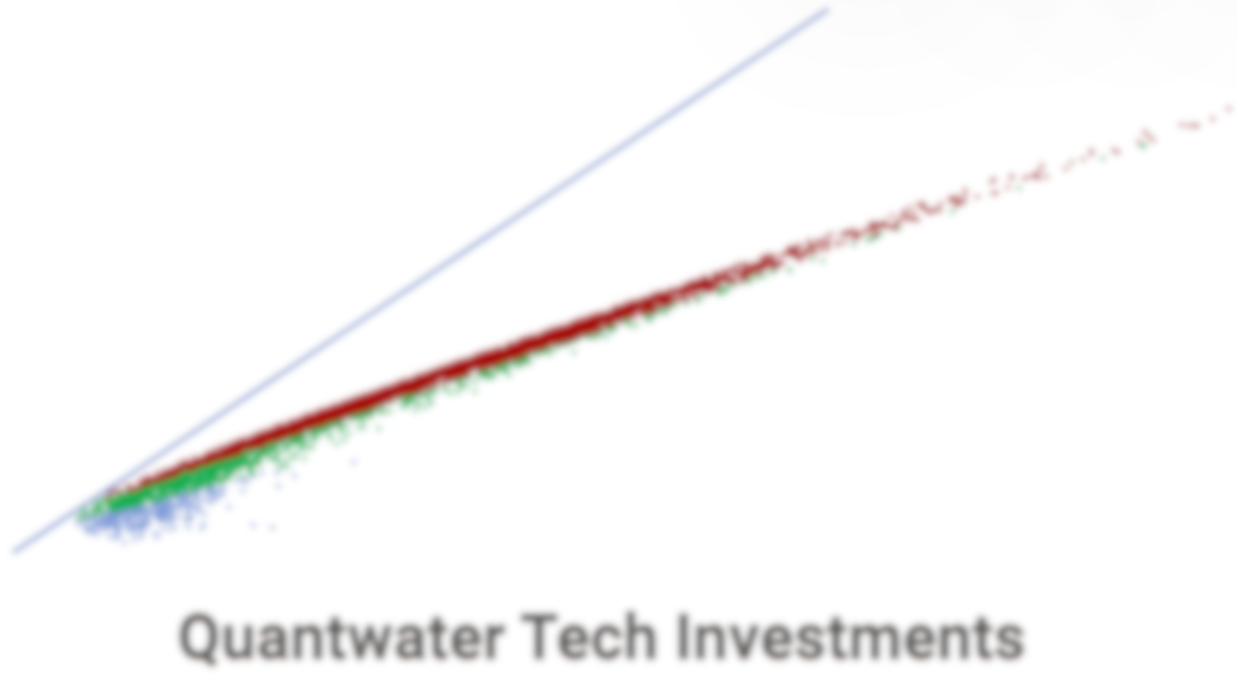
Project Spider Accelerating the Energy Transition 4thMar 2024 Pawan Quantwater Tech Investments
India on the Rise:
Market Outlook & Investment Trends
28th March 2025

Slide 2
Brief
Sr. No. | Particular
1 | Introduction
2 | Macroeconomic Overview
3 | Capital Market Performance in INR
4 | Capital Market Performance in USD
5 | Fixed Income Market
6 | Foreign Investments & Currency Market
7 | Emerging Sectors & Opportunities
8 | Risks & Challenges
9 | Conclusion: Navigating the India Opportunity
10 | Appendix –Seasonality & Important Information

Slide 3
Project Spider Accelerating the Energy Transition 4thMar 2024 Pawan Quantwater Tech Investments
Introduction

Slide 4

Introduction
Brief on India’s Economic Growth & Financial Markets
Real GDP growth (Annual % change)
India remains one of the fastest-growing economies, with GDP growth projected at 6-7% for 2025.
Strong domestic demand, digital transformation, and government initiatives like ‘Atmanirbhar Bharat’ and ‘Make in India’ are boosting economic activity.
Key Sectors Driving the Economy
IT & Software Services
Manufacturing
Renewable Energy
Infrastructure
Digital Payments
Pharma
As per World Bank’s Long-Term Growth Modeling (LTGM), India’s long-term GDP growth rate is projected to stabilize around 6.5% by 2035, before gradually slowing to 5.5% by 2050, reflecting economic maturation and demographic shifts.
GDP Contribution (2023-2024 %)
Investment Opportunities for 2025 and Beyond
Public and private equity
Government bonds
Fintech
New-age digital businesses.

Slide 5
Project Spider Accelerating the Energy Transition 4thMar 2024 Pawan Quantwater Tech Investments
Macroeconomic Overview

Slide 6
Macroeconomic Overview
GDP Growth
Inflation Trends
As per World Bank’s Long-Term Growth Modeling (LTGM), India’s long-term GDP growth rate is projected to stabilize around 6.5% by 2035, before gradually slowing to 5.5% by 2050, reflecting economic maturation and demographic shifts.
The Reserve Bank of India (RBI) has projected the Consumer Price Index (CPI) inflation to average 4.8% for the fiscal year 2024-25 (FY25) and to moderate to 4.2% for FY26.
Interest Rates & RBI Policy Stance
Fiscal Deficit & Government Spending
Recent Rate Cut: On February 7, 2025, the Reserve Bank of India (RBI) reduced the repo rate by 25 basis points, bringing it down from 6.50% to 6.25%, aiming to stimulate economic growth amid easing inflation.
Neutral Policy Stance: Despite the rate cut, the RBI maintained a ‘neutral’ policy stance, focusing on achieving a durable alignment of inflation with the target while supporting growth.
Anticipated Future Rate Cuts: Market analysts project further rate cuts in 2025, with expectations of an additional 50 basis points reduction by August, as the RBI seeks to balance growth and inflation dynamics.
Mid to Long-Term Projections (2027-2031): Specific forecasts for the RBI’s policy rates beyond 2026 are limited. However, the central bank’s actions will likely be influenced by factors such as domestic inflation trends, economic growth rates, and global financial conditions.
Fiscal Deficit Reduction: The government aims to decrease the fiscal deficit from 4.8% of GDP in FY 2024-25 to 4.4% in FY 2025-26, demonstrating a commitment to fiscal consolidation.
Expenditure Growth: Total government expenditure for FY 2025-26 is projected at ₹50.65 trillion, a 7.4% increase over the revised estimates for FY 2024-25, with capital expenditure earmarked at ₹11.21 trillion (3.1% of GDP) to boost infrastructure development.
Gross Borrowing Plans: The government plans to raise ₹8 trillion through bond sales from April to September 2025, accounting for 54% of the estimated gross borrowing for the upcoming fiscal year.
Debt-to-GDP Ratio Goal: A strategic objective has been set to reduce the central government’s debt-to-GDP ratio from 57.1% in FY 2024-25 to 50% by March 2031, promoting long-term fiscal sustainability.

Slide 7
Project Spider Accelerating the Energy Transition 4thMar 2024 Pawan Quantwater Tech Investments
Capital Market Performance in INR

Slide 8
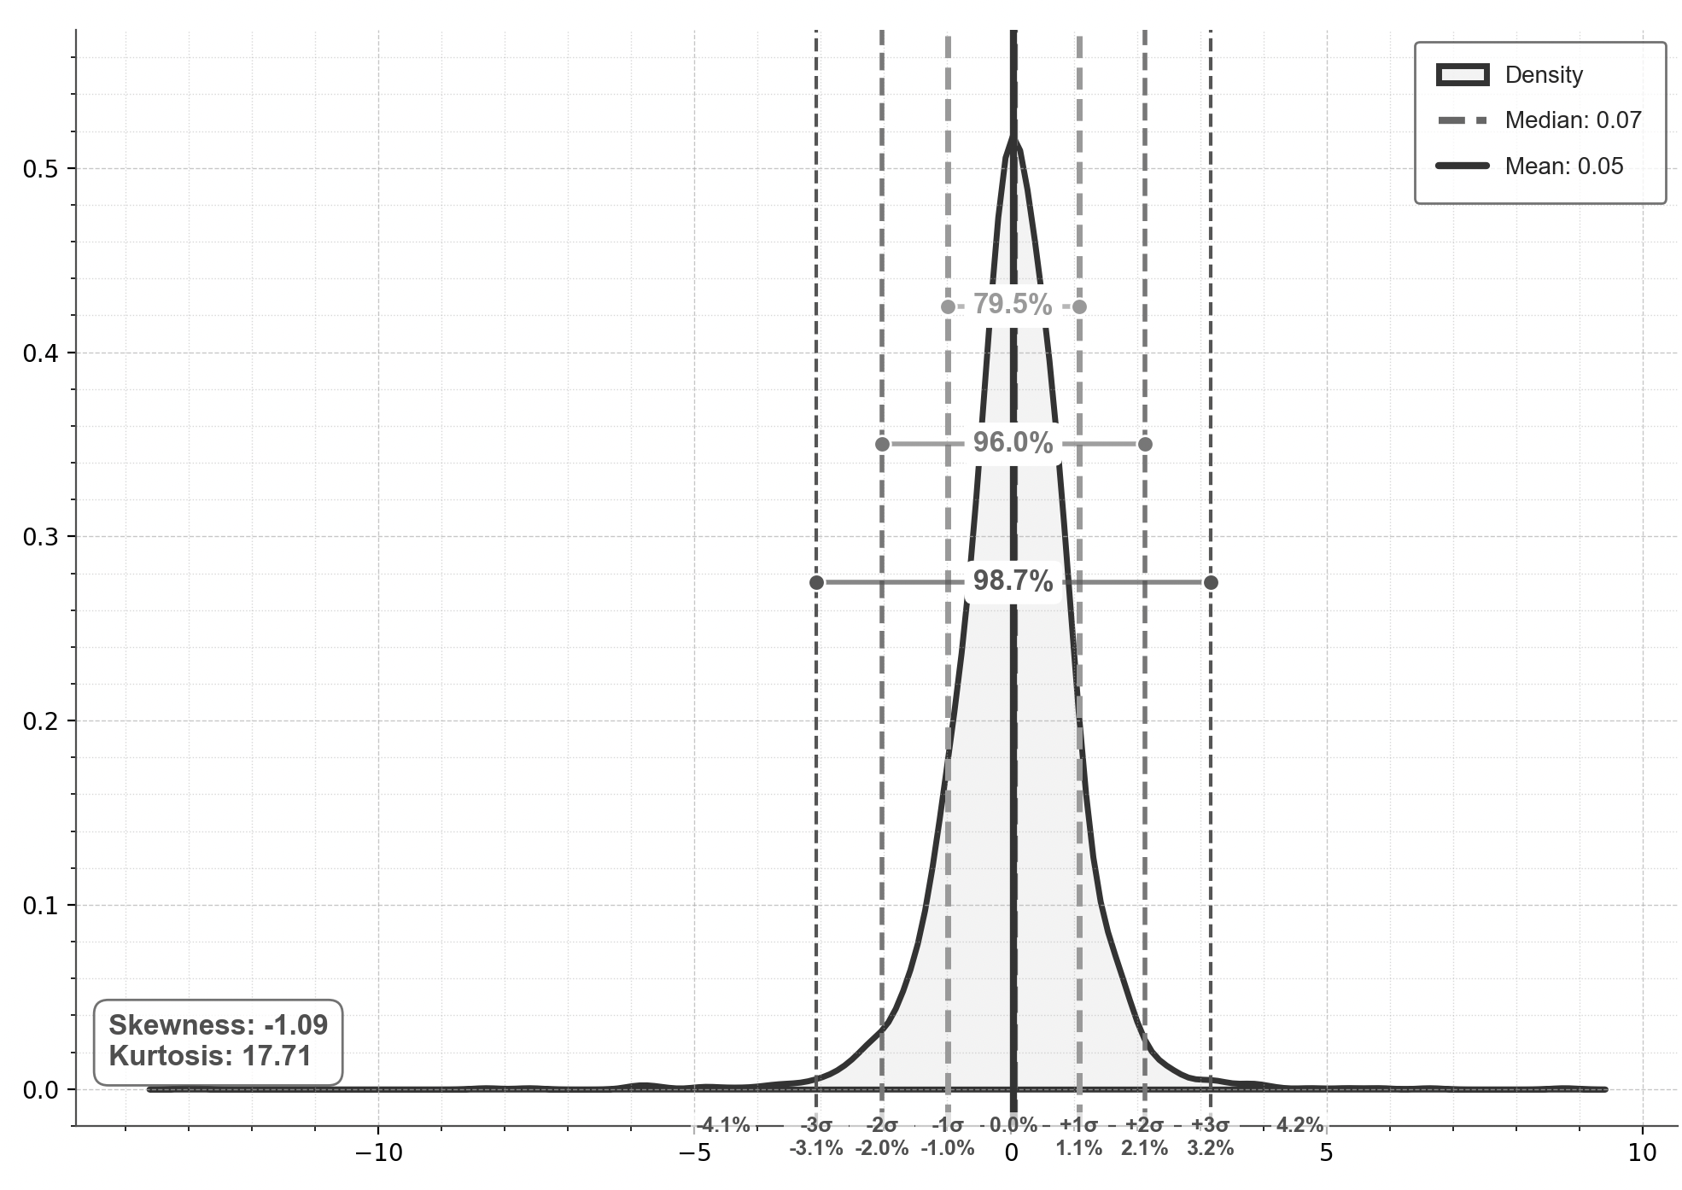
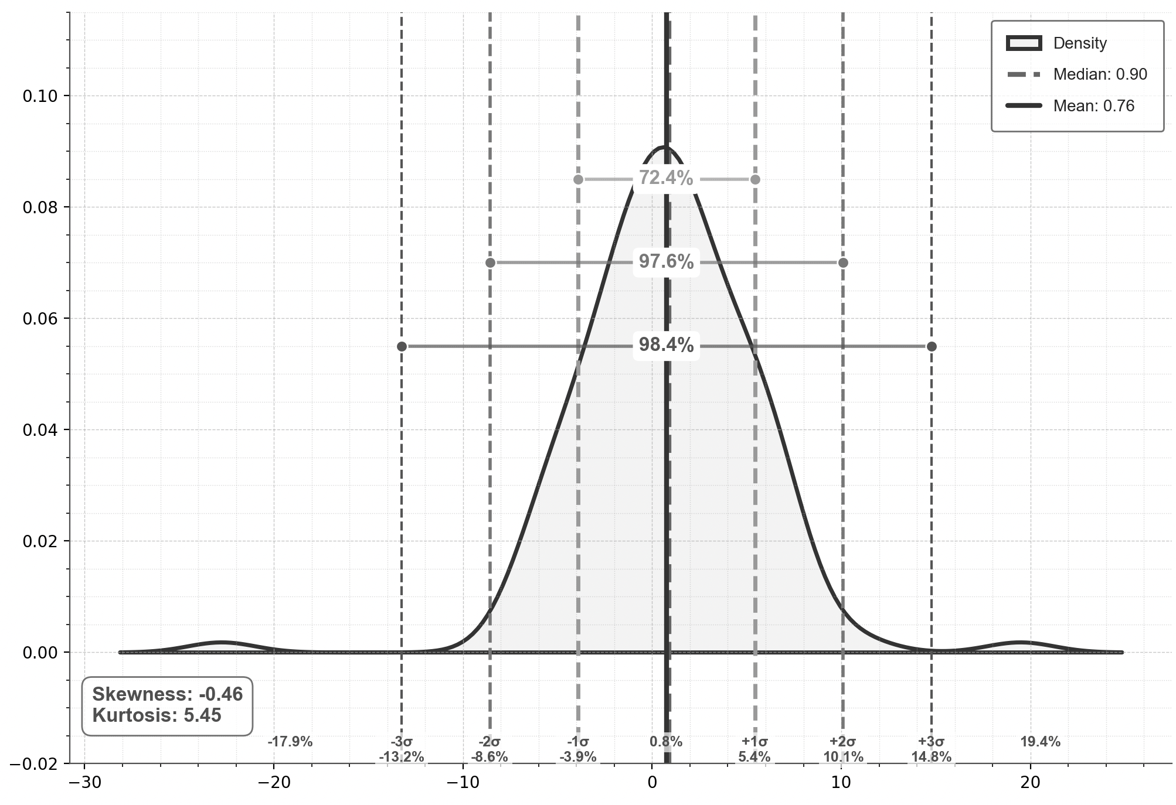
Capital Market Performance in INR - Indices
Major Indices (10 Year Performance) (1st Jan 2015 = 100)
Major Indices (6 Year Performance) (1st Jan 2019 = 100)
Density Plot Nifty 50 (10 Years, daily returns)
CAGR: 15%
CAGR: 11%
CAGR: 13%
Historical Returns – 10 Years
Historical Returns – 6 Years
Density Plot Nifty 50 (10 Years, Monthly returns)

Slide 9
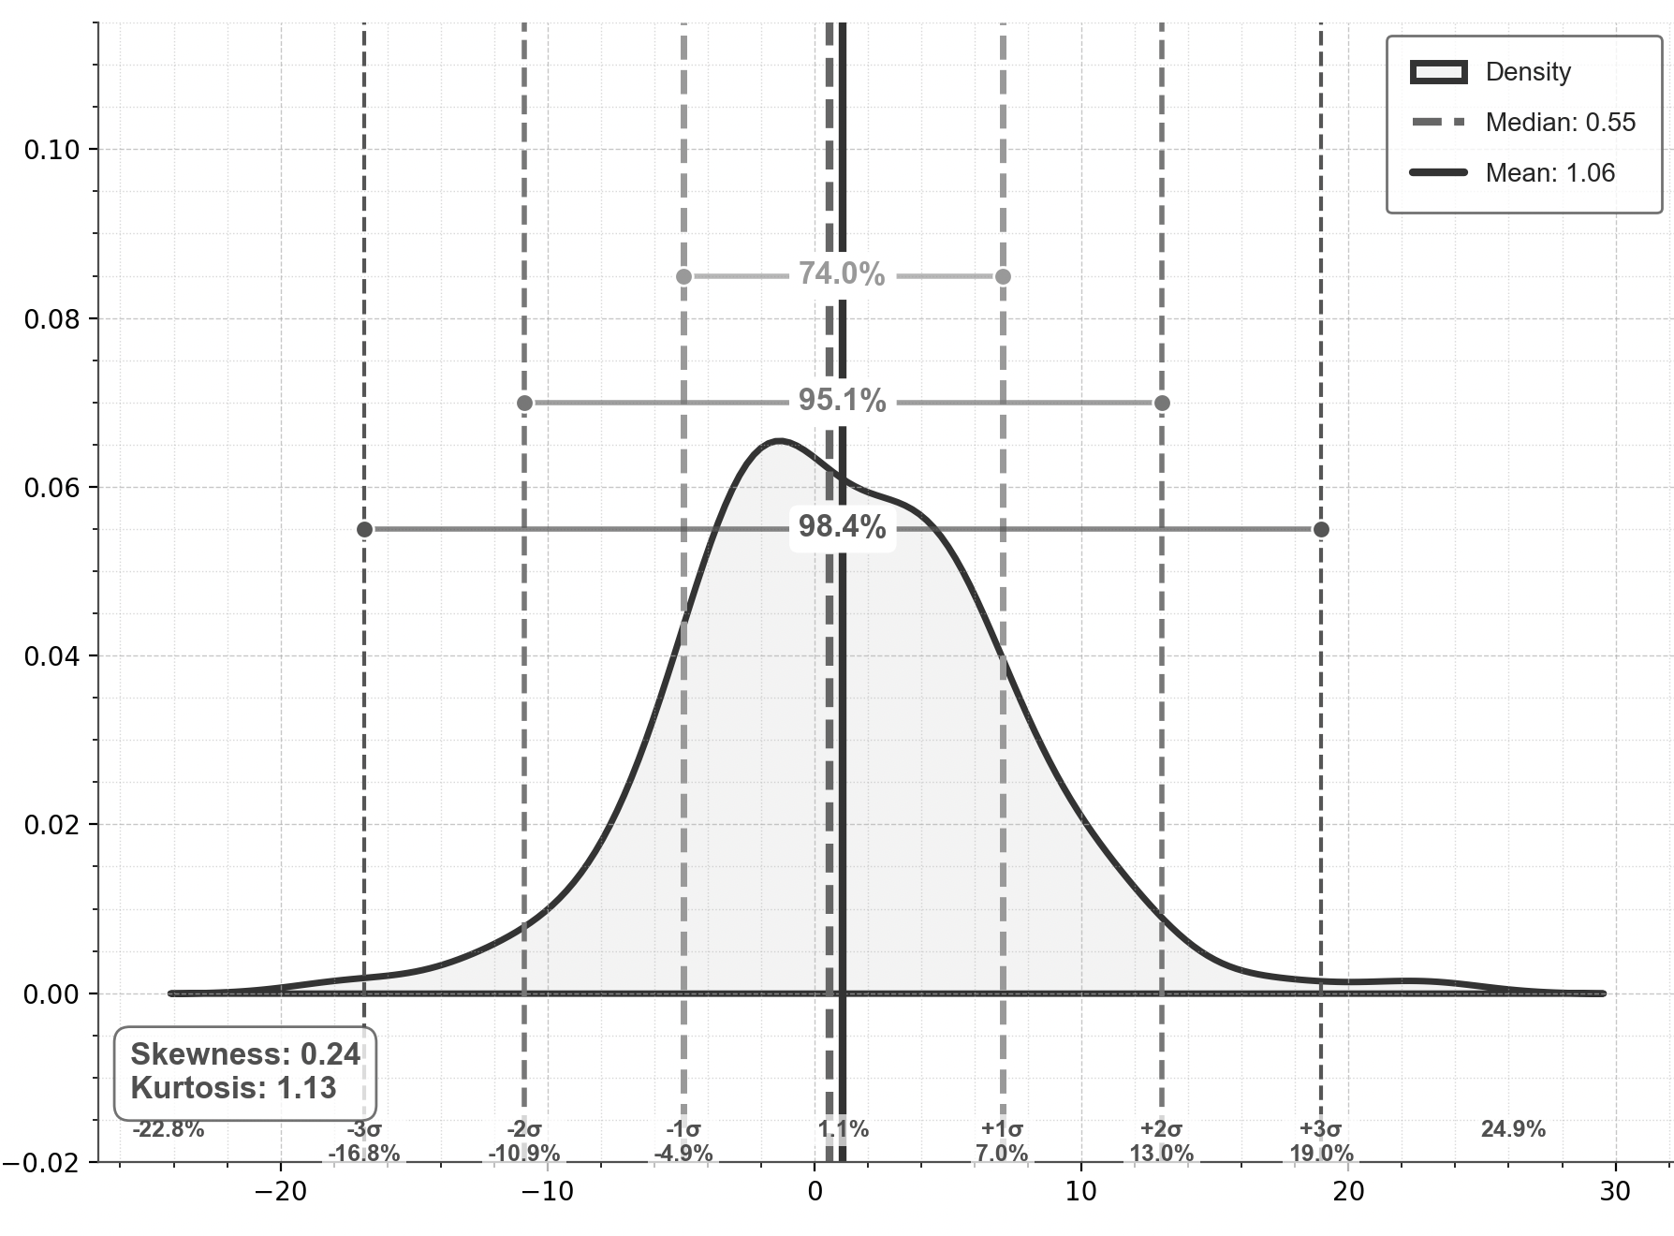
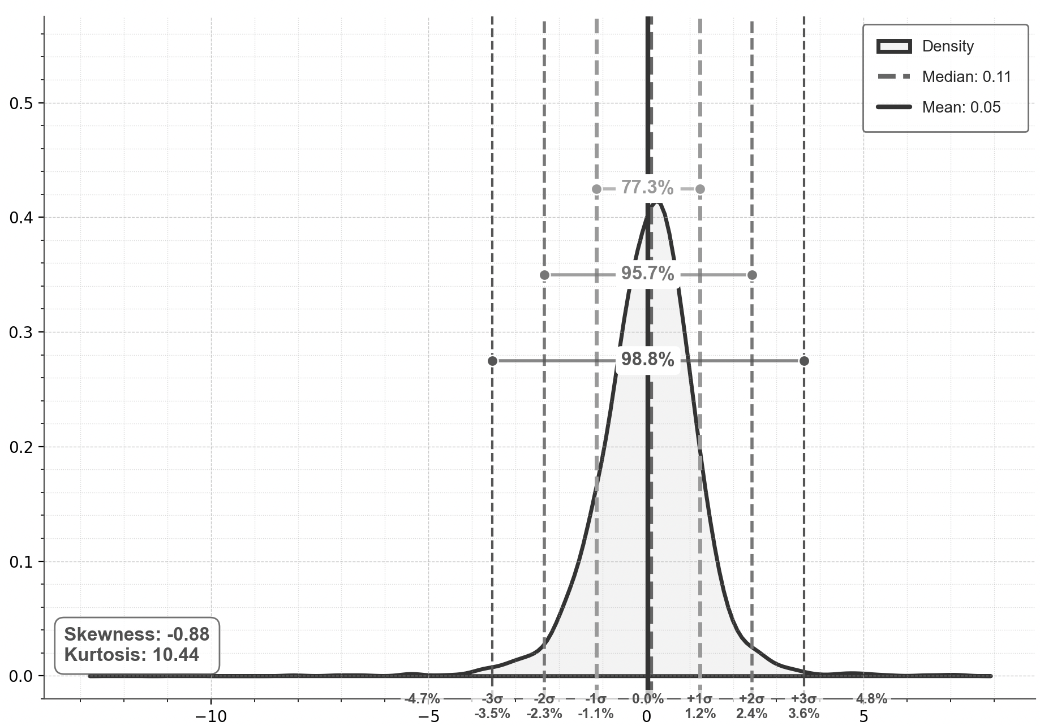
Capital Market Performance in INR - Sectors
Sectoral Performance (10 Years) (1st Jan 2015 = 100)
Sectoral Performance (6 Years) (1st Jan 2019 = 100)
Density Plot Nifty IT (10 Years, Monthly returns)
CAGR: 12%
CAGR: 10%
CAGR: 7%
Historical Returns – 10 Years
Historical Returns – 6 Years
Density Plot Nifty Infra (6 Years, Monthly returns)

Slide 10
Capital Market Performance in INR – Volatility
Annualized Volatility - Indices
Annualized Volatility - Sectors
Rolling Volatility (1 month) - Indices
Rolling Volatility (1 month) - Sectors

Slide 11
Project Spider Accelerating the Energy Transition 4thMar 2024 Pawan Quantwater Tech Investments
Capital Market Performance - USD

Slide 12
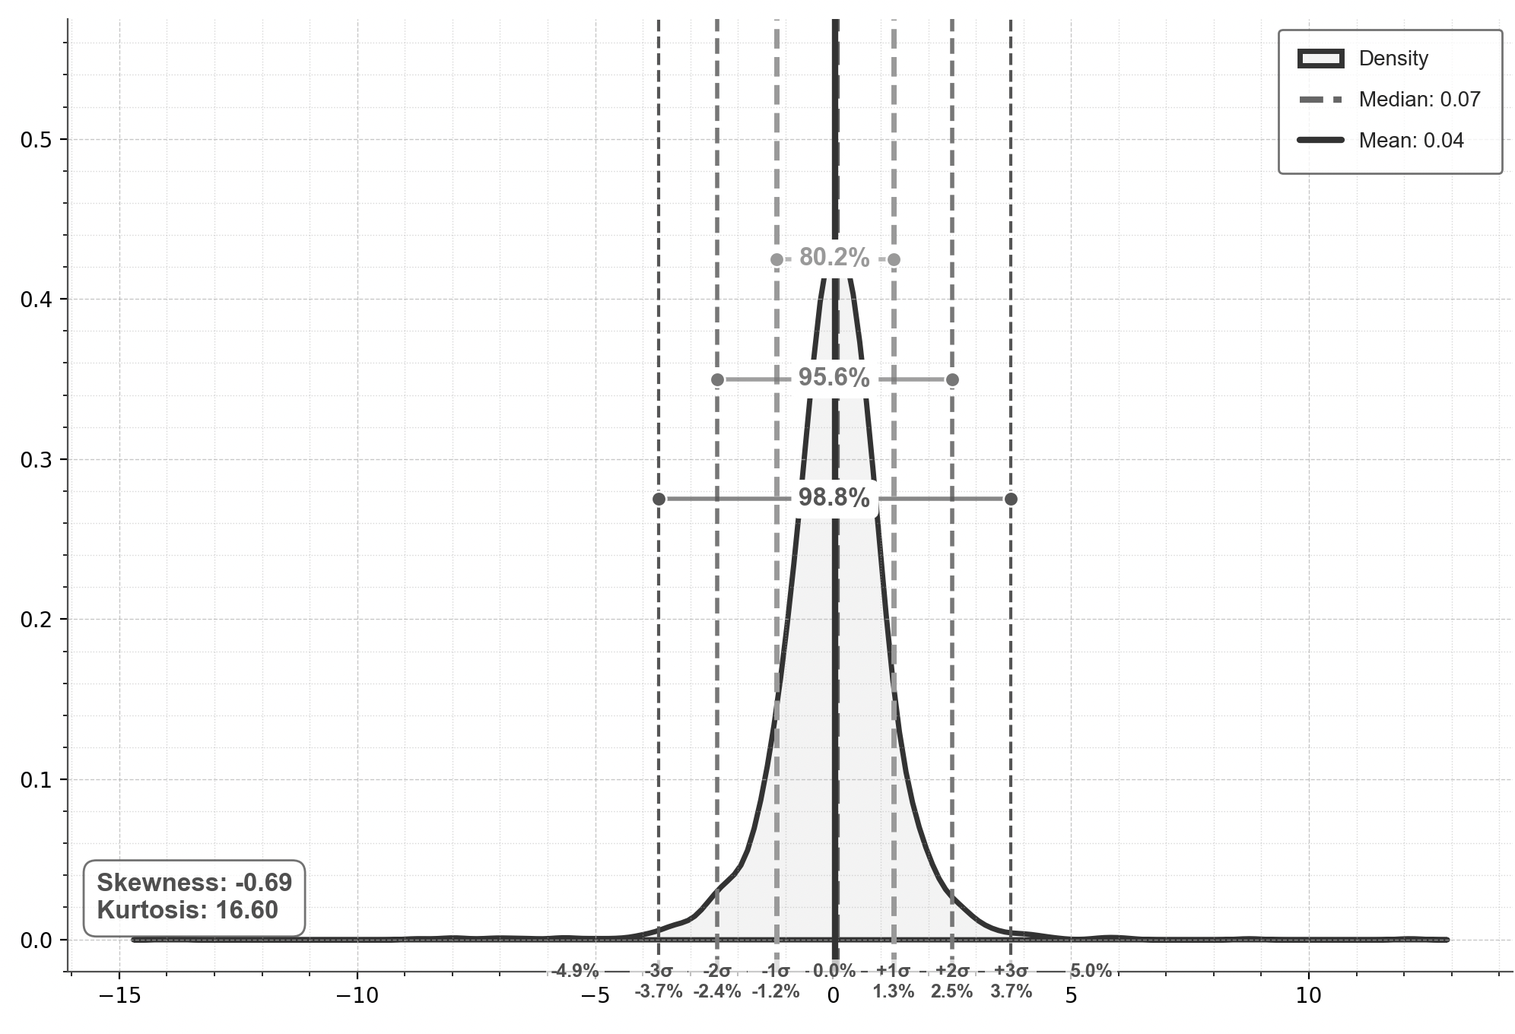
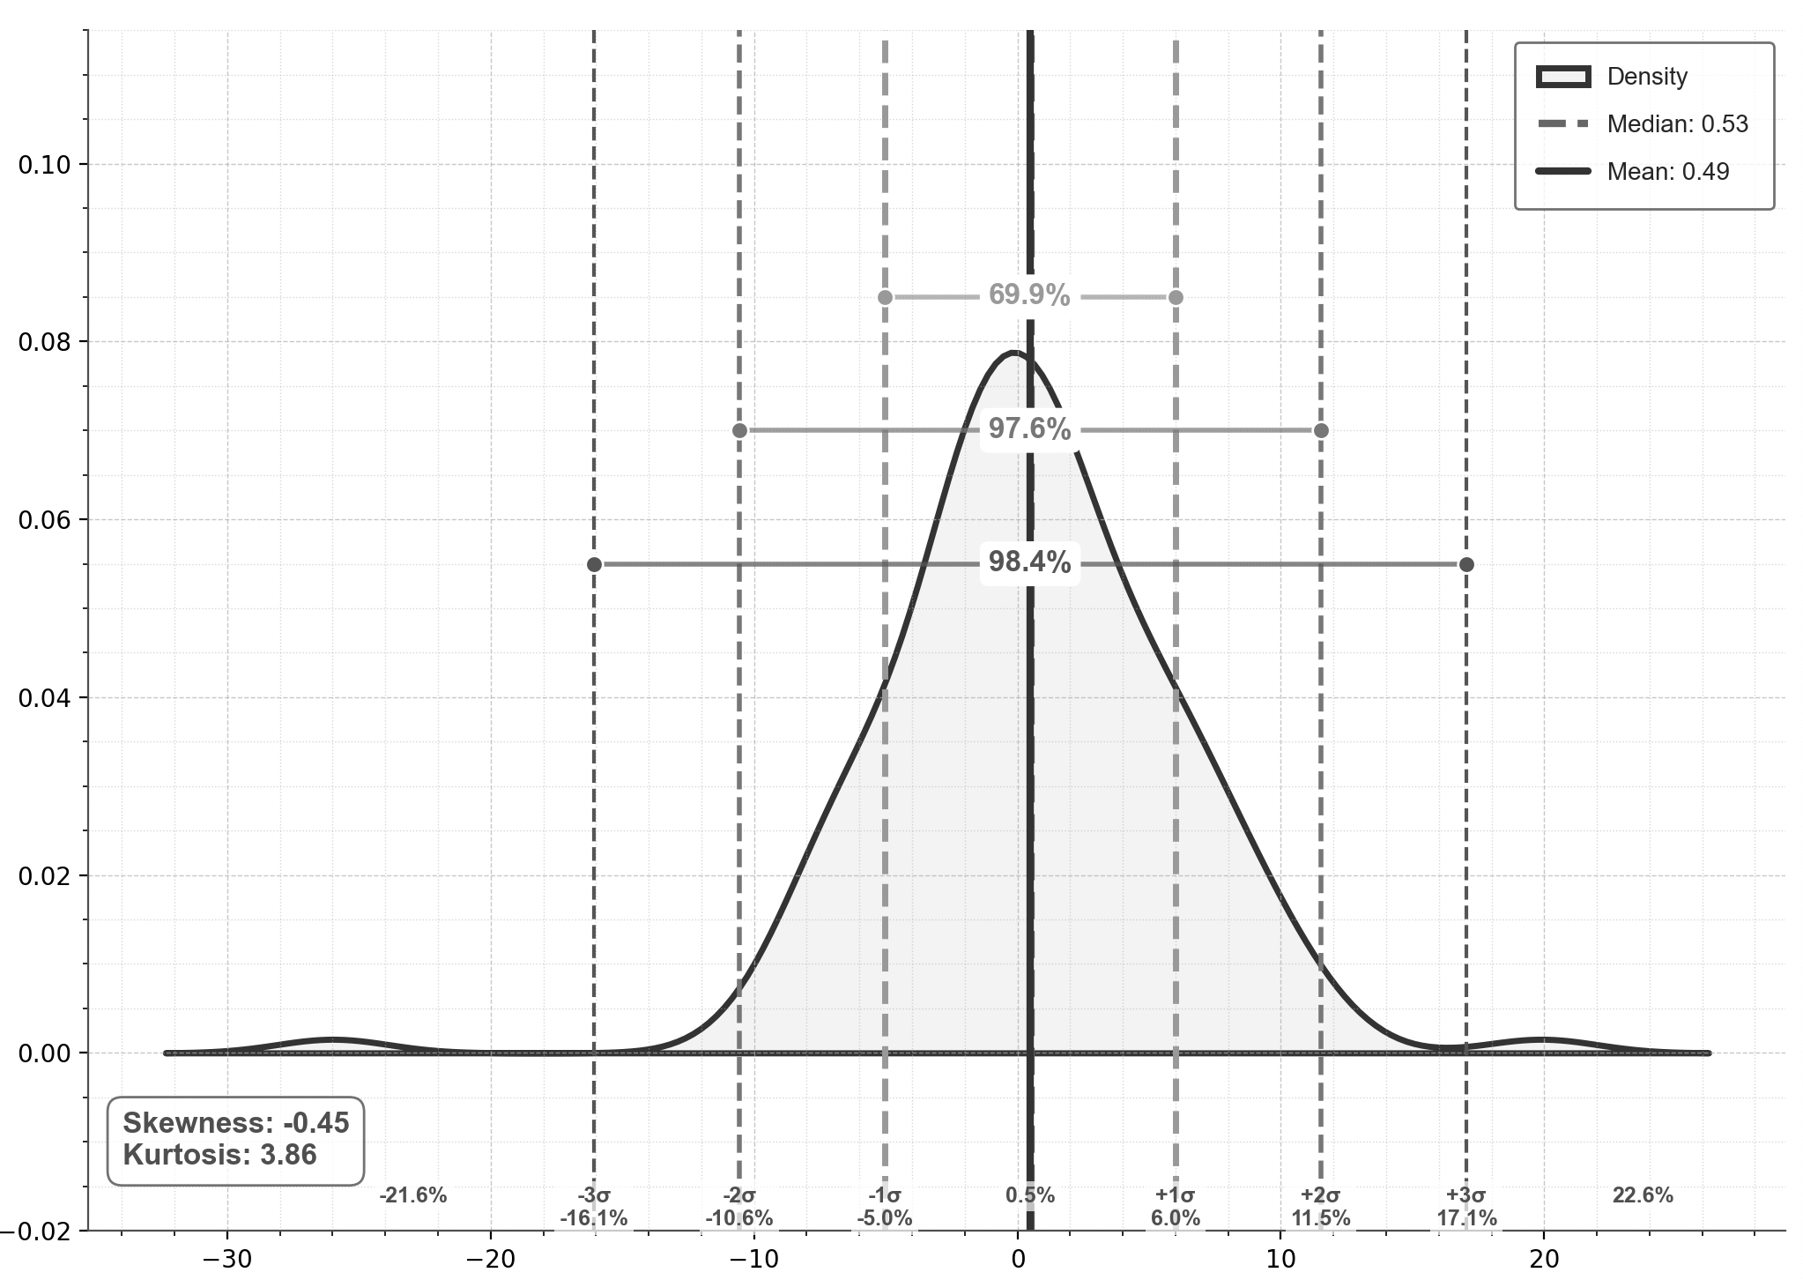
Capital Market Performance in USD - Indices
Major Indices (10 Year Performance) (1st Jan 2015 = 100)
Major Indices (6 Year Performance) (1st Jan 2019 = 100)
Density Plot Nifty 50 (10 Years, daily returns)
CAGR: 11%
CAGR: 7%
CAGR: 9%
Historical Returns – 10 Years
Historical Returns – 6 Years
Density Plot Nifty 50 (10 Years, Monthly returns)

Slide 13
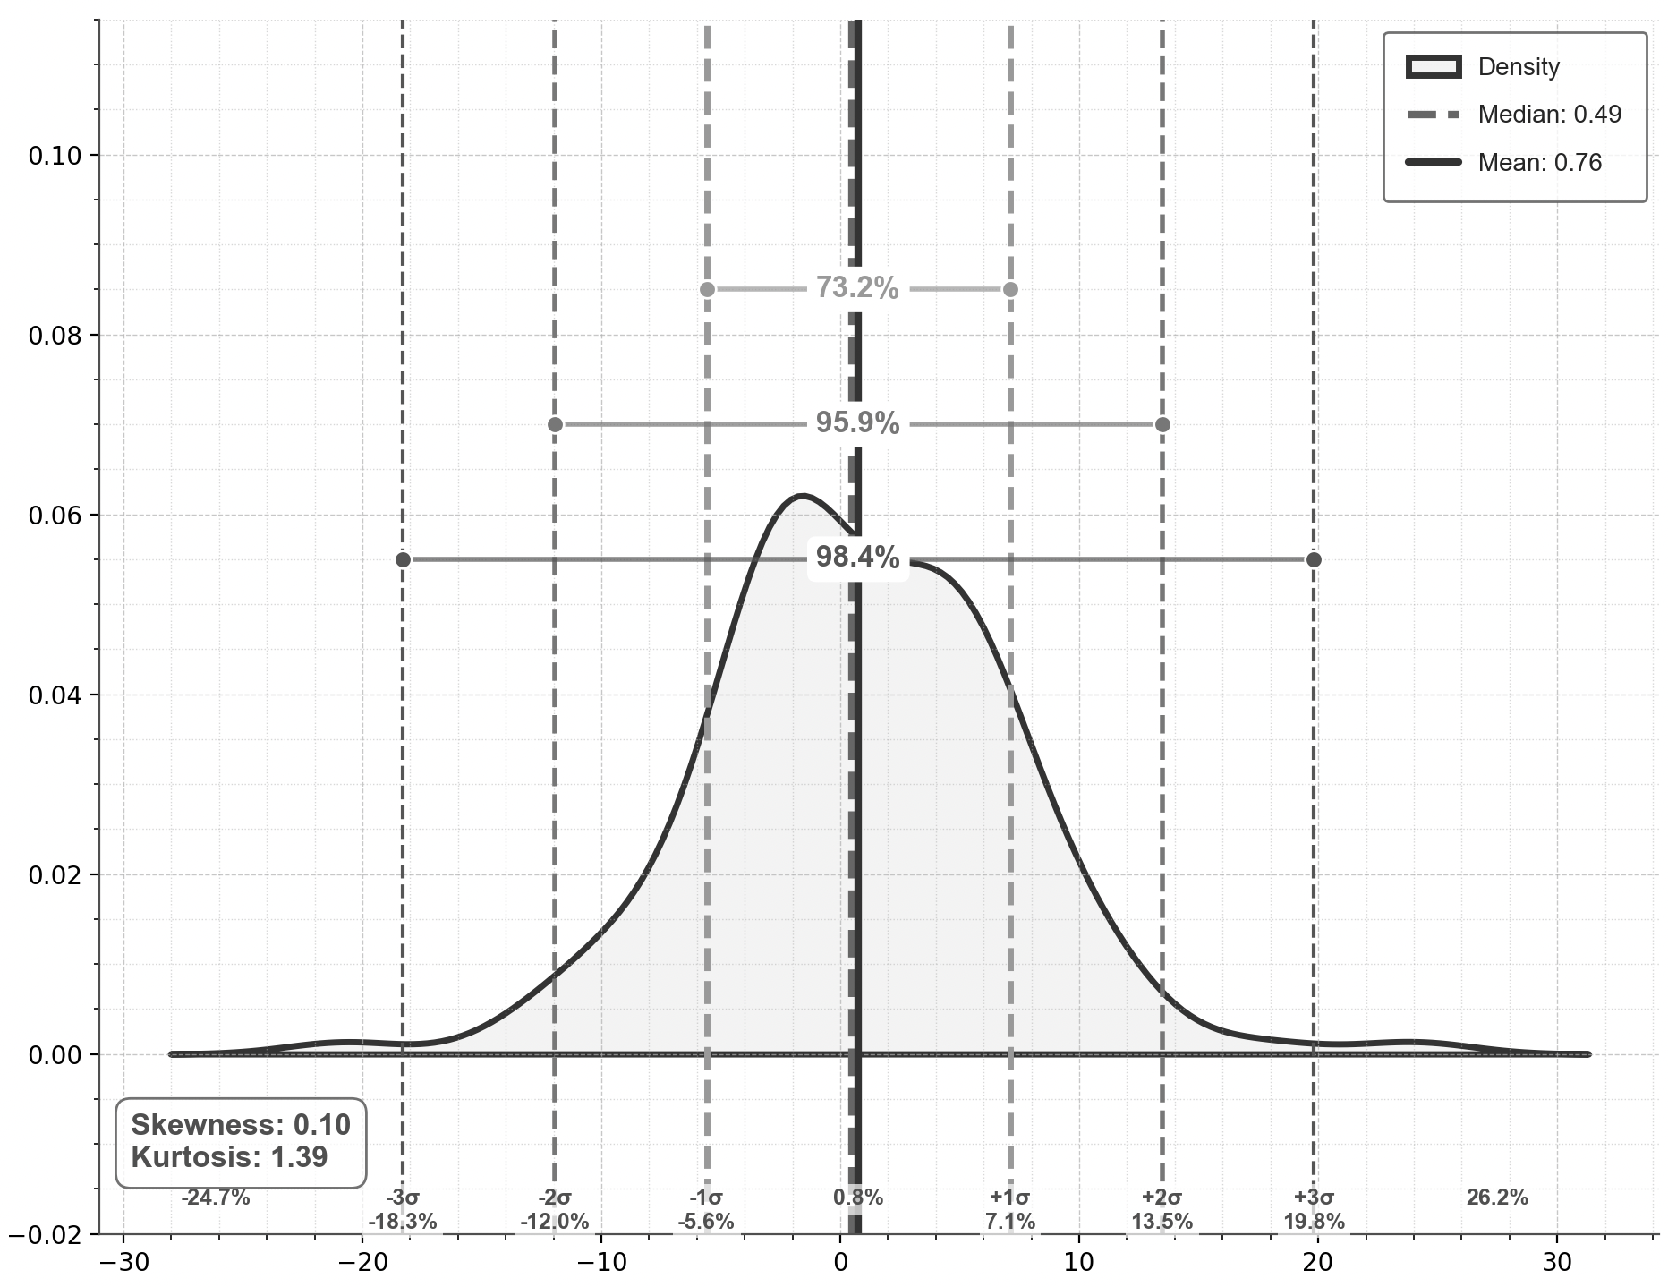
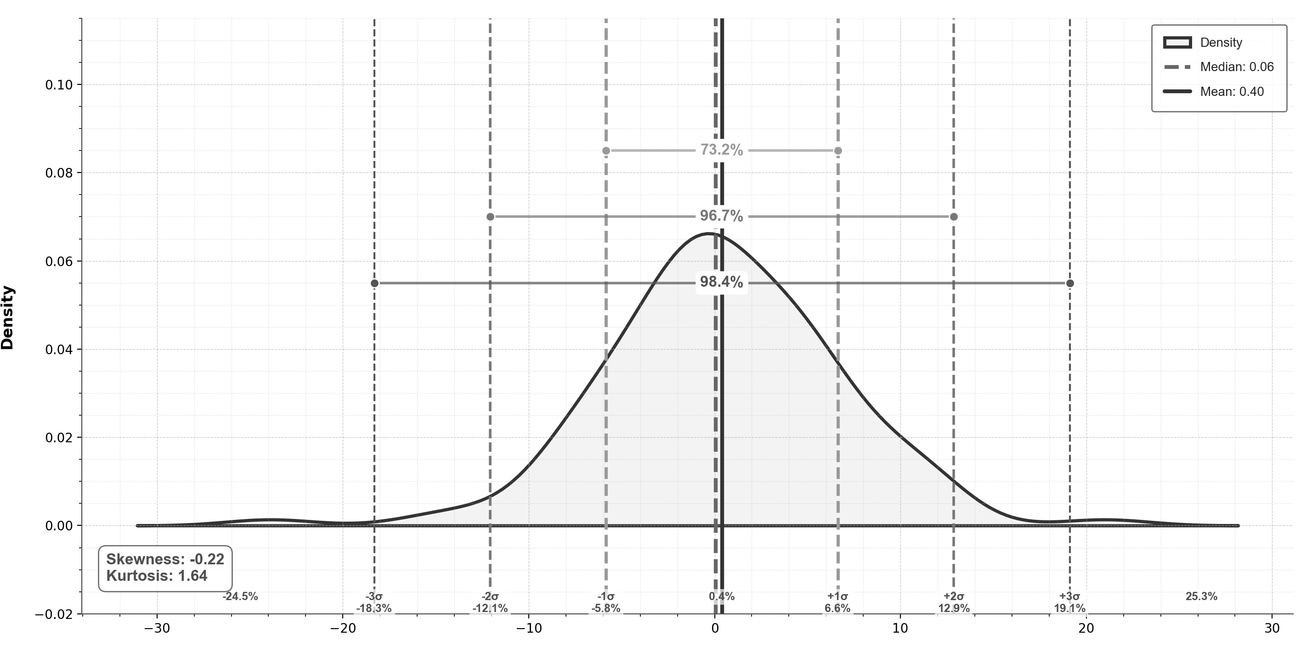
Capital Market Performance in USD - Sectors
Major Indices (10 Year Performance) (1st Jan 2015 = 100)
Major Indices (6 Year Performance) (1st Jan 2019 = 100)
Density Plot Nifty IT (10 Years, Monthly returns)
CAGR: 9%
CAGR: 6%
CAGR: 7%
Historical Returns – 10 Years
Historical Returns – 6 Years
Density Plot Nifty Infra (6 Years, Monthly returns)

Slide 14
Capital Market Performance in USD – Volatility
Annualized Volatility – Indices & Sectors
Rolling Volatility (1 month) - Indices
Rolling Volatility (1 month) - Sectors

Slide 15
Project Spider Accelerating the Energy Transition 4thMar 2024 Pawan Quantwater Tech Investments
Fixed Income Market

Slide 16
Fixed Income Market – Government Bonds
10Y & 5Y G-Sec Yield
Yield Curve Trend
Current yields: Upward sloping from 6.25% (6M) to 7% (40Y), steepening after 15Y mark
1-month ago: Generally higher than current yields, converging at longer terms
1-year ago: Consistently higher (7-7.25%) across all terms, showing significant rate decrease YoY
Normal positive slope maintained across all periods, suggesting economic growth expectations
OMO Commentary – Impact of RBI bond purchases
India-US10Y Yield Spread
10Y G-Sec - Repo Rate Spread
RBI conducts Open Market Operations (OMOs) by purchasing/selling government securities in the secondary market to regulate money supply and manage long-term interest rates
In April 2025, RBI announced plans to purchase ₹80,000 crore of G-Secs across four ₹20,000 crore tranches (April 3, 8, 22, 29) to enhance market liquidity
First auction saw strongest demand for mid-to-long dated securities with 8.24% GS 2033 receiving highest allocation (₹7,660 crore)
Cut-off yields ranged from 6.35% (short-term) to 6.64% (long-term), reflecting RBI's targeted intervention across different maturity segments
These operations support the current positive yield curve slope and demonstrate RBI's proactive approach to maintaining orderly market conditions amid changing interest rate environment

Slide 17
Fixed Income Market – Corporate Bonds
Credit Spreads: Reflecting Risk Perception
Spread Over 5Y G-Sec yields (bps)
Credit Rating Trends: Upgrades Outpace Downgrades
Definition: Credit spreads represent the additional yield investors demand for holding corporate bonds over government securities (G-Secs), compensating for credit risk and issuer uncertainty.
Market Behavior: These spreads tend to widen during periods of financial stress or uncertainty (when investor risk aversion rises) and narrow in more stable or optimistic (risk-on) environments.
Credit Rating Impact: Lower-rated bonds (e.g., AA-, BBB, high-yield) exhibit wider spreads compared to higher-rated bonds (e.g., AAA, AA), reflecting higher perceived default risk.
Tenor Influence: The term to maturity (tenor) affects spreads — longer tenors generally command higher spreads due to increased exposure to interest rate volatility and credit risk over time.
CRISIL Ratings Credit Ratio moderated but remains elevated: Stood at 1.79x in H2 FY24 (vs 1.91x in H1 FY24), indicating continued positive momentum (Upgrades > Downgrades).
Upgrade Rate (12.0% H2 FY24): Remains above the 10-year average (~11%), driven by domestic demand, infra spending, and healthy corporate balance sheets.
Downgrade Rate (6.7% H2 FY24): Close to the 10-year average (~6.4%), with export-linked sectors and those facing commodity price volatility seeing some pressure.
Overall: Corporate India shows resilience, supported by deleveraging and domestic economic activity.
High-Yield vs. Investment Grade Performance
Investment Grade (BBB- & above): Characterized by lower yields and higher credit stability, this segment has benefitted from corporate deleveraging and strong balance sheets.
High Yield (BB+ & below): Offers higher return potential but entails elevated credit and liquidity risk. Historically more prone to downgrades, especially among MSMEs and during economic slowdowns.
Relative Performance Tracking: Total returns across these categories can be monitored using bond indices (e.g., CRISIL, NSE, S&P BSE) and debt mutual fund performance data (e.g., AMFI, Value Research).

Slide 18
Fixed Income Market – FDs & Debt Mutual Funds
FD Interest Rates
Debt MF Returns
Category | 1Y Return | 3Y CAGR | 5Y CAGR
Short Duration Funds | 7.58% | 6.08% | 6.31%
Corporate Bond Funds | 7.94% | 5.85% | 6.16%
Gilt Funds (10Y) | 9.21% | 5.78% | 6.13%
CPI Inflation vs Returns (Real return view)
Investor Insight
Investors must look beyond nominal returns—real return tracking is essential in high inflation environments.
Duration strategy matters:
short duration funds offer stability,
while gilt funds offer potential upside with interest rate sensitivity.

Slide 19
Project Spider Accelerating the Energy Transition 4thMar 2024 Pawan Quantwater Tech Investments
Foreign Investment & Currency Market

Slide 20
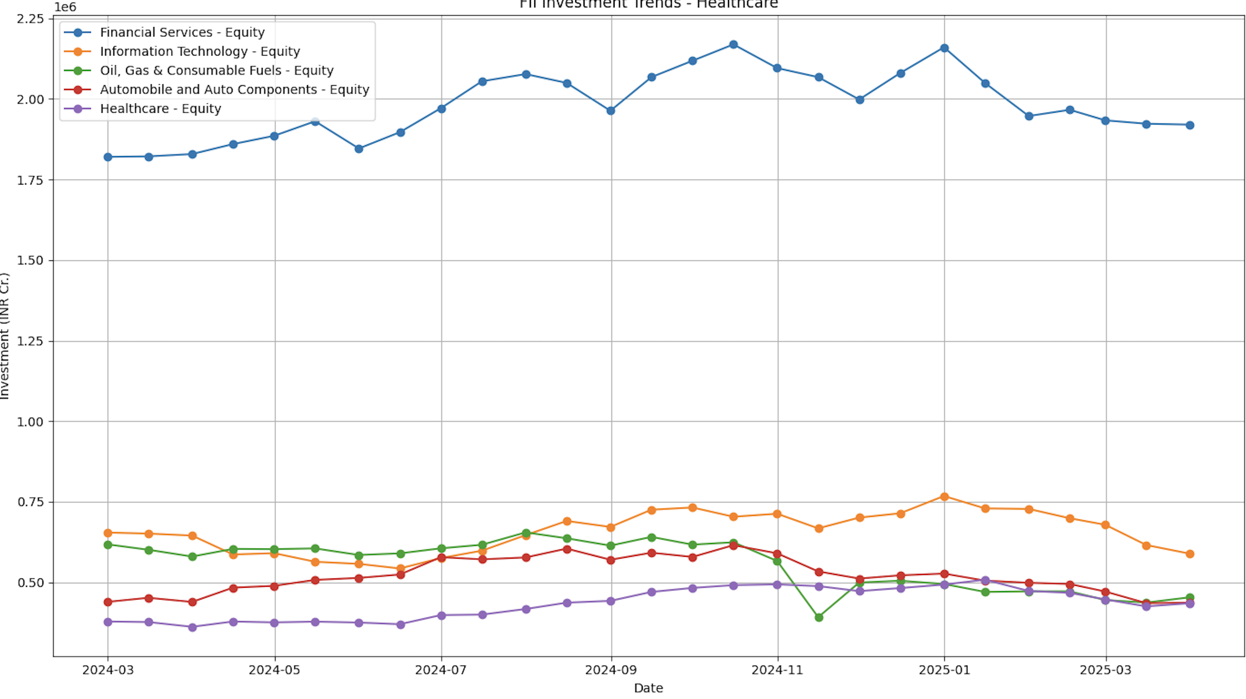
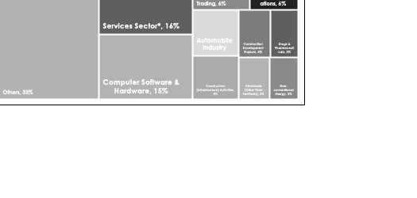
Foreign Investment & Currency Market
FDI Flows – Sector wise equity inflow from Apr 2000 to Dec 2024
FDI Trend
FII Flows - AUC
Total FDI equity inflow (Apr–Dec 2024): ₹3.4 lakh crore (~USD 40.67 billion)
Slight dip from FY24 full-year value (~USD 44.4 billion)
Despite global uncertainties, India continues to attract stable and diversified FDI
Total Inflow: USD 720B
*Services include financial, banking, insurance, outsourcing, R&D, courier, tech testing, etc.
INR/USD Exchange Rate
Impact of Global Macro Events
US Fed Cycles: Rate hikes (2022–23) led to FII outflows; easing from late 2023 supported inflows & INR stability.
Crude Oil Volatility: Price shocks (esp. 2018, 2022, 2023) stressed INR & CAD; remains a key risk.
China+1 Shift: Global realignment post-COVID accelerated FDI into India’s manufacturing, EVs, renewables.
Global Risk Events: COVID, geopolitical tensions, and bank crises led to short-term volatility but long-term resilience.
Resilient Sectors: Over 10Y, stable FDI in IT, Manufacturing, Digital Infra, Pharma – positioned well for 6Y horizon.
CAGR: 3%

Slide 21
Project Spider Accelerating the Energy Transition 4thMar 2024 Pawan Quantwater Tech Investments
Emerging Sectors & Opportunities

Slide 22
Emerging Sectors & Opportunities
Technology & AI
EV & Renewable Energy
India’s AI market projected to reach $17B by 2027 (30% CAGR).
Surge in AI start-ups, cloud infra, and SaaS exports.
Govt initiatives:
IndiaAI Mission – focused on compute capacity, datasets, & research.
AI Research Centers – 3 Centers of Excellence launched across top institutes to develop foundational models & applied AI solutions.
National Quantum Mission (2023–2031) – ₹6,000 Cr initiative to develop quantum computers, secure communication, and advanced quantum sensors.
Digital Public Infrastructure - UPI, Aadhaar, ONDC enabling innovation at scale.
EV market CAGR ~49% (2015-2023); strong growth in 2W, 3W segments.
Renewable capacity doubled in the last decade – solar leads.
Key policies: FAME II, Green Hydrogen Mission, PLI for Battery Storage.
Manufacturing & PLI Schemes
Digital Payments & FinTech
PLI Schemes (₹2L+ Cr) for electronics, pharma, semiconductors, and textiles.
India emerging as a “China+1” hub for global supply chains.
Electronics exports up >50% YoY (2023-2024); Apple & Foxconn expanding footprint.
UPI transactions > ₹1,300 Cr/month (as of 2024); fastest-growing globally.
FinTech valuation set to cross $150B by 2025.
Supportive ecosystem: Digital India, API stack, regulatory sandbox.
India is at the cusp of a tech-industrial transformation, with policy push, global realignment, and digital infrastructure as key tailwinds. These sectors will likely dominate investment narratives over the medium term.

Slide 23
Project Spider Accelerating the Energy Transition 4thMar 2024 Pawan Quantwater Tech Investments
Risks & Challenges

Slide 24
Risks & Challenges
Global Recession & Geopolitical Risks
Inflation & Rate Hike Concerns
Persistent concerns over a global slowdown, especially in the US and EU, may dampen exports and foreign investments.
Geopolitical tensions (Russia-Ukraine, China-Taiwan, Red Sea conflict, trade war) disrupt global supply chains and commodity flows.
Oil price volatility due to conflict zones can affect India’s import bill and fiscal balance.
Though moderating, core inflation remains sticky due to food and fuel price shocks.
Interest rate hikes by major central banks (Fed, ECB) may trigger capital outflows from emerging markets like India.
RBI’s stance remains cautious; further tightening could impact consumer demand and credit growth.
Strengthening Tech & Crypto Regulations in Response to Data Misuse & Privacy Breaches for exploitation
Global momentum around tech regulation is intensifying, particularly in data privacy — a necessary shift in response to increasing misuse with regards to exploitation of personal information. Regulatory scrutiny is also rising in areas like antitrust and AI ethics.
Crypto market under scrutiny – lack of clear domestic regulation poses risks for investors and FinTech firms.
Potential overregulation or policy uncertainty may slow innovation in emerging sectors like AI, quantum, and blockchain.

Slide 25
Project Spider Accelerating the Energy Transition 4thMar 2024 Pawan Quantwater Tech Investments
Conclusion: Navigating the India Opportunity

Slide 26
Conclusion: Navigating the India Opportunity
India presents a compelling long-term investment proposition, underpinned by strong macroeconomic fundamentals, favorable demographics, ongoing structural reforms, and a burgeoning digital economy. The resilience shown amidst global uncertainties highlights the depth of its domestic market and the effectiveness of policy support.
Significant opportunities exist across various sectors, particularly those benefiting from the digital transformation, infrastructure development, green energy transition, and advanced manufacturing push. Capital markets, while offering attractive potential returns in both INR and USD terms, come with inherent volatility influenced by domestic and global factors. The fixed income market provides diversification opportunities, albeit with careful consideration required for inflation and credit spreads.
However, investors must remain cognizant of the outlined risks. Global economic conditions, geopolitical instability, persistent inflation, and evolving regulatory landscapes necessitate a disciplined and selective approach. Careful monitoring of policy actions, currency movements, and market sentiment is crucial.
Overall, while challenges persist, the positive structural drivers supporting India's growth trajectory remain largely intact. For investors with a long-term horizon and a robust risk management framework, India continues to offer a significant allocation opportunity within emerging market portfolios. Navigating its complexities effectively will be key to unlocking its potential.

Slide 27
Project Spider Accelerating the Energy Transition 4thMar 2024 Pawan Quantwater Tech Investments
Appendix

Slide 28
Seasonality
Monthly Returns

Slide 29
Important Information
Quantwater Tech Investments
Data Release Deck – 14th April 2025
This document is for informational purposes only and does not constitute investment advice, an offer, or a solicitation to buy or sell any securities or financial instruments.
Past performance is not indicative of future results. Investments involve inherent risks, including the possible loss of principal. No representation or warranty, express or implied, is made regarding the accuracy, completeness, or reliability of the information contained herein.
The information in this presentation is derived from publicly available sources and internal analysis as of the date indicated and is subject to change without notice. Quantwater Tech Investments and its affiliates do not undertake any obligation to update or revise this material.
Neither Quantwater Tech Investments nor any of its affiliates, officers, or employees shall be liable for any direct or indirect losses arising from the use of this information. Any misrepresentation is strictly prohibited.

Slide 30
Thank You!
Thank You!
Pawan Jatale
pawan@quantwater.tech
Founder
Quantwater Tech Investments

