Slide 1
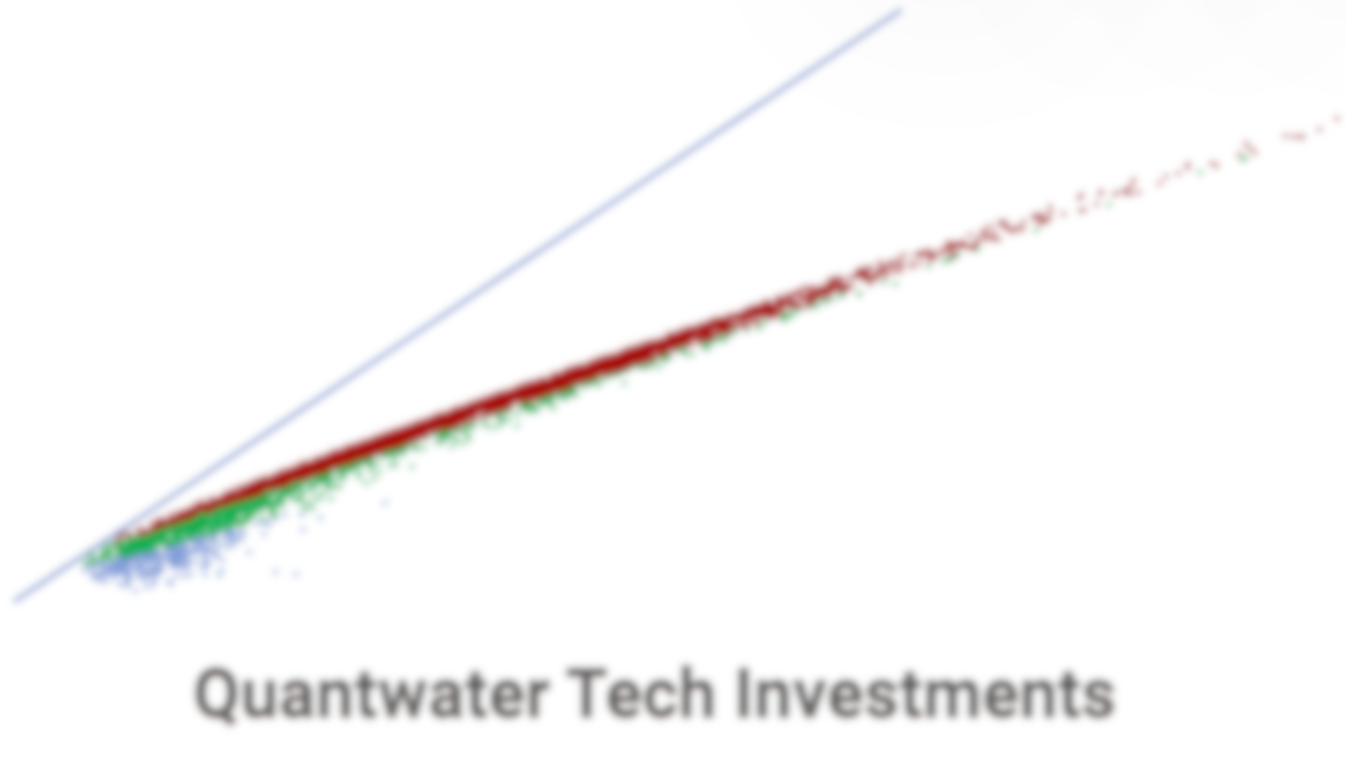
Project Spider Accelerating the Energy Transition 4thMar 2024 Pawan Quantwater Tech Investments
22nd December 2024
Economic Data Releases & Their Historical Impact on Assets

Slide 2
Legal Disclaimer
Quantwater Tech Investments
Data Release Deck –22nd December 2024
Past performance is not indicative of future results, and investments involve risks, including the potential loss of principal.
This presentation is based on publicly available data and internal analysis as of the date indicated and is subject to change without notice.
Quantwater Tech Investments and its affiliates disclaim any liability for any damages or losses arising from the use of this information. Any reproduction or redistribution of this presentation, in whole or in part, is prohibited without the express consent of Quantwater Tech Investments.

Slide 3
Brief
Date | Day | Time (IST) | Cur. | Imp. | Event
23-Dec-24 | Mon | 12:30 | GBP | 3 | GBP GDP (QoQ) (Q3)
23-Dec-24 | Mon | 12:30 | GBP | 3 | GBP GDP (YoY) (Q3)
23-Dec-24 | Mon | 20:30 | USD | 3 | USD CB Consumer Confidence (Dec)
24-Dec-24 | Tue | 5:30 | Global | 3 | Major markets closing early or closed.
24-Dec-24 | Tue | 19:00 | USD | 3 | USD Durable Goods Orders (MoM) (Nov) P
24-Dec-24 | Tue | 20:30 | USD | 3 | USD New Homes Sales (Nov)
25-Dec-24 | Wed | 5:30 | Global | 3 | Major markets closed.
26-Dec-24 | Thu | 19:00 | USD | 3 | USD Initial Jobless Claims
26-Dec-24 | Thu | 21:30 | USD | 3 | Crude Oil Inventories
30-Jan-25 | Thu | 0:30 | USD | 3 | Fed Interest Rate Decision
23-Dec-24 | Mon | 12:30 | GBP | 3 | GBP GDP (QoQ) (Q3)
23-Dec-24 | Mon | 12:30 | GBP | 3 | GBP GDP (YoY) (Q3)
23-Dec-24 | Mon | 20:30 | USD | 3 | USD CB Consumer Confidence (Dec)
24-Dec-24 | Tue | 5:30 | Global | 3 | Major markets closing early or closed.
24-Dec-24 | Tue | 19:00 | USD | 3 | USD Durable Goods Orders (MoM) (Nov) P
24-Dec-24 | Tue | 20:30 | USD | 3 | USD New Homes Sales (Nov)
25-Dec-24 | Wed | 5:30 | Global | 3 | Major markets closed.
26-Dec-24 | Thu | 19:00 | USD | 3 | USD Initial Jobless Claims
26-Dec-24 | Thu | 21:30 | USD | 3 | Crude Oil Inventories
30-Jan-25 | Thu | 0:30 | USD | 3 | Fed Interest Rate Decision
End |  |  |  |  | Annexure: Key Terms & Links

Slide 4
Project Spider Accelerating the Energy Transition 4thMar 2024 Pawan Quantwater Tech Investments
GBP GDP (QoQ) (Q3)

Slide 5
GBP GDP (QoQ) (Q3)
Event | GBP GDP (QoQ) (Q3) |  |  | Description
Actual: |  |  |  | Gross Domestic Product (GDP) gauges the inflation-adjusted value of all goods and services produced within the economy. It is the most comprehensive measure of economic activity and an important indicator of economic health. A reading that is stronger than forecast is generally supportive (bullish) for the GBP, while a weaker than forecast reading is generally negative (bearish) for the GBP. Historical impact on Assets: GBPJPY
Forecast: | 0.1%
Previous: | 0.5%
Time (GMT): | 7:00
Release Date | Actual | Forecast | Previous
15-Nov-24 | 0.1% | 0.2% | 0.5%
30-Sep-24 | 0.5% | 0.6% | 0.7%
15-Aug-24 | 0.6% | 0.6% | 0.7%
28-Jun-24 | 0.7% | 0.6% | -0.3%
10-May-24 | 0.6% | 0.4% | -0.3%
28-Mar-24 | -0.3% | -0.3% | -0.1%

Slide 6
Project Spider Accelerating the Energy Transition 4thMar 2024 Pawan Quantwater Tech Investments
GBP GDP (QoQ) (Q3)
GBPJPY

Slide 7
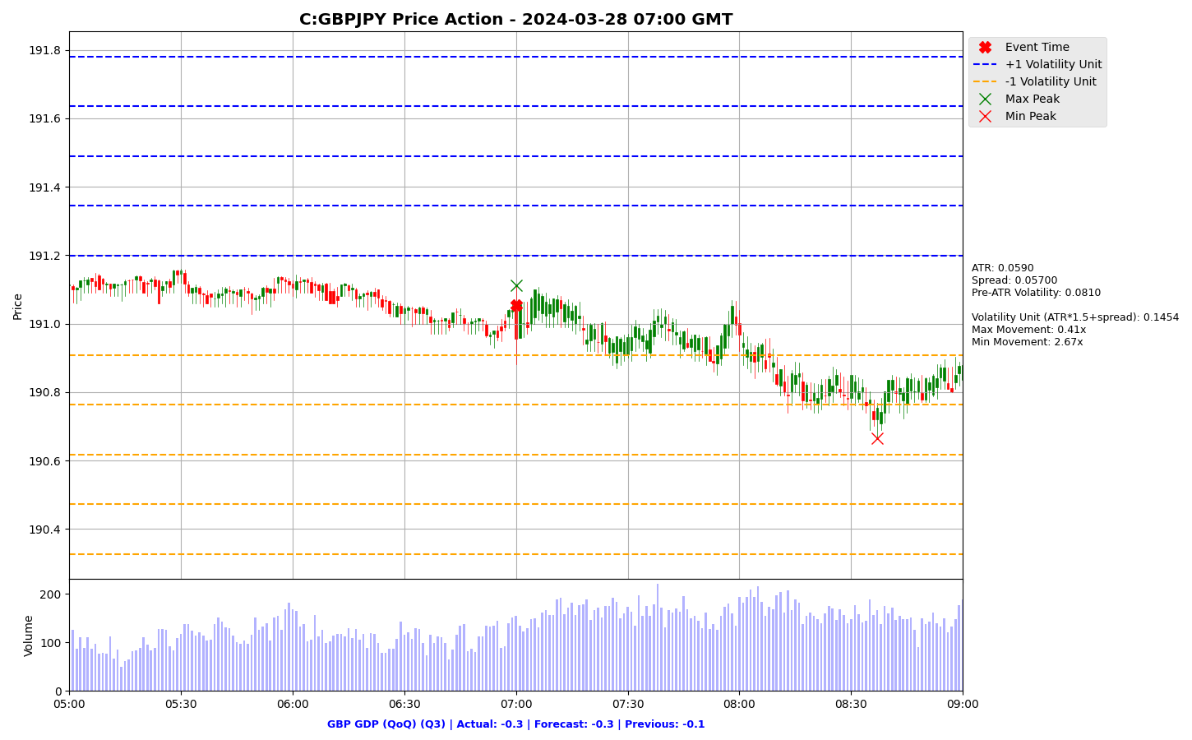

Slide 8
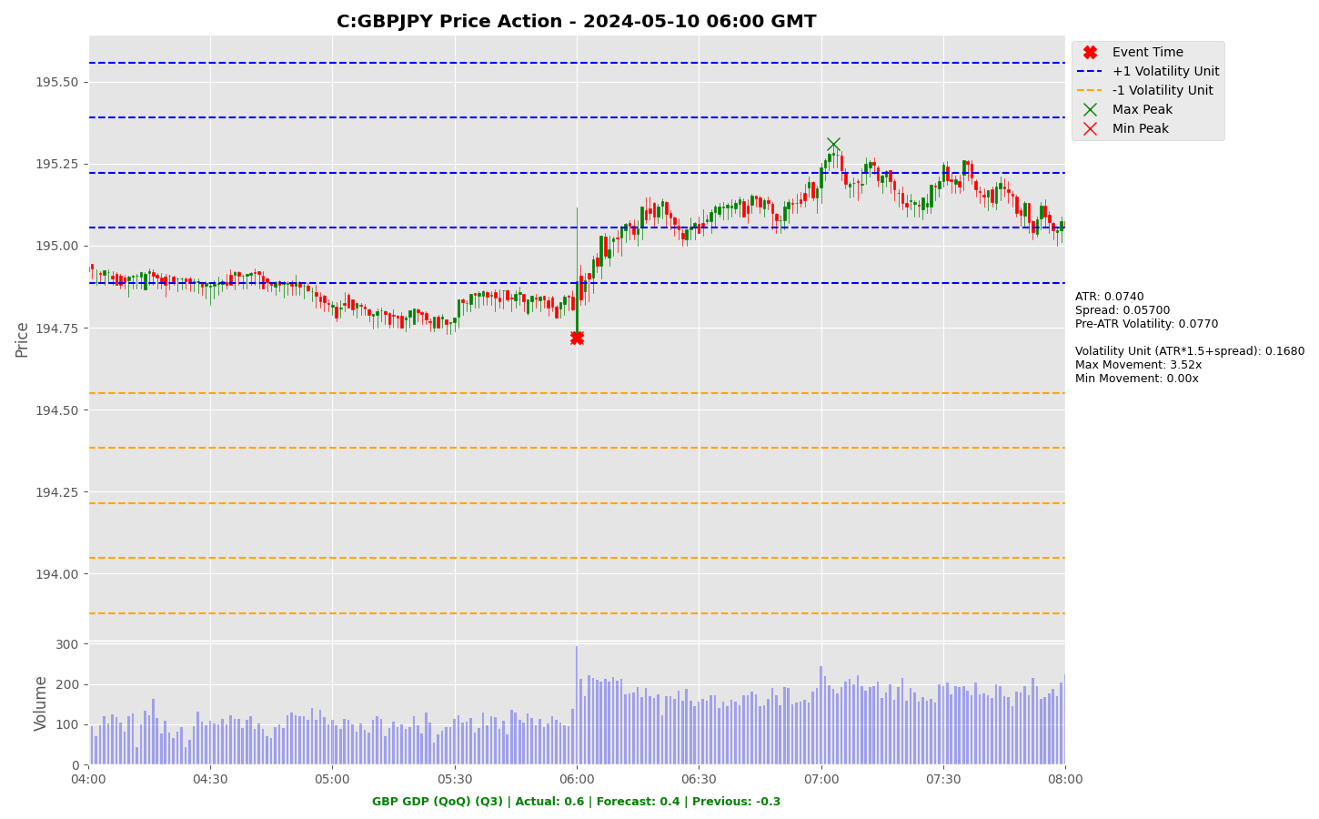

Slide 9
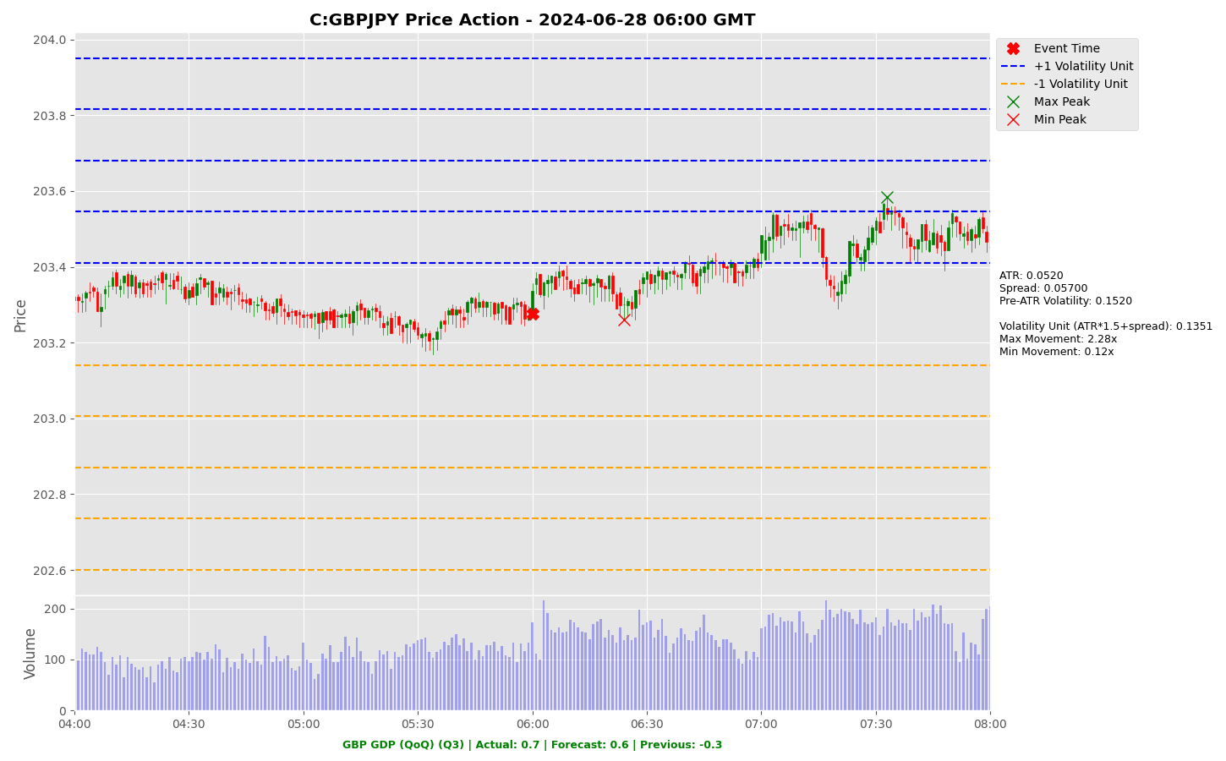

Slide 10
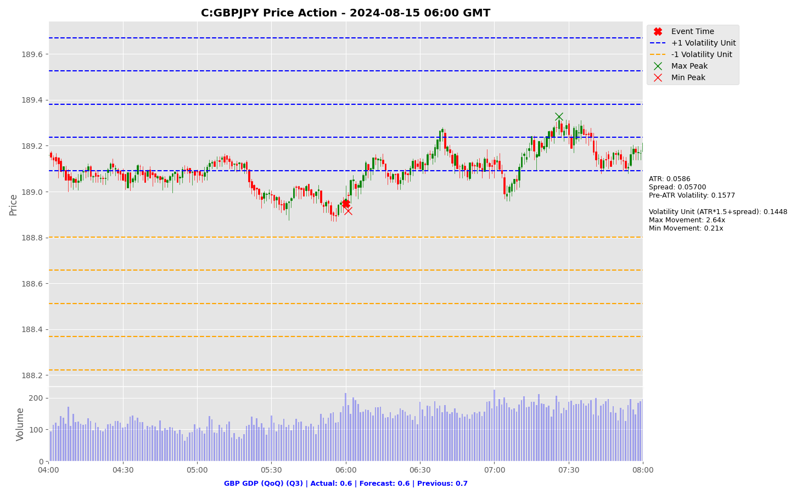

Slide 11
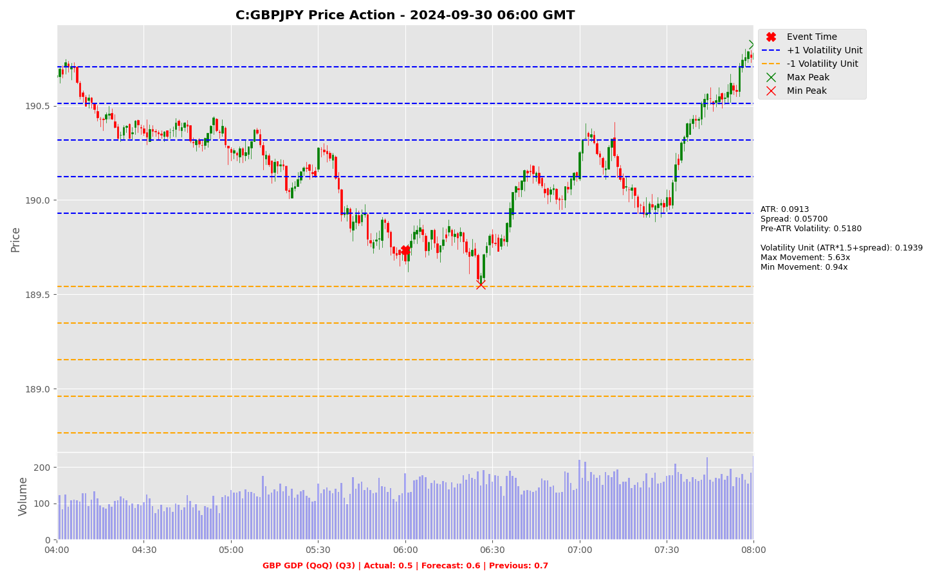

Slide 12
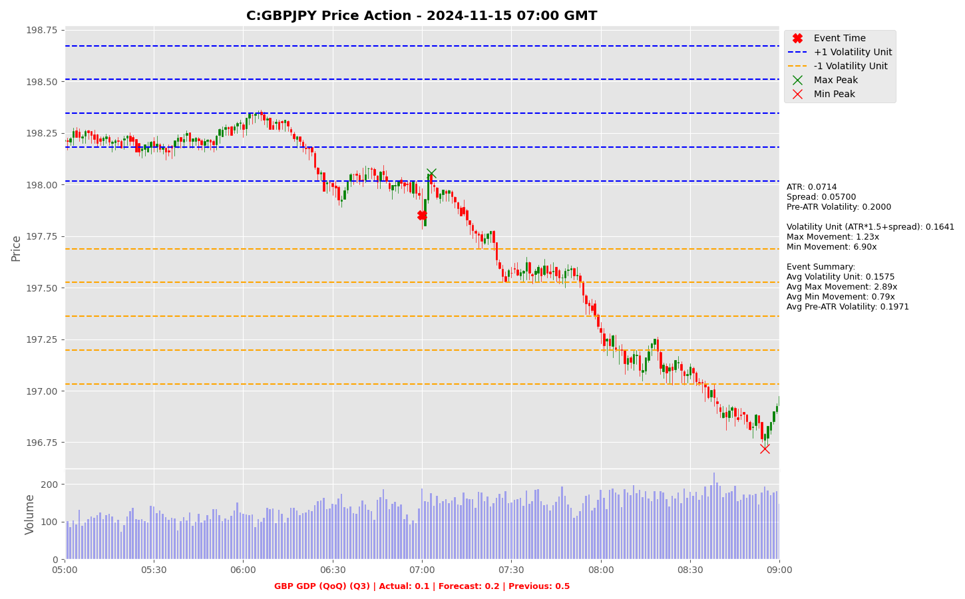

Slide 13
Project Spider Accelerating the Energy Transition 4thMar 2024 Pawan Quantwater Tech Investments
GBP GDP (YoY) (Q3)

Slide 14
GBP GDP (YoY) (Q3)
Event | GBP GDP (YoY) (Q3) |  |  | Description
Actual: |  |  |  | Gross Domestic Product (GDP) gauges the inflation-adjusted value of all goods and services produced within the economy. It is the most comprehensive measure of economic activity and an important indicator of economic health. A reading that is stronger than forecast is generally supportive (bullish) for the GBP, while a weaker than forecast reading is generally negative (bearish) for the GBP. Historical impact on Assets: GBPJPY
Forecast: | 1.0%
Previous: | 0.7%
Time (GMT): | 7:00
Release Date | Actual | Forecast | Previous
15-Nov-24 | 1.0% | 0.1% | 0.7%
30-Sep-24 | 0.7% | 0.9% | 0.3%
15-Aug-24 | 0.9% | 0.9% | 0.3%
28-Jun-24 | 0.3% | 0.2% | -0.2%
10-May-24 | 0.2% | 0.0% | -0.2%
28-Mar-24 | -0.2% | -0.2% | 0.3%

Slide 15
Project Spider Accelerating the Energy Transition 4thMar 2024 Pawan Quantwater Tech Investments
GBP GDP (YoY) (Q3)
GBPJPY

Slide 16
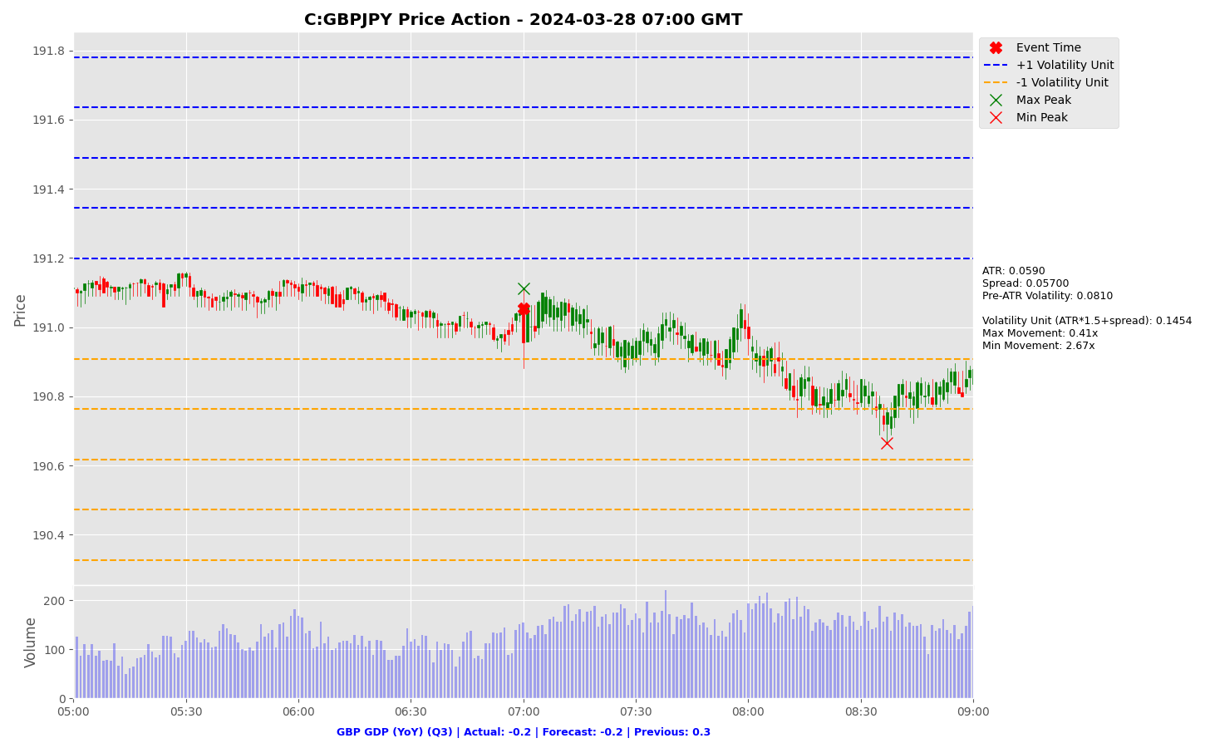

Slide 17


Slide 18


Slide 19


Slide 20


Slide 21
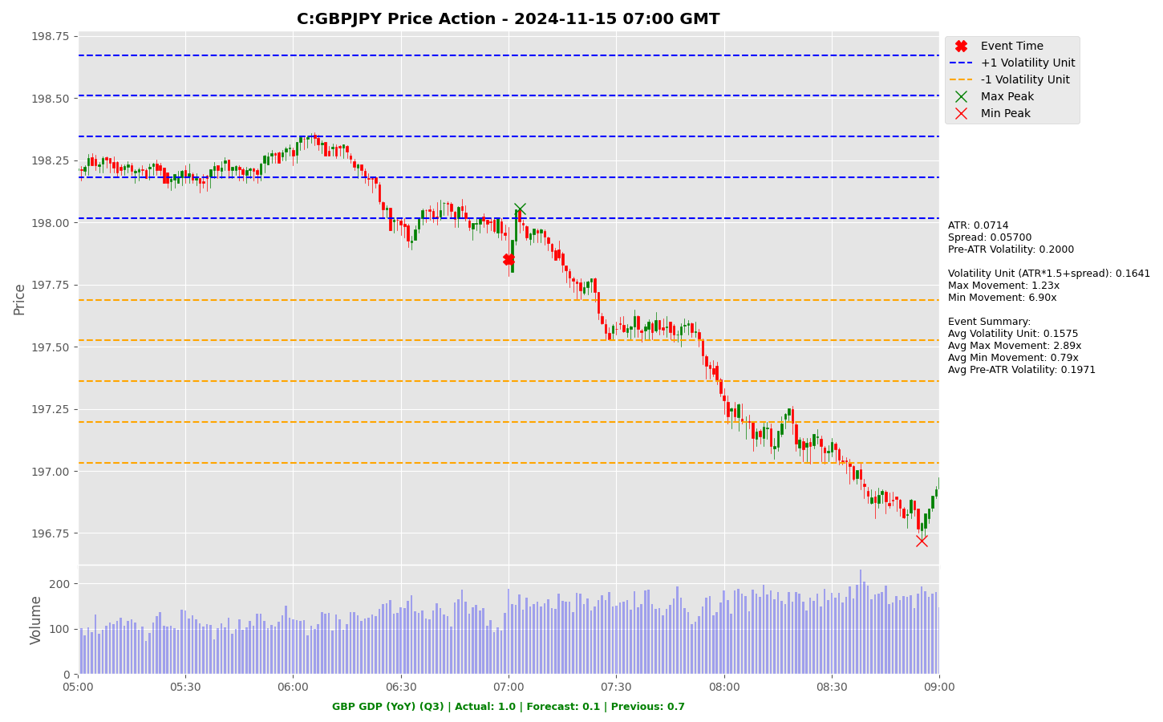

Slide 22
Project Spider Accelerating the Energy Transition 4thMar 2024 Pawan Quantwater Tech Investments
USD CB Consumer Confidence (Dec)

Slide 23
USD CB Consumer Confidence (Dec)
Event | USD CB Consumer Confidence (Dec) |  |  | Description
Actual: |  |  |  | Conference Board (CB) Consumer Confidence measures the level of confidence consumers have in the economy. When consumers are optimistic, they tend to spend more which increases consumption and overall economic growth. A reading that is stronger than forecast is generally supportive (bullish) for the USD, while a weaker than forecast reading is generally negative (bearish) for the USD. Historical impact on Assets: USDJPY
Forecast: | 113.0
Previous: | 111.7
Time (GMT): | 15:00
Release Date | Actual | Forecast | Previous
26-Nov-24 | 111.7 | 111.8 | 109.6
29-Oct-24 | 108.7 | 99.5 | 99.2
24-Sep-24 | 98.7 | 103.9 | 105.6
27-Aug-24 | 103.3 | 100.9 | 101.9
30-Jul-24 | 100.3 | 99.7 | 97.8
25-Jun-24 | 100.4 | 100.0 | 101.3

Slide 24
Project Spider Accelerating the Energy Transition 4thMar 2024 Pawan Quantwater Tech Investments
USD CB Consumer Confidence (Dec)
USDJPY

Slide 25
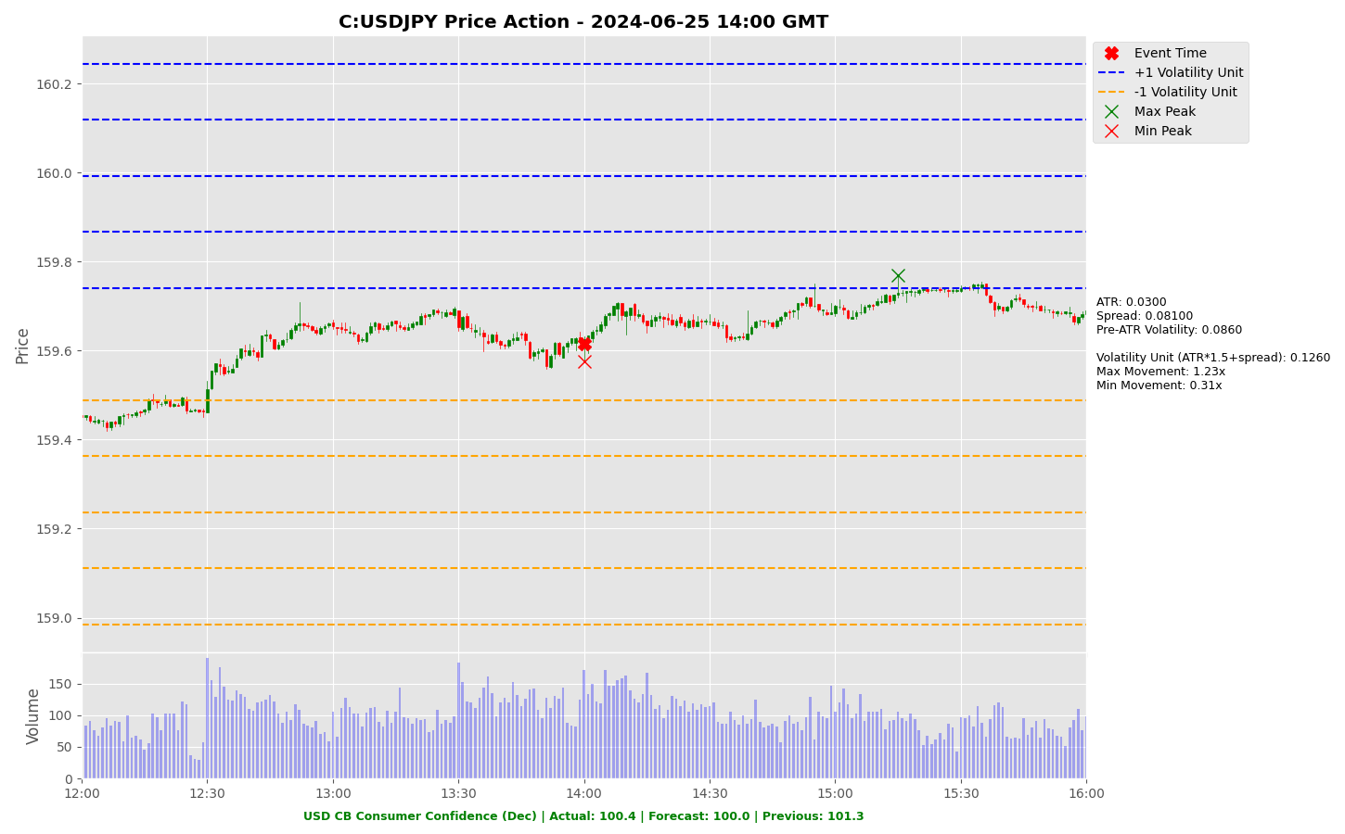

Slide 26
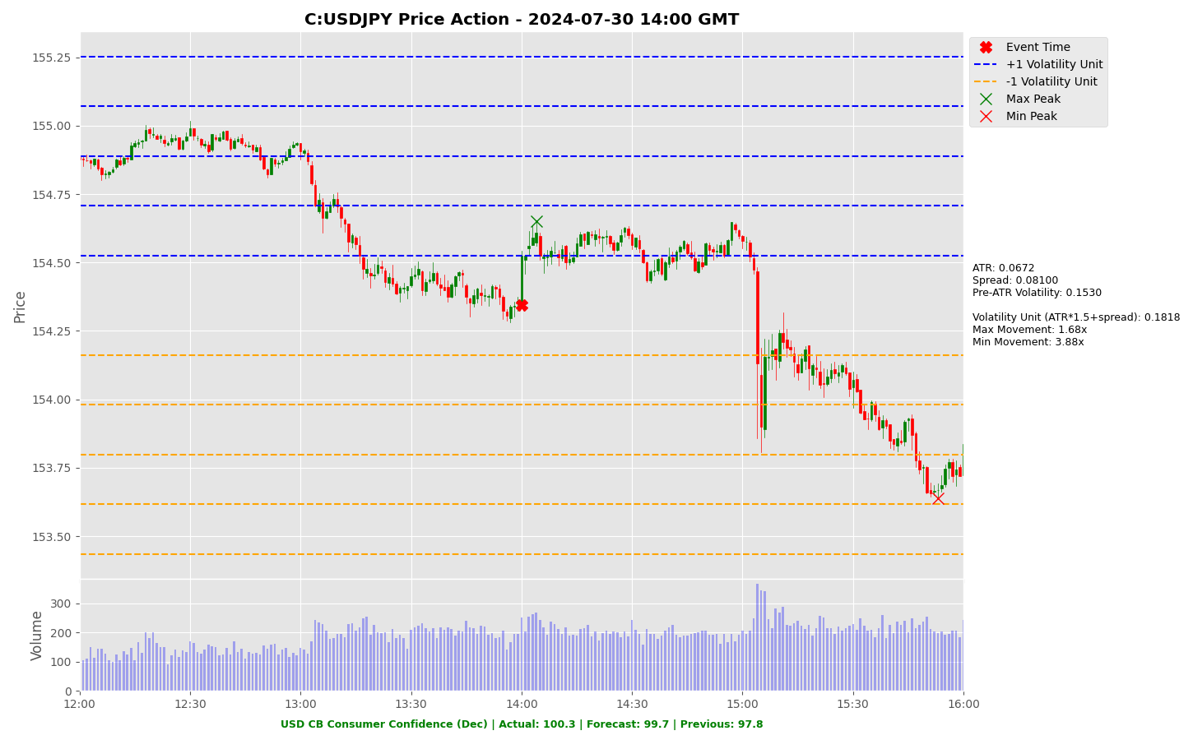

Slide 27
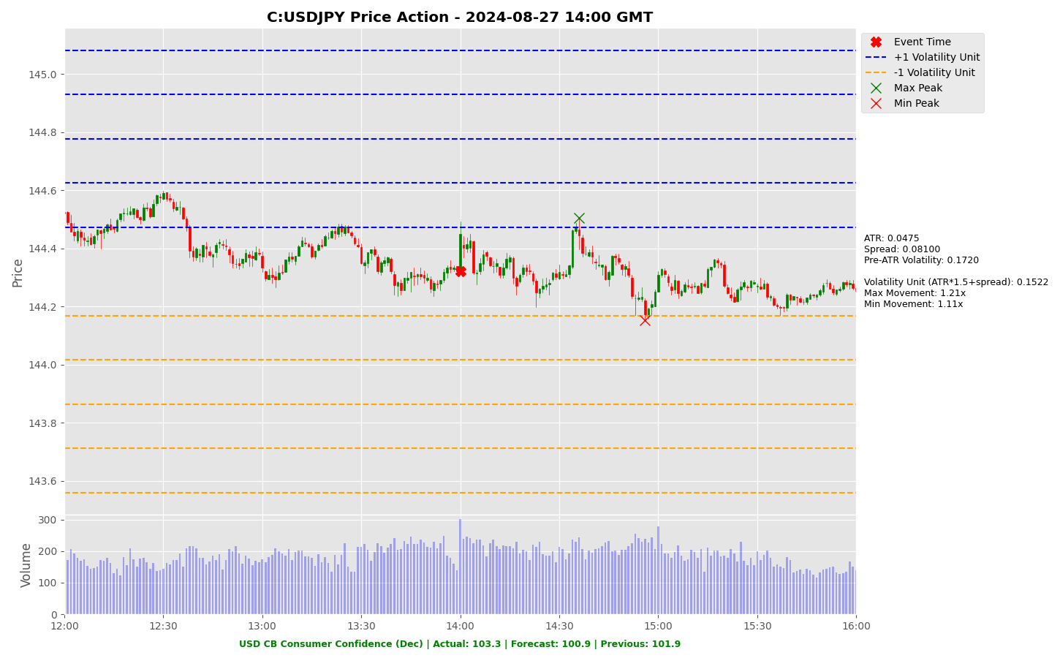

Slide 28
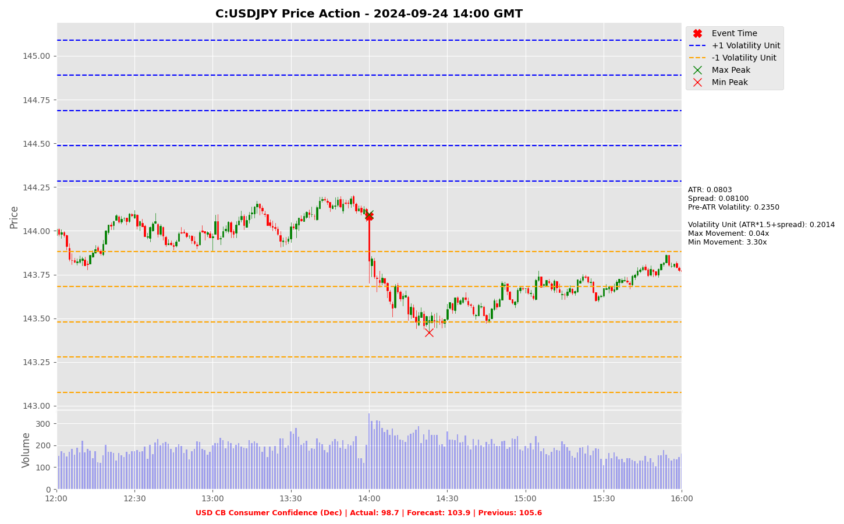

Slide 29
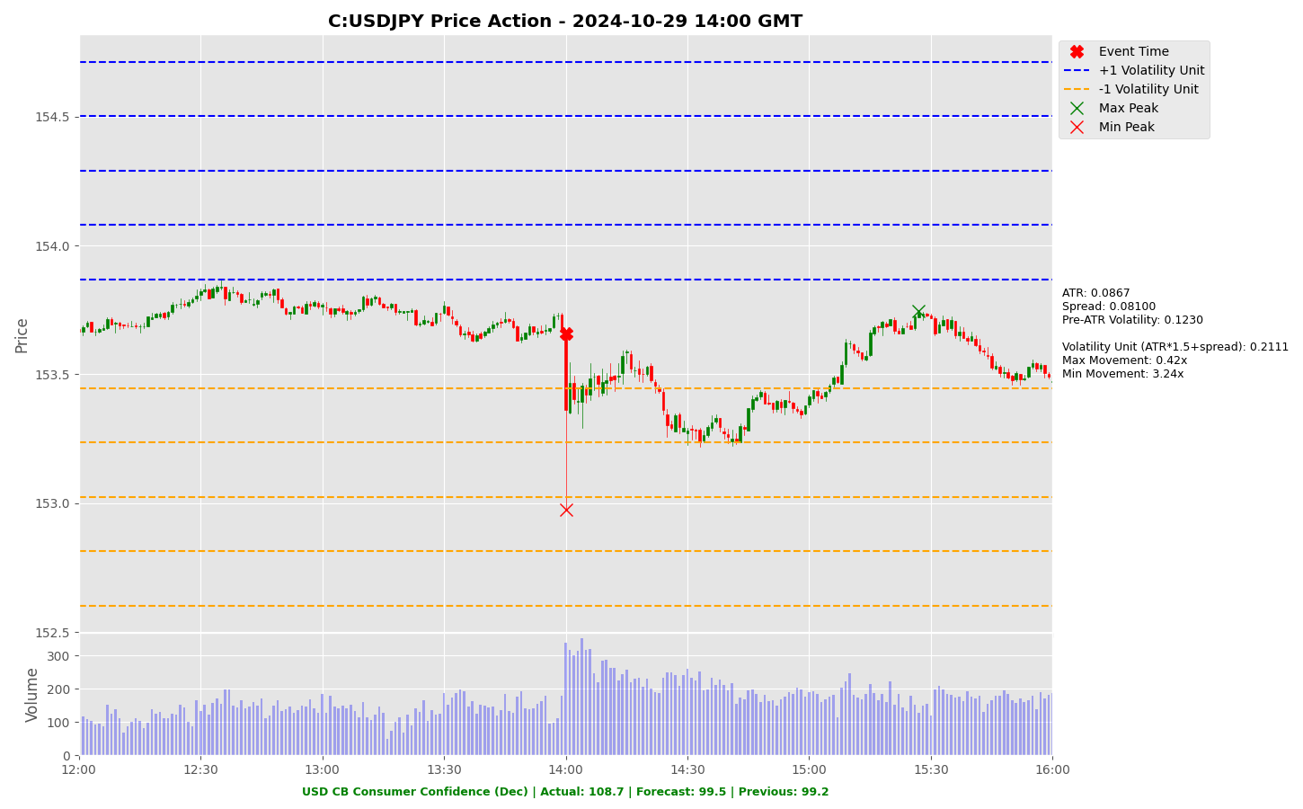

Slide 30
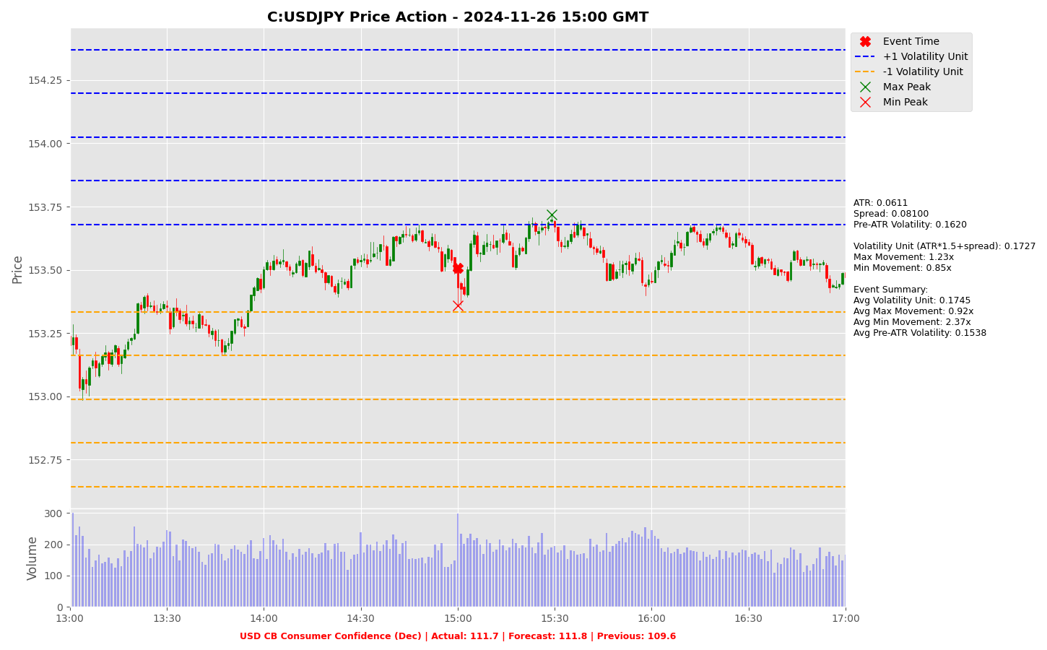

Slide 31
Project Spider Accelerating the Energy Transition 4thMar 2024 Pawan Quantwater Tech Investments
USD Durable Goods Orders (MoM)
(Nov) P

Slide 32
USD Durable Goods Orders (MoM) (Nov) P
Event | USD Durable Goods Orders (MoM) (Nov) P |  |  | Description
Actual: |  |  |  | Durable Goods Orders reports the change in the total value of new orders for long lasting manufactured goods, including transportation items. A reading that is stronger than forecast is generally supportive (bullish) for the USD, while a weaker than forecast reading is generally negative (bearish) for the USD. Historical impact on Assets: USDJPY
Forecast: | -0.4%
Previous: | 0.2%
Time (GMT): | 13:30
Release Date | Actual | Forecast | Previous
27-Nov-24 | 0.2% | -0.8% | -0.4%
25-Oct-24 | -0.8% | -1.1% | -0.8%
26-Sep-24 | 0.0% | -2.8% | 9.9%
26-Aug-24 | 9.9% | 4.0% | -6.9%
25-Jul-24 | -6.6% | 0.3% | 0.1%
27-Jun-24 | 0.1% | -0.5% | 0.2%

Slide 33
Project Spider Accelerating the Energy Transition 4thMar 2024 Pawan Quantwater Tech Investments
USD Durable Goods Orders (MoM)
(Nov) P
USDJPY

Slide 34
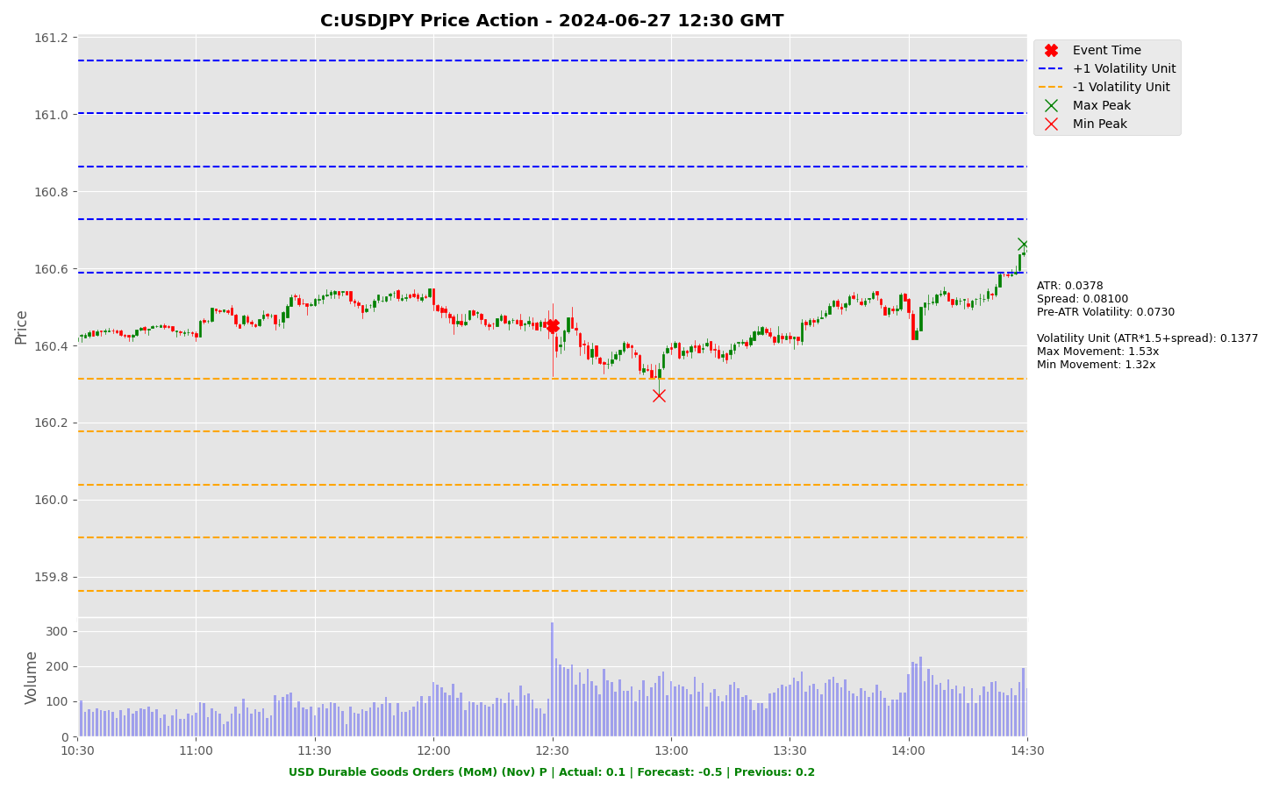

Slide 35
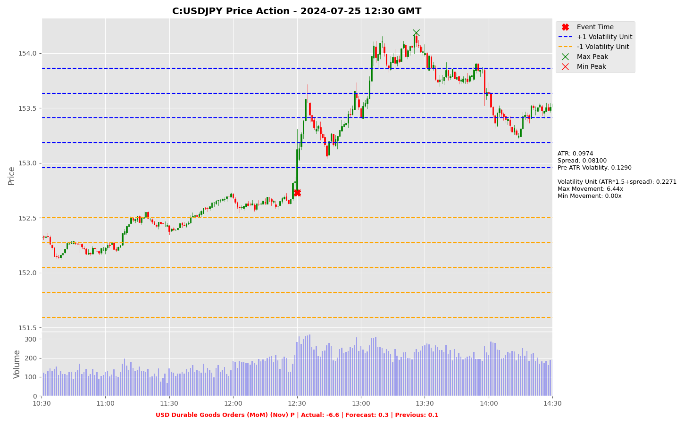

Slide 36
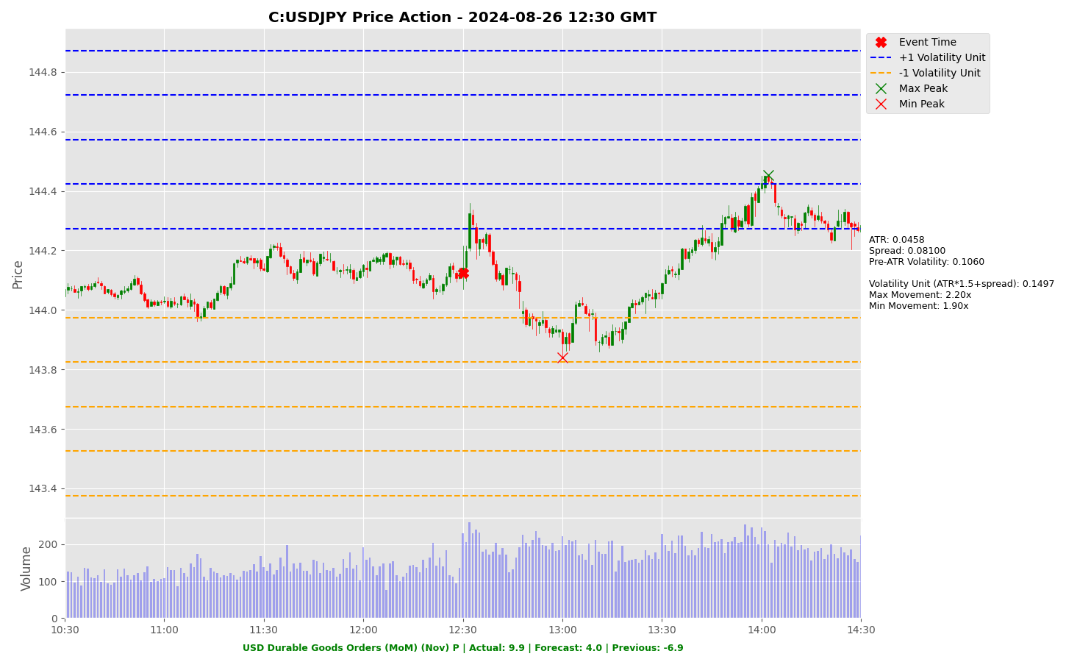

Slide 37
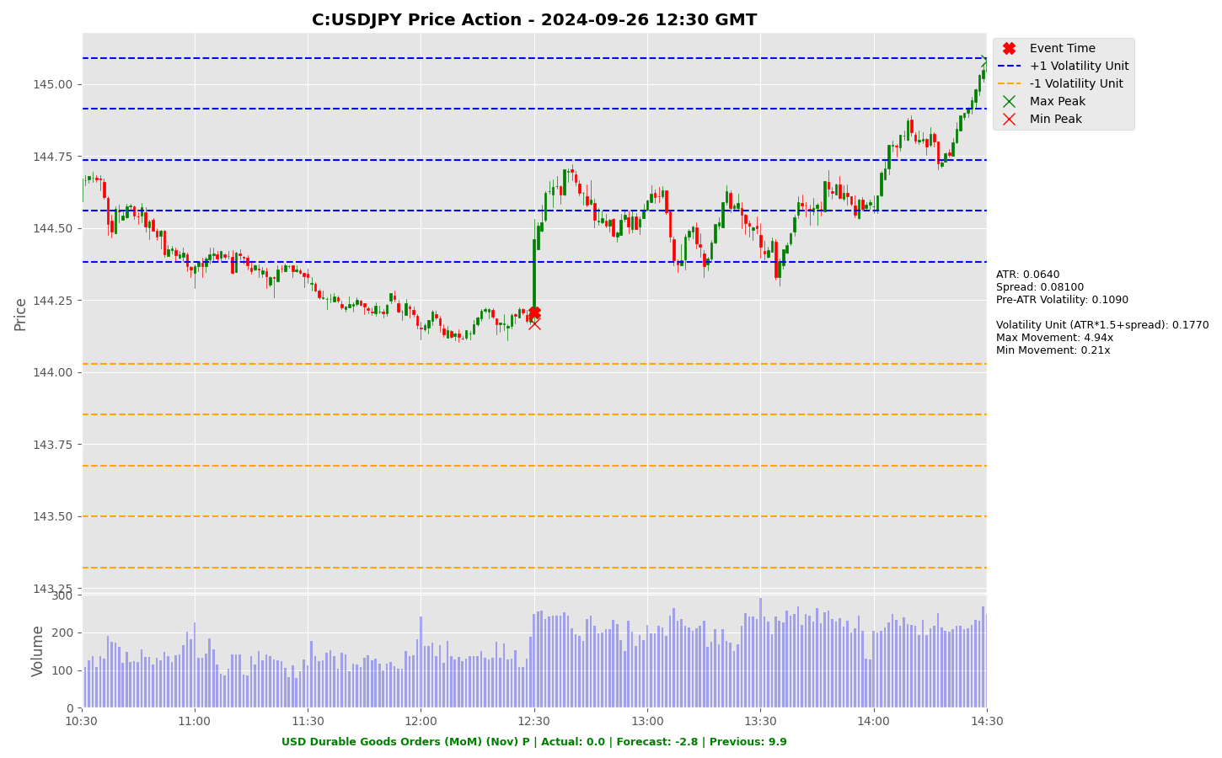

Slide 38
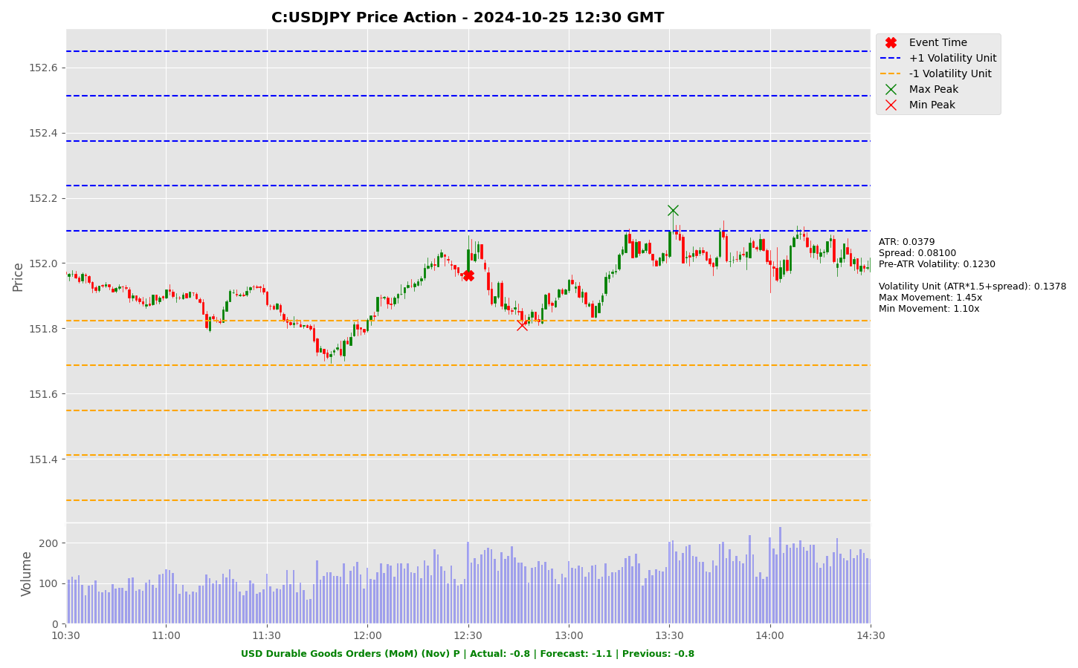

Slide 39
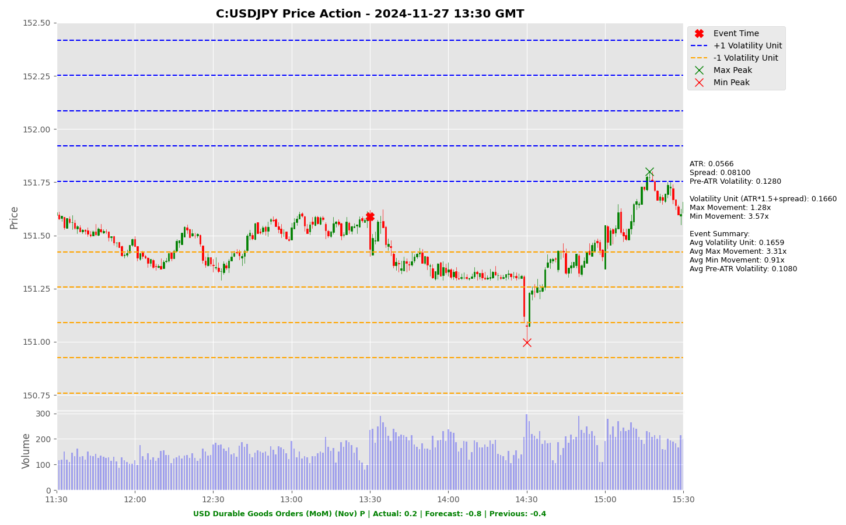

Slide 40
Project Spider Accelerating the Energy Transition 4thMar 2024 Pawan Quantwater Tech Investments
USD New Homes Sales (Nov)

Slide 41
USD New Homes Sales (Nov)
Event | USD New Homes Sales (Nov) |  |  | Description
Actual: |  |  |  | New Home Sales measures the annualised number of new single-family homes that were sold during the prior month. When it's released ahead of Existing Home Sales, this report tends to have more impact because the two reports are highly correlated. A reading that is stronger than forecast is generally supportive (bullish) for the USD, while a weaker than forecast reading is generally negative (bearish) for the USD. Historical impact on Assets: USDJPY
Forecast: | 650K
Previous: | 610K
Time (GMT): | 15:00
Release Date | Actual | Forecast | Previous
26-Nov-24 | 610 | 725 | 738
24-Oct-24 | 738 | 719 | 709
25-Sep-24 | 716 | 699 | 751
23-Aug-24 | 739 | 624 | 668
24-Jul-24 | 617 | 639 | 621
26-Jun-24 | 619 | 636 | 698

Slide 42
Project Spider Accelerating the Energy Transition 4thMar 2024 Pawan Quantwater Tech Investments
USD New Homes Sales (Nov)
USDJPY

Slide 43
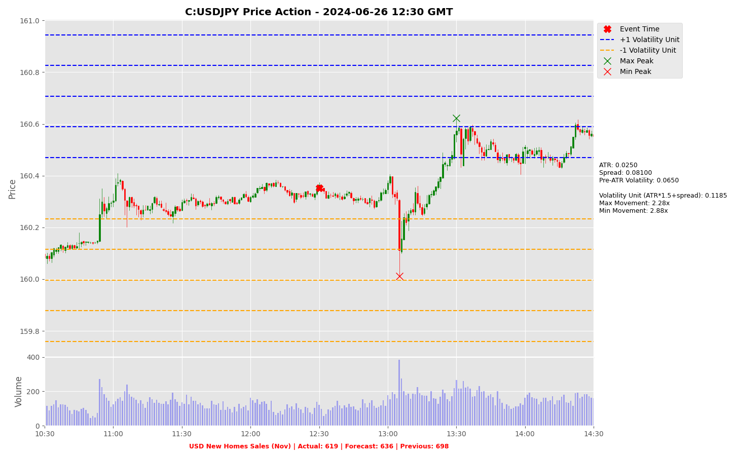

Slide 44
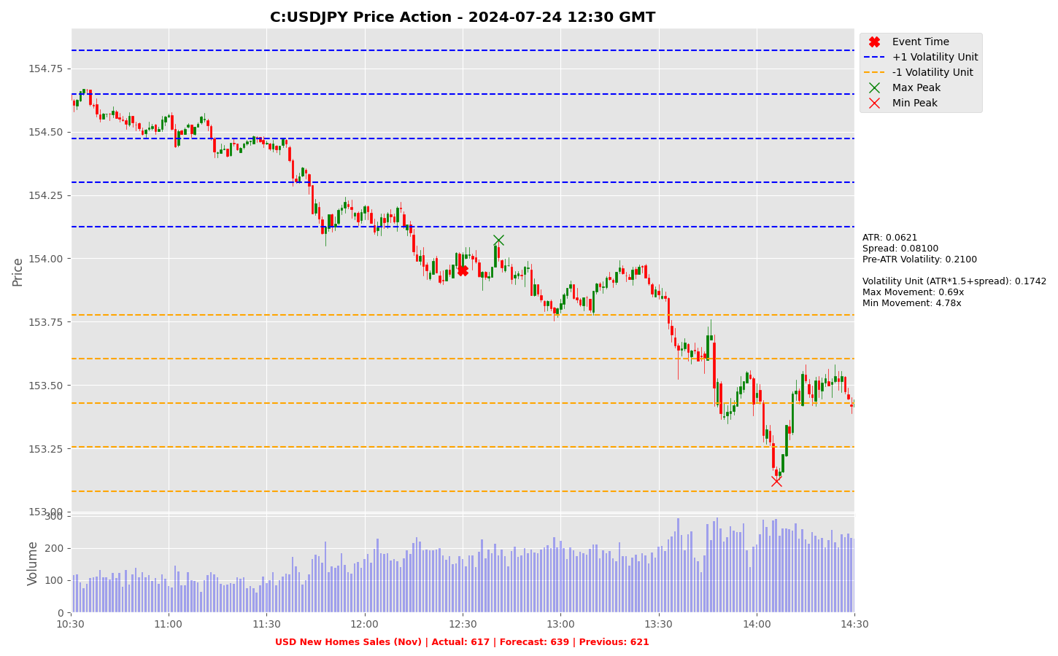

Slide 45
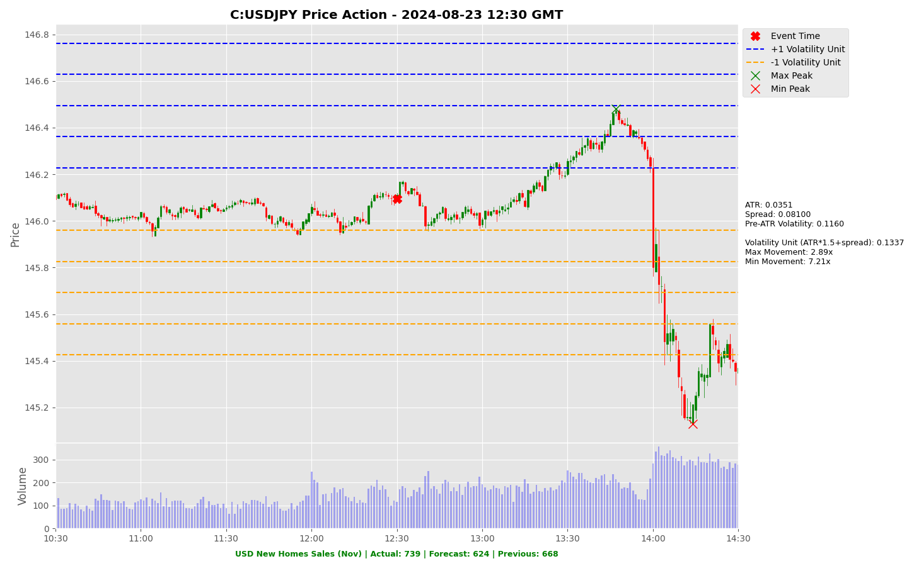

Slide 46
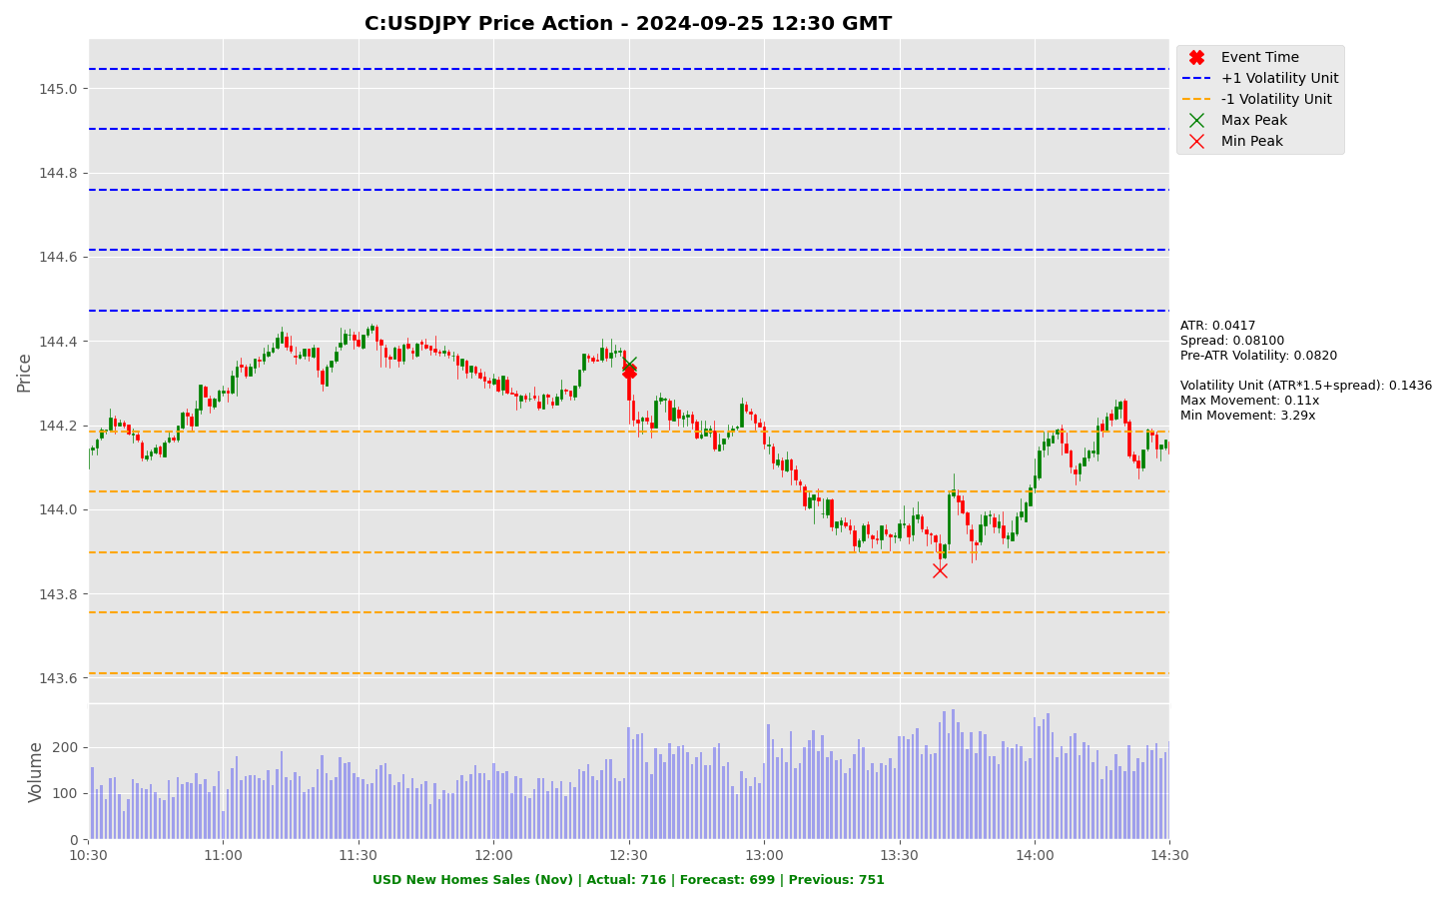

Slide 47
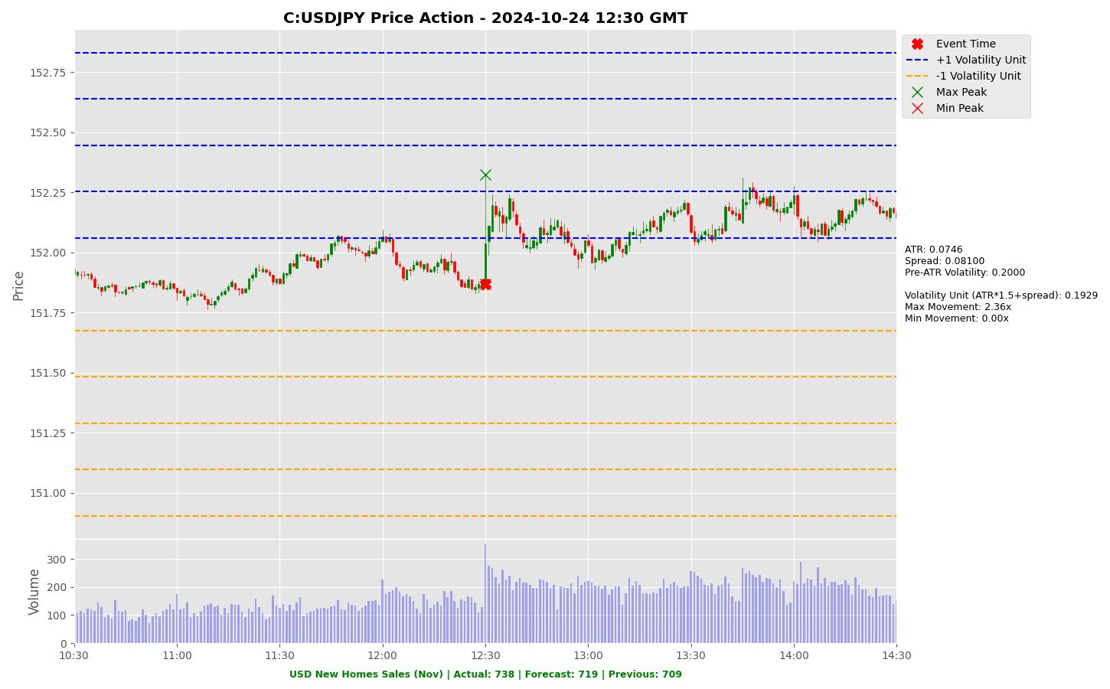

Slide 48
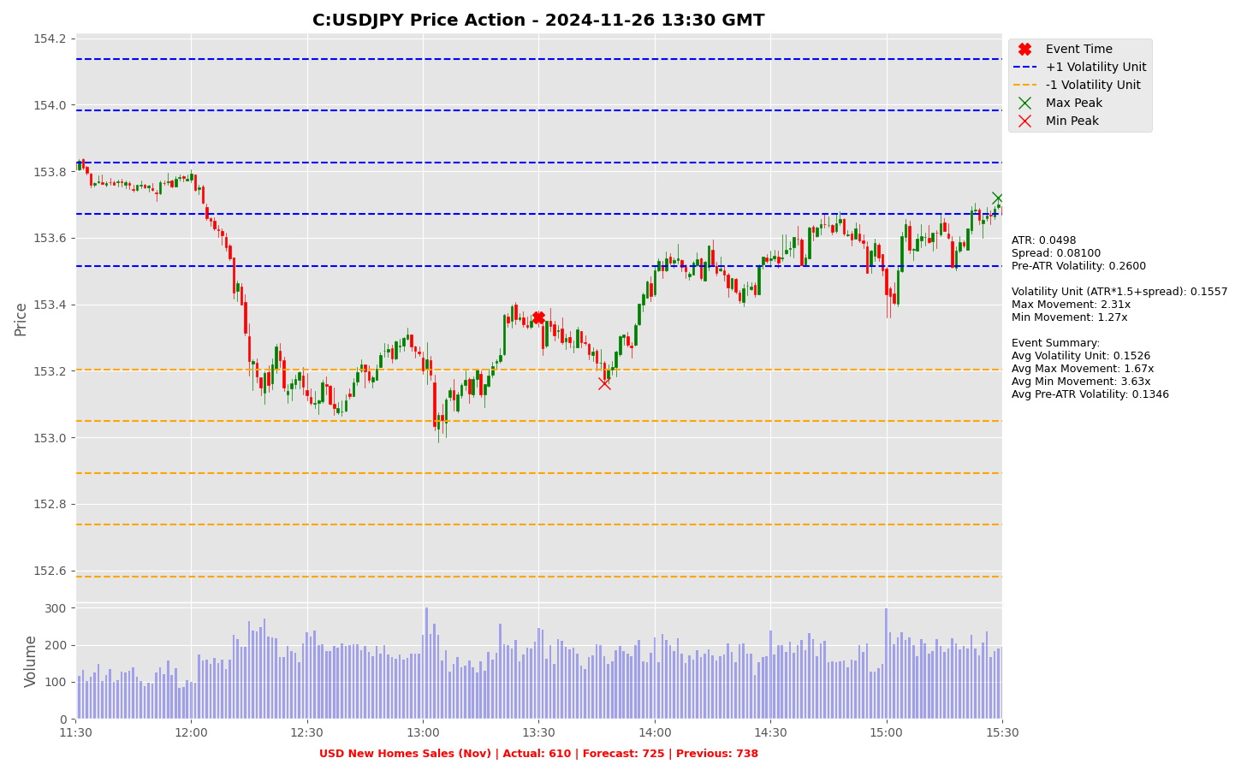

Slide 49
Project Spider Accelerating the Energy Transition 4thMar 2024 Pawan Quantwater Tech Investments
USD Initial Jobless Claims

Slide 50
USD Initial Jobless Claims
Event | USD Initial Jobless Claims |  |  | Description
Actual: |  |  |  | Initial Jobless Claims measures the number of people who filed for unemployment insurance for the first time during the past week. This is the most timely U.S. economic data, but the market impact varies from week to week. A reading that is higher than forecast is generally negative (bearish) for the USD, while a lower than forecast reading is generally supportive (bullish) for the USD. Historical impact on Assets: USDJPY
Forecast:
Previous: | 220K
Time (GMT): | 13:30
Release Date | Actual | Forecast | Previous
19-Dec-24 | 220 | 229 | 242
12-Dec-24 | 242 | 221 | 225
05-Dec-24 | 224 | 215 | 215
27-Nov-24 | 213 | 215 | 215
21-Nov-24 | 213 | 220 | 219
14-Nov-24 | 217 | 224 | 221

Slide 51
Project Spider Accelerating the Energy Transition 4thMar 2024 Pawan Quantwater Tech Investments
USD Initial Jobless Claims
USDJPY

Slide 52
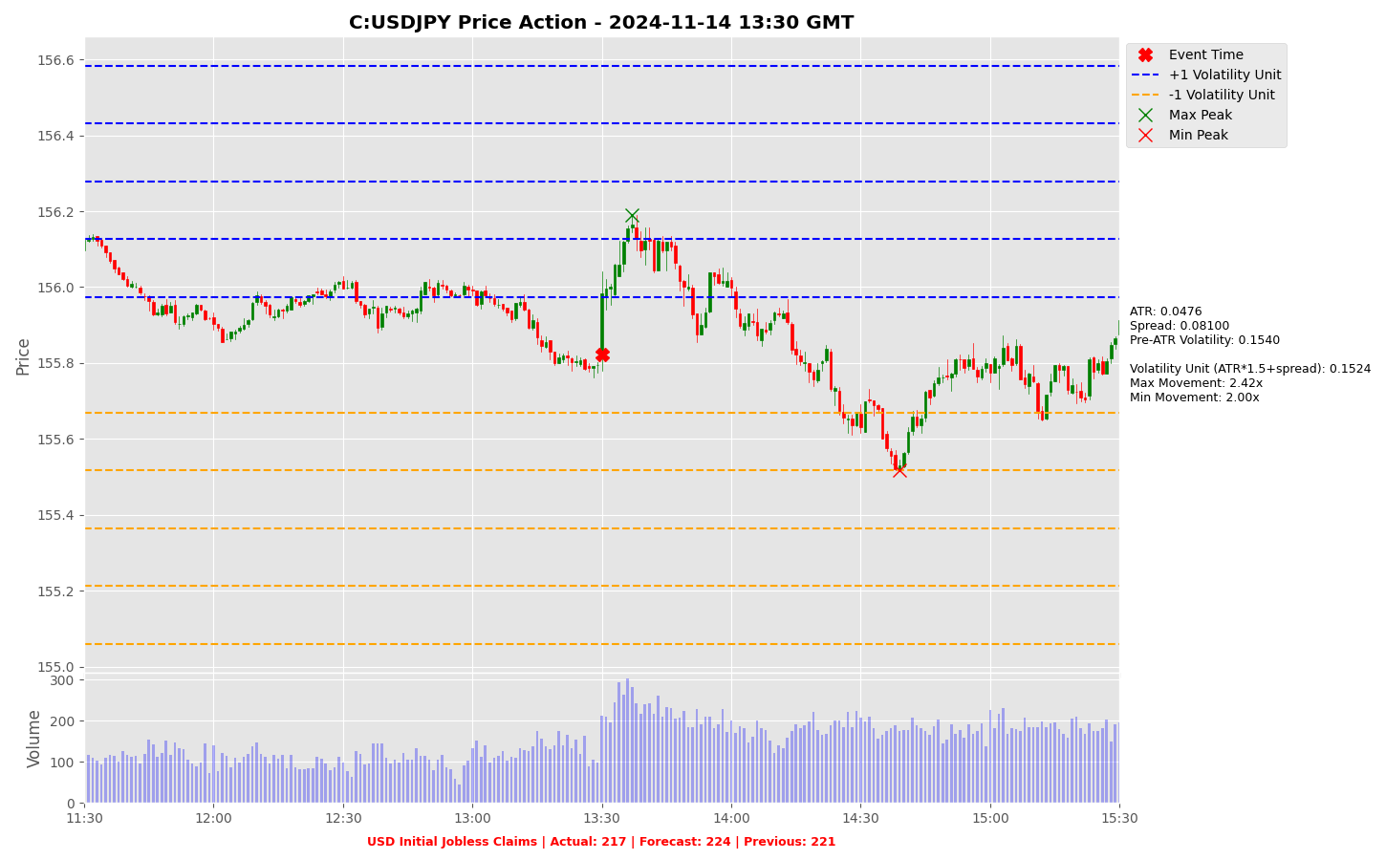

Slide 53
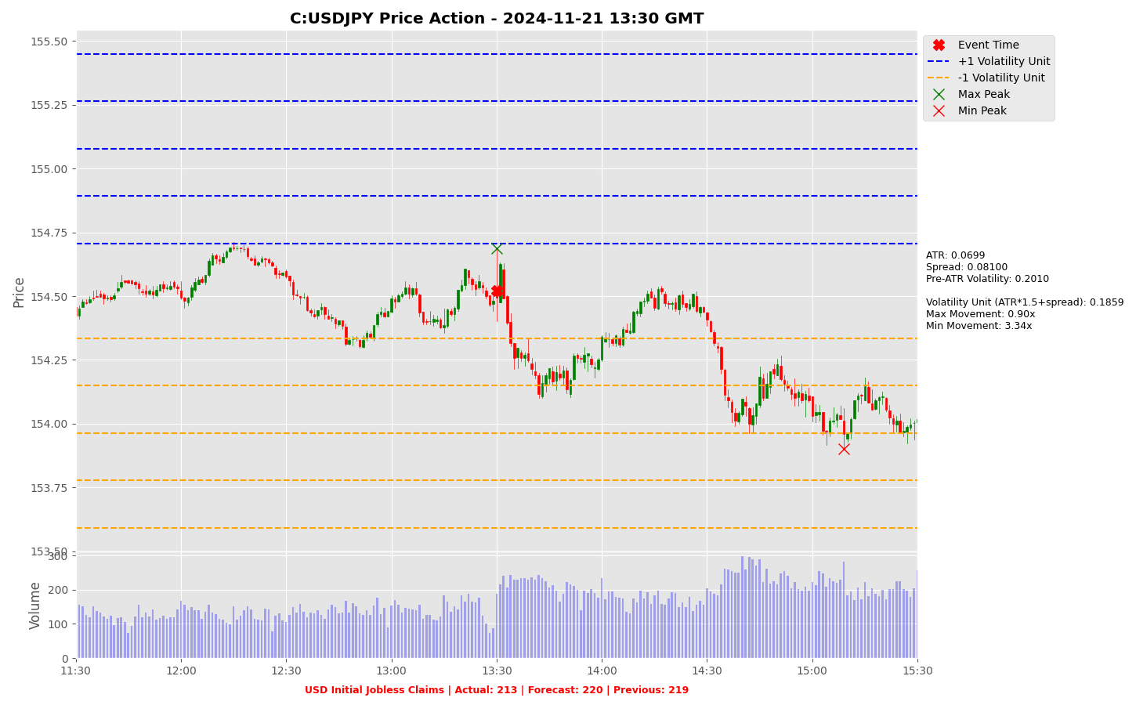

Slide 54
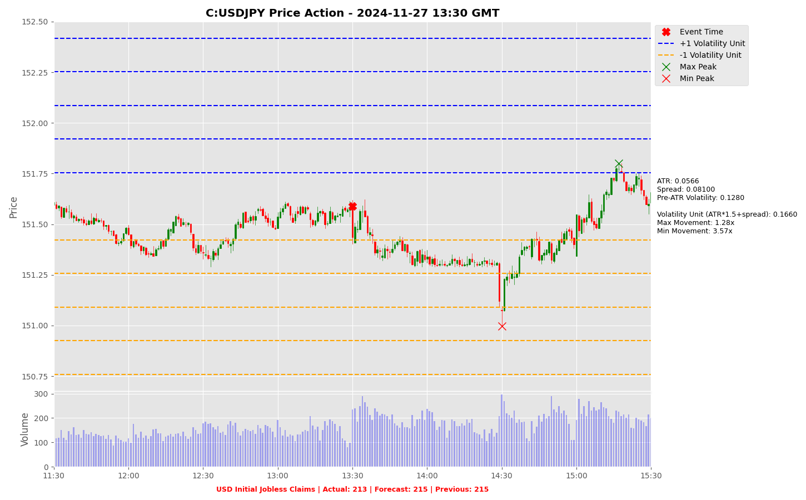

Slide 55
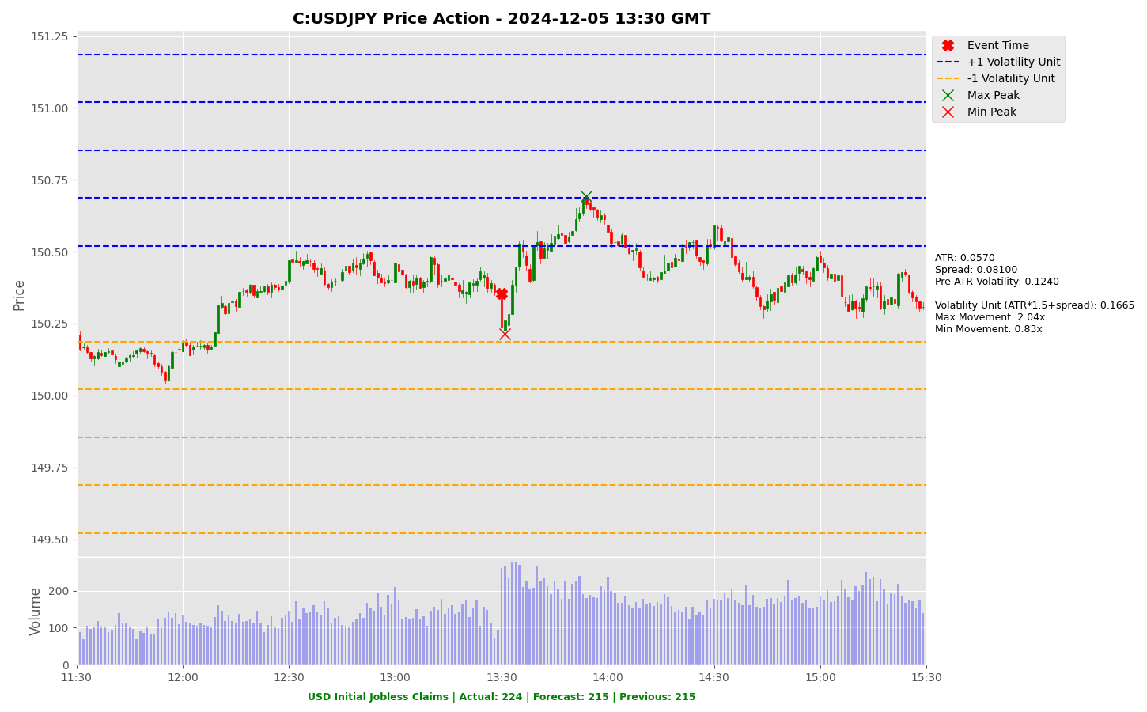

Slide 56
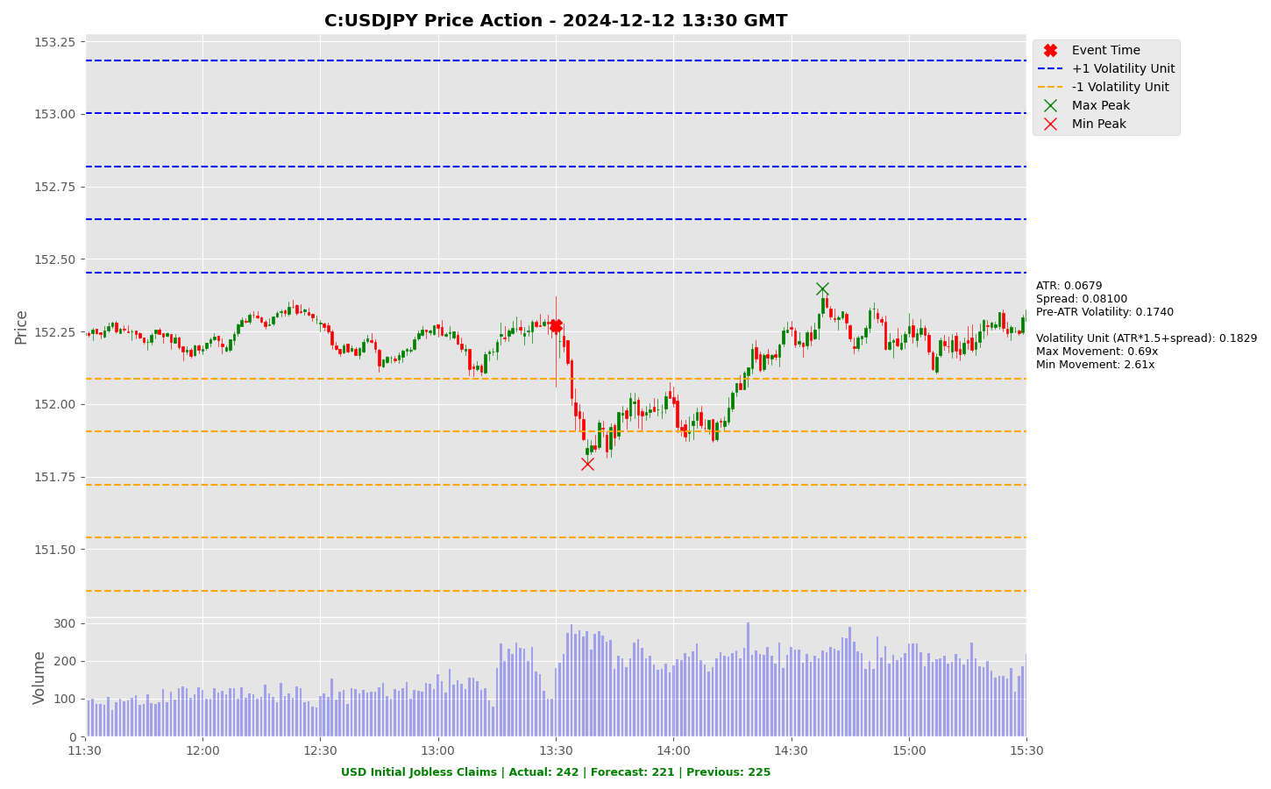

Slide 57
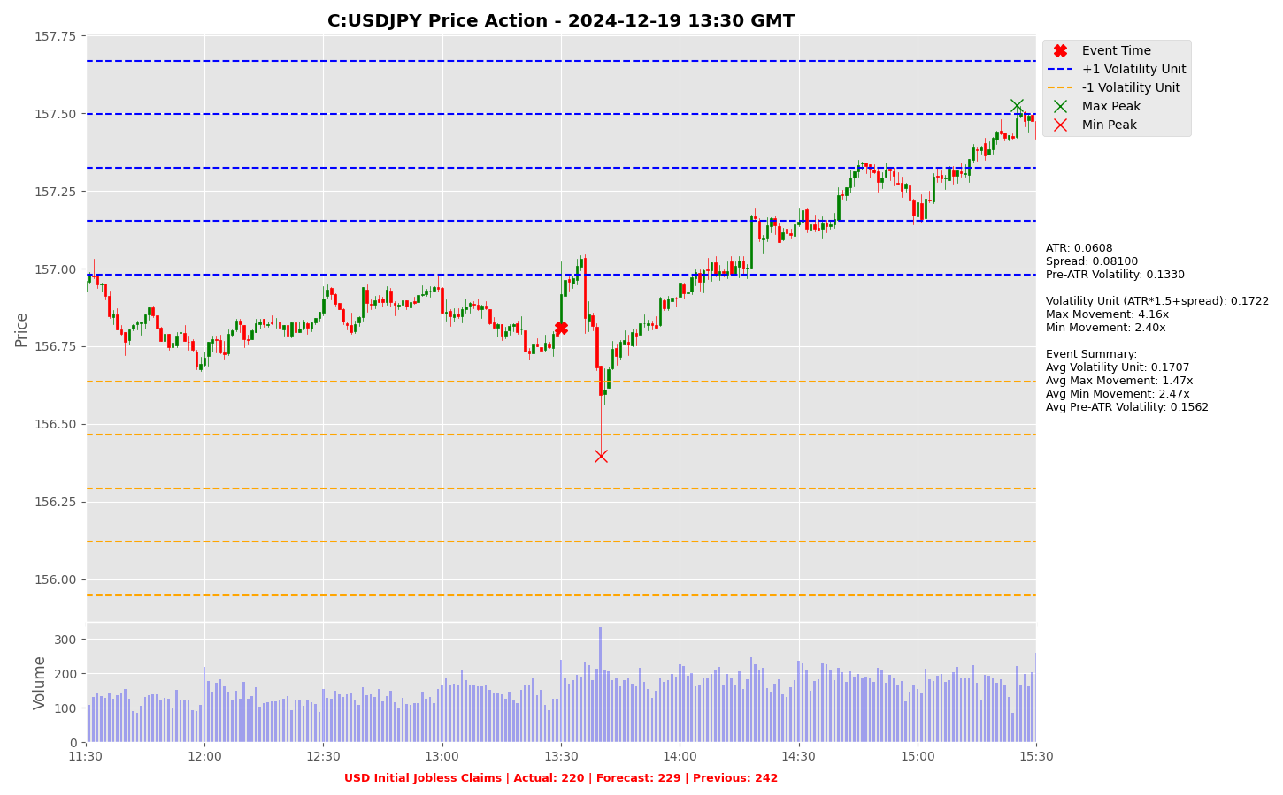

Slide 58
Project Spider Accelerating the Energy Transition 4thMar 2024 Pawan Quantwater Tech Investments
Crude Oil Inventories

Slide 59
Crude Oil Inventories
Event | Crude Oil Inventories |  |  | Description
Actual: |  |  |  | The Energy Information Administration's (EIA) Crude Oil Inventories measures the weekly change in the number of barrels of commercial crude oil held by US firms. The level of inventories influences the price of petroleum products, which can have an impact on inflation. If the increase in crude inventories is more than expected, it implies weaker demand and is bearish for crude prices. The same can be said if a decline in inventories is less than expected. If the increase in crude is less than expected, it implies greater demand and is bullish for crude prices. The same can be said if a decline in inventories is more than expected. Historical impact on Assets: USOILRoll
Forecast:
Previous: | -0.934M
Time (GMT): | 16:00
Release Date | Actual | Forecast | Previous
18-Dec-24 | -0.934 | -1.600 | -1.425
11-Dec-24 | -1.425 | -1.000 | -5.073
04-Dec-24 | -5.073 | -1.600 | -1.84
27-Nov-24 | -1.84 | -1.30 | 0.545
20-Nov-24 | 0.545 | 0.400 | 2.089
14-Nov-24 | 2.089 | 0.400 | 2.149

Slide 60
Project Spider Accelerating the Energy Transition 4thMar 2024 Pawan Quantwater Tech Investments
Crude Oil Inventories
USDJPY

Slide 61
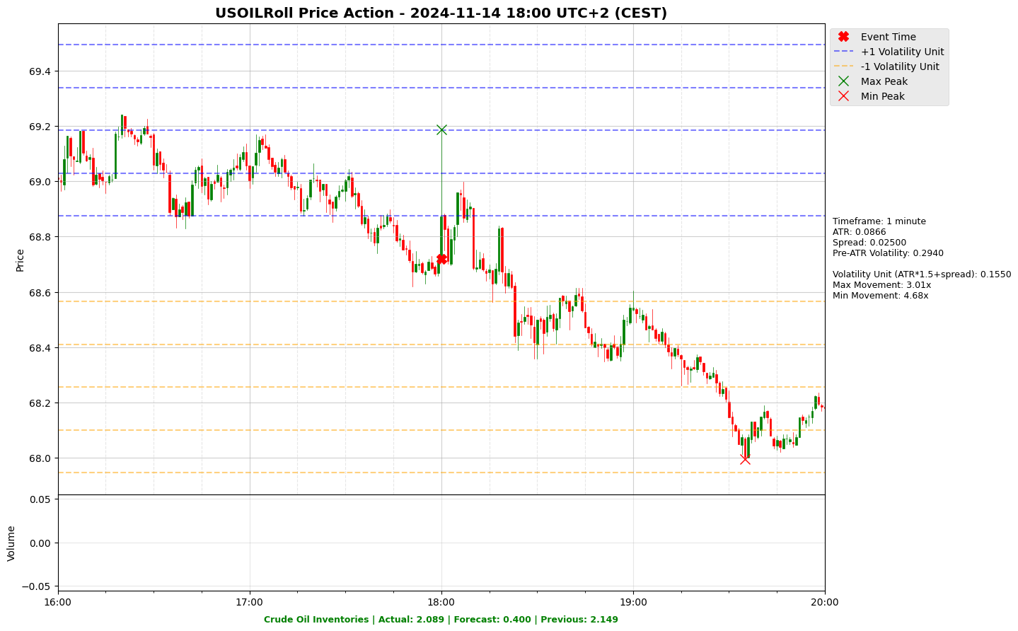

Slide 62
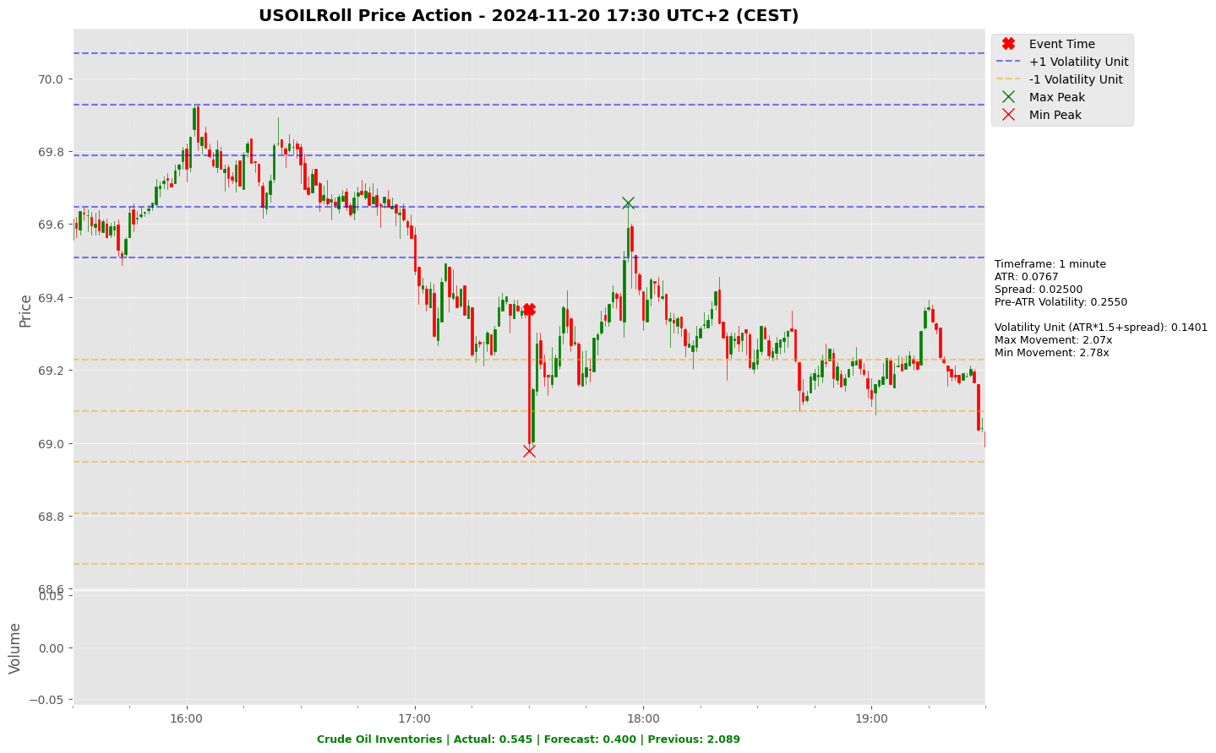

Slide 63
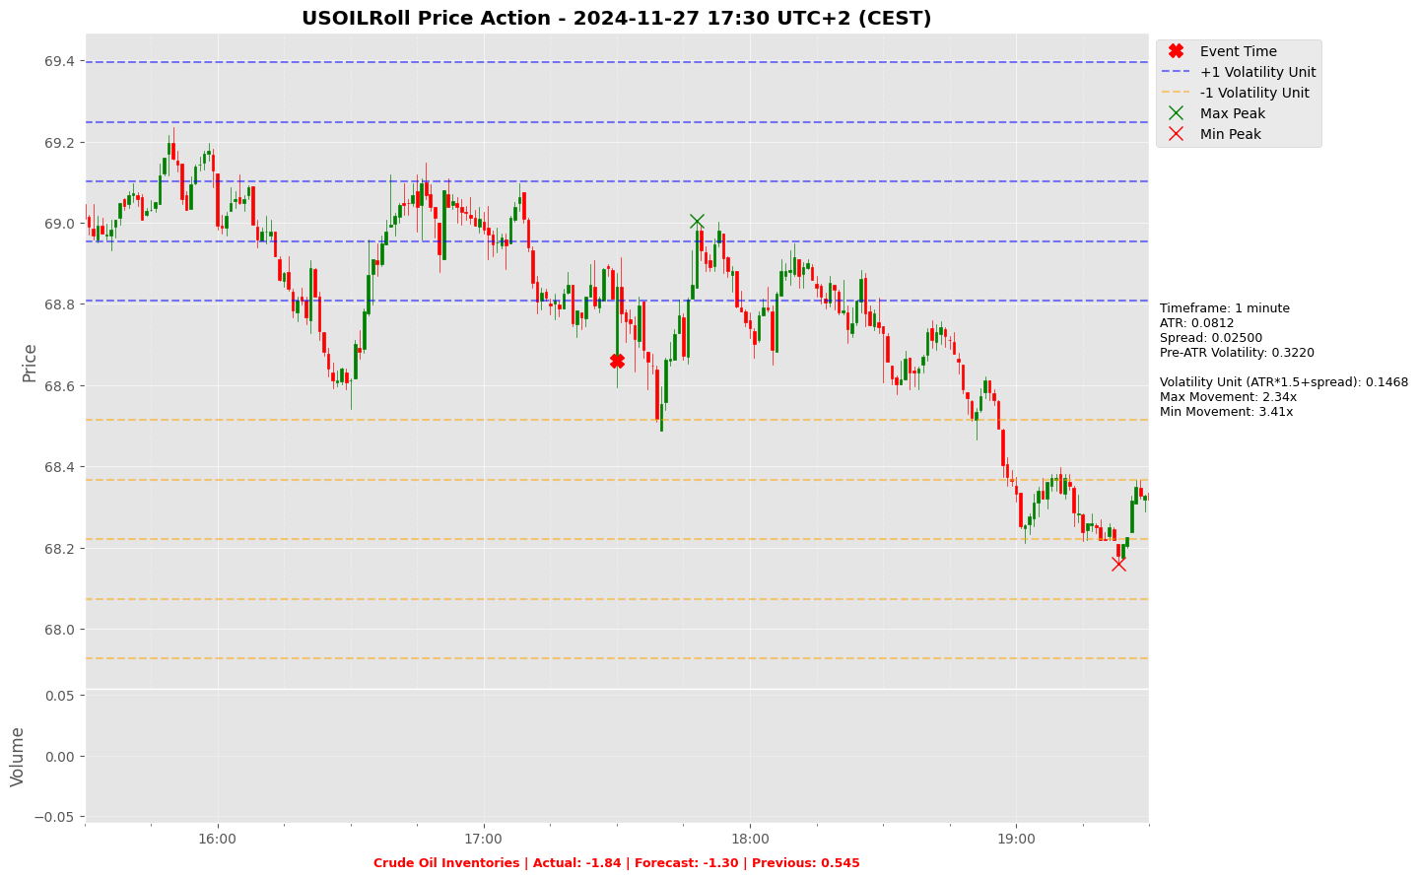

Slide 64
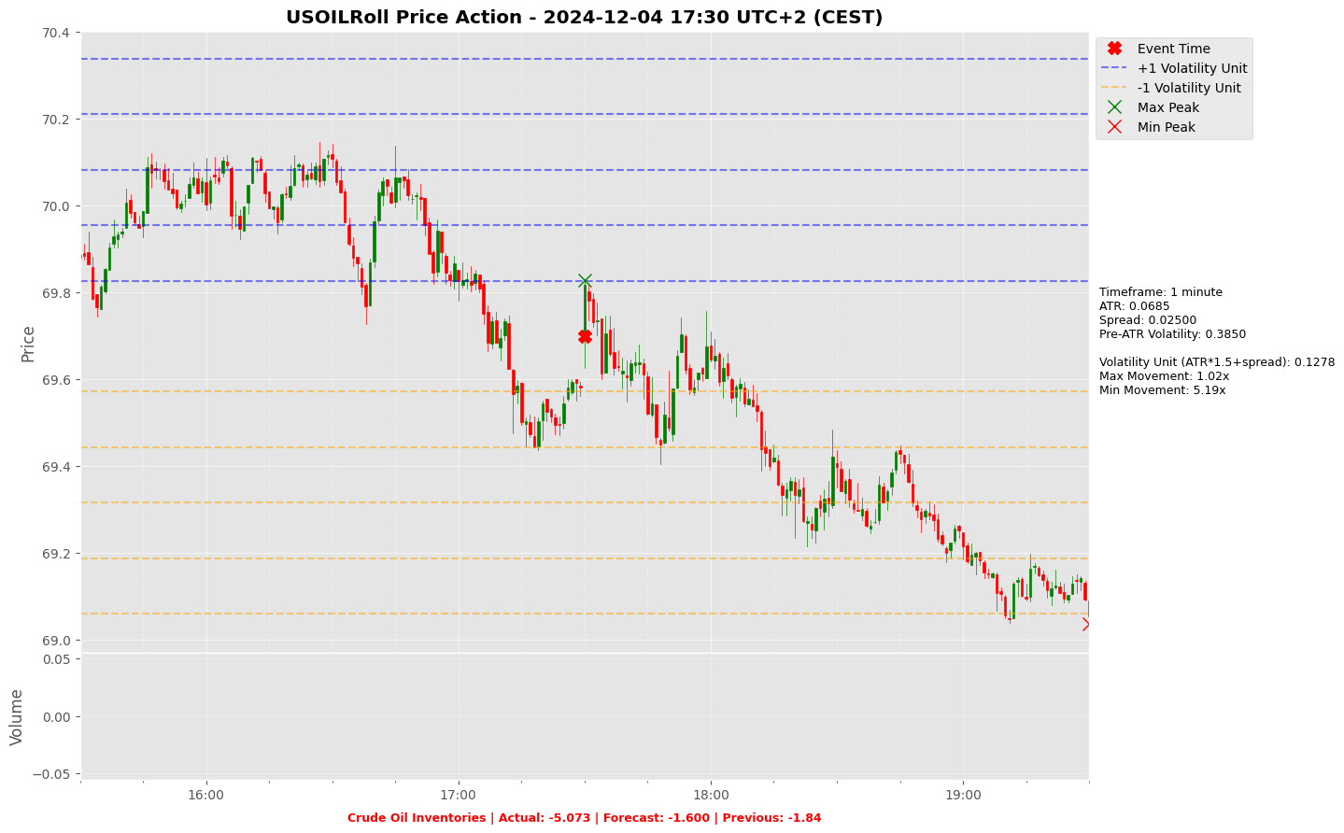

Slide 65
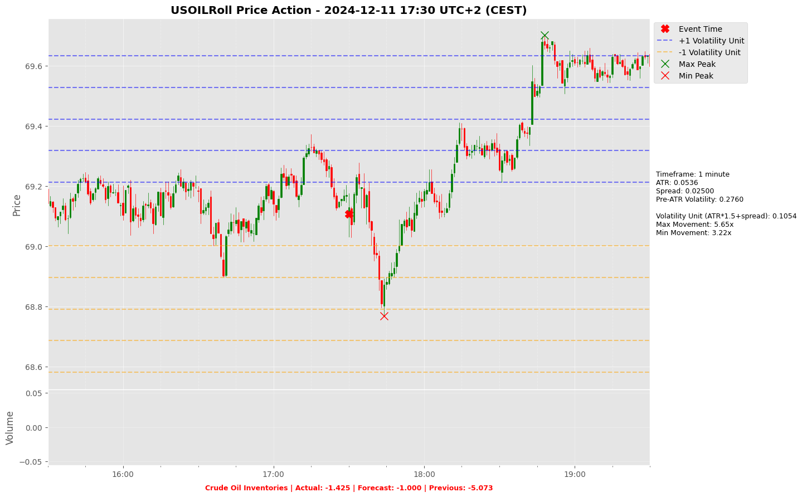

Slide 66
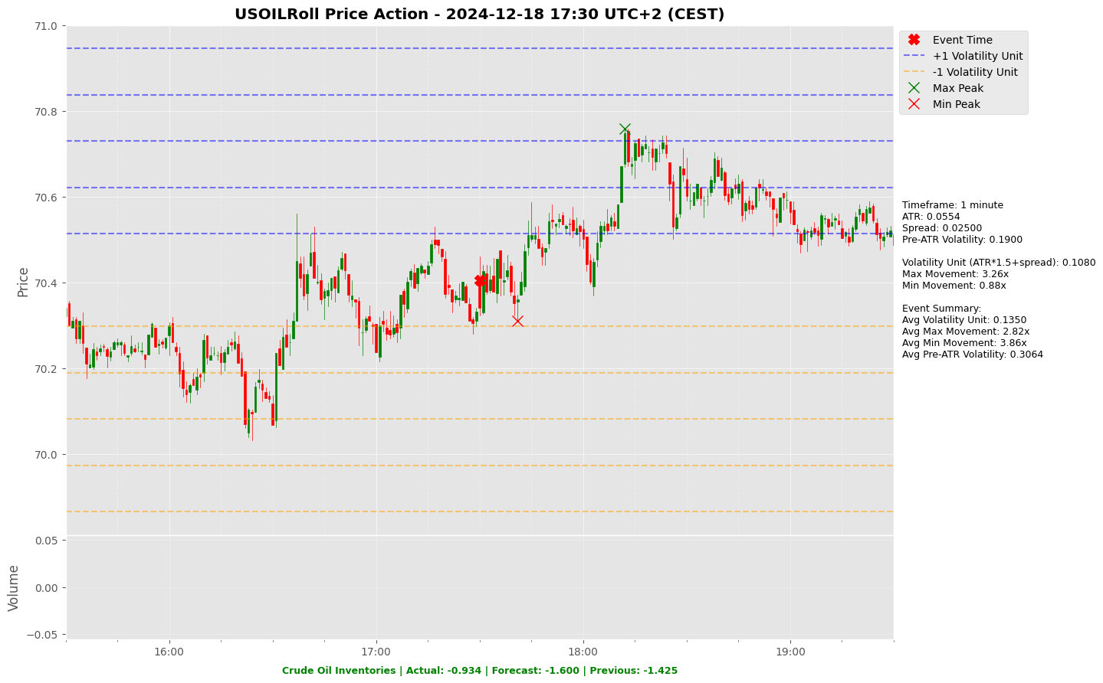

Slide 67
Appendix: Key Economic & Analytical Concepts
Economic Data Interpretation
Price Movements
Forecast Vs. Actual: Comparing predicted values with released data
Previous Reading: Last reported value, used as a benchmark
Market Impact: How releases affect financial markets
Max Movement: Largest upward price move after event
Min Movement: Largest downward price move after event
Both measured in Volatility Units
Average True Range (ATR)
Using This Analysis
Definition: A technical indicator that measures market volatility
Calculations:
Calculate True Range (TR) for each period:
TR = max [(high - low), abs(high – previous close), abs(low – previous close)]
ATR = Simple moving average of TR over N periods (typically 14)
Interpretation:
Higher ATR = Higher Volatility
Lower ATR = Lower Volatility
Usage in Our Analysis:
Helps standardize price movements across different market conditions
Forms the basis of our Volatility Unit Calculations
Analyze volatility across different economic releases
Identify patterns in market reactions
Assess importance of economic indicators based on market impact
Volatility Unit
Resources
Formula: (ATR * multiple) + Spread (multiple is typically 1.5)
Purpose: Standardizes price movements
https://github.com/pawan-pro/quantwater-tech-investments/blob/main/RiskEventTrader
https://quantwater.tech/research
[]

Slide 68
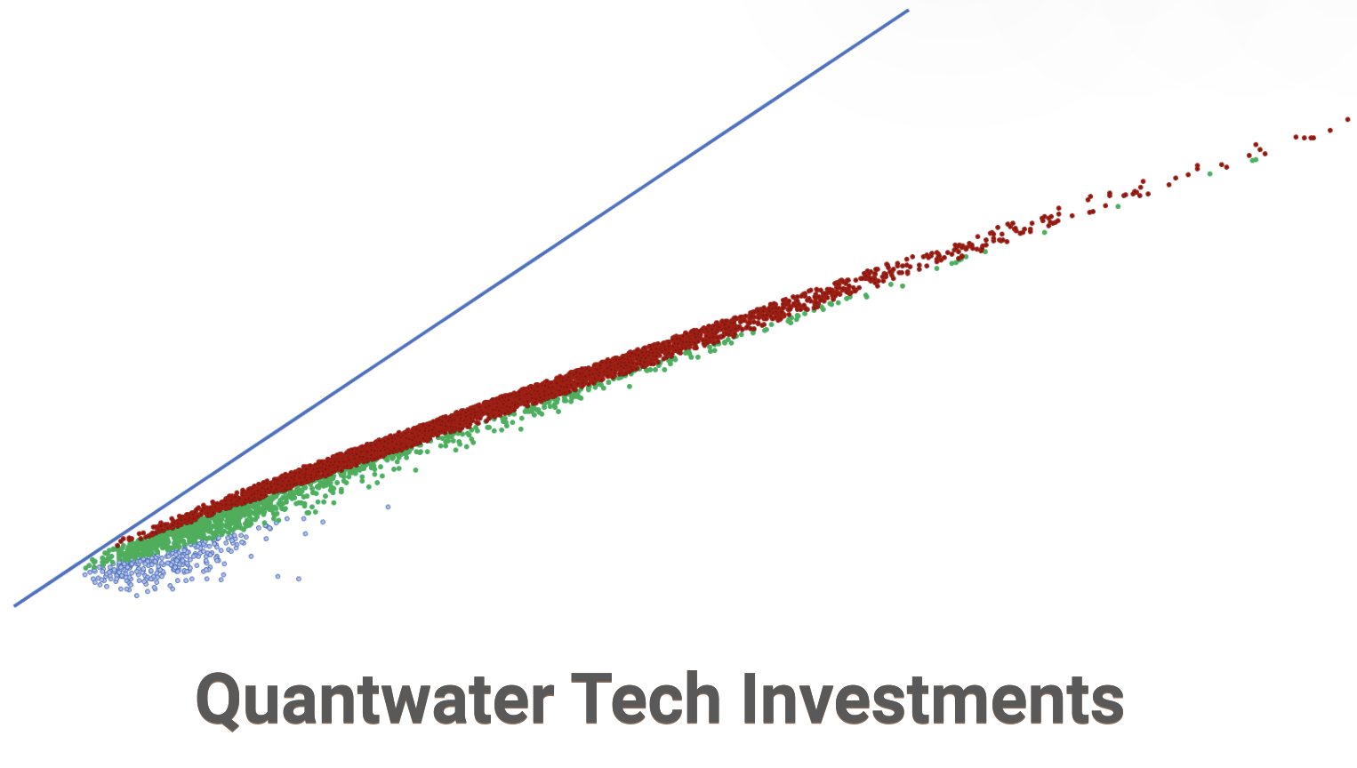
Thank You!
Thank You!
Pawan Jatale
pawan@quantwater.tech
Founder
Quantwater Tech Investments

