Slide 1
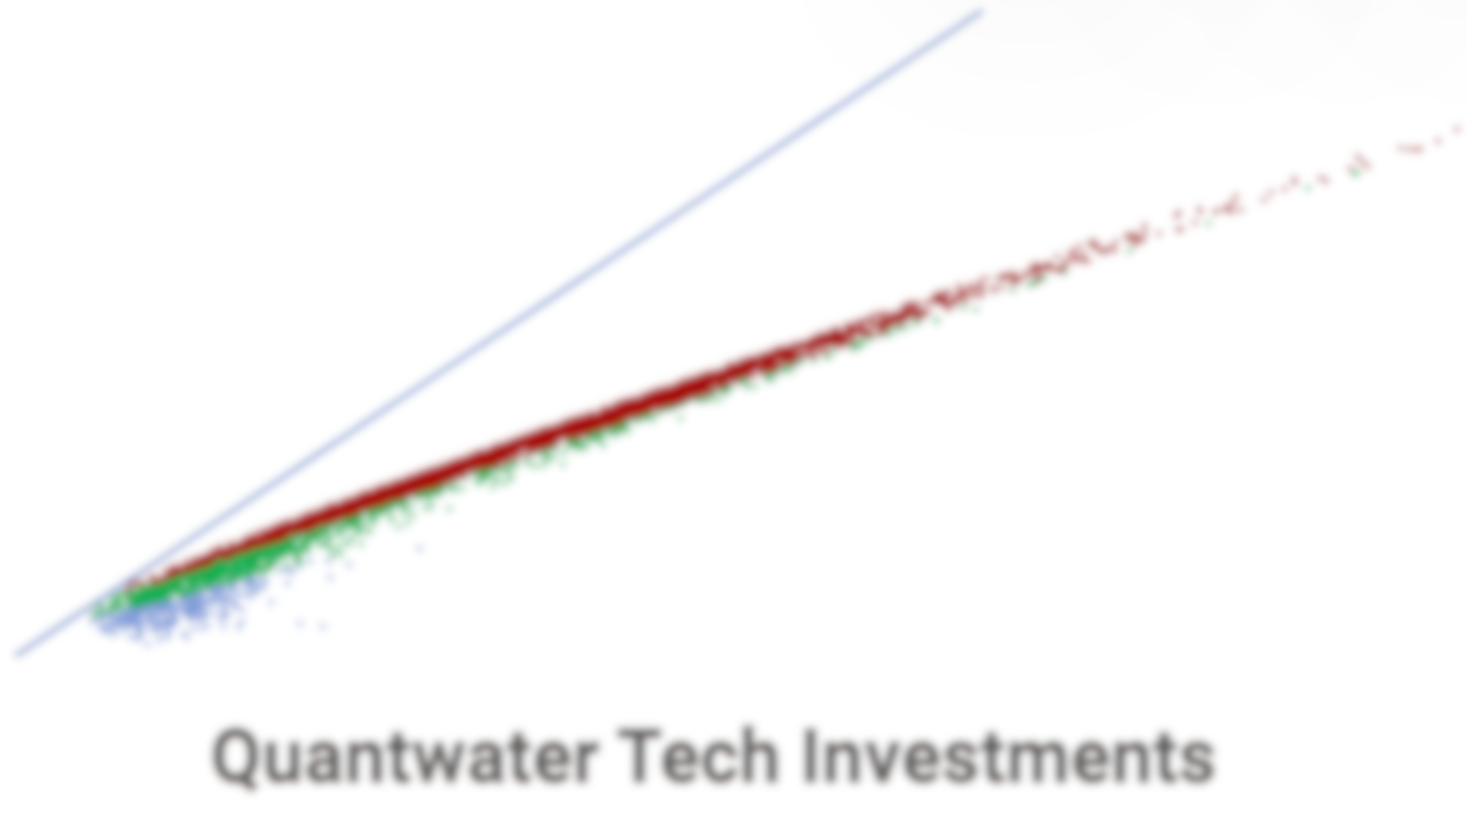
Project Spider Accelerating the Energy Transition 4thMar 2024 Pawan Quantwater Tech Investments
08th September 2025
Economic Data Releases & Their Historical Impact on Assets

Slide 2
Brief
Date | Day | Time (IST) | Cur. | Imp. | Event
08-Sep-25 | Mon | 05:20 | JPY | 3 | JPY - GDP (QoQ) (Q2)
10-Sep-25 | Wed | 18:00 | USD | 3 | USD - PPI (MoM) (Aug)
10-Sep-25 | Wed | 22:30 | USD | 3 | USD - Crude Oil Inventories
10-Sep-25 | Wed | 22:30 | USD | 3 | USD - 10-Year Note Auction
11-Sep-25 | Thur | 17:45 | EUR | 3 | EUR - Deposit Facility Rate (Sep)
11-Sep-25 | Thur | 17:45 | EUR | 3 | EUR - ECB Interest Rate Decision (Sep)
11-Sep-25 | Thur | 18:00 | USD | 3 | USD - Core CPI (MoM) (Aug)
11-Sep-25 | Thur | 18:00 | USD | 3 | USD - CPI (YoY) (Aug)
11-Sep-25 | Thur | 18:00 | USD | 3 | USD - CPI (MoM) (Aug)
11-Sep-25 | Thur | 18:00 | USD | 3 | USD - Initial Jobless Claims
11-Sep-25 | Thur | 18:15 | EUR | 3 | EUR - ECB Press Conference
11-Sep-25 | Thur | 22:30 | USD | 3 | USD - 30-Year Bond Auction
12-Sep-25 | Fri | 11:30 | GBP | 3 | GBP - GDP (MoM) (Jul)
12-Sep-25 | Fri | 11:30 | USD | 3 | EUR - German CPI (MoM) (Aug)
17-Sep-25 | Wed | 23:30 | USD | 3 | Fed Interest Rate Decision
Annexure: Key Terms & Links

Slide 3
Project Spider Accelerating the Energy Transition 4thMar 2024 Pawan Quantwater Tech Investments
JPY - GDP (QoQ) (Q2)

Slide 4
JPY - GDP (QoQ) (Q2)
Event | JPY - GDP (QoQ) (Q2) |  |  | Description
Actual: |  |  |  | Gross Domestic Product (GDP) measures the change in the inflation-adjusted value of all goods and services produced by the economy. It is the broadest measure of economic activity and the primary indicator of the economy's health. A reading that is stronger than forecast is generally supportive (bullish) for the JPY, while a weaker than forecast reading is generally negative (bearish) for the JPY. Learn More: USDJPY | EURJPY
Forecast:
Previous: | 0.3%
Time (GMT): | 23:50
Release Date | Actual | Forecast | Previous
14-Aug-25 | 0.30% | 0.10% | 0.10%
08-Jun-25 | 0.00% | -0.20% | 0.60%
15-May-25 | -0.20% | -0.10% | 0.60%
10-Mar-25 | 0.60% | 0.70% | 0.30%
16-Feb-25 | 0.70% | 0.30% | 0.40%
08-Dec-24 | 0.30% | 0.20% | 0.50%

Slide 5
Project Spider Accelerating the Energy Transition 4thMar 2024 Pawan Quantwater Tech Investments
JPY - GDP (QoQ) (Q2)
USDJPY

Slide 6
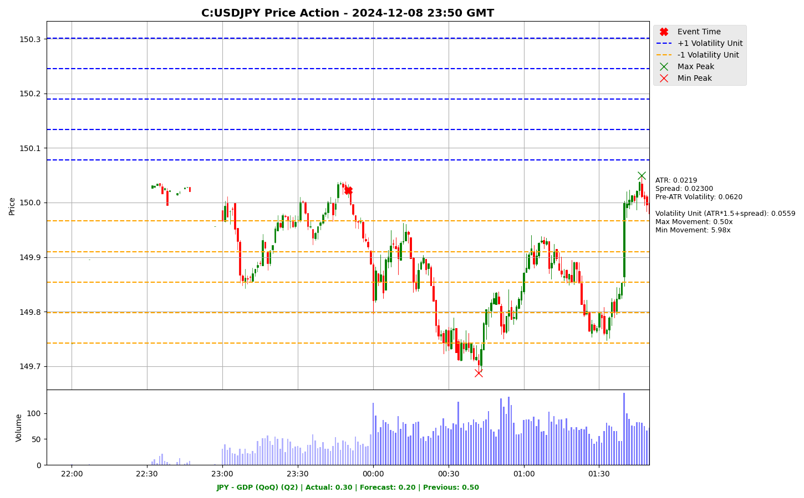

Slide 7
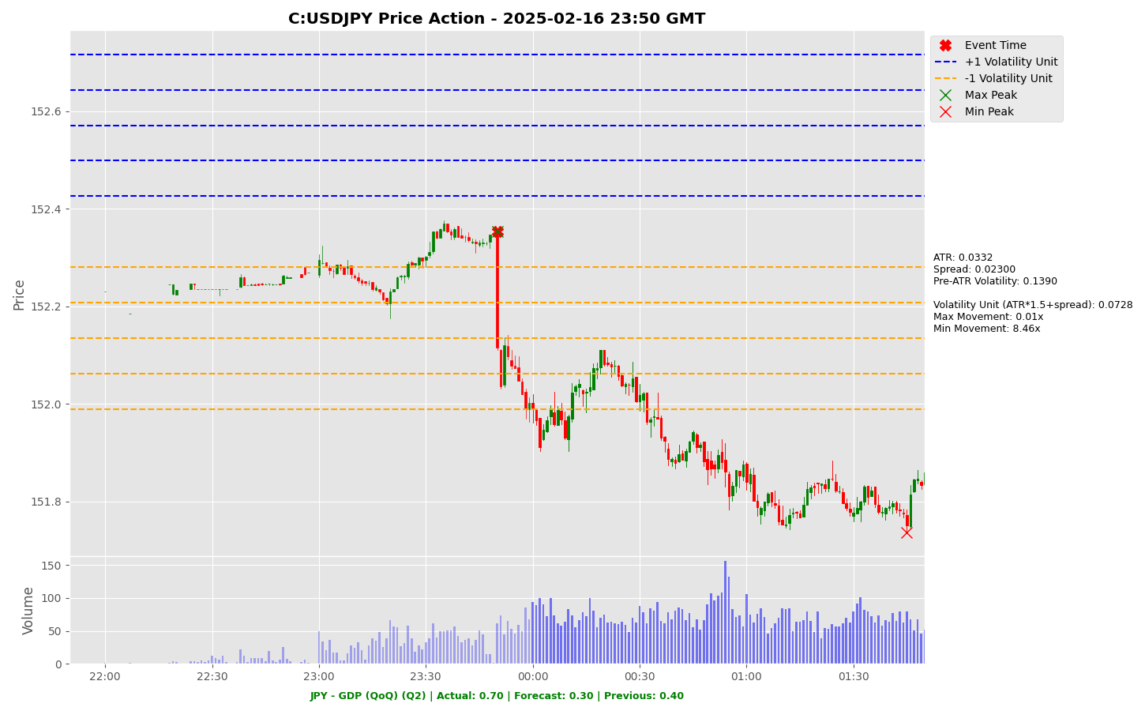

Slide 8
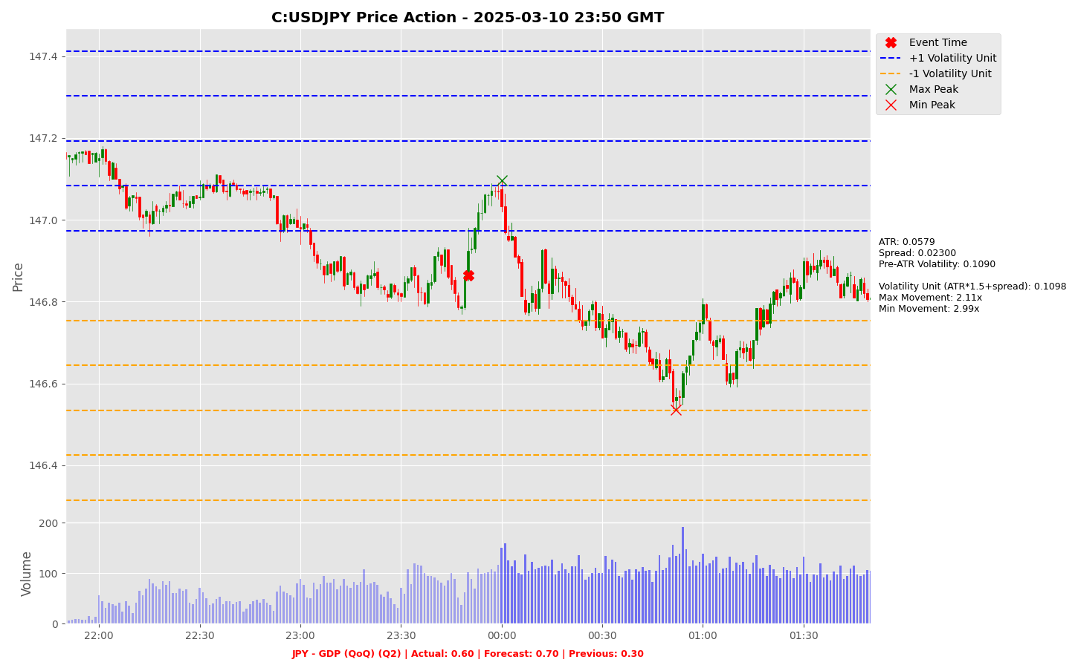

Slide 9
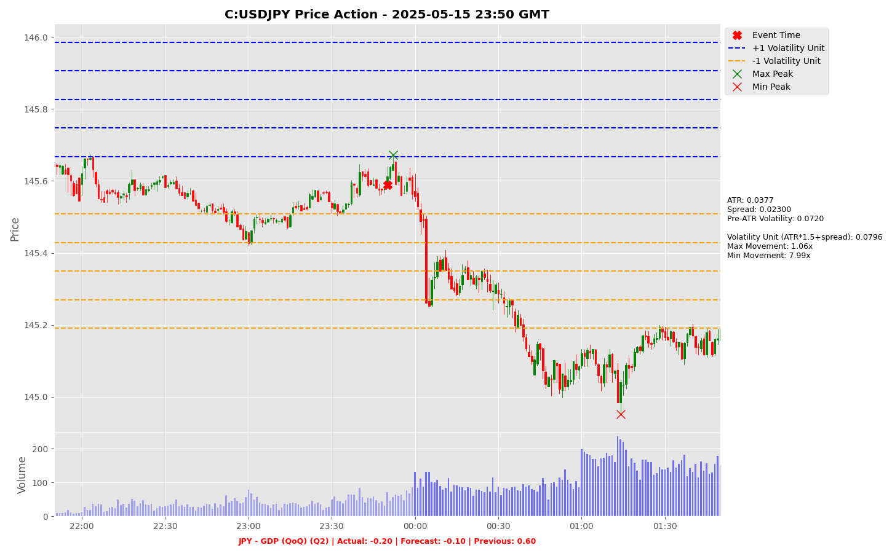

Slide 10
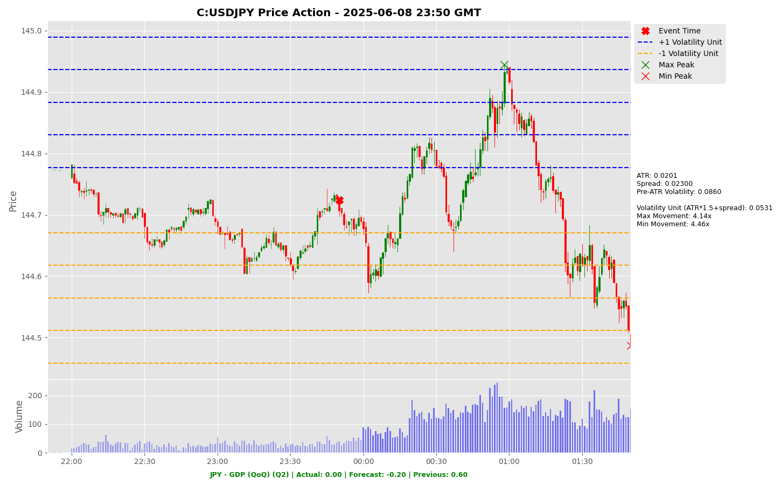

Slide 11
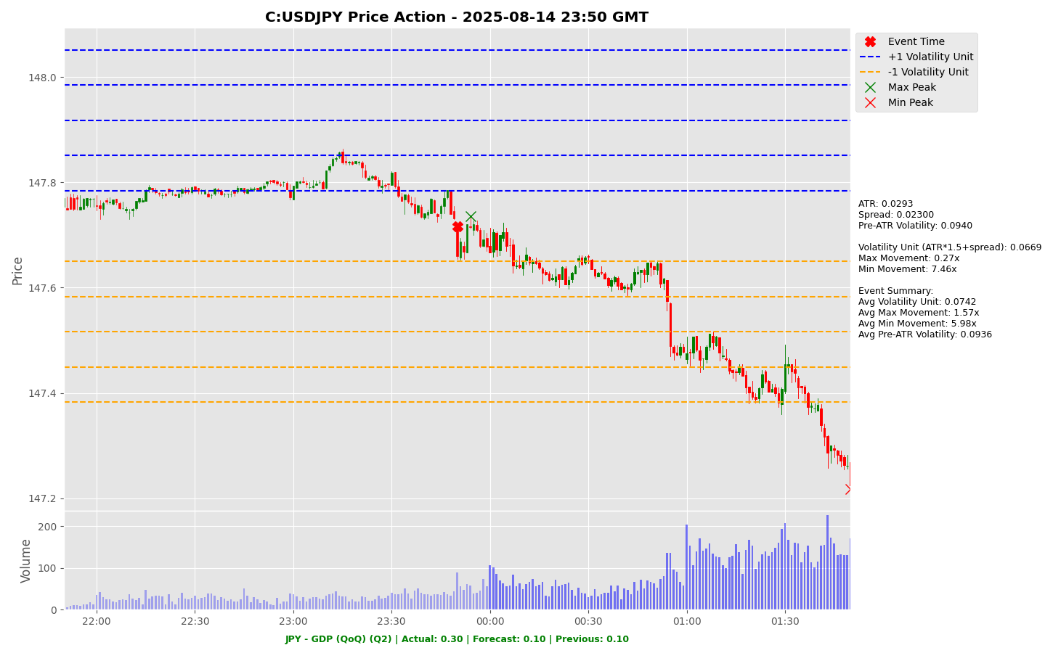

Slide 12
Project Spider Accelerating the Energy Transition 4thMar 2024 Pawan Quantwater Tech Investments
JPY - GDP (QoQ) (Q2)
EURJPY

Slide 13
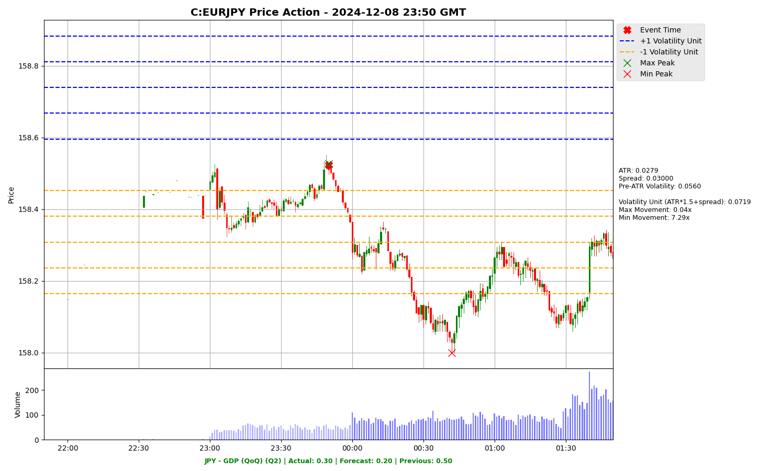

Slide 14
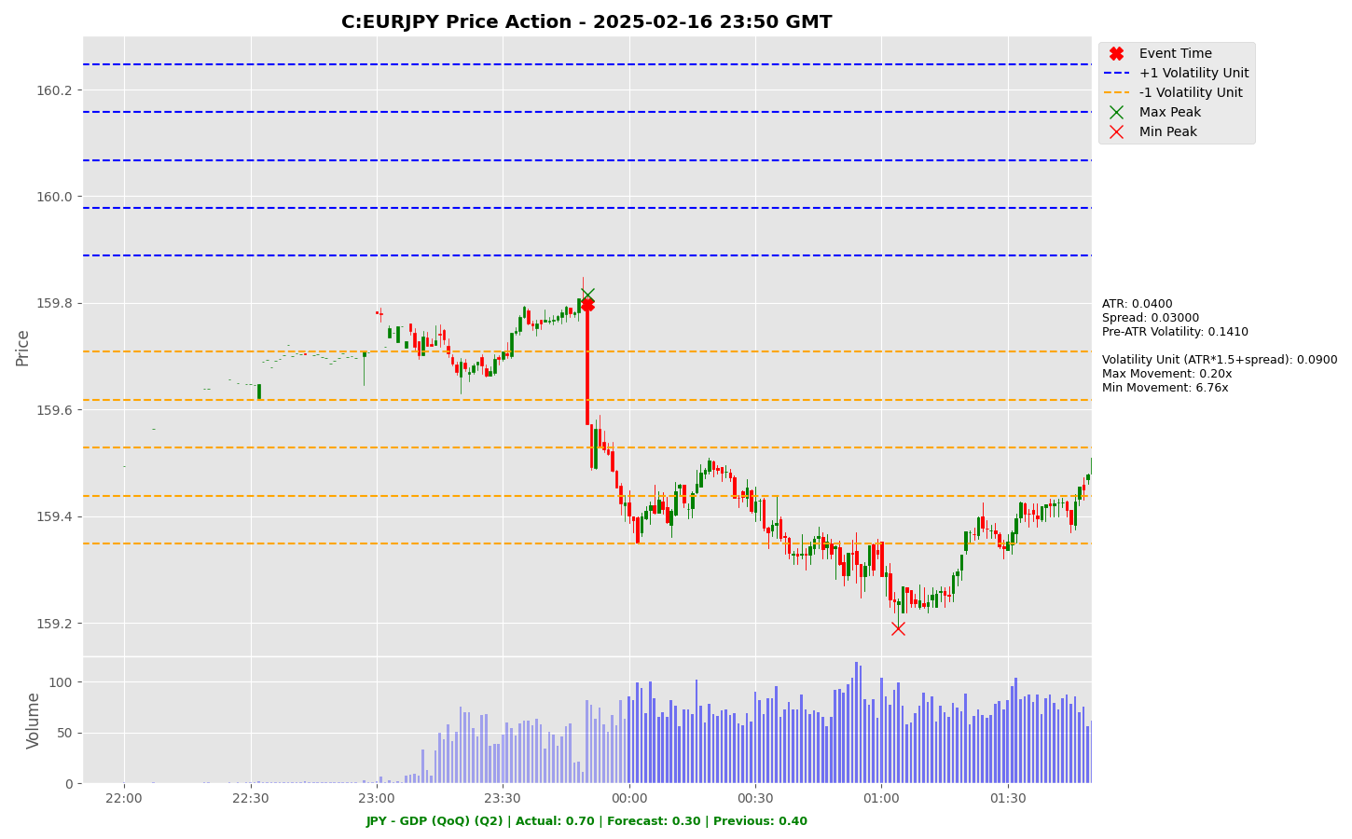

Slide 15
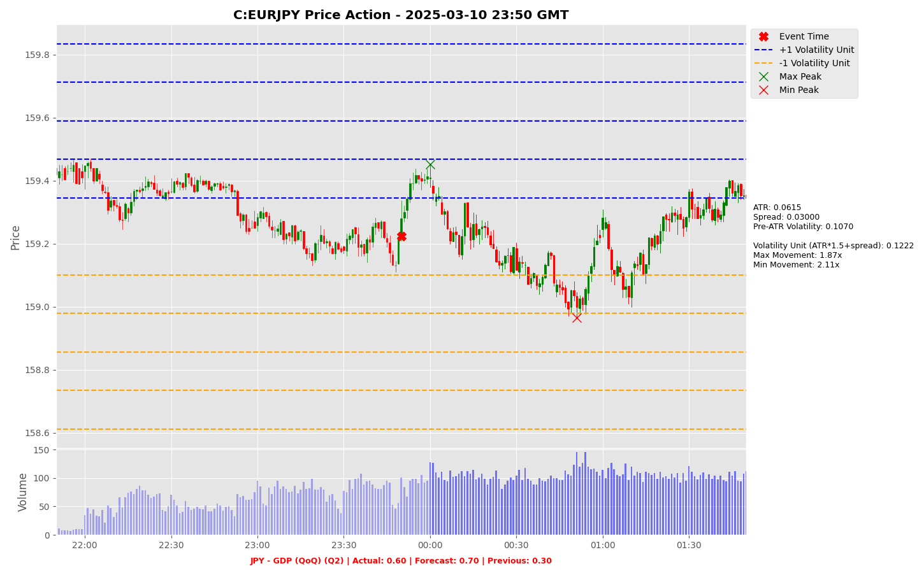

Slide 16
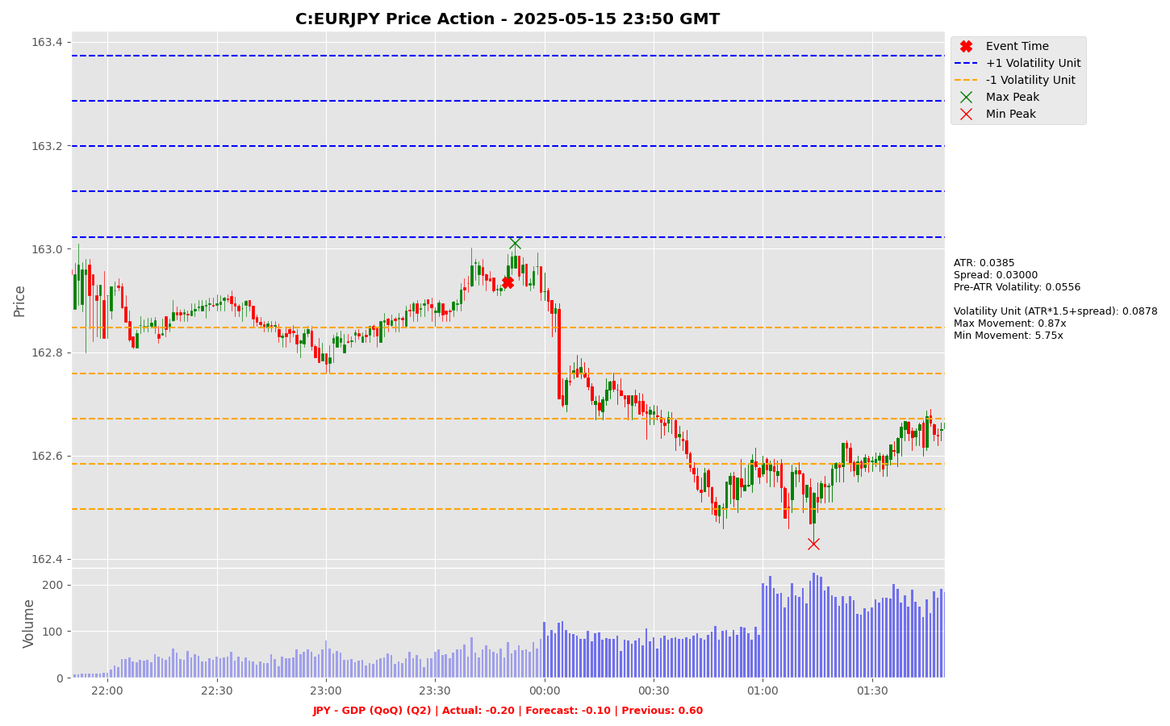

Slide 17
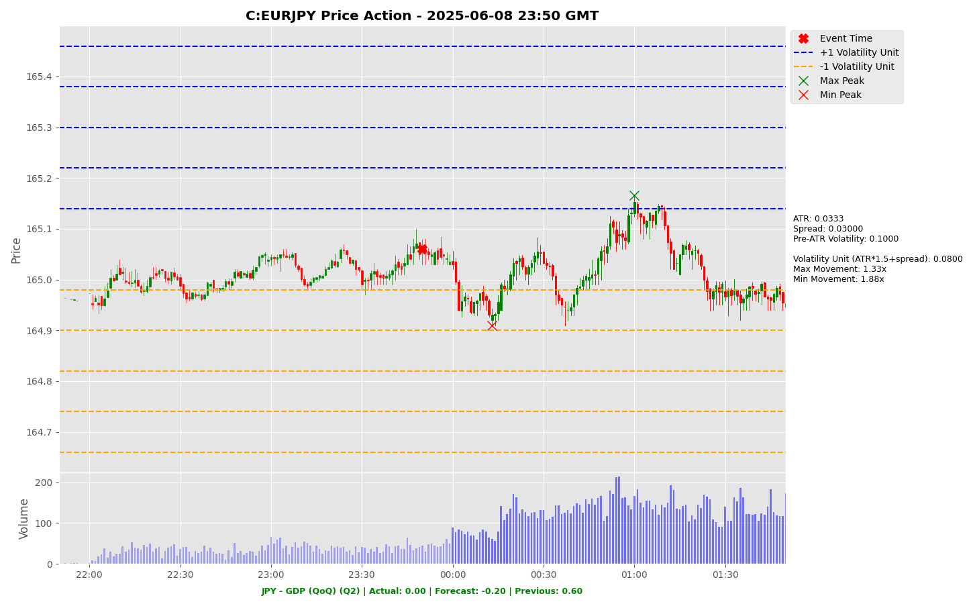

Slide 18
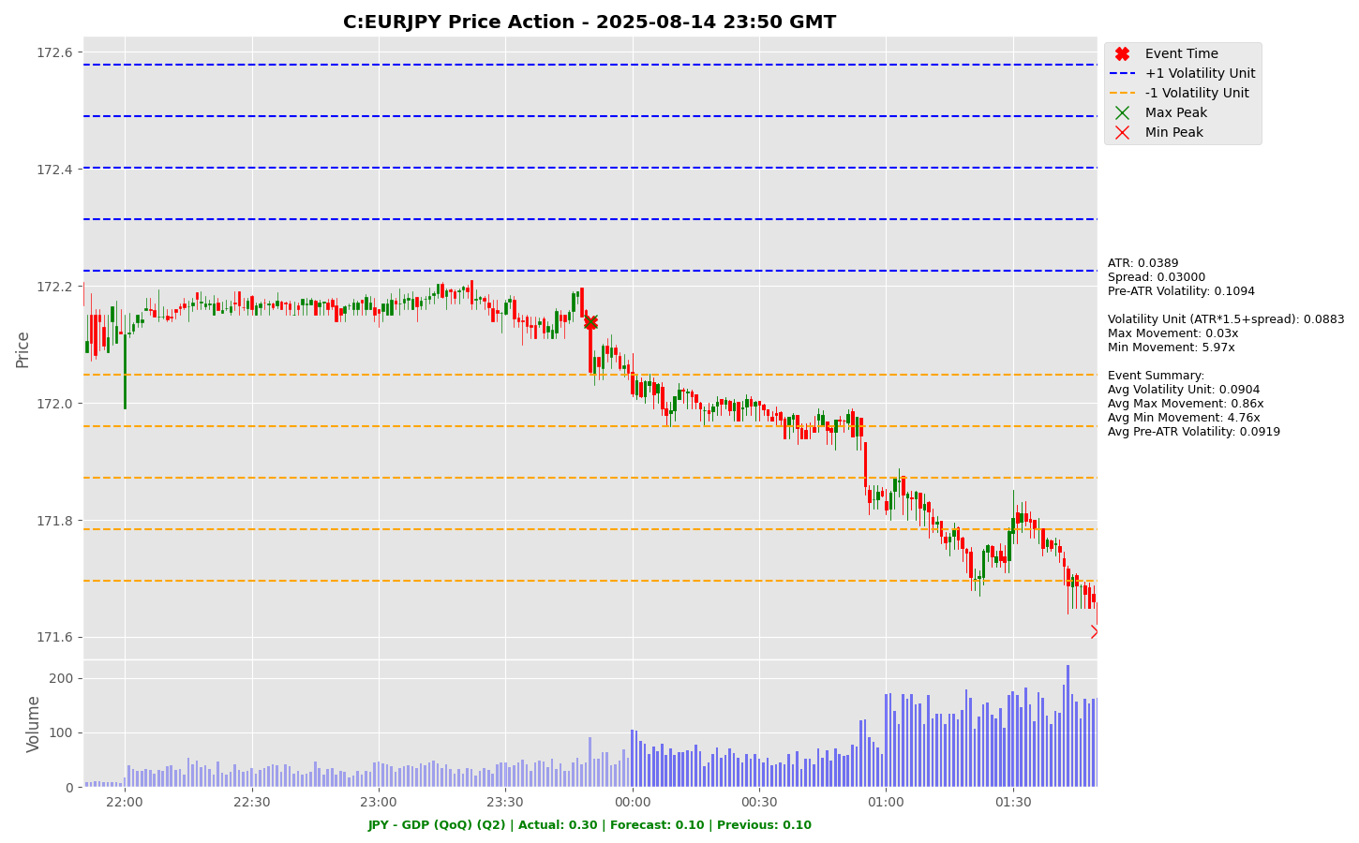

Slide 19
Project Spider Accelerating the Energy Transition 4thMar 2024 Pawan Quantwater Tech Investments
USD - PPI (MoM) (Aug)

Slide 20
USD - PPI (MoM) (Aug)
Event | USD - PPI (MoM) (Aug) |  |  | Description
Actual: |  |  |  | The Producer Price Index (PPI) measures a change in input prices of raw, semi-finished or finished goods and services. If input costs rise, some will be absorbed by the producer and some passed on to the consumer. Conversely, if input costs fall, some of the decline will be enjoyed as wider profit margins by the producer and some will be passed on to the consumer in the form of lower prices. Because PPI impacts consumer prices, it is watched by central bankers as part of fulfilling their mandate of price stability. A reading that is stronger than forecast is generally supportive (bullish) for the USD, while a weaker than forecast reading is generally negative (bearish) for the USD. Learn More: USDJPY | EURUSD
Forecast:
Previous: | 0.90%
Time (GMT): | 12:30
Release Date | Actual | Forecast | Previous
14-Aug-25 | 0.9% | 0.2% | 0.0%
16-Jul-25 | 0.0% | 0.2% | 0.3%
12-Jun-25 | 0.1% | 0.2% | -0.2%
15-May-25 | -0.5% | 0.2% | 0.0%
11-Apr-25 | -0.4% | 0.2% | 0.1%
13-Mar-25 | 0.0% | 0.3% | 0.6%

Slide 21
Project Spider Accelerating the Energy Transition 4thMar 2024 Pawan Quantwater Tech Investments
USD - PPI (MoM) (Aug)
USDJPY

Slide 22
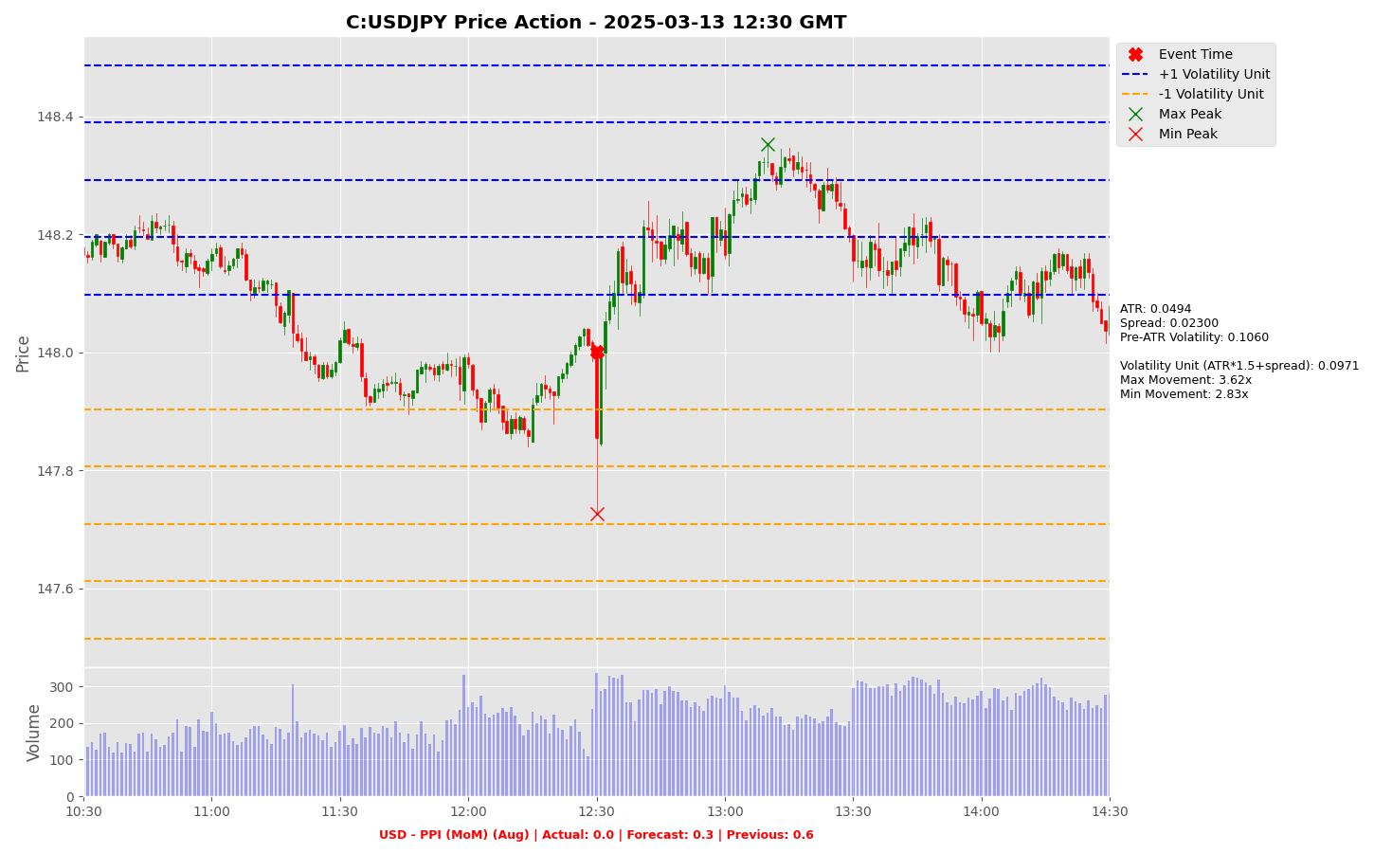

Slide 23
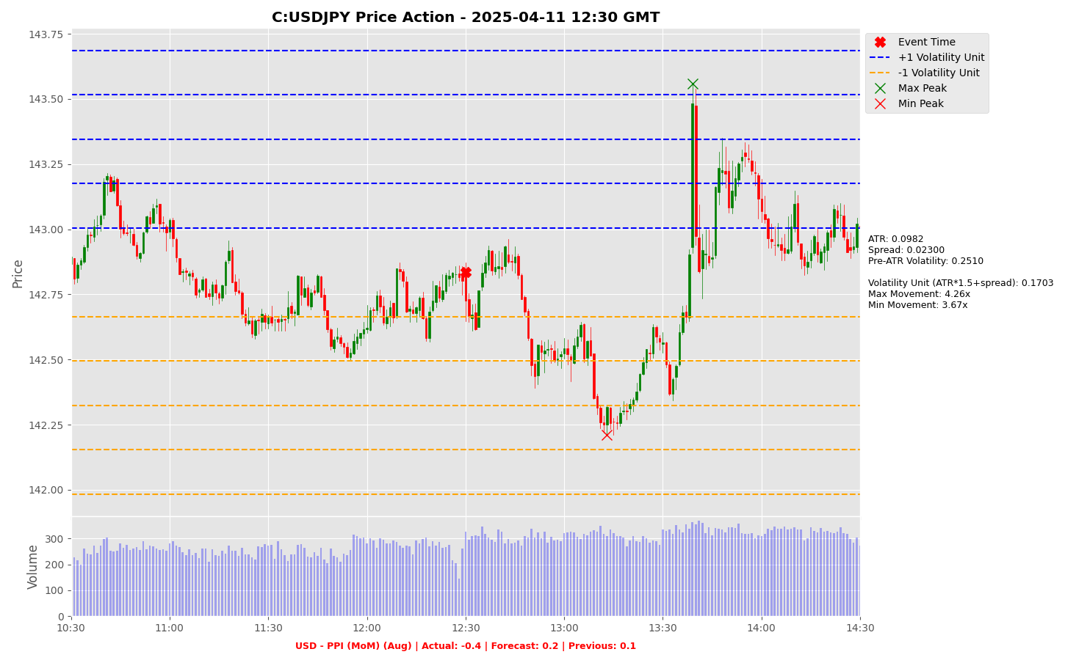

Slide 24
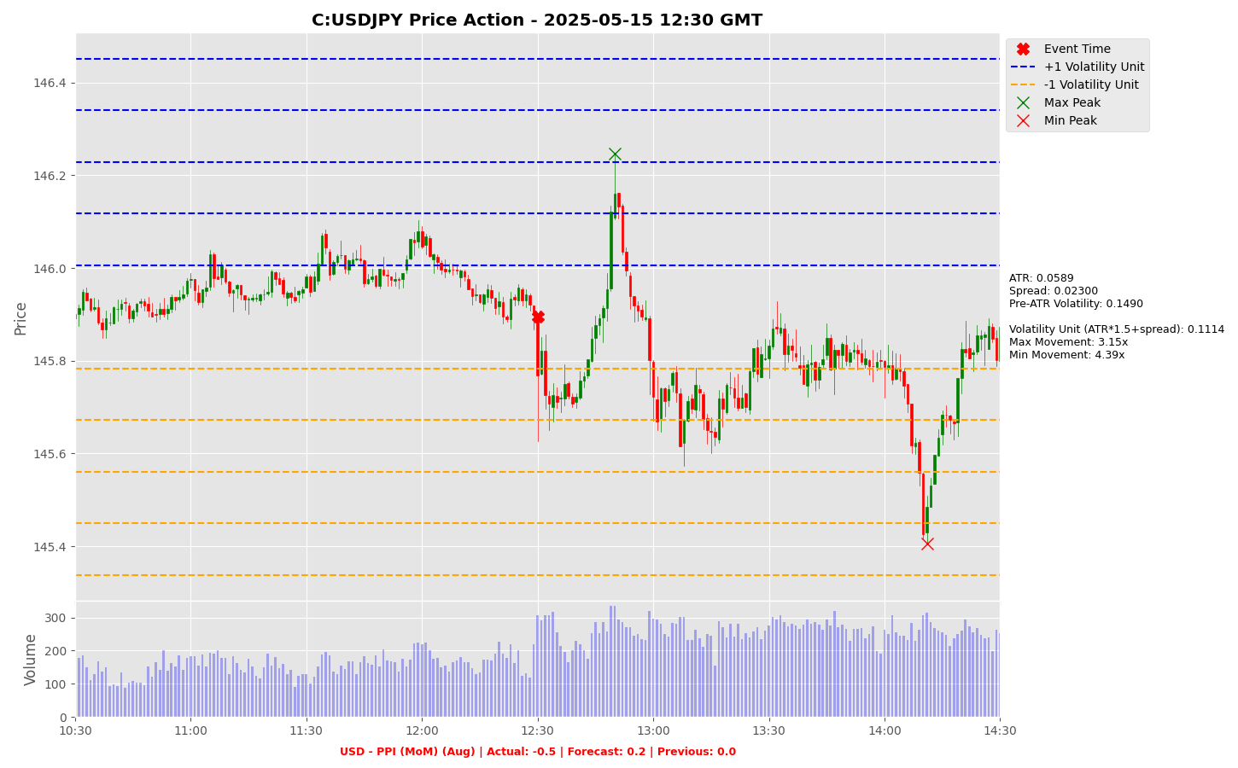

Slide 25
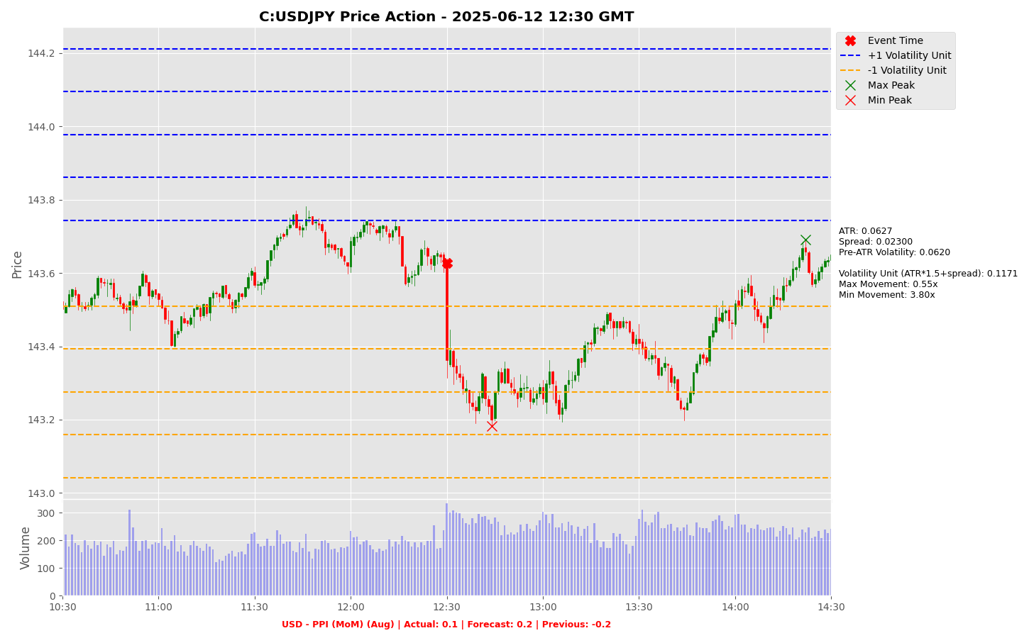

Slide 26
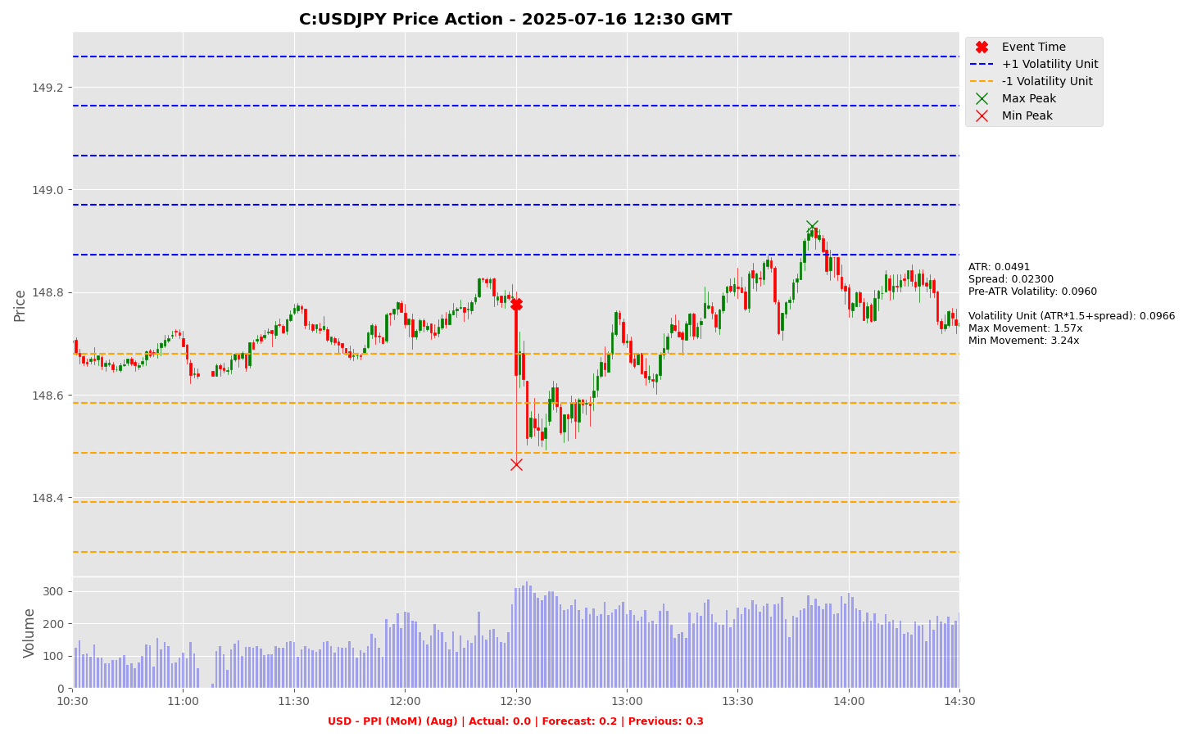

Slide 27
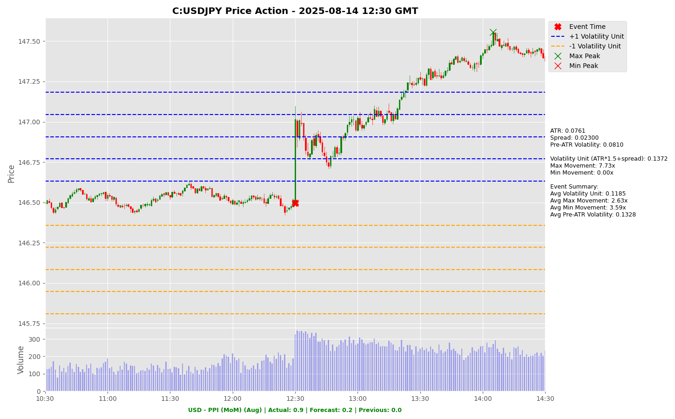

Slide 28
Project Spider Accelerating the Energy Transition 4thMar 2024 Pawan Quantwater Tech Investments
USD - PPI (MoM) (Aug)
EURUSD

Slide 29
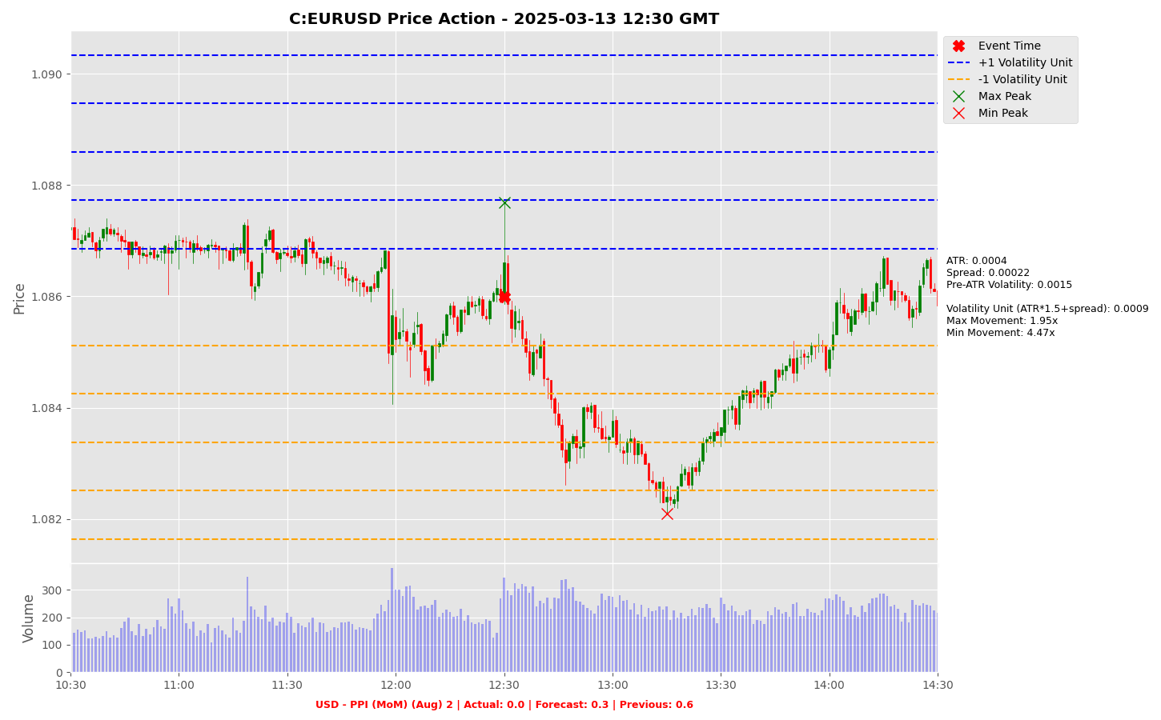

Slide 30
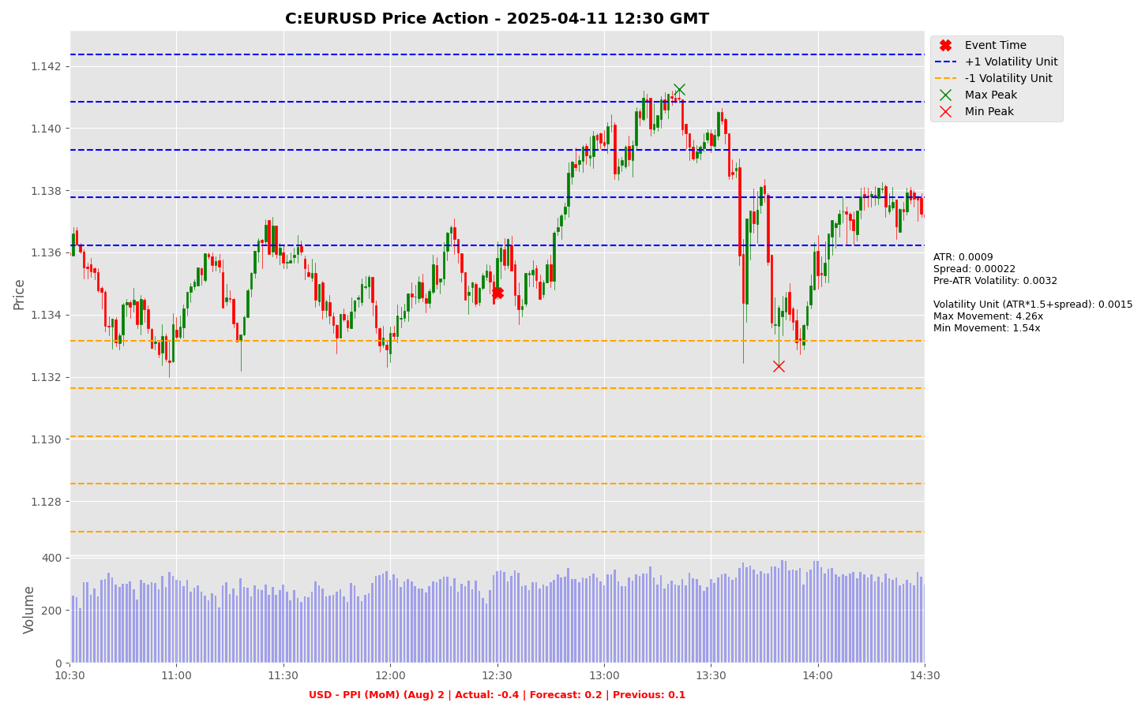

Slide 31
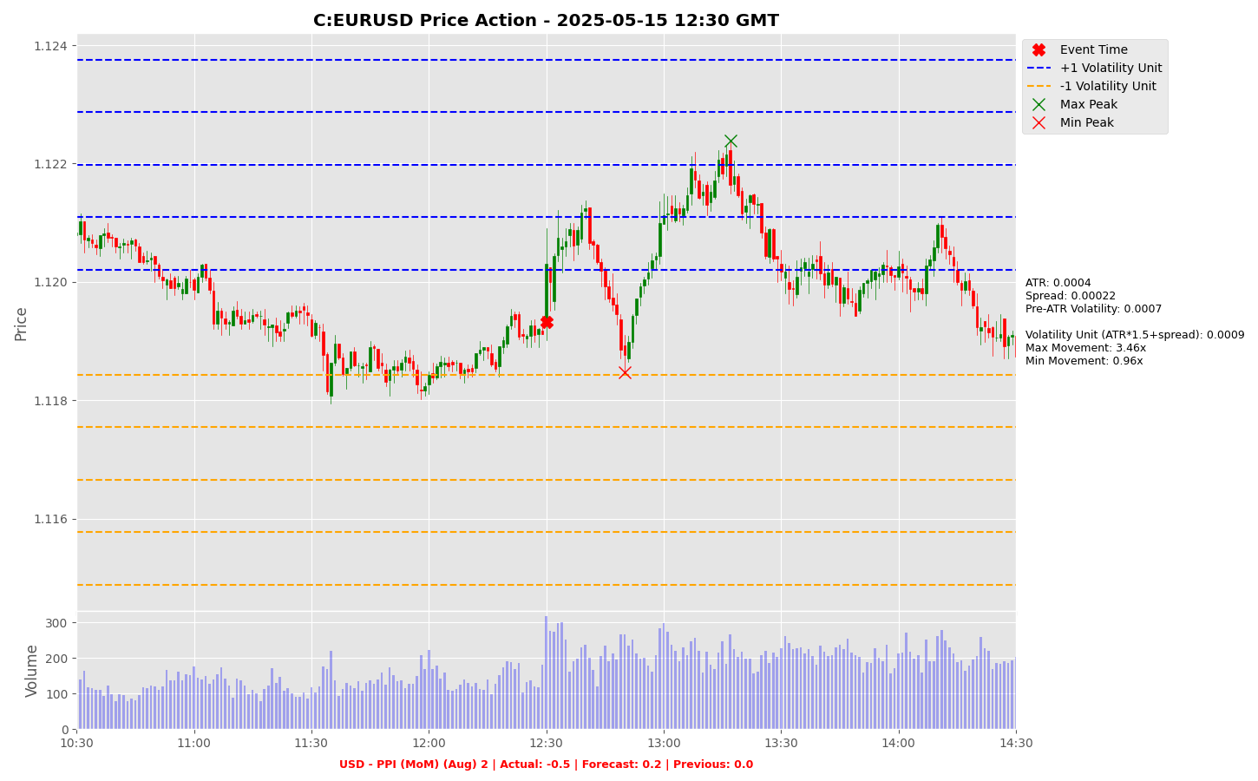

Slide 32
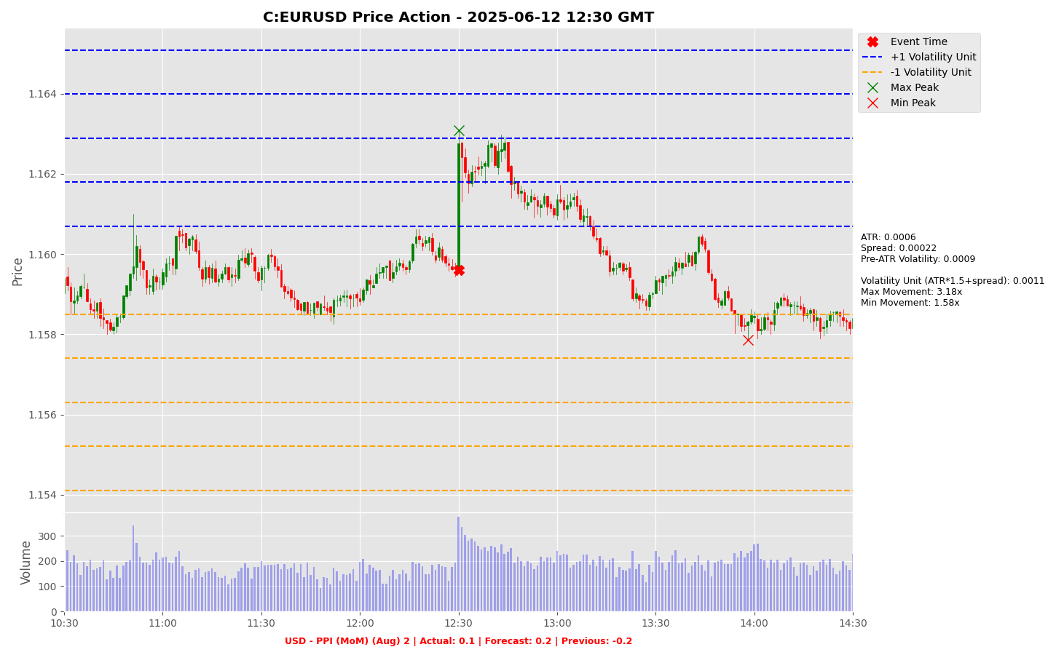

Slide 33
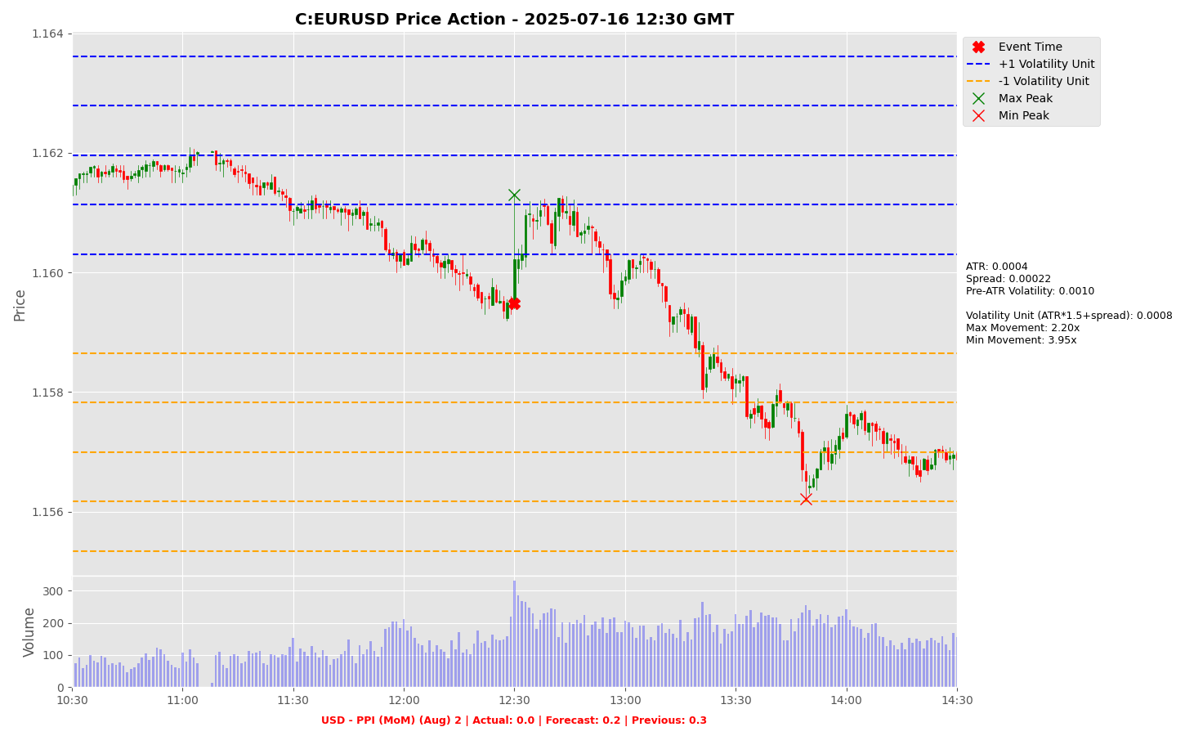

Slide 34
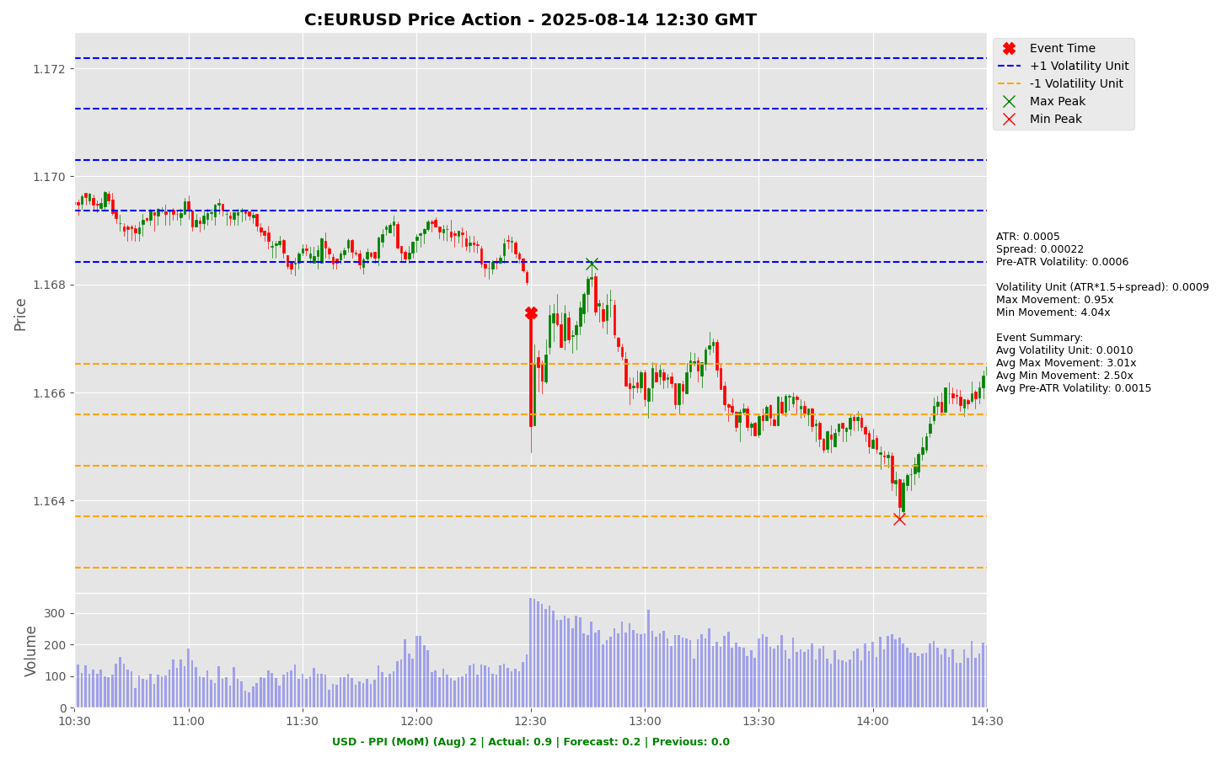

Slide 35
Project Spider Accelerating the Energy Transition 4thMar 2024 Pawan Quantwater Tech Investments
USD - Crude Oil Inventories

Slide 36
USD - Crude Oil Inventories
Event | USD - Crude Oil Inventories |  |  | Description
Actual: |  |  |  | The Energy Information Administration's (EIA) Crude Oil Inventories measures the weekly change in the number of barrels of commercial crude oil held by US firms. The level of inventories influences the price of petroleum products, which can have an impact on inflation. If the increase in crude inventories is more than expected, it implies weaker demand and is bearish for crude prices. The same can be said if a decline in inventories is less than expected. If the increase in crude is less than expected, it implies greater demand and is bullish for crude prices. The same can be said if a decline in inventories is more than expected. Learn More: USOILRoll
Forecast:
Previous: | 2.415M
Time (GMT): | 17:00
Release Date | Actual | Forecast | Previous
04-Sep-25 | 2.415 | -2.00 | -2.39
27-Aug-25 | -2.39 | -1.70 | -6.01
20-Aug-25 | -6.01 | -0.80 | 3.036
13-Aug-25 | 3.036 | -0.90 | -3.02
06-Aug-25 | -3.02 | 0.200 | 7.698
30-Jul-25 | 7.698 | -2.30 | -3.16

Slide 37
Project Spider Accelerating the Energy Transition 4thMar 2024 Pawan Quantwater Tech Investments
USD - Crude Oil Inventories
USOILRoll

Slide 38
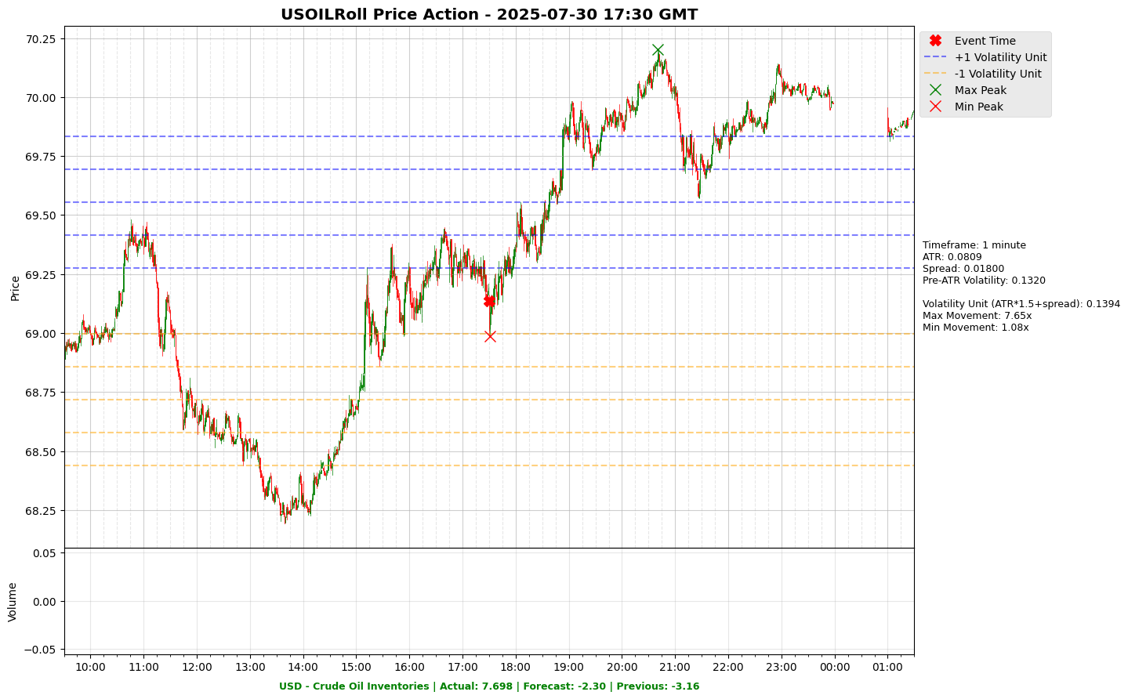

Slide 39
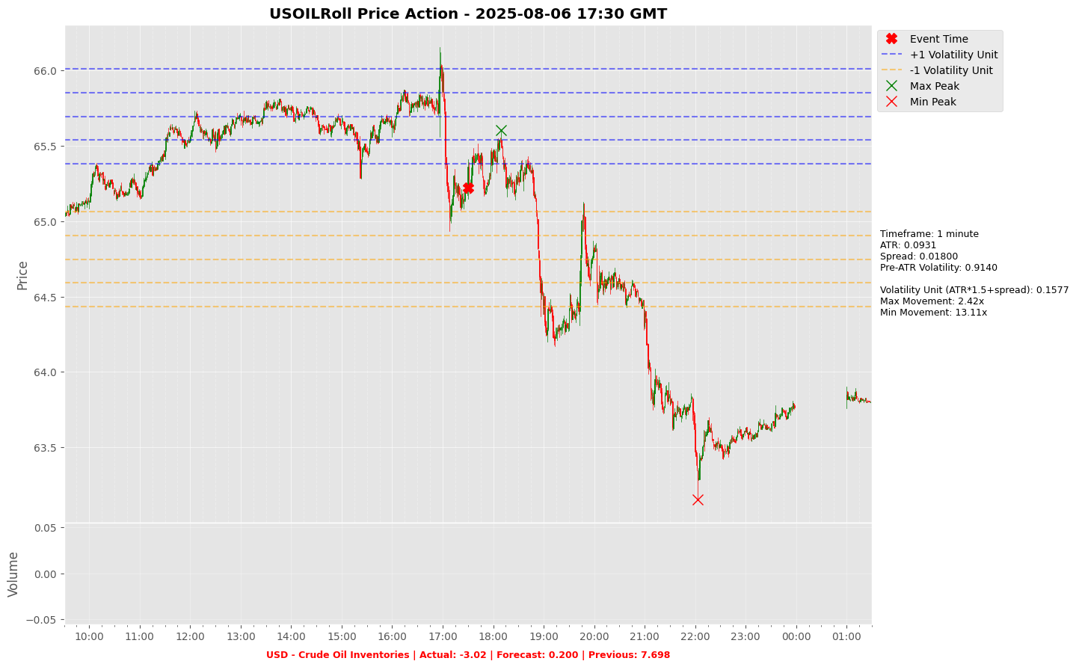

Slide 40
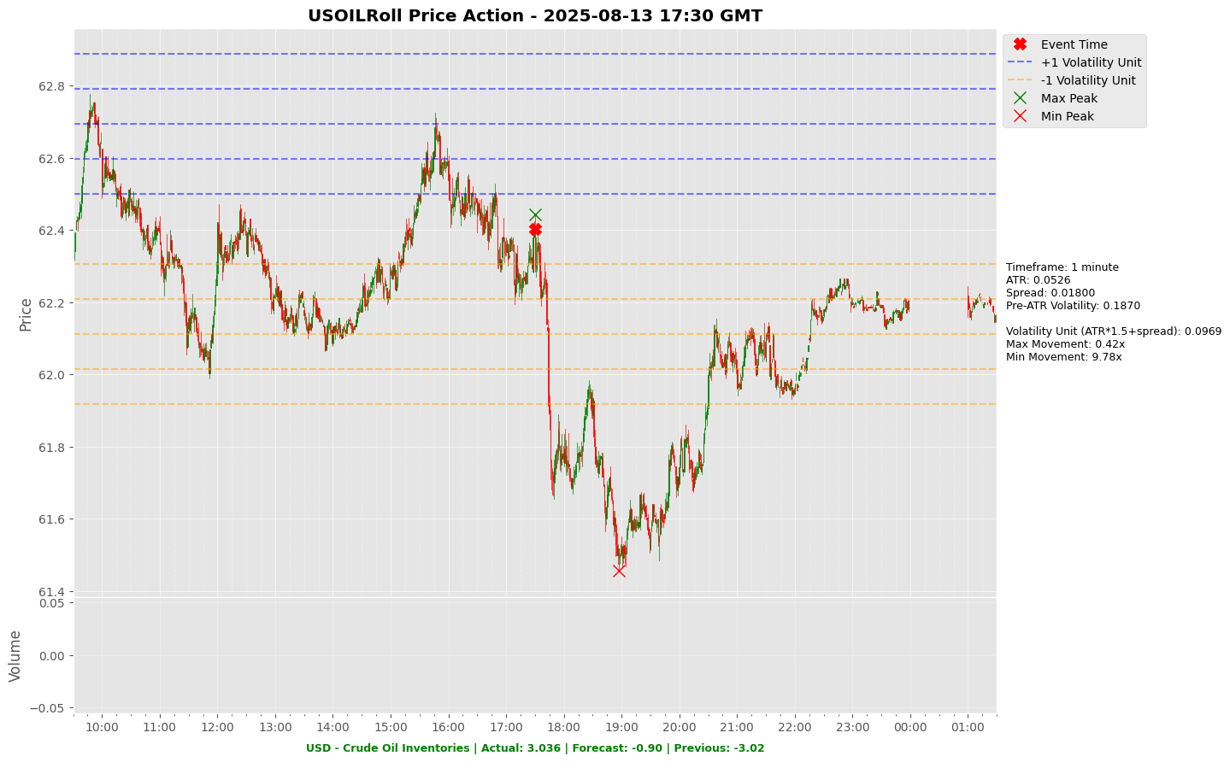

Slide 41
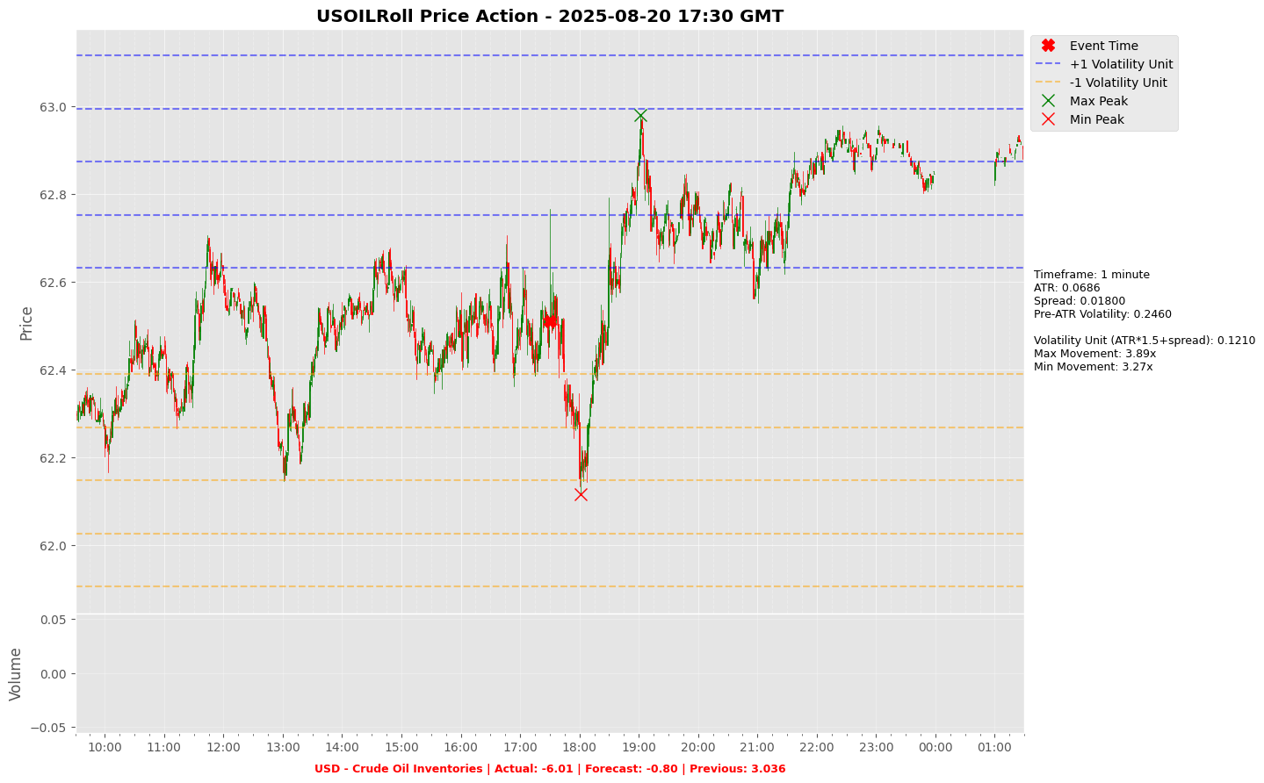

Slide 42
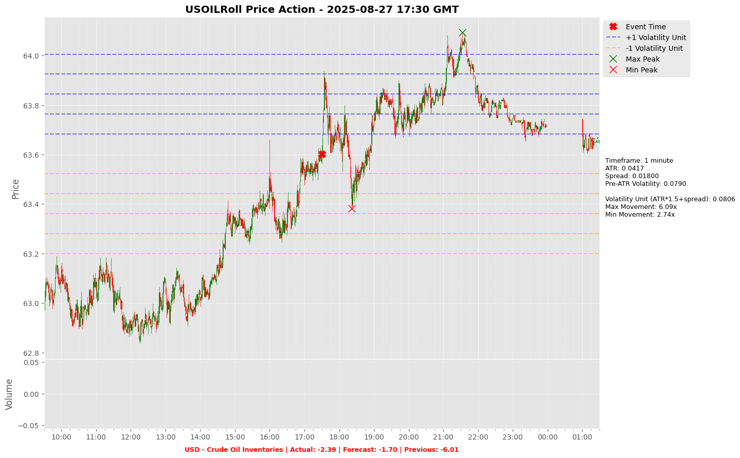

Slide 43
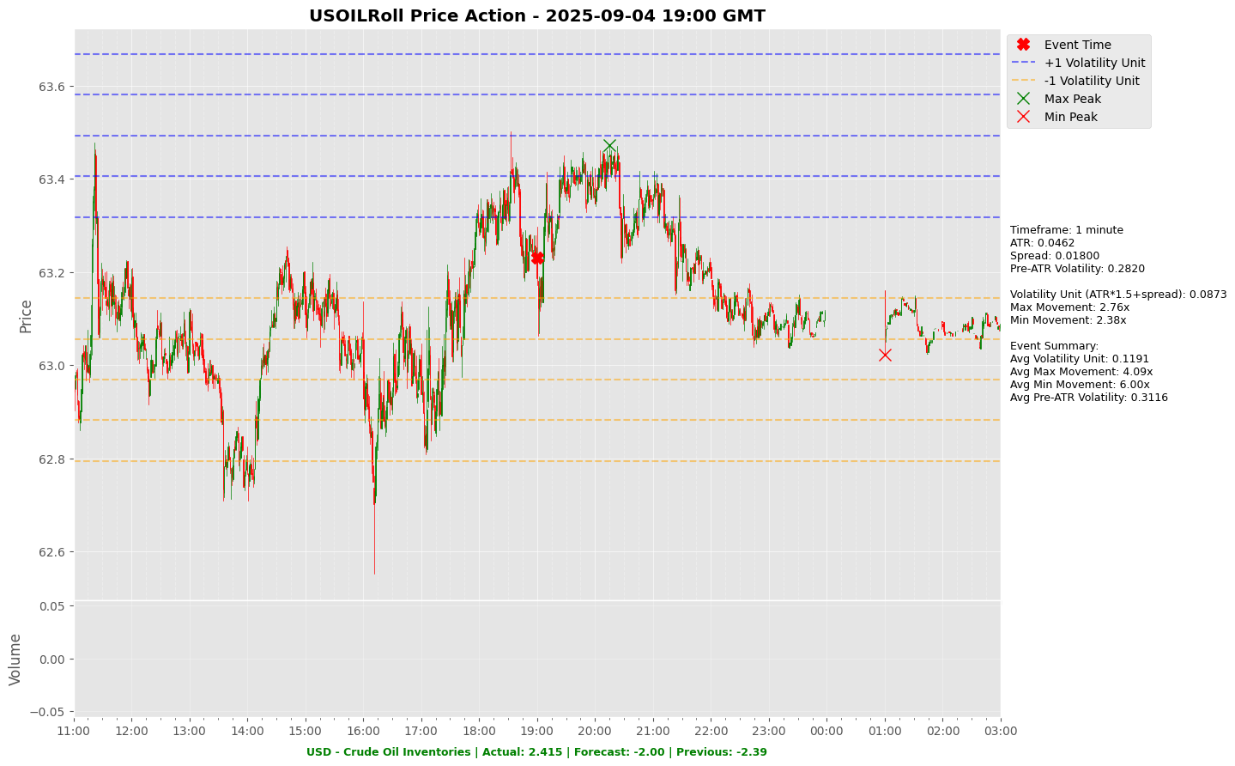

Slide 44
Project Spider Accelerating the Energy Transition 4thMar 2024 Pawan Quantwater Tech Investments
USD - 10-Year Note Auction

Slide 45
USD - 10-Year Note Auction
Event | USD - 10-Year Note Auction |  |  | Description
Actual: |  |  |  | The figures displayed in the calendar represent the yield on the Treasury Note auctioned. U.S. Treasury Notes have maturities of two to ten years. Governments issue treasuries to borrow money to cover the gap between the amount they receive in taxes and the amount they spend to refinance existing debt and/or to raise capital. The rate on a Treasury Note represents the return an investor will receive by holding the note for its entire duration. All bidders receive the same rate at the highest accepted bid. Yield fluctuations should be monitored closely as an indicator of the government debt situation. Investors compare the average rate at auction to the rate at previous auctions of the same security. Learn More: USDJPY | EURUSD
Forecast:
Previous: | 4.26%
Time (GMT): | 17:00
Release Date | Actual | Forecast | Previous
06-Aug-25 | 4.26% |  | 4.36%
09-Jul-25 | 4.36% |  | 4.42%
11-Jun-25 | 4.42% |  | 4.34%
06-May-25 | 4.34% |  | 4.44%
09-Apr-25 | 4.44% |  | 4.31%
12-Mar-25 | 4.31% |  | 4.63%

Slide 46
Project Spider Accelerating the Energy Transition 4thMar 2024 Pawan Quantwater Tech Investments
USD - 10-Year Note Auction
USDJPY

Slide 47
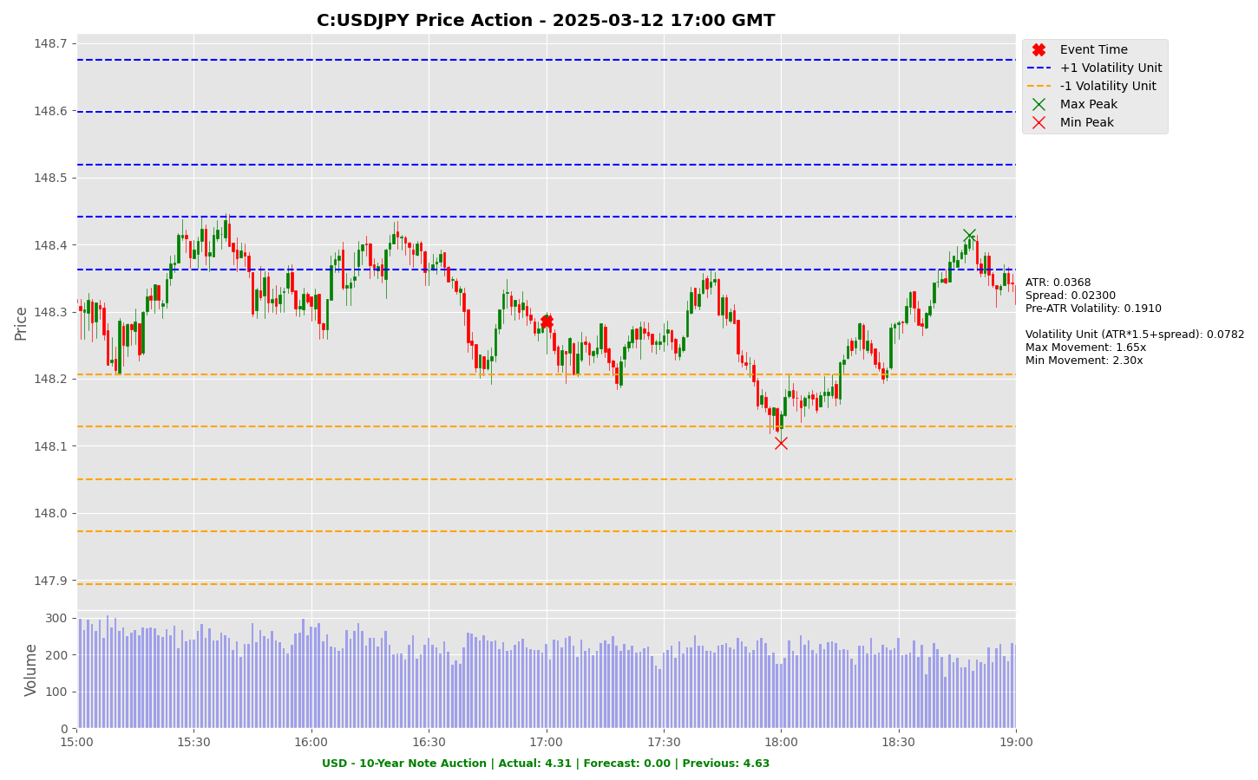

Slide 48
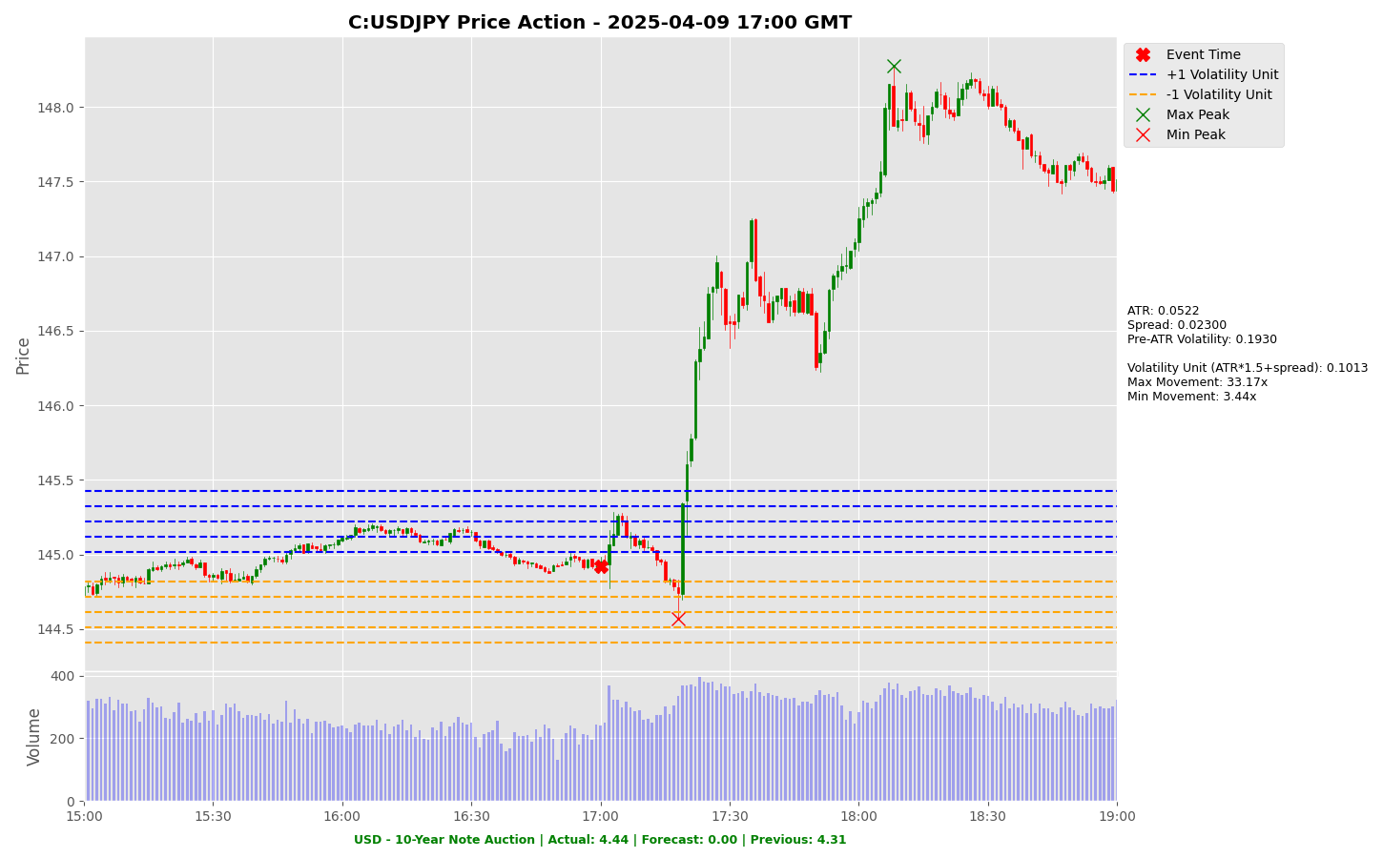

Slide 49
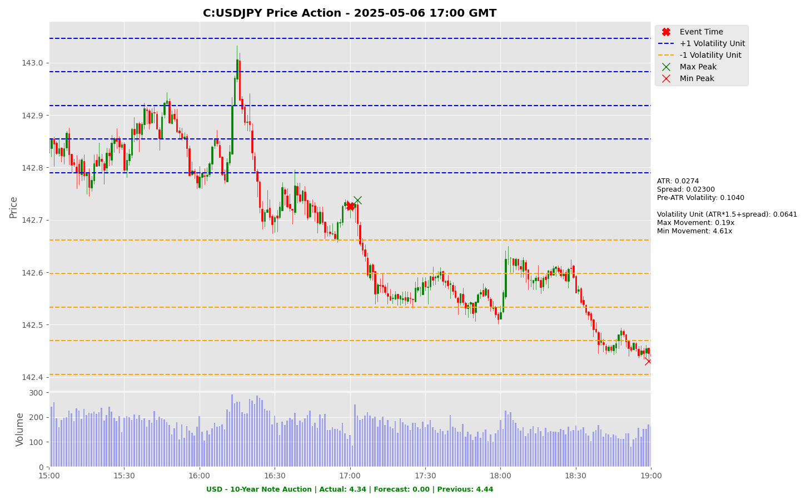

Slide 50
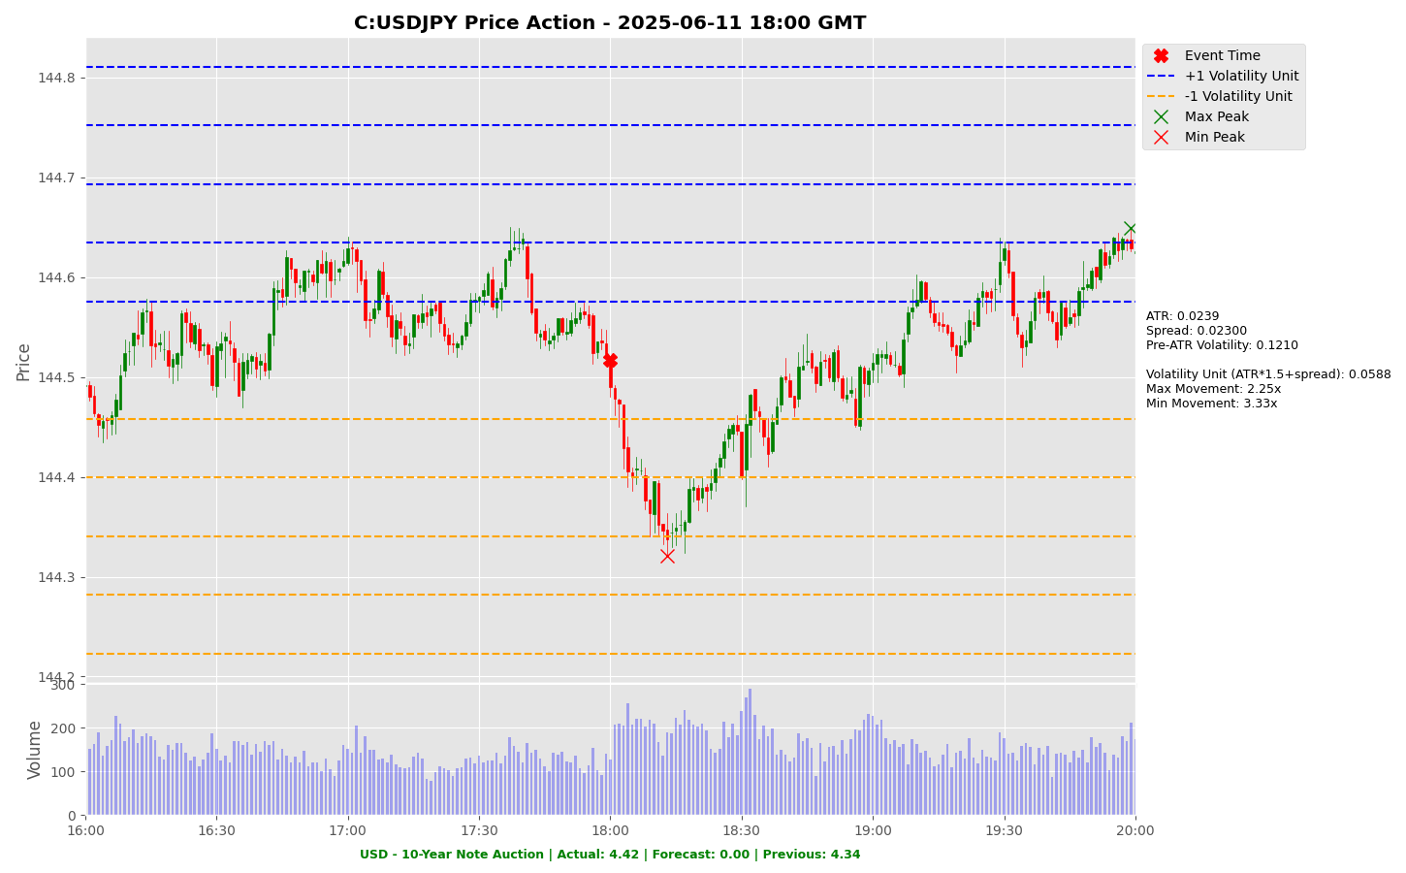

Slide 51
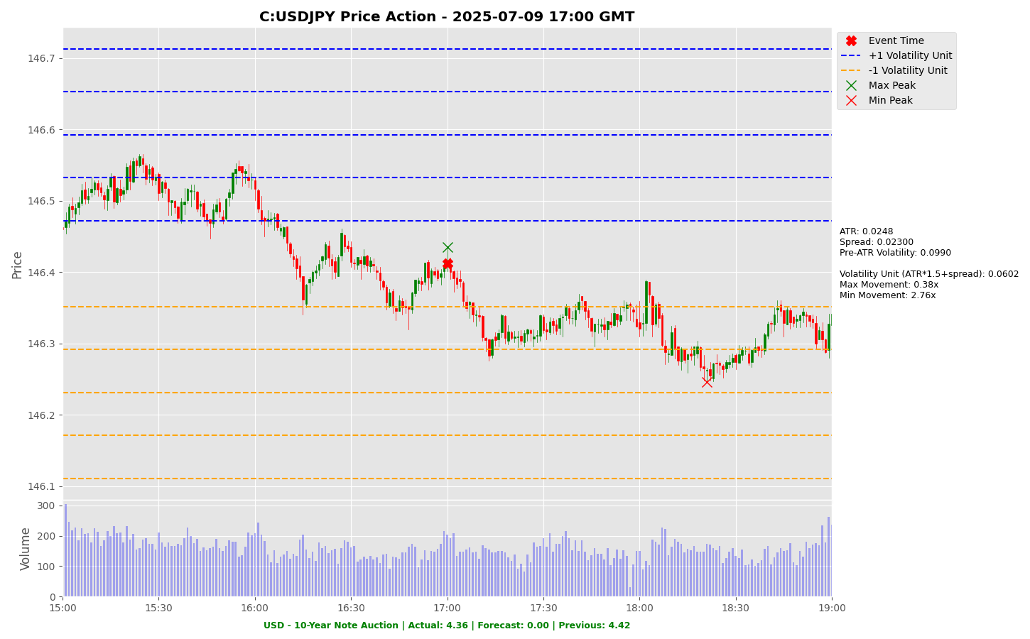

Slide 52
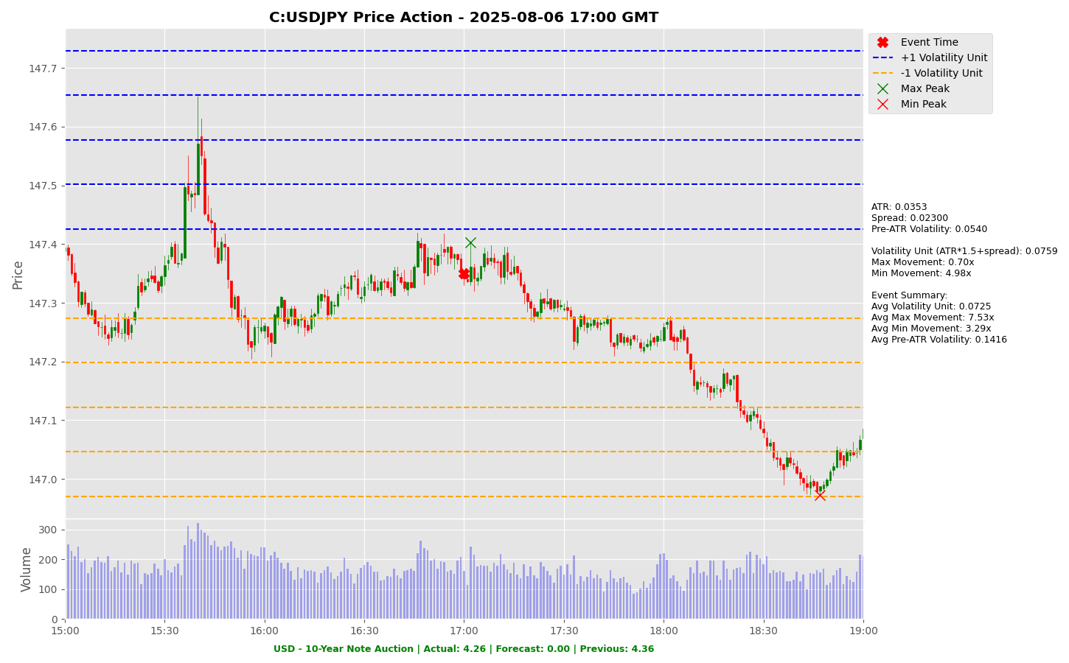

Slide 53
Project Spider Accelerating the Energy Transition 4thMar 2024 Pawan Quantwater Tech Investments
USD - 10-Year Note Auction
EURUSD

Slide 54
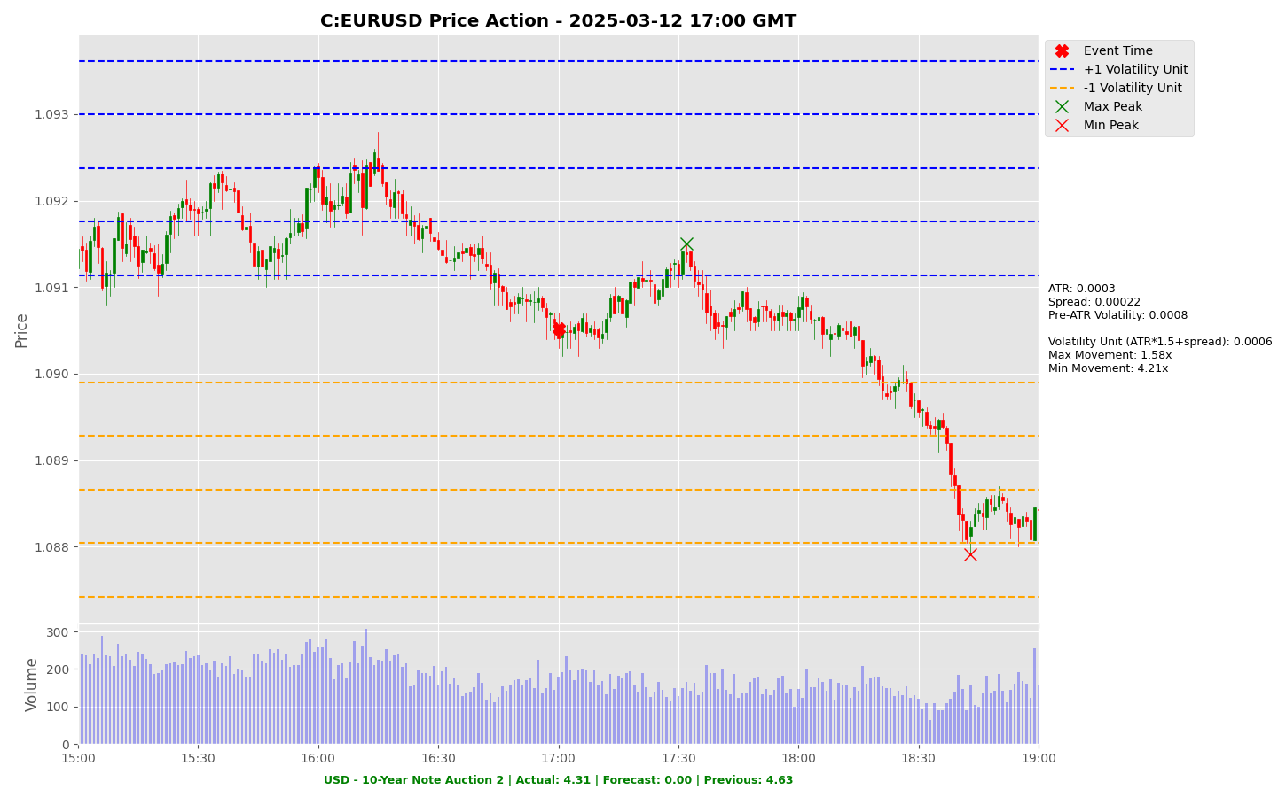

Slide 55
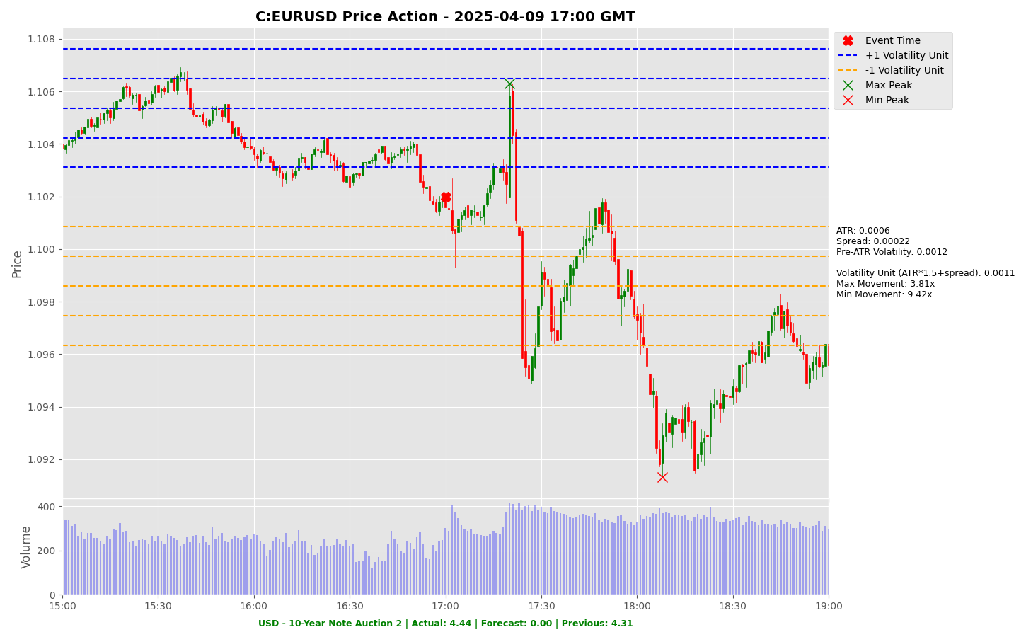

Slide 56
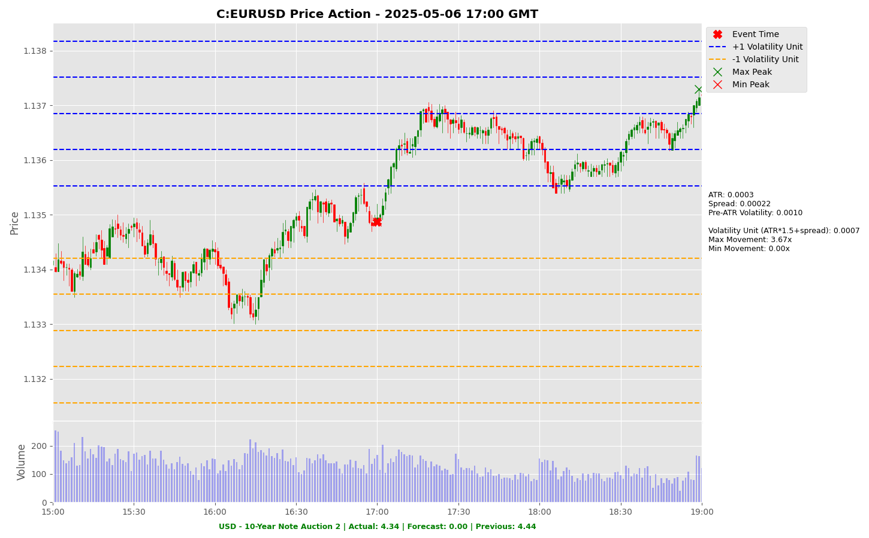

Slide 57
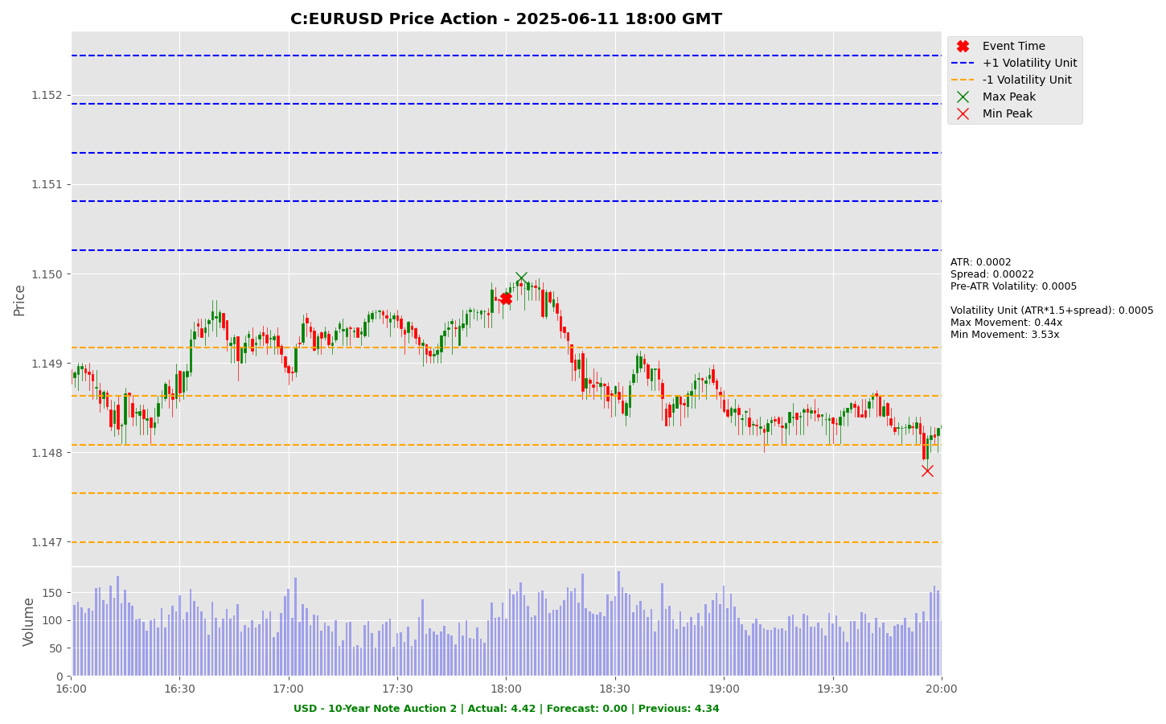

Slide 58
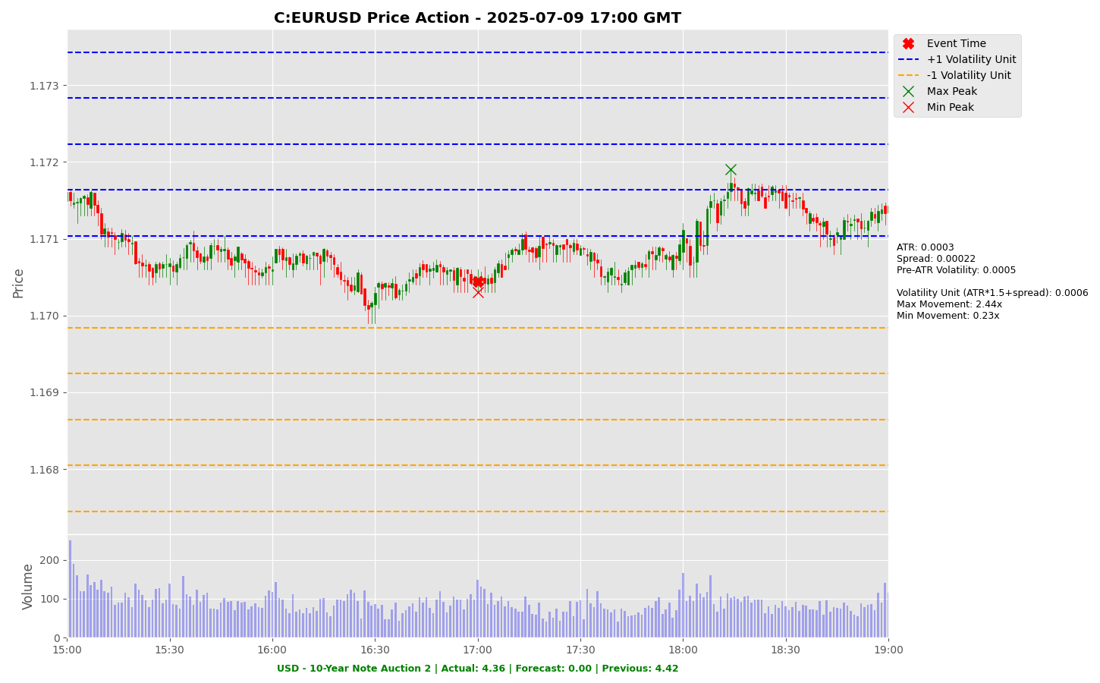

Slide 59
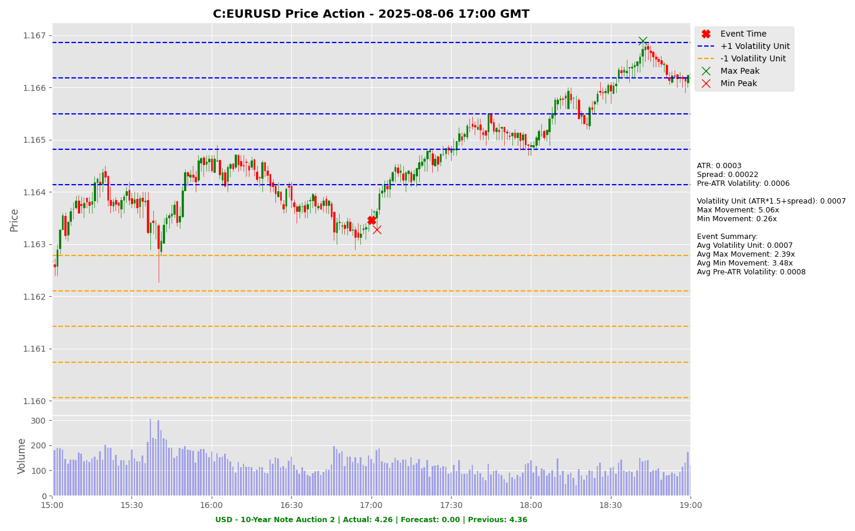

Slide 60
Project Spider Accelerating the Energy Transition 4thMar 2024 Pawan Quantwater Tech Investments
EUR - Deposit Facility Rate (Sep)

Slide 61
EUR - Deposit Facility Rate (Sep)
Event | EUR - Deposit Facility Rate (Sep) |  |  | Description
Actual: |  |  |  | The deposit facility is the rate which banks may use to make overnight deposits with the Eurosystem.] Learn More: EURJPY | EURUSD
Forecast: | 2.00%
Previous: | 2.0%
Time (GMT): | 12:15
Release Date | Actual | Forecast | Previous
24-Jul-25 | 2.00% | 2.00% | 2.00%
05-Jun-25 | 2.00% | 2.00% | 2.25%
17-Apr-25 | 2.25% | 2.25% | 2.50%
06-Mar-25 | 2.50% | 2.50% | 2.75%
30-Jan-25 | 2.75% | 2.75% | 3.00%
12-Dec-24 | 3.00% | 3.00% | 3.25%

Slide 62
Project Spider Accelerating the Energy Transition 4thMar 2024 Pawan Quantwater Tech Investments
EUR - Deposit Facility Rate (Sep)
EURJPY

Slide 63
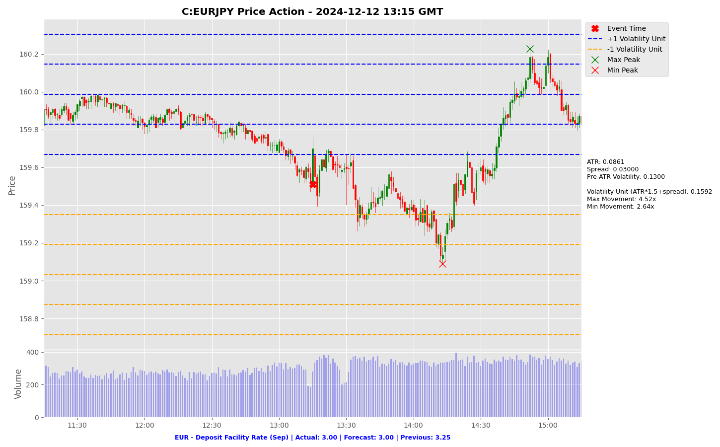

Slide 64
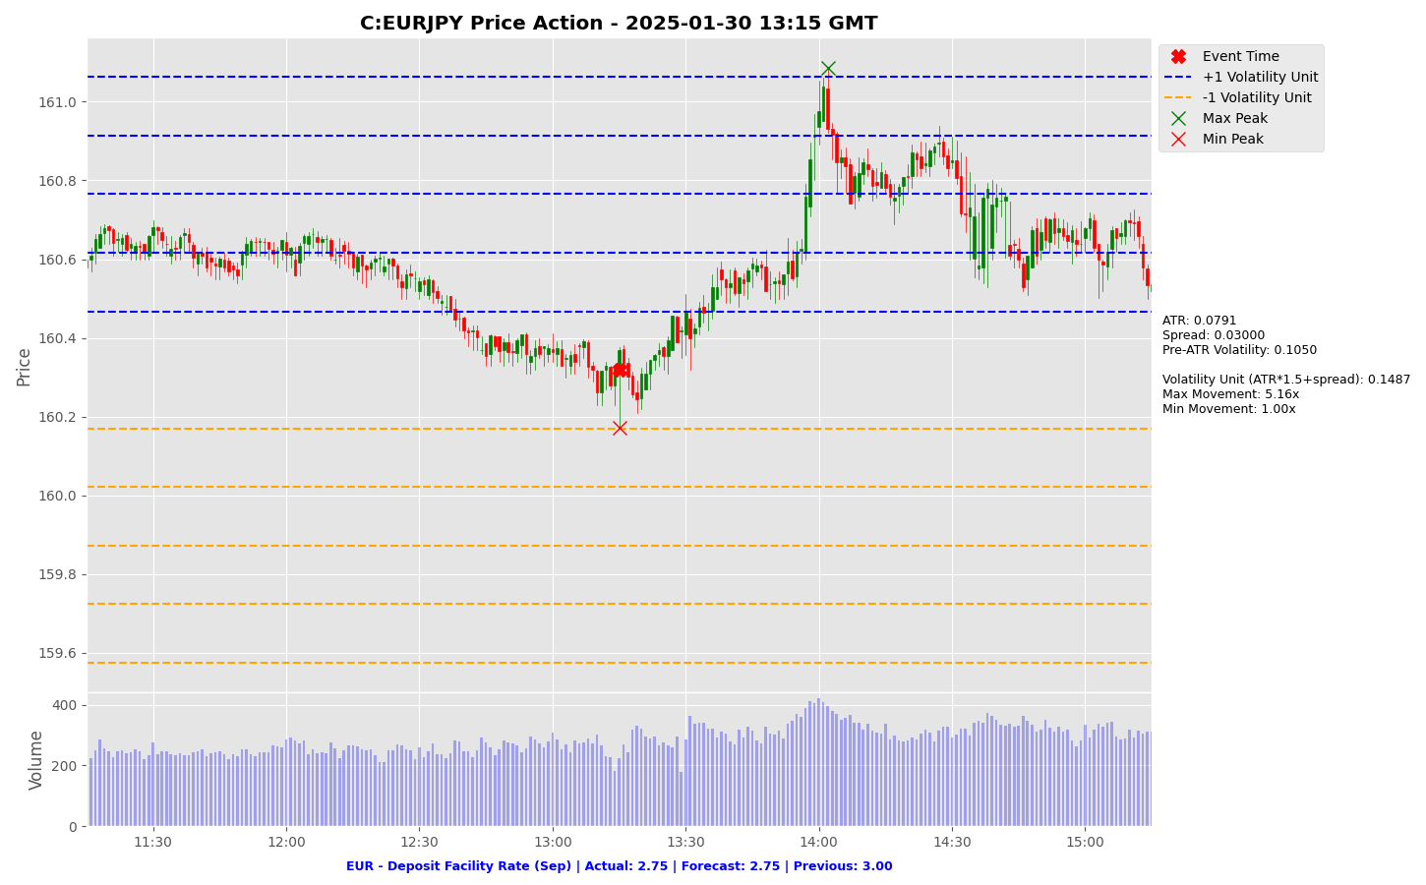

Slide 65
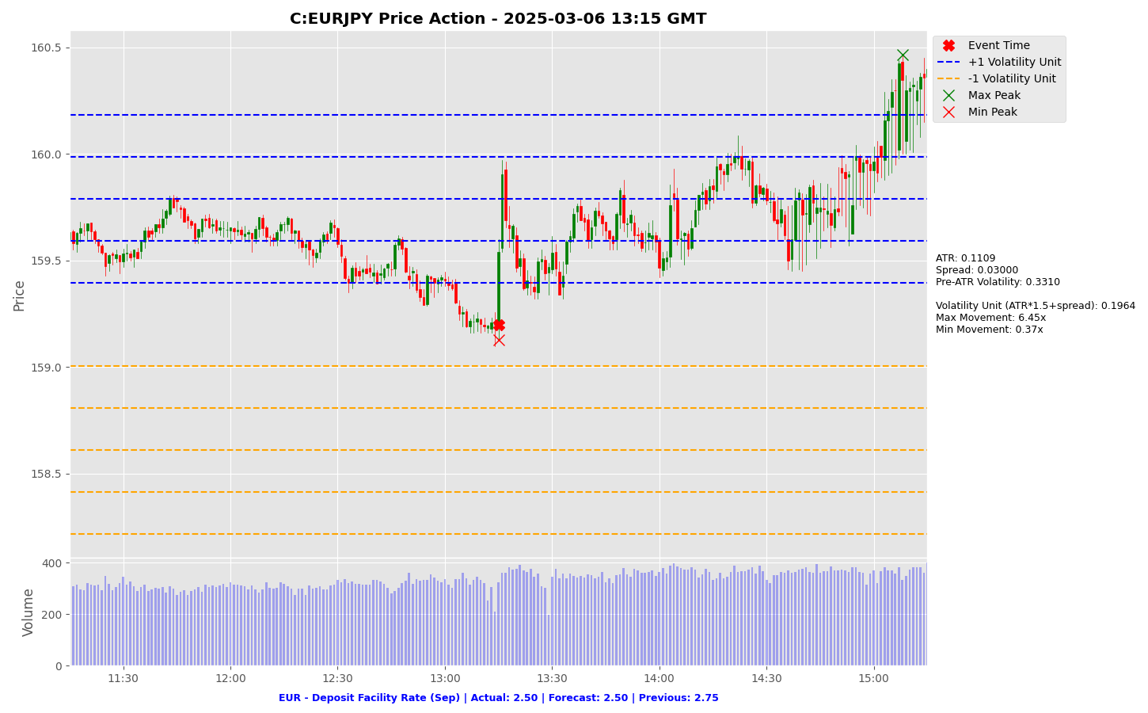

Slide 66
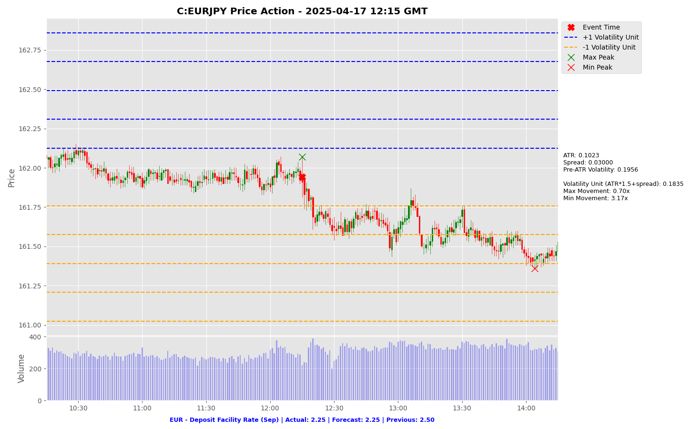

Slide 67
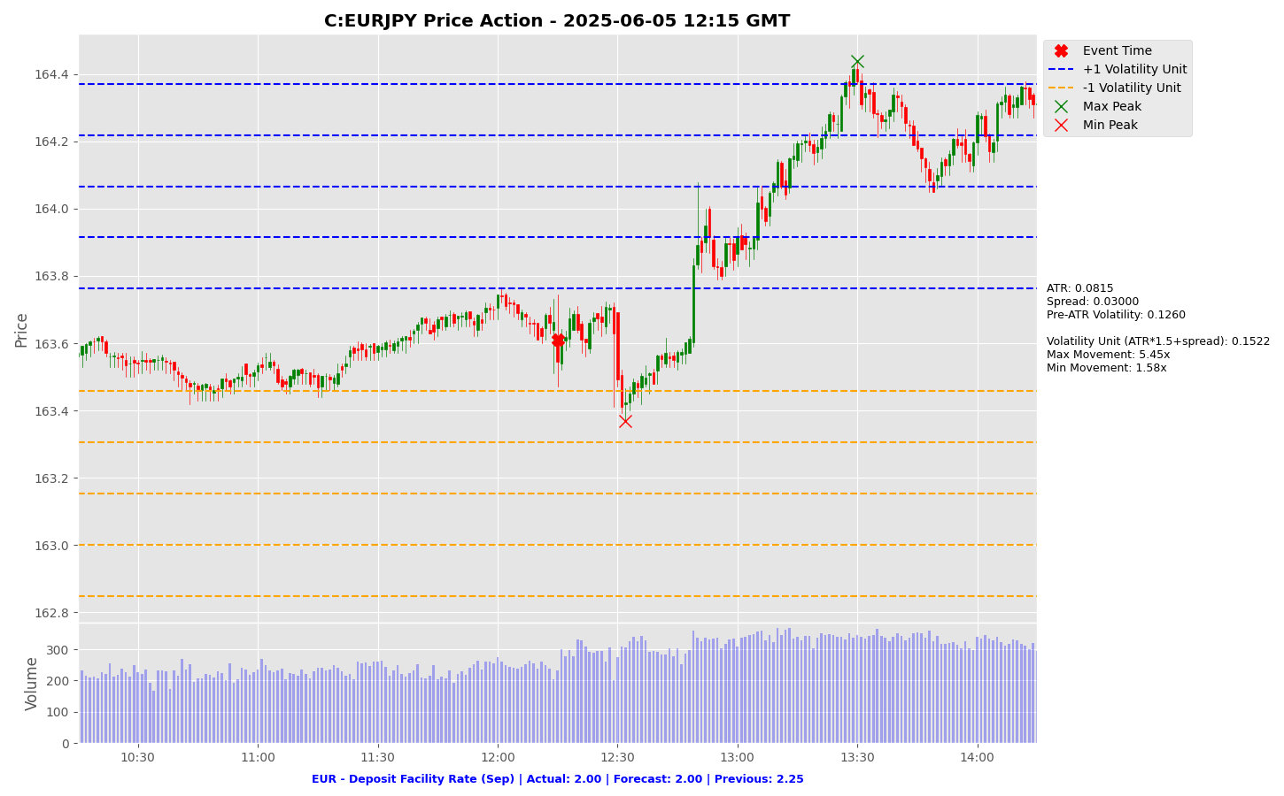

Slide 68
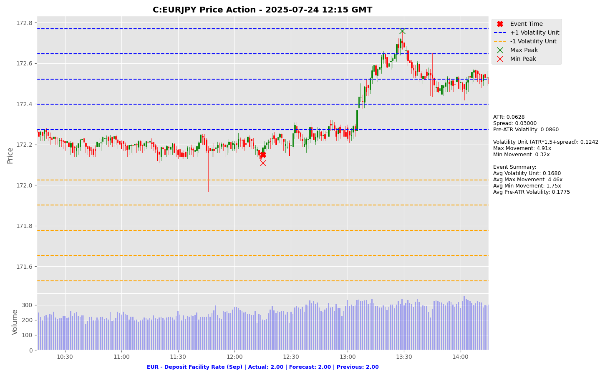

Slide 69
Project Spider Accelerating the Energy Transition 4thMar 2024 Pawan Quantwater Tech Investments
EUR - Deposit Facility Rate (Sep)
EURUSD

Slide 70
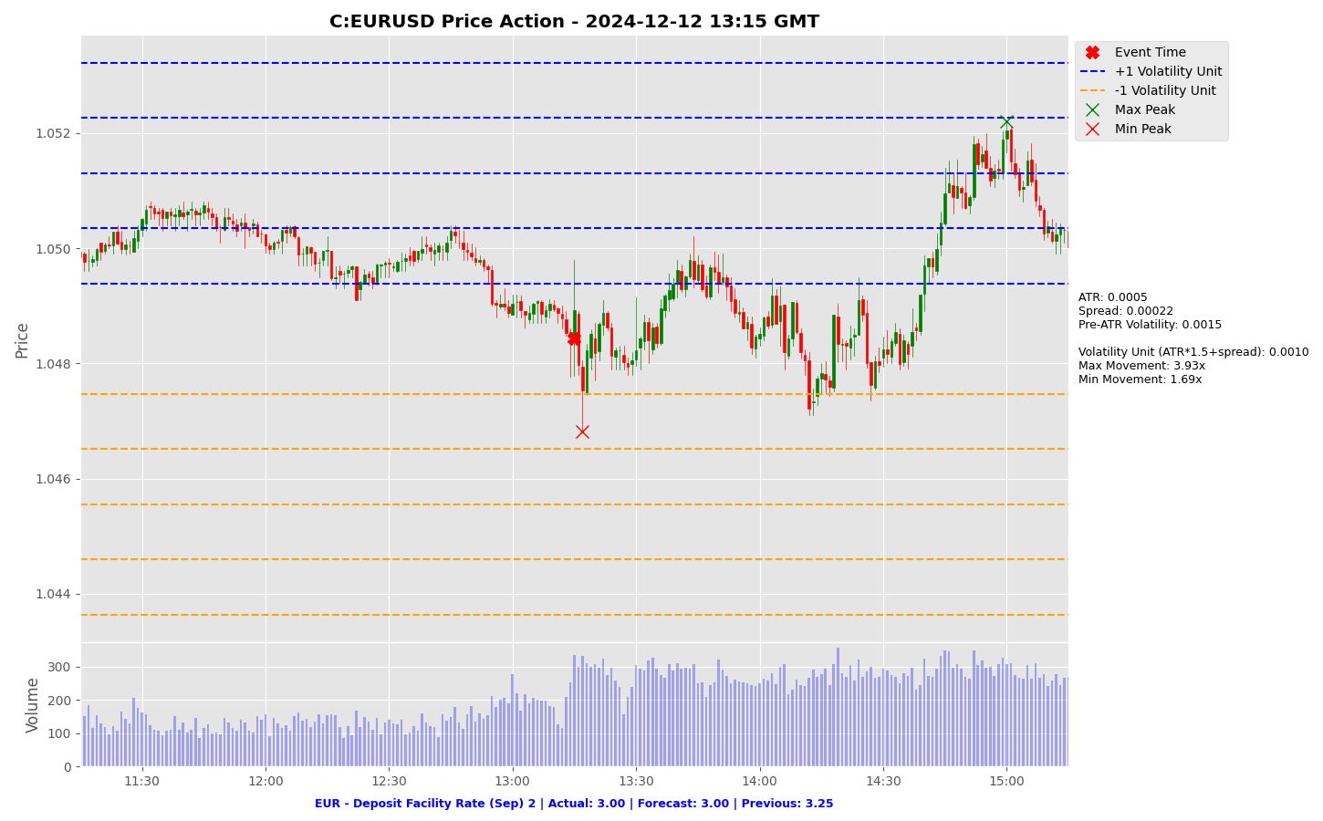

Slide 71


Slide 72


Slide 73


Slide 74


Slide 75


Slide 76
Project Spider Accelerating the Energy Transition 4thMar 2024 Pawan Quantwater Tech Investments
EUR - ECB Interest Rate Decision (Sep)

Slide 77
EUR - ECB Interest Rate Decision (Sep)
Event | EUR - ECB Interest Rate Decision (Sep) |  |  | Description
Actual: |  |  |  | The European Central Bank publishes its decision on where to set the benchmark interest rate. As short term interest rates are an important determinant of currency valuation, traders watch interest rate changes closely. A reading that is stronger than forecast is generally supportive (bullish) for the EUR, while a weaker than forecast reading is generally negative (bearish) for the EUR. Learn More: EURJPY | EURUSD
Forecast: | 2.15%
Previous: | 2.15%
Time (GMT): | 12:15
Release Date | Actual | Forecast | Previous
24-Jul-25 | 2.15% | 2.15% | 2.15%
05-Jun-25 | 2.15% | 2.15% | 2.40%
17-Apr-25 | 2.40% | 2.40% | 2.65%
06-Mar-25 | 2.65% | 2.65% | 2.90%
30-Jan-25 | 2.90% | 2.90% | 3.15%
12-Dec-24 | 3.15% | 3.15% | 3.40%

Slide 78
Project Spider Accelerating the Energy Transition 4thMar 2024 Pawan Quantwater Tech Investments
EUR - ECB Interest Rate Decision (Sep)
EURJPY

Slide 79


Slide 80


Slide 81


Slide 82


Slide 83


Slide 84


Slide 85
Project Spider Accelerating the Energy Transition 4thMar 2024 Pawan Quantwater Tech Investments
EUR - ECB Interest Rate Decision (Sep)
EURUSD

Slide 86


Slide 87


Slide 88


Slide 89


Slide 90


Slide 91


Slide 92
Project Spider Accelerating the Energy Transition 4thMar 2024 Pawan Quantwater Tech Investments
USD - Core CPI (MoM) (Aug)

Slide 93
USD - Core CPI (MoM) (Aug)
Event | USD - Core CPI (MoM) (Aug) |  |  | Description
Actual: |  |  |  | The Core Consumer Price Index (CPI) measures the changes in the price of goods and services, excluding food and energy. The Central bank pays very close attention to this figure in its role of maintaining price stability. Because the Fed believes that core inflation is a better gauge of underlying price pressures, it is more closely watched than overall inflation which tends to be more volatile. A reading that is stronger than forecast is generally supportive (bullish) for the USD, while a weaker than forecast reading is generally negative (bearish) for the USD. Learn More: USDJPY | EURUSD
Forecast: | 0.30%
Previous: | 0.30%
Time (GMT): | 12:30
Release Date | Actual | Forecast | Previous
12-Aug-25 | 0.30% | 0.30% | 0.20%
15-Jul-25 | 0.20% | 0.30% | 0.10%
11-Jun-25 | 0.10% | 0.30% | 0.20%
13-May-25 | 0.20% | 0.30% | 0.10%
10-Apr-25 | 0.10% | 0.30% | 0.20%
12-Mar-25 | 0.20% | 0.30% | 0.40%

Slide 94
Project Spider Accelerating the Energy Transition 4thMar 2024 Pawan Quantwater Tech Investments
USD - Core CPI (MoM) (Aug)
USDJPY

Slide 95


Slide 96


Slide 97


Slide 98


Slide 99


Slide 100


Slide 101
Project Spider Accelerating the Energy Transition 4thMar 2024 Pawan Quantwater Tech Investments
USD - Core CPI (MoM) (Aug)
EURUSD

Slide 102


Slide 103


Slide 104


Slide 105


Slide 106


Slide 107


Slide 108
Project Spider Accelerating the Energy Transition 4thMar 2024 Pawan Quantwater Tech Investments
USD - CPI (YoY) (Aug)

Slide 109
USD - CPI (YoY) (Aug)
Event | USD - CPI (YoY) (Aug) |  |  | Description
Actual: |  |  |  | The Consumer Price Index (CPI) measures the change in the prices of goods and services contained in a basket of consumer items. The Central bank pays very close attention to this figure in its role of maintaining price stability. A reading that is stronger than forecast is generally supportive (bullish) for the USD, while a weaker than forecast reading is generally negative (bearish) for the USD. Learn More: USDJPY | EURUSD
Forecast:
Previous: | 2.70%
Time (GMT): | 12:30
Release Date | Actual | Forecast | Previous
12-Aug-25 | 2.70% | 2.80% | 2.70%
15-Jul-25 | 2.70% | 2.60% | 2.40%
11-Jun-25 | 2.40% | 2.50% | 2.30%
13-May-25 | 2.30% | 2.40% | 2.40%
10-Apr-25 | 2.40% | 2.50% | 2.80%
12-Mar-25 | 2.80% | 2.90% | 3.00%

Slide 110
Project Spider Accelerating the Energy Transition 4thMar 2024 Pawan Quantwater Tech Investments
USD - CPI (YoY) (Aug)
USDJPY

Slide 111


Slide 112


Slide 113


Slide 114


Slide 115


Slide 116


Slide 117
Project Spider Accelerating the Energy Transition 4thMar 2024 Pawan Quantwater Tech Investments
USD - CPI (YoY) (Aug)
EURUSD

Slide 118


Slide 119


Slide 120


Slide 121


Slide 122


Slide 123


Slide 124
Project Spider Accelerating the Energy Transition 4thMar 2024 Pawan Quantwater Tech Investments
USD - CPI (MoM) (Aug)

Slide 125
USD - CPI (MoM) (Aug)
Event | USD - CPI (MoM) (Aug) |  |  | Description
Actual: |  |  |  | The Consumer Price Index (CPI) measures the change in the prices of goods and services contained in a basket of consumer items. The Central bank pays very close attention to this figure in its role of maintaining price stability. A reading that is stronger than forecast is generally supportive (bullish) for the USD, while a weaker than forecast reading is generally negative (bearish) for the USD. Learn More: USDJPY | EURUSD
Forecast: | 0.30%
Previous: | 0.20%
Time (GMT): | 20:20
Release Date | Actual | Forecast | Previous
28-May-25 | 0.20% | 0.20% | 0.30%
26-Feb-25 | 0.30% | 0.30% | 0.10%
20-Nov-24 | 0.10% | 0.20% | 0.20%
28-Aug-24 | 0.20% | 0.30% | -0.10%
22-May-24 | -0.10% | 0.10% | 0.20%
21-Feb-24 | 0.20% | 0.30% | 0.50%

Slide 126
Project Spider Accelerating the Energy Transition 4thMar 2024 Pawan Quantwater Tech Investments
USD - CPI (MoM) (Aug)
USDJPY

Slide 127


Slide 128


Slide 129


Slide 130


Slide 131


Slide 132


Slide 133
Project Spider Accelerating the Energy Transition 4thMar 2024 Pawan Quantwater Tech Investments
USD - CPI (MoM) (Aug)
EURUSD

Slide 134


Slide 140
Project Spider Accelerating the Energy Transition 4thMar 2024 Pawan Quantwater Tech Investments
USD - Initial Jobless Claims

Slide 141
USD - Initial Jobless Claims
Event | USD - Initial Jobless Claims |  |  | Description
Actual: |  |  |  | Initial Jobless Claims measures the number of people who filed for unemployment insurance for the first time during the past week. This is the most timely U.S. economic data, but the market impact varies from week to week. A reading that is higher than forecast is generally negative (bearish) for the USD, while a lower than forecast reading is generally supportive (bullish) for the USD. Learn More: USDJPY | EURUSD
Forecast:
Previous: | 237K
Time (GMT): | 12:30
Release Date | Actual | Forecast | Previous
04-Sep-25 | 237 | 230 | 229
28-Aug-25 | 229 | 231 | 234
21-Aug-25 | 235 | 226 | 224
14-Aug-25 | 224 | 225 | 227
07-Aug-25 | 226 | 221 | 219
31-Jul-25 | 218 | 222 | 217

Slide 142
Project Spider Accelerating the Energy Transition 4thMar 2024 Pawan Quantwater Tech Investments
USD - Initial Jobless Claims
USDJPY

Slide 143


Slide 144


Slide 145


Slide 146


Slide 147


Slide 148


Slide 149
Project Spider Accelerating the Energy Transition 4thMar 2024 Pawan Quantwater Tech Investments
USD - Initial Jobless Claims
EURUSD

Slide 150


Slide 151


Slide 152


Slide 153


Slide 154


Slide 155


Slide 156
Project Spider Accelerating the Energy Transition 4thMar 2024 Pawan Quantwater Tech Investments
EUR - ECB Press Conference

Slide 157
EUR - ECB Press Conference
Event | EUR - ECB Press Conference |  |  | Description
Actual: |  |  |  | The European Central Bank (ECB) press conference is held monthly, about 45 minutes after the Minimum Bid Rate is announced. The conference is approximately an hour long and has two parts. Firstly, a prepared statement is read, then the conference is open to press questions. The press conference examines the factors which affected the ECB's interest rate decision and deals with the overall economic outlook and inflation. Most importantly, it provides clues regarding future monetary policy. High levels of volatility can frequently be observed during the press conference as press questions lead to unscripted answers. Learn More: EURJPY | EURUSD
Forecast:
Previous: | -
Time (GMT): | 12:45
Release Date | Actual | Forecast | Previous
24-Jul-25
05-Jun-25
17-Apr-25
06-Mar-25
30-Jan-25
12-Dec-24

Slide 158
Project Spider Accelerating the Energy Transition 4thMar 2024 Pawan Quantwater Tech Investments
EUR - ECB Press Conference
EURJPY

Slide 159


Slide 160


Slide 161


Slide 162


Slide 163


Slide 164


Slide 165
Project Spider Accelerating the Energy Transition 4thMar 2024 Pawan Quantwater Tech Investments
EUR - ECB Press Conference
EURUSD

Slide 166


Slide 167


Slide 168


Slide 169


Slide 170


Slide 171


Slide 172
Project Spider Accelerating the Energy Transition 4thMar 2024 Pawan Quantwater Tech Investments
USD - 30-Year Bond Auction

Slide 173
USD - 30-Year Bond Auction
Event | USD - 30-Year Bond Auction |  |  | Description
Actual: |  |  |  | The figures displayed in the calendar represent the yield on the Treasury Bond auctioned. U.S. Treasury Bonds have maturities from ten up to 30 years. Governments issue treasuries to borrow money to cover the gap between the amount they receive in taxes and the amount they spend to refinance existing debt and/or to raise capital. The rate on a Treasury Bond represents the return an investor will receive by holding the bond for its entire duration. All bidders receive the same rate at the highest accepted bid. Yield fluctuations should be monitored closely as an indicator of the government debt situation. Investors compare the average rate at auction to the rate at previous auctions of the same security. Learn More: USDJPY | EURUSD
Forecast:
Previous: | 4.81%
Time (GMT): | 17:00
Release Date | Actual | Forecast | Previous
07-Aug-25 | 4.81% |  | 4.89%
10-Jul-25 | 4.89% |  | 4.84%
12-Jun-25 | 4.84% |  | 4.82%
08-May-25 | 4.82% |  | 4.81%
10-Apr-25 | 4.81% |  | 4.62%
13-Mar-25 | 4.62% |  | 4.75%

Slide 174
Project Spider Accelerating the Energy Transition 4thMar 2024 Pawan Quantwater Tech Investments
USD - 30-Year Bond Auction
USDJPY

Slide 175


Slide 176


Slide 177


Slide 178


Slide 179


Slide 180


Slide 181
Project Spider Accelerating the Energy Transition 4thMar 2024 Pawan Quantwater Tech Investments
USD - 30-Year Bond Auction
EURUSD

Slide 182


Slide 183


Slide 184


Slide 185


Slide 186


Slide 187


Slide 188
Project Spider Accelerating the Energy Transition 4thMar 2024 Pawan Quantwater Tech Investments
GBP - GDP (MoM) (Jul)

Slide 189
GBP - GDP (MoM) (Jul)
Event | GBP - GDP (MoM) (Jul) |  |  | Description
Actual: |  |  |  | The figures displayed in the calendar represent the yield on the Treasury Bond auctioned. U.S. Treasury Bonds have maturities from ten up to 30 years. Governments issue treasuries to borrow money to cover the gap between the amount they receive in taxes and the amount they spend to refinance existing debt and/or to raise capital. The rate on a Treasury Bond represents the return an investor will receive by holding the bond for its entire duration. All bidders receive the same rate at the highest accepted bid. Yield fluctuations should be monitored closely as an indicator of the government debt situation. Investors compare the average rate at auction to the rate at previous auctions of the same security. Learn More: GBPJPY | GBPUSD
Forecast:
Previous: | 0.40%
Time (GMT): | 06:00
Release Date | Actual | Forecast | Previous
14-Aug-25 | 0.40% | 0.20% | -0.10%
11-Jul-25 | -0.10% | 0.10% | -0.30%
12-Jun-25 | -0.30% | -0.10% | 0.20%
15-May-25 | 0.20% | 0.00% | 0.50%
11-Apr-25 | 0.50% | 0.10% | 0.00%
14-Mar-25 | -0.10% | 0.10% | 0.40%

Slide 190
Project Spider Accelerating the Energy Transition 4thMar 2024 Pawan Quantwater Tech Investments
GBP - GDP (MoM) (Jul)
GBPJPY

Slide 191


Slide 192


Slide 193


Slide 194


Slide 195


Slide 196


Slide 197
Project Spider Accelerating the Energy Transition 4thMar 2024 Pawan Quantwater Tech Investments
GBP - GDP (MoM) (Jul)
GBPUSD

Slide 198


Slide 199


Slide 200


Slide 201


Slide 202


Slide 203


Slide 204
Project Spider Accelerating the Energy Transition 4thMar 2024 Pawan Quantwater Tech Investments
EUR - German CPI (MoM) (Aug)

Slide 205
EUR - German CPI (MoM) (Aug)
Event | EUR - German CPI (MoM) (Aug) |  |  | Description
Actual: |  |  |  | The figures displayed in the calendar represent the yield on the Treasury Bond auctioned. U.S. Treasury Bonds have maturities from ten up to 30 years. Governments issue treasuries to borrow money to cover the gap between the amount they receive in taxes and the amount they spend to refinance existing debt and/or to raise capital. The rate on a Treasury Bond represents the return an investor will receive by holding the bond for its entire duration. All bidders receive the same rate at the highest accepted bid. Yield fluctuations should be monitored closely as an indicator of the government debt situation. Investors compare the average rate at auction to the rate at previous auctions of the same security. Learn More: USDJPY | EURUSD
Forecast: | 0.10%
Previous: | 0.30%
Time (GMT): | 06:00
Release Date | Actual | Forecast | Previous
29-Aug-25 | 0.10% | 0.00% | 0.30%
13-Aug-25 | 0.30% | 0.30% | 0.00%
31-Jul-25 | 0.30% | 0.20% | 0.00%
10-Jul-25 | 0.00% | 0.00% | 0.10%
30-Jun-25 | 0.00% | 0.20% | 0.10%
13-Jun-25 | 0.10% | 0.10% | 0.40%

Slide 206
Project Spider Accelerating the Energy Transition 4thMar 2024 Pawan Quantwater Tech Investments
EUR - German CPI (MoM) (Aug)
EURJPY

Slide 207


Slide 208


Slide 209


Slide 210


Slide 211


Slide 212


Slide 213
Project Spider Accelerating the Energy Transition 4thMar 2024 Pawan Quantwater Tech Investments
EUR - German CPI (MoM) (Aug)
EURUSD

Slide 214


Slide 215


Slide 216


Slide 217


Slide 218


Slide 219


Slide 220
Important Information
Quantwater Tech Investments
Data Release Deck – 07th September 2025
This document is for informational purposes only and does not constitute investment advice, an offer, or a solicitation to buy or sell any securities or financial instruments.
Past performance is not indicative of future results. Investments involve inherent risks, including the possible loss of principal. No representation or warranty, express or implied, is made regarding the accuracy, completeness, or reliability of the information contained herein.
The information in this presentation is derived from publicly available sources and internal analysis as of the date indicated and is subject to change without notice. Quantwater Tech Investments and its affiliates do not undertake any obligation to update or revise this material.
Neither Quantwater Tech Investments nor any of its affiliates, officers, or employees shall be liable for any direct or indirect losses arising from the use of this information. Any misrepresentation is strictly prohibited.

Slide 221
Thank You!
Thank You!
Pawan Jatale
pawan@quantwater.tech
Founder
Quantwater Tech Investments

