Slide 1










NETFLIX INSIGHTS
UNLEASHING THE POWER OF DATA:
INSIGHTS THAT INFORM AND INSPIRE
pawanyadav273life273@gmail.com
pawan-yadav-data

Slide 2
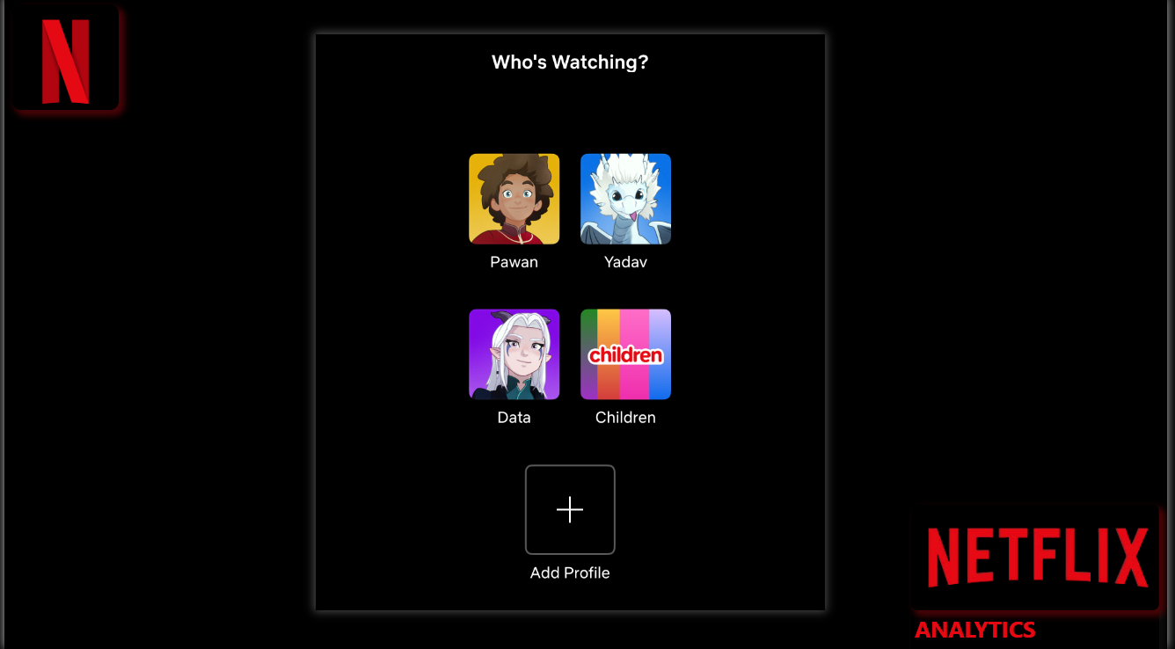

Slide 3
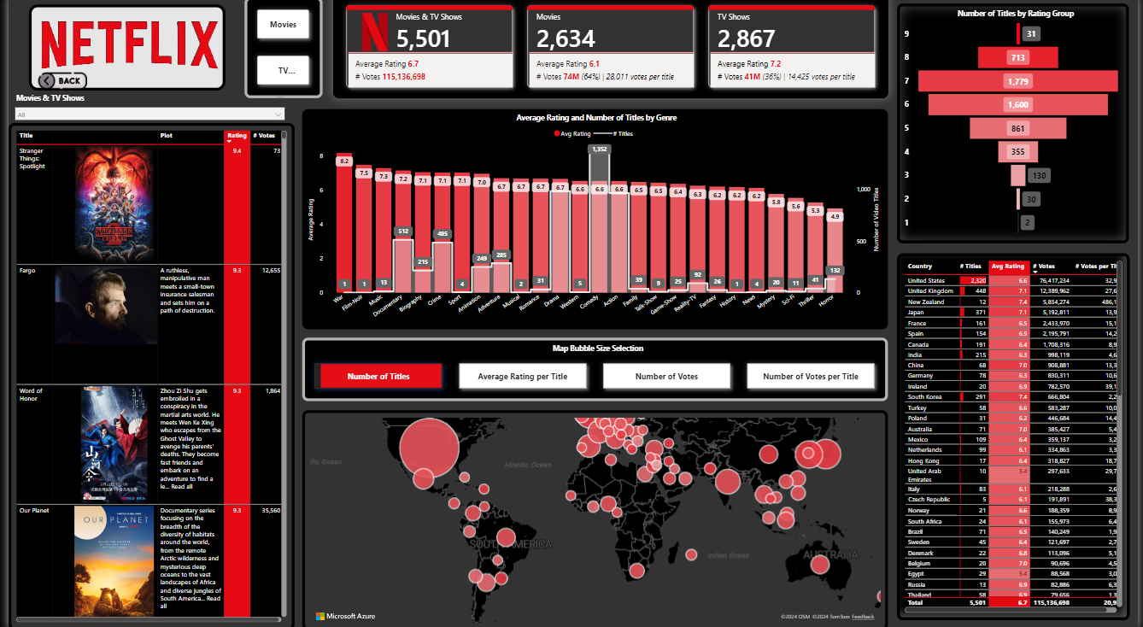

Slide 4

Live Dashboard Link
Click here to Access Live Dashboard

Slide 5

Project Walkthrough Video
Click here to Access Project overview video

