Slide 1
RASHTRAKAVI RAMDHARI SINGH DINKAR COLLEGE OF ENGINEERING, BEGUSARAI
PRESENTATION OF DATABASE MANAGEMENT SYSTEM
REPRESENTED BY
ARYAN ANKIT 22105125008
NAVEEN PRAKASH 22105125011
SHEKHAR SANU 22105125013
PRINCE KUMAR 22105125019
AYUSHMAAN SINGH 22105125025
NURUDDIN 22105125027
PAWAN KUMAR 22105125032

Slide 2
Introduction – What is DBMS?
DBMS (Database Management System) is a software system that allows users to:
Create, store, modify, and retrieve data efficiently.
Organize data in a structured format using tables or models.
Ensure data security, consistency, and integrity.
Example:
Popular DBMS tools include: MySQL, Oracle, Microsoft SQL Server, PostgreSQL, etc.

Slide 3
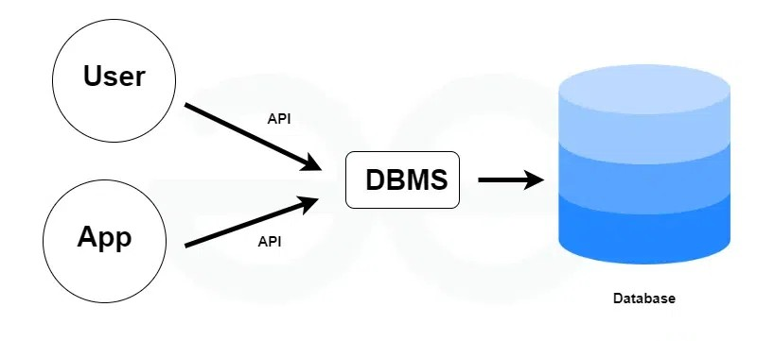

Slide 4
Importance of Data.
In today's world, data is the new fuel. Every organization relies on data to make decisions, analyze trends, and serve users.
Why Data is Important:
Helps in decision making.
Useful for analysis and predictions.
Essential for business operations.
Enables personalized services.
Problem:
Without proper management, data becomes disorganized, inaccurate, and hard to use.
Solution:
That’s why we need a Database Management System (DBMS) to handle data efficiently.

Slide 5
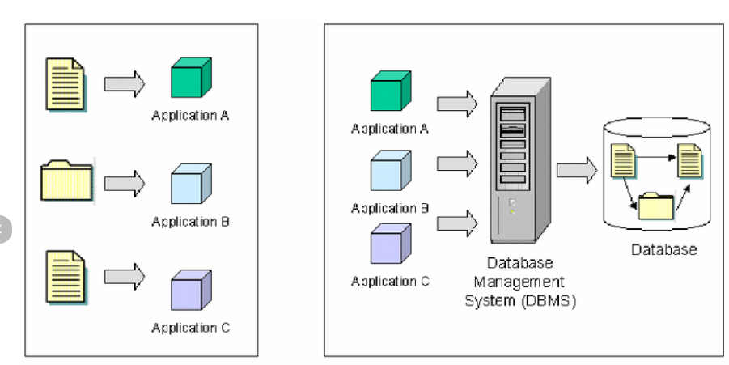
Scattered files vs. Organized database.

Slide 6
Need for DBMS.
As data grows in size and complexity, managing it manually becomes difficult. A DBMS solves these problems by providing a structured, secure, and efficient way to handle data.
Reasons We Need DBMS:
✅ To store large amounts of data efficiently
✅ To avoid data redundancy (duplicate data)
✅ To maintain data integrity and accuracy
✅ To allow multi-user access without conflict
✅ To provide data security and controlled access
✅ To support backup and recovery

Slide 7
Functions of DBMS.
A DBMS performs several key functions that help manage data efficiently and securely.
Key Functions of DBMS:
Data Storage Management ➤ Stores data in structured formats (tables, rows, columns)
Data Retrieval ➤ Allows users to access data quickly using queries (like SQL)
Data Manipulation ➤ Supports inserting, updating, and deleting records
Data Security ➤ Controls user access to sensitive data
Backup and Recovery ➤ Restores data in case of system failure
Data Integrity ➤ Ensures accuracy and consistency of data
Concurrency Control ➤ Allows multiple users to access data without conflict

Slide 8
Architecture of DBMS
DBMS architecture describes how data is stored, accessed, and managed within the system. The most common model is the three-level architecture.
Three Levels of DBMS Architecture:
Internal Level (Physical Level)
Deals with how data is actually stored on storage devices.
Conceptual Level (Logical Level)
Describes the structure of the entire database for the organization.
External Level (View Level)
Defines how users view the data (can be different for different users).
Benefits:
Data Abstraction
Improved Security
Flexibility for multiple users
Flexibility for multiple users

Slide 9
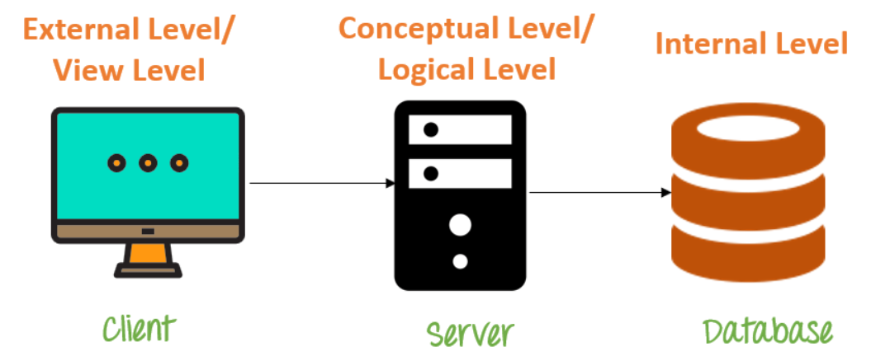
Three level of view.

Slide 10
Components of DBMS
A DBMS consists of several key components that work together to manage data efficiently.
Hardware
Physical devices (servers, storage, computers)
Software
DBMS software that controls the database (e.g., MySQL, Oracle)
Data
Raw facts stored in the database

Slide 11
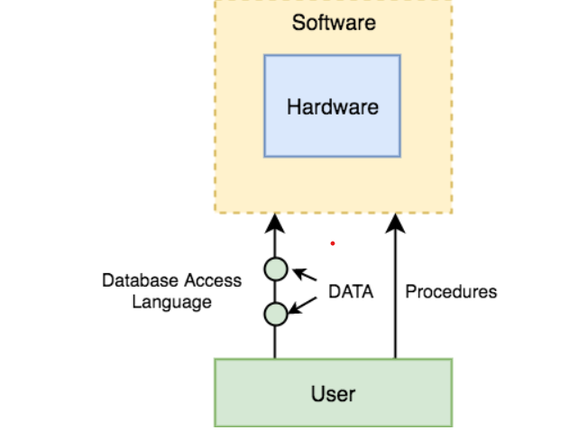
Users
Different types: • Database Administrator (DBA) • Application Programmers • End-users
Procedures
Instructions and rules for using the DBMS

Slide 12
Data Models Overview
A Data Model defines how data is connected, stored, and accessed in a DBMS. It provides a logical structure for a database.
Hierarchical Model ➤ Data is organized in a tree-like structure.
Network Model ➤ Data is represented as records connected by links (graph).
Relational Model ➤ Data is stored in tables (rows and columns).
Object-Oriented Model ➤ Combines database and object-oriented programming features.
Why Data Models Matter:
Helps in designing databases
Defines relationships between data
Ensures consistency and accuracy

Slide 13
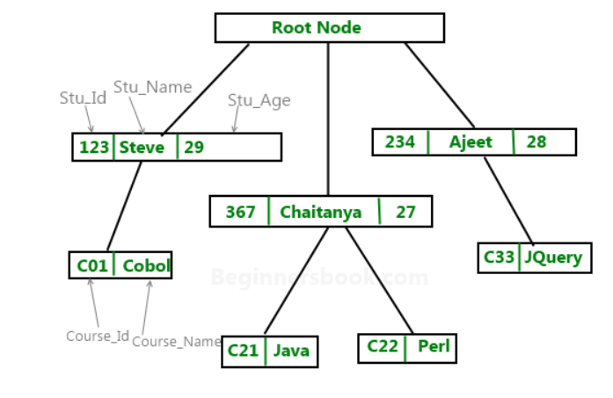
HIERARCHIICAL MODEL
Data is organized in a Tree structure.

Slide 14
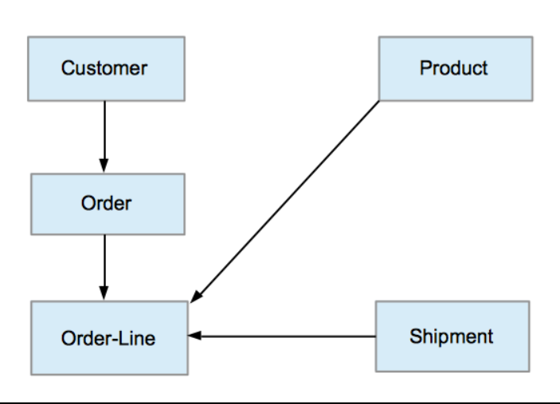
NETWORK MODEL
Data is represented in network model.

Slide 15
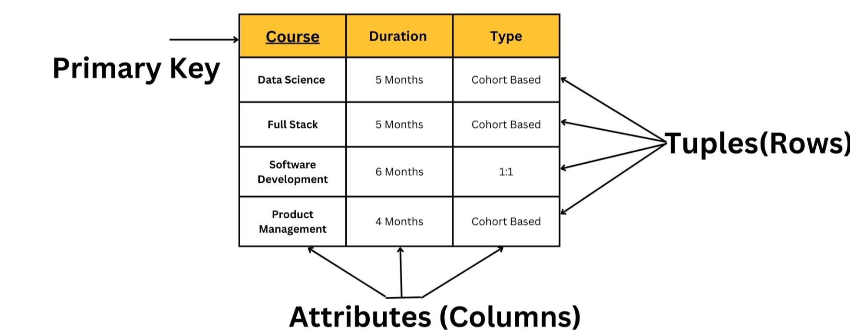
RELATIONAL MODEL
Data is stored in tables and row in the form of entities and attributes.

Slide 16
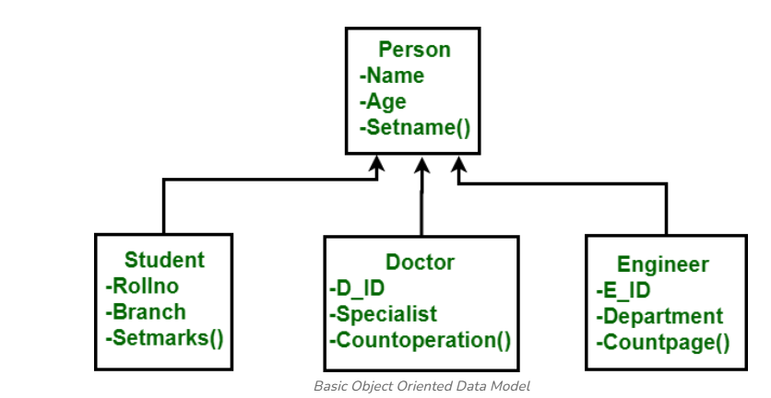
OBJECT ORIENTED MODEL.
Data is placed in object oriented forms.

Slide 17
Introduction to SQL
SQL (Structured Query Language) is the standard language used to interact with a Relational Database Management System (RDBMS).
What SQL Does:
Create and manage database structures
Insert, update, and delete data
Query and retrieve information from the database
Control user access and security
Why SQL is Important:
Easy to learn and use
Used in almost all RDBMS like MySQL, Oracle, PostgreSQL
Enables efficient data handling

Slide 18
Types of SQL Commands.
SQL commands are categorized based on their functionality in a database. Each type performs specific operations
1. DDL (Data Definition Language):
Used to define and modify the structure of database objects.
Commands: CREATE, ALTER, DROP
2. DML (Data Manipulation Language):
Used to manipulate data stored in tables.
Commands: INSERT, UPDATE, DELETE
3. DQL (Data Query Language):
Used to query and fetch data from the database.
Command: SELECT

Slide 19
4. DCL (Data Control Language):
Controls access to data in the database.
Commands: GRANT, REVOKE
5. TCL (Transaction Control Language):
Manages transactions in a database.
Commands: COMMIT, ROLLBACK, SAVEPOINT

Slide 20
Basic SQL Examples
Create Table:
CREATE TABLE Students (
ID INT,
Name VARCHAR(50),
Grade CHAR(1) );
Insert Data:
INSERT INTO Students (ID, Name, Grade)
VALUES (1, 'Anushka', 'A’);
Fetch Data:
SELECT * FROM Students;

Slide 21
Advantages of DBMS
A Database Management System offers many benefits that make data handling efficient, secure, and reliable
Data Redundancy Control
➤ Avoids storing duplicate data.
Data Consistency
➤ Ensures uniform and accurate data across the system.
Data Security
➤ Allows user access control and protects sensitive information.
Backup and Recovery
➤ Automatic backup systems protect data from loss.
Efficient Data Access
➤ Fast query processing and easy data retrieval.

Slide 22
Disadvantages of DBMS
High Cost
➤ DBMS software and hardware can be expensive.
Complexity
➤ Requires trained personnel to manage and operate.
Large Size
➤ DBMS software can take up significant storage space.
Performance Overhead
➤ Extra functionalities may slow down small operations.
Risk of Data Loss
➤ System failure or security breaches can result in data loss (if not
properly backed up).

Slide 23
Applications of DBMS
🌐 Common Applications:
Banking Systems
➤ Manage customer accounts, transactions, and loans securely.
Education
➤ Store student records, results, attendance, and course details.
Healthcare
➤ Maintain patient information, medical history, and billing.
Telecommunications
➤ Handle customer data, billing systems, and call records.
E-commerce
➤ Manage product inventories, orders, and customer profiles.

Slide 24
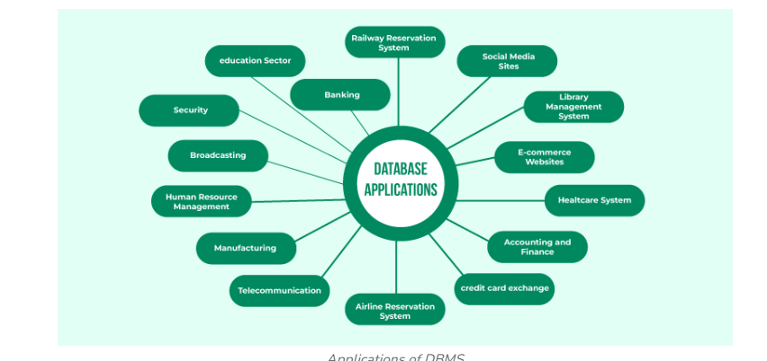

Slide 25
Future Trends in DBMS
As technology evolves, Database Management Systems are also advancing to meet new demands.
Cloud Databases
➤ Shift from local servers to cloud-based solutions (e.g., AWS, Azure).
Big Data Integration
➤ Handling large-scale, unstructured data from multiple sources.
AI & Machine Learning Integration
➤ Smarter query processing, automated indexing, predictive analytics.
NoSQL & New Data Models
➤ Use of non-relational databases for flexibility and scalability.
Blockchain Databases
➤ Decentralized data storage for enhanced security and transparency.

