Slide 1
AVISPA
Automated Validation of Internet Security Protocols and Applications

Slide 2
Avispa Tool
The Avispa Tool is a framework designed for the automated validation of security protocols and applications. Its primary function is to analyze the security properties of these protocols to ensure they are robust against various cyber threats.
At its core, Avispa uses a high-level protocol specification language called HLPSL (High-Level Protocol Specification Language). This language allows the user to describe protocols in an abstract way, focusing on their main security properties and mechanisms rather than low-level implementation details.

Slide 3
SPAN
SPAN, the Security Protocol ANimator for AVISPA, has been released!
SPAN is designed to help protocol developers in writing HLPSL specifications. From an HLPSL specification SPAN helps in interactively buiding Message Sequence Charts (MSC) of the protocol execution. Since SPAN implements an active intruder, it can also be used to interactively find and build attacks over protocols.

Slide 4
This is AVISPA:
AVISPA aims at developing a push-button, industrial-strength technology for the analysis of large-scale Internet security-sensitive protocols and applications. This technology will speed up the development of the next generation of network protocols, improve their security, and therefore increase the public acceptance of advanced, distributed IT applications based on them.
A central aim of the project is then to integrate this technology into a robust automated tool, tuned on practical, large-scale problems, and migrated to standardization bodies, whose protocol designers are in need of such tools.

Slide 5
The tool operates in several stages:
Specification: The user writes the protocol in HLPSL, specifying the roles involved, the messages exchanged, and the security properties expected (like secrecy or authentication).
Translation: The HLPSL specification is then automatically translated into a lower-level format that is suitable for analysis. This translation is handled by the tool itself.
Analysis: Avispa integrates several backend analyzers, each with its strengths and approaches to protocol analysis. These include tools like OFMC (On-the-Fly Model Checker) and CL-AtSe (Constraint-Logic-based Attack Searcher).
Results Interpretation: The output from the analyzers is then interpreted. Avispa can provide insights into potential vulnerabilities, confirming if the specified security properties are upheld or if there are scenarios where these can be violated.
Iterative Refinement: Based on the results, the user can refine the protocol specification to address any identified weaknesses and run the analysis again.

Slide 6
1. Specification
In this stage, a protocol is written in the High-Level Protocol Specification Language (HLPSL).
Example 1:
Roles and Messages: Consider a simple authentication protocol involving two roles – a client (Alice) and a server (Bob). Alice sends her ID to Bob, and in response, Bob sends a nonce (a random number) back. Alice then replies with the nonce encrypted with a shared secret key.
Security Properties: The protocol's main goal might be to ensure authentication (Alice proving her identity to Bob) and secrecy (the nonce should not be comprehensible to eavesdroppers).

Slide 7
1. Specification
Example 2:
Roles and Messages: In a key exchange protocol, there are two parties (say Alice and Bob again) and a trusted server. Alice requests a session key from the server, which sends a key encrypted with Alice's and Bob's individual keys. Alice decrypts her part, re-encrypts it with Bob's key, and sends it to Bob.
Security Properties: The aim here is to securely exchange a session key, ensuring both secrecy (the key should remain confidential) and key freshness (every session should have a new key).

Slide 8
2. Translation
This stage involves converting the HLPSL protocol into an intermediate format for analysis.
Example 1:
From HLPSL to Intermediate Format: Alice's and Bob's message exchanges are translated into a sequence of lower-level operations that mimic the exchange of messages, checks for correctness, and the encryption/decryption processes.
EX2: Translation Specifics: The key exchange steps, including requests, generation, encryption, decryption, and forwarding of keys, are translated into a form that can be processed by the backend analyzers.

Slide 9
3. Analysis
Avispa utilizes several backend analyzers like OFMC and CL-AtSe, each suitable for different kinds of analysis.
Example 1:
Using OFMC: This analyzer might simulate various scenarios to test if an intruder can intercept or forge messages in the simple authentication protocol.
CL-AtSe Analysis: For the key exchange protocol, CL-AtSe might test if there are logical flaws that would allow an attacker to deduce the session key or impersonate a participant.

Slide 10
4. Results Interpretation
After the analysis, the results are interpreted to determine if the security properties are upheld.
Example 1:
Authentication Protocol Results: The analysis might reveal a vulnerability where an intruder can replay an old nonce, breaking the protocol's authentication goal.
Key Exchange Results: The results might confirm that the session key remains secret under normal circumstances, but under certain conditions (like a compromised server), the secrecy might be violated.

Slide 11
5. Iterative Refinement
Based on the analysis results, the protocol can be refined and reanalyzed.
Example 1:
Refinement for Authentication: To address the replay attack, a timestamp might be added to the nonce to ensure its freshness.
Refinement for Key Exchange: If a vulnerability is found when the server is compromised, an additional layer of encryption or a different key distribution method might be introduced.

Slide 12
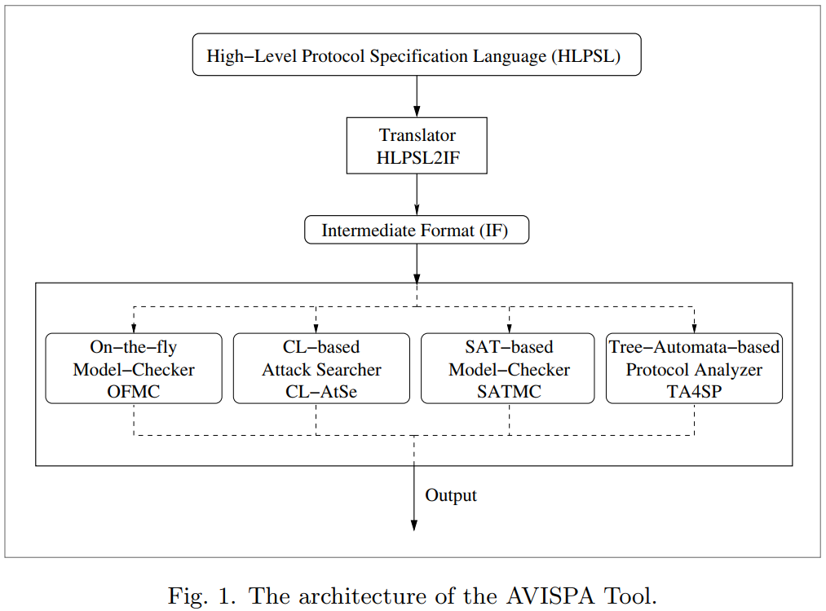

Slide 13
HLPSL
The High-Level Protocol Specification Language (HLPSL) is a crucial component in the architecture of the AVISPA Tool. HLPSL is specifically designed to enable the formal specification of security protocols and their properties in a way that is both abstract and expressive. Let's explore its role and features in the context of AVISPA's architecture:

Slide 14
Role in AVISPA's Architecture
Interface for Protocol Specification: HLPSL is the primary language used by protocol designers to describe the behavior of security protocols within the AVISPA framework. It serves as the interface between the user's protocol design and the automated analysis tools of AVISPA.
Abstraction Layer: HLPSL provides an abstraction layer that allows users to focus on the high-level logic and security properties of the protocol without delving into low-level implementation details.

Slide 15
Key Features of HLPSL
Role-Based Specification: HLPSL allows the definition of protocol roles (like initiator, responder, or server). Each role encapsulates the actions and states relevant to a participant in the protocol.
Multi-Role Protocols: HLPSL supports the specification of protocols involving multiple roles, facilitating the description of complex interactions between different entities.
Message Exchanges: The language allows specifying the messages exchanged between roles, including the order and the conditions under which these exchanges occur.
Security Properties: HLPSL enables the explicit declaration of security properties that the protocol aims to achieve, such as confidentiality, authentication, and integrity.
Modular Structure: HLPSL supports a modular approach, allowing components of the protocol to be specified and analyzed independently before being integrated into a larger system.

Slide 16
Integration with AVISPA's Analysis Components
Translation to Intermediate Format: Once a protocol is specified in HLPSL, the AVISPA Tool automatically translates this high-level description into an intermediate format. This format is compatible with the various backend analyzers included in AVISPA.
Compatibility with Analyzers: The translated protocol is then processed by backend analyzers like OFMC (On-the-Fly Model Checker) and CL-AtSe (Constraint-Logic-based Attack Searcher). These tools analyze the protocol based on the security properties defined in the HLPSL specification.
Feedback for Refinement: The results from these analyzers provide feedback on the security properties of the protocol. If vulnerabilities are identified, the protocol can be refined in HLPSL and reanalyzed, making HLPSL integral to the iterative design and analysis process in AVISPA.

Slide 18
Functionality of HLPSL2IF
Translation Process: HLPSL2IF takes the abstract, high-level protocol specifications written in HLPSL and translates them into a lower-level, more concrete representation called the Intermediate Format (IF). This translation is essential because the backend analyzers in AVISPA (like OFMC and CL-AtSe) operate on this Intermediate Format.
Preserving Protocol Semantics: During this translation, HLPSL2IF ensures that the semantics of the protocol — the behavior, roles, message flows, and security properties — are accurately preserved in the Intermediate Format.
Handling Complex Constructs: HLPSL allows for quite complex protocol specifications including various roles, concurrent sessions, and intricate message exchanges. HLPSL2IF handles these complexities and translates them into a form that can be systematically analyzed.

Slide 19
Importance in AVISPA's Architecture
Bridge Between Specification and Analysis: HLPSL2IF acts as the bridge between the protocol specification stage and the analysis stage. It enables the transition from a human-readable and writable specification to a machine-readable format tailored for automated analysis.
Enabling Automated Analysis: Without HLPSL2IF, it would be challenging to analyze the high-level HLPSL specifications directly. This translator automates the process of converting these specifications into a format suited for the analytical tools, facilitating a seamless analysis workflow.
Flexibility and Extensibility: The use of HLPSL2IF allows for flexibility in the AVISPA Tool's architecture. New analysis tools can be added to AVISPA as long as they can work with or are adapted to the Intermediate Format.
Error Detection and Reporting: During the translation, HLPSL2IF can also perform checks for syntactical correctness and logical consistency in the HLPSL specifications. It plays a role in early error detection and reporting, which is crucial for the iterative refinement of protocols.

Slide 20
HLPSL2IF
HLPSL2IF is a vital component within the AVISPA architecture, enabling the transition from high-level protocol design in HLPSL to detailed, automated analysis by various backend tools. Its role in accurately and efficiently translating protocols into a form suitable for analysis is key to the effectiveness and usability of the AVISPA Tool in the field of security protocol analysis.

Slide 22
Intermediate Format (IF)
The Intermediate Format (IF) in the AVISPA tool architecture serves as a standardized representation of security protocols, bridging the gap between the high-level protocol specifications written in HLPSL and the lower-level analysis that is conducted by the backend analyzers.

Slide 23
Purpose of the Intermediate Format (IF)
Universal Language for Analyzers: The IF is a standardized, low-level language that each of the backend analyzers understands. It allows these analyzers to interpret the protocol specifications consistently.
Bridge Between HLPSL and Analyzers: IF acts as the intermediary between the high-level HLPSL (High-Level Protocol Specification Language) specifications and the backend analyzers. It is the output of the translation process carried out by HLPSL2IF and the input for the backend tools.

Slide 24
Features of the Intermediate Format
Detailed Protocol Representation: IF provides a detailed representation of the protocol, which includes the roles, actions, state transitions, and message exchanges defined in the original HLPSL specification.
Analyzable Format: The format is designed to be easily parsable by automated tools, which can process it to detect security flaws, verify properties, and simulate the behavior of protocol participants under various conditions.
Minimal Loss of Information: The translation into IF aims to minimize the loss of information from the high-level specification, ensuring that the analysis is as true to the original design as possible.

Slide 26
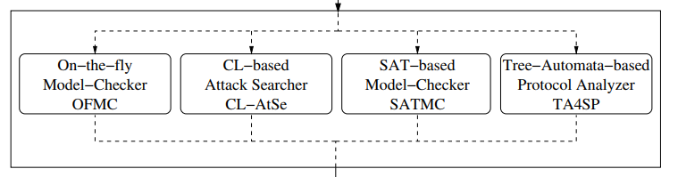
BACKEND ANALYSIS+

Slide 27
On-the-fly Model-Checker (OFMC)
Function: OFMC is a backend analyzer that performs automated security protocol verification. It uses an "on-the-fly" approach, meaning it dynamically constructs the state space of the protocol during the verification process rather than in advance.
Use Case: This is particularly useful for protocols with a large or infinite state space because it allows the analyzer to focus on the most relevant parts of the state space. It's good at finding attacks quickly and can handle a wide range of security properties.

Slide 28
On-the-fly Model-Checker (OFMC)
Real-life Example: Imagine a security checkpoint at a large international airport. The airport doesn't pre-plan checks for every passenger; instead, it performs checks dynamically as each passenger arrives, based on risk profiles and random selection. This is akin to the "on-the-fly" approach of OFMC.
Function: OFMC doesn't pre-compute the entire state space of a protocol (which could be very large or even infinite); it dynamically constructs states as it analyzes the protocol, which allows it to efficiently focus on the relevant parts of the protocol that might be susceptible to attacks.
Use Case: OFMC is particularly adept at handling security protocols used in online banking systems, where you have a vast number of transactions and user interactions. It can quickly identify potential security breaches by examining the transactions dynamically, just as the security checkpoint deals with passengers on a case-by-case basis.

Slide 29
BACKEND ANALYSIS+

Slide 30
Constraint-Logic-based Attack Searcher (CL-AtSe)
Function: CL-AtSe uses constraint logic programming to search for attacks against security protocols. It converts the protocol model and the security properties into a set of constraints and tries to find a solution that would constitute a breach of security.
Use Case: This tool is effective for protocols where potential attacks involve complex interactions and dependencies between different steps and messages in the protocol.

Slide 31
Constraint-Logic-based Attack Searcher (CL-AtSe)
Real-life Example: Consider a detective trying to solve a complex case with many suspects, where each suspect's alibi involves interactions with others. The detective uses clues to create constraints (alibis, times, motives) to eliminate suspects and find the culprit.
Function: CL-AtSe approaches protocol analysis similarly by converting the protocol and its expected security outcomes into a set of logical constraints. It then searches for scenarios that would violate these constraints, which would indicate a security flaw.
Use Case: CL-AtSe is effective in analyzing complex supply chain management systems where there are many dependent steps. If an attacker can exploit the dependencies between these steps, CL-AtSe would identify such a vulnerability.

Slide 32
BACKEND ANALYSIS+

Slide 33
SAT-based Model-Checker (SATMC)
Function: SATMC employs Boolean satisfiability solving techniques (SAT) to analyze protocols. It translates the problem of finding attacks on a protocol into a SAT problem, which is then solved using a SAT solver.
Use Case: SATMC is particularly useful for protocols where the underlying security properties can be effectively represented as Boolean equations. SAT solvers are very efficient and can handle large, complex protocols

Slide 34
SAT-based Model-Checker (SATMC)
Real-life Example: Think of a complex electrical circuit where you need to verify if a certain configuration of switches (true/false) will turn on all necessary lights. A SAT solver is like an electrician who tests combinations of switch positions to find a solution.
Function: SATMC converts the problem of finding vulnerabilities in a protocol into a SAT problem. It then uses a SAT solver, which is highly efficient at finding satisfying assignments to Boolean variables that would indicate a protocol attack.
Use Case: SATMC is useful for protocols with clearly defined logical conditions, such as access control systems where permissions might be based on a complex set of rules. SATMC can efficiently determine if there are rule combinations that would allow unauthorized access.

Slide 35
BACKEND ANALYSIS+

Slide 36
Tree Automata-based Protocol Analyzer (TA4SP)
Function: TA4SP uses tree automata techniques for the verification of security protocols. It translates the protocol into a tree structure and then applies tree automata to perform the analysis.
Use Case: This method is well-suited for dealing with protocols that have complex hierarchical message structures and can be used to verify a variety of security properties.

Slide 37
Tree Automata-based Protocol Analyzer (TA4SP)
Real-life Example: Imagine an organizational chart of a large corporation. To understand the flow of information and decision-making, you might analyze the chart from the CEO down to the interns, looking for any break in the hierarchy that could lead to miscommunication or unauthorized decisions.
Function: TA4SP looks at protocols as if they were tree structures, with the root representing the initial state and branches representing possible transitions. It then uses tree automata techniques to analyze the protocol's behavior.
Use Case: TA4SP is well-suited for protocols in complex software systems where different modules communicate hierarchically. If there’s a flaw in the communication structure that could be exploited to bypass security checks, TA4SP can help identify it.

Slide 38
BACKEND ANALYSIS

Slide 39
BACKEND ANALYSIS
these analyzers provide a comprehensive suite of tools for the analysis of security protocols within the AVISPA framework.
Depending on the specific characteristics of the protocol and the security properties of interest, different analyzers may be more or less suitable.
By offering a range of analysis methods, AVISPA allows users to choose the most effective tool for their particular needs or to use multiple analyzers in conjunction to ensure thorough analysis.
The dotted lines in the diagram indicate that these are separate modules within the architecture, and their analysis is not necessarily sequential; they can be used independently or in parallel as needed.

Slide 41
Next class

Slide 42
High Level Protocol Specification Language (HLPSL)
The HLPSL is the crux of AVISPA tool.
Any protocol or scheme to be tested by AVISPA is converted into HLPSL.
It explains the working of security protocols based on the security parameters to be tested.
The HLPSL transforms the under-trial protocols into roles.
There are two main roles specified by the HLPSL. These are basic roles and composed roles.
The basic roles describe the action of the entities (agents) that are part of the protocol.
The composed roles instantiate the basic roles that design the entire scheme (protocol) run.

Slide 43
Constants and Variables in HLPSL:
The HLPSL models the given protocols by defining the systems state. After defining the initial state, we specify the ways in which the state may change (depending on the function of each entity).
In HLPSL, the variables start with a capital letter while constants are written in small letters for easy identification.
Each variable and constant belong to a unique type. The state variables are defined in the basic roles.
The state variable indicates the current value of the variables used in the scheme. The future variables (also called prime variables) are not included in the basic role definition as they are generated later in the given scheme or protocol.

Slide 44
HLPSL Data Types:
The HLPSL is a typed programming language. Each variable and constant in HLPSL belongs to a specific type. Some of these are explained below.
agent: The agent represents the principal names used in the test protocol or scheme. Although the intruder is also an agent, it is represented by the letter (i).
symmetric_keys: These variable types represent the symmetric keys for encryption processes.
asymmetric_keys: The asymmetric key variables are used for asymmetric encryption/decryption process. For instance, for any public key (pk), the decryption key shall be inv(pk).
text: The text variable shows the nonces used in the protocol. The (fresh) attribute is added to the text variable to demonstrate the freshness of the nonces.
nat: The nat type represents the natural numbers. The nat is useful in non-message contexts. The examples include the test of number inequality (g: A < B) and modeling of countably infinite sets.
function: The function type represents different types of functions that are present in the protocol scheme and supported by the AVISPA tool. There are two types of functions in HLPSL. The functions that don’t change values throughout the protocol are called rigid functions. The other functions that change values (through mapping) are known as flexible functions.

Slide 45
HLPSL Syntax | BASIC ENTITIES
Lexical entities.
In HLPSL, all variables start with a capital letter, and constants start with a small letter; note that natural numbers can also be used as constants (without any specific interpretation).
var_ident: [A-Z][A-Za-z0-9_]*
const_ident: [a-z][A-Za-z0-9_]*
nat_ident: [0-9]+

Slide 46
HLPSL Syntax | Keywords
accept, agent, authentication_on, bool, channel, composition, cons, const, def=, delete, dy, end, exp, goal, hash, hash_func, iknows, in, init, intruder_knowledge, inv, local, message, nat, new, not, ota, played_by, protocol_id, public_key, request, role, secrecy_of, secret, set, start, symmetric_key, text, transition, weak_authentication_on, witness, wrequest, xor.

Slide 47
HLPSL Syntax | Keywords
accept: Not a standard HLPSL keyword, possibly user-defined or context-specific.
agent: Represents an entity that can perform actions within the protocol.
authentication_on: Used to specify that authentication should be performed.
bool: Denotes a Boolean data type.
channel: Defines a communication medium between agents.
composition: Used to combine roles or sessions to define the overall protocol.
cons: A constructor to build compound messages.
const: Declares a constant value.
def=: Begins the definition of a role or an environment.
delete: Not a standard HLPSL keyword, possibly user-defined or context-specific.
dy: Refers to a dynamic channel, which can be eavesdropped by an intruder.

Slide 48
HLPSL Syntax | Keywords
end: Marks the end of a role, environment, or goal definition.
exp: Represents an exponentiation operation, often used in cryptographic expressions.
goal: Used to define the security goals of the protocol.
hash: Refers to a hash operation, typically used for message digests.
hash_func: Represents a hash function.
iknows: Stands for "intruder knows," denoting what the intruder has knowledge of.
in: Used in the context of specifying what is within a set or list.
init: Specifies the initial state of a role.
intruder_knowledge: Defines what the intruder knows at the start of the protocol.
inv: Refers to the inverse of a key, typically the private key corresponding to a public key.

Slide 49
HLPSL Syntax | Keywords
local: Declares variables that are local to a role.
message: A type for messages being sent and received in the protocol.
nat: Refers to a natural number data type.
new: Used to generate fresh values, such as nonces or keys.
not: Represents logical negation.
ota: Not a standard HLPSL keyword, possibly user-defined or context-specific.
played_by: Indicates which agent plays a given role.
protocol_id: An identifier for a specific protocol.
public_key: Represents a public key in asymmetric cryptography.
request: Not a standard HLPSL keyword, but could be used to denote a request in the protocol.
role: Defines a role within the protocol.

Slide 50
HLPSL Syntax | Keywords
local: Declares variables that are local to a role.
message: A type for messages being sent and received in the protocol.
nat: Refers to a natural number data type.
new: Used to generate fresh values, such as nonces or keys.
not: Represents logical negation.
ota: Not a standard HLPSL keyword, possibly user-defined or context-specific.
played_by: Indicates which agent plays a given role.
protocol_id: An identifier for a specific protocol.
public_key: Represents a public key in asymmetric cryptography.
request: Not a standard HLPSL keyword, but could be used to denote a request in the protocol.
role: Defines a role within the protocol.

Slide 51
HLPSL Syntax | Keywords
secrecy_of: Used to define a secrecy goal for a given piece of data.
secret: Tags a piece of data as secret within the protocol.
set: A data type representing a collection of values.
start: Often used to indicate the beginning of a protocol or a signal to start the protocol.
symmetric_key: Represents a symmetric key used for encryption and decryption.
text: A data type for textual information.
transition: Defines state transitions within a role.
weak_authentication_on: Specifies a goal for weak authentication, usually meaning that one party assures the presence of another.
witness: Used to support authentication goals by asserting a witness property.
wrequest: Not a standard HLPSL keyword, possibly user-defined or context-specific.
xor: Represents the exclusive or operation, used in cryptographic expressions.

Slide 52
other constant names
Some other constant names are reserved and will be automatically renamed if used in a specification:
apply, attack_state, attack_states, contains, crypt, dummy_agent, dummy_bool, dummy_chnl, dummy_chnl_dy, dummy_chnl_ota, dummy_hash, dummy_msg, dummy_nat, dummy_nonce, dummy_pk, dummy_set, dummy_sk, equal, equations, initial_state, inits, intruder, leq, pair, properties, property, rules, scrypt, section, step, types.
have special significance in the HLPSL language or the internal workings of the tool.
They are typically renamed automatically if used in a specification to avoid conflicts with internal mechanisms.

Slide 53
other constant names
apply: Used in function application, but as a reserved word, it's often related to the application of rules or functions within the tool's analysis engine.
attack_state: A special state that represents a condition in which the security properties of the protocol are violated.
attack_states: Refers to the set of all possible attack states.
contains: Might be used to check if a set or sequence contains a certain element.
crypt: Usually refers to the cryptographic encryption function.
dummy_agent: A placeholder for an agent, often used in template or example specifications.
dummy_bool: A placeholder for a Boolean value.
dummy_chnl: A placeholder for a channel.

Slide 54
other constant names
dummy_chnl_dy: A placeholder for a dynamic channel, which can be overheard.
dummy_chnl_ota: A placeholder or example for a channel, possibly over-the-air or some other specific type.
dummy_hash: A placeholder for a hash function.
dummy_msg: A placeholder for a message.
dummy_nat: A placeholder for a natural number.
dummy_nonce: A placeholder for a nonce, a number used once in cryptographic communication.
dummy_pk: A placeholder for a public key.
dummy_set: A placeholder for a set.
dummy_sk: A placeholder for a symmetric key.

Slide 55
other constant names
equal: Used to denote equality, often in conditions or assertions.
equations: May refer to a set of equations defining relations in the protocol specification.
initial_state: The starting state of a role in the protocol.
inits: Could refer to the initial conditions or variables in a protocol.
intruder: Represents the potential attacker in the security protocol model.
leq: Represents the less than or equal to relation.
pair: A constructor for creating pairs or tuples of values.
properties: Refers to the security properties specified in the protocol.

Slide 56
other constant names
property: Singular form, referring to a single security property.
rules: Refers to the set of rules or transitions that define how the protocol proceeds.
scrypt: Could refer to a specific cryptographic script or function, not standard in HLPSL.
section: Might be used to define a particular section of a specification or document.
step: Represents a single action or transition step in the protocol.
types: Refers to the data types used in the protocol specification.

Slide 57
HLPSL specification comments and separators
comments: %ABCD
spaces: [\n\r\t ]
\n represents a newline character.
\r represents a carriage return character.
\t represents a tab character.

Slide 58
Structure of a HLPSL specification
A HLPSL specification is composed of three parts: a list of definitions of roles, a list of declarations of goals (if any), and the instantiation (read call) of the main role (usually without arguments).
SpecHLPSL ::=
Role_definition+
Goal_declaration?
% Call of the main role: (ex: environment() )
Role_instantiation

Slide 59
Definition of roles
The roles in a specification are of two kinds: basic roles played by agents, and composition roles describing the scenario to consider during analysis (for example, describing what is a session of the protocol, or what instances of sessions should be used).
% Roles may be either basic or compositional:
Role_definition ::=
Basic_role
| Composition_role

Slide 60
Definition of roles
Definition of a role. Roles are independent processes: they have a name, receive information by parameters and contain local declarations.
Basic roles are played by an agent whose name is received as parameter. The actions of a basic role are transitions, describing changes in their state depending on events or facts.

Slide 61
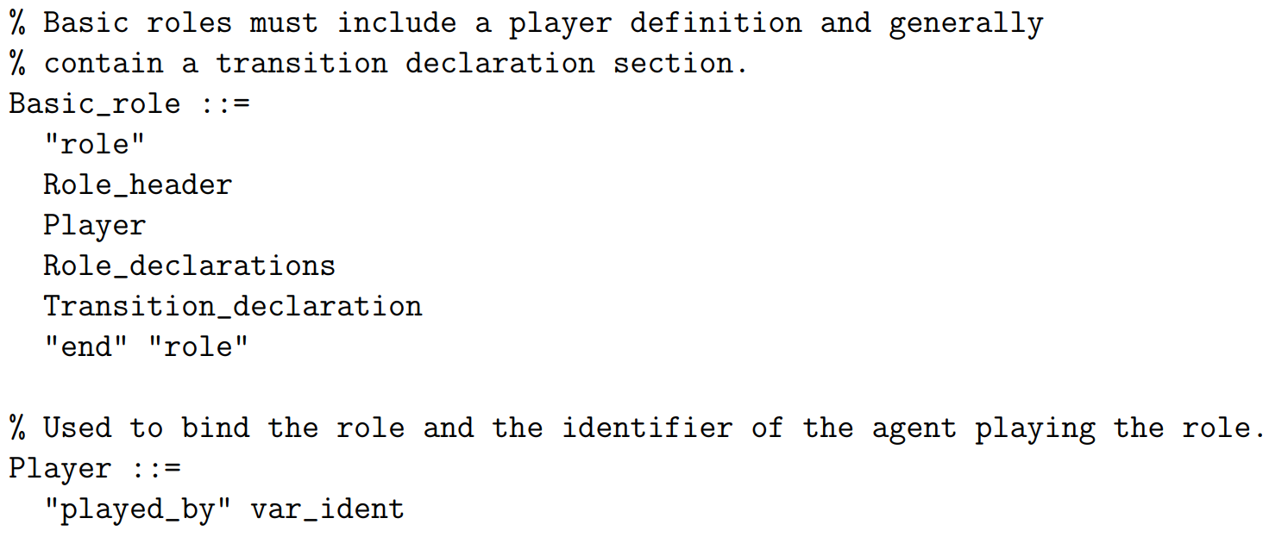
Definition of roles

Slide 62
Definition of roles
Basic_role Structure:
Basic_role is defined as a structure comprising several components that together describe the behavior and properties of a basic role in a security protocol.
"role": The keyword that begins the definition of a role.
Role_header: This would be where the role's name and the parameters (like agents and keys) are declared.
Player: This refers to the specific agent that will "play" or assume this role when the protocol is executed.
Role_declarations: Declarations of local variables, constants, and other role-specific information.
Transition_declaration: This part specifies the state transitions that the role can undergo, which are the core of the role's behavior in the protocol.
"end" "role": These keywords mark the end of the role definition.

Slide 63
Definition of roles

Slide 64
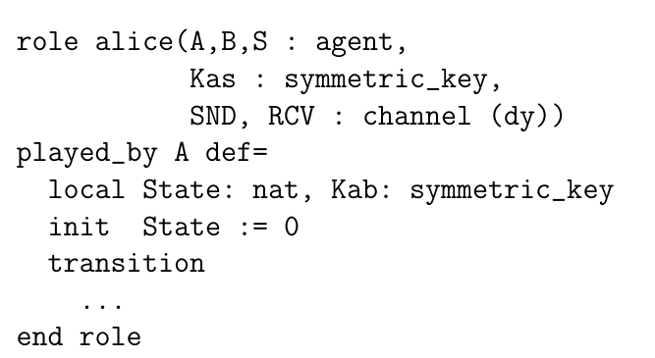
Alice is likely engaging in some form of communication or key exchange with another agent,

Slide 65
Alice is likely engaging in some form of communication or key exchange with another agent,
role alice begins the definition of a role named alice.
(A,B,S : agent, declares three parameters of the type agent, which are the entities involved in the protocol.
A represents Alice herself,
B is the agent Alice is communicating with, and
S could represent a server or third party.

Slide 66
Alice is likely engaging in some form of communication or key exchange with another agent,

Slide 67
Alice is likely engaging in some form of communication or key exchange with another agent,
Kas : symmetric_key, declares a parameter Kas which is of type symmetric_key.
This is a symmetric key that Alice shares with the server S (commonly used in protocols for encryption and decryption of messages).

Slide 68
Alice is likely engaging in some form of communication or key exchange with another agent,

Slide 69
Alice is likely engaging in some form of communication or key exchange with another agent,
SND, RCV : channel (dy)) declares two parameters SND and RCV which are of type channel (dy).
These represent the channels for sending (SND) and receiving (RCV) messages.
The (dy) indicates that these channels are dynamic, implying that messages sent over them can be overheard or intercepted by an intruder.

Slide 70
Alice is likely engaging in some form of communication or key exchange with another agent,

Slide 71
Alice is likely engaging in some form of communication or key exchange with another agent,
played_by A def= specifies that this role is played by the agent A (Alice), and begins the definition block for the role's behavior.
local State: nat, declares a local variable State of type natural number (nat) which is used to keep track of the current state within the role's execution (like a step in the protocol).
Kab: symmetric_key declares a local variable Kab which is of type symmetric_key. This is typically a session key that Alice will share with B for secure communication.

Slide 72
Alice is likely engaging in some form of communication or key exchange with another agent,

Slide 73
Alice is likely engaging in some form of communication or key exchange with another agent,
init State := 0 initializes the State variable to 0. This sets the initial state of the protocol for Alice.
transition begins the declaration of the state transitions for the role. The actual transitions would follow this keyword, defining how Alice moves from one state to another based on received messages and local computations.
.... = ach transition would have conditions and actions that dictate the protocol's flow.
end role signifies the end of the role definition.

Slide 74
Alice_Role is the Role_header defining a role for the agent Alice with parameters such as another agent Bob, a symmetric key Kas, and communication channels SND and RCV.
The role is played by the agent identified as Alice,
and it contains local declarations and
transitions
The role ends with end role.

Slide 75
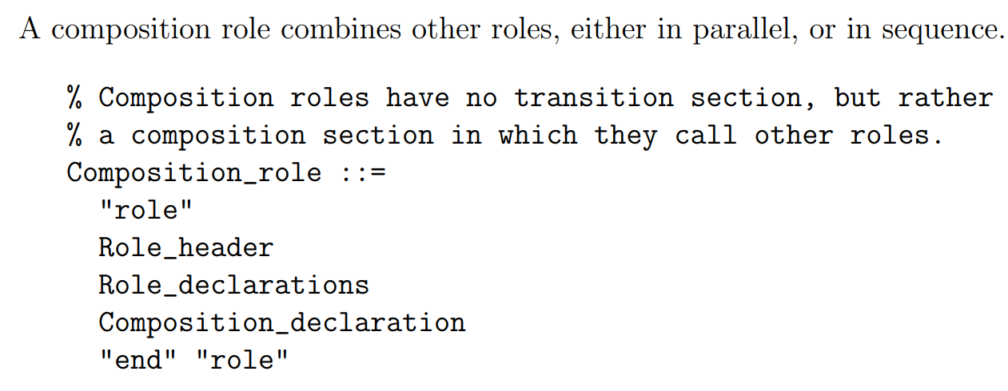
Definition of roles

Slide 76
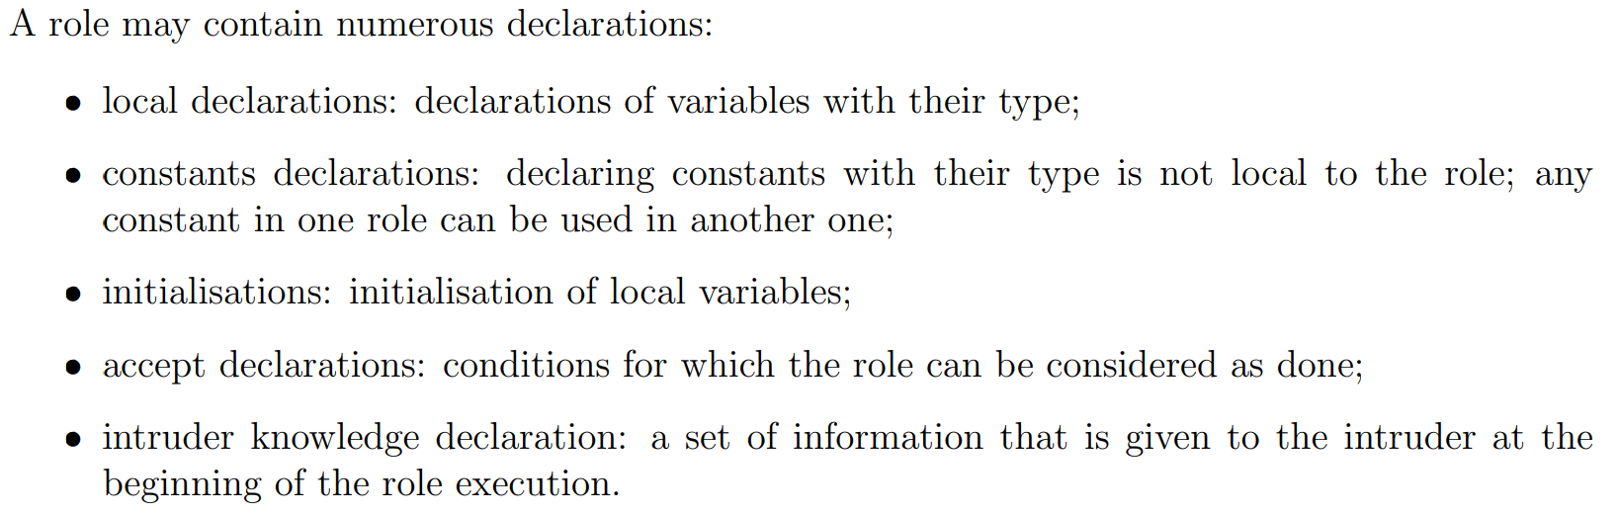
Declarations in roles

Slide 77
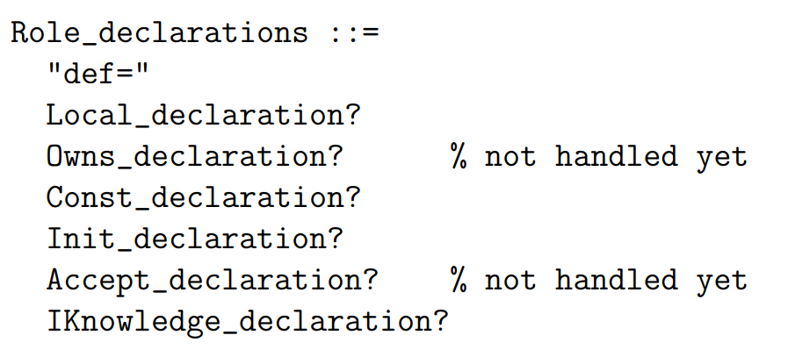
Declarations in roles

Slide 78
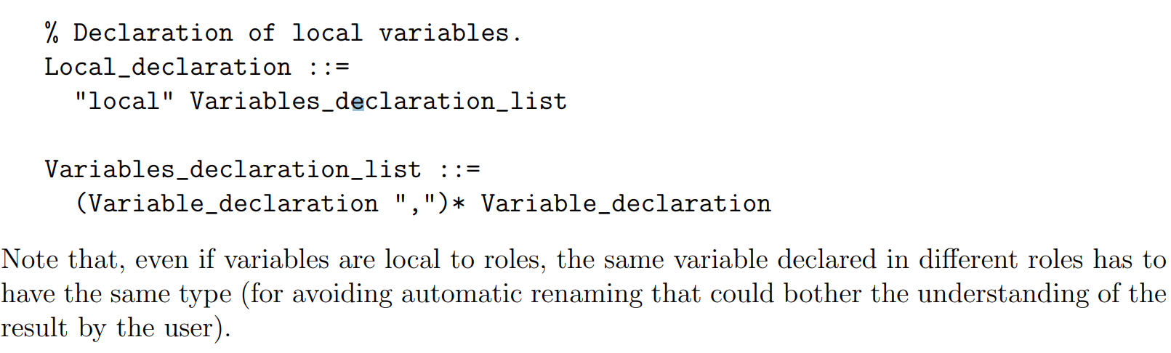
Declaration of local variables.
Declarations of variables are grouped by type, separated by a comma.

Slide 79
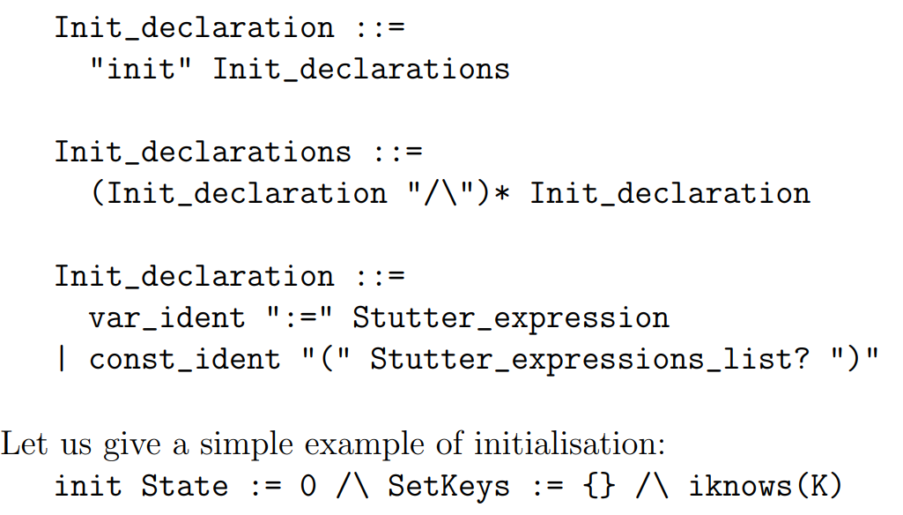
Initialisation of local variables
The initialisation section is a conjunction of simple assignments to variables and of constant predicates. Expressions used for assignments and in the predicates have to use initialised variables; this is the meaning of a stutter expression.

Slide 80
Declaration of the acceptance state.
Acceptance is used for sequential composition to mark the stop states after which the following instantiation may begin.
Accept_declaration ::=
"accept" Predicates
However, since sequential composition is not fully handled in the current version of the AVISPA tool, ”accept” declarations are useless.

Slide 81
Actions
An action can be the assignment of a variable, possibly with a fresh value (e.g.: Na’:=new()), the call of a user-defined predicate (such as sending a message in a channel), or the call of predefined goal predicates. The expression assigned to a variable can be either a stutter one, or a non-stutter one.

Slide 82
Actions
In any transition, the old value and the new value of a variable are syntactically distinguished:
the prime symbol (’) has to be attached to the name of a variable for considering its new value.
Examples: M’:={M}_K and Snd(M’.M).
Reactions ::= Actions
Actions ::= (Action "/\")* Action

Slide 83
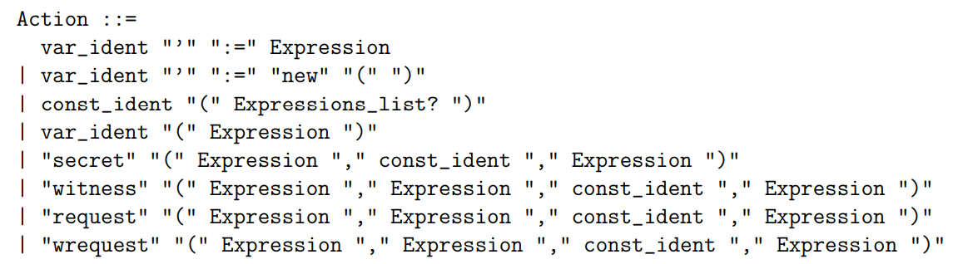
Actions and reactions

Slide 84
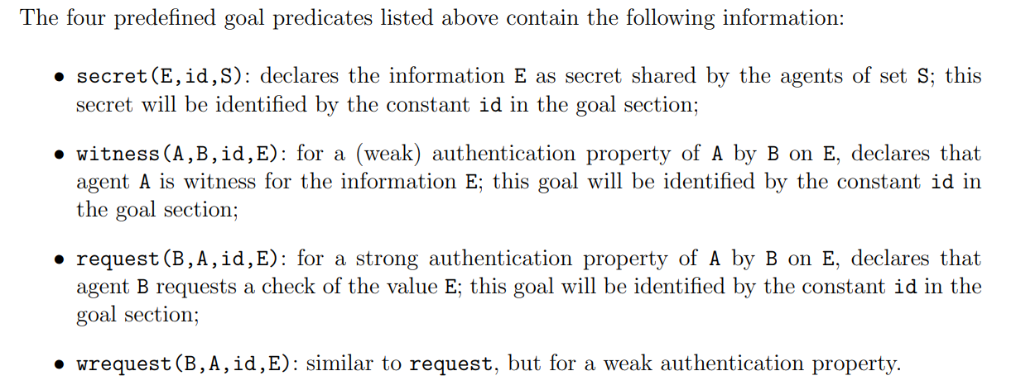
Actions

Slide 85
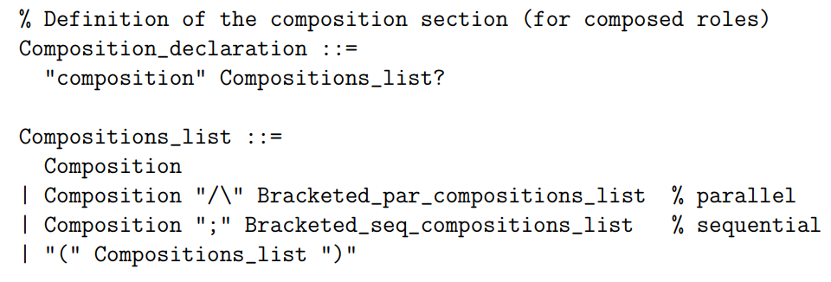
Composition of roles
Roles, basic and/or composition, can be composed in parallel or sequentially. Such scenarios are described in the composition section of so called composition roles.

Slide 86
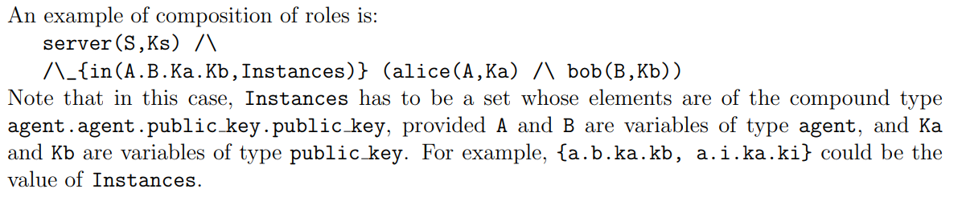
Composition of roles

Slide 87
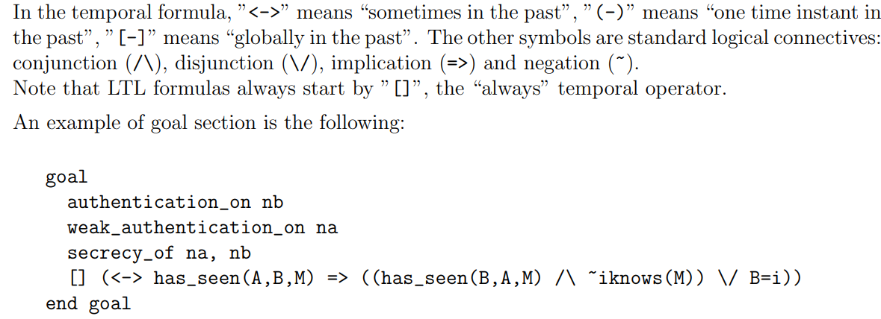
Declaration of goals
Goals are declared in a specific section. Such declarations are done either by using predefined macros, or by using a LTL formula.

Slide 88
environment()

Slide 89
Outputs

