Slide 1


Docker
A platform for building, running and shipping applications
Pramod Negi , 16 Nov 2021

Slide 2
01. What is Docker ?
02. Virtual Machine vs Containers
03. Architecture of Docker
04. Practical
05. Q & A

Slide 3

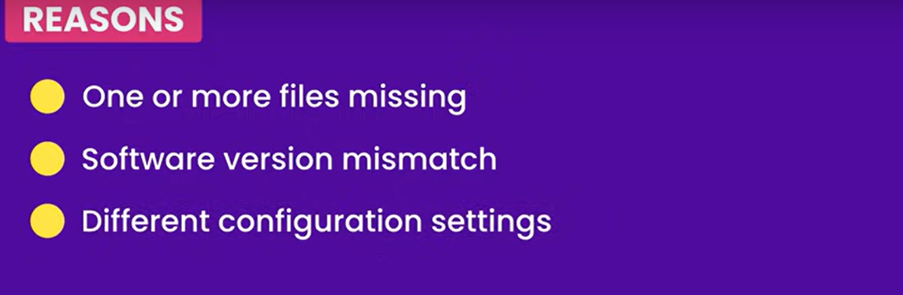
What is Docker?
Docker is an open source containerization platform. It enables developers to package applications into containers—standardized executable components combining application source code with the operating system (OS) libraries and dependencies required to run that code in any environment.

Slide 4
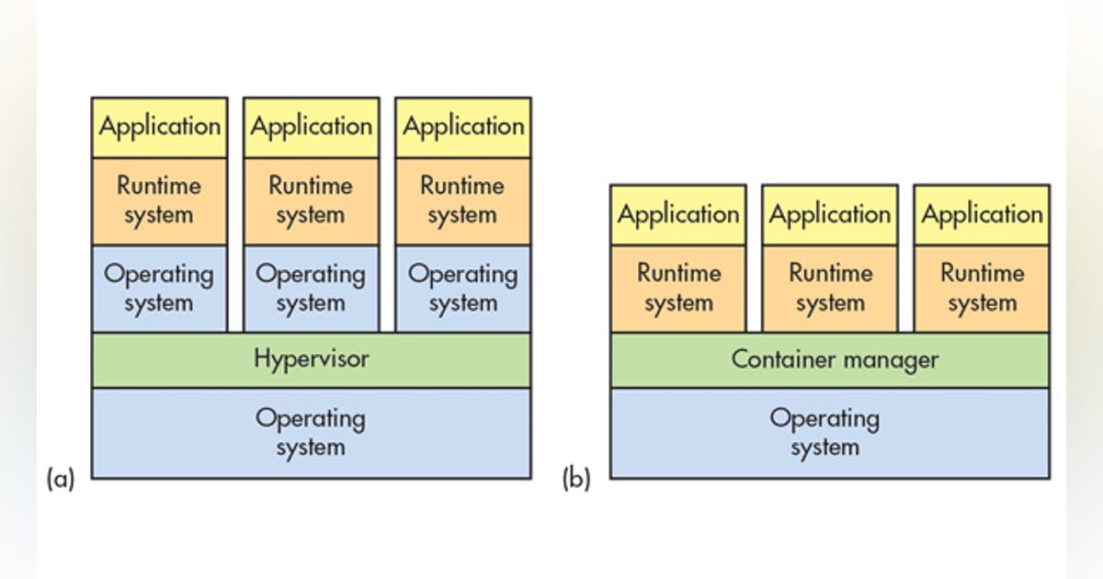
VM’s vs Container

Slide 5
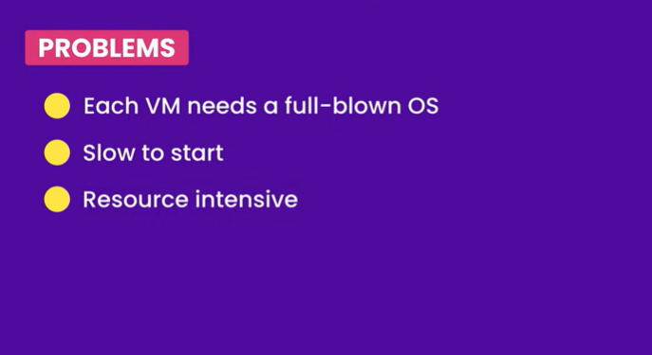
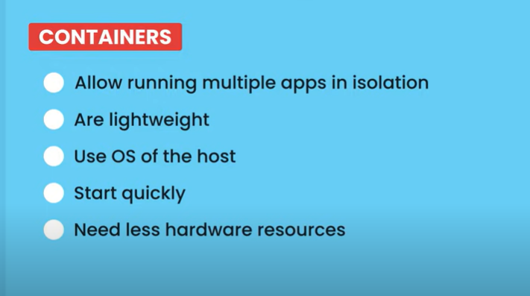
Drawback of VM’s implementation
Advantages Dockers

Slide 6
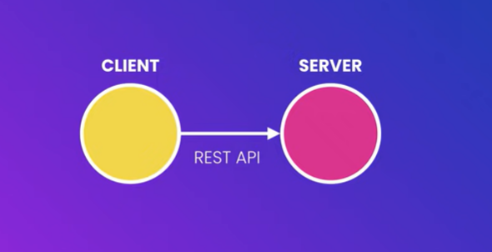
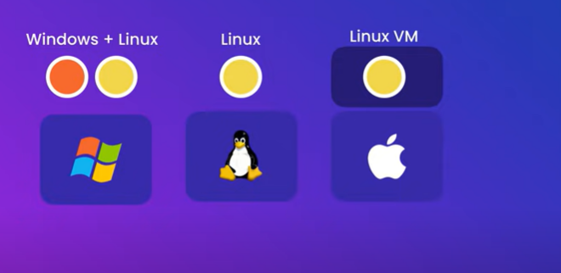
Architecture of Docker

Slide 7

Q & A

Slide 8
THANK YOU

