Slide 1
Ruby
Session 2 –strings, Arrays and flow control Statements

Slide 2
Recap
C++ is a Object oriented and Compiled language with Static and Weak typing.
Clojure is a Functional language with Dynamic and Strongly typed. It is JIT Compiled.
What is a Data Type?
How to get the type of a variable?
How do you print to screen in Ruby?
How does Combined comparison ( <=> ) operator works?
What is string Interpolation?

Slide 3
Strings Basics
Useful methods
Comparing Strings

Slide 4
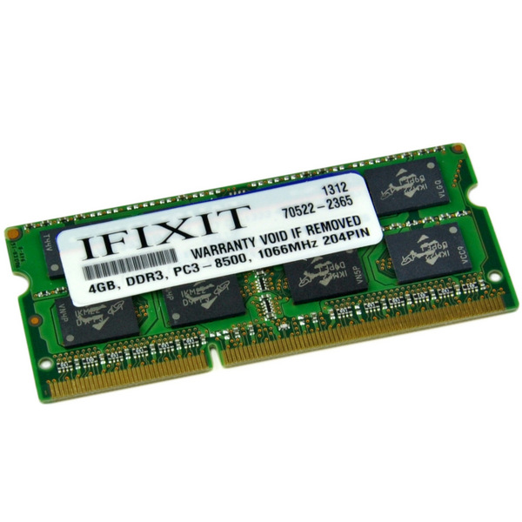
Memory
Memory(RAM) & Storage(HDD, Flash, SSD)
Main Difference – Data is permanent of Storage and volatile on RAM
Why 2 why not entirely on Storage?
Storage is Huge but very Slow & cheaper
RAM is fast but small & Costlier
Combined work
Apps are stored in Storage
Loaded to Memory when usage
Will run out of space when we try to open them all
Notes:
2 Mechanisms to store data on computer – Memory(RAM) & Storage(HDD, Flash, SSD)
Main Difference – Data is permanent of Storage and volatile on RAM
Some times if we don’t save we will loose the working data from RAM
RAM is like a rough sheet (for temporary storage of computational results).
Task Manager memory monitor
Why 2 why not entirely on Storage?
Storage is Huge but very Slow & cheaper where as RAM is fast but small & Costlier
Storage is like basement and RAM is like desk.
Combined work
Apps are stored in Storage
Loaded to Memory when usage
Will run out of space when we try to open them all

Slide 5
Memory Assignment
a = 10
b = true
a.object_id
10
true
a -- 2000
b -- 2008

Slide 6
Array
Lists or Vectors
Series of values stored in memory continuously.
Ruby can have multiple Types in a single array.
Notes:
Ruby is always pass by value.

Slide 7
Array Memory Layout
Memory Location | Value
………. | …………
1000 | Ruby
1004 | Java
1008 | Kotlin
1012 | Lua
1016 | Perl
1020 | ………….
Names

Slide 8
Indexing of Arrays
Indexing
0 | 1 | 2 | 3 | 4
Ruby | Java | Kotlin | Lua | Perl
-5 | -4 | -3 | -2 | -1
names[1] = Java
names[-3] = Kotlin
SLICING
[start..end(inclusive)] [start…end(exclusive)] slice(index) slice(start, end)
names[1..4] = [Java, Kotlin, Lua, Perl]
names[-5..-3] = [Ruby, Java, Kotlin]
names[3…-1] = [Lua]
names[3..-4] = []

Slide 9
Strings as Array
Strings are the Syntactic sugar of Character Array.
Why only Character Array?
Name = “Ruby”
Memory Location | Value
1000 | R
1002 | u
1004 | b
1006 | y
1008 | ……………

Slide 10
Methods or Functions
Purpose: Reduce the duplication of Code
DRY – Don’t Repeat Yourself
Function Definition
def function_name (input parameters)
# Do Some Computations
return result
end
Notes:
Grouped Collection of statements that serves a purpose

Slide 11
Thank You

