Slide 1
Facial Emotion Recognition using Machine Learning
Presented by:
Pawan Agrahari (230277162)

Slide 2
Introduction:
Facial Emotion Recognition combines computer vision, psychology and AI to analyze human emotions through facial expressions
Emotions impact decisions, interactions, and relationships.
Our system intends to predict the user's facial emotion
Applications: Healthcare, education, security, marketing, and human-computer interaction.

Slide 3
Objectives
Specific objectives:
1) Develop a system that accurately detects and classifies facial emotions using machine learning techniques.
General objectives:
Create a user-friendly application for real-time facial emotion detection.
Implement and evaluate various machine learning models to enhance emotion recognition accuracy
.

Slide 4


Slide 5
Anagha S. Dhavalikar and Dr. R. K. Kulkarni proposed an Automatic Facial Expression Recognition system in their paper (Davalikar & Kulkarni, 2014) that first detects faces within images and then analyses them to identify emotional expressions, such as happiness, sadness, anger, and surprise.
J. H. Immanuel, J. J. A. Arnold, J. M. MasillaRuban, M. Tamilarasan, and R. Saranya proposed a system named Emotion Based Music Recommendation System (Immanuel, et al., 2019) where they used FER-2013 dataset and model is trained using SVM.
The research by (Mellouk & Handouzi, 2020) emphasizes the growing importance of automatic facial emotion recognition (FER) and its applications in fields like safety, healthcare, and human-machine interfaces.
The research paper published by (Kavitha & Vinodhini, 2024) used Convolutional Neural Networks (CNNs) and Linear Binary Patterns (LBPs) in facial recognition systems to identify emotions are popular methods in deep learning algorithms for facial feature extraction and emotion classification.

Slide 6
Yong-Hwan Lee, Woori Han, and Young Kim Lee (Lee, et al., 2013) presented a method that uses Bezier curve fitting for emotion recognition.
The study carried out by (Huang, et al., 2023) explored the application of Convolutional Neural Networks (CNN) in conjunction with a mix of Squeeze-and-Excitation Networks (SENet) and Residual Neural Networks (ResNet) for Facial Emotion Recognition (FER).
(Hameed, et al., 2024) introduced a novel human behaviour detection system that prioritizes privacy, leveraging Frequency-Modulated Continuous Wave (FMCW) radar alongside Machine Learning (ML) techniques to identify facial expressions.

Slide 7


Slide 8
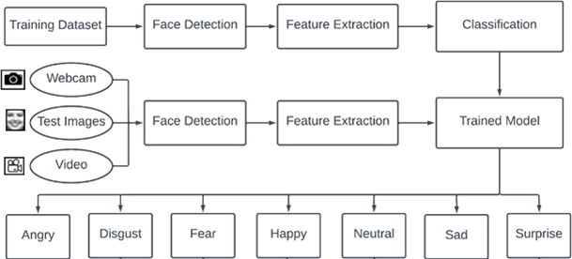
System Diagram

Slide 9
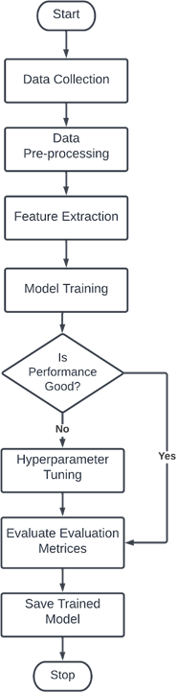
Model Training Flowchart

Slide 10
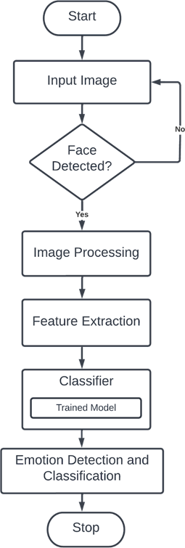
Model Testing Flowchart

Slide 11
Dataset Used
We used two different datasets. They are:
FER-2013 (Approx. 28,000 images for training, 3500 images for testing)
Self-created dataset (4336 images)

Slide 12
Modules Used in our System
We have used two modules in our proposed system:
1) Emotion Detection Module
Image Acquisition – Used static image for model training and testing
Face Detection – Used Haar Cascade Classifier for face detection

Slide 13
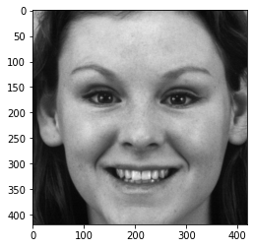
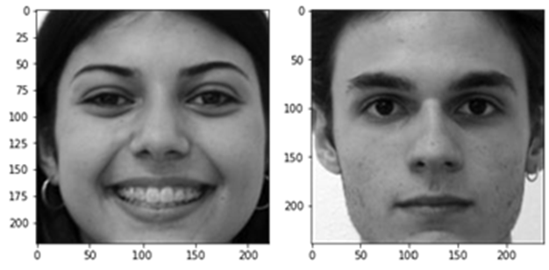
We had used grayscale pixel values as features to train our model.
Gray Scale Images

Slide 14
3) Emotion Classification Module
This is the model building module using different machine learning algorithms. The algorithms used are:
Support Vector Machine (SVM)
Logistic Regression
Random Forest Classifier

Slide 15
Hyperparameter Tuning
Logistic Regression:
C = 1.0 (default)
Solver = liblinear (default)
SVM:
C = 1.0 (default)
Kernel = rbf (default)
gamma = scale (default)
probability = false (default)
Random Forest:
n_estimators = 100 (default)

Slide 16
System Evaluation
Precision: Ratio of correctly identified instances to the total number of predicted instances
Recall: Ratio of accurately assigned expressions to the overall number of expressions
F-score: Combined metric that balances sensitivity and specificity, rewarding algorithms with higher sensitivity while challenging those with greater specificity

Slide 17


Slide 18
Experiment on FER-2013 Dataset
Grey Scale Pixel as feature
 | Model | best_score | best_params
0 | SVM | 0.4281 | {‘C’:100, ‘kernel’: ‘rbf’}
1 | Random Forest | 0.3260 | {‘n_estimators’:10}
2 | Logistic Regression | 0.3025 | {‘C’:1}

Slide 19
Performance Evaluation of FER-2013 Dataset
Evaluation Types | Result Percentage
Precision | 42%
Recall | 43%
F1-score | 42%
Accuracy | 43%

Slide 20
Experiment on Self-Created Dataset
Grey Scale Pixel as feature
 | Model | best_score | best_params
0 | SVM | 0.7769 | {‘C’:10, ‘kernel’: ‘rbf’}
1 | Random Forest | 0.5965 | {‘n_estimators’:10}
2 | Logistic Regression | 0.6196 | {‘C’:1}

Slide 21
Performance Evaluation of FER-2013 Dataset
Evaluation Types | Result Percentage
Precision | 77%
Recall | 77%
F1-score | 77%
Accuracy | 77%

Slide 22
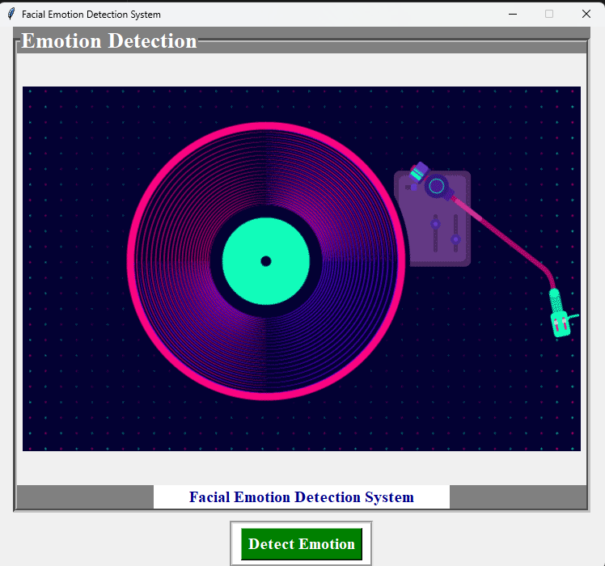
Sample Outputs

Slide 23
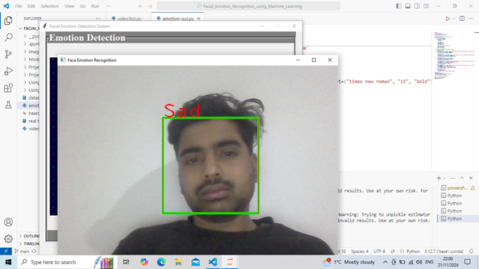
Sample Outputs
Emotion detection

Slide 24
Challenges and Limitations
Variability in emotional expression due to cultural differences and real-world conditions (lighting, occlusions, camera quality).
Privacy and ethical concerns require transparent data usage policies and bias mitigation in models.

Slide 25
Future Enhancement
Focus on diverse datasets and multi-modal data integration (e.g., combining facial expressions with physiological signals)..
Development of privacy-preserving methods and mobile-friendly interfaces for broader accessibility.

Slide 26
Conclusion
Facial emotion recognition (FER) using machine learning is a transformative technology with applications in healthcare, education, marketing, security, and human-computer interaction
While advancements in deep learning have enhanced the precision of FER systems, challenges like environmental variability, cultural differences, and ethical concerns persist, necessitating the integration of multimodal data and the establishment of responsible frameworks for deployment.

Slide 27
THANK YOU!!!

Slide 28
QUESTIONS???

