Slide 1

GOVERNMENT POLYTECHNIC BANTWAL
DEPT OF COMPUTER SCIENCE & ENGINEERING
Final Report
Presented By:
PAWAN
Reg. No :163CS21034
Under the Guidance of
Lecturer
Mr. Gagandeep M N

Slide 2
Content
Company Overview
Organization Structure
OJT1
Introduction
Aim
Objective
Purpose
Scope
Advantages
Conclusion
OJT2
Introduction
Aim
Objective
Purpose
Scope
Advantages
Conclusion
Usecase-1
Usecase-2
Result
Reference

Slide 3
1.Company Overview:
Codelab System is a rapidly growing company in the field of computer application Implementation, solutions and services.
Codelab System is a service provider of Web-based Development & Web based Software Development Solutions, Mobile Application Development, Graphic Design and Windows Applications.
Codelab Systems has the experience to undertake any IT development or deployment works on a single point responsibility basis.
Codelab Systems develop software and web-based applications with Latest Technologies.
Codelab Systems is always proactive to fulfill client’s needs and requirements.

Slide 4
Organaization structure:
ORGANISATION
MANAGEMENT
ADVISORY BOARD
MANAGING DIRECTOR
DIRECTOR
HEAD HR
HEAD ACCOUNTANT
HEAD IT OPERATIONS
HEAD TRAINING & DEVELOPMENT
HEAD BUSINESS OPERATION
HEAD ADMINISTARTION

Slide 5
2.OJT-1
INTRODUCTION:
As the commercial site of the world is almost fully undergone in online platform people is trading products through different e-commerce website.
And for that reason reviewing products before buying is also a common scenario.
Also now a day, customers are more inclined towards the reviews to buy a product, So analyzing the data from those customer reviews to make the data more dynamic is an essential field nowadays.
A study on amazon last year revealed over 88% of online shoppers trust reviews as much as personal recommendations.
Any online item with large amounts of positive reviews provides a powerful comment of the legitimacy of the item.
In our model, we used both manual and active learning approach to label our datasets.
In the active learning process different classifiers are used to provide accuracy until reaching satisfactory level.

Slide 6
AIM:
The world we see nowadays is becoming more digitalized.
In this digitalized world e-commerce is taking the ascendancy by making products available within the reach of customers where the customer doesn’t have to go out of their house.
But in this prospering day of machine learning, going through thousands of reviews would be much easier if a model is used to polarize those reviews and learn from it.
We used supervised learning method on a large scale amazon dataset to polarize it and get satisfactory accuracy.

Slide 7
OBJECTIVE:
The objective of this research is to develop a supervised learning model that efficiently categorizes customer feedback into positive and negative sentiments for various products.
In an era dominated by online commerce, where consumer decisions are heavily influenced by reviews, the need to streamline the analysis of vast amounts of feedback is paramount.
By automating the sentiment polarization process, this study aims to provide consumers with valuable insights for informed purchasing decisions and assist businesses in understanding the reception of their products in the market.
Ultimately, the goal is to develop a robust model capable of efficiently categorizing customer feedback, thereby empowering both consumers and businesses in their decision-making processes within the dynamic landscape of online commerce.

Slide 8
PURPOSE:
The purpose of this research is to address the pivotal role of online product reviews in influencing consumer behavior and purchasing decisions in the digital marketplace.
With the increasing reliance on e-commerce platforms for trading goods, the significance of customer feedback has surged, as shoppers often turn to reviews to guide their buying choices.
This study seeks to develop a supervised learning model that can automatically categorize customer feedback into positive and negative sentiments for diverse products.
By leveraging machine learning algorithms, the aim is to streamline the process of sentiment analysis, making it more efficient and scalable.
The ultimate objective is to empower both consumers and businesses with actionable insights derived from large-scale review data. The ultimate objective is to empower both consumers and businesses with actionable insights derived from large-scale review data.
Ultimately, the research endeavors to contribute to the optimization of online shopping experiences and the enhancement of consumer satisfaction in the digital age.

Slide 9
SCOPE:
The scope of this research encompasses the development and implementation of a supervised learning model aimed at categorizing customer feedback into positive and negative sentiments across various products within the realm of e-commerce.
Given the widespread reliance on online platforms for trading goods and the growing importance of customer reviews in influencing purchasing decisions, the study focuses on analyzing large volumes of review data to derive actionable insights.

Slide 10
ADVANTAGES:
The script preprocesses the raw text data by removing stop words and cleaning the reviews, which helps in improving the quality of the input data for analysis.
Through bar charts and pie charts, the script provides a visual representation of the distribution of positive and negative sentiments in the dataset, allowing for quick insights into sentiment proportions.
The logistic regression model is a simple yet effective algorithm for binary classification tasks like sentiment analysis. It offers interpretability and can handle large feature spaces efficiently.
The script evaluates the performance of the sentiment analysis model using accuracy score, providing a quantitative measure of how well the model performs on unseen data.
The trained logistic regression model is saved using pickle, allowing for easy deployment and reuse without the need for retraining.

Slide 11
CONCLUSION:
In conclusion, as online commerce continues to dominate global trade, the significance of customer reviews in influencing purchasing decisions has never been greater.
Analyzing vast amounts of feedback to categorize and polarize sentiments towards products is essential in this landscape.
This study aimed to develop a supervised learning model to categorize positive and negative feedback, leveraging both manual and active learning approaches to label datasets.
Understanding and effectively polarizing customer feedback is crucial for businesses in maintaining consumer trust and competitiveness in the online marketplace.

Slide 12
3.OJT-2
INTRODUCTION:
In recent years, internet has become an integral part of life.
With increased use of internet, numbers of email users are increasing day by day.
This increasing use of email has created problems caused by unsolicited bulk email messages commonly referred to as Spam.
Spam emails are the emails that the receiver does not wish to receive.
Email has now become one of the best ways for advertisements due to which spam emails are generated.

Slide 13
AIM:
The possibility that anybody can leave an email or a message provides a golden opportunity for spammers to write spam message about our different interests.
Spam fills inbox with number of ridiculous emails.
Identifying these spammers and also the spam content can be a hot topic of research and laborious tasks.
Email spam is an operation to send messages in bulk by mail.
Since the expense of the spam is borne mostly by the recipient, it is effectively postage due advertising.
Spam email is a kind of commercial advertising which is economically viable because email could be a very cost-effective medium for sender.

Slide 14
OBJECTIVE:
Develop strategies or tools to effectively manage and filter spam emails to reduce clutter and ensure important messages are easily accessible.
Investigate methods to mitigate the impact of spam on internet speed, whether through network optimization or more efficient email protocols.
Develop efficient spam identification and filtering techniques to reduce the time users spend dealing with spam emails and improve productivity.
Explore new approaches or technologies to more accurately identify spammers and their tactics, making it easier to combat spam at its source.

Slide 15
PURPOSE:
The purpose of this passage is to highlight the growing problem of spam emails and its detrimental effects on internet users.
It discusses how spam inundates inboxes, slows down internet speeds, compromises privacy by stealing information, and alters search results.
The passage also mentions the challenges in identifying and filtering spam effectively despite various studies and techniques.
Overall, it aims to raise awareness about the seriousness of the spam issue and the need for effective spam filtering techniques to protect users' mailboxes.

Slide 16
SCOPE:
The passage primarily focuses on the issue of spam emails and its consequences on internet users.
The passage also briefly mentions the use of spam for malicious purposes such as phishing and distributing malware.
Additionally, it touches upon the challenges associated with identifying and filtering spam effectively despite the existence of numerous studies and techniques.
It primarily
aims to inform readers about the problems caused by spam and the importance of implementing effective spam filtering techniques.

Slide 17
ADVANTAGES:
Customized the preprocessing steps, such as removing punctuations and stop-words, which can improve the quality of features extracted from the text data.
By visualizing the data distribution using bar charts, pie charts, and word clouds, you gain insights into the characteristics of spam and non-spam emails, which can inform feature engineering and model selection.
Providing a user-friendly interface for users to input email messages and receive predictions on whether they are spam or not-spam.

Slide 18
CONCLUSION:
In conclusion, the proliferation of spam emails has become a significant issue in today's digital landscape.
Despite efforts to combat spam through various filtering techniques, including content-based analysis and sender reputation systems, the problem persists.
Identifying and mitigating spam remains a challenging task, requiring ongoing research and innovation in cybersecurity.
In the face of this persistent threat, it is crucial for individuals and organizations to remain vigilant and employ robust spam filtering measures to protect themselves from unwanted solicitations and potential security breaches.

Slide 19
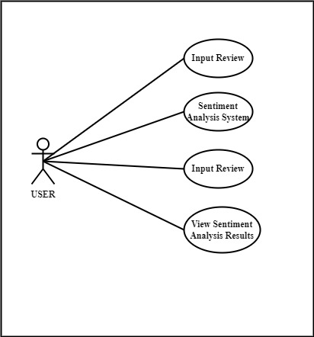
4.Usecase-1:

Slide 20
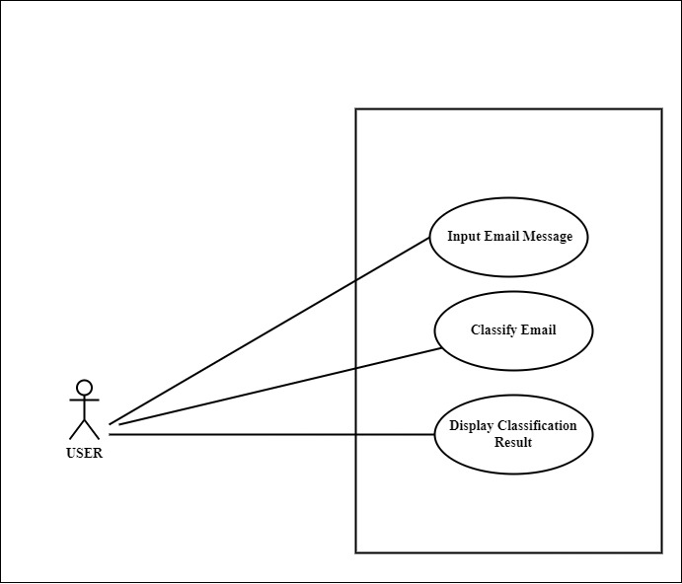
5.Usecase-2:

Slide 21
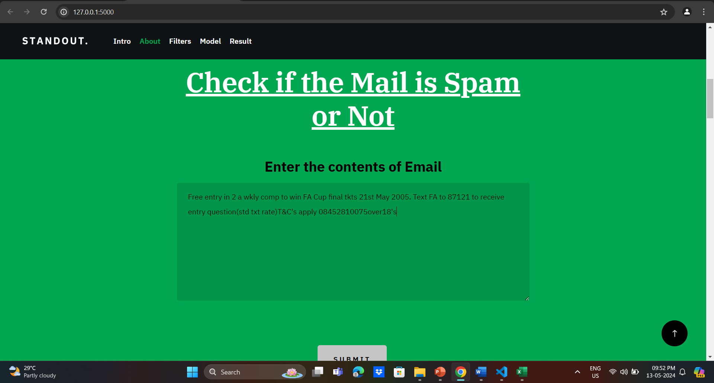
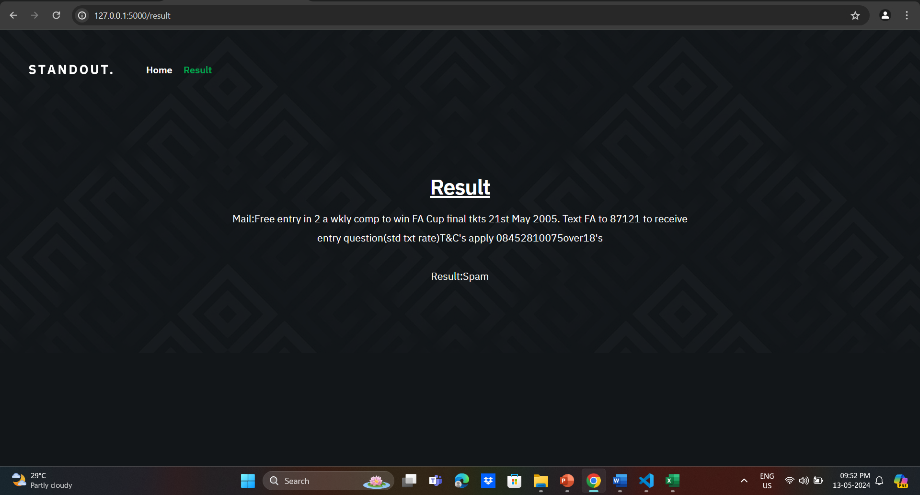
6. Result:( working of project):
Input : Output:

Slide 22
7.Reference:
https://www.ijert.org/email-based-spam-detection
https://www.academia.edu/51233708/IJERT_Email_Spam_Detection_and_Data_Optimization_using_NLP_Techniques
https://www.irjmets.com/uploadedfiles/paper/issue_4_april_2023/36685/final/fin_irjmets1682217866.pdf

Slide 23
THANK YOU

