Slide 1


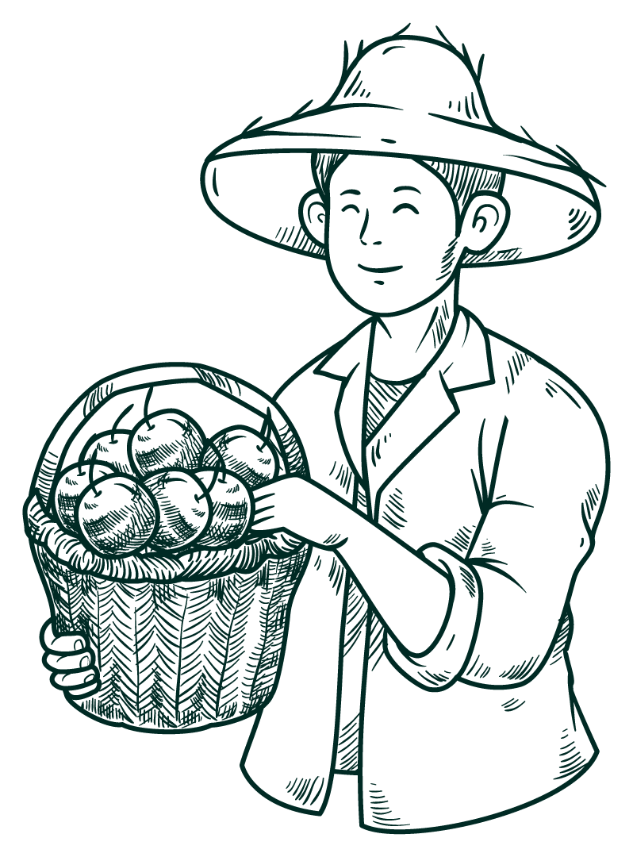



AgriGenie - Crop Prediction app
That Help Farmer To Predict Seasonal Crops

Slide 2

Project Overview
AgriGenie is a revolutionary mobile application designed to empower farmers by providing accurate predictions for seasonal crops and personalized recommendations for crops and fertilizers. With the aim of maximizing agricultural productivity and sustainability, this app combines advanced data analytics, machine learning algorithms, and agricultural expertise to assist farmers in making informed decisions regarding crop selection and fertilization practices.

Slide 3


Project Goals
Accurate crop predictions: Provide farmers with reliable forecasts for seasonal crop selection based on weather data and performance records.
Efficient fertilizer usage: Optimize fertilizer recommendations to improve crop growth while minimizing waste and environmental impact.
Empower farmers with knowledge: Equip farmers with a comprehensive knowledge base to enhance decision-making and improve agricultural practices.

Slide 4
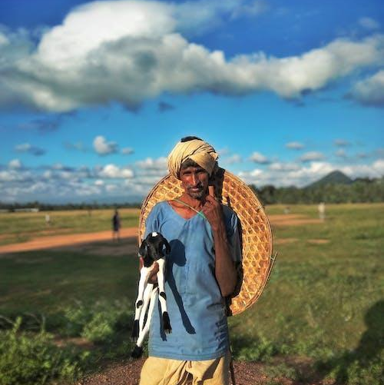

Problem Statement
Farmers face challenge in selecting the most suitable crops for specific seasons and optimizing fertilizer usage, resulting in potential crop failure, inefficient resource allocation, and limited access to up-to-date agricultural knowledge.

Slide 5



Problem Solution
Do you know what helps farmers make informed decisions in agriculture? AgriGenie does.
With its features like accurate crop predictions,
Efficient fertilizer usage,
Empowering farmers with knowledge,
AgriGenie aims to revolutionize farming practices. By leveraging technology and data analysis, AgriGenie simplifies decision-making, organizes information clearly, and ensures farmers never miss crucial details.

Slide 6

Technologies used
frontend
backend
We use Flutter to make interactive UI that farmers can easily use and understand the feature of the app
We used Firebase for User Authentication (Create with Google)and Machine Learning Model to predict Crop for farmers.

Slide 7
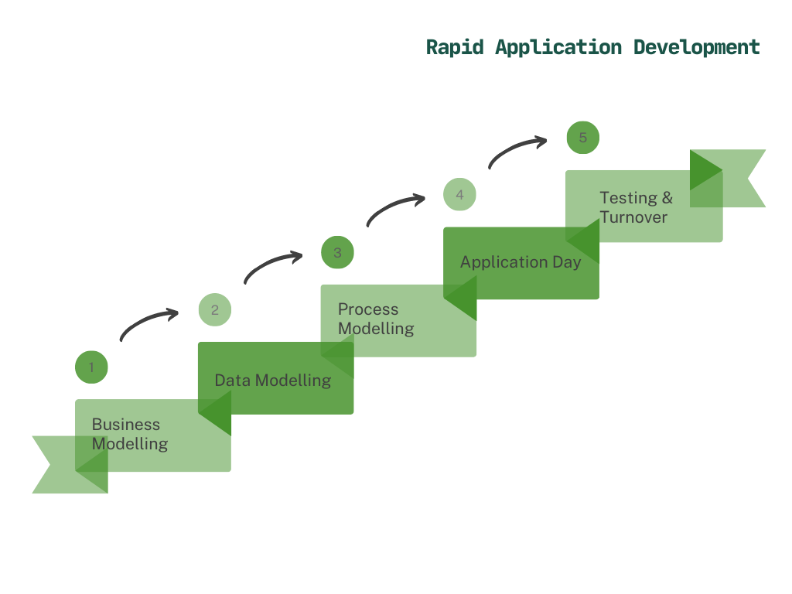
Project flow

Slide 8
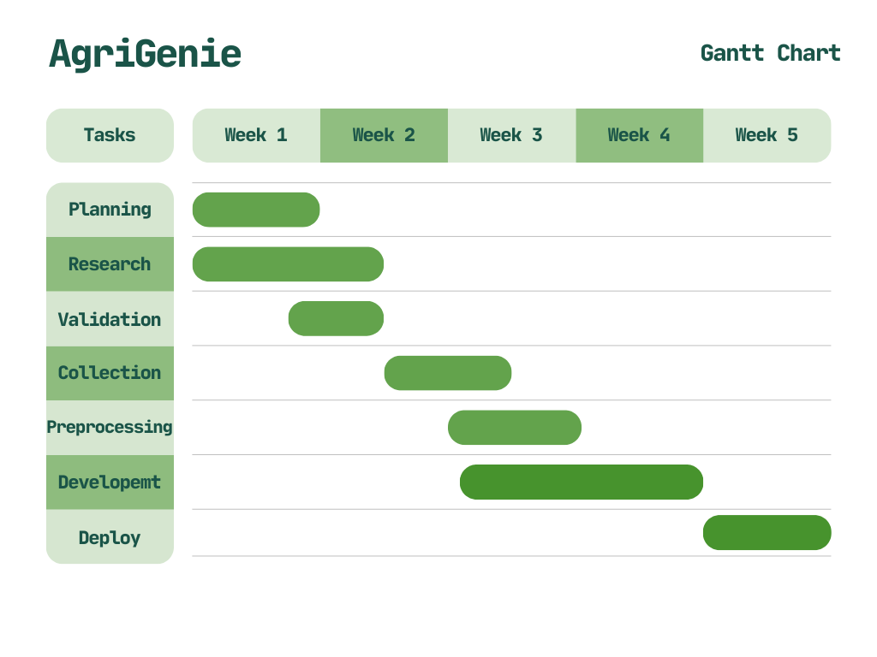

Slide 9
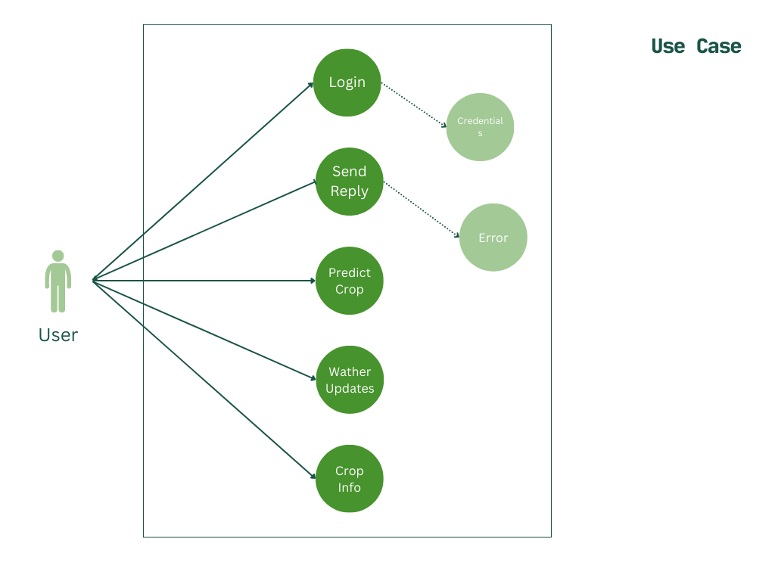

Slide 10
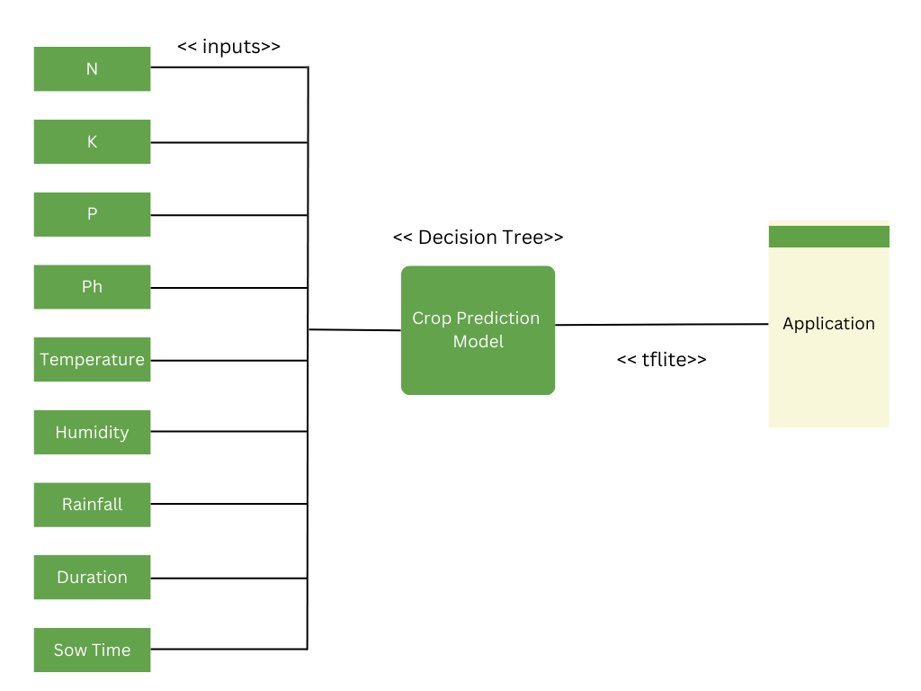

Project Flow

Slide 11
Thank You!

