Slide 1
Presentation on Speech Emotion Reorganization
Presentation by
PawaneshKumarYadav(1905250130035)
Priyanka Jaiswal (1905250130037)
Vandana Kushwaha (1852513057)
Rupali Dubey (1905250130043)
Under the Guidance of
Mr. Manish Gupta
Department of Information Technology
Buddha Institute of Technology
Gorakhpur, India

Slide 2
Content
Introduction
Literature Survey
Proposed Work
Methodology
Reference

Slide 3
Introduction
[1] There are many ways of communication but the speech signal is one of the fastest and most natural methods of communications between humans. Therefore the speech can be the fast and efficient method of interaction between human and machine also.
[1] Humans have the natural ability to use all their available senses for maximum awareness of the received message.
[3] Therefore the purpose of emotion recognition system is to use emotion related knowledge in such a way that human machine communication will be improved.
[1] Speech Emotion Recognition (SER) is the task of recognizing the emotional aspects of speech irrespective of the semantic contents.
[4] In speech monologues, emotional recognition is an area traditionally studied in psychology and cognitive science, but in modern generations, the data science domain has [2] been especially engaged in this area.
[1] Here becomes the main understanding of the value of human– machine interfaces in speech communication. The essential and motivating aspect of Human-Computer Interaction (HCI) is the identification of emotions by speech signals

Slide 4
Literature Survey
Author | Methodology | Features | Challenge
Leila Kerkeni | the Spanish Dataset in order to achieve a higher and more accurate rate of. | Modulation spectral features and MFCC, to extract the emotional features. | Recurrent Neural Networks (RNN)
Aditya Kumar Pandey | Smart phone users for the most complex intelligent systems focused on deep learning | This machine translation technique is used in artificial neural networks to predict the probability of a series of terms. | Is proposed to encrypt the input sequence to one fixed length vector
Ashish B. Ingale, D. S. Chaudhari | Gaussian Mixtures Model (GMM), Hidden Markov Model (HMM) and Artificial Neural Network (ANN). | Therefore an extraction of these speech features which represents emotions is an important factor. | System contains five main modules emotional speech input, feature extraction, feature selection , classification

Slide 5
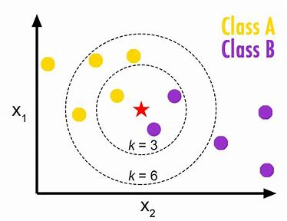
Proposed Work
Using KNN (K Nearest Neighbor) algorithm to predict the emotions. K Nearest Neighbor (KNN) is intuitive to understand and an easy to implement the algorithm. Beginners can master this algorithm even in the early phases of their Machine Learning studies. Software: - Python, Data Science, Artificial intelligence Hardware: - Windows-11/10, Ram-8gb, Hard disk-512gb

Slide 6
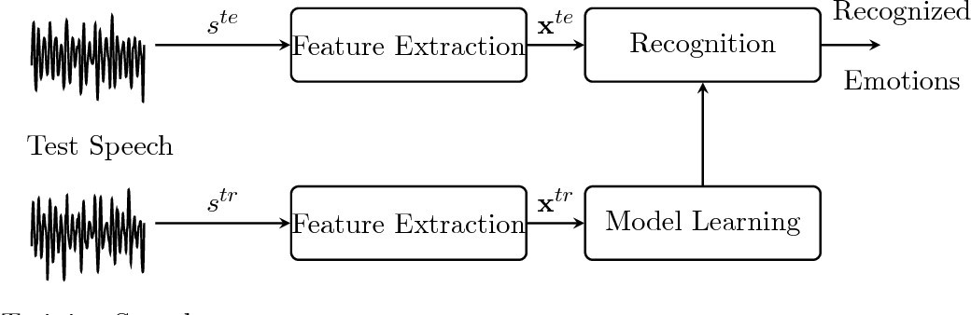
Methodology

Slide 7
References
[1] https://www.sciencedirect.com/science/article/pii/S2214785320398928
[2] https://www.sciencedirect.com/topics/computer-science/speech-emotion_x0002_recognition
[3]https://www.researchgate.net/publication/257470335_Speech_emotion_recognition_Features_and_classification_models
[4] https://www.roboticstomorrow.com/article/2021/09/understanding_x0002_human-machine interfaces-hmis/17446
[4] https://basicknowledge101.com/pdf/km/machine_learning_outline.pdf
[5] https://labelyourdata.com/articles/ai-emotion recognition#:~:text=AI%20reading%20human%20faces%20to%20recognize%20emotions%20Emotion,emotions%3A%20fear%2C%20anger%2C%20happiness%2C%20sadness%2C%20disgust%2C%20and%20surprise.
[6] https://www.verywellmind.com/what-is-observational-learning-2795402

Slide 8
Thank You

