Slide 1
Student Management System
A Role-Based Academic Platform for Schools
Manage students · Track grades · Monitor performance · Generate reports
Python CLI
File-Based DB
Role-Based Access
Analytics Engine

Slide 2
What We'll Cover
A guided tour of the Student Management System
01
03
05
System Overview
Admin Capabilities
Search & Filter
Architecture, tech stack, and key features
User management, grade control, system settings
Flexible queries by performance and ECA status
02
04
06
Authentication & Roles
Academic Management
Analytics & Reports
Login flow, role-based access, security setup
Grade recording, ECA tracking, student data
Dashboards, charts, CSV exports, performance alerts

Slide 3
01 System Overview
Core Modules
Data Storage
Key Features
main.py — Orchestrator
auth.py — Authentication
core.py — Business Logic
database.py — Data Layer
analytics.py — Reports
ui.py — Terminal UI
users.txt — Profiles
passwords.txt — Hashed
grades.txt — Scores
eca.txt — Activities
logs.txt — Audit Trail
Automated backups
3 role types (Admin/Teacher/Student)
Subjects: Math, Science, English, Computer, Physics
ECA participation tracking
Performance alerts & analytics
CSV export & matplotlib charts
Secure password hashing
Tech Stack: Python 3.x · pandas · matplotlib · numpy · hashlib (SHA-256) · Terminal UI (ANSI colors)

Slide 4
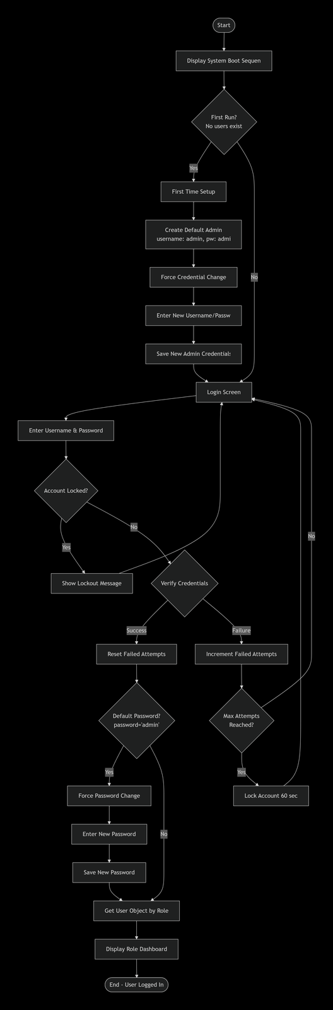
02 Authentication & Security
System Boot & Login Flow
🔒 First-Run Setup
Admin account auto-created on first launch. Temporary credentials force a password change before any access is granted.
🔑 Login (3 Attempts)
Username + password validated. Failed attempts are tracked — system exits after 3 consecutive failures.
🛡️ SHA-256 Hashing
All passwords stored as hashed values. Plain-text passwords are never written to disk.
👤 Role Dispatch
After login, system checks the user role (Admin / Teacher / Student) and routes to the appropriate dashboard.
Flowchart: System Boot & Authentication Flow

Slide 5
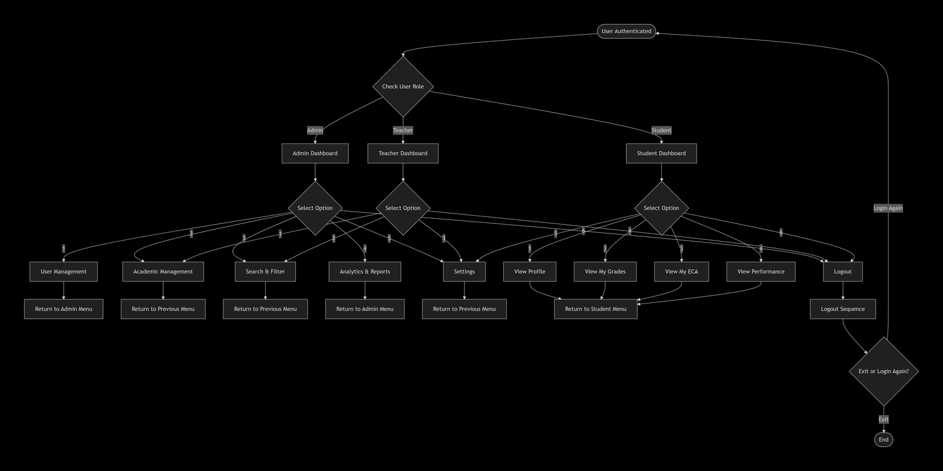
Role-Based Navigation — Three Dashboards
Flowchart: Main Menu Navigation by Role — Admin · Teacher · Student
Admin
Teacher
Student
User Mgmt · Academics · Search · Analytics · Settings
Academics · Search · Analytics · Settings
Profile · Grades · ECA · Performance · Export

Slide 6
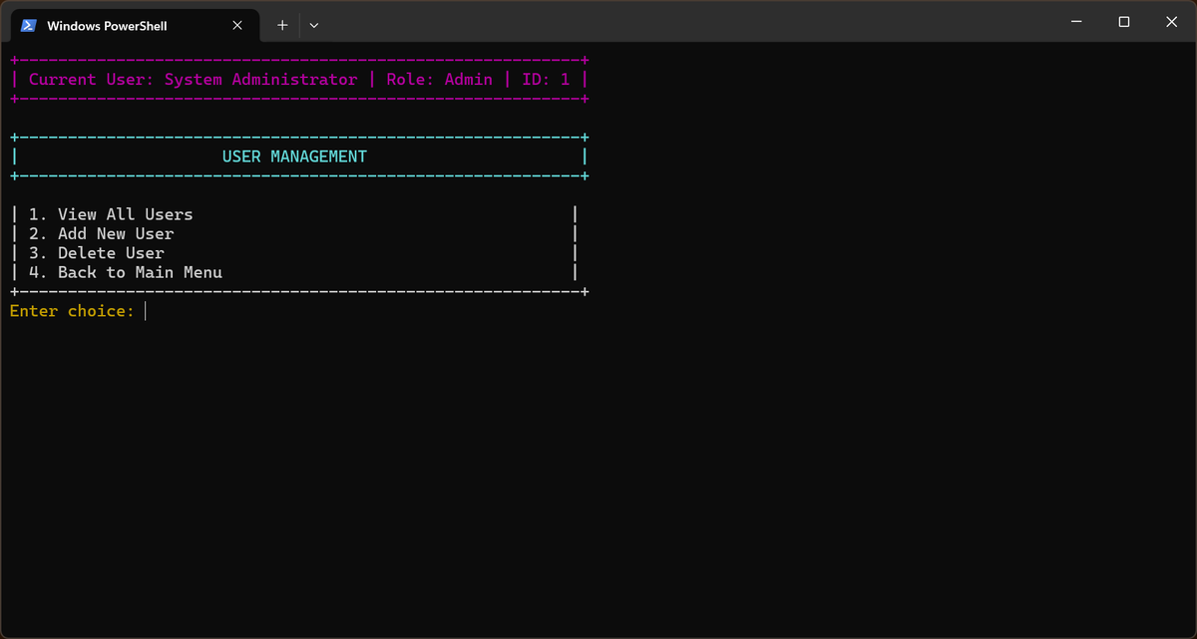
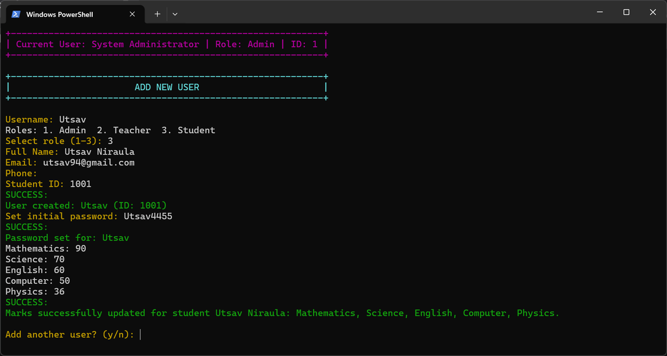
03 Admin · User Management
Admin Controls
View All Users
List all admins, teachers, and students with IDs and roles
Add New User
Create accounts for Admin / Teacher / Student roles. Student creation includes immediate mark entry for all 5 subjects.
Delete User
Remove user accounts with confirmation prompt to prevent accidental deletion
Set Passwords
Admins can set initial passwords; users must change defaults on first login
Flowchart: User Management (Admin)

Slide 7
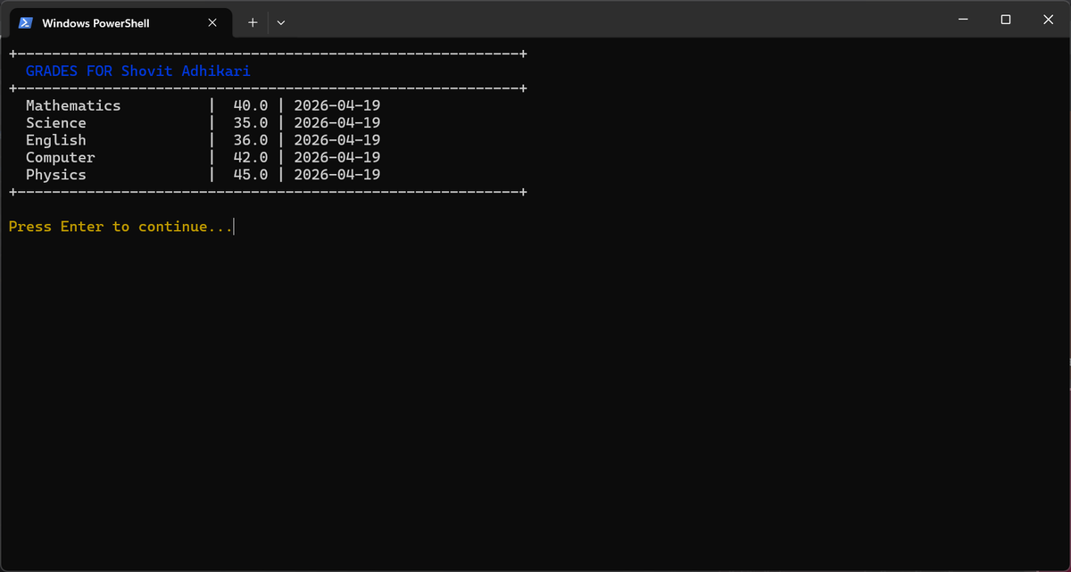
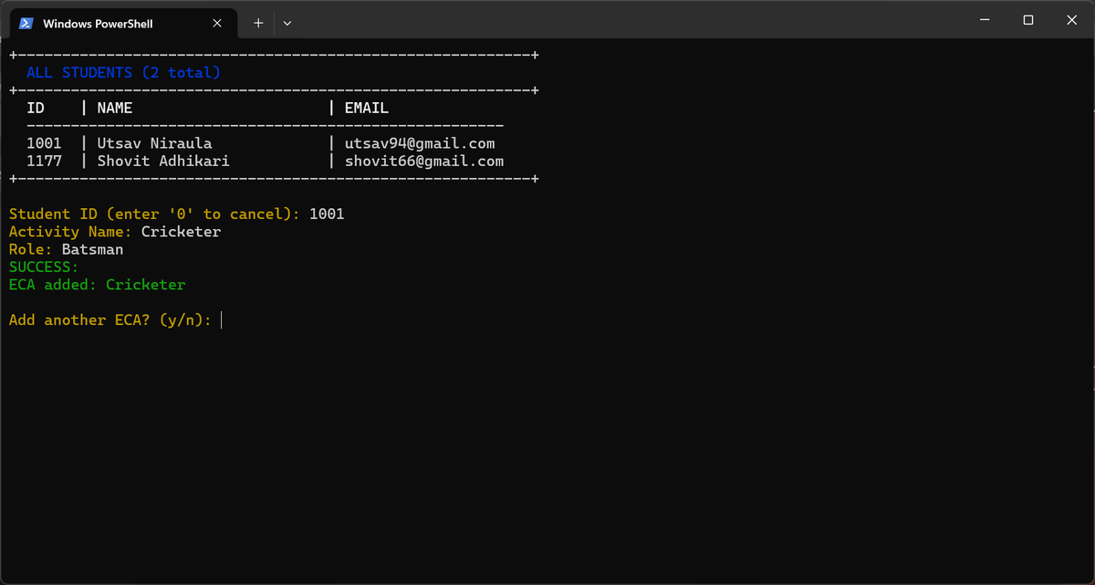
04 Academic Management — Grades & ECA
Student Grades View
Add ECA Activity
Mathematics
Science
English
Computer
Physics

Slide 8
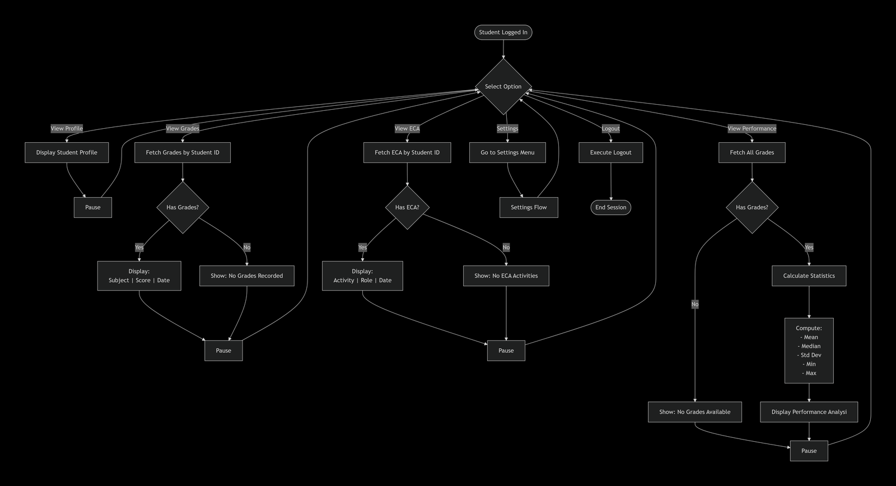
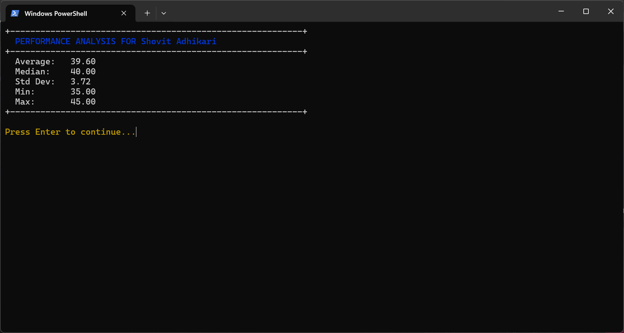
Student Self-Service Portal
My Profile
View personal info — name, email, phone, student ID
My Grades
See scores across all 5 subjects with subject averages
My ECA
View extracurricular activities and assigned roles
Performance
Flowchart: Student Self-Service Flow
Statistical analysis — avg, min, max, GPA band, rank
Export CSV
Download personal grade report as a spreadsheet file
Student Performance Analysis

Slide 9
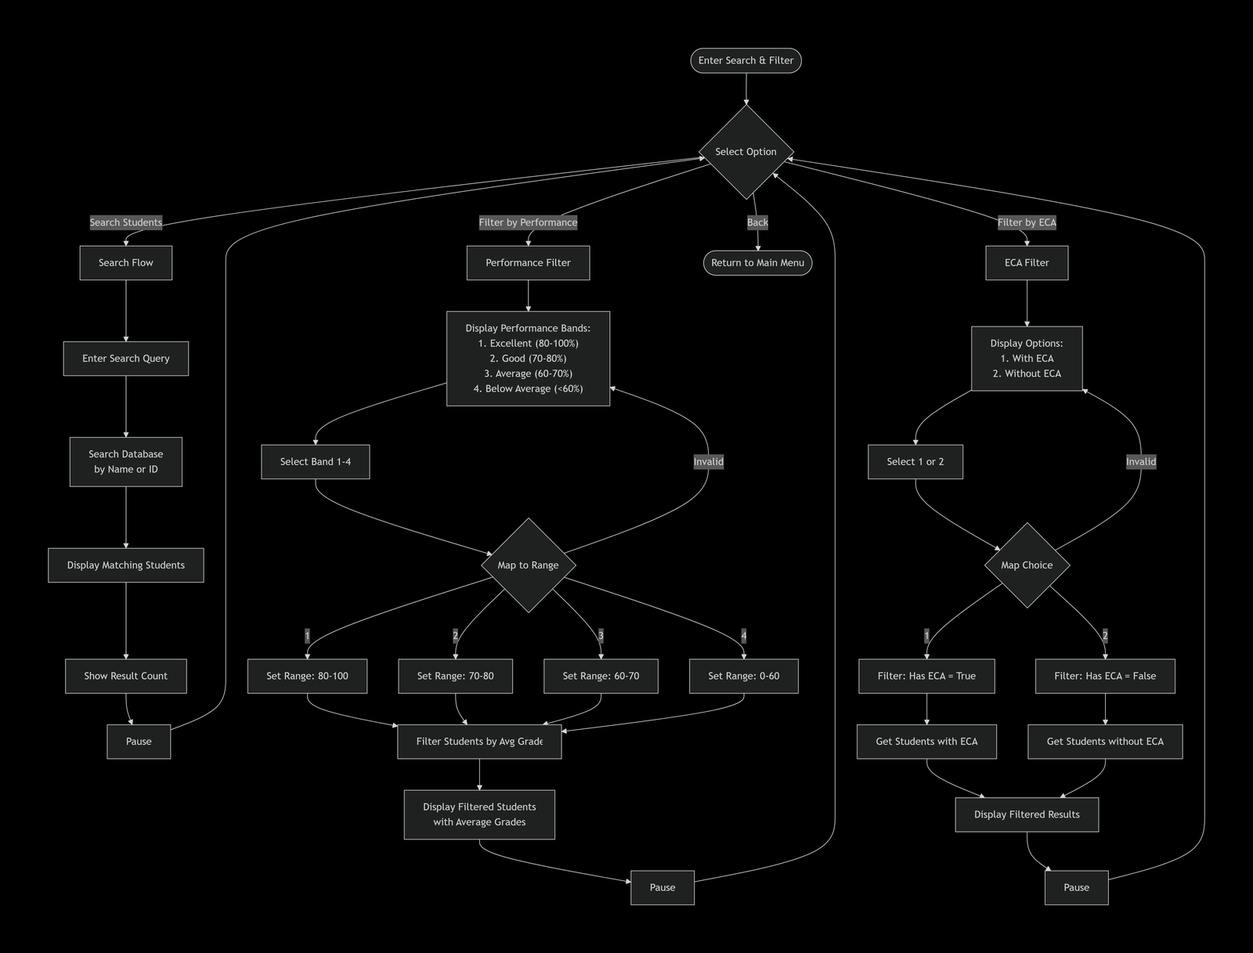
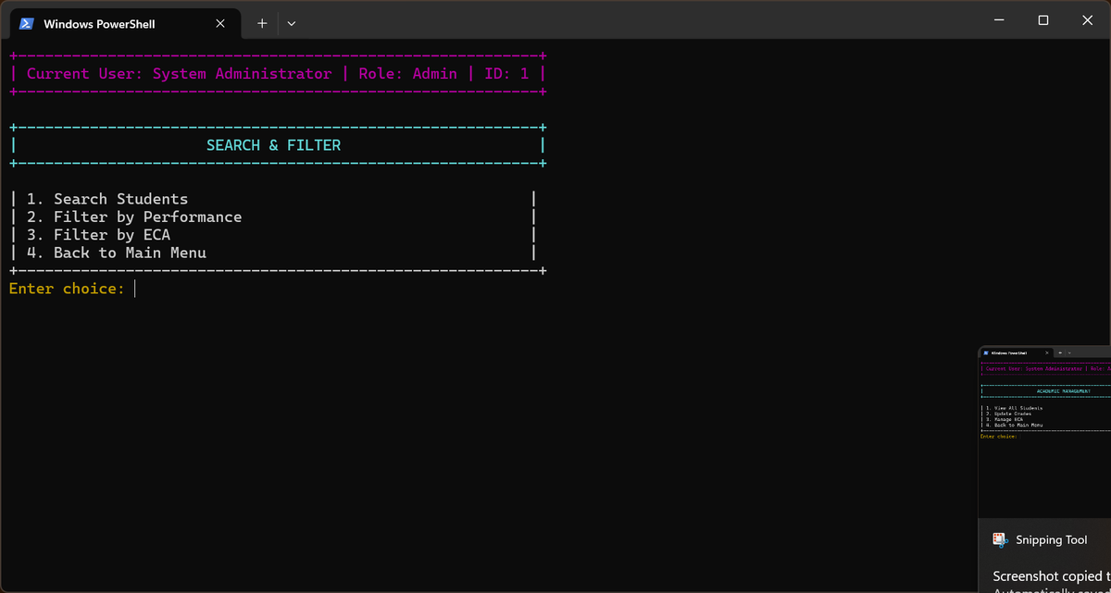
05 Search & Filter System
Three Search Modes
🔍 Search Students
Search by name or username
Partial match supported
Returns profile + grade summary
📊 Filter by Performance
Excellent: 80–100%
Good: 70–80%
Average: 60–70%
Below Average: <60%
Flowchart: Search & Filter System
🏃 Filter by ECA
With ECA participation
Without ECA participation
Useful for engagement tracking

Slide 10
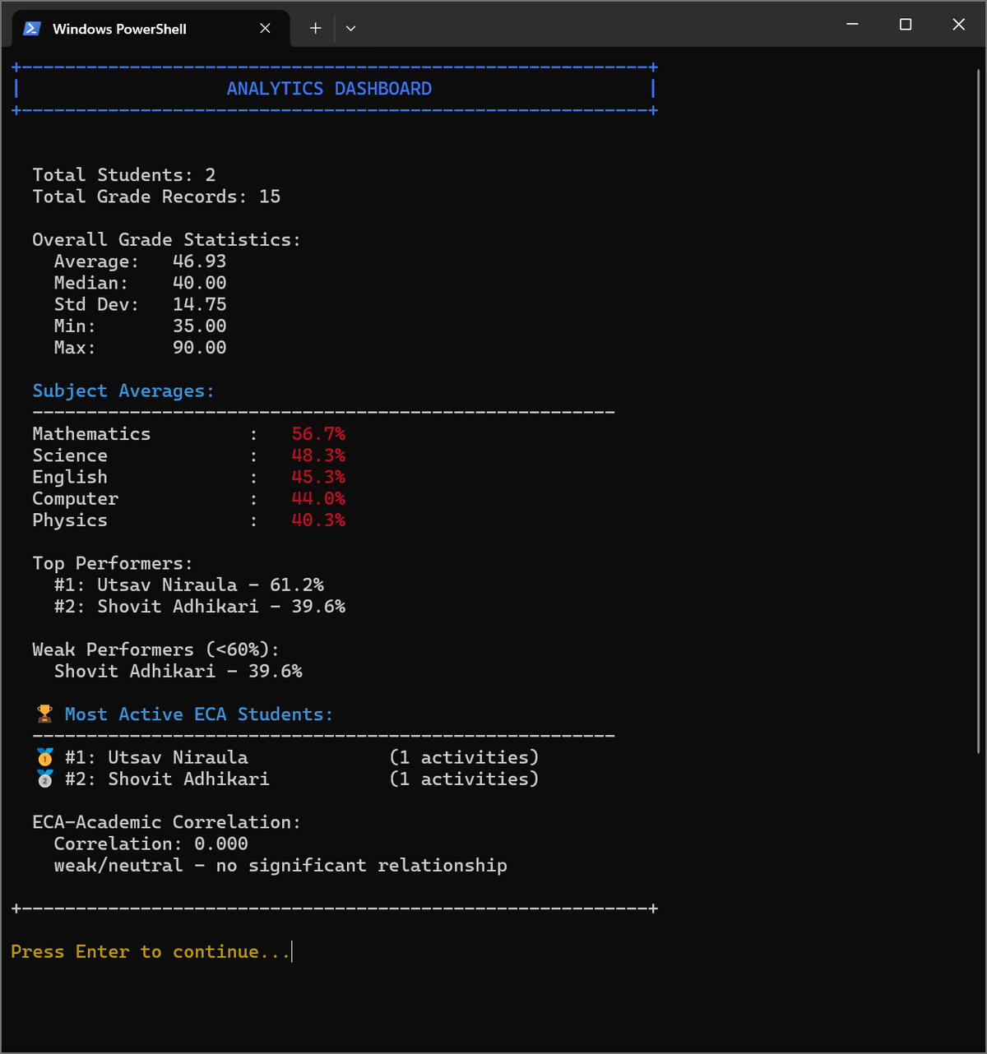
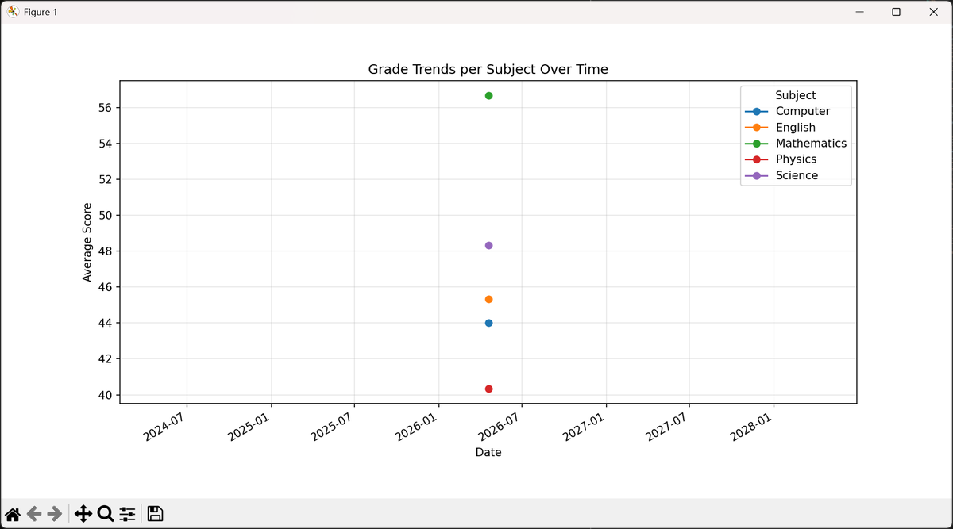
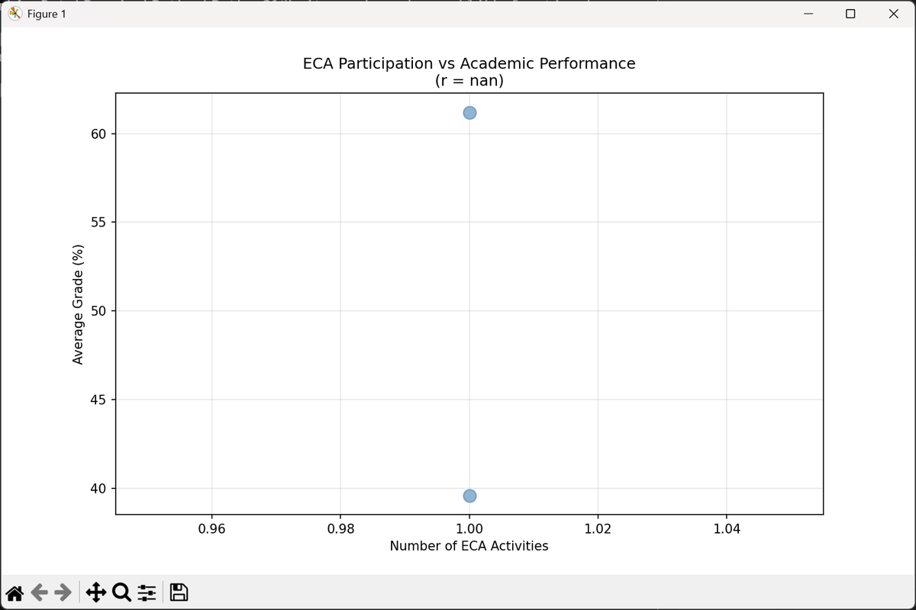
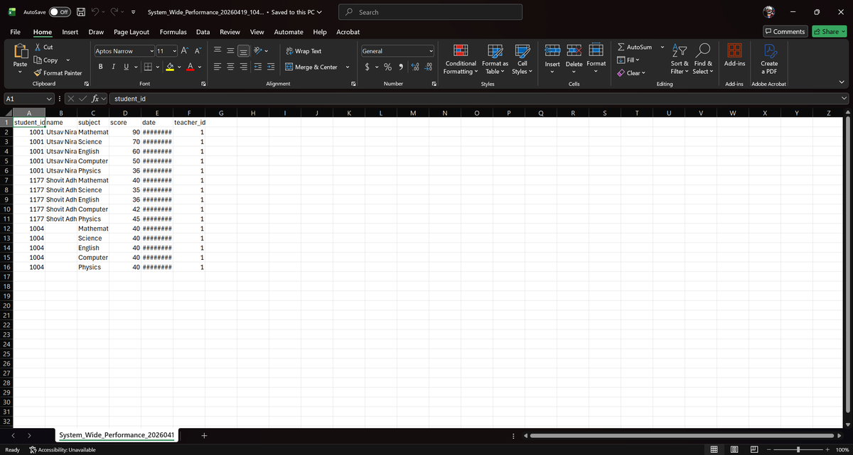
06 Analytics & Reports
Analytics Features
📊 Text Dashboard
Mean, median, std dev, min/max, subject breakdowns, top & weak performers
📈 Grade Trends
matplotlib line chart of grade changes over time per subject
Grade Trends Chart
🔗 ECA Correlation
Scatter plot: ECA activity count vs. academic average with Pearson r
🚨 Perf. Alerts
Auto-flags students below threshold with severity levels
ECA vs. Academic Correlation
📁 CSV Export
System-wide student performance exported as Excel-compatible CSV
Analytics Dashboard

Slide 11
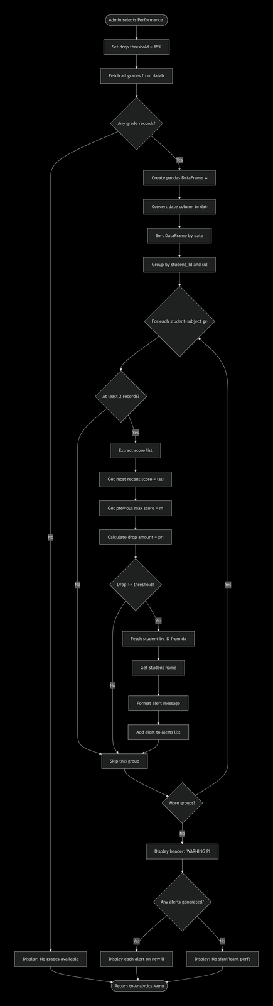
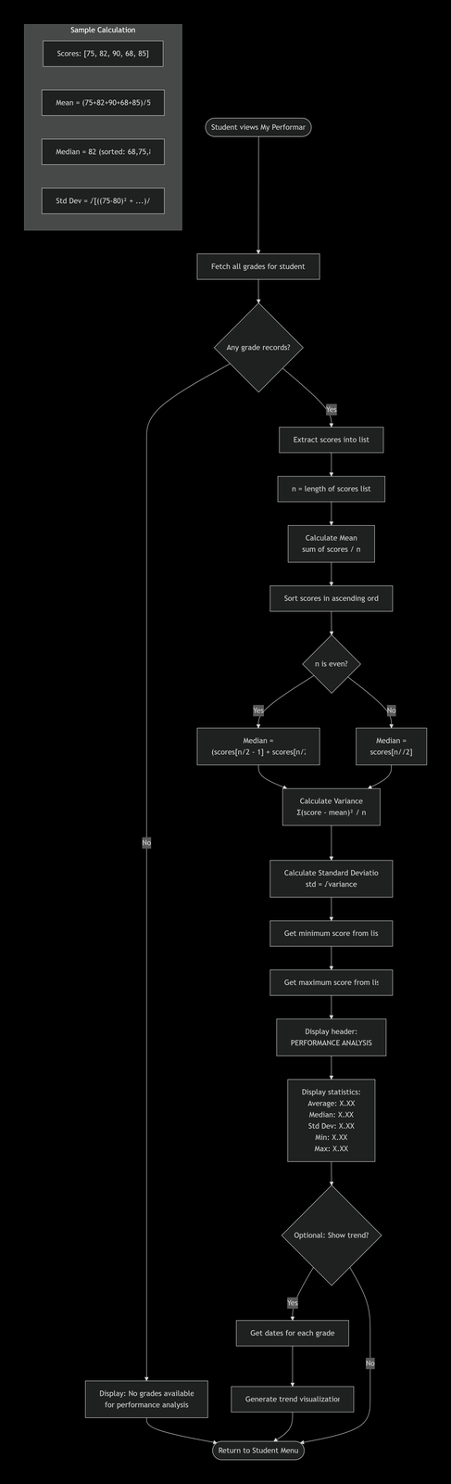
Performance Alert & Statistics System
Grade Band System
80–100%
Excellent
70–79%
Good
60–69%
Average
<60%
Below Average
Statistics Computed
Mean, Median, Std Deviation
Min / Max scores
Overall GPA average
Grade band classification
Class rank position
Flowchart: Performance Alert Generation System
Flowchart: Student Performance Statistics Calculation

Slide 12
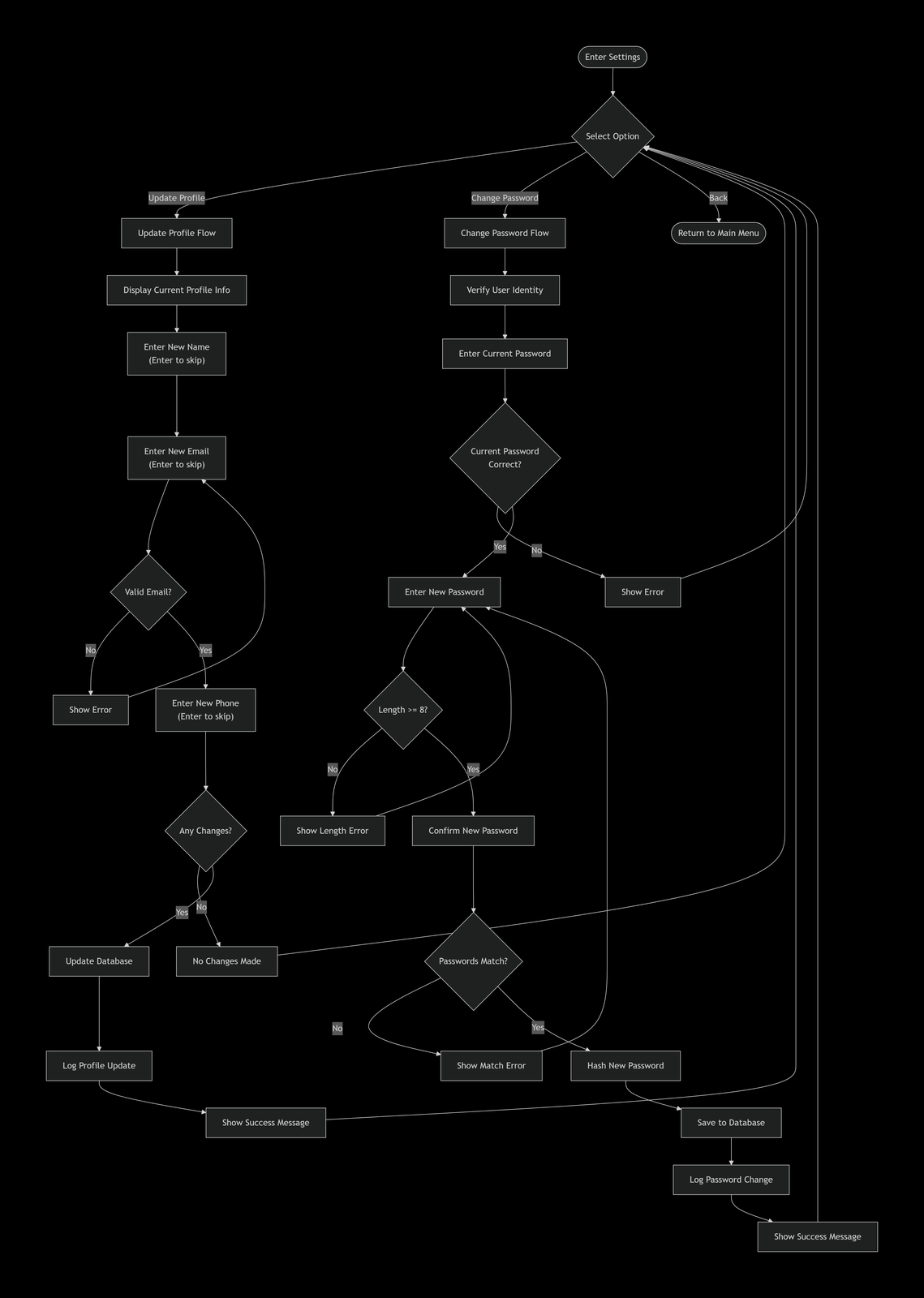
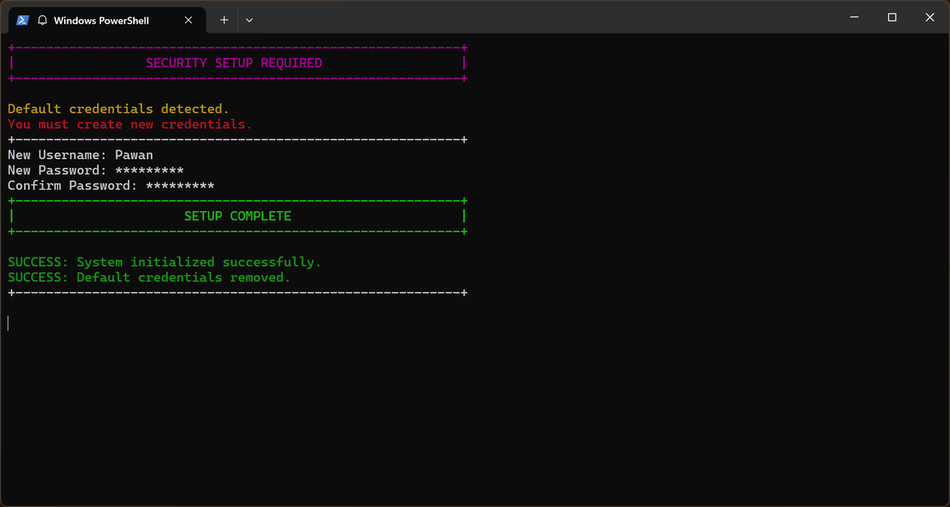
Data Architecture & Settings
File-Based Database Structure
Settings & Profile Management
File | Contents | Format
users.txt | User profiles (ID, username, role, name, email, phone) | Pipe-delimited
passwords.txt | Hashed passwords (SHA-256) | username|hash
grades.txt | Student scores per subject with timestamps | Timestamped records
eca.txt | ECA activities and roles per student | student_id|activity|role
logs.txt | All user actions audit trail | timestamp|user|action
🔄 Automated Backup System
Flowchart: Settings & Profile Management
Before every write operation, the system automatically snapshots all critical data files (users, passwords, grades, eca) into a timestamped backup directory — enabling rollback at any point.
Security Setup Complete

Slide 13
System Summary
Student Management System — Feature Highlights
A complete terminal-based academic platform built in Python
🔐 Secure Auth
📝 Grade Tracking
📊 Analytics Engine
SHA-256 hashed passwords, forced password change, 3-attempt lockout
5 core subjects, score validation 0–100, timestamped grade records
Text dashboards, matplotlib charts, performance alerts, CSV exports
👥 Role Management
🏆 ECA Monitoring
💾 Data Reliability
3 distinct roles — Admin, Teacher, Student — each with tailored menus
Activity logging with roles; correlation analysis with academic performance
Automated backups before every write; full audit log of all actions

