Slide 1
LIVE PRODUCT DEMO
YojanaConnect
Enterprise-grade Welfare Scheme Discovery Platform
Age-aware · Bilingual · REST + MySQL · Production URL live
https://yojnaconnect.prakharkr.online/schemes
Technical Deep-Dive Pitch · Tamil Nadu / Enterprise Review
YojanaConnect · Live: yojnaconnect.prakharkr.online · Confidential pitch
01 / 16

Slide 2
Agenda
What we will cover in this technical walkthrough
01
Problem → Solution
Why scheme discovery fails citizens today
02
Live Architecture
3-tier design, data flow, API contracts
03
Engineering Depth
Stack, schema, filtering engine, i18n, bot
04
Enterprise Readiness
Security, scale path, ops, TN pilot
05
Roadmap & Ask
What ships next and how to partner
YojanaConnect · Live: yojnaconnect.prakharkr.online · Confidential pitch
02 / 16

Slide 3
The Problem: Discovery Gap
India runs 400+ welfare schemes — eligibility still fails at the first click
Fragmented Sources
Complex Eligibility
Ministry sites, PDFs, state portals — no unified citizen entry
Bureaucratic language blocks rural / first-time digital users
Language Barrier
Zero Personalization
English-first UX excludes large Hindi / regional audiences
Users browse catalogs; systems rarely start from life-stage
YojanaConnect · Live: yojnaconnect.prakharkr.online · Confidential pitch
03 / 16

Slide 4
Solution: Life-Stage First Discovery
From “which yojana am I eligible for?” → shortlist + official apply path in under 60 seconds
1
2
3
4
AGE SIGNAL
FILTER ENGINE
SCHEME INTEL
OFFICIAL HANDOFF
Citizen sets age → Teen / YA / Middle / Senior
Sector · Income · Keyword · Central/State
Eligibility · Docs · Steps · Terms
Apply Now → government portal (no PII)
YojanaConnect · Live: yojnaconnect.prakharkr.online · Confidential pitch
04 / 16

Slide 5
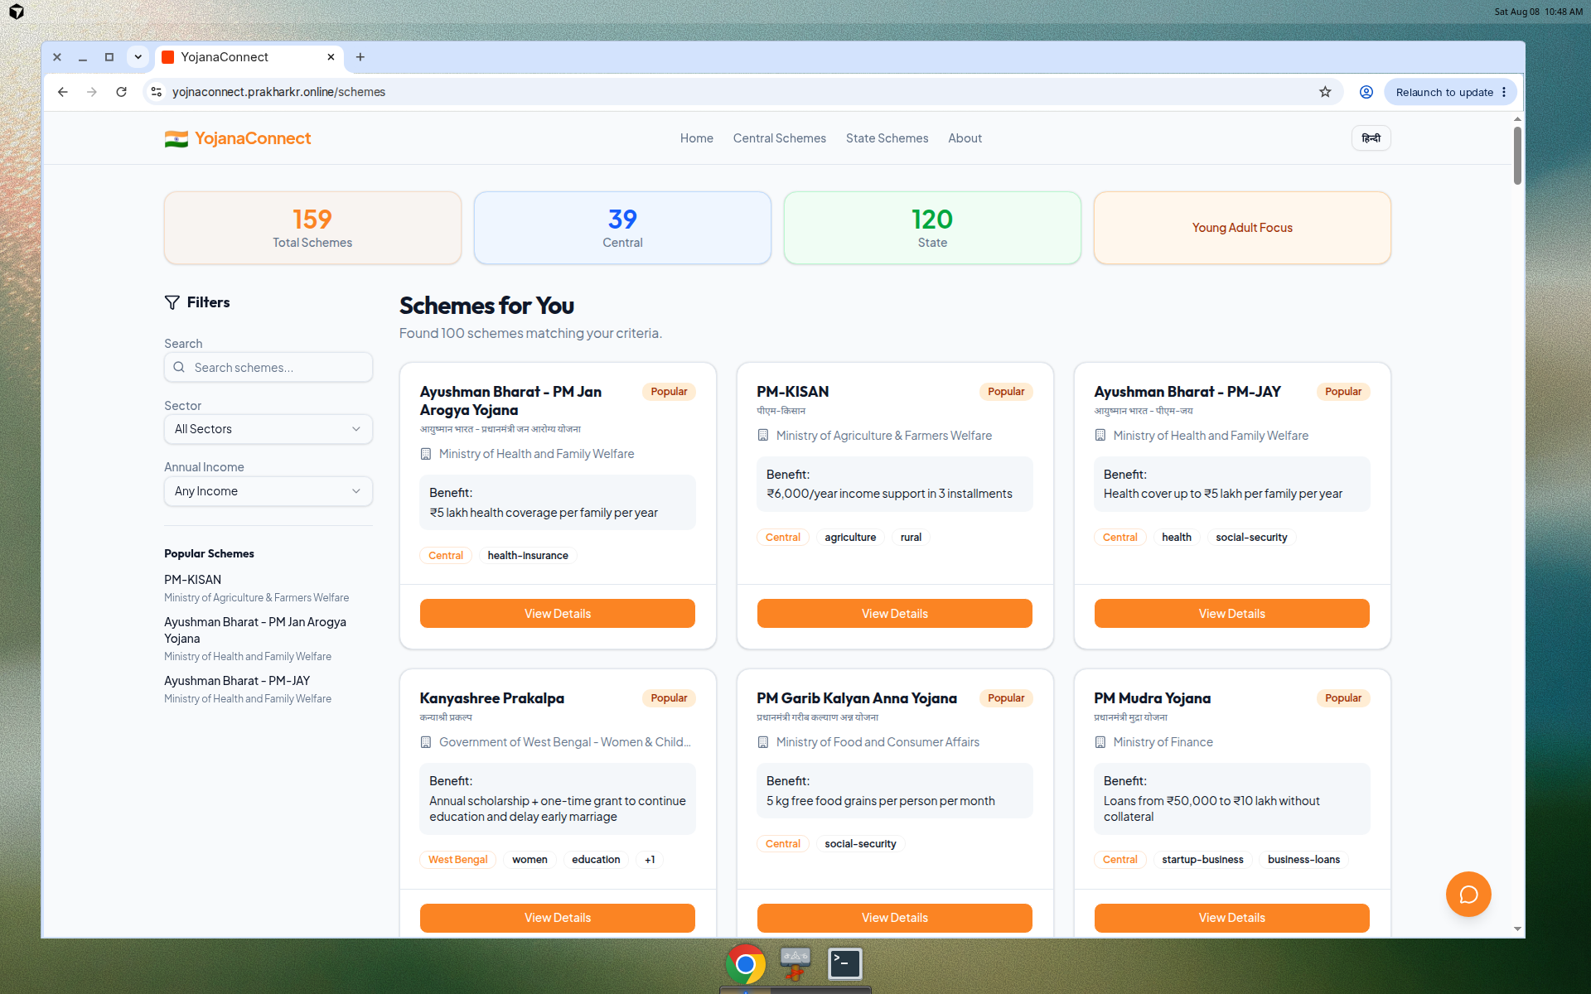
Live Product Snapshot
Production: yojnaconnect.prakharkr.online/schemes
159
39
120
2
Total Schemes
Central
State
Languages
✓ Age-personalized scheme grid with popularity ranking
✓ Sector + income + keyword filters with live counts
✓ Detail pages: eligibility, documents, how-to-apply
✓ WhatsApp share + official Apply Now handoff
✓ YojanaBot guided assistant + EN / हिन्दी i18n
✓ Responsive SPA — mobile-first civic UX
YojanaConnect · Live: yojnaconnect.prakharkr.online · Confidential pitch
05 / 16

Slide 6
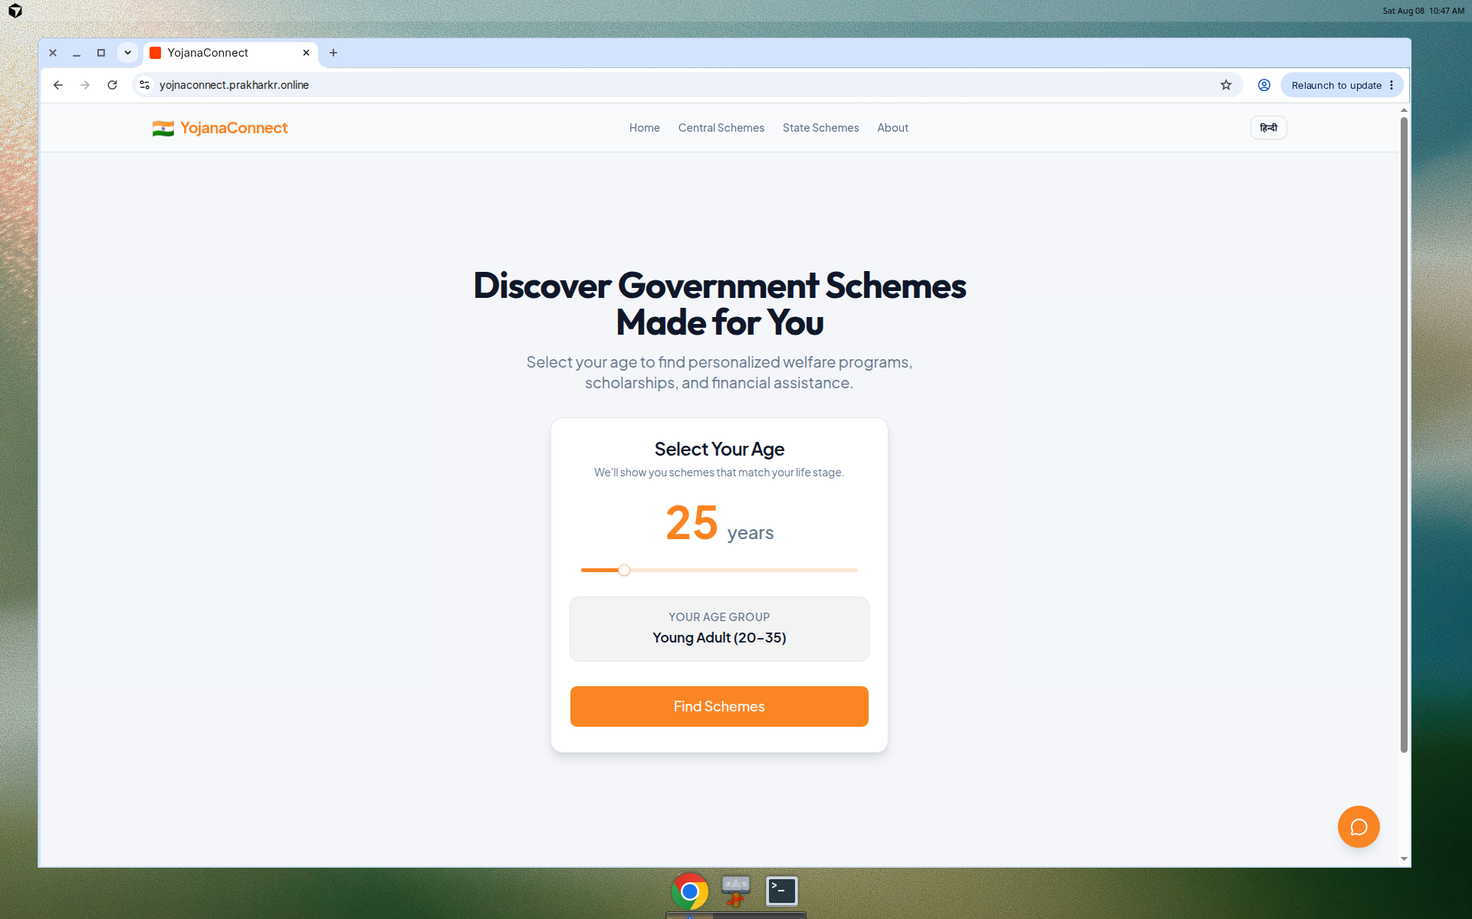
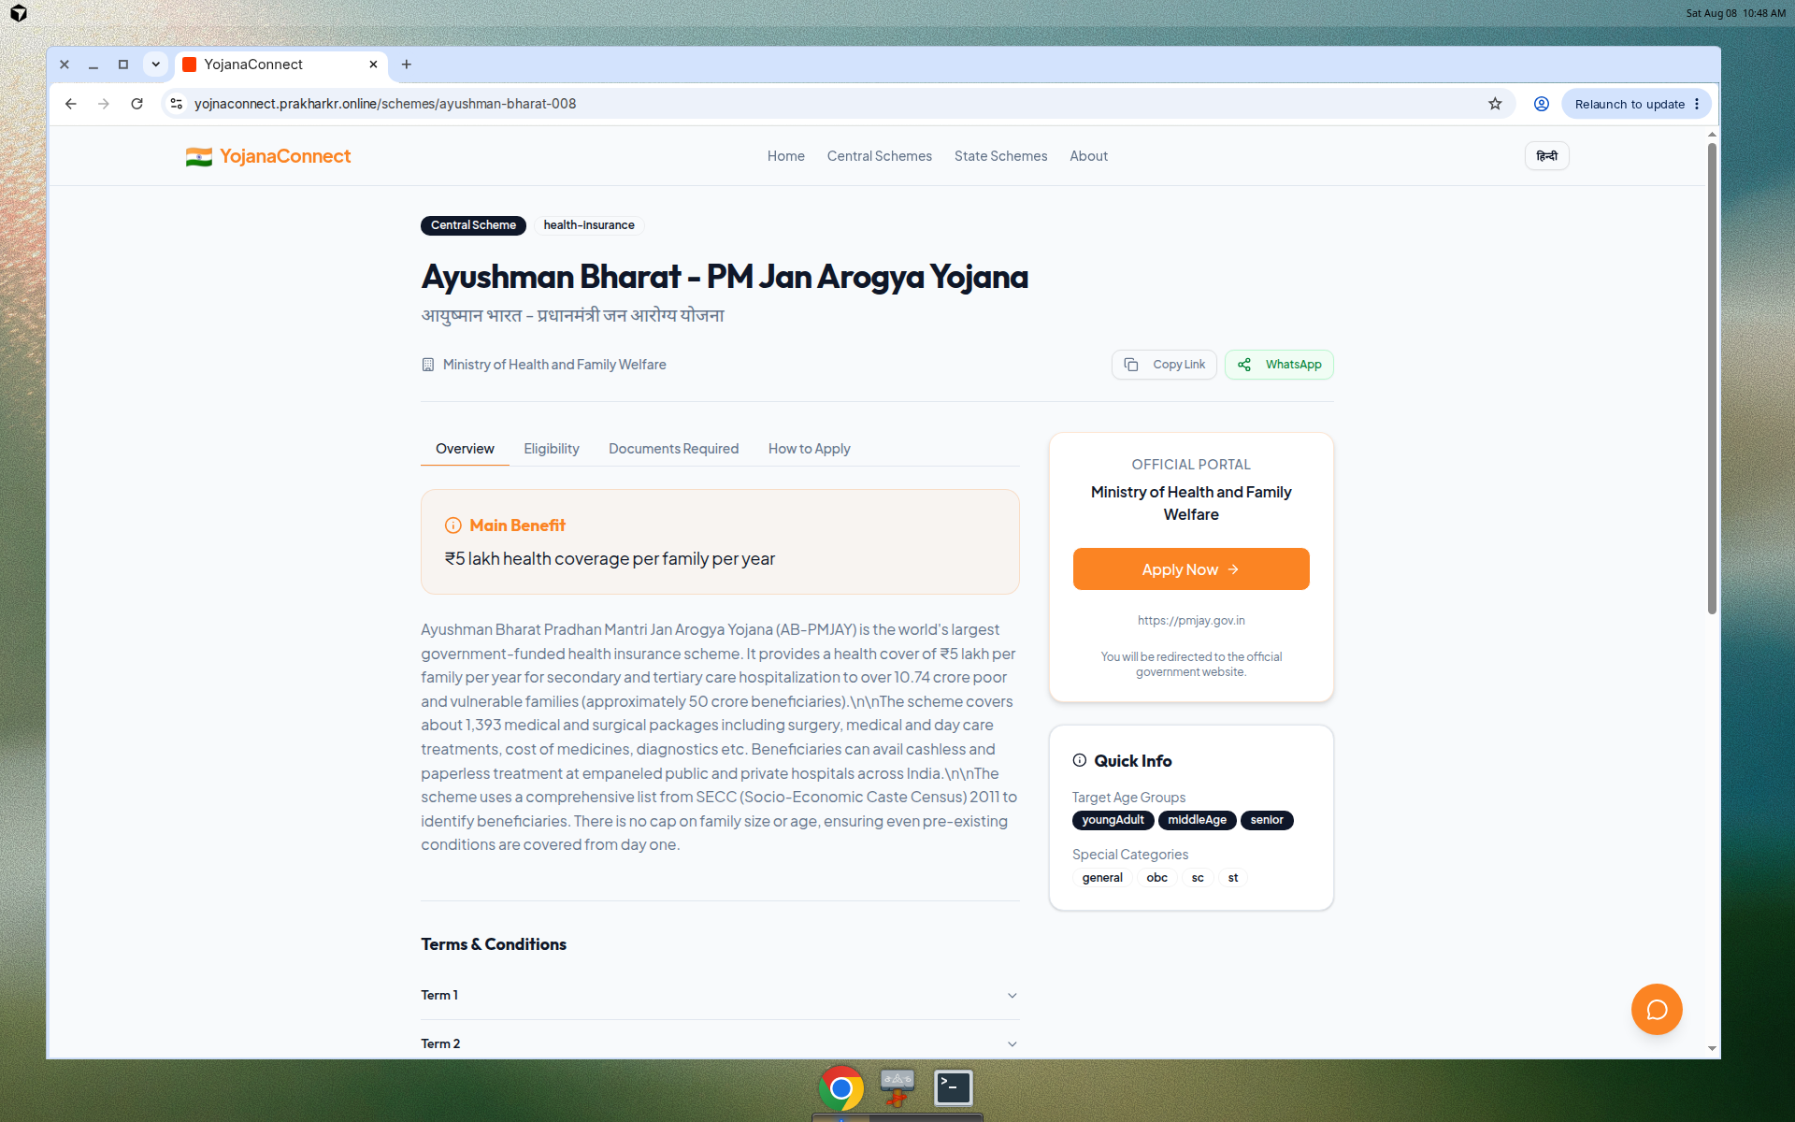
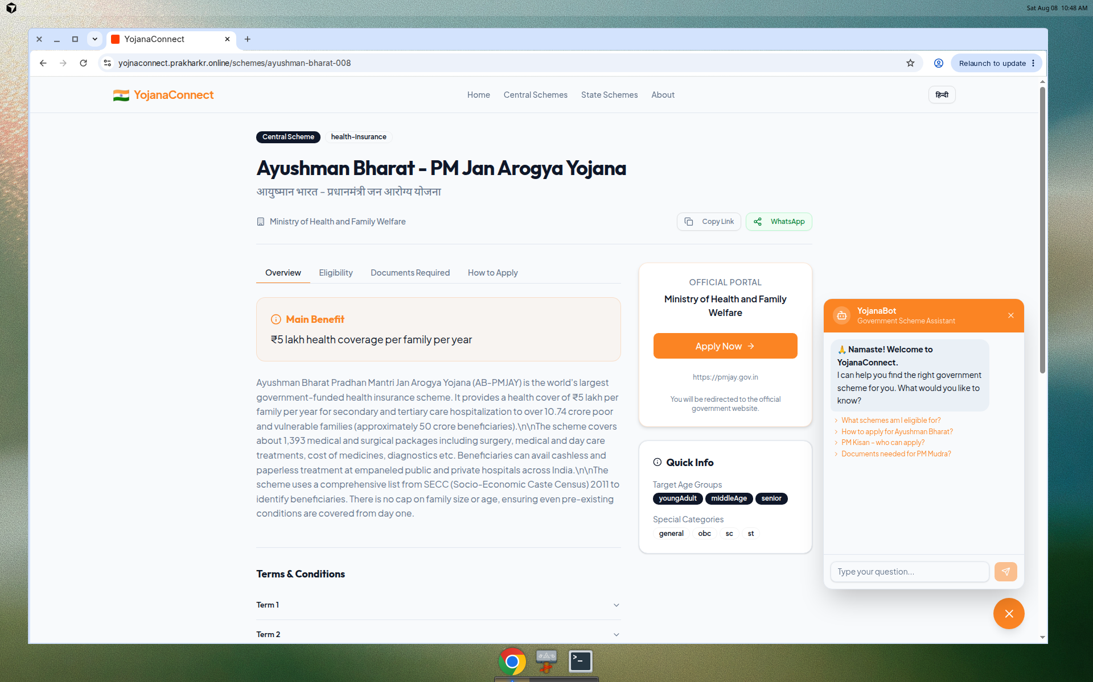
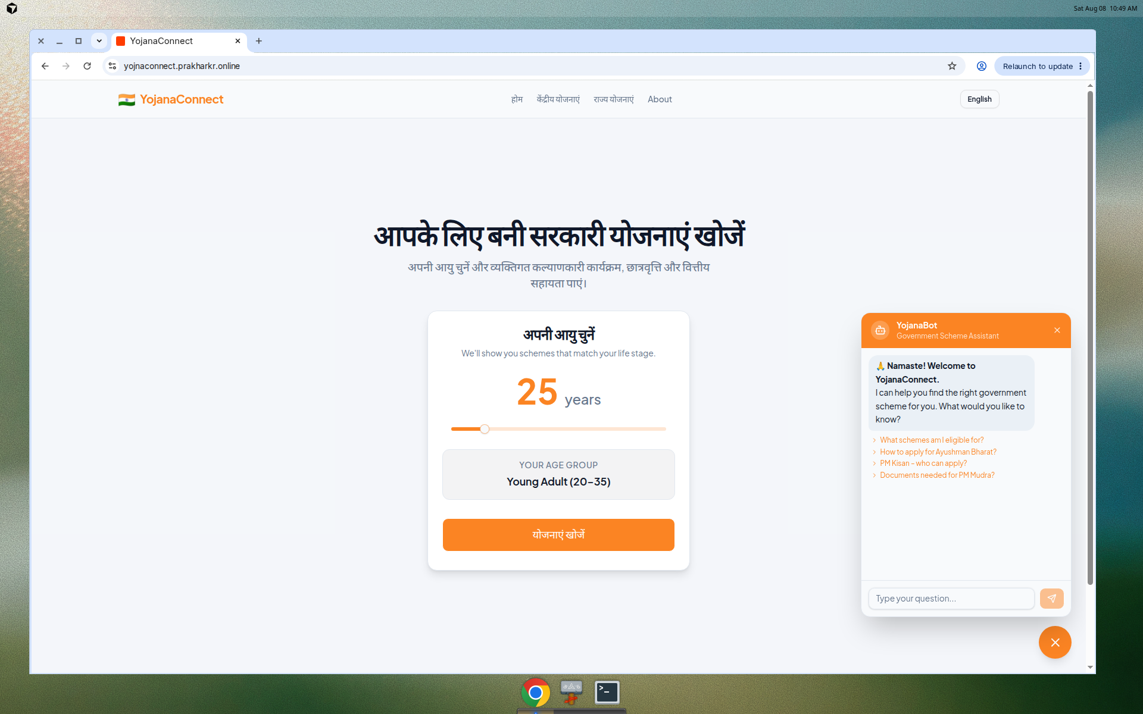
Product Surfaces
Age Entry
Scheme Detail
YojanaBot
Hindi UI
YojanaConnect · Live: yojnaconnect.prakharkr.online · Confidential pitch
06 / 16

Slide 7
System Architecture
Classic 3-tier — optimized for clarity, auditability, and gov IT familiarity
PRESENTATION
React 19 · TypeScript · Vite
TanStack Query · Wouter · i18next
Tailwind v4 · Radix / shadcn
APPLICATION
Node.js · Express 5 REST
Controllers · parameterized SQL
JSON field parsers · CORS
DATA
MySQL 8+
JSON columns for age/sectors
Popularity score ranking
Connection pooling
YojanaConnect · Live: yojnaconnect.prakharkr.online · Confidential pitch
07 / 16

Slide 8
Request Path & Filtering Engine
01
Browser → React SPA (ageGroup in localStorage)
02
GET /api/schemes?ageGroup&sector&incomeLimit&search
03
Express controller builds parameterized WHERE clause
04
MySQL: JSON_CONTAINS(age_groups) + income brackets + LIKE
05
ORDER BY popularity_score → JSON parse → SchemeCards
06
Detail: /api/schemes/:id → Apply Now = official_link
YojanaConnect · Live: yojnaconnect.prakharkr.online · Confidential pitch
08 / 16

Slide 9
Technology Stack — Production Choices
Frontend
Backend
Data & Ops
▸ React 19
▸ Node.js
▸ MySQL 8 JSON
▸ TypeScript
▸ Express 5
▸ Seed SQL
▸ Vite
▸ mysql2 pool
▸ Nginx reverse proxy
▸ TanStack Query
▸ dotenv
▸ Static SPA build
▸ Wouter
▸ CORS
▸ Healthz endpoint
▸ i18next
▸ REST JSON API
▸ Env-based config
▸ Framer Motion
▸ pnpm monorepo
▸ Mobile-first UX
▸ Tailwind CSS v4
▸ Orval client
▸ Live HTTPS
YojanaConnect · Live: yojnaconnect.prakharkr.online · Confidential pitch
09 / 16

Slide 10
API Surface — Contract Design
Read-optimized REST — clean for CSC apps, WhatsApp bots, or state portals later
GET
/api/healthz
Liveness probe
GET
/api/schemes
Filtered list (age, sector, income, search, state)
GET
/api/schemes/:id
Full scheme document
GET
/api/schemes/:id/related
Related / popular adjacency
GET
/api/schemes/popular
Top-N by popularity_score
GET
/api/schemes/stats
Aggregate KPIs for dashboard
GET
/api/sectors
Sector taxonomy (+ age filter)
YojanaConnect · Live: yojnaconnect.prakharkr.online · Confidential pitch
10 / 16

Slide 11
Data Model — Flexible Scheme Knowledge Base
schemes
sectors
id · name · name_hindi · ministry
age_groups (JSON) · sectors (JSON)
income_limit · categories · benefit
eligibility / documents (JSON arrays)
how_to_apply · official_link · deadline
terms_and_conditions · tags
is_state · state · popularity_score
sector_id · name · name_hindi
age_groups (JSON) · icon
Why JSON columns?
Multi-value age/sector tags without join explosion
Fast iteration for scheme metadata
Queryable via MySQL JSON_CONTAINS
YojanaConnect · Live: yojnaconnect.prakharkr.online · Confidential pitch
11 / 16

Slide 12
Security · Privacy · Trust Model
Current Posture
Enterprise Hardening Path
✓ Discovery platform — not a benefit processor
✓ No Aadhaar / bank / KYC collected today
✓ Apply happens on official government portals
✓ Parameterized SQL — injection-resistant queries
✓ Secrets via environment variables
✓ HTTPS live deployment behind Nginx
Production hardening backlog:
• Remove debug endpoints from public edge
• Suppress stack traces in client errors
• Tighten CORS to known origins
• Rate-limit public GET APIs
• Add WAF / CDN + audit logging
• Auth only when bookmarks/admin ship
YojanaConnect · Live: yojnaconnect.prakharkr.online · Confidential pitch
12 / 16

Slide 13
Scale & Reliability Path
NOW
NEXT
SCALE
GOV
SPA + Node API + MySQL
Cache + CDN
Horizontal API
Managed hosting
Single region, read-heavy catalog, connection pool
Redis for popular lists, Cloudflare/Nginx static cache
Stateless replicas behind LB; MySQL replica reads
NIC / state DC / Kubernetes; observability + SLOs
YojanaConnect · Live: yojnaconnect.prakharkr.online · Confidential pitch
13 / 16

Slide 14
Differentiation vs Generic Portals
Life-stage entry
Age → personalized shortlist (not ministry-first browsing)
Unified UX
Eligibility + docs + steps + official link in one flow
Bilingual native
EN / HI UI + Hindi scheme names in data model
In-product guide
YojanaBot for high-frequency scheme FAQs
Extensible API
Same REST can power CSC kiosks / WhatsApp later
TN-ready story
State layer + Tamil localization as pilot upgrade
YojanaConnect · Live: yojnaconnect.prakharkr.online · Confidential pitch
14 / 16

Slide 15
Tamil Nadu Pilot Roadmap
Phase 1
Phase 2
Phase 3
Localize
Pilot
Operate
Tamil UI strings
Top TN schemes seed
Content QA with dept sources
1–2 districts / CSC
Discovery KPIs
Feedback loop
Admin CMS
Analytics dashboard
SLA + hosting on gov infra
YojanaConnect · Live: yojnaconnect.prakharkr.online · Confidential pitch
15 / 16

Slide 16
THE ASK
Pilot YojanaConnect for Tamil Nadu
1. Verified TN scheme content + Tamil language pack
2. Preferred hosting guidance (state DC / cloud)
3. CSC / district discovery pilot with measurable KPIs
https://yojnaconnect.prakharkr.online/schemes
Thank you — open for architecture deep-dive & live walkthrough
YojanaConnect · Live: yojnaconnect.prakharkr.online · Confidential pitch
16 / 16

