Slide 1
Problem Statement : Sentiment analysis for stock
Team Name: AlgoArchitects
Team Id: 12
Idea:
Leverage social media sentiment analysis from tweets to predict stock market movements, providing investors with real-time insights.
Solution:
Use the Twitter API to gather and preprocess tweets, extract features, classify sentiment, aggregate scores, and integrate with stock prediction models for comprehensive trading insights.
Live Demo: PrediStock

Slide 2
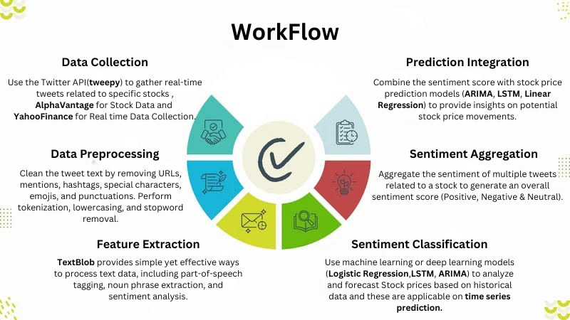

Slide 3
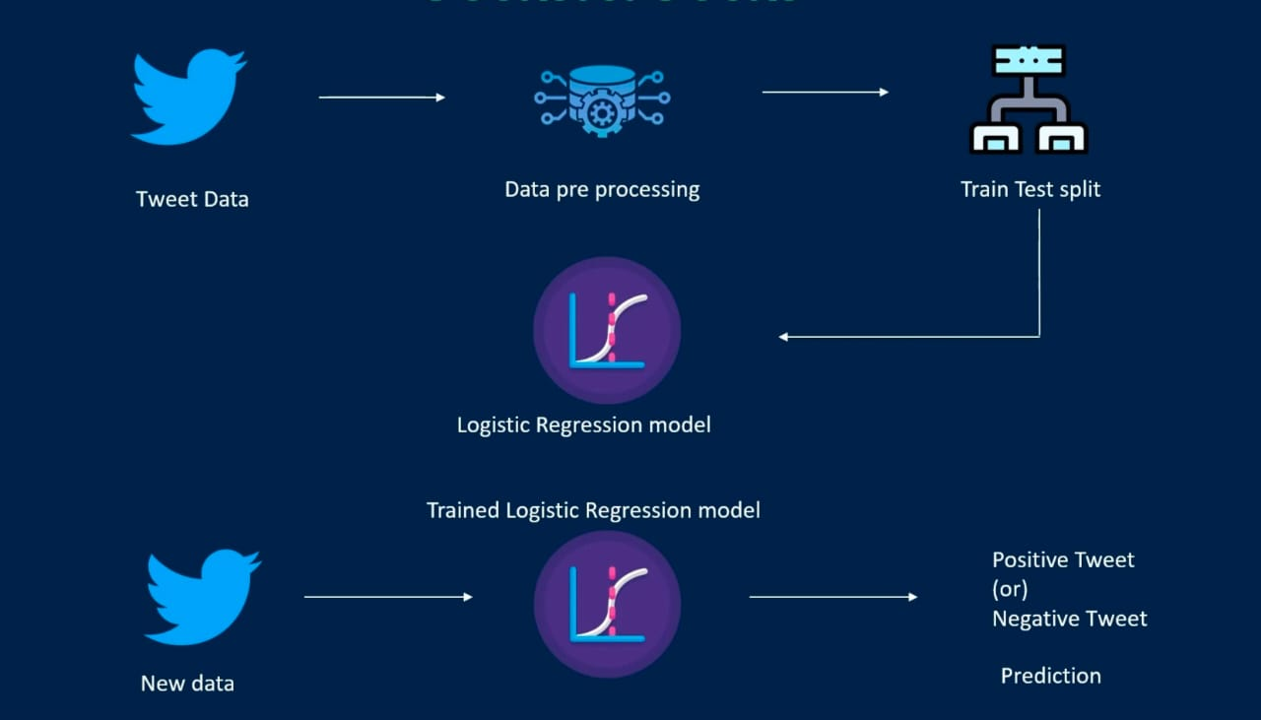
1. Tweet Data: Contains tweets and their dates.
2. Data Preprocessing: Text is cleaned(Preprocessor), tokenized, and converted into numerical data for model training.
3. Training Dataset: Data is split for training a Logistic Regression model.
4. Logistic Regression Model: The model predicts tweet sentiment (positive/negative) and accuracy is checked.
5. New Predictions: The model classifies the sentiment of new tweets.

