Slide 1
ARMEK – Agentic AI-Powered Loan Underwriting and Risk Assessment System
Kuppam Engineering College · Department of Computer Science and Engineering · Academic Year: 2026–2027
Abstract
Team Members
ARMEK is an AI-powered loan underwriting and risk assessment system designed to simplify the loan application process. It uses a multi-agent architecture in which a Master Agent coordinates specialized agents to perform eligibility checks, verification, fraud detection and risk assessment. The system integrates React.js, FastAPI and OpenAI GPT-4o-mini to provide a conversational interface and organized loan processing workflow.
Y N PAWANKALYAN
V RAMYA
C NANDINI
S DILLI RAJESH

Slide 2

BACKGROUND
Introduction
Loan underwriting is the foundational process by which financial institutions evaluate a borrower's eligibility and repayment capacity. Understanding the limitations of traditional approaches motivates the design of ARMEK.
Conventional Underwriting Background
• Eligibility Evaluation: Loan underwriting evaluates a borrower's eligibility and repayment capacity against defined financial criteria.
• Multi-Stage Verification: Traditional loan processing involves multiple verification stages across departments and personnel.
• Time and Coordination Costs: Manual processing can require considerable time and coordination between different review teams.
Motivation for Multi-Agent AI System
• Information Inconsistency: Incomplete or inconsistent applicant information can make structured assessment difficult without automated validation.
• Structured AI Workflows: AI can support information processing and structured decision workflows, reducing manual delays.
• ARMEK Multi-Agent Orchestration: ARMEK organizes these underwriting activities through an orchestrated multi-agent architecture.
LOAN UNDERWRITING WORKFLOW STAGES
1. Loan Application
→
2. Information Collection
→
3. Verification
→
4. Risk Assessment
→
5. Loan Decision

Slide 3
PROJECT GOALS
Objectives
Main Objective:
To develop an AI-powered loan underwriting system that organizes applicant information processing, verification workflows and risk assessment through a multi-agent architecture.
1
User-Friendly Loan Interface
Provide a user-friendly loan application interface.
2
Applicant Information Processing
Collect and process applicant information in a structured and validated manner.
3
Master Agent Coordination
Coordinate loan assessment through a Master Agent.
4
Eligibility & Verification Checks
Perform eligibility and verification checks.
5
Risk & Fraud Assessment
Support credit-related risk assessment and fraud checks.
6
Document Generation & Status
Generate loan-related documents and display application status.

Slide 4


ACADEMIC FOUNDATION
Literature Survey
Three peer-reviewed research papers form the academic basis for ARMEK's design, establishing the viability of machine-learning and AI methods in loan underwriting and credit-risk prediction.
S. No. | Author and Year | Research Paper | Method / Focus | Key Findings
1 | Turiel & Aste (2020) | Peer-to-peer loan acceptance and default prediction with artificial intelligence Journal: Royal Society Open Science, 7(6), 191649 DOI: https://doi.org/10.1098/rsos.191649 | Machine-learning methods for loan acceptance and default prediction. | Evaluated ML models on peer-to-peer lending data; demonstrated improved classification of loan applications and default prediction.
2 | Xu, Lu & Xie (2021) | Loan default prediction of Chinese P2P market: a machine learning methodology Journal: Scientific Reports, 11, 18759 DOI: https://doi.org/10.1038/s41598-021-98361-6 | Machine-learning approaches for loan default prediction. | Analyzed borrower features in P2P lending; showed ensemble and ML techniques enhance default risk identification.
3 | Alonso Robisco & Carbó Martínez (2022) | Measuring the model risk-adjusted performance of machine learning algorithms in credit default prediction Journal: Financial Innovation, 8, 70 DOI: https://doi.org/10.1186/s40854-022-00366-1 | Credit-default prediction, machine-learning performance and model risk. | Assessed ML performance under model risk constraints; emphasized balancing predictive accuracy with model stability.

Slide 5
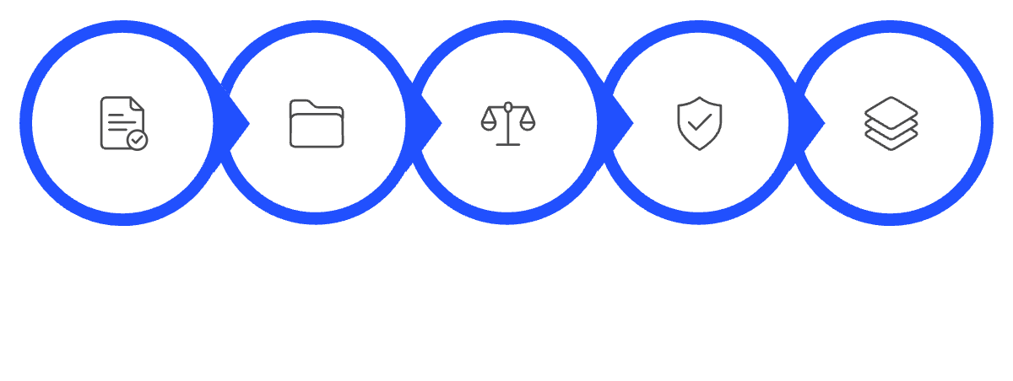

STATUS QUO
Existing System
Conventional loan processing relies on sequential, manual stages across separate departments, creating operational overhead and review delays.
Conventional loan processing follows a sequential, largely manual workflow. Understanding this baseline is essential to appreciating the structural improvements ARMEK introduces.
Conventional Application & Checking
• Application Submission: Applicants submit personal and financial information through manual paper forms or static portals.
• Document Collection: Documents are collected and checked manually for completeness across disparate office channels.
• Eligibility Assessment: Eligibility is evaluated using financial criteria and manual debt calculations.
Review & Decision Process
• Credit & Identity Checks: Credit and identity checks are performed as isolated administrative steps.
• Departmental Reviews: Different stages may require separate reviews and handoffs between departments.
• Decision Communication: Final loan decisions are communicated to applicants after notable administrative turnaround times.
CONVENTIONAL LOAN PROCESSING WORKFLOW
1. Applicant
→
2. Application Submission
→
3. Document Verification
→
4. Eligibility Assessment
→
5. Risk Assessment
→
6. Loan Decision

Slide 6

COMPARATIVE EVALUATION
Existing System: Advantages and Disadvantages
Objective evaluation of traditional loan underwriting procedures, highlighting established institutional strengths alongside procedural bottlenecks.
✓ ADVANTAGES
⚠ DISADVANTAGES
1. Established lending procedures. Built upon established lending procedures with long-standing regulatory familiarity and standardized compliance.
2. Human review for complex applications. Direct availability of human judgment for complex, non-standard, or edge-case loan applications.
3. Familiar verification processes. Verification processes are universally recognized, accepted, and audited across traditional banking institutions.
4. Suitable for standard banking workflows. Well-suited for standard banking workflows, established audit trails, and legal regulatory frameworks.
1. Multiple manual processing stages. Multi-stage manual handoffs significantly increase overall application turnaround times.
2. Repeated document handling. Repeated document handling and redundant verification steps across disparate departments.
3. Coordination between different departments. Coordination friction between separate review teams, branch managers, and credit underwriting desks.
4. Delays may occur during application review. Delays frequently occur during application review, discrepancy resolution, and manual escalation.
5. Limited automation in some workflows. Limited automation in routine verification and assessment workflows leads to higher processing effort.

Slide 7







PROPOSED SYSTEM
ARMEK – Agentic AI-Powered Loan Underwriting and Risk Assessment System
A multi-agent loan underwriting architecture coordinating specialized worker agents through a central Master Agent, backed by modern web and AI technologies.
React Frontend
Applicant Interface
React-based frontend for applicant interaction, structured information input, conversational form submission, and real-time status display.
FastAPI Backend
Application Processing
Python FastAPI backend for application processing, session management, REST endpoints, and Pydantic-validated data models.
AI Integration
OpenAI GPT-4o-mini
OpenAI GPT-4o-mini integration for AI-enabled conversational assistance, applicant guidance, and structured parameter reasoning.
Worker Agents
Modular Verification
Specialized agents executing eligibility checks, state reconciliation, credit assessment, fraud checks, and sanction document generation.
END-TO-END ORCHESTRATED WORKFLOW PIPELINE
Applicant
→
React Frontend
→
FastAPI Backend
→
AI Integration
▼
★ MASTER AGENT ★
(Central Coordination)
→
Specialized Worker Agents
(Eligibility · KYC · Bureau · Fraud)
→
Assessment & Docs
(ReportLab Sanction Letter)
→
Application
Status & Results

Slide 8
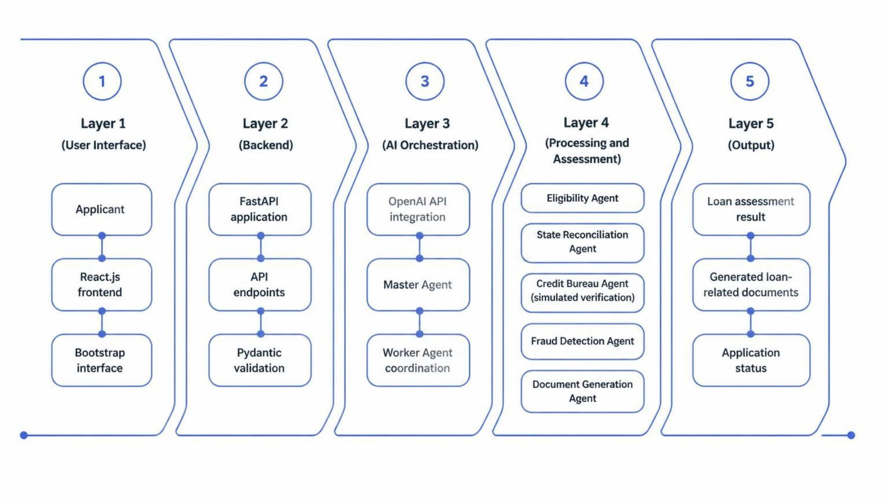

SYSTEM BENEFITS
Proposed System: Advantages
Key operational and structural advantages delivered by ARMEK's orchestrated multi-agent underwriting architecture.
Organized Multi-Agent Workflow
Organized multi-agent workflow distributing assessment across specialized agents, preventing processing bottlenecks in any single stage.
Reduced Manual Coordination
Reduced repetitive manual coordination steps through automated agent handoffs orchestrated by the central Master Agent.
Centralized Information Processing
Centralized applicant information processing in a unified pipeline, eliminating data duplication and state inconsistency across stages.
Conversational AI-Based Interaction
Conversational AI-based interaction powered by GPT-4o-mini, providing an intuitive and accessible experience for loan applicants.
Separate Worker Responsibilities
Separate responsibilities for specialized worker agents (eligibility, reconciliation, credit checks, fraud detection, and document generation).
Clear Status & Document Workflow
Clear application status and document generation workflow, providing real-time visibility and automated sanction letter generation upon approval.

Slide 9

TECHNICAL DESIGN
System Architecture Diagram
Five-tier modular architecture illustrating data flow, agent orchestration, and component responsibilities in ARMEK.
Layer 1 – User Interface: Applicant · React.js · Bootstrap 5 · Axios
▼
Layer 2 – Backend: Python FastAPI · API Endpoints · Pydantic Validation
▼
Layer 3 – AI Orchestration: OpenAI API · GPT-4o-mini · ★ MASTER AGENT ★
Coordinates the 5 specialized worker agents, manages session state, and evaluates decision conditions
▼
Layer 4 – Worker Agent Processing (Master Agent Coordinates the Five Worker Agents)
Eligibility Agent
Income & FOIR checks
State Reconciliation Agent
Cross-field consistency
Credit Bureau Agent
Credit-related risk checks
Fraud Detection Agent
Anomaly & fraud checks
Document Generation Agent
Sanction letter generation
▼
Layer 5 – Output: Loan Assessment Result · Loan-Related Documents · Application Status
Note: Credit-related assessment and bureau verification are simulated internally within the ARMEK pipeline. The system does not connect to live external government or credit bureau APIs.

Slide 10



ACADEMIC SOURCES
References
Research Papers
S. No. | Author(s) & Year | Paper / Documentation Title | Journal / Source | DOI / URL
1 | Turiel, J. D., & Aste, T. (2020) | Peer-to-peer loan acceptance and default prediction with artificial intelligence | Royal Society Open Science, 7(6), 191649 | https://doi.org/10.1098/rsos.191649
2 | Xu, J., Lu, Z., & Xie, Y. (2021) | Loan default prediction of Chinese P2P market: a machine learning methodology | Scientific Reports, 11, 18759 | https://doi.org/10.1038/s41598-021-98361-6
3 | Alonso Robisco, A., & Carbó Martínez, J. M. (2022) | Measuring the model risk-adjusted performance of machine learning algorithms in credit default prediction | Financial Innovation, 8, 70 | https://doi.org/10.1186/s40854-022-00366-1
4 | Meta Open Source (2024) | React Official Documentation: The Library for Web and Native User Interfaces | React Technical Documentation (https://react.dev/) | https://react.dev/
5 | Sebastián Ramírez (2024) | FastAPI Official Documentation: Modern, Fast Web Framework for Python | FastAPI Framework Documentation (https://fastapi.tiangolo.com/) | https://fastapi.tiangolo.com/
6 | OpenAI (2024) | OpenAI API Documentation and Platform Reference Guides | OpenAI Developer Documentation (https://platform.openai.com/docs/) | https://platform.openai.com/docs/
7 | Bootstrap Authors (2024) | Bootstrap 5 Documentation: The World's Most Popular Front-End Toolkit | Bootstrap Technical Documentation (https://getbootstrap.com/docs/) | https://getbootstrap.com/docs/

