Slide 1


KUPPAM ENGINEERING COLLEGE (Autonomous)
(Recognized by AICTE & Affiliated to JNTUA)
KES Nagar, Kuppam – 517425, Chittoor Dist., A.P.
P R O J E C T P R E S E N T A T I O N
ARMEK – Agentic AI-Powered Loan Underwriting and Risk Assessment System
ARMEK is an AI-powered loan underwriting and risk assessment system designed to simplify the loan application process. It uses a multi-agent architecture in which a Master Agent coordinates specialized agents to perform eligibility checks, verification, fraud detection and risk assessment. The system integrates React.js, FastAPI and OpenAI GPT-4o-mini to provide a conversational interface and organized loan processing workflow.
SUBMITTED BY
Team Members :
1. Y N PAWANKALYAN
2. V RAMYA
3. C NANDINI
4. S DILLI RAJESH
Department : Computer Science and Engineering
Batch : 2023–2027
UNDER THE GUIDANCE OF
Mrs.K.Shandhini, M.E.,
Assistant Professor
Department of Computer Science and Engineering
Academic Year : 2026–2027
ARMEK / PROJECT PRESENTATION
01 - KUPPAM ENGINEERING COLLEGE

Slide 2

BACKGROUND
Introduction
Loan underwriting evaluates a borrower's eligibility and repayment capacity against defined financial criteria.
Conventional Loan Underwriting
• Meaning of Underwriting: Loan underwriting evaluates a borrower's eligibility and repayment capacity against defined institutional risk parameters.
• Traditional Multi-Stage Process: Traditional loan processing involves multiple verification stages across disparate departments and manual review queues.
• Time and Coordination: Manual processing can require considerable time and coordination, leading to delays and administrative friction.
Motivation for Multi-Agent Architecture
• Data Consistency Challenges: Incomplete or inconsistent applicant information makes manual assessment difficult without automated validation.
• Structured AI Workflows: AI can support information processing and structured decision workflows, organizing tasks with greater consistency.
• ARMEK Multi-Agent Solution: ARMEK organizes these underwriting activities through a multi-agent architecture coordinating eligibility, KYC, and risk checks.
LOAN UNDERWRITING WORKFLOW PROCESS
1. Loan Application
→
2. Information Collection
→
3. Verification
→
4. Risk Assessment
→
5. Loan Decision
ARMEK / PROJECT PRESENTATION
02 - KUPPAM ENGINEERING COLLEGE

Slide 3
PROJECT GOALS
Objectives
Primary aim and specific engineering goals established for the ARMEK multi-agent loan underwriting system.
Main Objective:
To develop an AI-powered loan underwriting system that organizes applicant information processing, verification workflows and risk assessment through a multi-agent architecture.
1
User-Friendly Interface
Provide a user-friendly loan application interface.
2
Information Processing
Collect and process applicant information in a structured and validated manner.
3
Master Agent Coordination
Coordinate assessment through a Master Agent.
4
Eligibility & Verification
Perform eligibility and verification checks.
5
Risk & Fraud Checks
Support credit-related risk assessment and fraud checks.
6
Document Generation
Generate loan-related documents and display application status.
ARMEK / PROJECT PRESENTATION
03 - KUPPAM ENGINEERING COLLEGE

Slide 4


ACADEMIC FOUNDATION
Literature Survey
Comparative review of foundational peer-reviewed research papers on AI and machine-learning credit risk prediction.
S. No. | Author and Year | Research Paper | Method / Focus | Key Findings
1 | Turiel and Aste (2020) | Peer-to-peer loan acceptance and default prediction with artificial intelligence Journal: Royal Society Open Science, 7(6), 191649 DOI: https://doi.org/10.1098/rsos.191649 | Machine-learning methods (logistic regression, SVM, deep neural networks) for loan acceptance and default prediction. | Demonstrated that AI and ML models effectively classify loan applications and improve default-risk prediction in peer-to-peer lending.
2 | Xu, Lu and Xie (2021) | Loan default prediction of Chinese P2P market: a machine learning methodology Journal: Scientific Reports, 11, 18759 DOI: https://doi.org/10.1038/s41598-021-98361-6 | Machine-learning approaches (Random Forest, Gradient Boosting, Neural Networks) for loan default prediction. | Analyzed borrower features in P2P lending; showed ensemble and tree-based ML methods significantly enhance default identification.
3 | Alonso Robisco and Carbó Martínez (2022) | Measuring the model risk-adjusted performance of machine learning algorithms in credit default prediction Journal: Financial Innovation, 8, 70 DOI: https://doi.org/10.1186/s40854-022-00366-1 | Credit-default prediction, machine-learning performance and model risk assessment. | Assessed ML performance under model risk constraints; emphasized balancing predictive accuracy with model stability and validation.
ARMEK / PROJECT PRESENTATION
04 - KUPPAM ENGINEERING COLLEGE

Slide 5
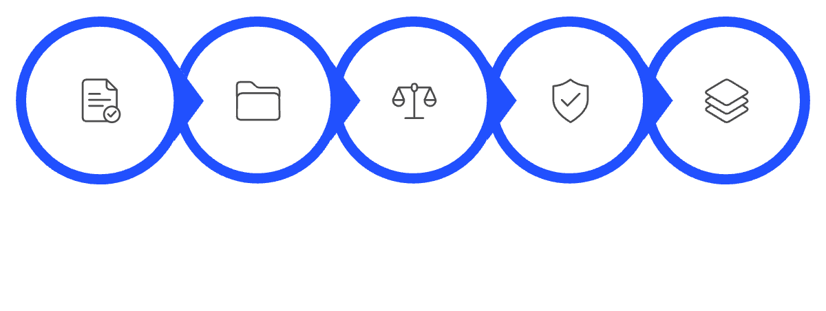

STATUS QUO
Existing System
Conventional loan processing relies on sequential, manual stages across separate departments, creating operational overhead.
Conventional Processing Stages
• Application Submission: Applicants submit personal, financial, and employment information through manual paper forms or static portals.
• Document Collection: Physical and digital documents (pay slips, tax returns, bank statements) are manually collected and examined.
• Eligibility Assessment: Loan officers manually verify borrower eligibility and calculate debt-to-income against rigid financial criteria.
Verification & Departmental Reviews
• Credit & Identity Checks: Credit bureau scores and identity credentials are queried as separate, uncoordinated administrative tasks.
• Departmental Reviews: Different verification stages require separate departmental reviews, manual escalations, and cross-team handoffs.
• Final Loan Decision: Final loan approval or rejection decisions are communicated to applicants after notable processing turnaround times.
CONVENTIONAL LOAN PROCESSING WORKFLOW
1. Applicant
→
2. Application Submission
→
3. Document Verification
→
4. Eligibility Assessment
→
5. Risk Assessment
→
6. Loan Decision
ARMEK / PROJECT PRESENTATION
05 - KUPPAM ENGINEERING COLLEGE

Slide 6

COMPARATIVE EVALUATION
Existing System: Advantages and Disadvantages
Objective evaluation of traditional loan underwriting procedures, highlighting established institutional strengths alongside procedural bottlenecks.
✓ ADVANTAGES
⚠ DISADVANTAGES
1. Established lending procedures. Built on established lending procedures with long-standing regulatory familiarity and standardized compliance.
2. Human review for complex applications. Direct availability of human judgment for complex, edge-case, or non-standard loan applications.
3. Familiar verification processes. Verification processes are universally recognized, accepted, and audited across traditional banking institutions.
4. Suitable for standard banking workflows. Well-suited for standard banking workflows, established audit trails, and legal regulatory frameworks.
1. Multiple manual processing stages. Multi-stage manual handoffs significantly increase overall application turnaround times.
2. Repeated document handling. Repeated document handling and redundant verification steps across disparate departments.
3. Coordination between departments. Coordination friction between separate review teams, branch managers, and credit underwriting desks.
4. Delays during application review. Delays frequently occur during application review, discrepancy resolution, and manual escalation.
5. Limited automation in some workflows. Limited automation in routine verification and assessment workflows leads to higher processing effort.
ARMEK / PROJECT PRESENTATION
06 - KUPPAM ENGINEERING COLLEGE

Slide 7







PROPOSED SYSTEM
ARMEK – Agentic AI-Powered Loan Underwriting and Risk Assessment System
A multi-agent loan underwriting architecture coordinating specialized worker agents through a central Master Agent, backed by modern web and AI technologies.
React.js Frontend
Applicant Interface
React-based frontend for applicant interaction, structured information input, conversational form submission, and real-time status display.
FastAPI Backend
Application Processing
Python FastAPI backend for application processing, session management, REST endpoints, and Pydantic-validated data models.
OpenAI Integration
GPT-4o-mini
OpenAI GPT-4o-mini integration for AI-enabled conversational assistance, applicant guidance, and structured parameter reasoning.
Specialized Worker Agents
Modular Verification
Dedicated agents executing eligibility checks, state reconciliation, credit assessment, fraud checks, and sanction document generation.
END-TO-END ORCHESTRATED WORKFLOW PIPELINE
Applicant
→
React Frontend
→
FastAPI Backend
→
AI Integration
▼
★ MASTER AGENT ★
(Central Coordination)
→
Specialized Worker Agents
(Eligibility · KYC · Bureau · Fraud)
→
Assessment & Docs
(ReportLab Sanction Letter)
→
Application
Status & Results
ARMEK / PROJECT PRESENTATION
07 - KUPPAM ENGINEERING COLLEGE

Slide 8
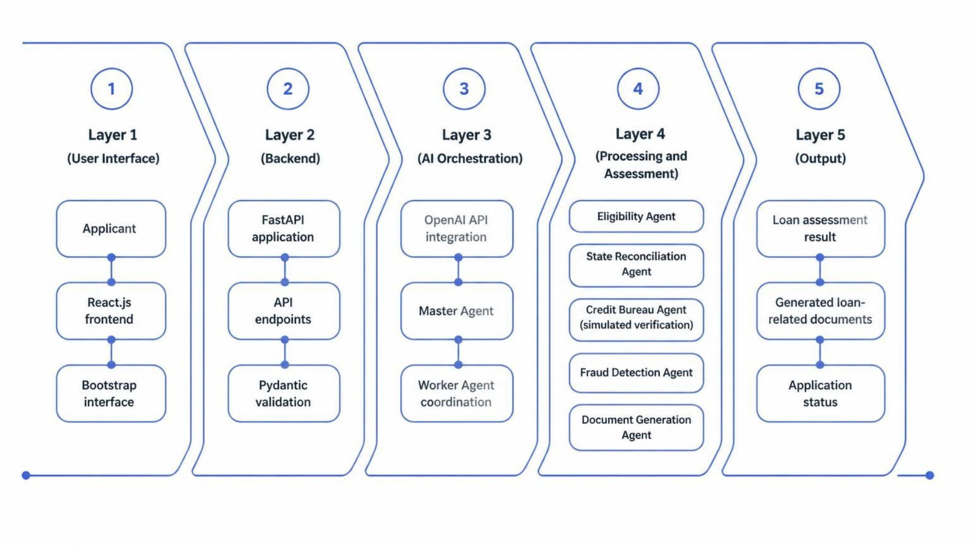

SYSTEM BENEFITS
Proposed System: Advantages
Structural and operational improvements delivered by ARMEK's orchestrated multi-agent underwriting architecture.
✓
Organized multi-agent workflow.
Organized multi-agent workflow distributing assessment across specialized agents, preventing processing bottlenecks in any single stage.
✓
Reduced manual coordination.
Reduced repetitive manual coordination steps through automated agent handoffs orchestrated by the central Master Agent.
✓
Centralized information processing.
Centralized applicant information processing in a unified pipeline, eliminating data duplication and state inconsistency across stages.
✓
Conversational AI-based interaction.
Conversational AI-based interaction powered by GPT-4o-mini, providing an intuitive and accessible experience for loan applicants.
✓
Separate responsibilities for worker agents.
Separate responsibilities for specialized worker agents (eligibility, reconciliation, credit checks, fraud detection, and document generation).
✓
Clear application status and document workflow.
Clear application status and document generation workflow, providing real-time visibility and automated sanction letter generation upon approval.
ARMEK / PROJECT PRESENTATION
08 - KUPPAM ENGINEERING COLLEGE

Slide 9

TECHNICAL DESIGN
System Architecture Diagram
Five-tier modular architecture illustrating data flow, agent orchestration, and component responsibilities in ARMEK.
Layer 1 – User Interface: Applicant · React.js · Bootstrap · Axios
▼
Layer 2 – Backend: Python FastAPI · API endpoints · Pydantic validation
▼
Layer 3 – AI Orchestration: OpenAI API · GPT-4o-mini · ★ MASTER AGENT ★
Coordinates the specialized worker agents, manages session state, and evaluates decision conditions
▼
Layer 4 – Worker Agent Processing (Master Agent Coordinates the Five Worker Agents)
Eligibility Agent
Income & FOIR checks
State Reconciliation Agent
Cross-field consistency
Credit Bureau Agent
Credit-related risk checks
Fraud Detection Agent
Anomaly & fraud checks
Document Generation Agent
Sanction letter generation
▼
Layer 5 – Output: Loan assessment result · Loan-related documents · Application status
Note: Credit-related assessment and bureau verification are simulated internally. The system does not connect to live external government or credit-bureau APIs.
ARMEK / PROJECT PRESENTATION
09 - KUPPAM ENGINEERING COLLEGE

Slide 10



ACADEMIC & TECHNICAL SOURCES
References
Comprehensive research literature and official technical documentation supporting the ARMEK loan underwriting system.
S. No. | Author(s) and Year | Paper / Documentation Title | Journal / Source | DOI / URL
1 | Turiel and Aste (2020) | Peer-to-peer loan acceptance and default prediction with artificial intelligence | Royal Society Open Science, 7(6), 191649 | https://doi.org/10.1098/rsos.191649
2 | Xu, Lu and Xie (2021) | Loan default prediction of Chinese P2P market: a machine learning methodology | Scientific Reports, 11, 18759 | https://doi.org/10.1038/s41598-021-98361-6
3 | Alonso Robisco and Carbó Martínez (2022) | Measuring the model risk-adjusted performance of machine learning algorithms in credit default prediction | Financial Innovation, 8, 70 | https://doi.org/10.1186/s40854-022-00366-1
4 | Meta Open Source (2024) | React Official Documentation: The Library for Web and Native User Interfaces | React Technical Documentation (https://react.dev/) | https://react.dev/
5 | Sebastián Ramírez (2024) | FastAPI Official Documentation: Modern, Fast Web Framework for Python | FastAPI Framework Documentation (https://fastapi.tiangolo.com/) | https://fastapi.tiangolo.com/
6 | OpenAI (2024) | OpenAI API Documentation and Platform Reference Guides | OpenAI Developer Documentation (https://platform.openai.com/docs/) | https://platform.openai.com/docs/
7 | Bootstrap Authors (2024) | Bootstrap 5 Documentation: The World's Most Popular Front-End Toolkit | Bootstrap Technical Documentation (https://getbootstrap.com/docs/) | https://getbootstrap.com/docs/
ARMEK / PROJECT PRESENTATION
10 - KUPPAM ENGINEERING COLLEGE

Slide 11
PROJECT SUMMARY
Conclusion
Summary of system achievements, multi-agent workflow benefits, and project outcomes.
ARMEK is an AI-powered loan underwriting system that makes the loan application and assessment process more organized. It uses a Master Agent to coordinate different worker agents for eligibility checking, verification, fraud detection and risk assessment. The system combines React.js, FastAPI and OpenAI GPT-4o-mini to support applicant interaction and loan processing. Overall, ARMEK demonstrates how multi-agent AI can help simplify loan assessment through a structured workflow.
ARMEK / PROJECT PRESENTATION
11 - KUPPAM ENGINEERING COLLEGE

