Slide 1
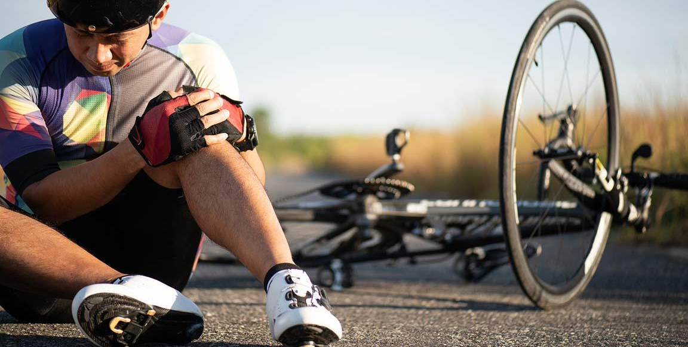
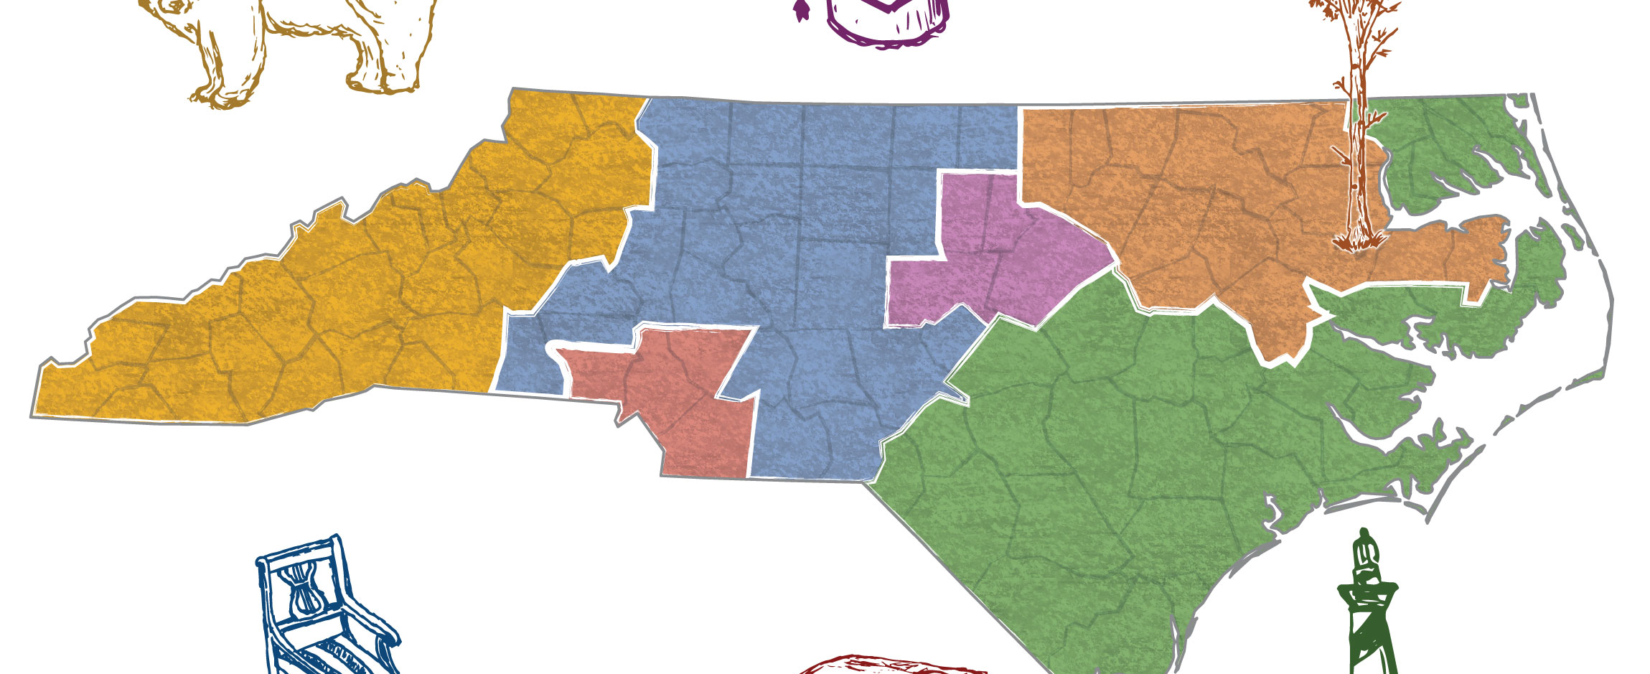
Bike Crash Analysis Proposal to North Carolina Road Control
Prepared by:
Pawan Kumar Vadlamani
Umar
Ghousiya Shaik
Shengjie Jin

Slide 2
Overview
Objective is to clean, transform, analyze bike crash data in the state of North Carolina state and generate patterns to visualize frequency of Serious & Fatal accidents. We plan to utilize supervised Machine Learning techniques to identify the root causes of these accidents and develop strategies for prevention.
Goal of project : To determine what causes the crashes, level of severity to help the road safety departments improvise safety measures and policies pertaining to reduce the occurrence of crashes.
DataSet Source: The dataset is collected from Kaggle website. The link for the data is
https://www.kaggle.com/datasets/atharvaingle/bikepedcrash
Our dataset holds all of the information related to bike crash include the bike rider's information the driver's information and the other objective conditions such as weather and road conditions etc, which will allow us to understand the attributions that lead to the bike crash and correlated circumstances.

Slide 3



Outline
Benefit of the project
Problems need to be Solved
Machine learning Algorithm

Slide 4



The Benefit of the project
Primary - Department of transportation for the state of Carolina
(Provide safer road, educate public drivers and riders, prevent fatality, reduce severity of crashes)
Secondary - Insurance companies
(notice high prone crash area, provide more accurate premium)

Slide 5
Problems Need to be Solved
The most crashes happened?
Factors contribute to fatality?
Our business intelligence suggestions?
Limitations from our data?
Future analysis & conclusion.

Slide 6
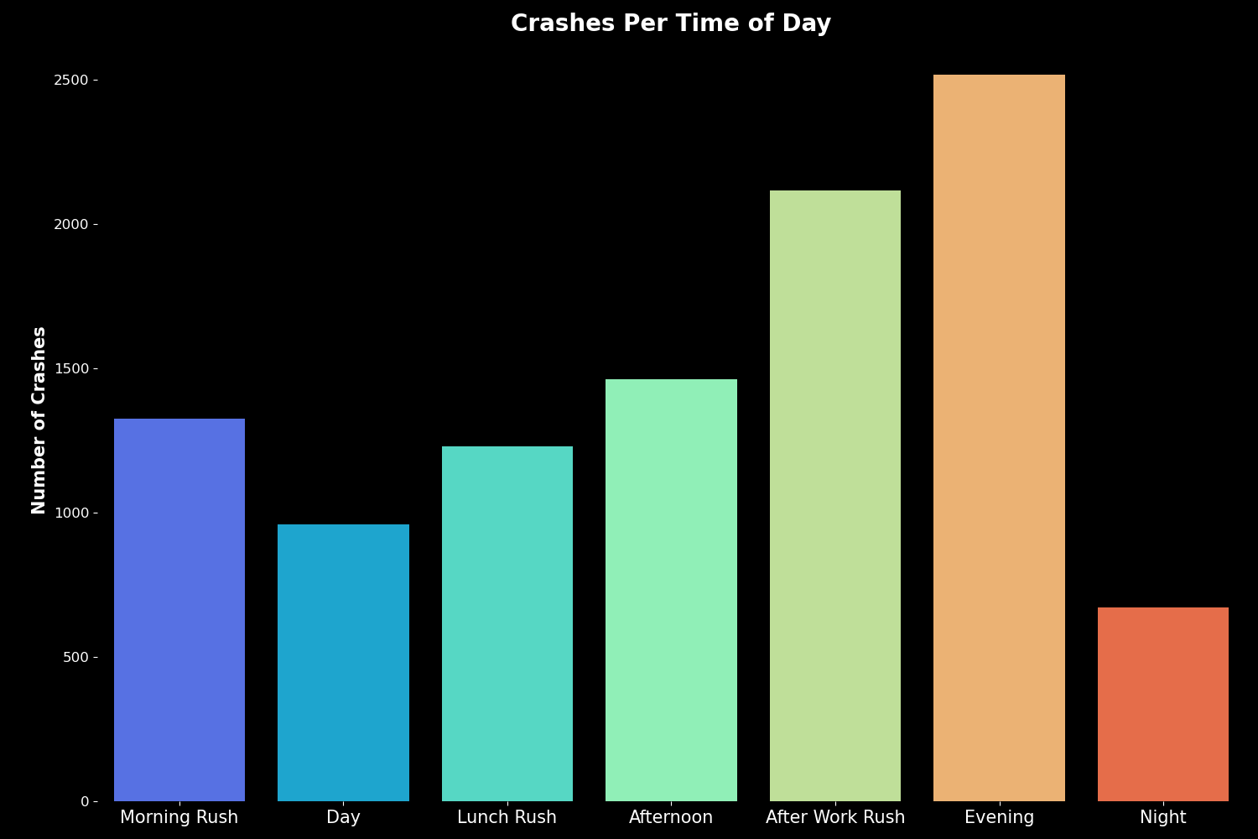
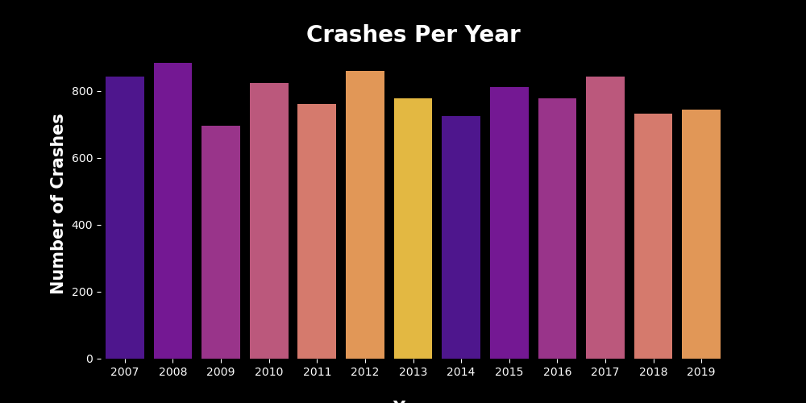
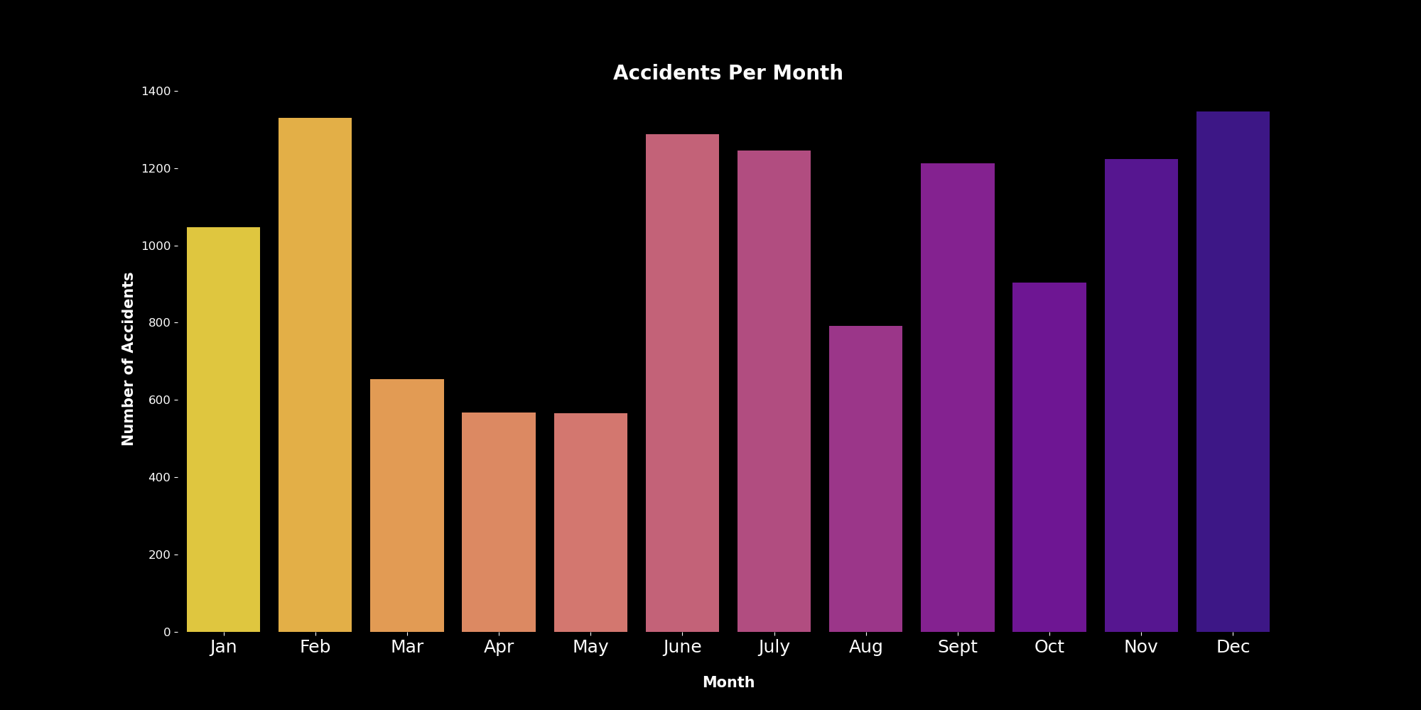
Visualization of Crashes over period of time (Day, Month, Year)
Notes:
From the visualizations it can be interpreted that the evening and after work hours are more prone to occurrence of crash
The distribution of crash over the subsequent years from 2007 to 2019 doesn’t imply any potential decline in the accident occurrence

Slide 7
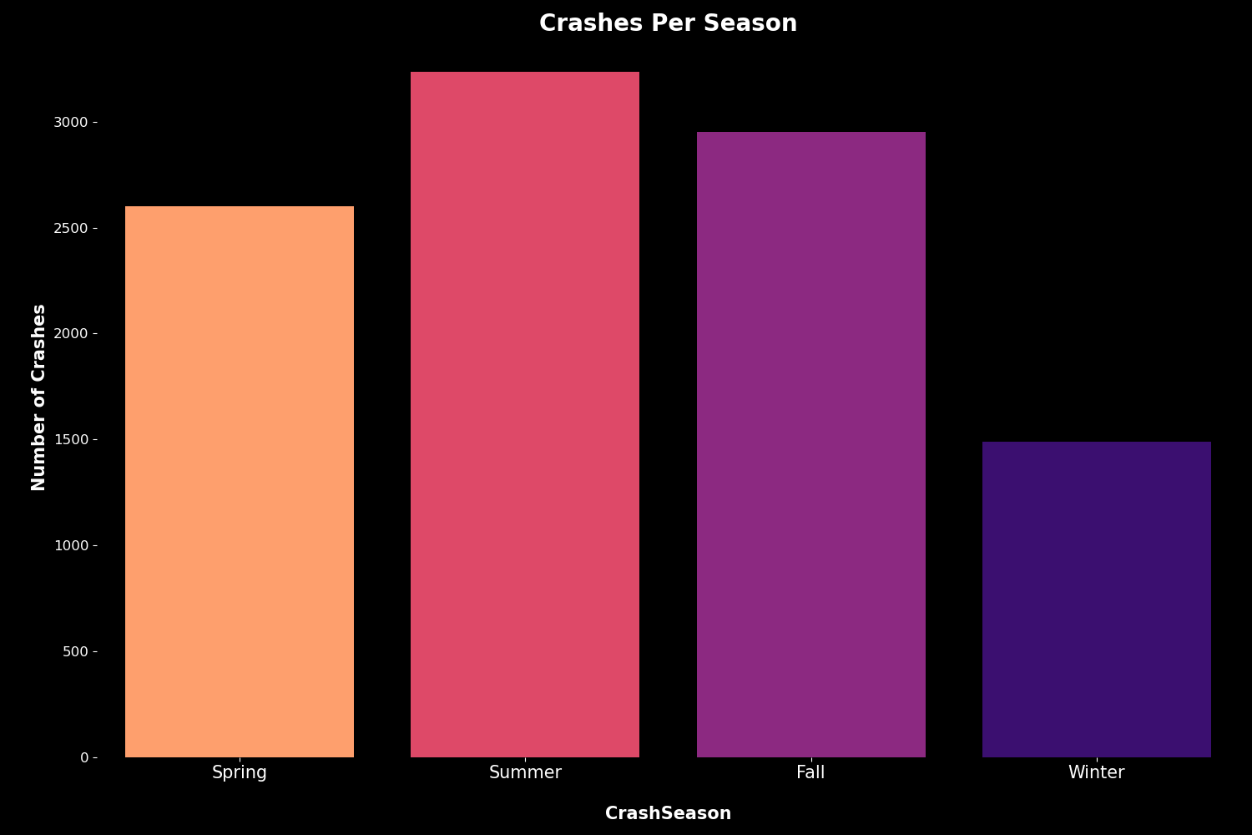

Slide 8
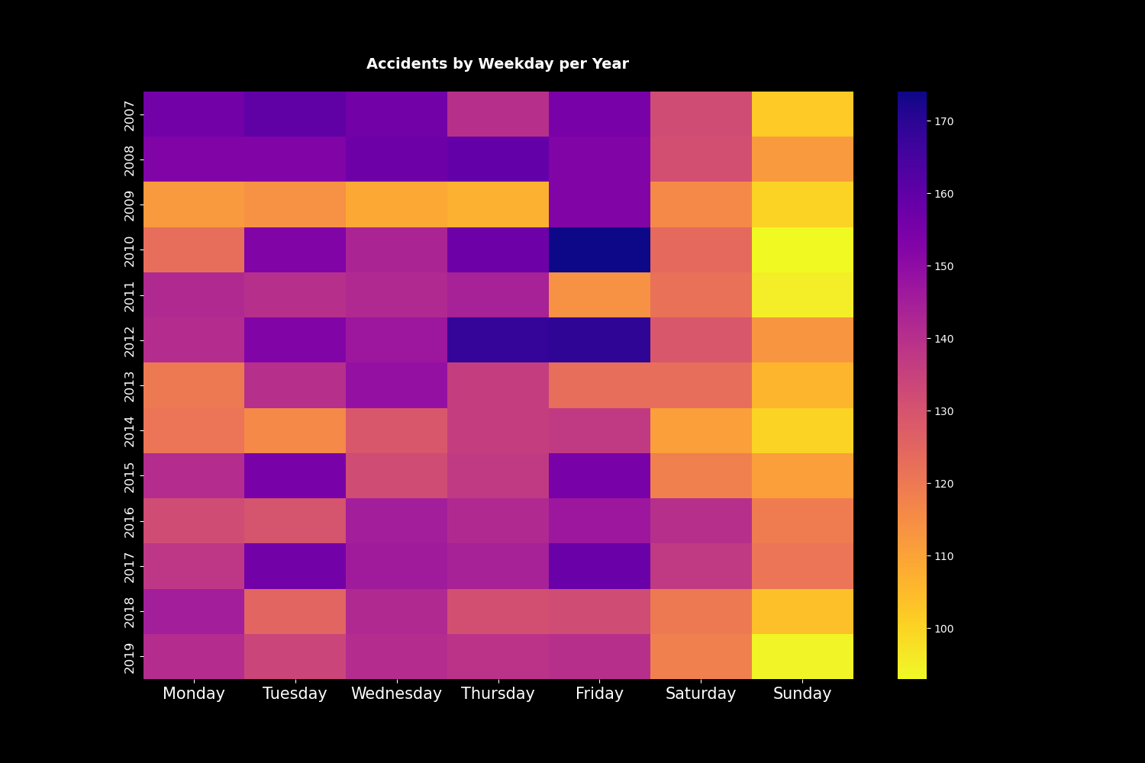
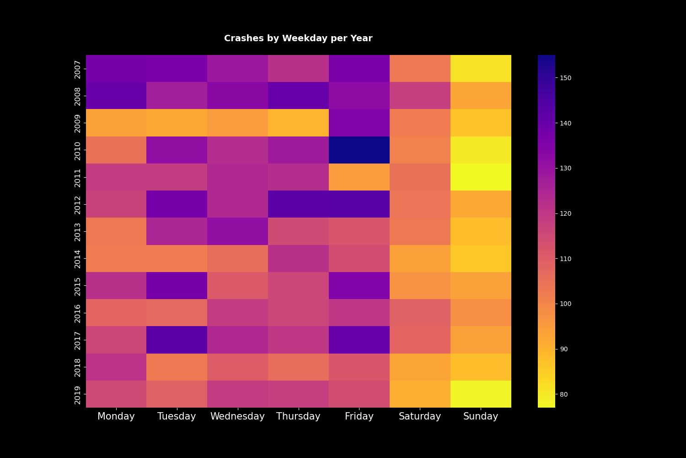
Heat Map distribution

Slide 9
When do the most crashes happened? (distribution of the age-group, place, time etc.)
Display number of crashes – days, month, season, year, age, race etc.
Trend, analysis and insight

Slide 10
How do the factors contribute to fatality ?
Attributes
Correlations

Slide 11
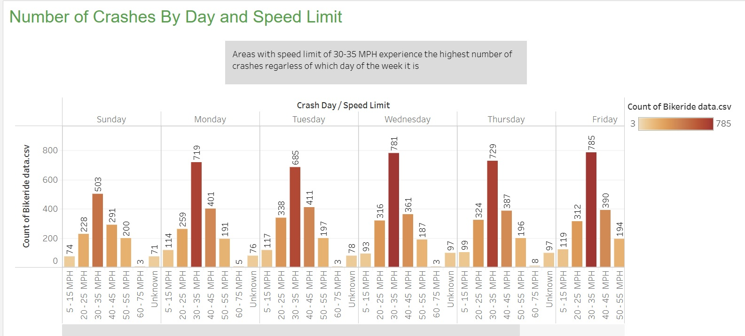

Slide 12
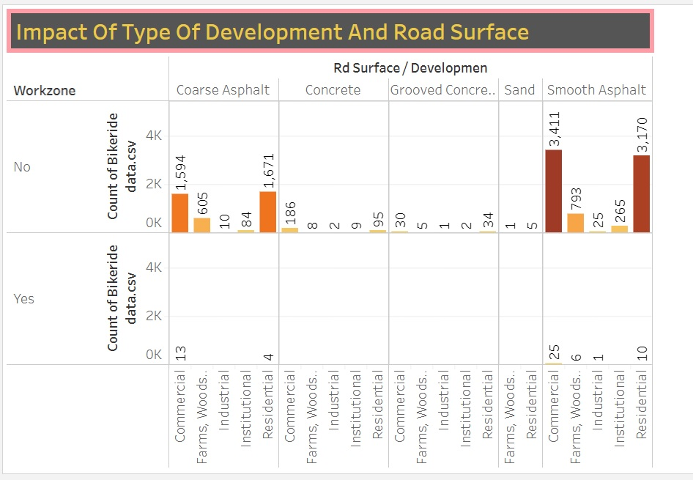

Slide 13
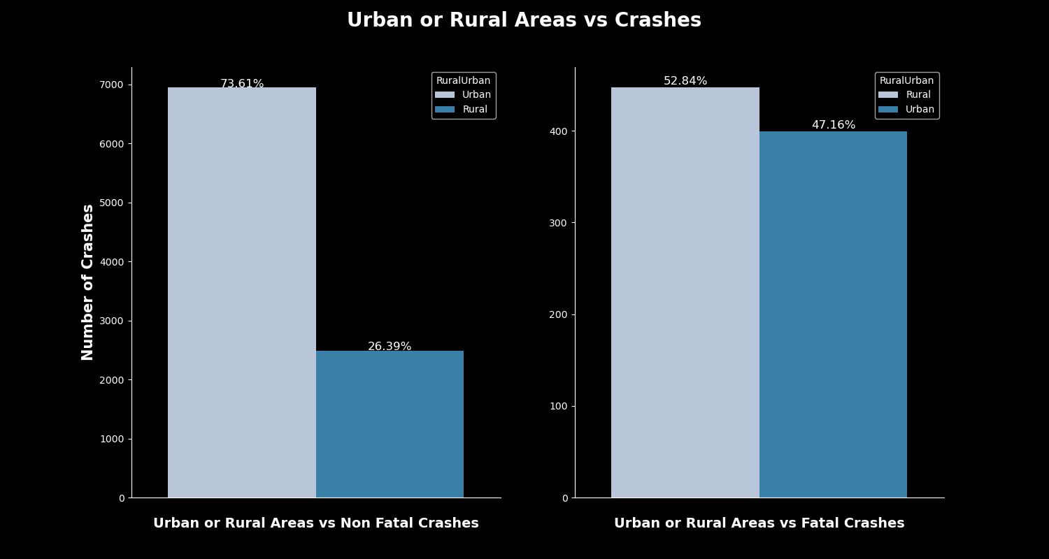

Slide 14
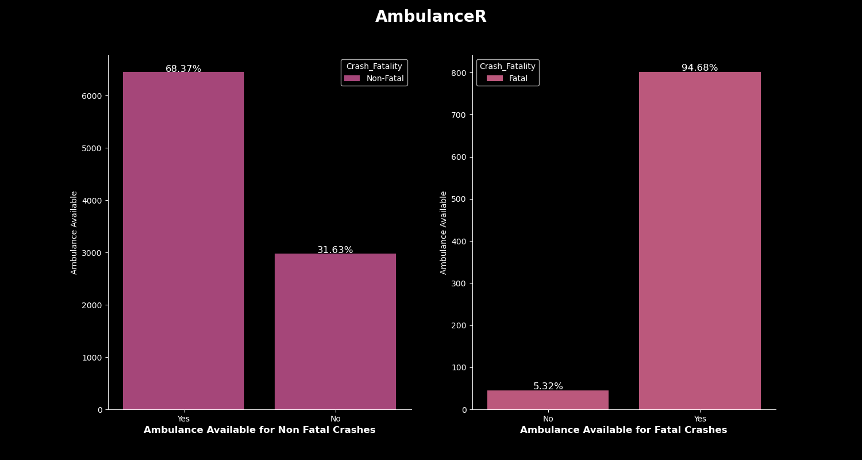

Slide 15
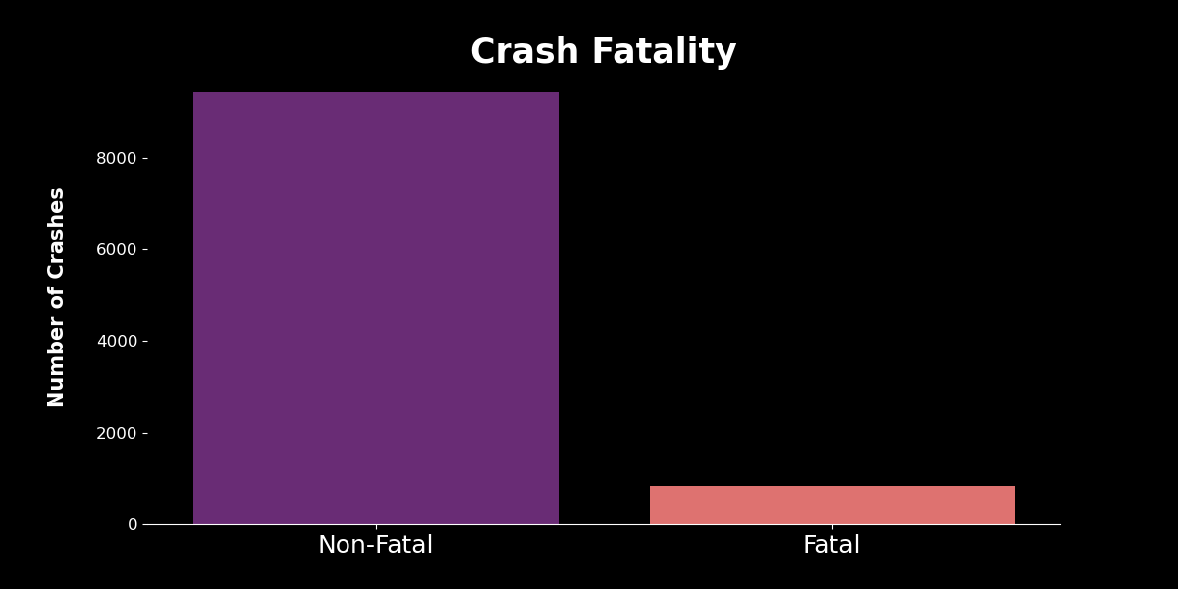

Slide 16
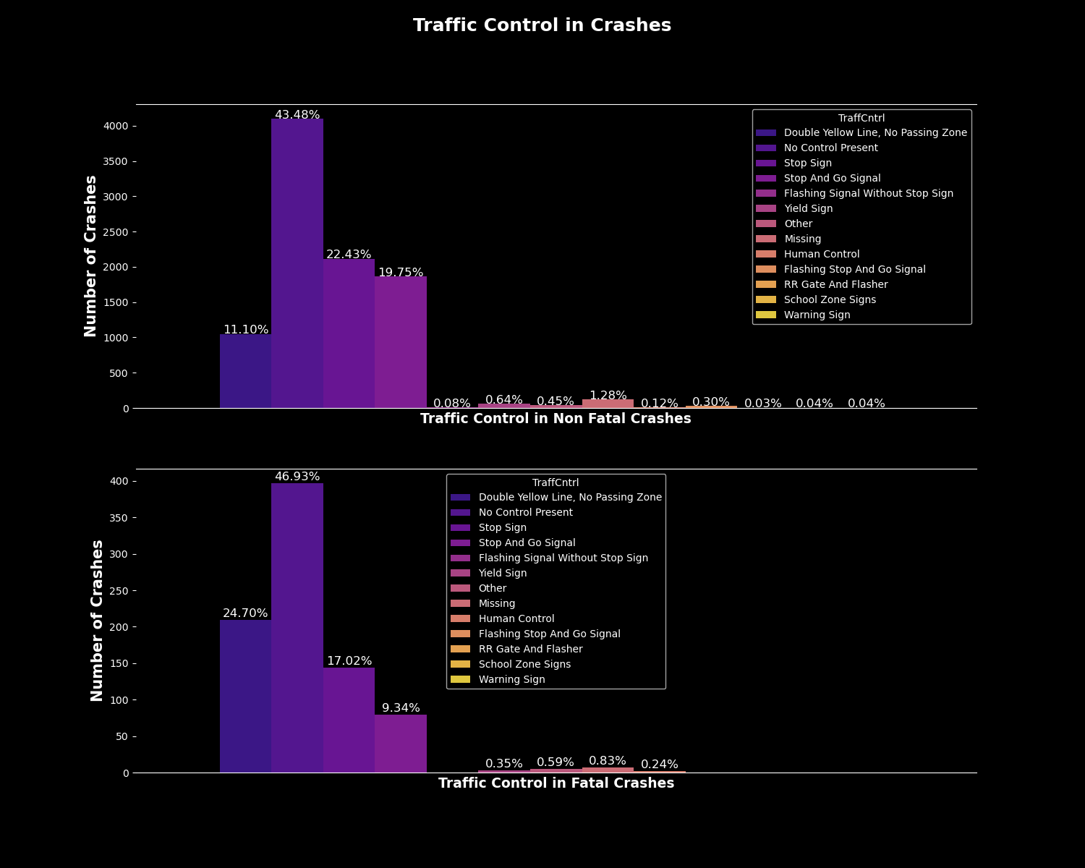
Traffic control need to be enhanced: more warning sign, more clear speed limit

Slide 17
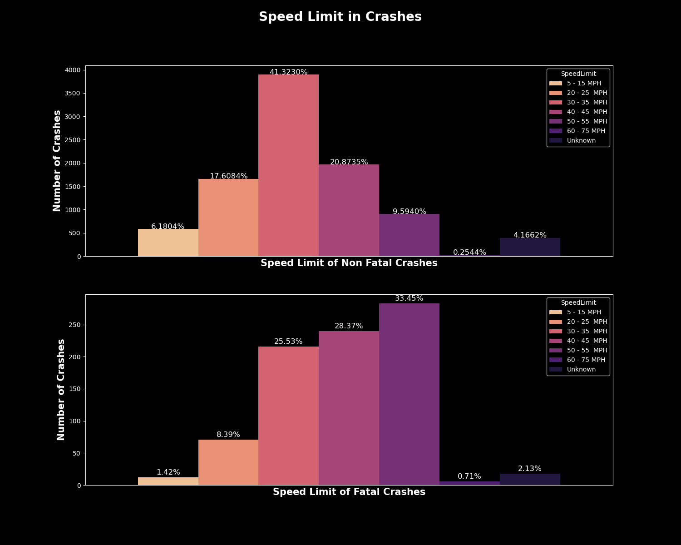

Slide 18
Machine Learning Algorithm

Slide 19
Our business intelligence suggestions

Slide 20
Limitation of our Data

Slide 21
Future Analysis & Conclusion

