Slide 1
K L (DEEMED TO BE) UNIVERSITY / COMPUTER SCIENCE & ENGINEERING
Parallel File Search
Using Threads
A multithreaded file-search application
built with C++17 and Qt 6
PROJECT TEAM
D Pawan Kumar · 2520090102
Ajith Reddy · 2520090186
Hitesh Suthar · 2520090078
FACULTY GUIDE
Raghupathi M
Hyderabad · Academic Year 2026–2027
PARALLEL FILE SEARCH USING THREADS / CSE PROJECT
01

Slide 2
01 / PROJECT OVERVIEW
A practical application of concurrency
A desktop tool to search filenames and text across directory trees.
THE NEED
THE APPROACH
THE OUTCOME
Large folders make manual and sequential file inspection time-consuming.
A coordinator schedules independent file-search tasks to a reusable worker pool.
A responsive GUI with progress information, result filtering, activity logs, and CSV export.
Core principle: keep interface work separate from concurrent file processing.
Built for developers, administrators, students, researchers, and everyday computer users.
PARALLEL FILE SEARCH USING THREADS / CSE PROJECT
02

Slide 3
02 / PROBLEM DEFINITION
The problem is more than search speed
The system addresses performance, responsiveness, and coordination challenges.
01 SLOW INSPECTION
02 UI BLOCKING
03 CONCURRENCY RISKS
Sequential scans inspect files one by one and can be slow across large directory trees.
Running file operations on the GUI thread can make the application appear unresponsive.
Multiple workers require safe shared-state updates, cancellation, progress reporting, and clean shutdown.
Problem definition: build a concurrent search tool that remains usable while managing threads and filesystem resources safely.
PARALLEL FILE SEARCH USING THREADS / CSE PROJECT
03

Slide 4
03 / SCOPE
A focused, useful feature set
Features documented in the project report.
SEARCH
MATCHING
TRAVERSAL
Filename, file contents, or both
Case options and regular expressions
Recursive or immediate directory entries
FILE SAFETY
MONITORING
RESULTS
Binary detection; skip files over 50 MB
Progress, active workers, elapsed time, logs
Sort, quick-filter, context actions, CSV export
PARALLEL FILE SEARCH USING THREADS / CSE PROJECT
04

Slide 5
04 / NOVELTY & INNOVATION
Innovation through thoughtful engineering
The project combines established technologies in a practical, integrated workflow.
BOUNDED, REUSABLE THREAD POOL
RESPONSIVE UI SEPARATION
Reuses worker threads instead of creating one thread per file; schedules batches of 25 paths per task.
Search processing is separated from the Qt interface; progress is relayed through signals and slots.
RESOURCE-AWARE SEARCH
USABLE SEARCH OUTPUT
Reads content line by line and skips files larger than 50 MB to constrain per-file processing.
Combines regex options, binary detection, cancellation, activity logs, and CSV export.
Novelty claim is based on the documented design—not a claim of being the first such tool.
PARALLEL FILE SEARCH USING THREADS / CSE PROJECT
05

Slide 6
05 / OS CONCEPTS
Operating-system ideas in action
The project makes concurrency and synchronization visible in a real application.
THREADS
MUTEX
CONDITION VARIABLE
Worker threads process independent batches while sharing process resources.
Protects the task queue and shared result collections.
Workers wait efficiently until tasks arrive or shutdown begins.
ATOMIC STATE
FILESYSTEM
LIFECYCLE
Tracks running/cancellation flags and progress counters.
std::filesystem traverses directories; std::ifstream reads lines.
Owned threads are joined during clean shutdown.
PARALLEL FILE SEARCH USING THREADS / CSE PROJECT
06

Slide 7
06 / ARCHITECTURE DESIGN
A modular pipeline with clear responsibilities
GUI, coordination, worker execution, logging, and export are separated.
MainWindow
SearchController
SearchEngine
ThreadPool
SearchWorker
LOGGER
EXPORT MANAGER
DATA MODELS
Timestamped INFO, SUCCESS, WARN, and ERROR messages.
Escaped CSV output with UTF-8 BOM encoding.
SearchResult and SearchOptions represent results and settings.
Qt signals and slots carry updates back to the UI thread.
PARALLEL FILE SEARCH USING THREADS / CSE PROJECT
07

Slide 8
07 / WORKFLOW
From user query to useful results
The coordinator discovers files and distributes independent work.
01
02
03
04
05
Choose directory
Enter pattern
Configure options
Discover files
Batch paths
06
07
08
09
10
Schedule tasks
Match filenames / text
Update safe counters
Review and filter
Export CSV
On completion or cancellation, the application coordinates shutdown and joins owned threads.
PARALLEL FILE SEARCH USING THREADS / CSE PROJECT
08

Slide 9
08 / IMPLEMENTATION
Implementation choices that matter
Focused engineering details behind the user-facing features.
TASK SCHEDULING
CONTENT MATCHING
FILE HANDLING
Mutex-protected queue, condition-variable notifications, futures for task results.
Incremental line-by-line reads; ordinary text and std::regex matching.
Heuristic binary detection and a 50 MB maximum file-size guard.
CANCELLATION
SYNCHRONIZATION
BUILD & TEST
Atomic flags communicate cancellation and running state.
Mutexes protect shared results; critical sections should stay short.
CMake targets the core library, desktop app, and CTest test suite.
PARALLEL FILE SEARCH USING THREADS / CSE PROJECT
09

Slide 10
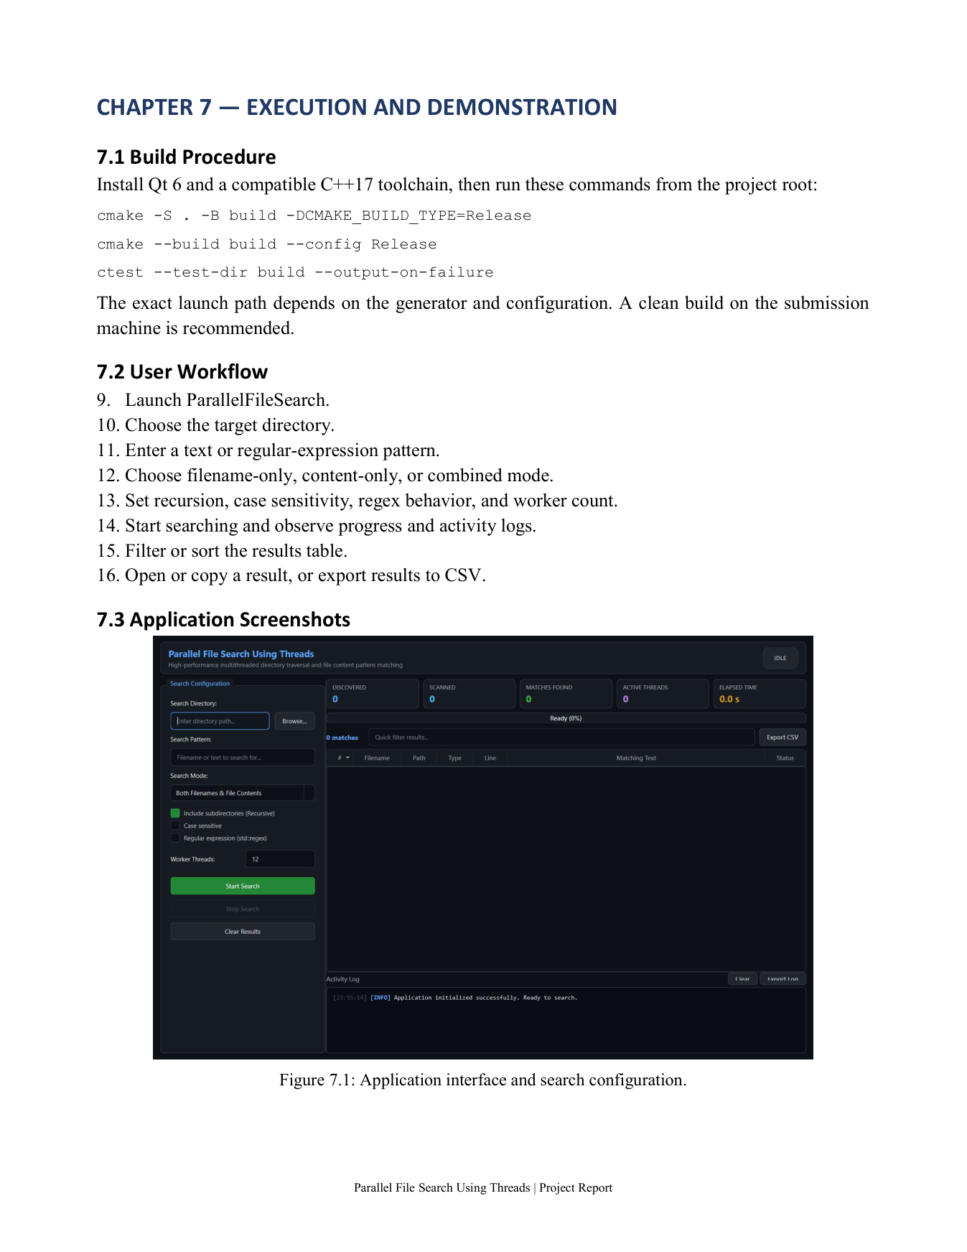
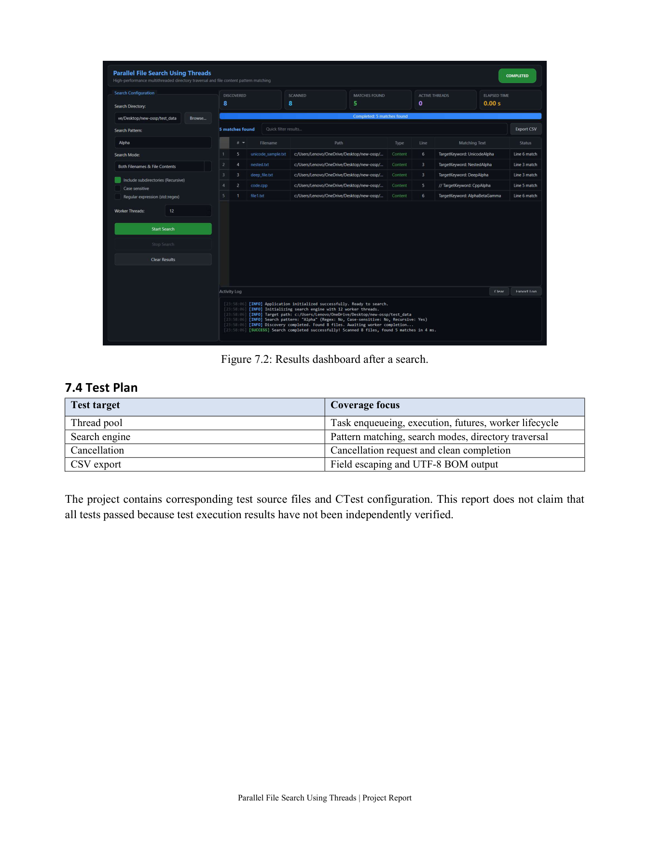
09 / APPLICATION DEMO
The actual application
Screenshots reproduced from the supplied project report, pages 13–14.
SEARCH CONFIGURATION
RESULTS DASHBOARD
PARALLEL FILE SEARCH USING THREADS / CSE PROJECT
10

Slide 11
10 / TESTING & VALIDATION
A documented test plan—not assumed results
The report identifies these test targets; outcomes must be verified by running the suite.
THREAD POOL
SEARCH ENGINE
Task enqueueing, execution, futures, and worker lifecycle.
Pattern matching, search modes, and directory traversal.
CANCELLATION
CSV EXPORT
Cancellation request and clean completion.
Field escaping and UTF-8 BOM output.
Validation step: run ctest --test-dir build --output-on-failure and record the actual output.
PARALLEL FILE SEARCH USING THREADS / CSE PROJECT
11

Slide 12
11 / DOCUMENTATION
Make the project easy to reproduce
Documentation is strongest when another person can build, run, and verify the system.
README
ARCHITECTURE
USER GUIDE
Project overview, prerequisites, setup, and launch instructions.
Module responsibilities, workflow, and concurrency design.
Search configuration, result handling, and CSV export steps.
BUILD STEPS
TEST EVIDENCE
SCREENSHOTS
CMake configure/build commands for the target environment.
CTest output and reproducible test cases should be added after execution.
Interface and results screenshots from the project report.
PARALLEL FILE SEARCH USING THREADS / CSE PROJECT
12

Slide 13
12 / TEAMWORK & BUSINESS IMPACT
Who benefits—and how the team collaborates
Use the team contribution fields below to reflect the work actually completed.
D PAWAN KUMAR · 2520090102
AJITH REDDY · 2520090186
Contribution: [add actual module / responsibility]
Contribution: [add actual module / responsibility]
HITESH SUTHAR · 2520090078
POTENTIAL BUSINESS IMPACT
Contribution: [add actual module / responsibility]
Can help developers search code, administrators inspect logs, and users locate information across folders.
Before presenting: replace contribution placeholders with verified team responsibilities.
PARALLEL FILE SEARCH USING THREADS / CSE PROJECT
13

Slide 14
13 / CONCLUSION & REPOSITORY
A practical demonstration of operating-system design
Concurrency is valuable when paired with clear architecture, safe coordination, and usable output.
TAKEAWAY
GITHUB REPOSITORY
A Qt interface and reusable C++17 search core demonstrate threads, synchronization, filesystem traversal, cancellation, and lifecycle management.
Add your real repository URL here:
[PASTE GITHUB REPOSITORY LINK]
Repository URL was not supplied, so no link has been invented.
REFERENCES
C++ reference: en.cppreference.com · Qt: doc.qt.io
CMake: cmake.org/cmake/help/latest · RFC 4180: rfc-editor.org/rfc/rfc4180
THANK YOU · QUESTIONS
PARALLEL FILE SEARCH USING THREADS / CSE PROJECT
14

