Slide 1

Mid Project Report
Researcher: Pawan Kumar
Supervisor: Gabriel Campero Durand

Slide 2
Agenda
Background & Motivation
Prototype Design & Research Questions
Experimental Setup & Initial Result
Further Steps & Future Scope

Slide 3
Motivation
We Begin with what is Scheduling and its Really hard why ( NP hard Problem)
We are Considering Task Placement ( Currently there are much gaps since solutions are not open sourced , Not use of SOTA algorithms)
Research Questions( 1. DQFD vs R2d3 2. How do they do when they go online)
Choice of Reward Functions and Model Parameters will be evaluated here
Brief About Workload Placement( Background)
How the Other Existing Solutions works and How my solution will differ from them
Prototype Design ( Reinforcement Learning)
Briefly Experimental Setup ( which Dataset I used how I converted in Demonstratiom
Algorithm Selected
Initial Results
Next Steps Structure of Thesis
Notes:
What is Graph Placement ?
Lack of Opens Source Solutions for using the State of the Art RL Algorithm for Task Placement
These are the GAP we try to address
Background – Idea of the Problem and other solutions
Prototype Design ( Just Give a outline about the Reinforcement Learning)
Experimental Setup

Slide 4
Background
Scheduling problem belongs to a broader class of combinatorial search process
We focus on domain scheduling for task placement, which aims at placement of tasks to suitable resources
Task Scheduling is hard
Notes:
Task Scheduling is Hard Because :
Each Task might be dependant or independent of getting placed at certain machines
Each Task might have soft and hard constraints
Task Scheduling is most popularly used in cloud computing where various objectives are tried to be optimized such as Resource Utilization , Waiting Time , Cost , makespan

Slide 5
Motivation
Existing Solutions to Task Scheduling
First Come First out
Round Robin
Shortest Job Scheduling
Pre-emptive and Non Pre-emptive Scheduling
Notes:
1. The existing approaches doesn’t scale well when the complexity of the scheduling environment increases which motivates us
To use machine learning approaches to deal with complexities in the scheduling environment. The usage of ML techniques would allow us
Scale our solution( by modficiation and hyper param tuning) even when the complexity of the environment increases( Large amount of Incoming tasks )
2. There exists a lack of open source solutions available which uses SOTA techniques for solving the scheduling problem

Slide 6
Motivation
Why Machine Learning Approach ?
Scalability
Reproducibility
Comparison Metrics
Lack of Open Source Solutions using State of the Art
Notes:
With the use of machine learning , the system would be able to correct its own misconception and improve its performance based on experience.

Slide 7
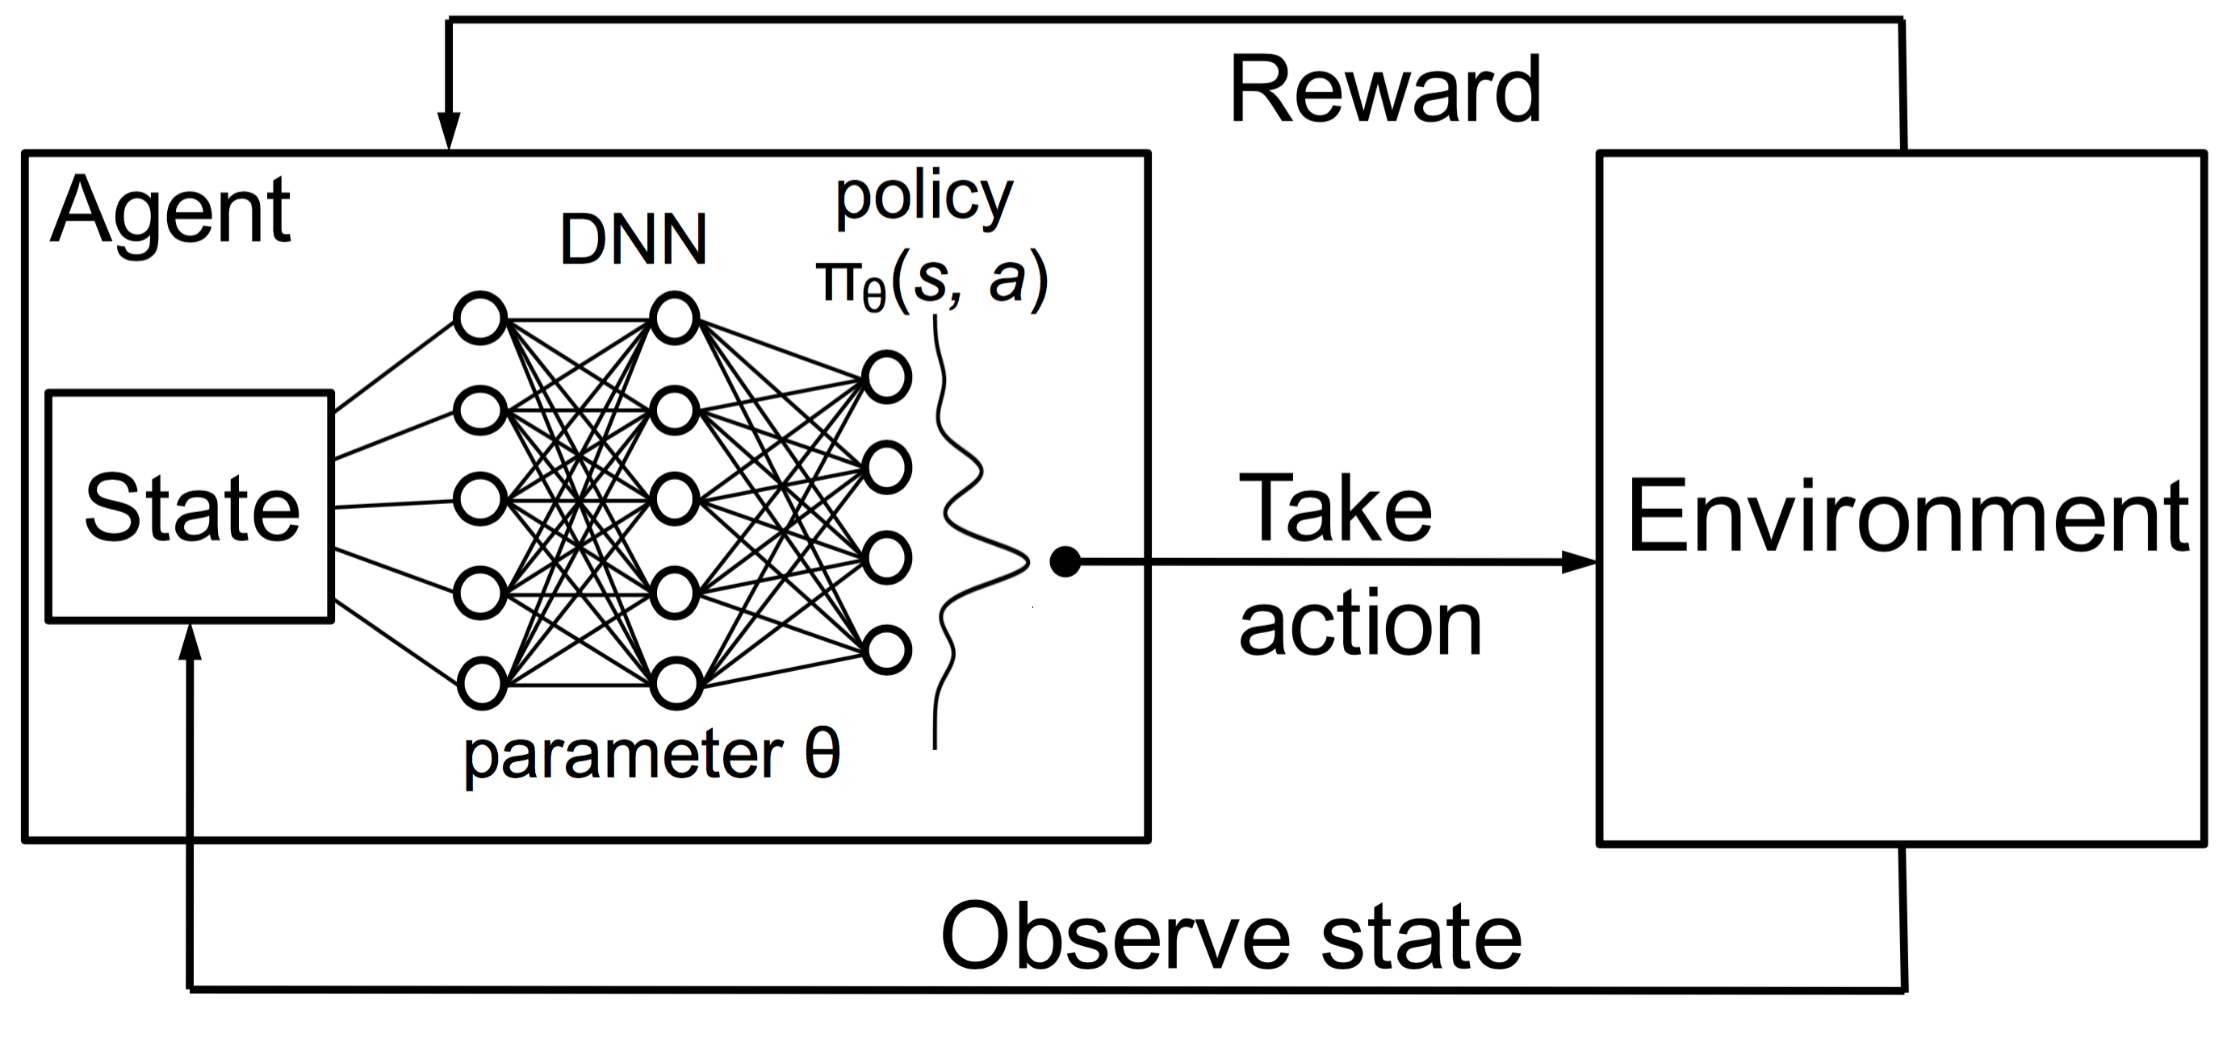
Prototype Design
Notes:
Usage of Reinforcement Learning:
Subset of Machine Learning approach , having self learning agents trying to maximize the rewards in particular situation. ( Specific Metric)
The Problem in our situation can be converted into a Markov Decison Processes , where we will define state , action, transition function which describes how our problem
Evolves with every action taken.
3. We will aim to optimize our action taken for each given state so as to maximize the Reward ( Specific metric)
4. Most RL algorithms require a considerable offline training time. However, once trained, they can be executed much faster than search-based methods. This property is also known as compute compression
5. Luckily for our production scheduling problem, using the historical data we can build a quite precise simulation and can close the “sim to real” gap to an exte

Slide 8
Research Questions
To what extent reinforcement learning learns from offline data and performs task placement on machines.(implicit)
To what extent are we able to learn the choice of decision making from existing schedulers using the State of the Art Learning from Demonstration.
How does the DQFD and R2D3 agents perform in different choice of hyper parameters and reward functions
How does these agents performs (DQFD(SOTA) vs Memory Based(R2d3)) : Parameter changes
when they go online? ( Future Scope)

Slide 9
Experimental Setup – Dataset Selection
Lack of open source data , revealing patterns and complexities in real production environment
Google Cluster trace data ( May,2011)
Dataset includes diverse workloads which ran on 12.5k heterogeneous machines over a period of 29 Days .
Heterogeneous Machines and Heterogeneous Jobs
Notes:
1. Heterogeneous means that both, the machines and the jobs can have different properties, e.g. different throughput for the machines and different required processing time for the jobs, and many more in practice.

Slide 10
Experimental Setup – Dataset Selection(ER Diagram)
Dataset Schema description
Table Name | Key Attributes
Machine Events Table | Machine ID ( Unique Identifier) , CPU_cap , Memory_cap
Job Events Table | Job ID(Unique Identifier),event_type,scheduling_class,time( Microseconds)
Task Events Table | Job ID(Foreign Key), Task Index, event type , cpu req , memory req , priortity , machine ID , time(Microseconds)
Task Usage Table | Start time , End time , Job ID , cpu usage, memory usage, machine ID, priority , scheduling class
Notes:
The Trace Data contains information for 29 Days of logs captured by the monitoring tool of google where the google scheduler named Borg takes decision based on its own functionality.
The Dataset is divided into 500 trace files where each file contains information of jobs and tasks events on an average of 3 - 4 hours.

Slide 11
Experimental Setup – Transformation Pipeline
Data Pre-Processing
RL Formulation
Subset Selection
& Feature Selection
State and Action Formulation
Event Based Filtering
Environment Construction
Time Base Selection
Notes:
Subset Selection : We perform a random selection of trace file out of 500 since the constraint of memory and size we have limited ourselves to learn from single trace file
Feature Selection : We only include most relevant features which describes the best of job and task request and consumption
Event Based Filtering: We filter out to include only jobs which started and ended successfully.
Time Base Selection: We translated the timeframe from microseconds to seconds for our convenience of State formulation

Slide 12
Experimental Setup – Sample States
Machine State
Time Column:
118780
118800
119890
.........
Machine ID | Cpu Usage | Memory Usage | Count
1095052 | 0.45 | 0.1 | 3
1095068 | 0.3 | 0.2 | 2
476 Machines

Slide 13
Experimental Setup – Sample States
Machine State ( Alternate)
Time Column:
118780
118800
119890
.........
Machine_ID | Cpu_Usage | Memory_Usage | Count | Available_Cpu_Cap | Available_Memory_Cap
567902 | 0.08484 | 0.004814 | 1 | 0.5 - 0.08484 | 0.4995 - 0.004814
567902 | 0.08484 | 0.004814 | 0 | 0.5 | 0.4995
476 Machines

Slide 14
Experimental Setup – Sample States
Task State
Time Column:
118780
118800
119890
.........
Cpu request | Memory Request | Cpu Usage | Memory Usage | Done
0.4 | 0.4 | 0.1 | 0.3 | 0
0.6 | 0.5 | 0.3 | 0.5 | 0

Slide 15
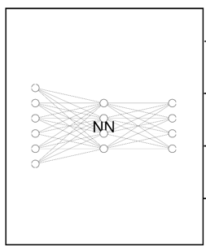
Experimental Setup – Sample States
INPUT
OUTPUT
S1
Score of Machine 1
Machine State
Task
State
S2
Score of Machine 2
.
.
.
.
S427
Score of Machine 427
Reward Formula:
Highest Scoring Node gets Selected

Slide 16

Reward Formulation
The agent is supposed to mimic the decisions made as compared to the scheduler(Google)
Penalty term for each action taken which does not matches the decision of Google Scheduler

Slide 17

Experimental Setup – Choice of Algorithm
Deep Q learning from Demonstration (DQFD)
Learning from Demonstration
Recurrent Replay Distributed DQN from Demonstrations (R2D3)
Notes:
Explain a brief about the Imitationlearning
Pre Training and Post Training Process of Both Algorithms
How We will be comparing these algorithms with each other

Slide 18
Further Steps
Inference of Results
Hypothesis Justificaiton
Parameter Tuning
Evaluation metrics

Slide 19
Appendix

