Slide 1
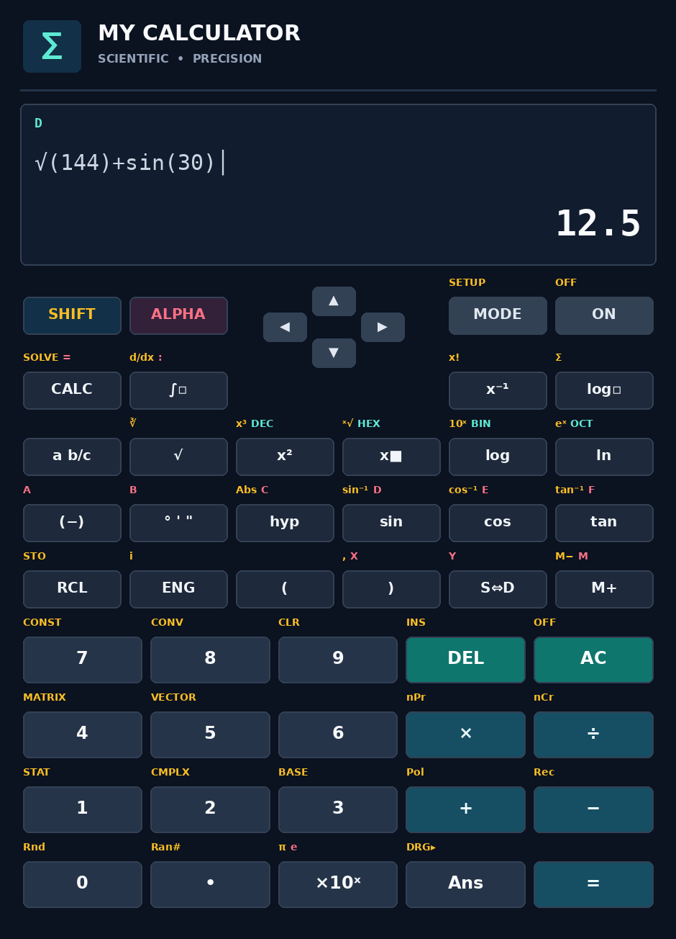
My Calculator
PYTHON • TKINTER PROJECT
A Casio-style scientific calculator built with Python
Presented by
Pawan Kumar Vaishnav

Slide 2




Project Introduction
My Calculator is a desktop scientific calculator written in pure Python. It copies the familiar Casio fx-991 keypad, with SHIFT and ALPHA keys and eight working modes, inside a modern dark window.
1,400+
lines of Python code
8
calculation modes in one app
Language: Python 3, one file: my_calculator.py
Interface: Tkinter desktop window
0
external libraries, only the standard library
Inspired by: Casio fx-991 keypad style
Developer: Pawan Kumar Vaishnav

Slide 3


Problem and Objectives
The Problem
Objectives
Physical scientific calculators cost money and are easy to forget.
Many apps hide how answers are produced, so learners cannot study them.
Simple software calculators often skip matrices, complex numbers and statistics.
Build a full scientific calculator using only Python.
Offer 8 modes together in one clean window.
Keep the code readable and easy to extend.
Use a modern dark design that is easy on the eyes.

Slide 4





Technology Stack
Python 3
Tkinter
math and cmath
Core language. The whole program lives in one file.
Builds the window, LCD, keys and pop-up dialogs.
Trig, log, hyperbolic and complex-number functions.
fractions
re (regex)
random
Turns decimals into exact fractions for the S⇔D key.
Rewrites typed symbols into valid Python code.
Powers the Ran# key for random numbers.

Slide 5




System Architecture
User Input
App class
Engine class
Helpers and data
Keypad clicks and the PC keyboard
GUI layer
The calculation brain
Maths tools and tables
Mouse click
Key press
build()
key() press()
refresh()
stat() eqn()
table()
evaluate()
namespace()
fmt() exact()
solve()
Matrix Vec
solve_linear()
poly_roots()
stat_calc()
REPL CONSTS CONV
Result returns to the App and is drawn on the LCD

Slide 6
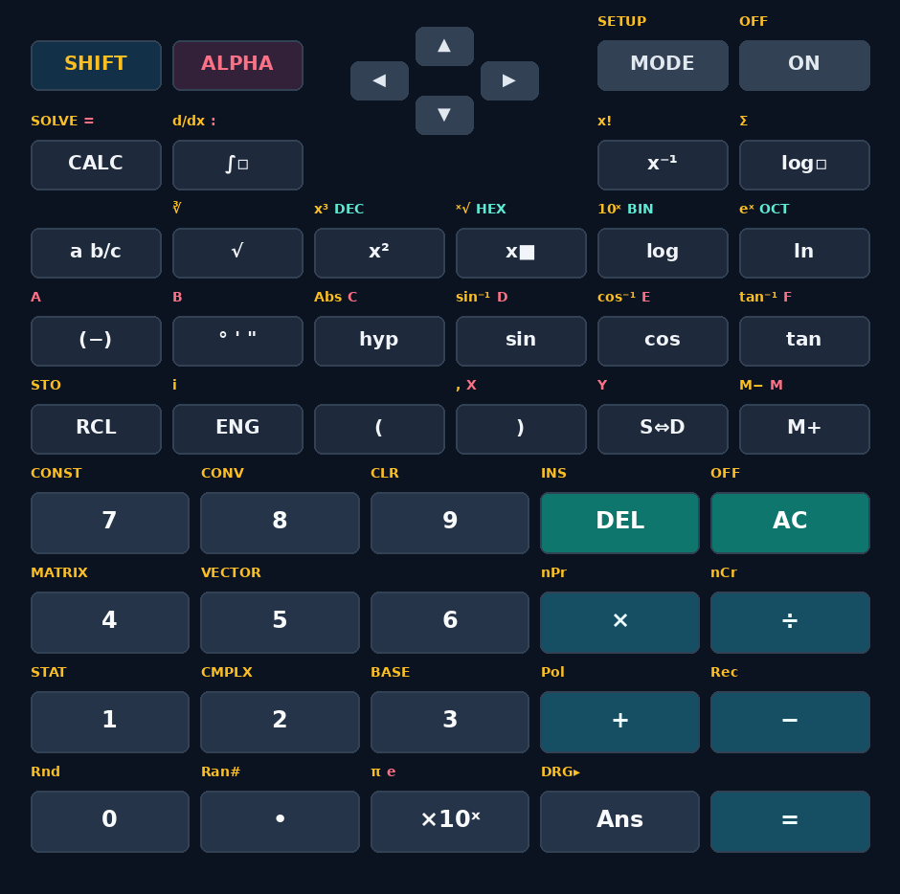
The SHIFT and ALPHA Key System
SHIFT (yellow labels)
Second function on every key. SHIFT + √ gives ∛ and SHIFT + log gives 10ˣ.
ALPHA (pink labels)
Reads variables A–F, X, Y and M. ALPHA + (−) types the variable A.
Green labels
BASE-N keys: x² is DEC, x■ is HEX, log is BIN and ln is OCT.
Mode shortcuts
SHIFT + 1 STAT, 2 CMPLX, 3 BASE, 4 MATRIX, 5 VECTOR. MODE opens all 8.

Slide 7
How an Expression Is Evaluated
1
2
3
4
5
Read tokens
Tidy the text
Swap symbols
Add hidden ×
Safe eval
Keys pressed are stored as a list of tokens.
Closes open brackets, fixes ° and ! factorials.
The REPL table turns × ÷ √ π into Python names.
A regex makes 2π mean 2*(pi).
eval() runs with builtins switched off.
You type | Rewritten as | Answer
√(144)+sin(30) | sqrt(144)+sin(30) | 12.5
2π | 2*(pi) | 6.283185307
5! | fact(5) | 120

Slide 8
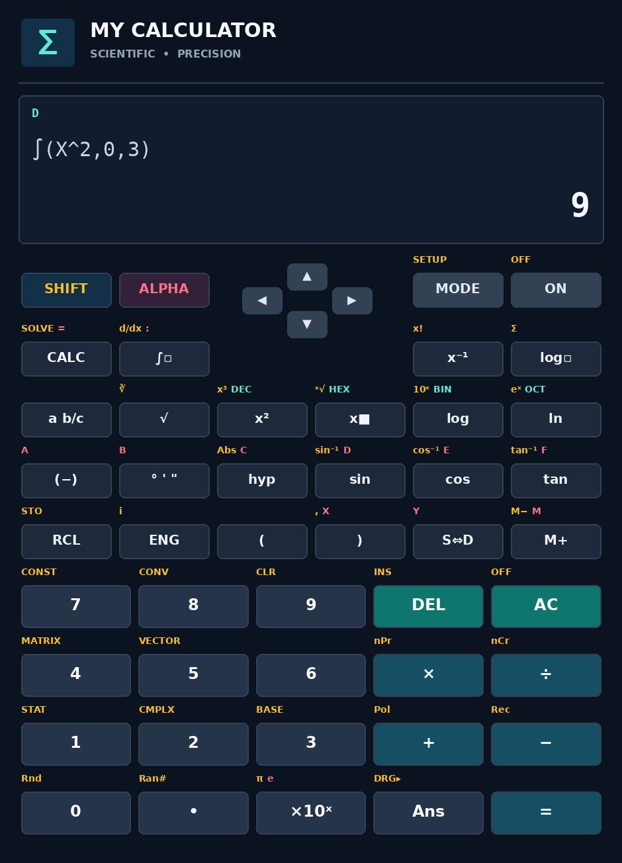

COMP Mode: Scientific Calculations
Trigonometry
Verified results
sin, cos, tan, inverses, hyp
Expression | Result
sin(30°) | 0.5
√(144) | 12
10 nCr 3 | 120
∫ X² (0 to 3) | 9
d/dx X³ at 2 | 12
Σ X (1 to 10) | 55
Logs and powers
log, ln, logₐb, 10ˣ, eˣ, √, ∛, ˣ√
Counting
n!, nPr, nCr
Calculus
∫ dx, d/dx, Σ
Coordinates
Pol( ) and Rec( )
Others
Abs, Rnd, Ran#, Ans, DRG

Slide 9
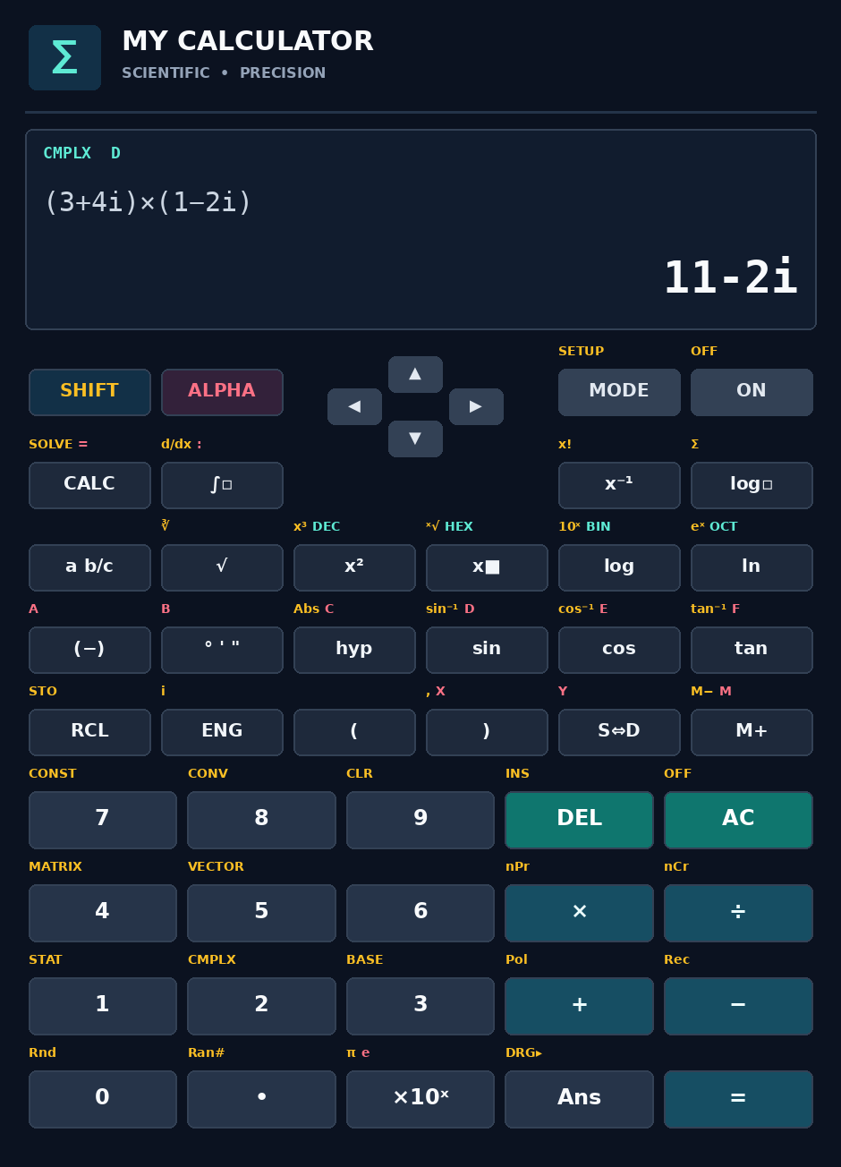
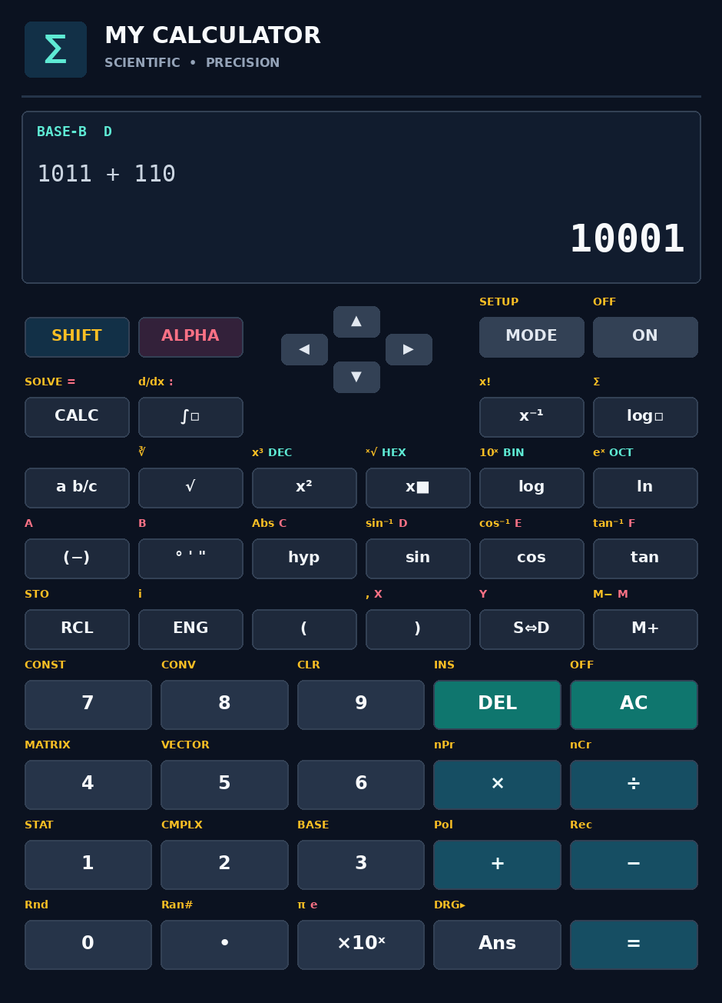
CMPLX and BASE-N Modes
CMPLX
BASE-N
(3+4i)×(1−2i) = 11−2i
√(−4) = 2i
Abs, Arg, Conjg, Re, Im
Show as a+bi or r∠θ
Bases: DEC, HEX, BIN, OCT
and, or, xor, xnor, Not, Neg
1011 + 110 = 10001 (BIN)
Keys A–F type HEX digits
CMPLX switches on complex-aware functions. BASE-N uses its own evaluator and display.

Slide 10
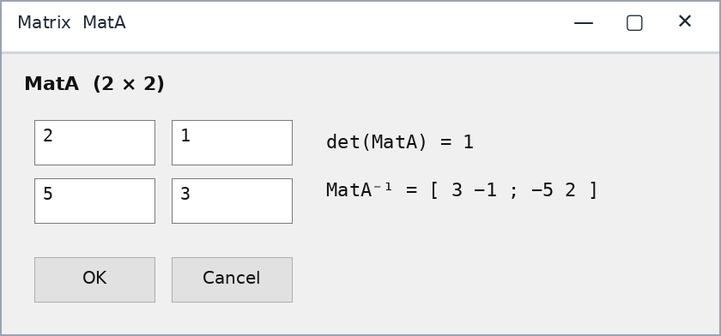


MATRIX and VECTOR Modes
Matrix class
Edit MatA, MatB, MatC in a grid window
Add, subtract, multiply, inverse, power
det( ), Trn( ), Ident( ) functions
Vector class
Vector cross product
Edit VctA, VctB, VctC
× gives the cross product
Dot( ), Angle( ), UnitV( ), Abs = length
VctA = (1, 2, 3) VctB = (4, 5, 6)
VctA × VctB = (−3, 6, −3)

Slide 11
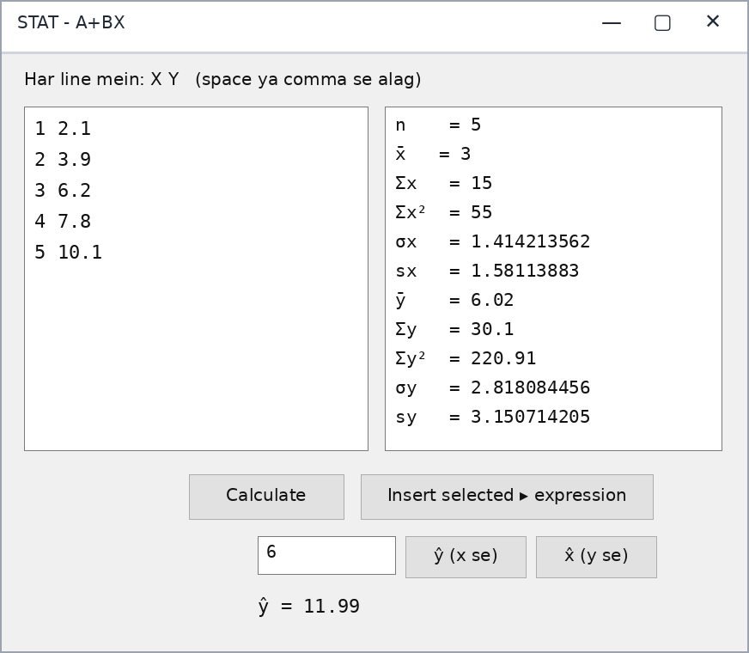
STAT Mode: Statistics and Regression
8 data types
1-VAR
A+BX
_+CX²
ln X
e^X
A·B^X
A·X^B
1/X
What you get
n, x̄, Σx, Σx², σx and sx
Min, Q1, Median, Q3, Max
Regression values A, B, C and r
Predict ŷ from x and x̂ from y
Test data: x = 1 to 5, y = 2.1 to 10.1
Result: A = 0.05, B = 1.99, r = 0.9987

Slide 12
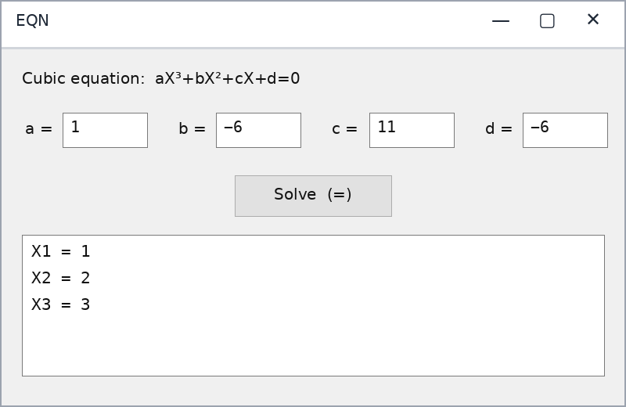
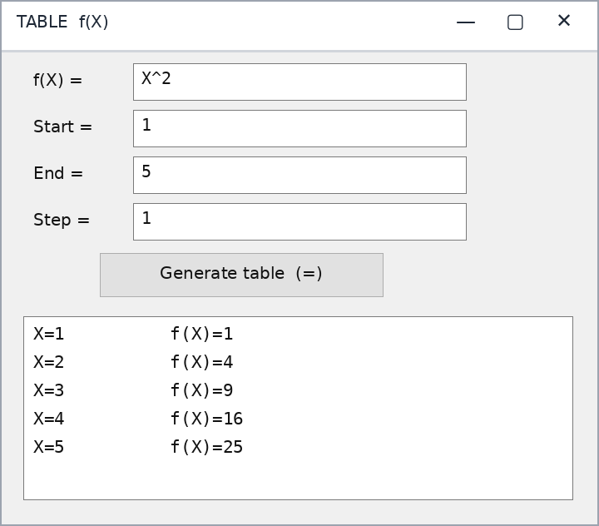
EQN and TABLE Modes
EQN solves linear systems (2 or 3 unknowns), quadratics and cubics. Here X³−6X²+11X−6=0 gives 1, 2, 3.
TABLE lists f(X) from Start to End with a Step, up to 100 rows.

Slide 13
Numerical Methods Used
Feature | Method | Detail
∫ Integral | Simpson's rule | 2,000 intervals
d/dx | Central difference | step h = 10⁻⁵
SOLVE | Newton–Raphson | up to 200 iterations
Linear systems | Gauss elimination | partial pivoting
Cubic roots | Durand–Kerner | complex roots, 600 rounds
Regression | Least squares | gives A, B, C and r

Slide 14
Constants and Unit Conversion
40
Sample constants
Sample conversions
Name | Value
Speed of light (C0) | 299792458
Gravity (g) | 9.80665
Planck (h) | 6.626×10⁻³⁴
Avogadro (NA) | 6.022×10²³
Electron mass (me) | 9.109×10⁻³¹
Convert | Rule
in ▸ cm | × 2.54
lb ▸ kg | × 0.4536
mile ▸ km | × 1.6093
hp ▸ kW | × 0.7457
°F ▸ °C | (x − 32) ÷ 1.8
physical constants
SHIFT + 7 (CONST)
40
unit conversions
SHIFT + 8 (CONV)

Slide 15






Smart Features
Angle units
Display formats
DEG, RAD or GRA from SETUP. Trig functions follow it.
Fix, Sci, Norm 1/2 and ENG notation for results.
S⇔D key
Memory
Shows exact fractions, π and √ forms, like 1/3.
STO and RCL for A–F, X, Y, M. Also M+, M− and Ans.
History and editing
Errors and keyboard
Up and Down recall old lines. INS, DEL and arrows edit.
Syntax and Math ERROR messages. PC keys work too.

Slide 16
Testing and Verification
Area | What was checked | Result
COMP | Trig in DEG, RAD, GRA, logs, roots, nPr, nCr, ∫, d/dx, Σ | Correct
CMPLX | Multiply, divide, √(−4), Abs, Arg, Conjg | Correct
MATRIX, VECTOR | det, inverse, A × A⁻¹ = I, size errors, cross and dot | Correct
STAT | All 8 types, checked with independent formulas | Correct
EQN, SOLVE | Linear, quadratic, cubic roots, Newton method | Correct
BASE-N | BIN, HEX, OCT sums, and, or, xor, Not, Neg | Correct
Units | in, lb, mile, km/h, °F, °C, J, cal | Correct
123
automated checks, all passed
2 bugs found and fixed
ˣ√ key gave Syntax ERROR
Cubic roots came in mixed order
The maths engine was run and tested. The window screens were checked by reading the code.

Slide 17


Conclusion and Future Scope
Conclusion
Future Scope
A complete scientific calculator in about 1,400 lines of pure Python.
8 modes, 40 constants and 40 conversions in one window.
App and Engine are separate, so new features are easy to add.
Graph plotting for functions
Save and export calculation history
Light and dark theme switch
Ship the test suite with the project
Thank You!
Developed by
Pawan Kumar Vaishnav

