Slide 1
Computer Vision and Gen AI
REVA Academy for Corporate Excellence (RACE)
29-05-2026
Bismillah Kani
Mentor
www.reva.edu.in

Slide 2
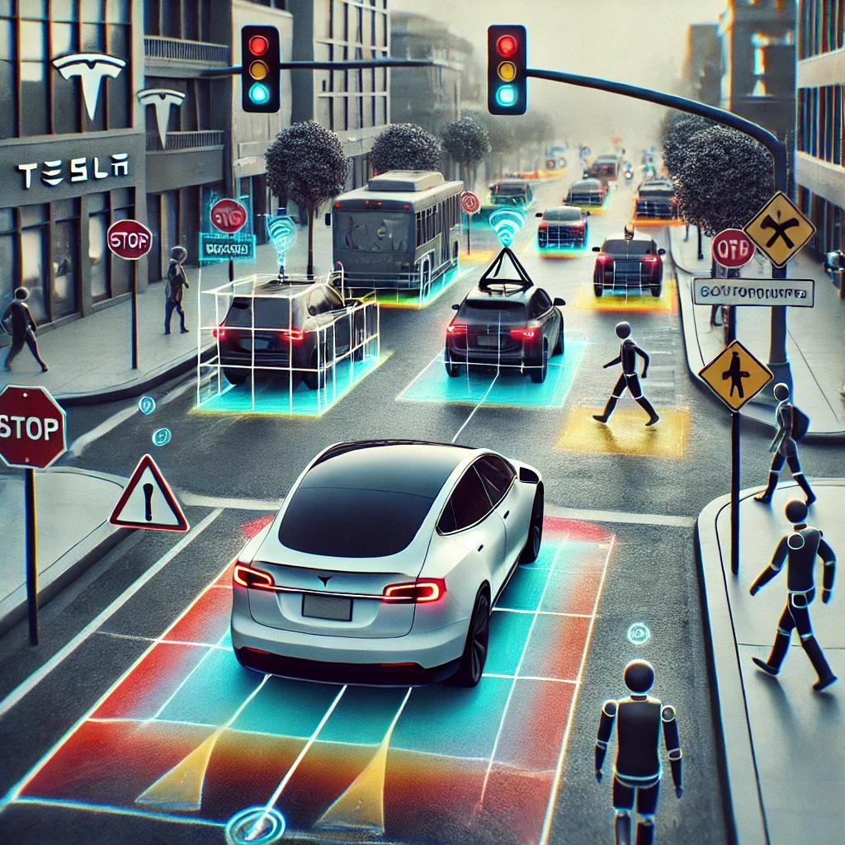
What is Computer Vision?
Field of AI that enables machines to interpret and make decisions based on visual data.
Integrates image processing with machine learning models to analyze and understand visual information.
Applications in the Real World:
Autonomous Vehicles: Detect pedestrians, signs, and obstacles for safe navigation (e.g., Tesla).
Healthcare: Diagnose diseases from X-rays, MRIs, etc. (e.g., detecting lung cancer).
Retail: Automated checkouts, product tracking (e.g., Amazon Go).
Security: Face recognition for unlocking devices and access control (e.g., Apple Face ID).

Slide 3
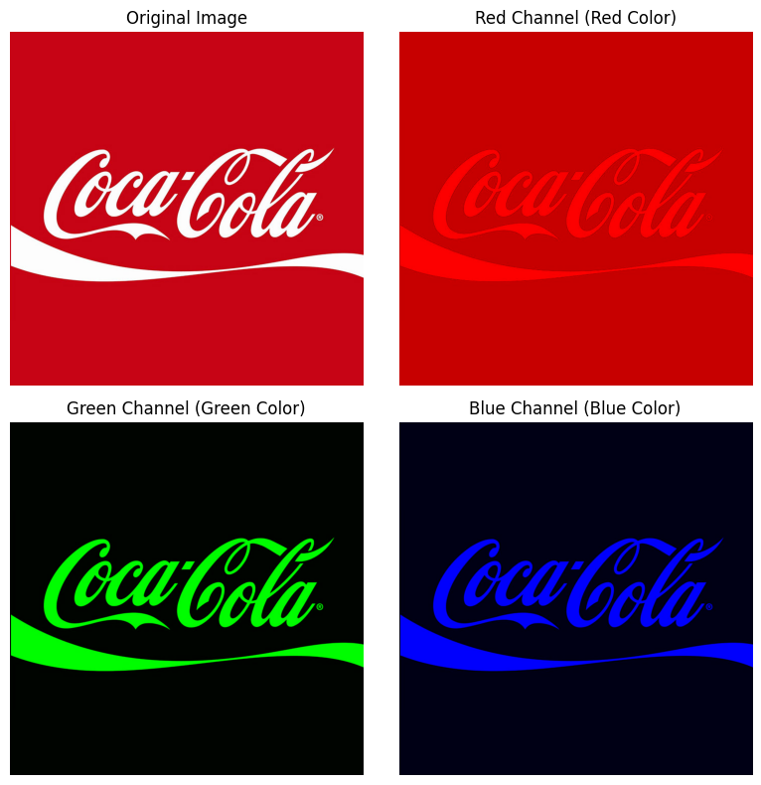
Image Representation
Digital Image: A 2D grid of pixels, each representing the intensity or color at that point.
Types of Image Representations:
Grayscale:
Each pixel is a shade of gray (0 = black, 255 = white).
Simplifies image analysis and reduces computation.
RGB (Red, Green, Blue):
Color images with three channels for Red, Green, and Blue values.
Each pixel stores three values (R, G, B), making up a wide range of colors.
HSV (Hue, Saturation, Value):
Separates color information (Hue) from intensity (Value), often used in color-based processing.

Slide 4
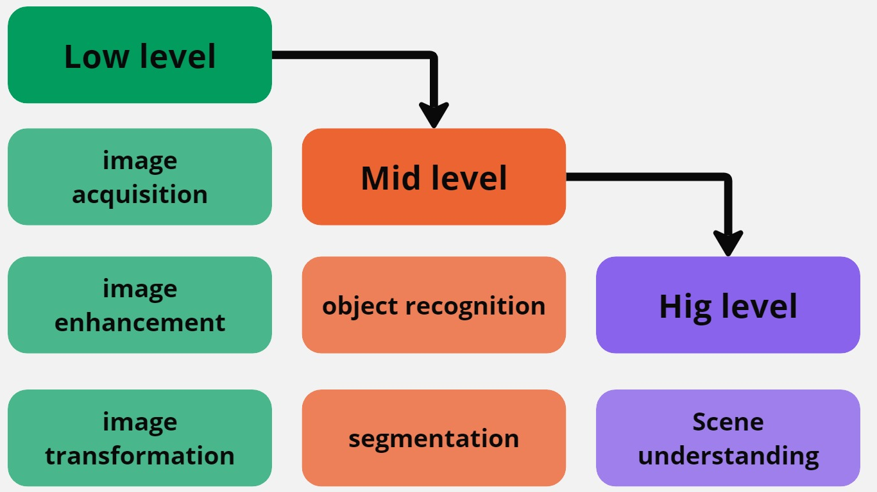
Workflow
Low-Level: Includes basic tasks to prepare the image for analysis.
Mid-Level: Focuses on tasks to identify meaningful objects within the image.
High-Level: Understanding the overall scene and extracting semantics, enabling the system to interpret the image contextually.

Slide 5

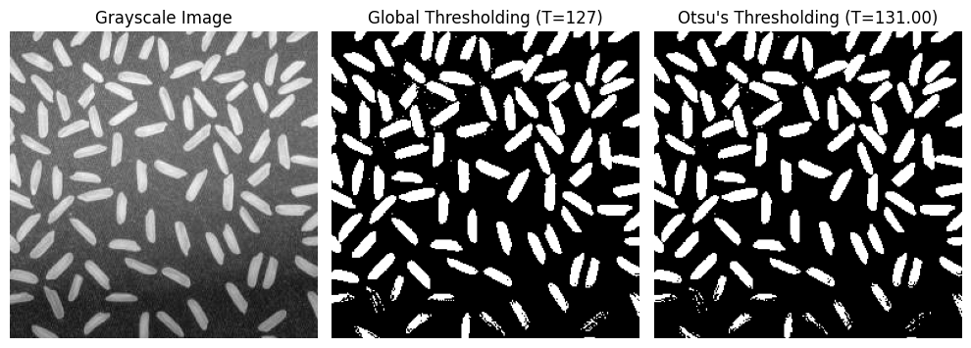
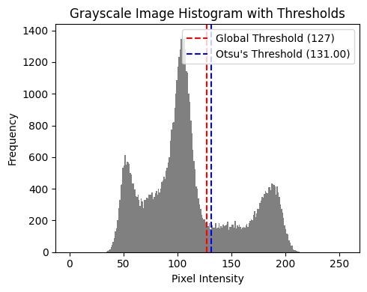
Thresholding
What is Thresholding?
Thresholding divides an image into regions based on pixel intensity, separating important features from the background.
Types:
Global Thresholding: Applies a fixed threshold value across the entire image.
Adaptive Thresholding: Applies varying thresholds based on local regions.
Otsu’s Method: Automatically finds the optimal threshold by minimizing intra-class variance.

Slide 6
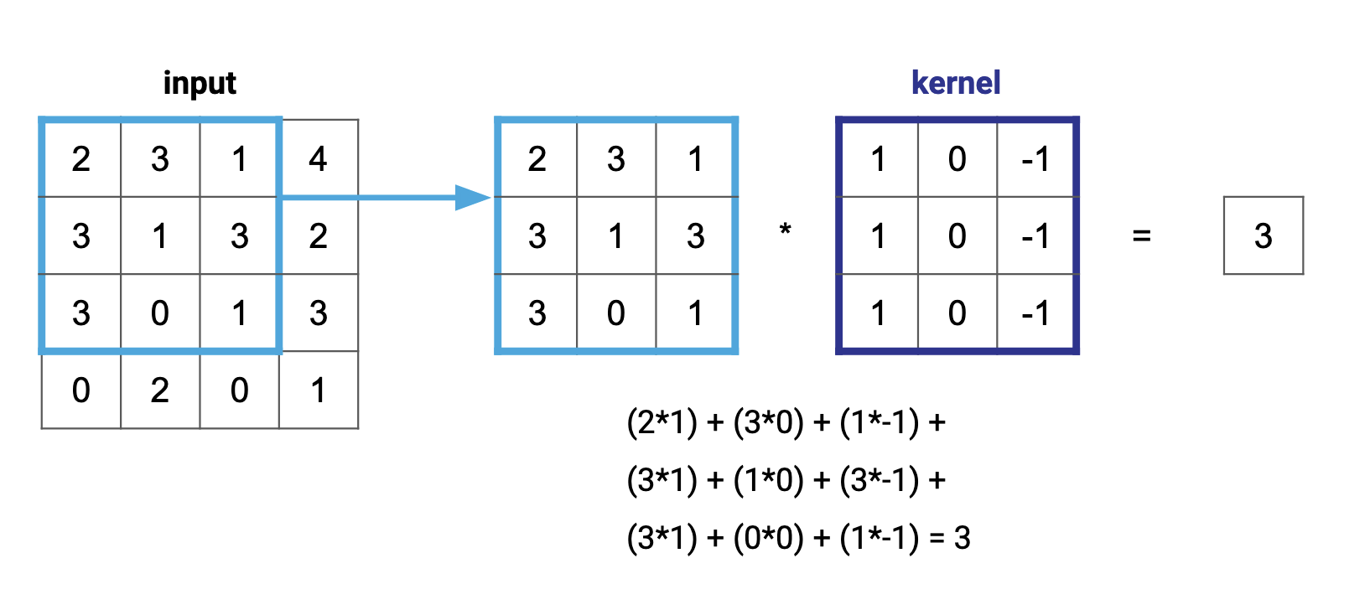
Filtering
Image Filtering:
Enhances or modifies images by emphasizing certain features, such as smoothing, sharpening, and edge detection.
Convolution:
Linear filtering involves calculating the output pixel's value as a linear combination of the pixel values in its surrounding neighborhood.
Linear filtering is performed using a process called convolution, where each output pixel is the weighted sum of the neighboring input pixels.
The weights are stored in a matrix known as the convolution kernel or filter.
Common Filters:
Sobel Filter: Detects edges by computing gradients in the image.
Canny Filter: A multi-step algorithm for edge detection.
Gaussian Filter: Smooths images by averaging pixel values using a Gaussian kernel.
Median Filter: Removes noise by replacing each pixel with the median value of its neighbours.

Slide 7
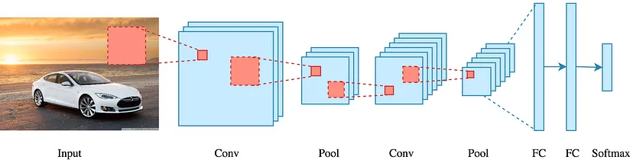
Convolutional Neural Networks (CNNs)
CNNs are one of the most powerful deep learning models, mainly used for image classification.
CNNs gained attention after AlexNet (2012) and further evolved to deeper models like ResNet (152 layers).
Input Image: The raw input to the CNN (e.g., a 32x32 image).
Convolutional Layers: Apply filters (kernels) to extract features like edges, textures, etc.
Pooling Layers: Reduce feature map size, preventing overfitting and reducing computational cost.
Fully Connected Layers: Final layers that combine features for classification.
Output Layer: Often uses Softmax for multiclass classification.

Slide 8
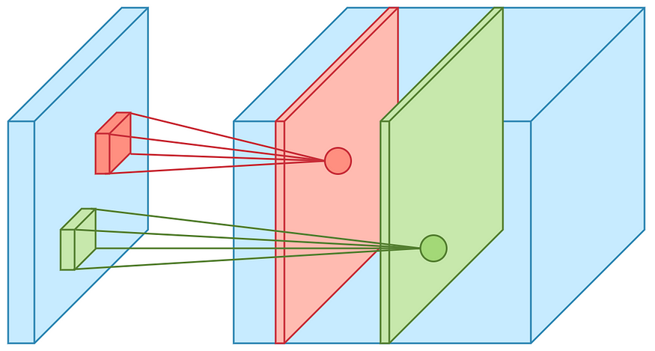
Key CNN Components
Convolution:
The Convolutional Layer applies a filter (e.g., 3x3) to the input image.
Receptive Field: The region of the input covered by the filter at a time.
Output: Produces a feature map showing the presence of features at different locations.

Slide 9
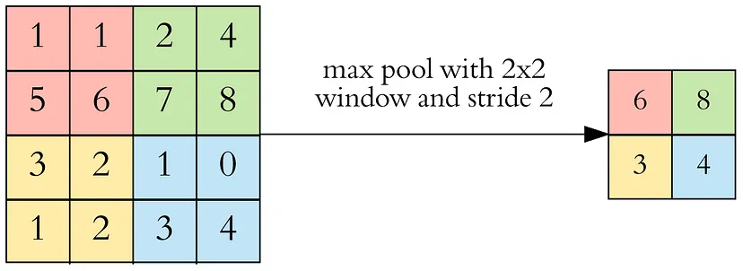
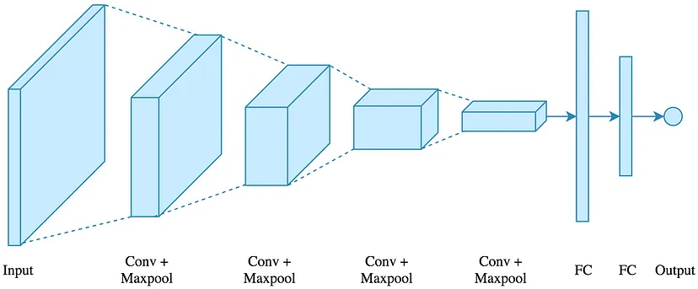
Key CNN Components
Stride & Padding:
Stride: Controls how the filter moves across the input image. Larger strides result in smaller feature maps.
Padding: Adds extra pixels around the input to maintain the output size.
Pooling:
Max Pooling: Reduces the size of the feature map by keeping the maximum value in each window.
Reduces dimensions while preserving important information..
Fully Connected Layers:
Convert the output from convolutional layers into a 1D vector for classification.
Final Step: Fully connected layers handle the final decision-making for class labels.

Slide 10
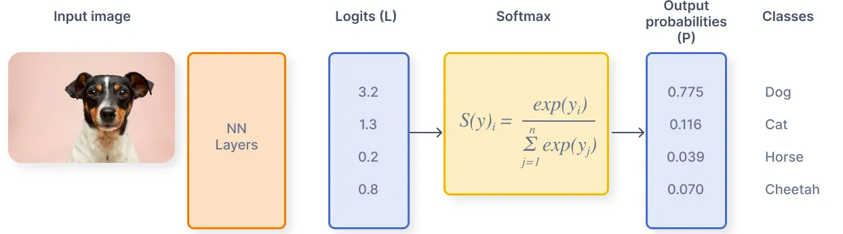
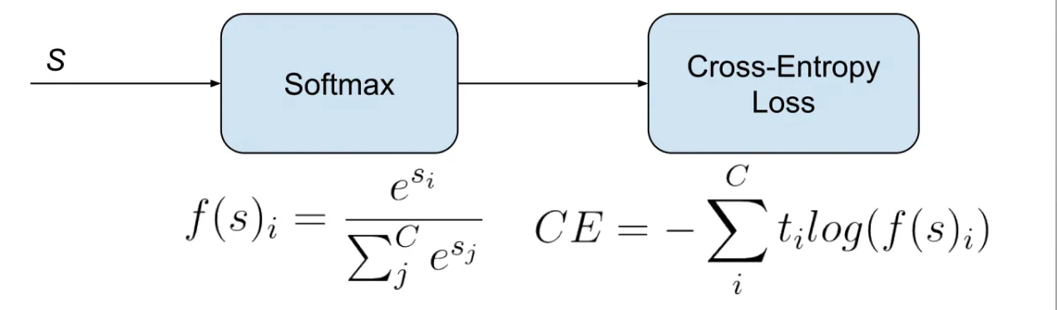
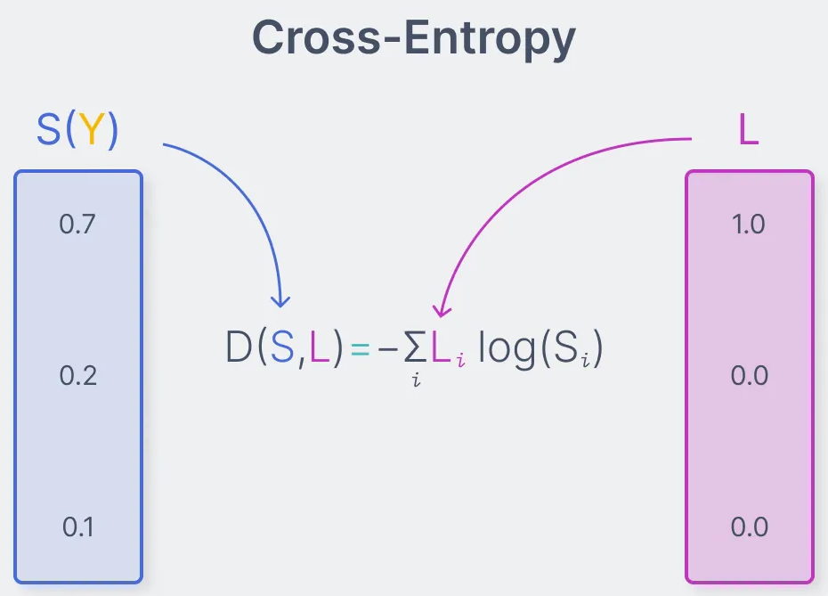
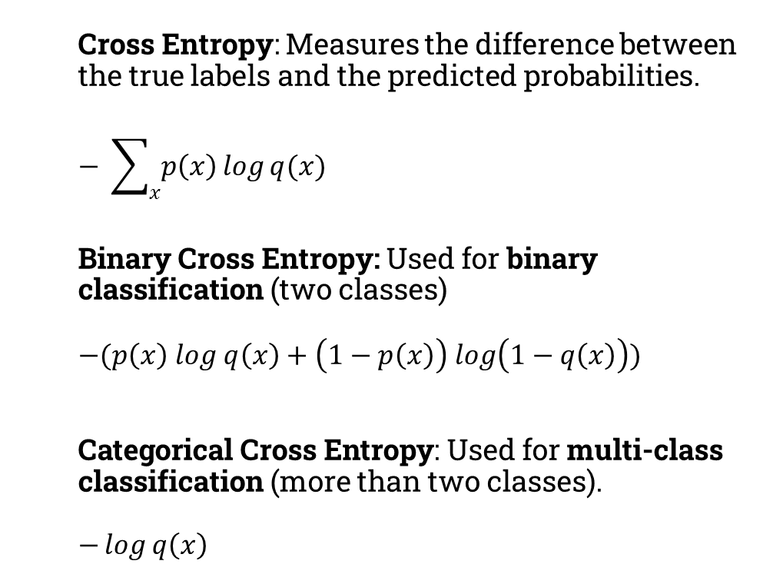
Loss Function
Cross Entropy: Measures the difference between the true labels and the predicted probabilities.
$$− \sum_{x}{p\left(x\right)\log{q(x)}}$$
Binary Cross Entropy: Used for binary classification (two classes)
$$−(p\left(x\right) log q\left(x\right)+\left(1−p\left(x\right)\right) log\left(1−q\left(x\right)\right))$$
$\text{Categorical} \text{Cross} \text{Entropy}$: Used for multi-class classification (more than two classes). $$−\log{q\left(x\right)}$$

Slide 11
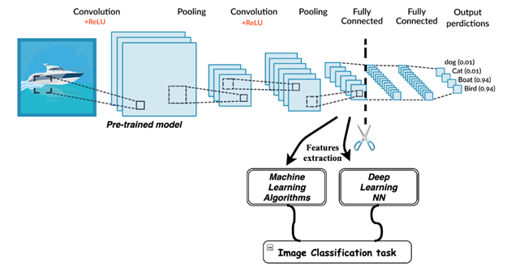
Transfer Learning
Make use of the knowledge gained while solving one problem and applying it to a different but related problem.
Can be used for feature extraction or fine-tuned for a custom dataset.
Dataset Size
Train all layers from scratch
Train some layers
of Conv Base
Dataset Similarity
Freeze some layers
of Conv Base
Freeze Conv Base
Frozen
Trained

Slide 12
References
https://towardsdatascience.com/intuitively-understanding-convolutions-for-deep-learning-1f6f42faee1
https://sgugger.github.io/convolution-in-depth.html
https://towardsdatascience.com/applied-deep-learning-part-4-convolutional-neural-networks-584bc134c1e2
https://d2l.ai/chapter_convolutional-modern/index.html
https://poloclub.github.io/cnn-explainer/
https://blog.paperspace.com/writing-cnns-from-scratch-in-pytorch/
https://jovian.com/learn/deep-learning-with-pytorch-zero-to-gans/lesson/lesson-4-image-classification-with-cnn
https://learnopencv.com/getting-started-with-opencv/

Slide 13


