Slide 1
DIRECT CONNECT++
Easy, Fast, Real Time

Slide 2
Plan
Introduction
Purpose
Demonstration
Solution
Possible Improvements and Extensions

Slide 3
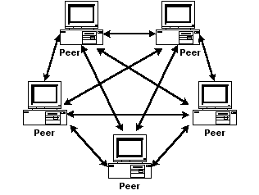
Introduction
A file sharing software
Peer to Peer
Speed
Real Time
Server Administered
Image Source :http://www.novice.com/KB/WCF/614028/pto1.png

Slide 4
Purpose
Every time you don’t have a pen drive.
Downloading the same media again and again will be avoided.
When the internet is not working and you want something, DC will be a good source that time.

Slide 5


Demonstration
C1:Vinayak
C2:Shreeja

Slide 6
Solution
Socket Programming
-Uses IP and Port of Server to connect.
Multithreading

Slide 7
Next Step
Individual Validation
Server Administered Traffic
File sharing limit
Private Network
Intranet->Internet

Slide 8
References
www.Whatis.com
You tube
Computer Networking: A top down approach, James F. Kurose, Keith W. Ross.
www.Creately.com

Slide 9
Thank You

