Slide 1


Rust File Shuffler
Yesho Reddipalli

Slide 2


Languages used
Rust
Shell Script

Slide 3
Used to get the target directory
fn get_target_directory() -> String {
let output = Command::new("whoami")
.stdout(Stdio::piped())
.output()
.unwrap();
let current_user = String::from_utf8(output.stdout).unwrap().trim().to_string();
format!("/home/{}/Documents/project/data", current_user)
}

Slide 4
This function takes an IntoIter from a WalkDir and creates a HashMap that groups files and directories by their depth. The resulting HashMap has integer keys representing the depth, and the values are vectors containing all the files and directories at that depth, in no particular order.
fn sort_by_depth(walk: &mut IntoIter) -> HashMap<usize, Vec<PathBuf>> {
let mut files_by_depth: HashMap<usize, Vec<PathBuf>> = HashMap::with_capacity(15);
while let Some(Ok(entry)) = walk.next() {
let depth = entry.depth();
files_by_depth
.entry(depth)
.or_insert_with(Vec::new)
.push(entry.into_path());
}
files_by_depth
}

Slide 5
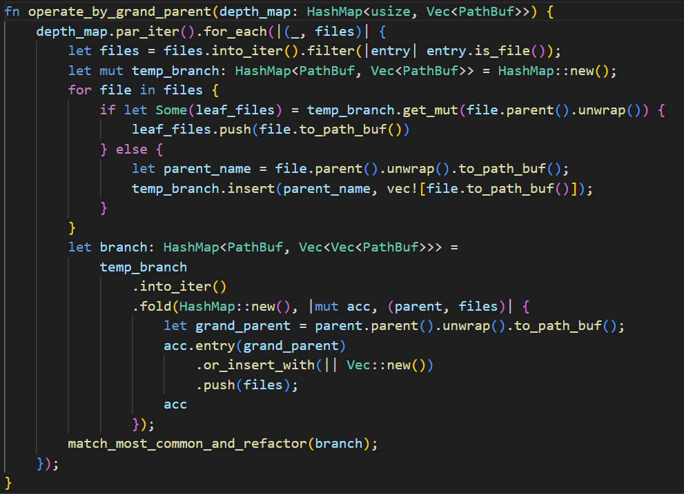
This function takes a HashMap of files and directories organized by their depth and reorganizes them by their grandparent files to perform a specified operation. The operation is performed on the grouped files, and the function returns nothing (unit type).

Slide 6
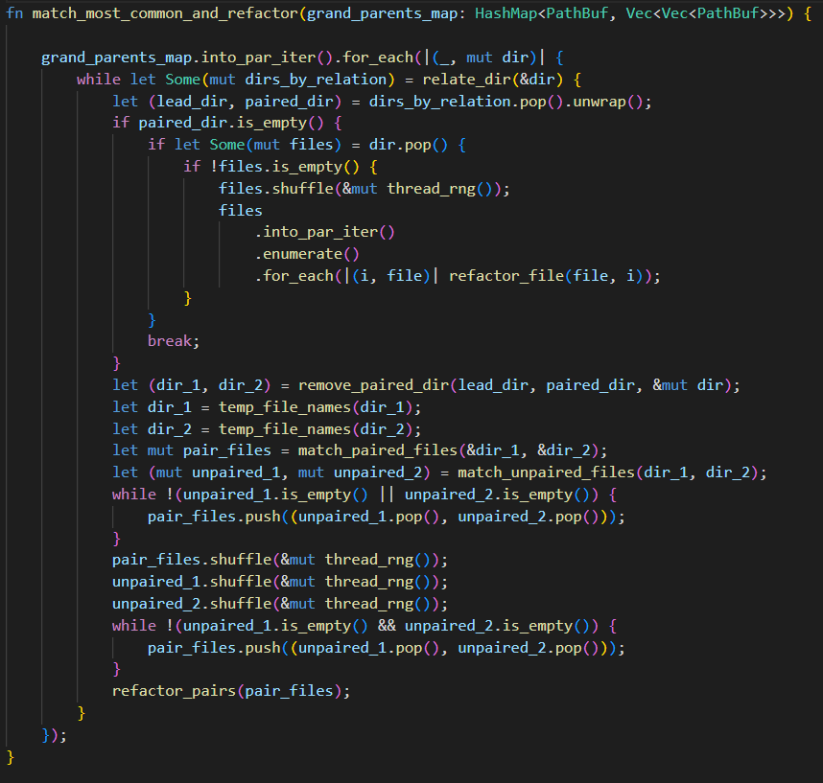
This function takes a HashMap containing directories organized by their grandparent directory. It matches the most closely related files in the subdirectories, and then refactors the filenames and timestamps of the matched files.

Slide 7
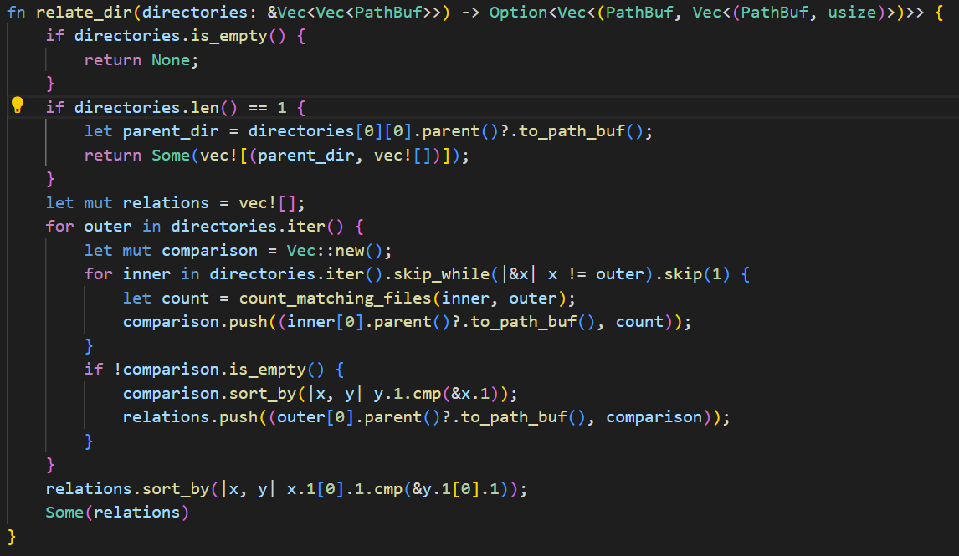
This function takes a vector of vectors representing directories and the files they contain. It then determines the degree of similarity between directories that share the same grandparent file, and returns a vector of tuples. Each tuple consists of a directory, the other directories that share the same grandparent file, and the total number of matching files.

Slide 8
This function takes two directories and returns the count of files that have the same name in both directories. The function returns an integer value of type i32 representing the count of files with the same name in both directories.
fn count_matching_files(dir_1: &Vec<PathBuf>, dir_2: &Vec<PathBuf>) -> usize {
let dir_1: HashSet<_> = dir_1.iter().map(|f| f.file_name()).collect();
let dir_2: HashSet<_> = dir_2.iter().map(|f| f.file_name()).collect();
dir_2.iter().filter(|&f| dir_1.contains(f)).count()
}

Slide 9
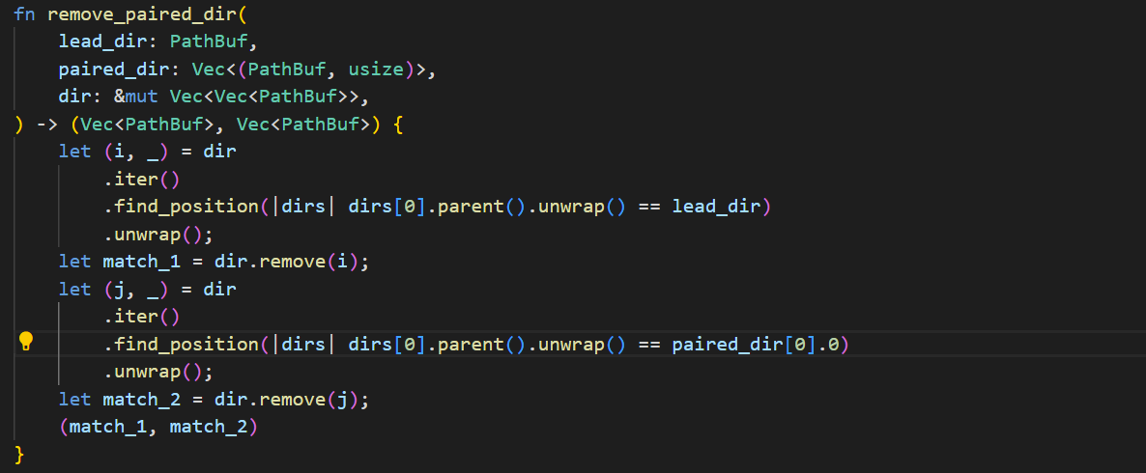
This function takes three arguments: the original directory (lead_dir), the directory most closely related to the original directory (paired_dir), and the total collection of directories from which the two directories will be removed.
The function returns a tuple containing two vectors of PathBuf objects. Each tuple represents a pair of files that have the same name in both the lead_dir and paired_dir directories. The first vector in the tuple contains the PathBuf objects from the lead_dir, while the second vector contains the PathBuf objects from the paired_dir.

Slide 10
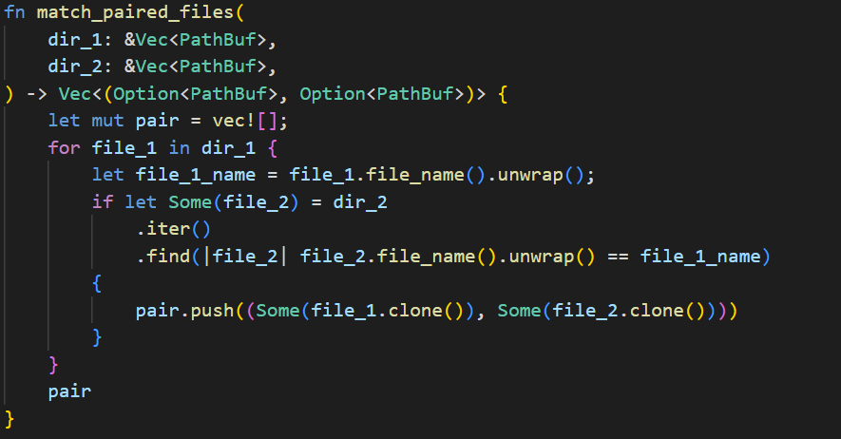
This function groups files with the same name but differing parent directories together, given two directories as input. It returns a vector of tuples where each tuple contains two Option<PathBuf> objects representing the corresponding files in each directory.

Slide 11
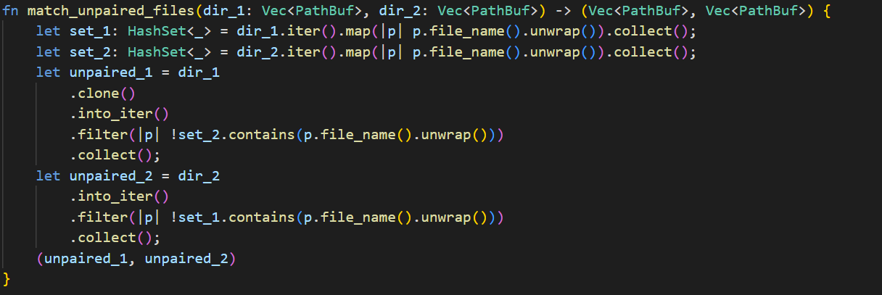
This function takes two directories as input and determines all files in the two directories that do not match. It then collects the non-matching files into a vector of tuples and returns the vector. The function returns a tuple containing two vectors of PathBuf objects. The first vector contains the non-matching files from the first directory (dir_1), while the second vector contains the non-matching files from the second directory (dir_2).

Slide 12
This function renames a file to an integer value and outputs the file's old name and creation date, as well as the file's new name and a random creation date no more than ten days before its creation.
The function takes two arguments: the file to be renamed and its location in the vector (index).
There is no information provided about the return type of this function.

Slide 13
This function copies files from a source directory to a unified directory where the files are sorted into left and right. It also calls the create_directory function.
The function takes three arguments: the source directory to copy files from, the unified directory to copy files to, and a boolean flag to indicate whether to copy files to the left or right subdirectory.

Slide 14
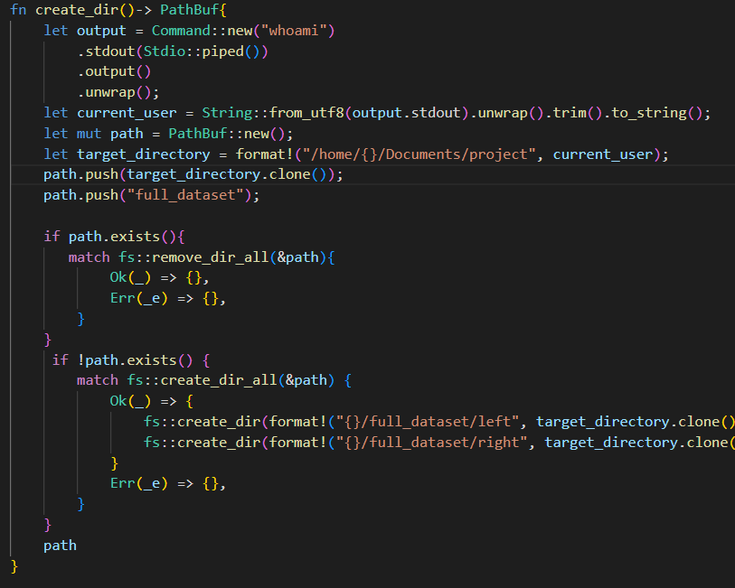

This function creates a directory named "full_dataset" at a specified location. If the directory already exists, it deletes it and creates it again. If the directory does not exist, it creates it along with two sub-directories named "left" and "right".
The function returns a PathBuf object representing the path to the "full_dataset" directory.
The function also gets the current user's username by running the "whoami" command and uses it to determine the target directory for the "full_dataset" directory.

Slide 15
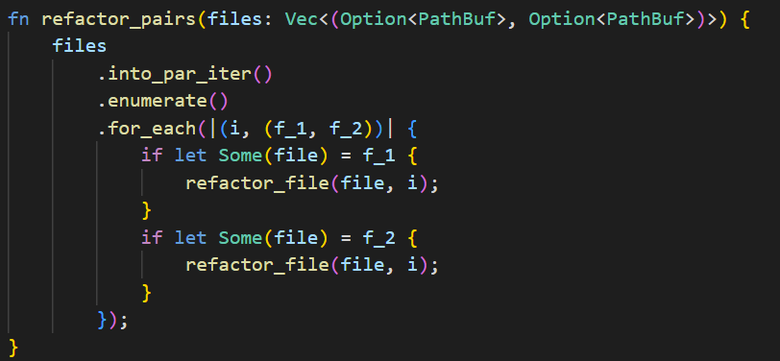
This function takes a vector of paired files and iterates through the vector, changing the name and date of all the files. If a file is a pair of another file, it will have the same name as the matching file.
The function doesn't have a name, so I'll call it update_paired_files.

Slide 16
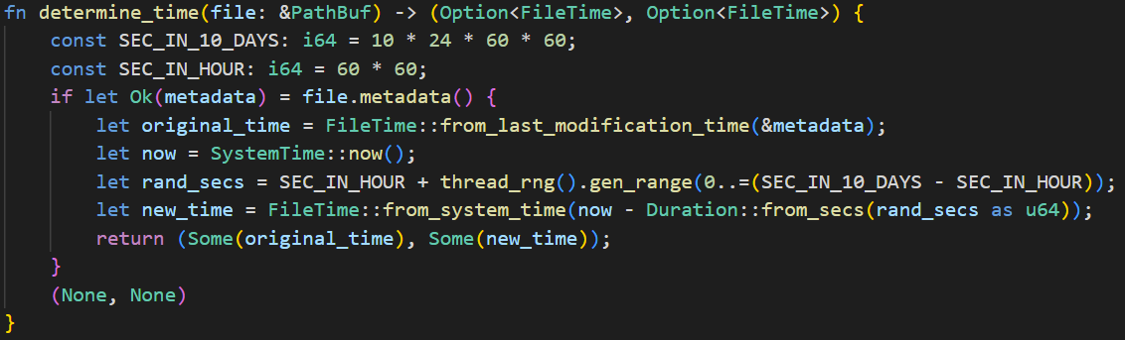
The function takes a file as an argument and returns a tuple containing the file's original creation time and a new randomly generated creation time. The creation times are wrapped in Option types since they may not exist for certain files.

Slide 17
Takes a FileTime object and converts it to a DateTime<Utc> object representing the same date and time in Coordinated Universal Time (UTC).
fn convert_time_format(time: FileTime) -> DateTime<Utc> {
let time = NaiveDateTime::from_timestamp_opt(time.unix_seconds(), 0).unwrap();
DateTime::from_utc(time, Utc)
}

Slide 18
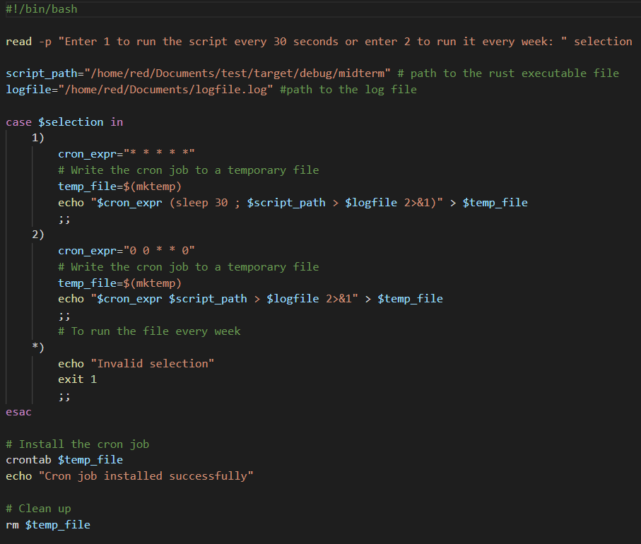
Bash Script
This is a Bash script that prompts the user to select between running a Rust executable every 30 seconds or every week using a cron job.
The script sets the path to the Rust executable and the path to the log file. It then reads the user's selection and sets the cron expression and the command to run the Rust executable with its output redirected to the log file.
The script creates a temporary file, writes the cron job to it, and installs the cron job using the crontab command. Finally, it cleans up by removing the temporary file.
Overall, this script automates the running of a Rust executable on a schedule specified by the user. The output of the Rust executable is redirected to a log file for later analysis.

Slide 19


Thank You
Yesho Reddipalli

