Slide 1
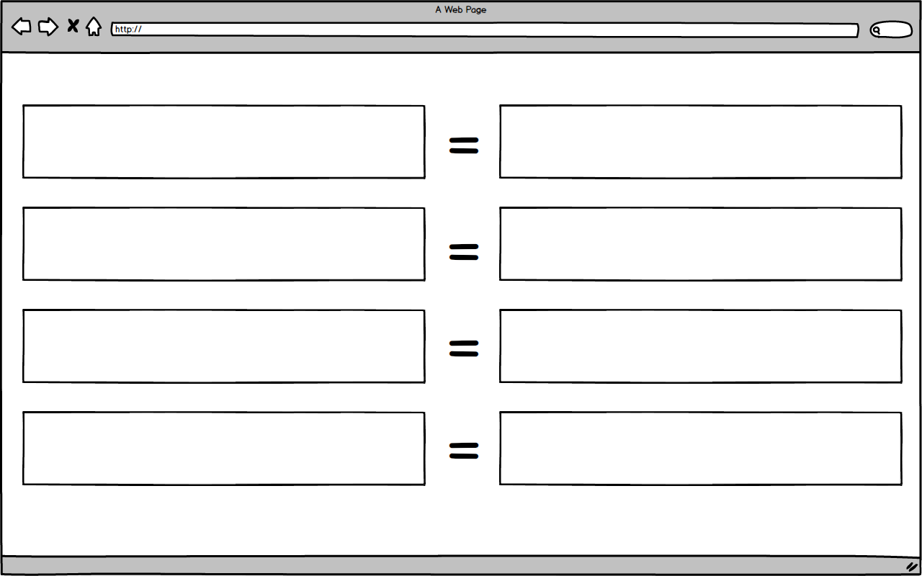
Notes:
Browser zoomed w/ context
CODE: ZoomRect

Slide 2
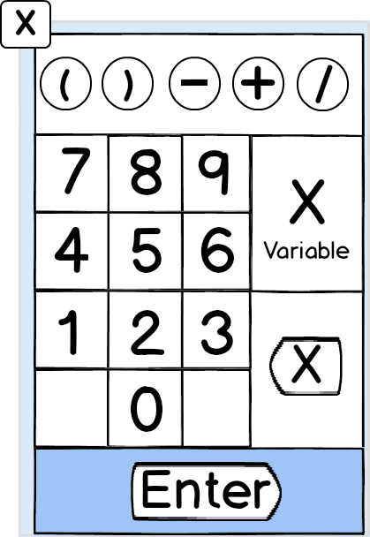
Numpad style keyboard
CODE: NUMRect

Slide 3
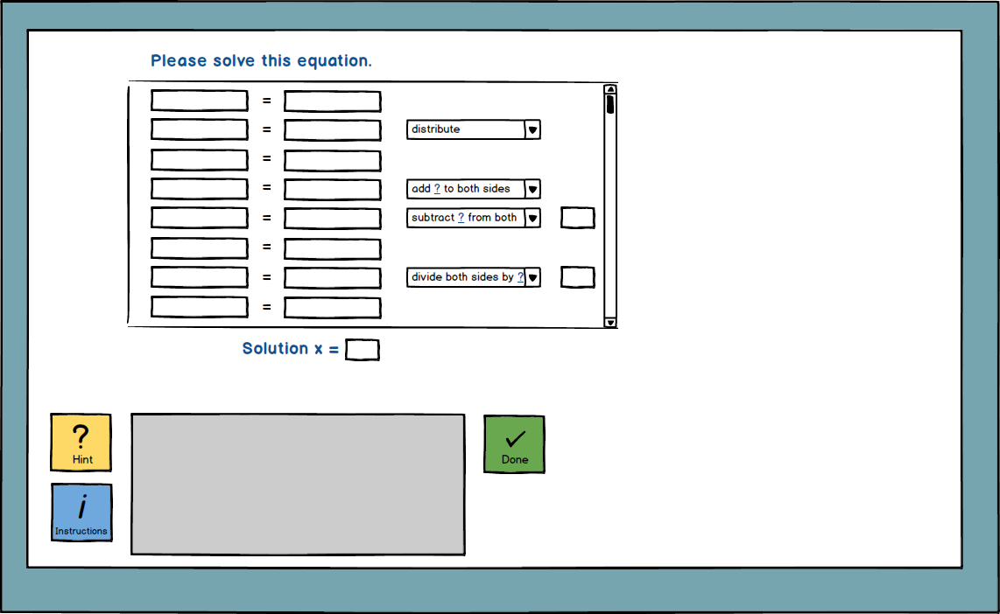
Notes:
BACKCUT-ls-NZ
- Back cut, landscape, no zoom
- Print plenty

Slide 4
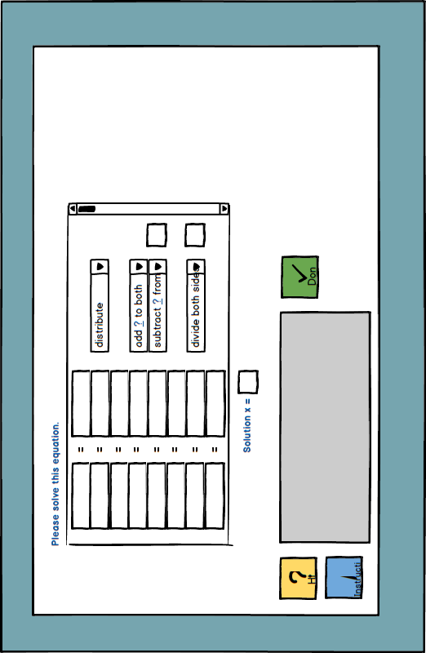
Notes:
BACKCUT-pt-NZ
- Print plenty to place on top of PORTRAITu

Slide 5
Notes:
BACKCUT-pt-NZ
- Print plenty to place on top of PORTRAITu

Slide 6
Notes:
BACKCUT-pt-NZ
- Print plenty to place on top of PORTRAITu

Slide 7
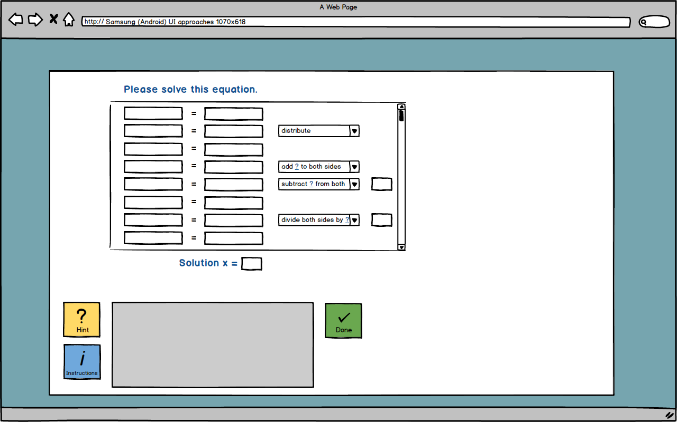
Notes:
BROWSERu
- Unmarked browser

Slide 8
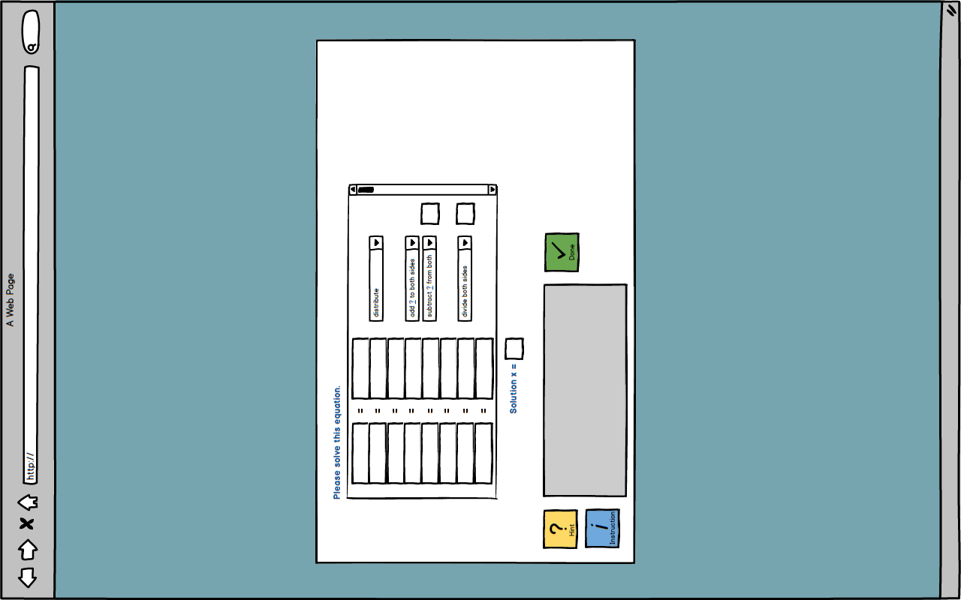
Notes:
PORTRAITu
- Unmarked portrait

Slide 9
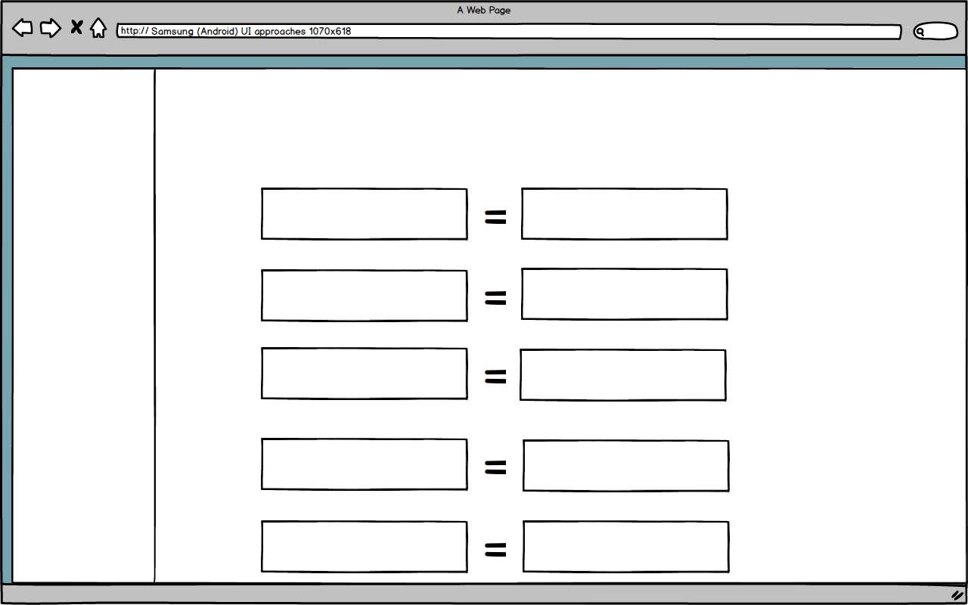
Notes:
ZoomRect2
- Use as zoomed landscape browser

Slide 10
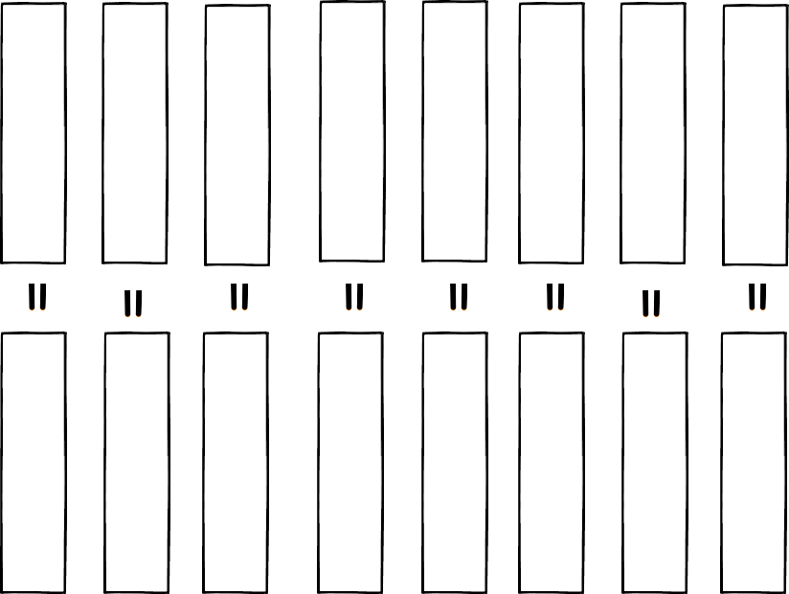
Notes:
ZoomBoxes
- Zoomed boxes for background of ZoomRect2

Slide 11
Notes:
ZoomBoxes
- Zoomed boxes for background of ZoomRect2

Slide 12
Notes:
ZoomBoxes
- Zoomed boxes for background of ZoomRect2

Slide 13
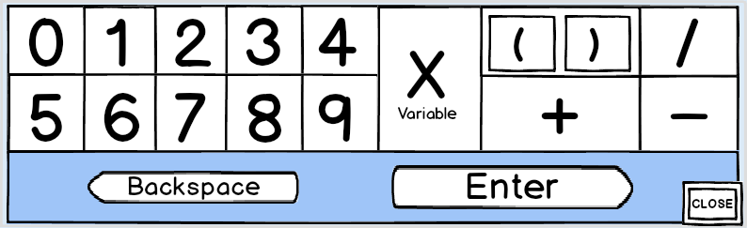
Notes:
COMPENDIOUS
- Use as both portrait keyboard and compact

Slide 14
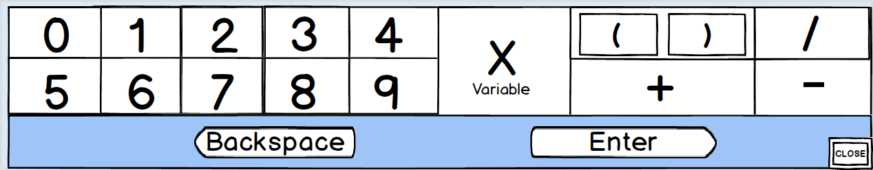
Notes:
LONGrect

Slide 15
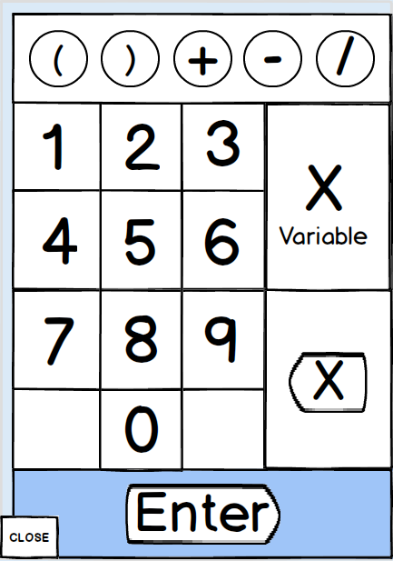
Notes:
NUMPAD

