Slide 1

Information about Computer
Pawan Mahadu Sarule
Class: FYBCA(Sci)

Slide 2
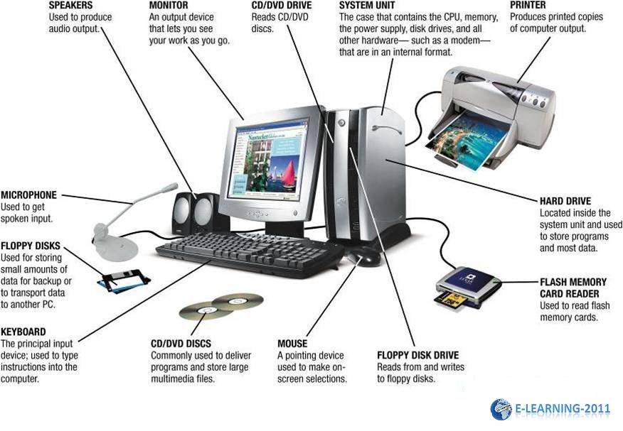

Slide 3
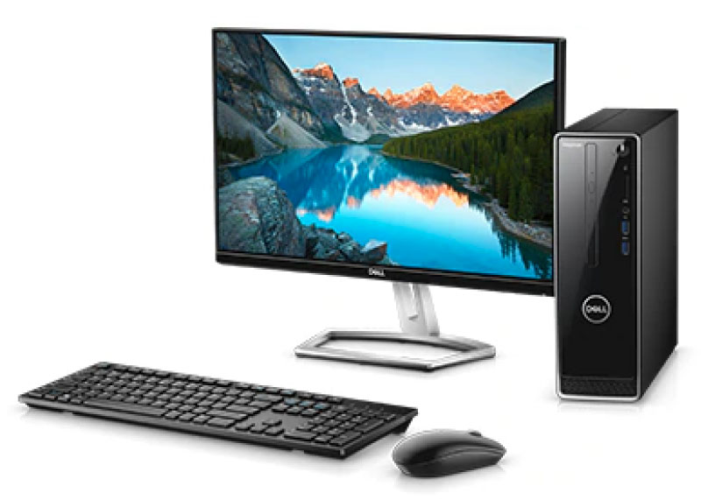
What is a computer?
Computer is an electronic machine that takes data and instructions, processes according to the given instructions, gives results and stores them for later use.

Slide 4

Characteristics
Processing
Speed
A computer can process the given instructions for processing of data.
Computers work at a very high speed. They are much faster than humans.
Storage
A computer can store large amounts of data permanently
Accuracy
No Intelligence
Accuracy means the capability to provide results without any errors.
Recalling
A computer can recall the stored data and information at any time, as and when required.
Computer itself is not intelligent. It only follows the given instructions.

Slide 5
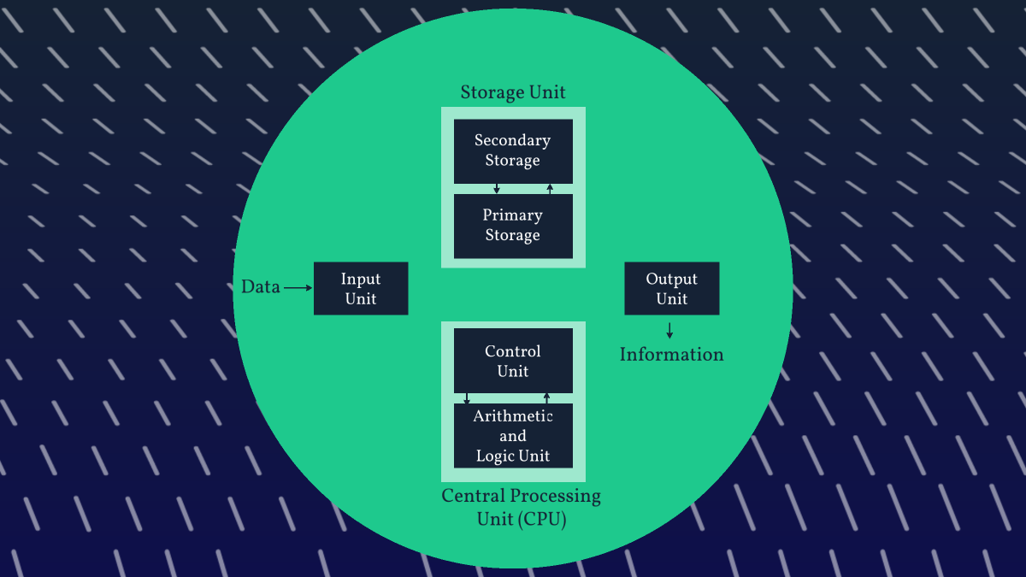

Slide 6
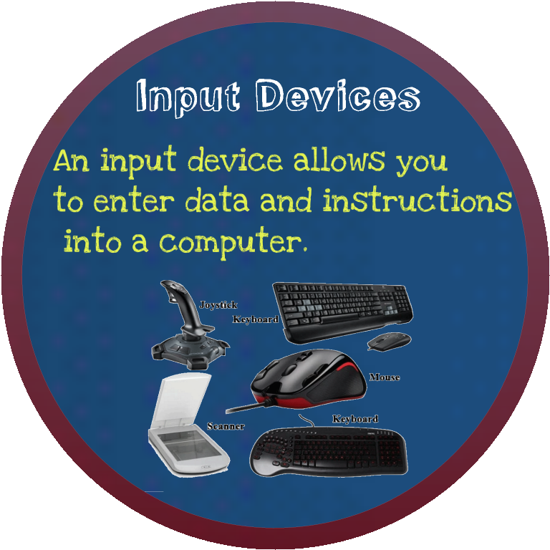

Slide 7
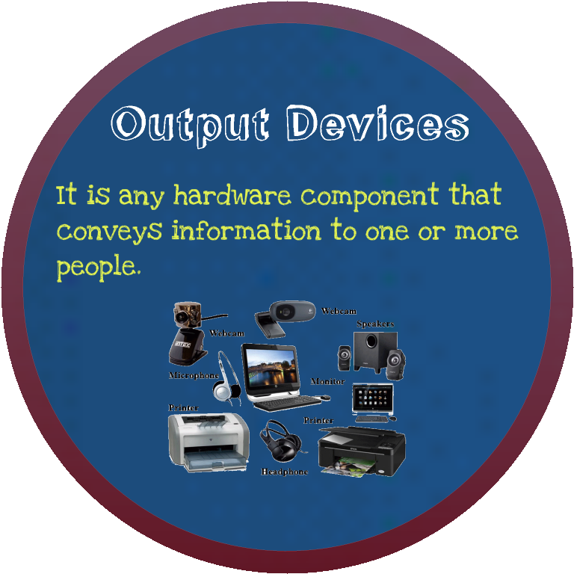

Slide 8
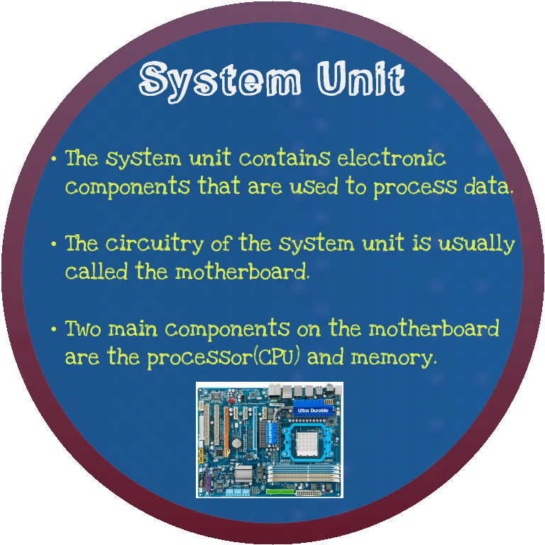

Slide 9
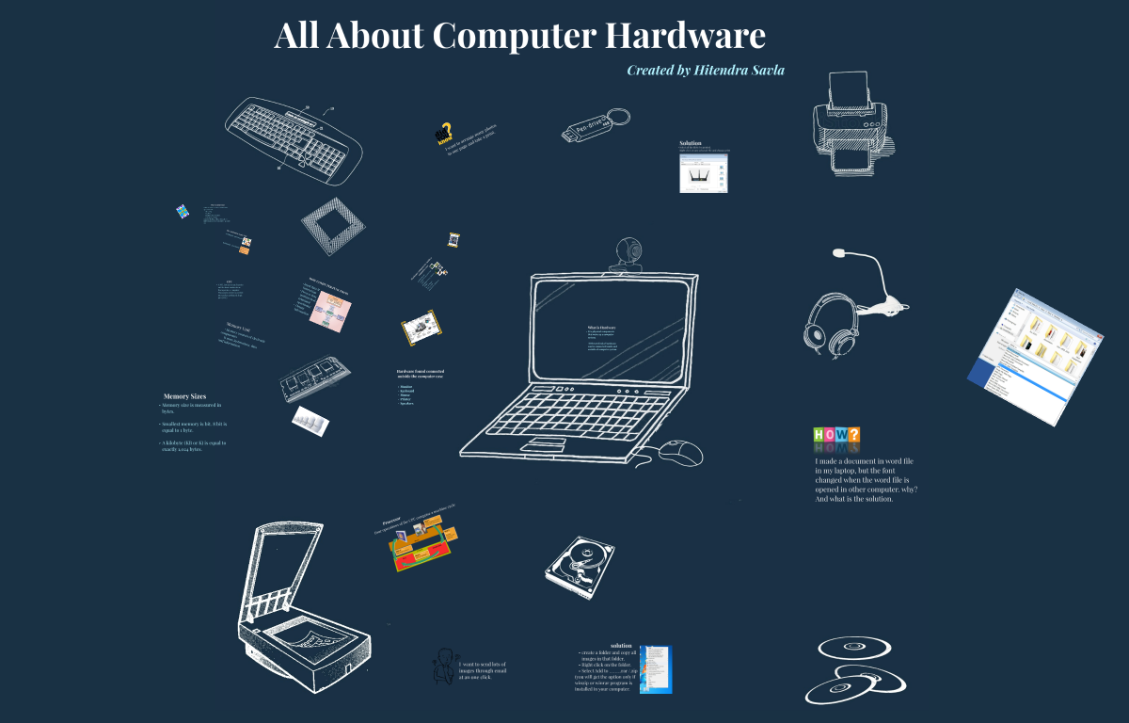
Thank You

