Slide 1
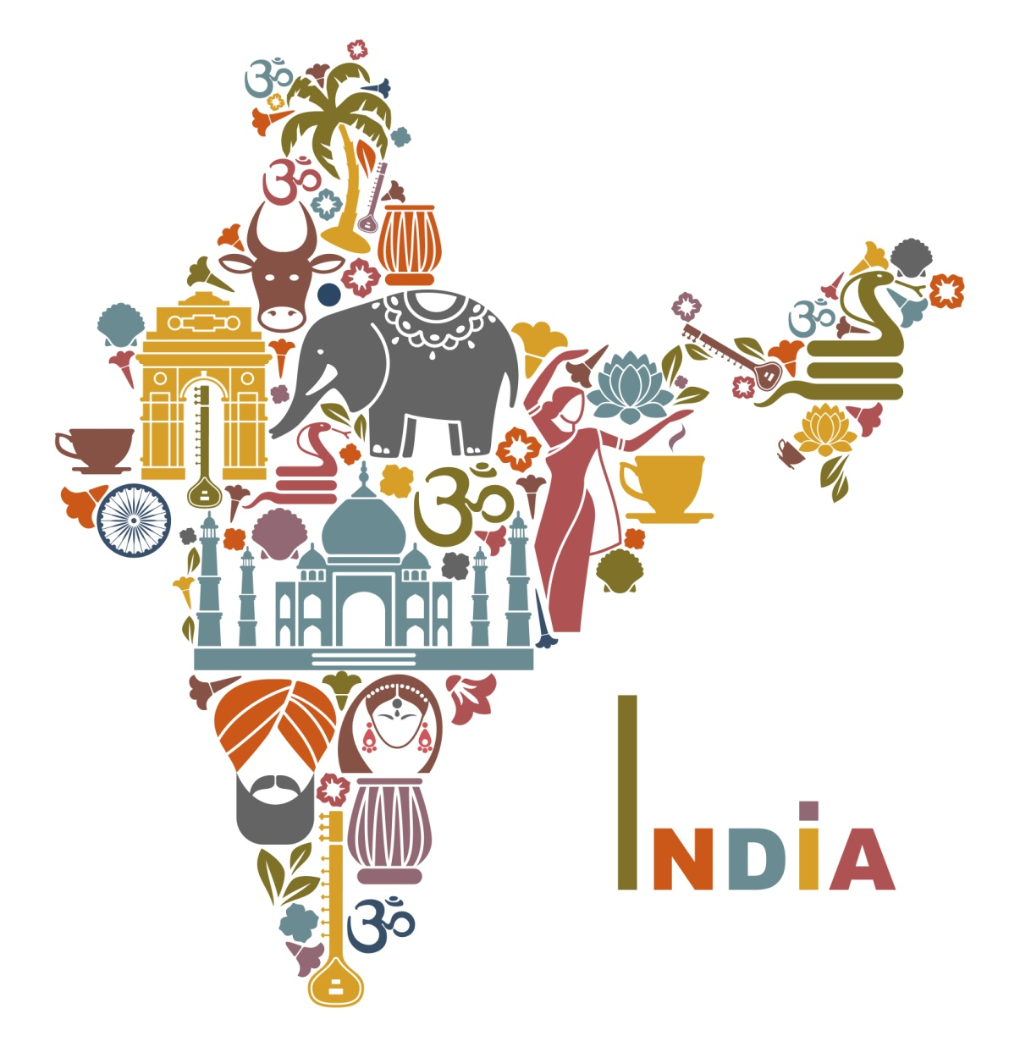
Pawan Mahadu Sarule
Class: FYBCA(sci)
UNITY IN DIVERSITY

Slide 2
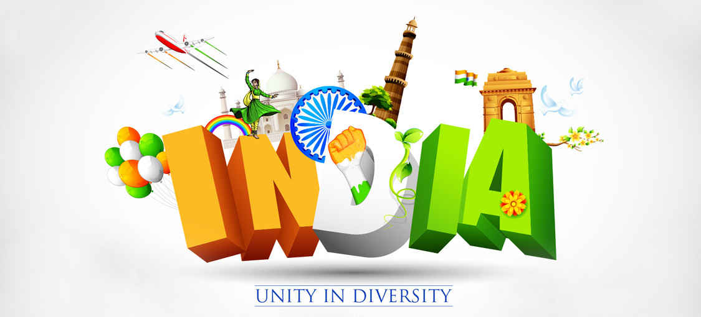
Unity in diversity means oneness in the varieties. India is a best country proving this concept for many years. India is a country where it is very clear to see unity in diversity because people of many religion, race, culture and tradition live together without affecting each others feelings and believes to their religion. Unity in diversity focuses on the existence of unity even after lots of differences of cultural, social, physical, linguistic, religious, political, ideological, psychological, etc. More number of diversities makes more complex unity.
The struggle for freedom is the great example of unity in diversity in India. Unity in diversity concept in India gives everyone a strong message that nothing is without unity. Living together with love and harmony provides the real essence of life.People in India are united in spite of the much diversity of races, religions, castes, sub-castes, communities, languages and dialects.We can never forget the freedom movements run by the people of all religions of India to make India an independent country

Slide 3
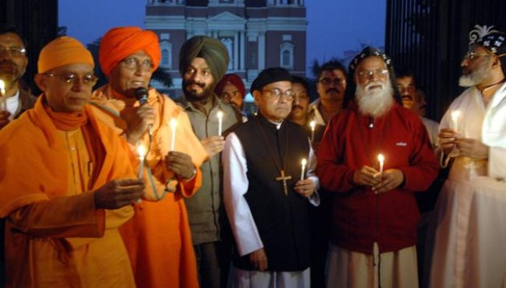
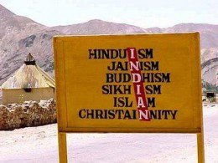
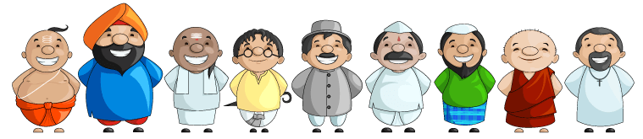
Religious diversity
In the religious sphere also India possesses great diversity. Almost all the principal religions of the world like Brahmanism, Buddhism, Jainism, Islam and Christianity are found here. Most of these religions are further sub- divided into various sects and divisions.

Slide 4
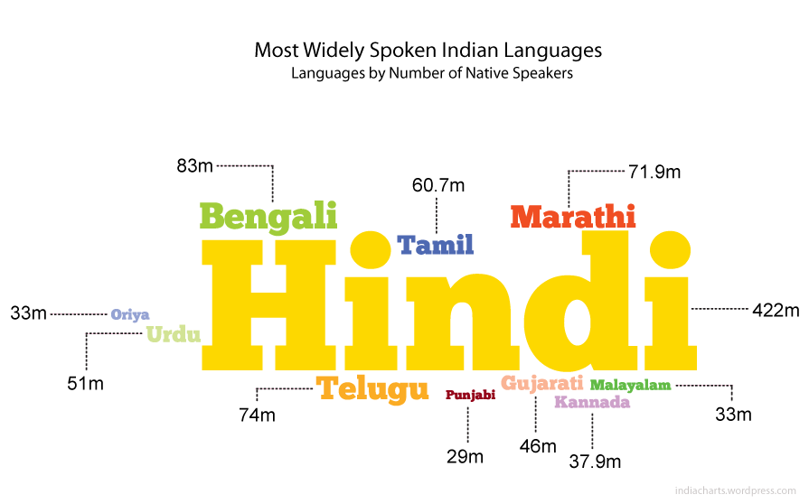
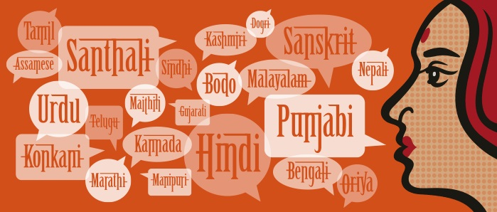
linguistic
diversity
India not only possesses racial diversity but also linguistic diversity-In fact it is commonly believed that in India the language changes after every four kooks. The fact of the matter is that many people speak more than one language; there are also instances of people who do not speak their mother tongue, but speak other languages of the region in which they have settled. However, it is important to note that there is no state in the Indian Union that is monolingual in terms of mother tongue.

Slide 5
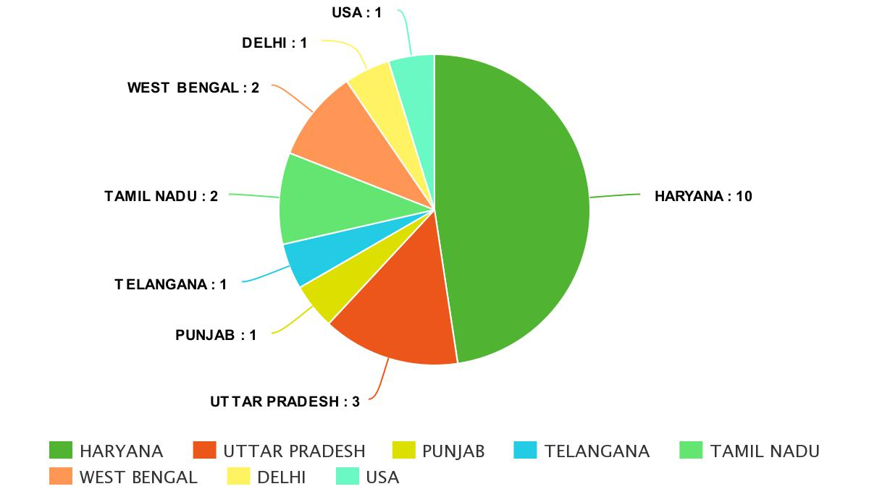
SURVEY ANALYSIS

Slide 6


