Slide 1
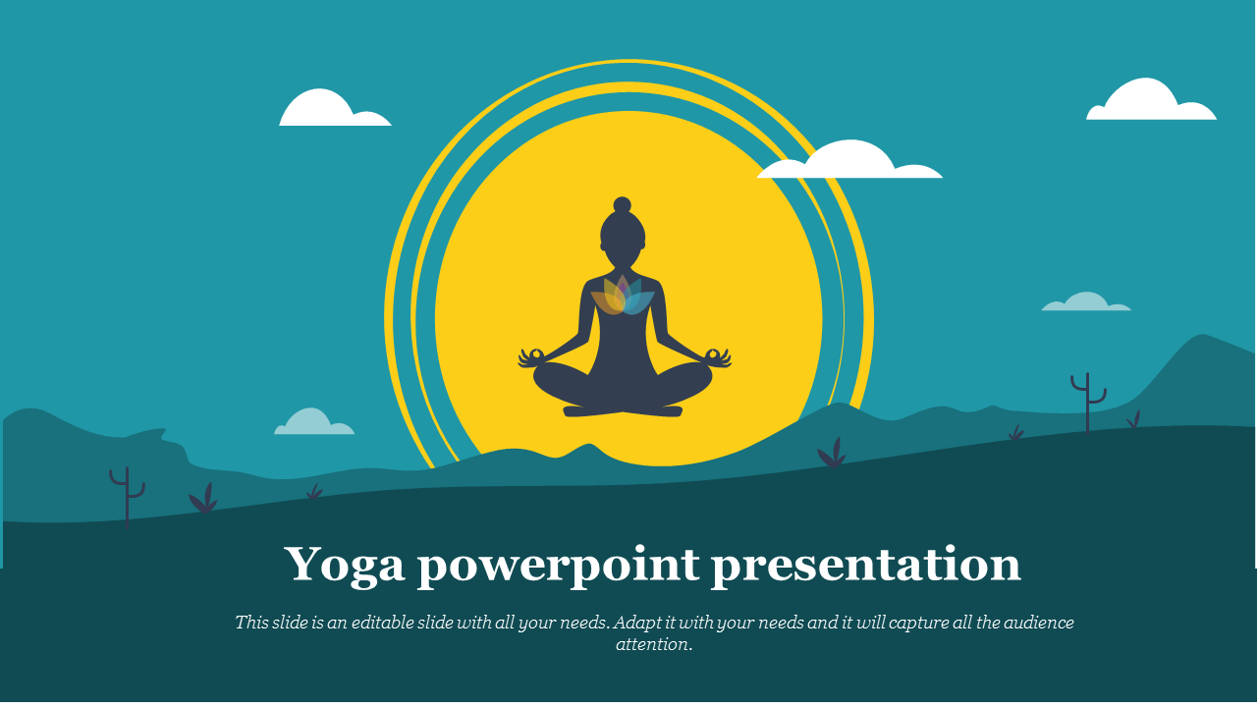
National Yoga Day Celebrated on 21st June
By
Pawan Mahadu Sarule
Class: FYBCA(sci)

Slide 2
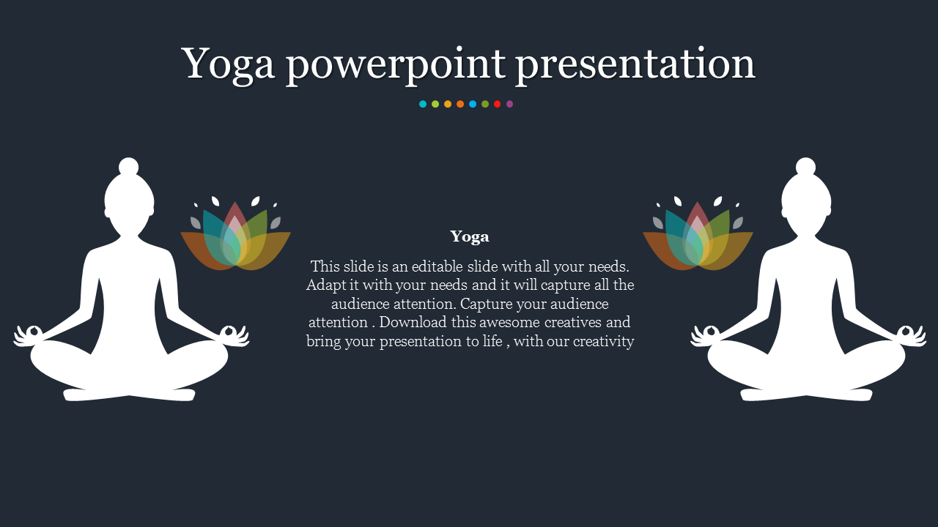
INTRODUCTION
NATIONAL DAY OF YOGA 21st June. Theme 2019 “Climate Action”. PREPARED BY: MR VIJAYREDDY VANDALI PHD Scholar, MSC (N), PGCDE,PGDHA INDIA.

Slide 3
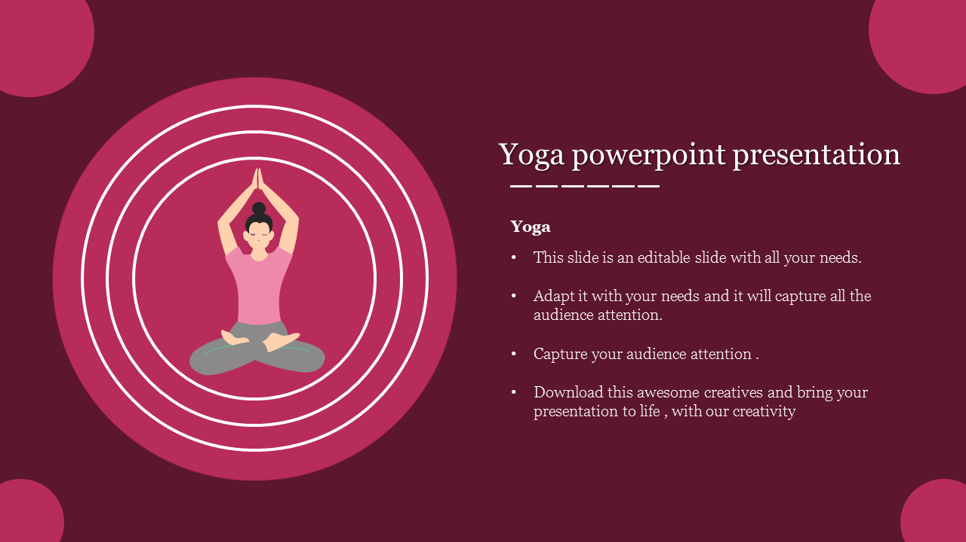
National Day of Yoga 2019 is being celebrated on Friday, 21stJune. This year the world will be celebrating the fifth International Day of Yoga with the International day of yoga is also called as the world yoga day. United Nations General Assembly has declared 21st of June as an International Yoga Day on 11th of December in 2014. Yoga in India is considered to be around 5,000 year old mental, physical and spiritual practice. Yoga was originated in India in ancient time when people were used of meditation to transform their body and mind. Launching a particular date of practicing yoga all across the world and celebrating as yoga day was initiated by the Indian Prime Minister to the United Nations General Assembly.

Slide 4
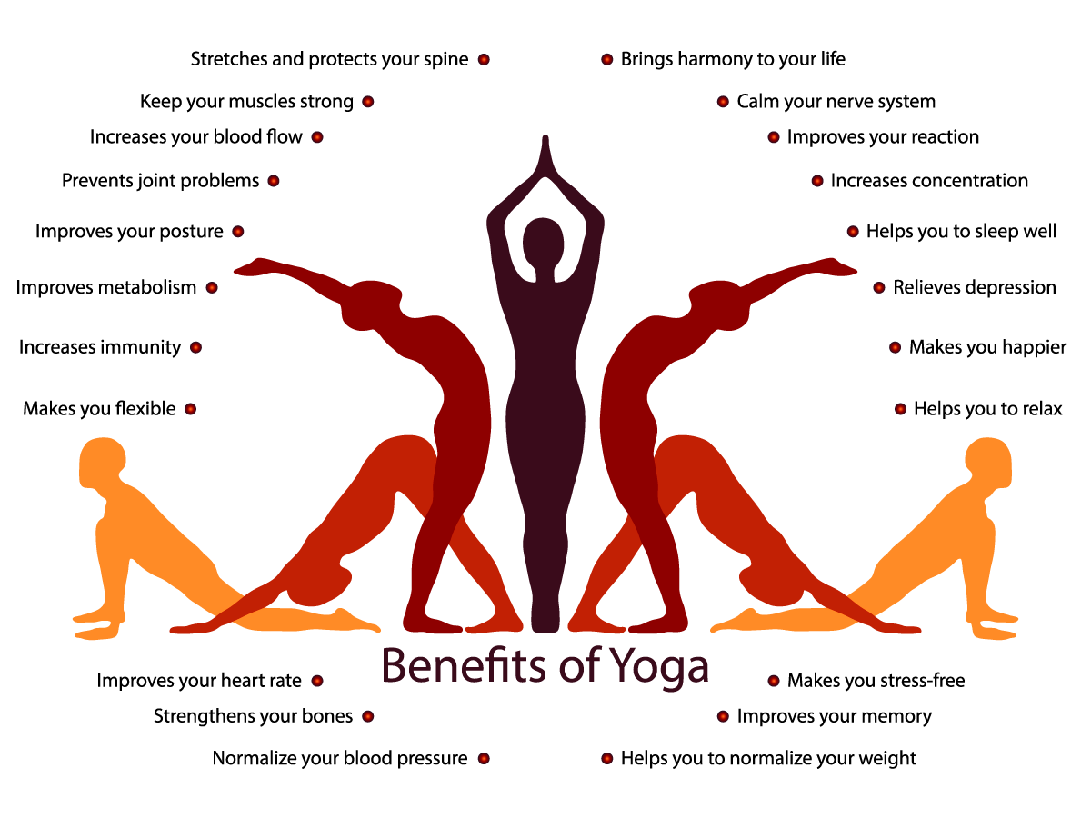

Slide 5
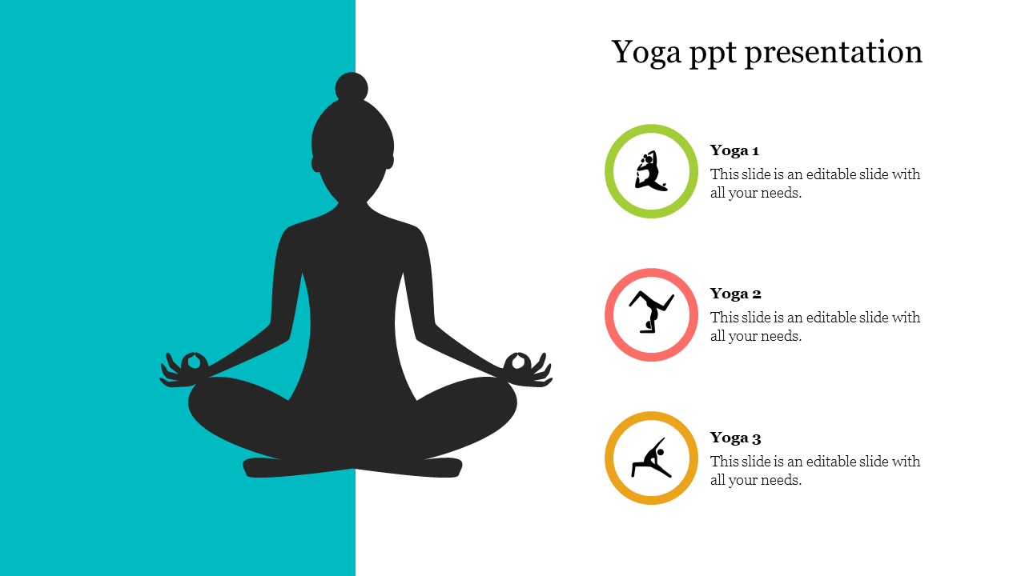
Necessary of Yoga
Yoga is very necessary and beneficial for all human being if it is practiced by all on daily basis in the early morning. Official name of this day is UN International Yoga Day and also called as Yoga Day. It is a worldwide event celebrated by the people of all countries through practicing yoga, meditation, debates, meetings, discussions, variety of cultural performances, etc.

Slide 6
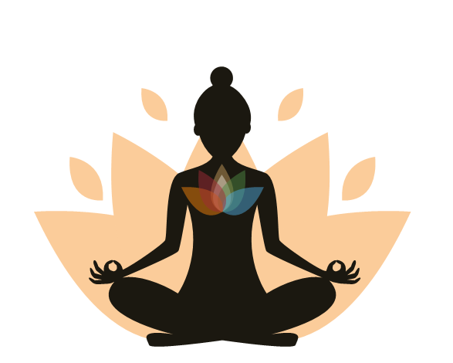
NATIONAL YOGA DAY THEME
The theme of World Yoga Day 2019 is “Climate Action”.
The theme of World Yoga Day 2018 was “Yoga for Peace”.
Theme of 2017 was “Yoga For Health”.
Theme of 2016 was “Connect the Youth”.
Theme of 2015 was “Yoga For Harmony And Peace”.

Slide 7

OBJECTIVES OF WORLD YOGA DAY
International Day of Yoga has been adopted to fulfill the following objectives:
To let people know the amazing and natural benefits of yoga.
To connect people to the nature by practicing yoga.
To make people get used of meditation through yoga.
To draw attention of people worldwide towards the holistic benefits of yoga.
To reduce the rate of health challenging diseases all over the world. To bring communities much close together to spend a day for health from busy schedule.
To enhance growth, development and spread peace all through the world.
To help people in their bad situations themselves by getting relief from stress through yoga.

Slide 8

Thank You

